Slide 1









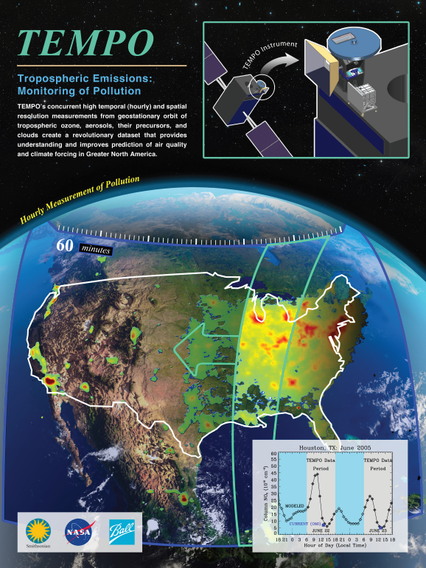
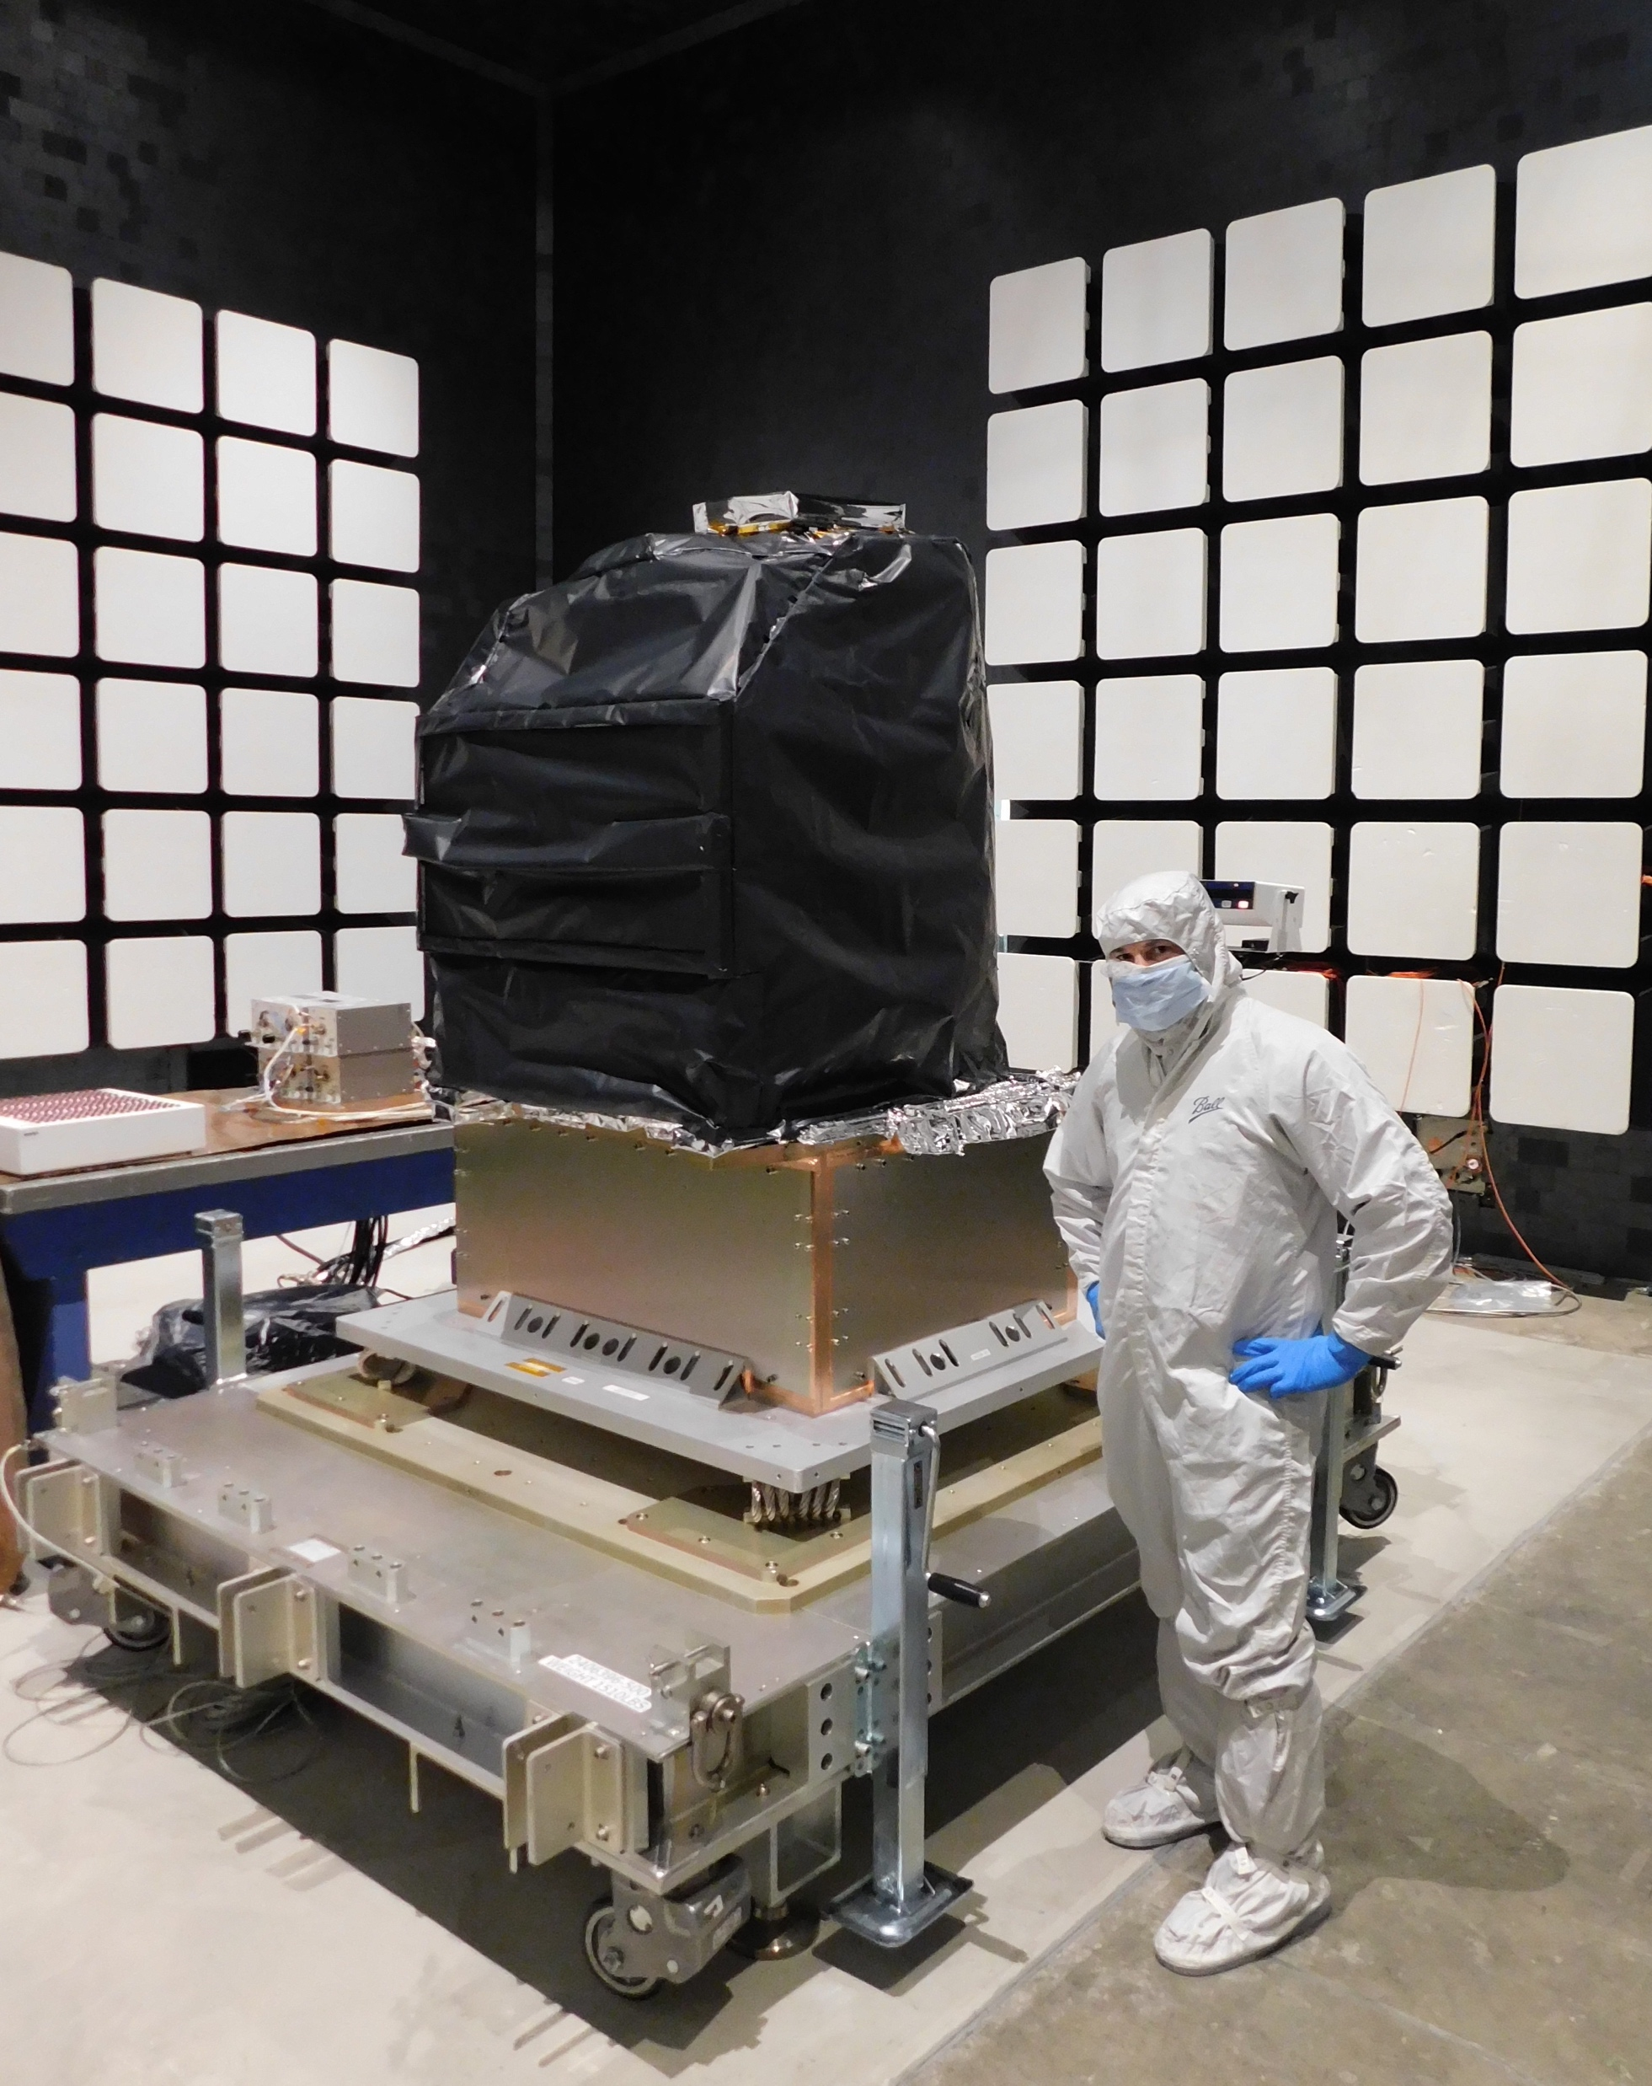
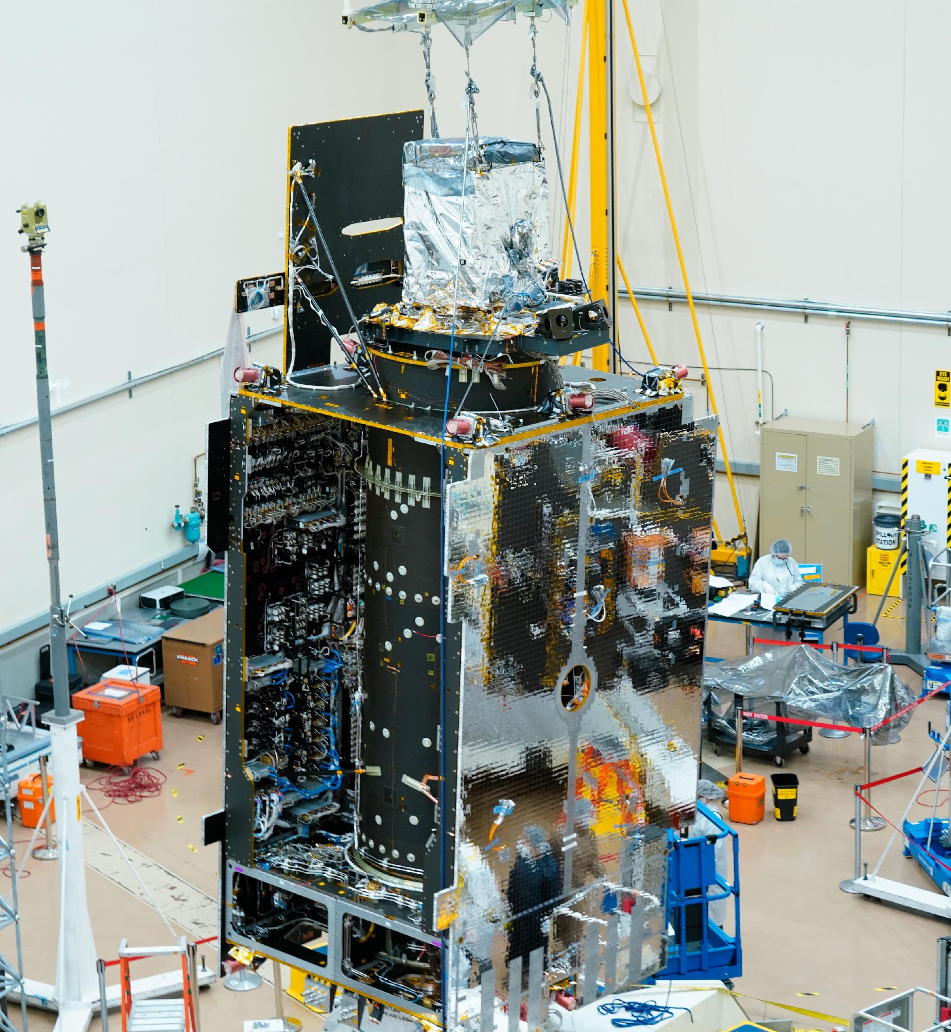
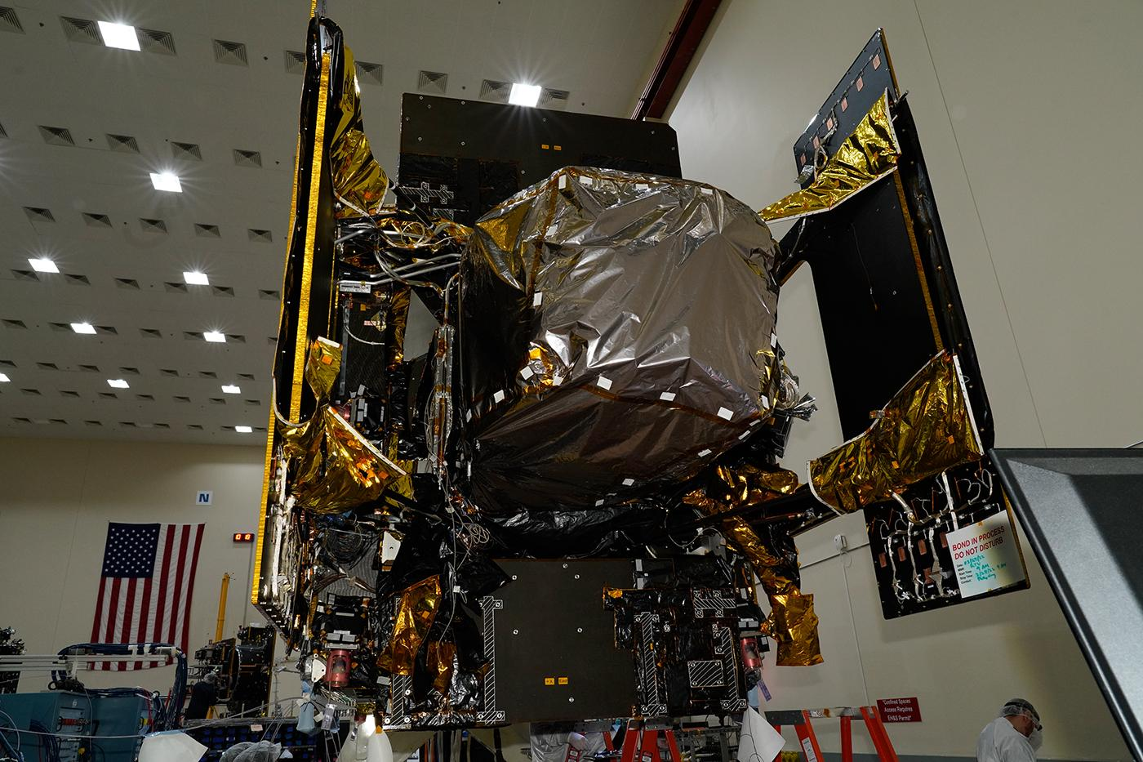
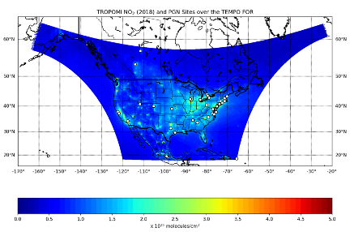
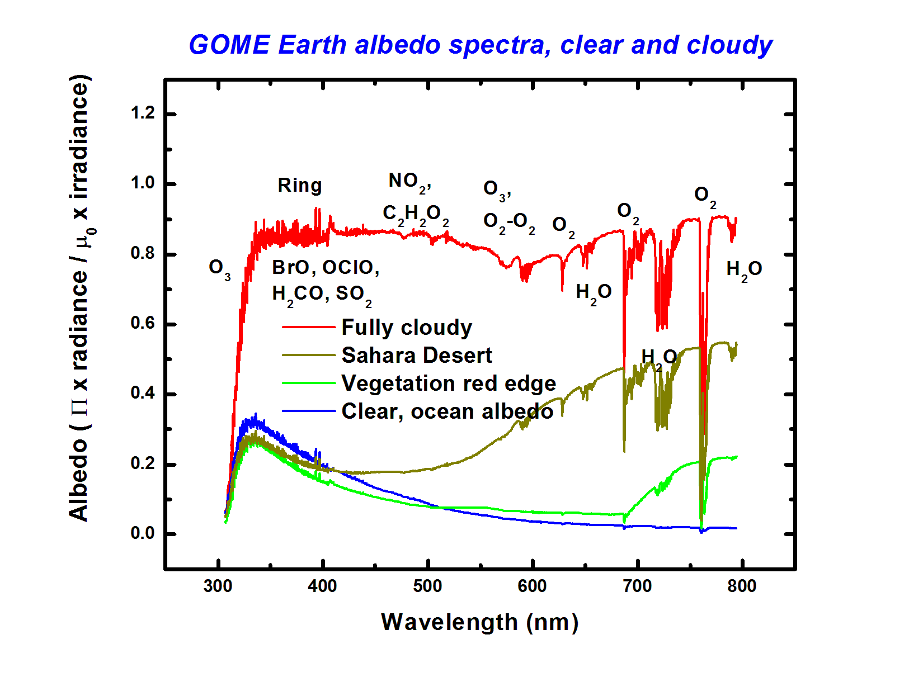
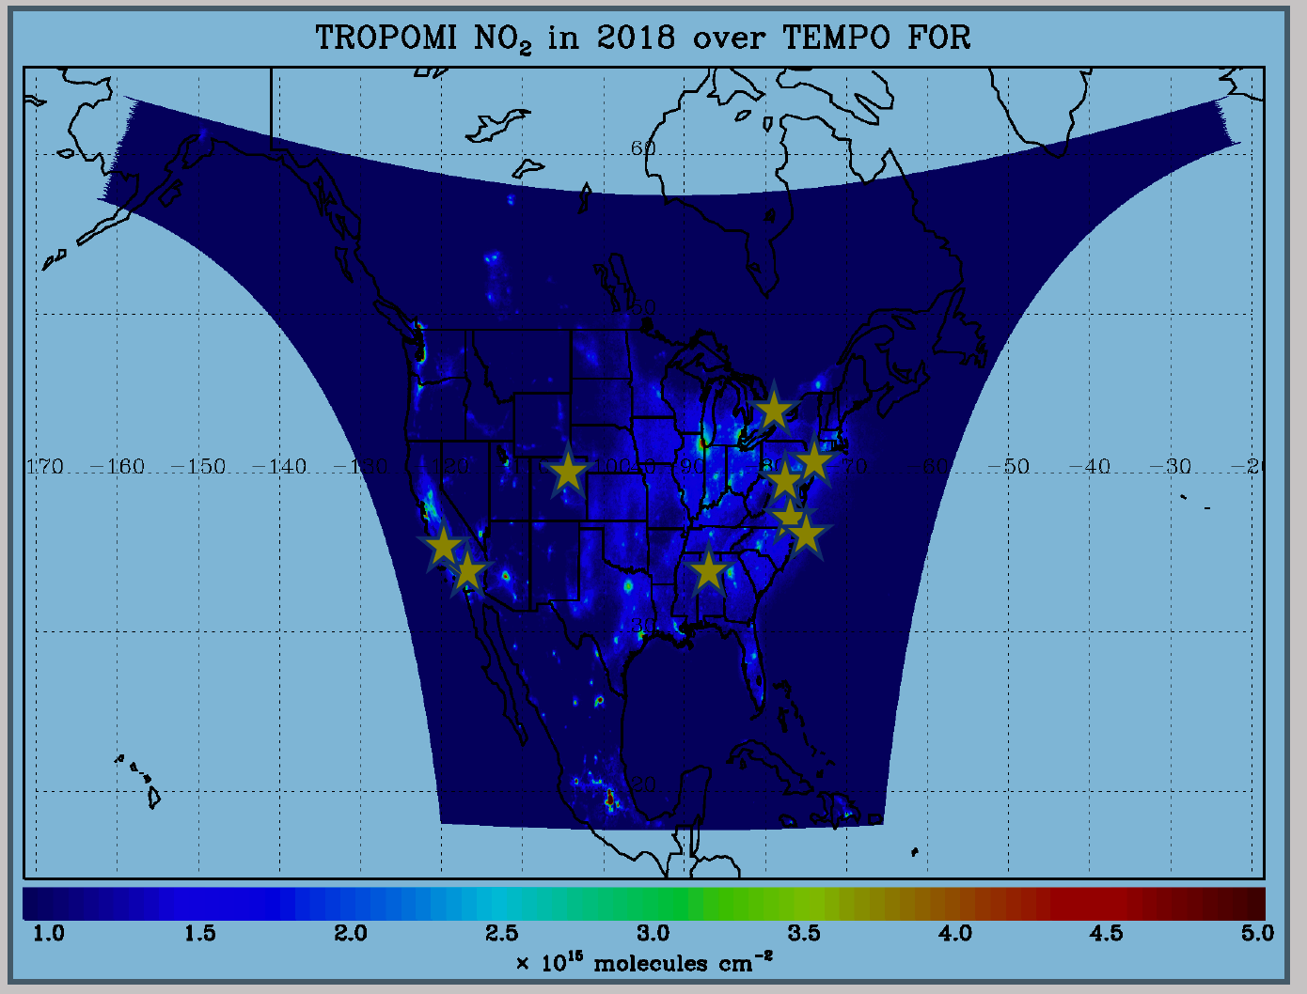

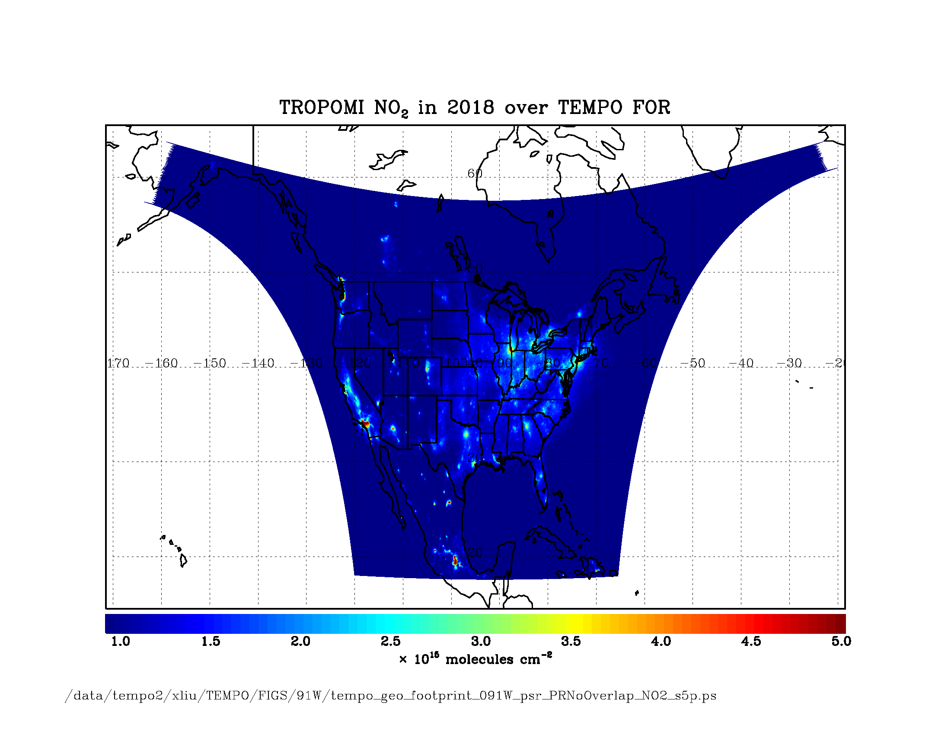



Status of Tropospheric Emissions: Monitoring of Pollution (TEMPO)
A55K-1233
Xiong Liu^{1,*}, Kelly Chance¹, Raid M. Suleiman¹, Kevin J. Daugherty², David E. Flittner², John Houck¹, John E. Davis¹, Gonzalo Gonzalez Abad¹, Caroline Nowlan¹, Huiqun Wang¹, Chistopher Chan Miller^{1,3}, Juseon Bak⁴, Hee-sung Chong¹ and The TEMPO Team
¹Center for Astrophysics (CfA) | Harvard & Smithsonian ²NASA LaRC ³Harvard University ⁴Pusan National University *xliu@cfa.harvard.edu
Introduction: TEMPO, it is about time!
TEMPO Requirements
  TEMPO baseline requirements are specified for four pixels coadded with additional time-average
  Aerosols, SO₂, C₂H₂O₂ were removed from baseline products during KDPC (Key Decision Point before Phase C), working to add them back
  Cloud product (cloud fraction, cloud pressure): required for trace gas/aerosol retrievals
TEMPO Algorithm Development Status and Plan
  Science Data Processing Center (SDPC) V3 (launch ready) completed early this year
  Algorithm mostly based on OMI heritage algorithms except for new L0-1b processor (including INR using GOES-R from Carr Astronautics), with main L1-2 updates shown below:
  Add visible to SAO UV O₃ profile algorithm
  SAO trace gas algorithm with adapted NASA stratospheric/tropospheric separation for NO₂
  CLDO₄^{new}: SAO O₂-O₂ fitting + GSFC’s O₂-O₂ cloud at ~477 nm (H. Wang, E.-S. Yang, A. Vasilkov)
  NASA GMAO’s GEOS-CF trace gas profiles and meteorology (E. Knowland and GMAO)
  Hourly resolved monthly mean GLER climatology (C. Chan Miller, W. Qin, Z. Fasnacht)
  Development of other products
  CHOCHO, H₂O, BrO: will use SAO’s trace gas algorithm
  SO₂: OMI PCA SO₂ algorithm adapted for TEMPO/GEMS from synthetic/GEMS data (C. Li)
  Aerosols: being adapted from OMI/TROPOMI AEROUV algorithm (O. Torres’s team), and from EPIC/TROPOMI Aerosol Layer Height algorithm using O₂-A/B (J. Wang’s team)
  Continue algorithm refinement/optimization during commissioning and nominal operation
Introduction: TEMPO, it is about time!
  Provide revolutionary hourly daytime atmospheric pollution over North America from the GEO
  NASA’s first EVI selected in 2012 and first host payload.
    PI-led mission from SAO by PI Dr. Kelly Chance
    Instrument project management at NASA LaRC
    Instrument development at Ball Aerospace & Technologies.
    Science team includes other institutions, Universities, and companies with international collaboration.
    Mission project management also at NASA LaRC as designated by NASA to find host and launch vehicle for TEMPO.
    Host satellite provider by Maxar Technologies, host by Intelsat on Intelsat 40e (IS40e), launch on SpaceX Falcon 9
  North America component of an international geostationary air quality constellation.
TEMPO baseline and threshold measurement requirements
Species/Products | Required Precision | Temporal Revisit*
0-2 km O₃ (Selected Scenes) Baseline only | 10 ppbv | 2 hour
Tropospheric O₃ | 10 ppbv | 1 hour
Total O₃ | 3% | 1 hour
Tropospheric NO₂ | 1.0 × 10¹⁵ molecules cm⁻² | 1 hour
Tropospheric H₂CO | 1.0 × 10¹⁶ molecules cm⁻² | 3 hour
Tropospheric SO₂ | 1.0 × 10¹⁶ molecules cm⁻² | 3 hour
Tropospheric C₂H₂O₂ | 4.0 × 10¹⁴ molecules cm⁻² | 3 hour
Aerosol Optical Depth | 0.10 | 1 hour
* # of hours to be averaged to achieve required precision
Mission duration: 20 months for baseline, 12 mons for threshold
Spatial resolution: < 60 km² for baseline (4 pixels coadded), < 300 km² for threshold
TEMPO Status
  Delivery by Ball in Nov. 2018
  Maxar selected in July 2019
  Intelsat selected in 02/2020.
  TEMPO sensor fully integrated onto IS40e on 6/30/2022.
  Spacecraft thermal vacuum testing completed in Oct. & spacecraft dynamic testing in mid-Dec.
  Operation/Mission Readiness Review (ORR/MRR) in late Jan./early Feb. 2022
  KDP-E in Feb. 2023
  Launch ~ 3/21/2023
Courtesy from Maxar
TEMPO Data Products, Product Archival and Distribution
Commissioning Plan Timeline and Data Release Plan
Introduction: TEMPO, it is about time!
TEMPO data products including proposed NRT and additional products
Launch
TEMPO Power on
TEMPO 1st light
PLAR
Level | Product | Algorithm | Major Outputs | Res km^{2 *} | Freq/Size
L0 | Digital counts | Raw to L0 | Reconstructed/reformatted digital counts | 2.0 x 4.75 | Daily/hourly
L1-b | Irradiance ^{NRT} | SAO L0-1 | Calibrated & quality flags |  | daily
 | Radiance ^{NRT} | SAO L0-1 | Geolocated,calibrated, viewing,geolocation&quality flags | 2.0 x 4.75 | Hourly, granule
L2 | Cloud ^{NRT} | OMI O2-O2 | Cloud fraction, cloud pressure | 2.0 x 4.75 | Hourly, granule
 | O₃ profile | SAO O3 profile | O3 profile, total/strat/trop/0-2 km O3 column, errors, a priori, AKs | <= 8.0 x 4.75** | Hourly, granule
 | Total O₃ | TOMS V8.5 | Total O3, AI, cloud fraction | 2.0 x 4.75 | Hourly, granule
 | NO₂ ^{NRT} | SAO trace gas, BU strat/trop sep. | SCD, strat./trop. VCD, error, shape factor, scattering weights | 2.0 x 4.75 | Hourly, granule
 | H₂CO ^{NRT} | SAO trace gas | SCD, VCD, error, shape factor, scattering weights | 2.0 x 4.75 | Hourly, granule
 | C₂H₂O₂ | SAO trace gas |  | 2.0 x 4.75 | Hourly, granule
 | H₂O | SAO trace gas |  | 2.0 x 4.75 | Hourly, granule
 | BrO | SAO trace gas |  | 2.0 x 4.75 | Hourly, granule
 | Aerosol ^{NRT} | OMAERUV+UI AOCH | AAI, UVAOD, UVSSA, AOCH, VISAOD | 8.0 x 4.75 | Hourly, granule
 | SO₂ | OMSO2 PCA | SCD, VCD (PBL,TRL,TRM,TRU,STL) | 2.0 x 4.75 | Hourly, granule
 | TEMPO/GOES-R Synerg. product | GOES-R products on TEMPO pixels | Radiance, aerosol, cloud & mask, fire/hotspot, snow/ice, rainfall, precipitable water, land/sea surface T, lightning | 2.0 x 4.75 | Hourly, granule
L3 | Gridded L2 | SAO L2-3 | Same as L2 | 2 x 2 (?) | Hourly, scan
L4 | UVB | GEMS/GSFC UVB | UV irradiance, erythemal irradiance, UVI | TBD | Hourly, scan
L+0
L+88 days
L+120 days
L+178 days
Outgassing
S/C Activity
(TEMPO Off)
TEMPO Commissioning
Nominal Operations
Courtesy from Ball
Activation
Instrument Characterization and Analysis
* L+# days are approximate
TEMPO comm.: 06/17-9/17/2023, first light ~7/17/2023
Nominal operation after PLAR: ~9/17/2023
Plan for initial public release of baseline products at ASDC (L1b in ~4 mons, 1/2024, L2/3 in ~6 mons, 3/2024):
Provide baseline data products to validation team priori to the public release via ASDC.
Activity | Intelsat
LEOP: Orbit Transfer | 2 Weeks
Spacecraft Bus + Payload IOT | 1 + 4 Weeks
Drift to Location 60ºW-91ºW | 4 Weeks (TBD)
Commercial Services | 1 Week
TEMPO Commissioning Begins | L+12 Weeks
Courtesy from Maxar
Left: 1st fully integrated powered testing of TEMPO in July on IS40e.
Introduction: TEMPO, it is about time!
TEMPO Validation Plan
  TEMPO PLRA: bare minimum validation requirements (3 Pandoras, 1 month per season)
  Jim Szykman led the development of best-of-effort basis validation plan: beta, provisional, full
  Satellite observations (i.e., LEOs + EPIC/DSCOVR)
  Pandonia Global Network (PGN): NO₂, HCHO, total O₃
  TOLNet with 8 LIDARs: tropospheric O₃ & 0-2 km O₃
  Airborne instruments: GEO-TASO, GCAS, HSRL-2, SeaRey UAV, in-situ …
  Other ground-based instruments: ozonesonde, MAXDOAS, FTIR, Dobson/Brewer, AERONET, …
  Planned flight campaigns: AGES (STAQS, AEROMMA+ CUPiDs, GOTHAAM) in June-August 2023
  Indirect validation with CTMs and data assimilation
TEMPO Instrument & Measurements
  Imaging grating spectrometer measuring solar irradiance and solar backscattered Earth radiance
  Nominal: scan Field of Regard (FOR) within 1 hour in 10 granules with ~2.5 M pixels with native spatial resolution 2.0x4.75 km² at center of FOR (from 8 km² in Mexico City to 21 km² at Canadian tar sands)
  Optimized scan: daylight portion of FOR in early AM/late PM at higher temporal resolution (~30 mins)
  High-time scan (up to 25%): selected portion of FOR at higher temporal resolution (e.g., <= 10 mins)
~60 in TEMPO FOR, ~20 to add in 2 yrs
https://www.pandonia-global-network.org
~293-494 nm
~538-741 nm
TEMPO instrument & measurement characteristics | 1.4 m x 1.1 m x 1.2 m, 137kg
Volume, Mass | 1.4 m x 1.1 m x 1.2 m, 137kg
Average operating power | 138 W
Detector size | Two 2048 (spatial) x 1028 (spectral)
Wavelength range | UV band: ~293 - 494 nm Visible band: 538 - 741 nm
Spectral resolution | ~0.6 nm @FWHM(0.54-0.63 nm)
Spectral sampling | ~0.2 nm or ~3 pixels /FWHM (2.7-3.2)
Spectral co-registration¹ | < 0.1 pixel (for UV, visible, UV/visible)
Orbit | GEO (35786 km), 91.0°W above equator
Instantaneous FOV | 41.49 µrad (N/S) x 129.20 µrad (E/W)
MTF @Nyquist | 0.31-0.41 N/S x 0.38-0.49 E/W
Field of view² | 4.92° N/S x 8.64° E/W
Spatial resolution | 2.0 km (N/S) x 4.75 km (E/W) km @center of FOR
Temporal resolution³ | ~1 hour, ~3s snapshot / mirror step
Spectra per hour^{2,3,4} | 2035 N/S (cross-track) x 1226 E/W (mirror step)
Maximum SNR⁵ | 1350 @ 330 - 340 nm, EOL
www-air.larc.nasa.gov/missions/TOLNet
Black: launch-ready baseline products; green/orange/purple: additional products
Proposed NRT (L1b <~1 hr, L2 cloud <~1.5 hr, L2/3 trace gas < ~2.5 hrs): from SNWG, NASA+NOAA OMB, NOAA to produce aerosol NRT
NRT data products timeline, 4-5 months behind baseline products (1/2024 start NRT processing, 6/2024: public release)
* Spatial resolution at center of FOR. ** Might be at 8 x 9.5 km²
TEMPO Green Paper: Chemistry Experiments
  Green paper is a living document at: http://tempo.si.edu/publications.html
  High-time special mode can be requested: https://weather.msfc.nasa.gov/tempo/green_paper.html
  TEMPO data are sent to ASDC @NASA LaRC for archival/distribution with tools & services
  User support and other resources: Earthdata Login, Earthdata Forum, ASDC user support
  EPA RSIG3D Gateway: TEMPO data can be served directly through the EPA RSIG. https://www.epa.gov/hesc/remote-sensing-information-gateway
NASA Earthdata Search: CMR Search, Metadata
NASA WorldView: GIBS API, visualization
Harmony and OPeNDAP: transform, subsetting, reformatting, distribution
HTTPS data access: datapool, permanent URL/direct access, enables scripts/workflow
Geospatial Web Services: WCS, WMS, ArcGIS
Example scripts: Python/Jupyter Notebook, R scripts, contributed tutorials/scripts
Early Adopters are key to building the TEMPO Green Paper!
Examples of typical TEMPO-like spectra (based on GOME). The boxes show the two TEMPO bands.
NORMAL TIME RESOLUTION STUDIES | Volcanoes
Air quality and health | Socio-economic studies
Ultraviolet exposure | National pollution inventories
Biomass burning | Regional and local transport of pollutants
Synergistic GOES-16/17 Products | Sea breeze studies for Florida and Cuba
Advanced aerosol products | Transboundary pollution gradients
Soil NO_{x} after fertilizer application and after rainfall | Transatlantic dust transport
Solar-induced fluorescence from chlorophyll | HIGH TIME RESOLUTION EXPERIMENTS
Foliage studies | Lightning NO_{x}
Mapping NO₂ and SO₂ dry deposition at high resolution | Morning and evening higher-frequency scans
Crop and forest damage from ground-level ozone | Dwell-time studies & temporal selection to improve detection limits
Halogen oxide studies in coastal and lake regions | Assessing pollution transport during upslope flows
Air pollution from oil and gas fields | Tidal effects on estuarine circulation and outflow plumes
Night light measurements resolving lighting type | Air quality responses to sudden changes in emissions
Ship tracks, drilling platform plumes, other concentrated sources | Cloud field correlation with pollution
Water vapor studies | Agricultural soil NO_{x} emissions and air quality
Summary
  We are currently on track for TEMPO launch onto the GEO at 91∘W in March 2023 and produce at-launch products, to provide hourly daylight observation of atmospheric pollution at high spatial resolution over North America.
  Acknowledgements: Thanks to NASA for funding (NNL13AA09C). Thanks to TEMPO instrument/mission management team @NASA LaRC, Ball, Maxar, Intelsat, and the TEMPO team.
¹Smile, keystone, and UV/visible co-alignment are within 0.1 pixel.
²Assume 123µrad E/W mirror step size (6.2µrad overlap) & 1226 steps as in left Fig.
³Nominal mode.
⁴2035 out of 2048 spatial pixels are valid; 1016 out of spectral 1028 pixels are valid.
⁵For the nominal radiance.
An optimized TEMPO FOR. Actual FOR can extend by ~200 pixels in E/W, move by ~200 pixels in N/S.
AGU Fall meeting 2022, December 12-16, 2022, Chicago, IL, USA

