Slide 1


Two Satellite Missions to Launch in 2023:
TEMPO and MethaneSAT
Xiong Liu
on behalf of The TEMPO & MethaneSAT Team
Center for Astrophysics | Harvard & Smithsonian
xliu@cfa.harvard.edu
GESTAR II Seminar
July 14, 2022

Slide 2

Common Features between TEMPO and MethaneSAT
Low budget
High profile
Both instrument built by Ball
Essentially 2k x 2k detector array & Large data volume (~TROPOMI)
Data Fire Hose

Slide 3
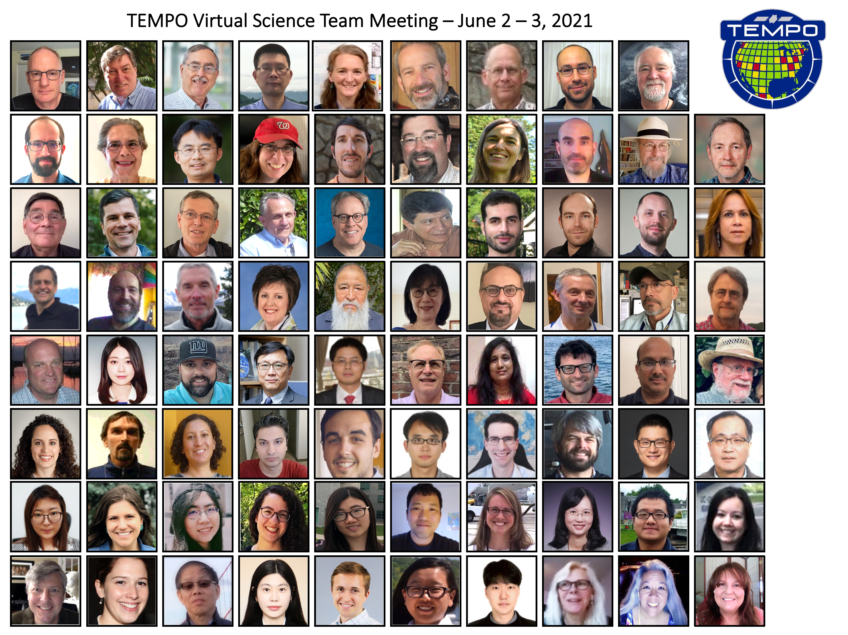

Tropospheric Emissions: Monitoring of Pollution (TEMPO)
Xiong Liu^{1,*}, Kelly Chance¹
on behalf of The TEMPO Team
¹Center for Astrophysics | Harvard & Smithsonian
* xliu@cfa.harvard.edu
GESTAR II Seminar
July 14, 2022

Slide 4

Hourly daytime atmospheric pollution over North America from the GEO
NASA’s first Earth Venture Instrument (EVI) selected in 2012 & first host payload
PI: Kelly Chance, SAO: STM, ground systems, science data processing center
Instrument Development: Ball Aerospace
Instrument Project Management: NASA LaRC, PM: Kevin Daugherty
Other Institutions: NASA GSFC, NOAA, EPA, NCAR, Harvard, UC Berkeley, St. Louis U, UAH, U Nebraska, Sitting Bull College, RT Solutions, Carr Astronautics
International collaboration: Mexico, Canada, Cuba, Korea, U.K., ESA, Spain
Mission Project Management: NASA LaRC, current PM: Kevin Daugherty
Host Satellite Provider: Maxar Technologies
Satellite Host: Intelsat (IS40e)
Launch: SpaceX
Provides hourly daylight observations to capture rapidly varying emissions & chemistry important for air quality
  UV/visible grating spectrometer to measure key elements in tropospheric ozone and aerosol pollution
  Distinguishes boundary layer from free tropospheric & stratospheric ozone
Aligned with Earth Science 2007 Decadal Survey recommendations
  Makes many of the GEO-CAPE atmospheric measurements
  Responds to the phased implementation recommendation of GEO-CAPE mission design team along with GeoCarb and GLIMR

Slide 5
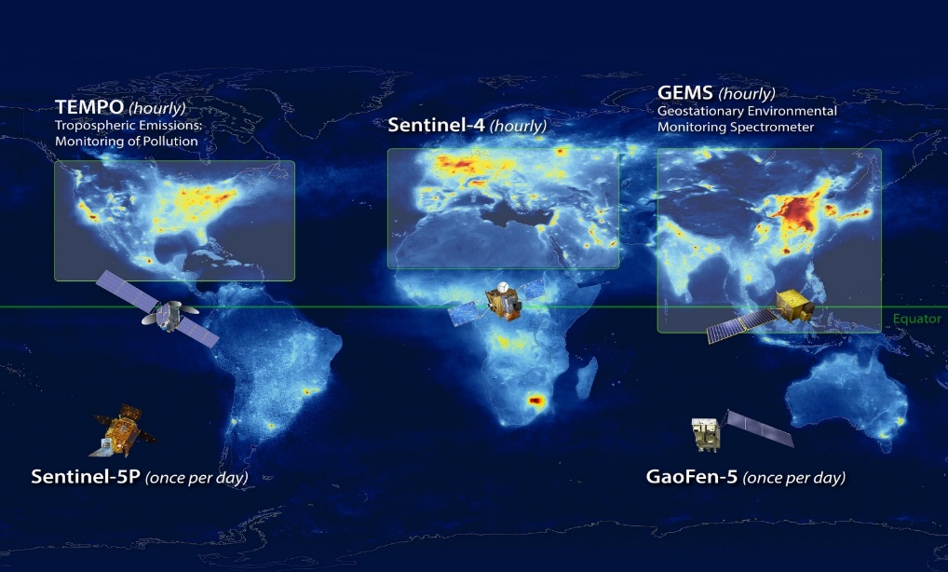
North American Component of An International Geostationary Air Quality Constellation
Launch Jan 2023
Launch 2023
Launch Feb 2020
Image Credit: NASA LaRC

Slide 6
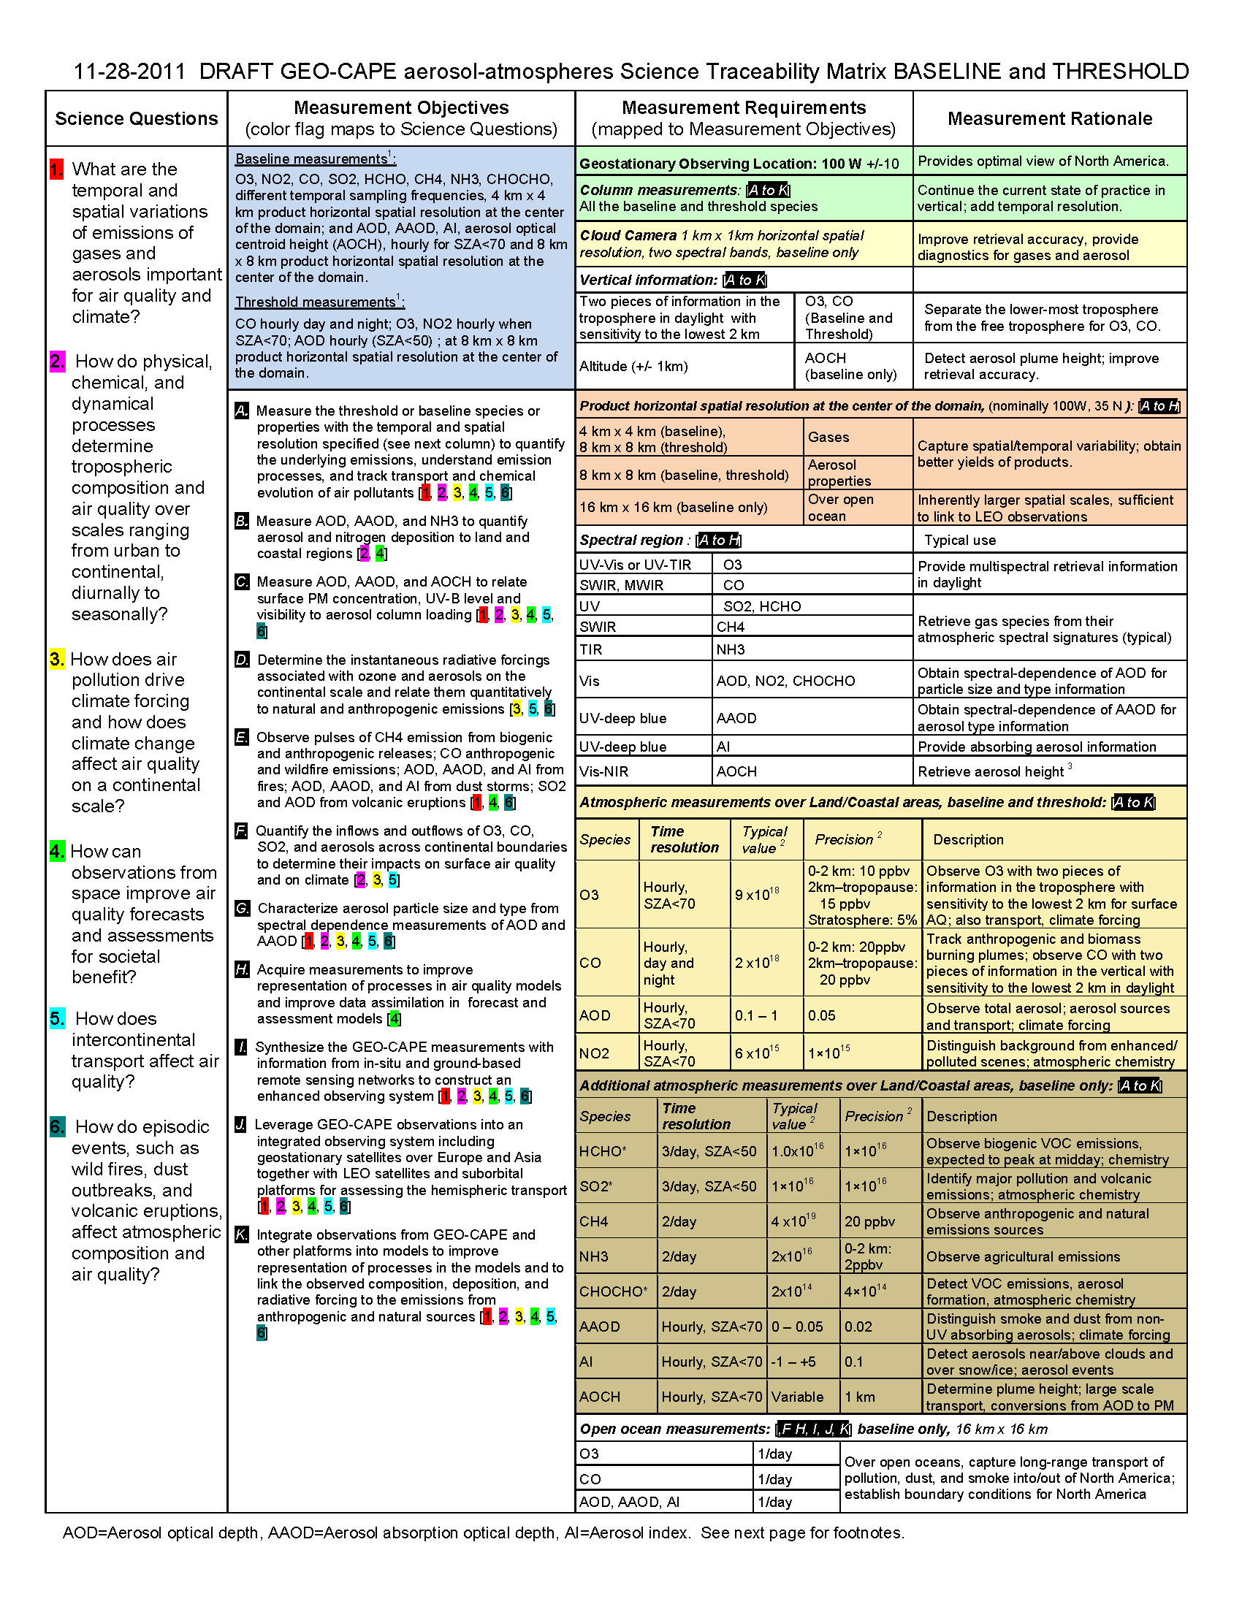
TEMPO Requirements and Science Questions are leveraged from the GEO-CAPE Science Traceability Matrix

Slide 7
TEMPO Science Questions
What are the temporal and spatial variations of emissions of gases and aerosols important for air quality and climate?
How do physical, chemical, and dynamical processes determine tropospheric composition and air quality over scales ranging from urban to continental, diurnally to seasonally?
How does air pollution drive climate forcing and how does climate change affect air quality on a continental scale?
How can observations from space improve air quality forecasts and assessments for societal benefit?
How does intercontinental transport affect air quality?
How do episodic events, such as wild fires, dust outbreaks, and volcanic eruptions, affect atmospheric composition and air quality?

Slide 8
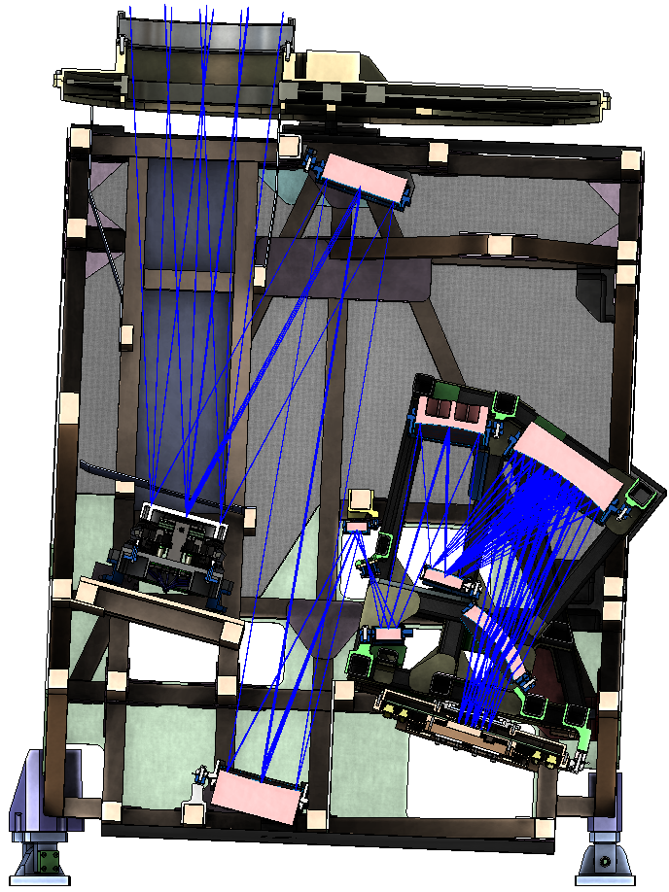
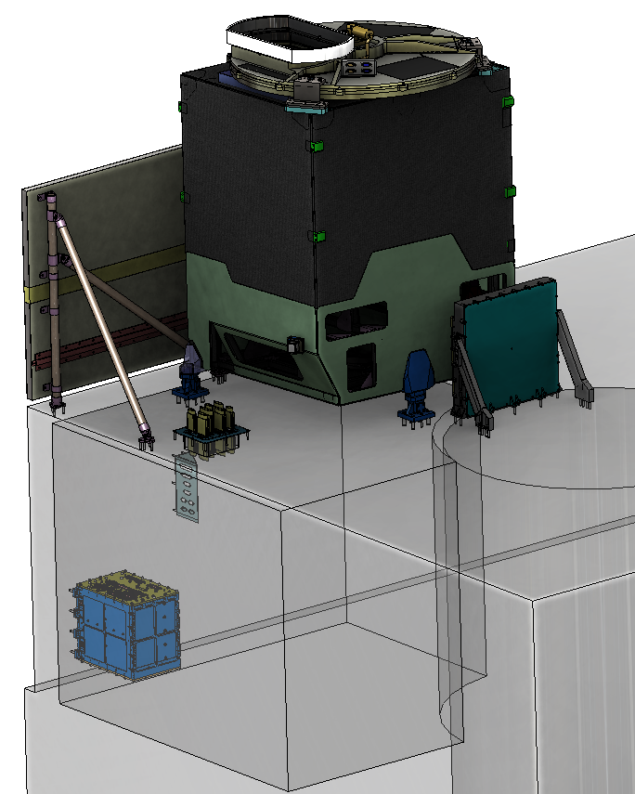

TEMPO Status
  Instrument delivery by Ball Aerospace in Nov. 2018
  Host satellite provider: Maxar selected in July 2019
  Host: Intelsat 40e (IS40e) selected on Feb 2020
  TEMPO sensor integrated onto IS-40e on 11/17/2021, and integration completed on 6/30/2022.
  TEMPO Ground Systems to be ready in August 2022
  Operation/Mission Readiness Review (ORR/MRR) in Jan. 2023
  Launch on SpaceX Falcon 9 in late January 2023
Calibration Mechanism Assembly
Telescope Assembly
Scan Mechanism Assembly
Spectrometer Assembly
Radiator Assembly
Focal Plane Electronics
Focal Plane
Assembly
Instrument
Control Electronics
Instrument Support
Assembly
Courtesy from Ball Aerospace

Slide 9
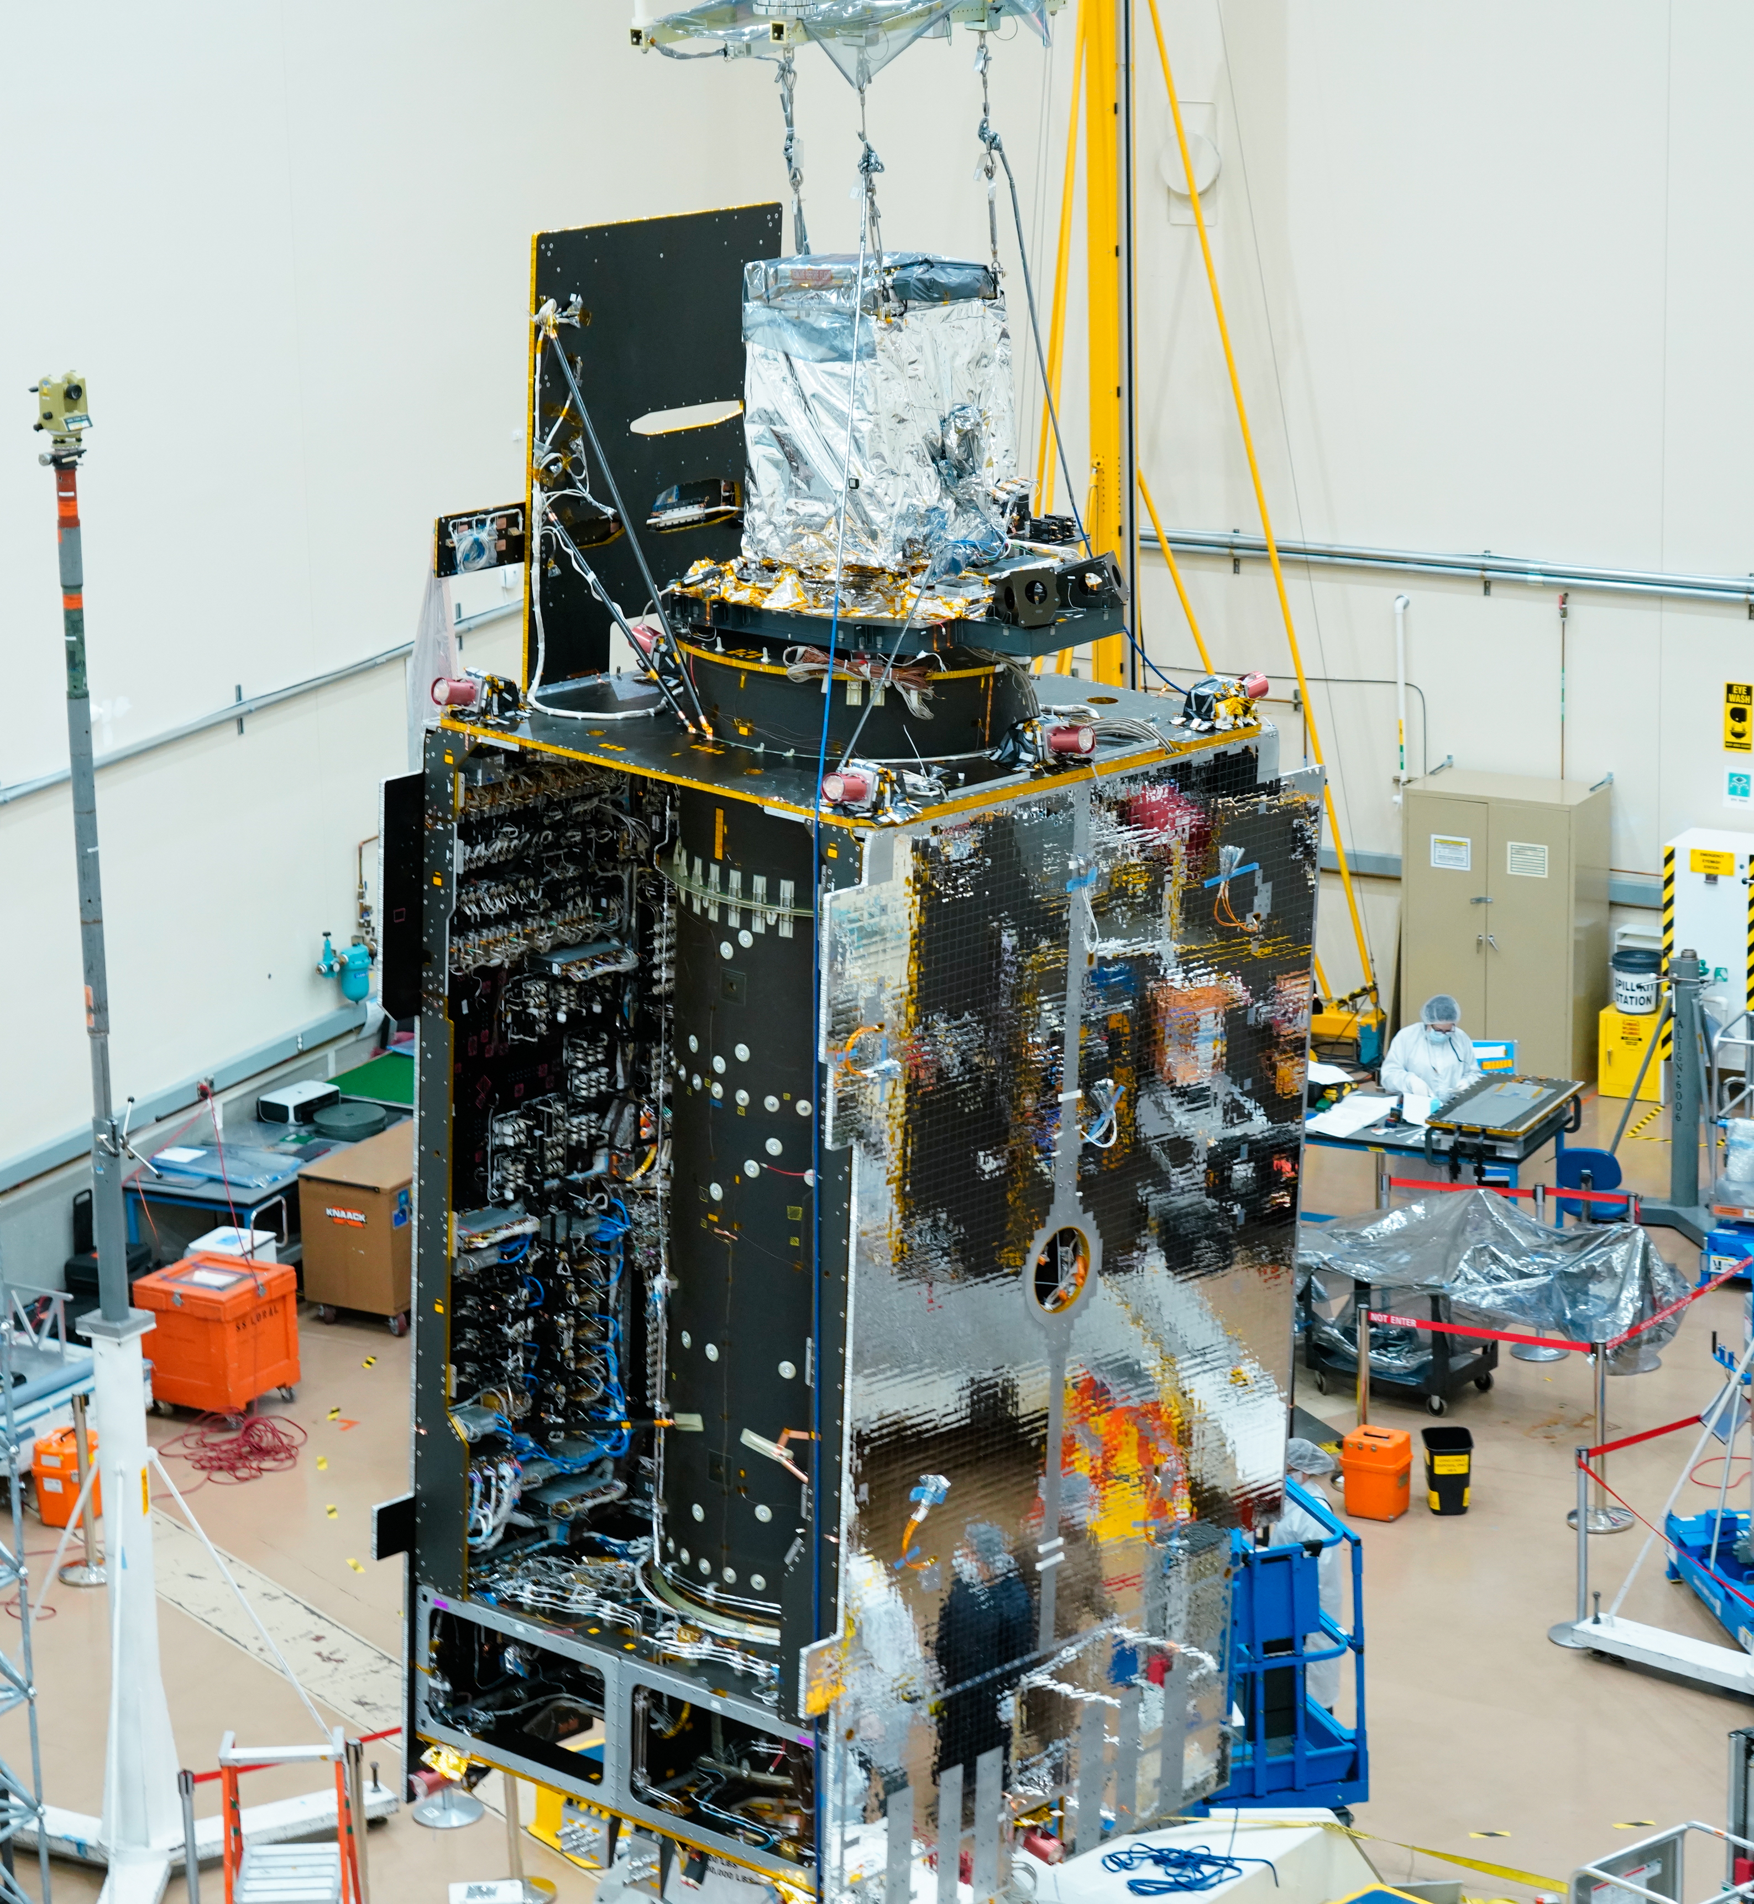
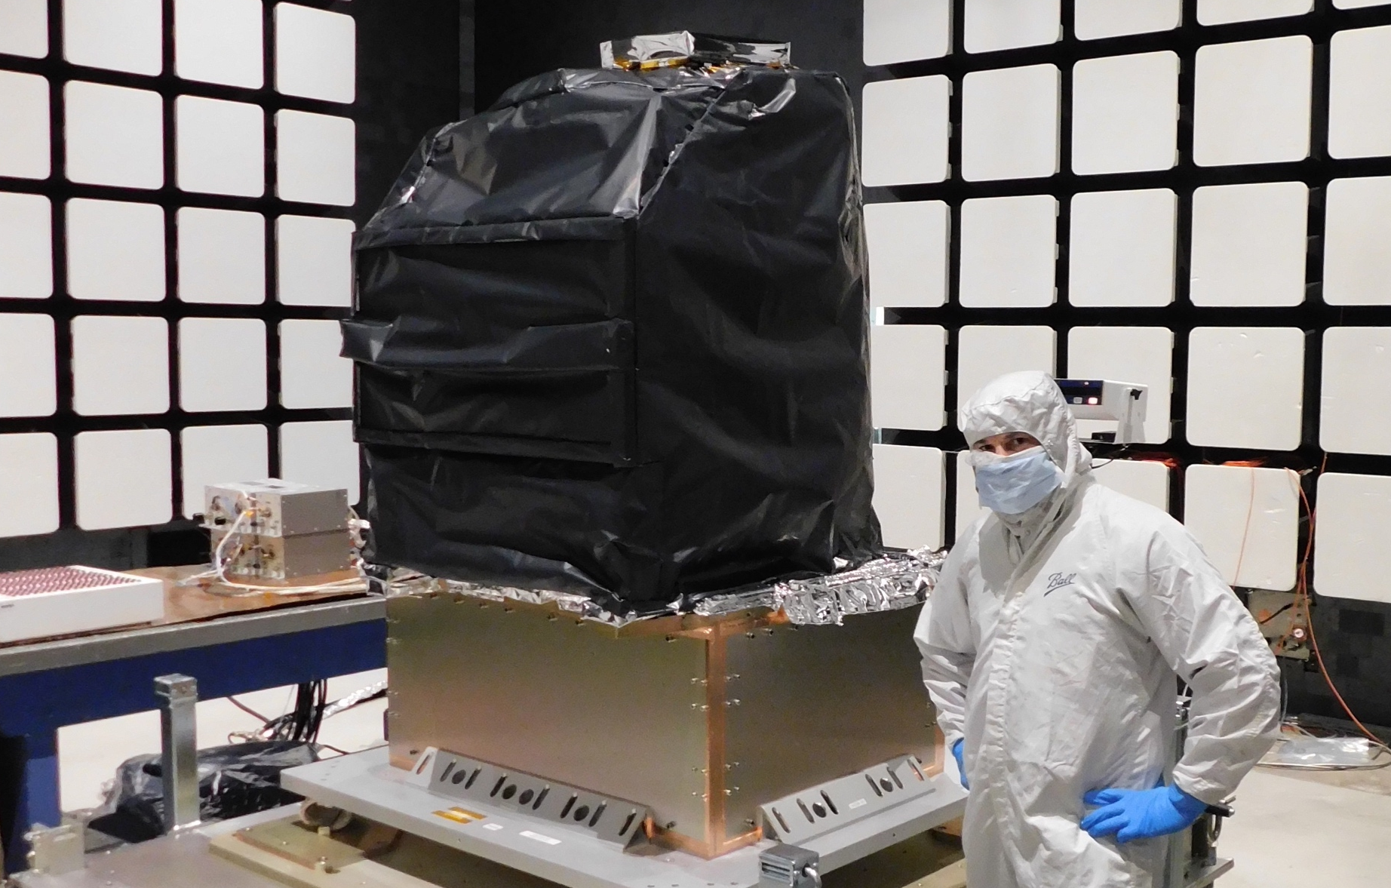
TEMPO Status
  Instrument delivery by Ball Aerospace in Nov. 2018
  Host satellite provider: Maxar selected in July 2019
  Host: Intelsat 40e (IS40e) selected on Feb 2020
  TEMPO sensor integrated onto IS-40e on 11/17/2021, and integration completed on 6/30/2022.
  TEMPO Ground Systems to be ready in August 2022
  Operation/Mission Readiness Review (ORR/MRR) in Jan. 2023
  Launch on SpaceX Falcon 9 in late January 2023
Courtesy from Ball Aerospace
Courtesy from Maxar

Slide 10
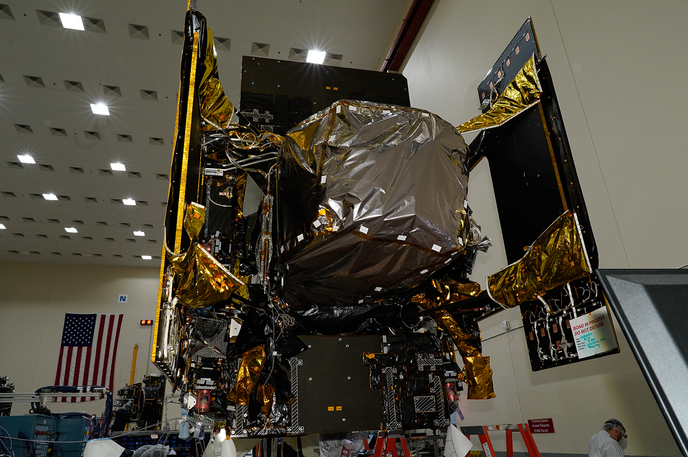
TEMPO Status
  Instrument delivery by Ball Aerospace in Nov. 2018
  Host satellite provider: Maxar selected in July 2019
  Host: Intelsat 40e (IS40e) selected on Feb 2020
  TEMPO sensor integrated onto IS-40e on 11/17/2021, and integration completed on 6/30/2022.
  TEMPO Ground Systems to be ready in August 2022
  Operation/Mission Readiness Review (ORR/MRR) in Jan. 2023
  Launch on SpaceX Falcon 9 in late January 2023
Crews recently completed the first fully integrated powered testing of TEMPO, instrument on Intelsat IS40e at Maxar Technologies' satellite manufacturing facility in Palo Alto, California.
Credits: Image courtesy of Maxar Technologies

Slide 11
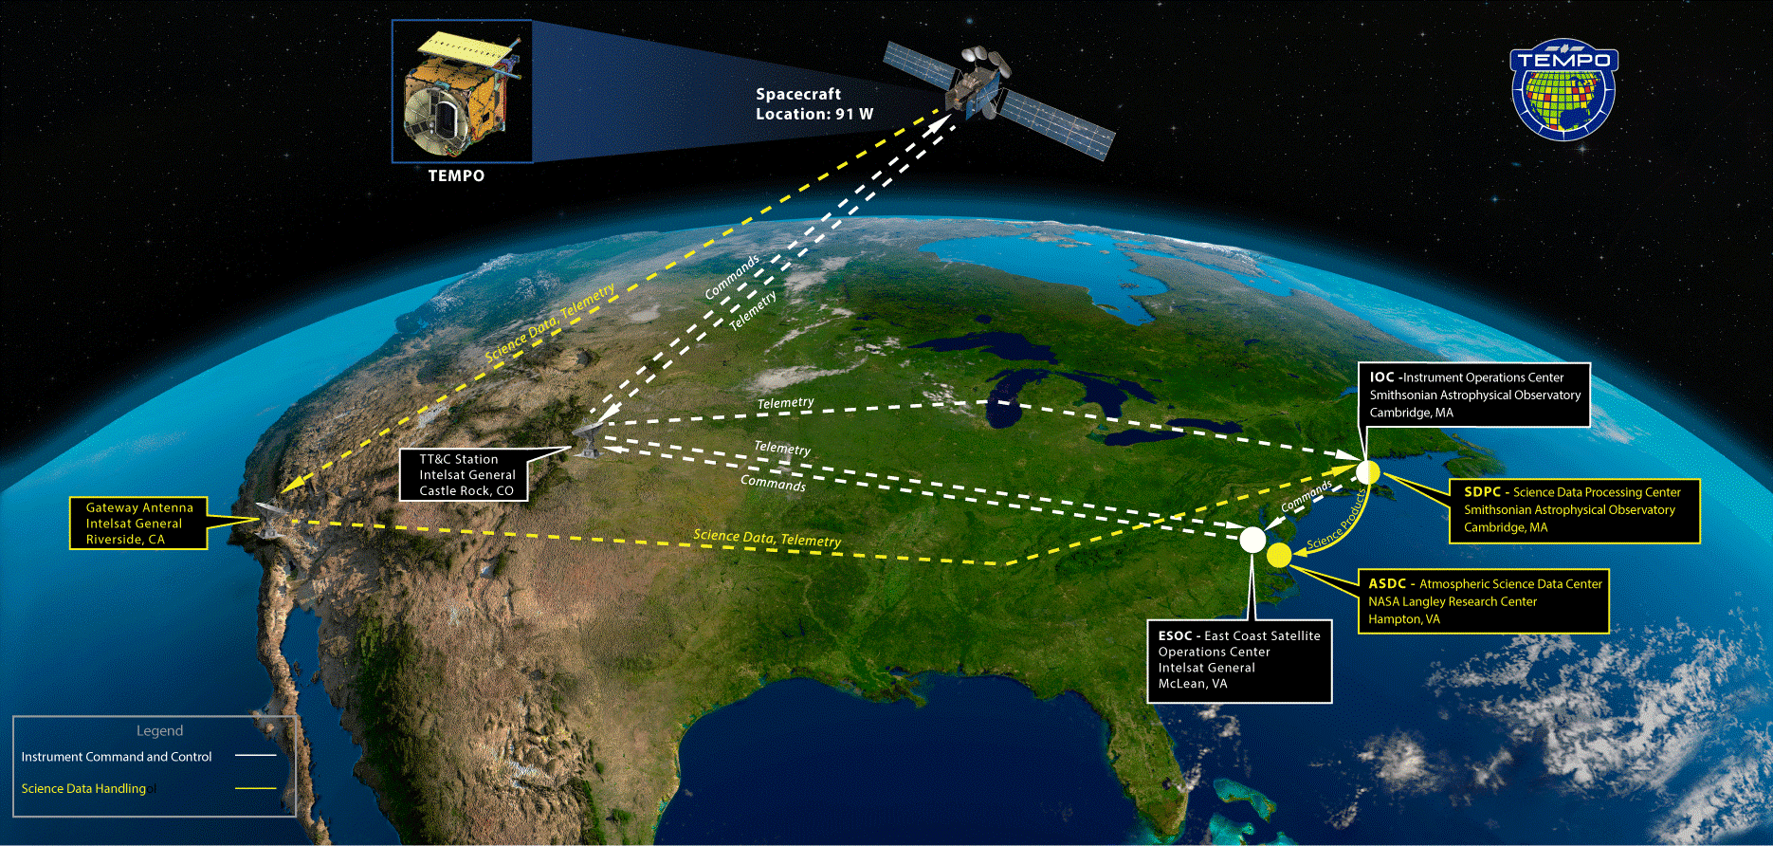
Ground System Architecture Review

Slide 12

TEMPO Instrument
  Imaging grating spectrometer measuring solar backscattered Earth radiance
    2 channels (1 focal plane but with 2 2-D 2 k x 1k detectors ): ~293-494 + 538-741 nm
    ~0.6 nm FWHM, ~0.2 nm sampling
~293-494 nm
~538-741 nm
Examples of spectra based on GOME

Slide 13
Including Visible to Improve Tropospheric Ozone Retrieval Sensitivity
This example is for SZA=25, VZA=45, AZA=86, SNR with 4 pixels coadded
Add visible to improve retrieval sensitivity in the lower troposphere and help separate free tropospheric O3 from boundary layer O3
Under ideal conditions (4-pixel coadded): 3-5 total DFS with up to ~1.5 in the troposphere, and up to ~0.5 DFS in 0-2 km
Adapted from OMI (Liu et al., 2010): Spectral fitting + VLIDORT + Optimal Estimation (OE) from Fitting windows: 293-345 nm, 540-650 nm
Retrieve partial O₃ columns at ~24 layers (bottom layer is 0-2 km above the surface) as well as total, stratospheric, and tropospheric O₃ columns, other trace gases, and auxiliary parameters. Output includes retrieval a priori, retrieval error and its covariance matrix, averaging kernels.
Climatological a priori: a combination of tropopause-based climatology (Bak et al., 2013) with diurnally-resolved GEOS-CF data

Slide 14

TEMPO Operation
  Operate on geostationary communications satellite Intelsat 40e (IS40e) at 91 ∘ W
Nominal: Scan FOR in 1 hour with 10 granules
~ 2K N/S pixels x 1226 steps/hr, ~ 2.5 M pixels/hr, daily # spatial pixels ~TROPOMI
2 x 4.75 km² @center of FOR, from 8 km² at Mexico City to 21 km² at Canadian Tar Sands
FOR: N/S +/-210 pixels,
E/W +230/160 pixels
Optimized scan: in the early morning and late afternoon, daylight portion of FOR, higher temporal resolution
High-time scan (up to 25%): selected portion of FOR at higher temporal resolution (e.g., <= 10 mins)
Field of regard is optimized to cover both Puerto Rico and Canadian tar sands.
S5p-TROPOMI NO2 product oversampled by Kang Sun.

Slide 15
Baseline and Threshold Products (Variables) & Requirements
Species/Products | Required Precision | Temporal Revisit*
0-2 km O₃ (Selected Scenes) Baseline only | 10 ppbv | 2 hour
Tropospheric O₃ | 10 ppbv | 1 hour
Total O₃ | 3% | 1 hour
Tropospheric NO₂ | 1.0 × 10¹⁵ molecules cm⁻² | 1 hour
Tropospheric H₂CO | 1.0 × 10¹⁶ molecules cm⁻² | 3 hour
Tropospheric SO₂ | 1.0 × 10¹⁶ molecules cm⁻² | 3 hour
Tropospheric C₂H₂O₂ | 4.0 × 10¹⁴ molecules cm⁻² | 3 hour
Aerosol Optical Depth | 0.10 | 1 hour
* # of hourly measurements to be averaged to achieve required precision
Mission duration: 20 months for baseline
Spatial resolution: < 60 km² for baseline (4 native pixels coadded)
Aerosols, SO₂, C₂H₂O₂ were removed from baseline products during KDPC
  Proposed to bring them back along with additional products and produce NRT/off-line products for some species, pending on funding from Satellite Needs Working Group (SNWG) in late 2022 or 2023.
Cloud product (cloud fraction, cloud pressure): used in trace gas/aerosol retrievals

Slide 16
TEMPO Data Products
(Inc. Proposed Additional & NRT Products)
Level | Product | Algorithm | Major Outputs | Res km^{2 **} | Freq/Size
L0 | Digital counts | Raw to L0 | Reconstructed/reformatted digital counts | 2.0 x 4.75 | Daily/hourly
L1-b | irradiance^{NRT} | SAO L0-1 | Calibrated & quality flags |  | daily
 | radiance^{NRT} | SAO L0-1 | Geolocated,calibrated, viewing,geolocation&quality flags | 2.0 x 4.75 | Hourly, granule
L2 | Cloud ^{NRT} | OMI O2-O2* | Cloud fraction, cloud pressure | 2.0 x 4.75 | Hourly, granule
 | O₃ profile | SAO O3 profile | O3 profile, total/strat/trop/0-2 km O3 column, errors, a priori, AKs | 8.0 x 4.75 *** | Hourly, granule
 | Total O₃ | TOMS V8.5 | Total O3, AI, cloud fraction | 2.0 x 4.75 | Hourly, granule
 | NO₂ ^{NRT} | SAO trace gas, BU strat/trop sep. | SCD, strat./trop. VCD, error, shape factor, scattering weights | 2.0 x 4.75 | Hourly, granule
 | H₂CO ^{NRT} | SAO trace gas | SCD, VCD, error, shape factor, scattering weights | 2.0 x 4.75 | Hourly, granule
 | C₂H₂O₂ | SAO trace gas |  | 2.0 x 4.75 | Hourly, granule
 | H₂O | SAO trace gas |  | 2.0 x 4.75 | Hourly, granule
 | BrO | SAO trace gas |  | 2.0 x 4.75 | Hourly, granule
 | Aerosol ^{NRT} | OMAERUV+UI AOCH | AAI, UVAOD, UVSSA, AOCH, VISAOD | 8.0 x 4.75 | Hourly, granule
 | SO₂ ^{NRT} | OMSO2 PCA | SCD, VCD (PBL,TRL,TRM,TRU,STL) | 2.0 x 4.75 | Hourly, granule
 | TEMPO/GOES-R Synerg. product | GOES-R products on TEMPO pixels | Radiance, aerosol, cloud & mask, fire/hotspot, snow/ice, rainfall, precipitable water, land/sea surface T, lightning | 2.0 x 4.75 | Hourly, granule
L3 | Gridded L2 | SAO L2-3 | Same as L2 | 2 x 2 (?) | Hourly, scan
L4 | UVB | GEMS/GSFC UVB | UV irradiance, erythemal irradiance, UVI | TBD | Hourly, scan
*Algorithm changed from NASA GSFC’s OMCLDRR to GSFC’s new O₂-O₂ cloud algorithm combined with SAO’s trace gas retrieval algorithm to retrieve O2-O₂ SCDs. ** Spatial resolution at center of FOR. *** Might be at 8 x 9.5km²
Black: baseline, green/orange/purple: additional products (being proposed)
^{NRT}: NRT products & off-line products (with additional NRT funding, otherwise produce 1 product within 3-6 hours except for O₃ profile)

Slide 17
TEMPO Algorithm Teams
Operational Algorithm | Personnel
Raw to L0 | John Davis
L0-1b | John Houck, Xiong Liu, Dave Flittner, Weizhen Hou, Jim Carr, Chris Chan Miller
Ozone profile | Xiong Liu, Juseon Bak, Weizhen Hou
Total ozone | Dave Haffner, Joanna Joiner
Nitrogen dioxide | Caroline Nowlan, Gonzalo González Abad, Jeff Geddes, Chris Chan Miller
Formaldehyde | Gonzalo González Abad, Caroline Nowlan, Hyeong-Ahn Kwon, Chris Chan Miller
Glyoxal | Gonzalo González Abad, Hyeong-Ahn Kwon, Chris Chan Miller
Clouds | Huiqun Wang, Alexander Vasilkov, Eun-Su Yang, Joanna Joiner
Sulfur dioxide | Can Li, Nicolay Krotkov
Aerosols | Omar Torres, Jun Wang
Operational implementation and IT support @ SAO Science Data Processing Center (SDPC) by John Houck

Slide 18
Algorithm Development
Algorithm Development Status & Plan
SDPC V3 (launch ready) completed in Feb. 2022, verification almost done
Algorithm mostly based on OMI heritage algorithms except for new L0-1b processor (including INR using GOES-R from Carr Astronautics)
Updates to L1-2 algorithms (O₃ profile, NO₂, HCHO, cloud, total O₃):
  Adapted for TEMPO in NetCDF-4 format
  Add visible to SAO UV O3 profile algorithm, SAO trace gas algorithm with adapted NASA strat/trop separation for NO2
  CLDO4^{new}: SAO O₂-O₂ fitting + GSFC’s O₂-O₂ cloud at ~477/466 nm (Huiqun Wang, Eun-Su Yang, Alexander Vasilkov)
  NASA GMAO’s GEOS-CF trace gas profiles and meteorology (Emma Knowland and GMAO)
  Hourly resolved monthly mean Geometry-dependent Lambertian Equivalent Reflectivity (GLER) climatology (Christopher Chan Miller, Wenhan Qin, Zachary Fasnacht)
Development of other products
  CHOCHO, H₂O, BrO: will use SAO’s trace gas algorithm
  SO₂: OMI PCA SO₂ algorithm adapted for TEMPO/GEMS from synthetic/GEMS data (Can Li)
  Aerosols: being adapted from OMI/TROPOMI AERUV algorithm (Omar’s team), from EPIC/TROPOMI Aerosol Layer Height algorithm using O₂-A/B (Jun Wang’s team)
Continue to make minor updates to improve beyond V3
  Further improvements using synthetic and GEMS data: destriping, radiance reference & background correction, cross section updates, empirical correction
  Algorithm refinement/optimization during commissioning (Jun-Aug 2023) and nominal operation

Slide 19
NRT vs. Off-line Trace Gas Products
(if with additional NRT funding)
Implementing both NRT and off-line trace gas products (e.g., NO₂, HCHO) for NO2, HCHO, aerosol, SO₂, cloud
Major potential differences between NRT and offline products
 | NRT | Off-line
Trace gas profiles/Met data | GEOS-CF | GEOS-CF Replay
Surface | GLER climatology | MODIS/VIIRS albedo/BRDF products
L1B | Skip wavelength calibration One-pass INR Default/No Pol. Correction | Two-pass Kalman Filter INR Improved pol. Correction with L2 retrievals?
L2 algorithms | Smaller fitting windows Avoid waiting for the entire hourly scan | More optimized fitting windows Improve radiance reference & cross-track correction
Data Latency | Within 2-3 hours upon receipt of raw data at SAO Ground System | + 8 days as MODIS BRDF is produced using data +/- 8 days

Slide 20
Research Products
TEMPO research products will greatly extend science and applications
  OClO, IO, HNO₂, NO₃, volcanic (SO₂ plume height and VCD)
  Additional/improved cloud with O₂-O₂ bands / O₂-B bands
  Additional aerosol products from hyperspectral spectra, O₂-B and O₂-O₂-bands, and TEMPO + GOES-R synergy at @U Iowa, NOAA, GSFC
  Vegetation/Ocean Color products: vegetation indices, Growth Primary Productivity (GPP), Solar Induced fluorescence (SIF), ocean color
  Surface albedo/BRDF products
  Diurnal out-going shortwave radiation and cloud forcing
  Night lights: allows discrimination between lightning types
  Higher-level products: Near-real-time pollution/AQ indices

Slide 21
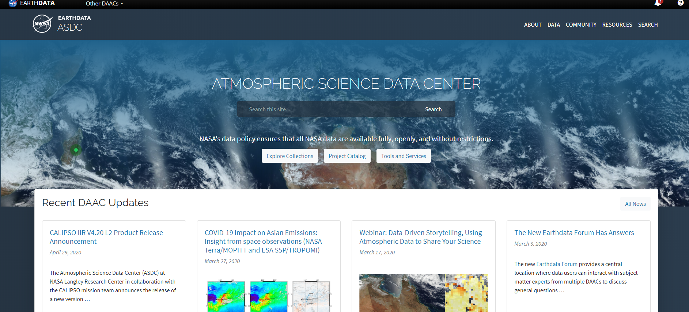



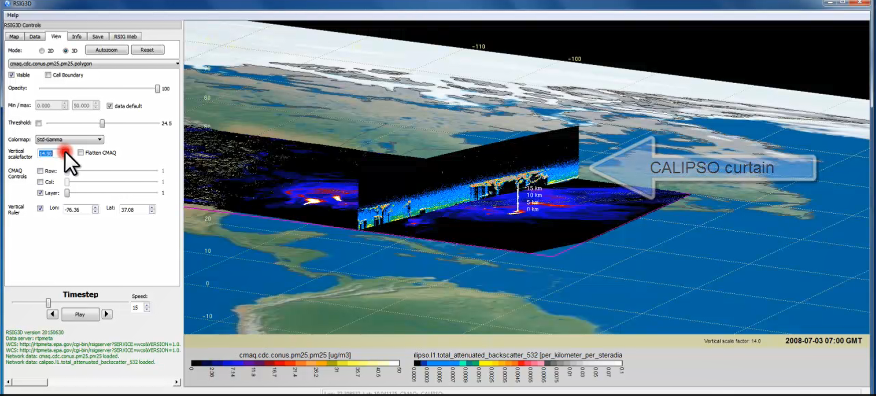
TEMPO Data Products Distribution
ASDC Data Archival & Distribution: Tools and Services
NASA Earthdata Search
  CMR Search ⚬ Metadata
NASA WorldView
  GIBS API ⚬ visualization
Harmony and OPeNDAP
  ⚬ transform ⚬ subsetting
  ⚬ reformatting ⚬ distribution
HTTPS data access
  ⚬ datapool
  ⚬ permanent URL/direct access
  ⚬ enables scripts/workflow
Geospatial Web Services
  ⚬ WCS ⚬ WMS ⚬ ArcGIS Image Service
Example scripts
  ⚬ Python/Jupyter Notebook
  ⚬ R scripts
  ⚬ contributed tutorials/scripts
EPA RSIG3D Gateway
TEMPO data can be served directly through the EPA RSIG. https://www.epa.gov/hesc/remote-sensing-information-gateway
User Support and Other Resources
Earthdata Login https://urs.earthdata.nasa.gov
Earthdata Forum https://forum.earthdata.nasa.gov/
ASDC User Support support-asdc@earthdata.nasa.gov
Slides from Jeff Walters, Tim Larson at TEMPO STM 2020 & EAWNov2021

Slide 22
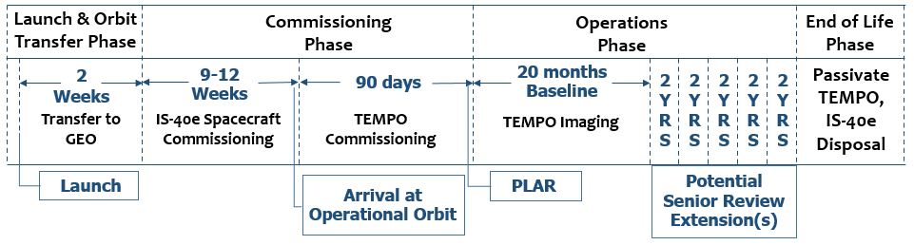
Commissioning Timeline & Data Release
TEMPO commissioning: ~L+105-L+195 (mid-May – mid August)
Nominal operation: ~6 months after launch
Plan to release initial L1b in ~4 mons, L2/3 in ~6 mons to the public after commissioning (i.e., Dec 2023 for L1b, Feb 2024 for L2/3).
Provide data products to validation team priori to the public release via ASDC.

Slide 23
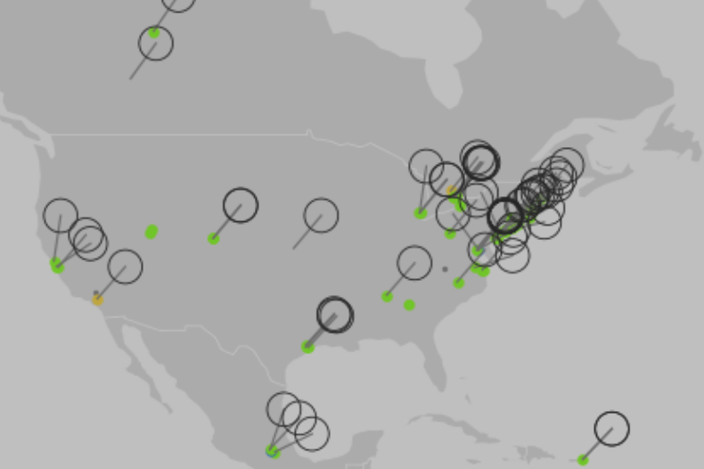
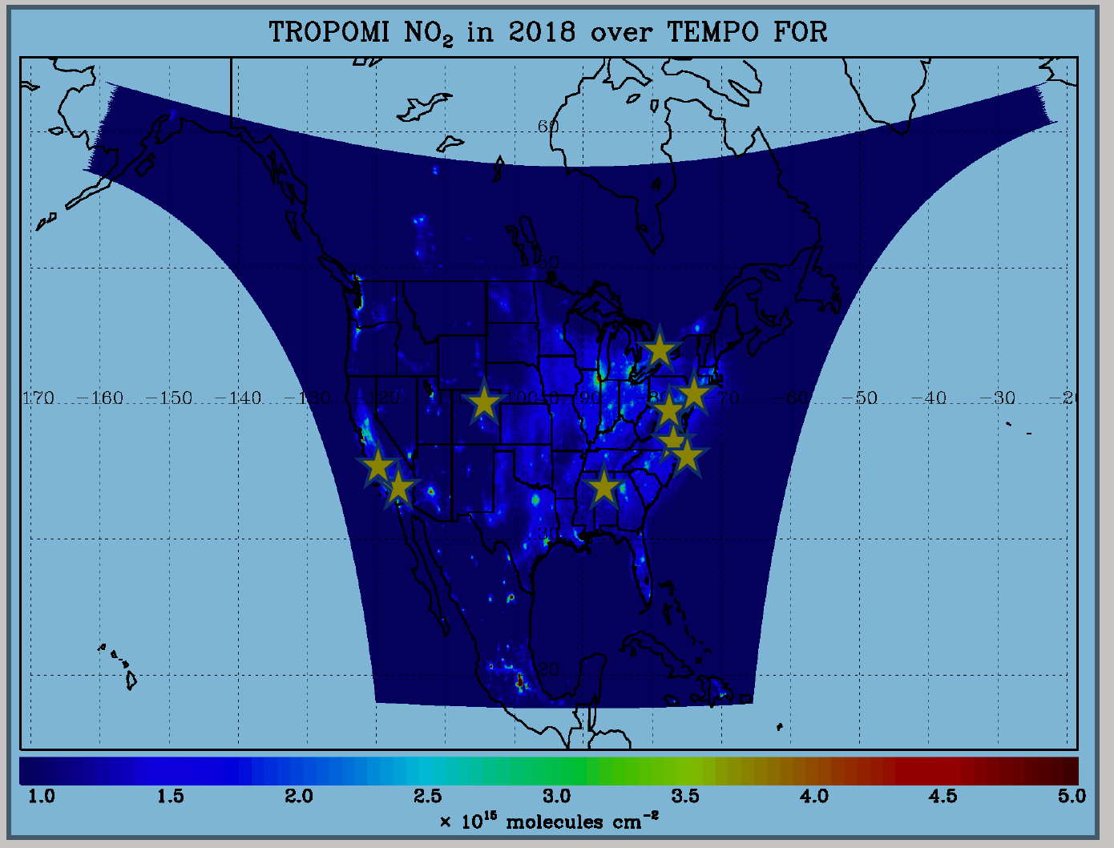
TEMPO Validation Plan
TEMPO PLRA has a bare minimum validation requirements (3 Pandoras, 1 month per season)
Jim Szykman is leading development of best-of-effort basis validation plan: pre-beta, beta, provisional, full
Use satellite observations (i.e., LEO and EPIC/DSCOVR) for cross validations
Pandora & Pandonia Global Network (PGN): validate NO₂, HCHO, total O₃ and diurnal variation
TOLNet: 8 LIDAR instruments by time of launch to validate tropospheric O₃ & 0-2 km O₃ and diurnal variation
https://www.pandonia-global-network.org/
www-air.larc.nasa.gov/missions/TOLNet/
~60 PGNs in TEMPO FoR, ~20 to add in the next 2 years
Nowlan et al. (2018) GCAS, DISCOVER-AQ, Texas, Sep 2013
Airborne instruments: GEO-TASO, GCAS, HSRL-2, SeaRey UAV
Other instruments: ozonesonde, MAXDOAS, FTIR, Dobson/Brewer, AERONET, …
Planned flight campaigns like STAQS, AEROMMA, GOTHAAM during June-Aug 2003, provide integrated approaches linking TEMPO Science, Applications, and Validation

Slide 24
TEMPO Early Adopters Program
Led by Aaron Naeger at UAH and NASA-SPoRT, funded by NASA Applied Sciences
User-centric program focused on broadening and enhancing applications of TEMPO data, with special attention to health & air quality
Objective 1
Engage a broad spectrum of stakeholders & end users to expand use of TEMPO data and understand user needs
Objective 2
Use current sensors and proxy data to demonstrate TEMPO capabilities and develop applications
Objective 3
Better align TEMPO mission, products, and data interfaces to user needs and applications
TEMPO Launch
Early Adopters are individuals and groups who:
1) Have an interest or need for using TEMPO data
2) Have an existing or new application for TEMPO data
3) Work with end-users & understand their decision-making process
Inclusive from all end-users and stakeholders:
1) ~260 Early Adopters across TEMPO FoR
2) Includes federal, state, and local AQ agencies, Health Organization, NGOs, and international participation
3) Recent EA data tutorial/workshops in April/Nov 2021 have ~170 attendees
Overarching Goal
Maximize and accelerate the use of TEMPO data for societal benefits
Extend TEMPO mission lifetime
https: weather.msfc.nasa.gov/tempo/

Slide 25
TEMPO Green Paper:
Chemistry Experiments with TEMPO
NORMAL TIME RESOLUTION STUDIES | Volcanoes
Air quality and health | Socio-economic studies
Ultraviolet exposure | National pollution inventories
Biomass burning | Regional and local transport of pollutants
Synergistic GOES-16/17 Products | Sea breeze studies for Florida and Cuba
Advanced aerosol products | Transboundary pollution gradients
Soil NO_{x} after fertilizer application and after rainfall | Transatlantic dust transport
Solar-induced fluorescence from chlorophyll | HIGH TIME RESOLUTION EXPERIMENTS
Foliage studies | Lightning NO_{x}
Mapping NO₂ and SO₂ dry deposition at high resolution | Morning and evening higher-frequency scans
Crop and forest damage from ground-level ozone | Dwell-time studies and temporal selection to improve detection limits
Halogen oxide studies in coastal and lake regions | Exploring the value of TEMPO in assessing pollution transport during upslope flows
Air pollution from oil and gas fields | Tidal effects on estuarine circulation and outflow plumes
Night light measurements resolving lighting type | Air quality responses to sudden changes in emissions
Ship tracks, drilling platform plumes, and other concentrated sources. | Cloud field correlation with pollution
Water vapor studies | Agricultural soil NO_{x} emissions and air quality
Early Adopters are key to building the TEMPO Green Paper!
The TEMPO Green Paper living document at weather.msfc.nasa.gov/tempo/
Early Adopters can request high-time observations!

Slide 26






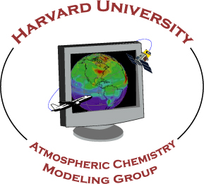



















We are on track to get ready for the TEMPO launch in January 2023.

