Slide 1

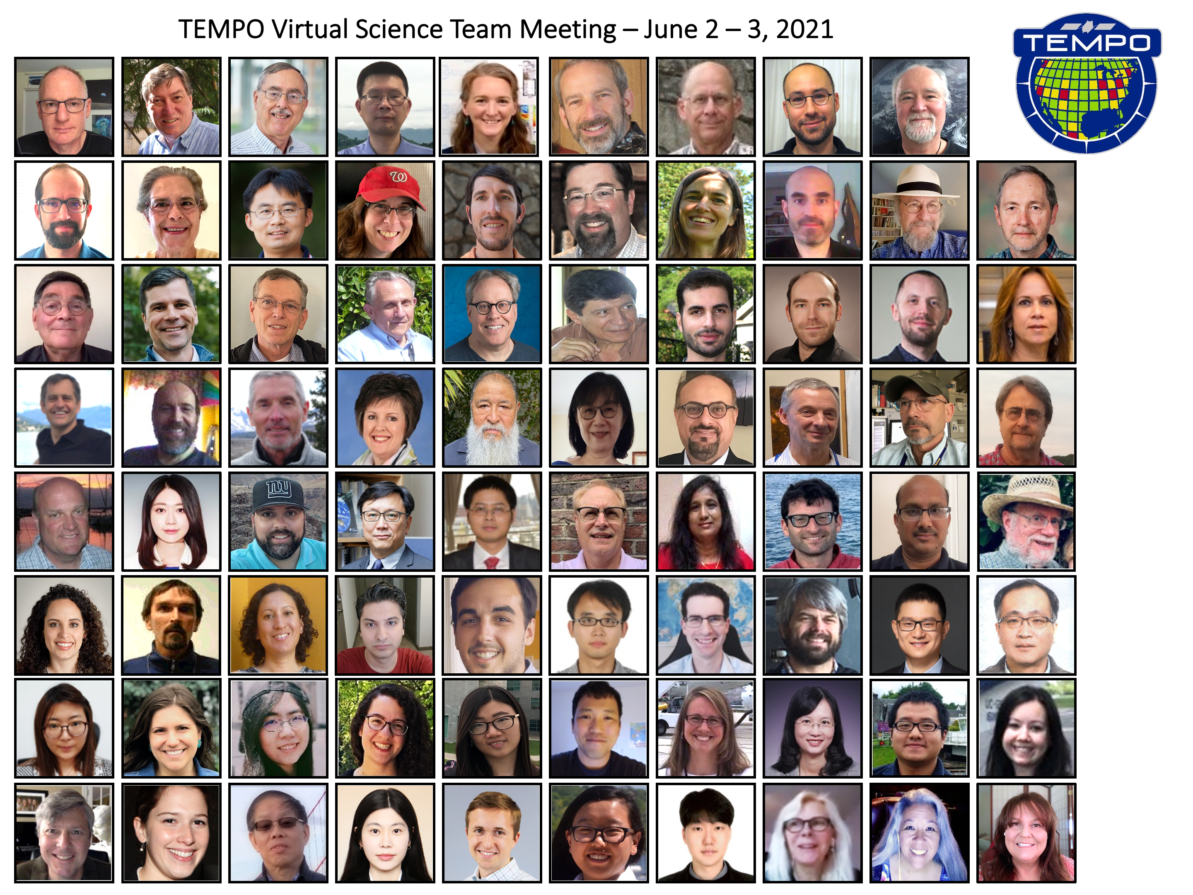

A11A-06
Status of Tropospheric Emissions: Monitoring of Pollution (TEMPO)
Xiong Liu^{1,*}, Kelly Chance¹, Raid M. Suleiman¹,
Kevin J. Daugherty², David E. Flittner², Jassim A Al-Saadi², Scott J. Janz³, Aaron R. Naeger⁴, Mike Newchurch⁴,
John E. Davis¹, John Houck¹, Gonzalo Gonzalez Abad¹, Caroline R. Nowlan¹, Christopher Chan Miller¹,
Juseon Bak⁵, Huiqun Wang¹,
and The TEMPO Team
¹Center for Astrophysics | Harvard & Smithsonian
²NASA LaRc ³NASA GSFC
⁴University of Alabama in Huntsville
⁵Pusan National University
* xliu@cfa.harvard.edu
December 13, 2021

Slide 2

Hourly daytime atmospheric pollution over North America from the geostationary Earth orbit
NASA’s first Earth Venture Instrument (EVI) selected in 2012 & first host payload
PI: Kelly Chance, Smithsonian Astrophysical Observatory (SAO)
Deputy PI: Xiong Liu, Smithsonian Astrophysical Observatory
Instrument Development: Ball Aerospace
Instrument Project Management: NASA LaRC, PM: Kevin Daugherty
Other Institutions: NASA GSFC, NOAA, EPA, NCAR, Harvard, UC Berkeley, St. Louis U, UAH, U Nebraska, Sitting Bull College, RT Solutions, Carr Astronautics
International collaboration: Mexico, Canada, Cuba, Korea, U.K., ESA, Spain
Mission Project Management: NASA LaRC, current PM: Kevin Daugherty
Host Satellite Provider: Maxar
Satellite Host: Intelsat
Launch: SpaceX
  North American component of an international geostationary air quality constellation along with GEMS launched in Feb. 2020 (Please see A23F-01 by Prof. Jhoon Kim about GEMS’s first year results) over Asia and Sentinel-4 over Europe

Slide 3
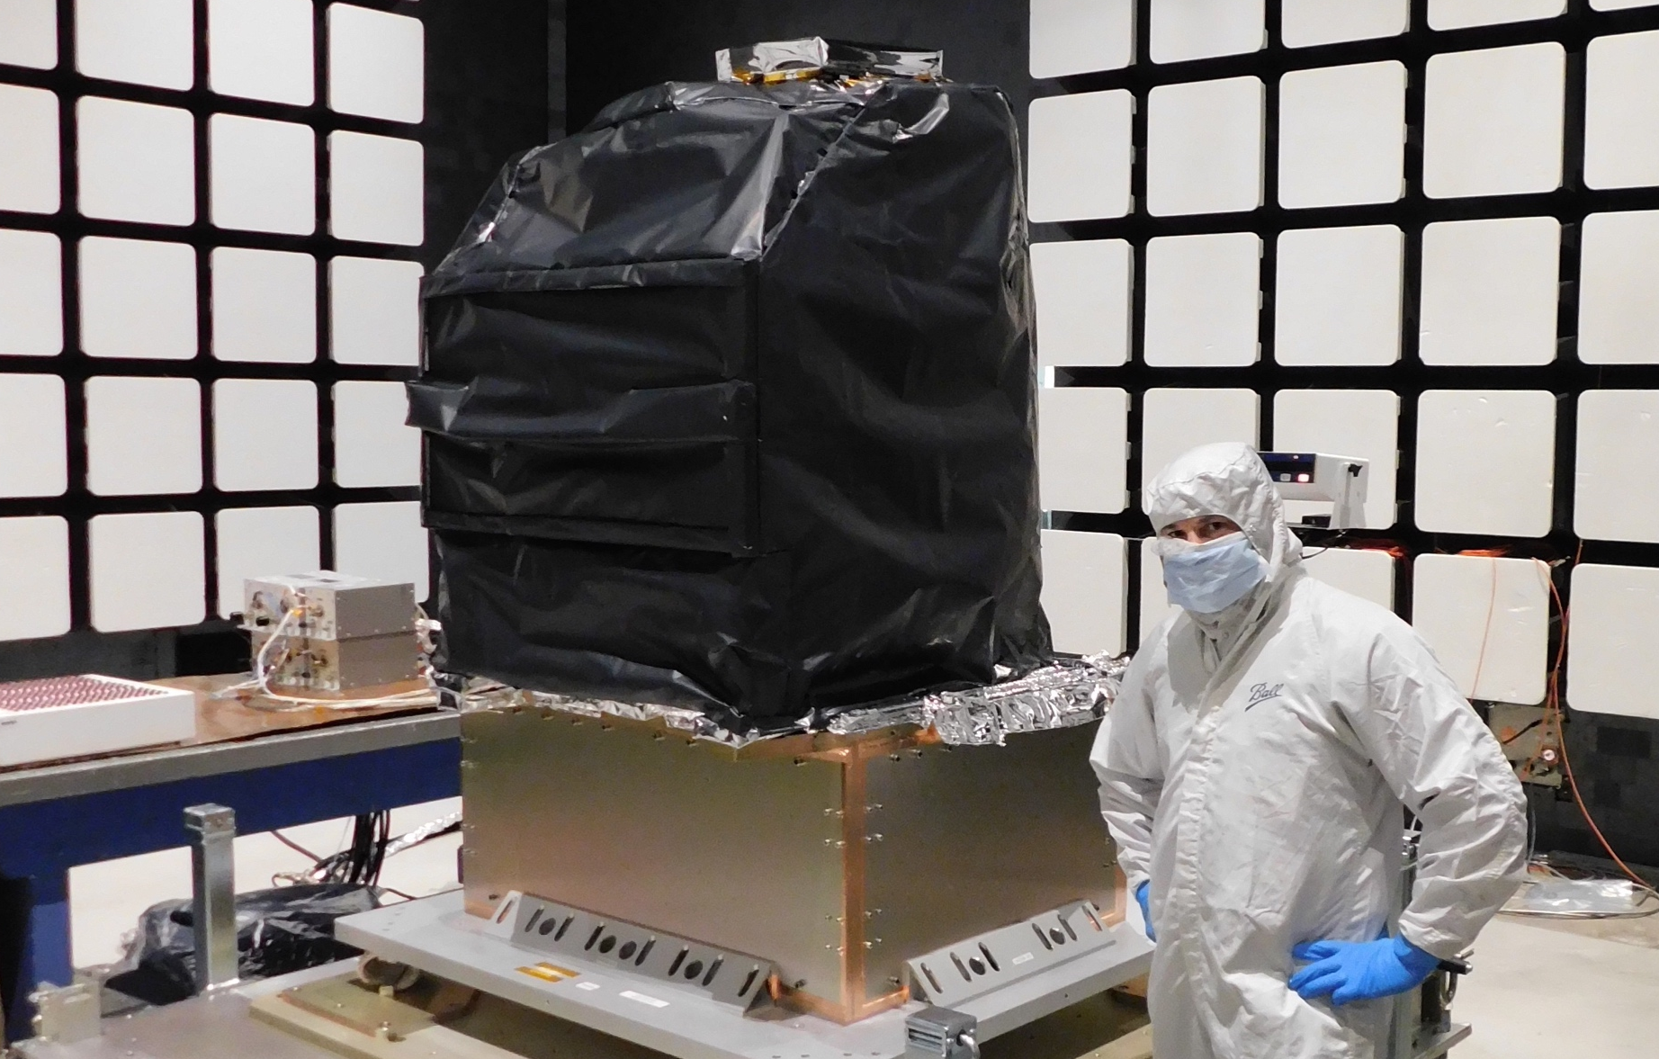
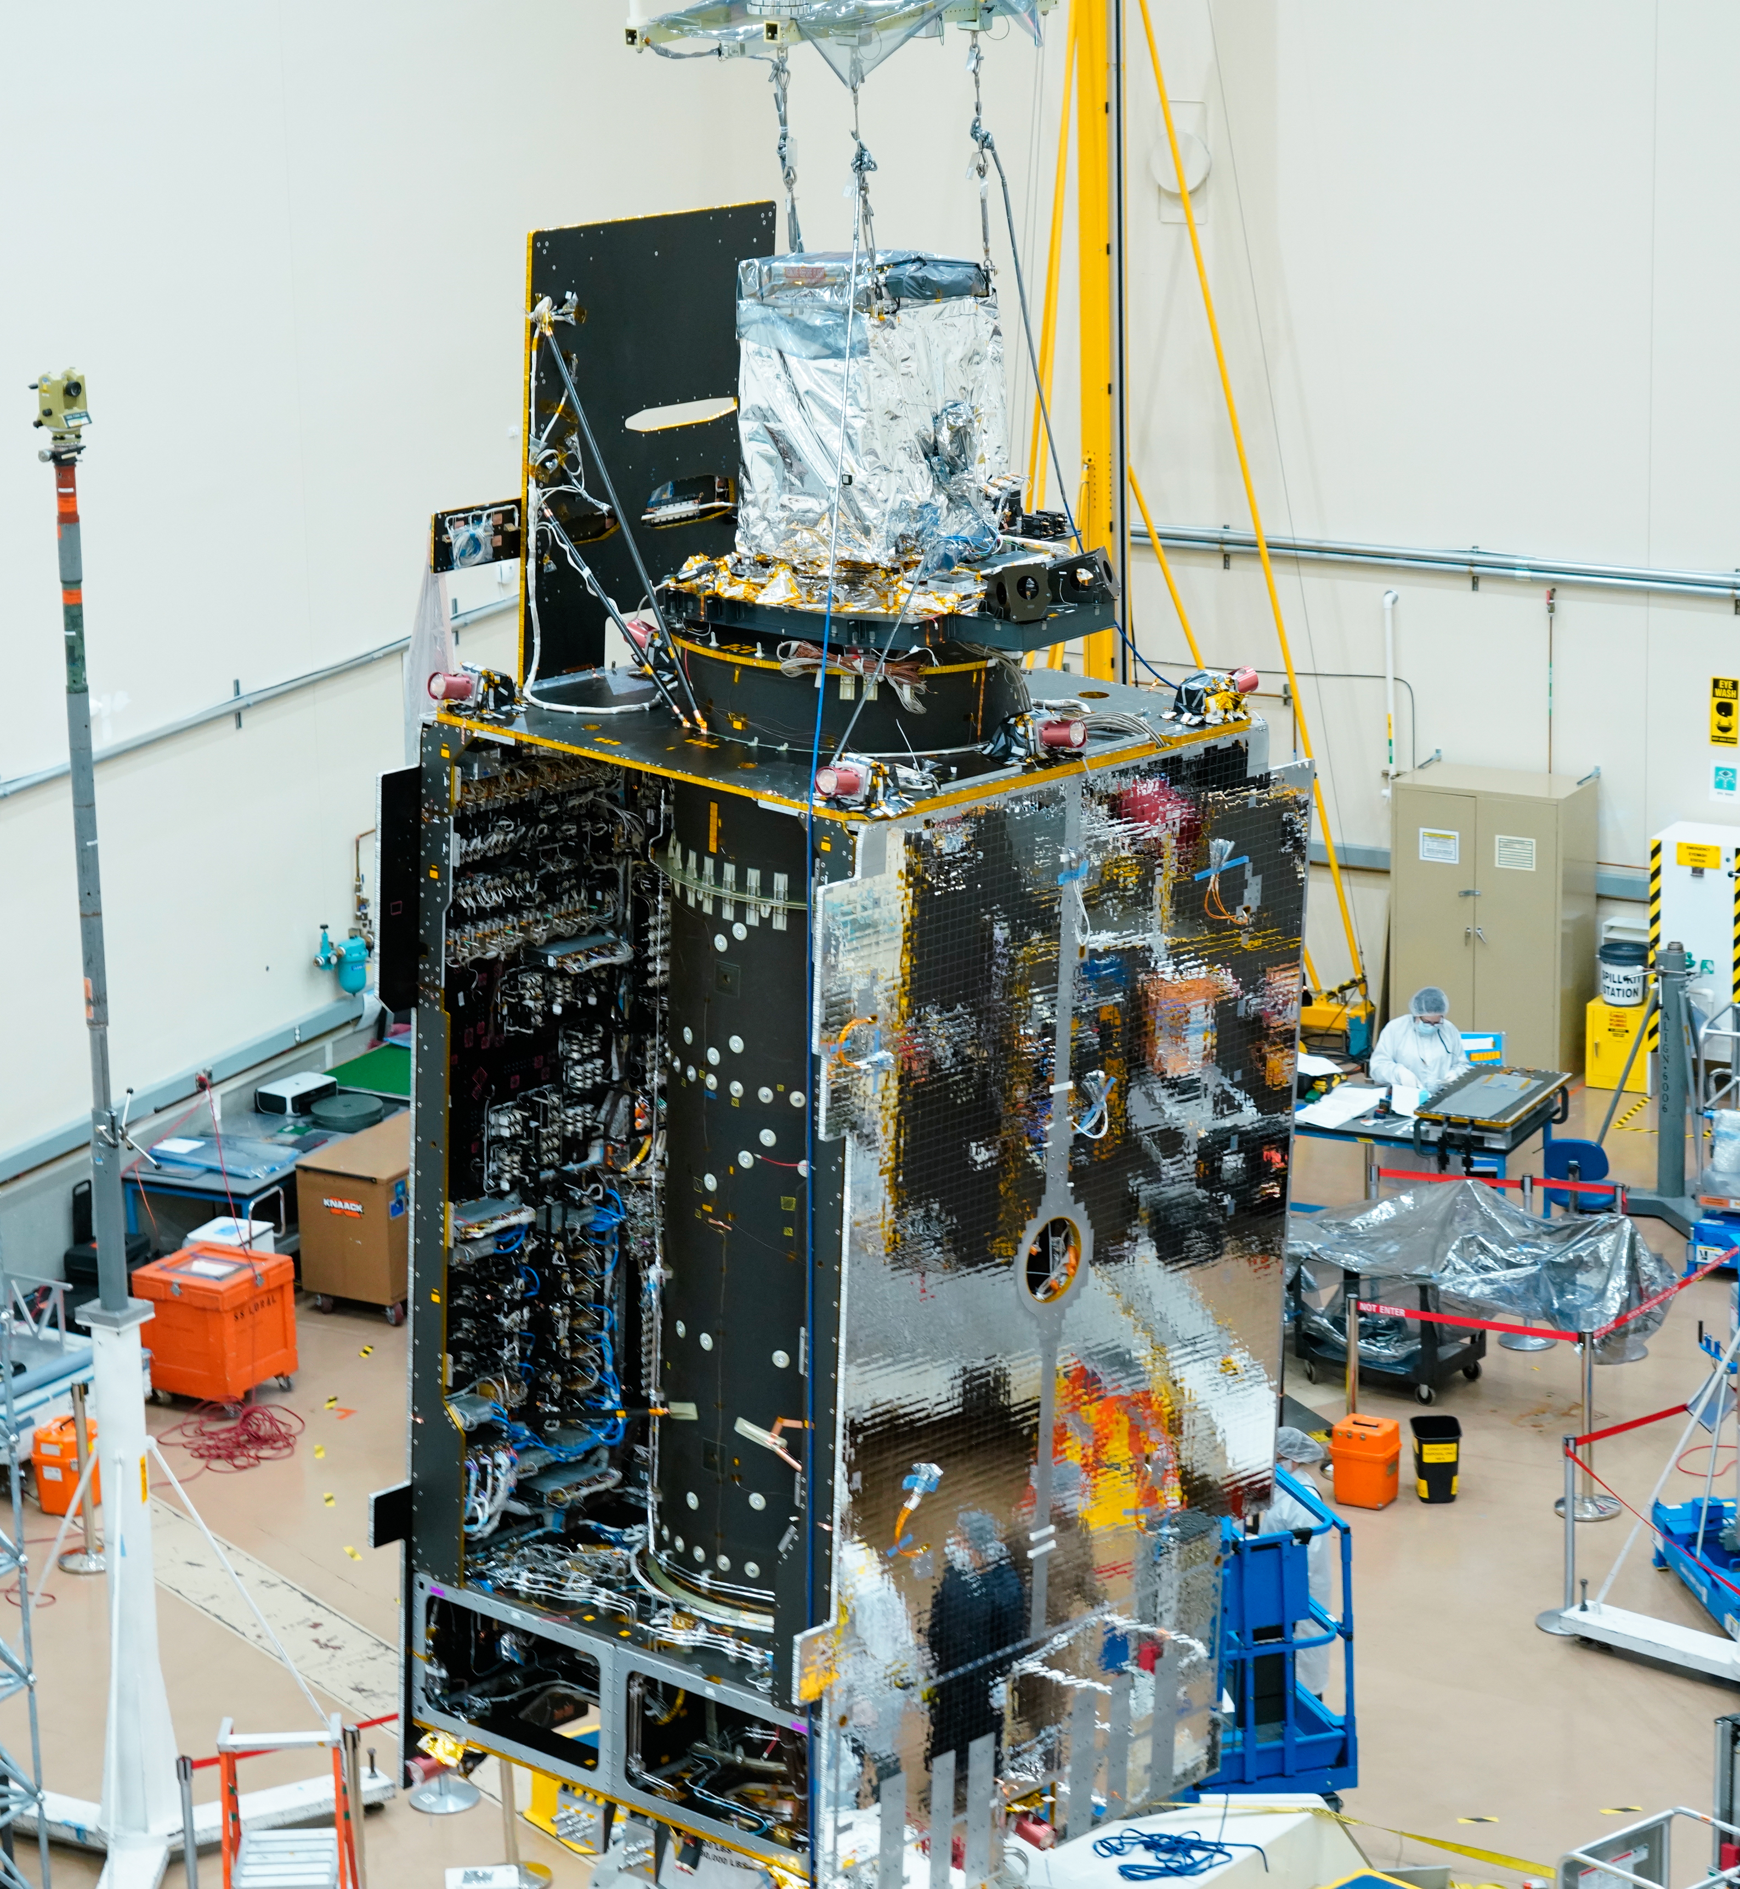
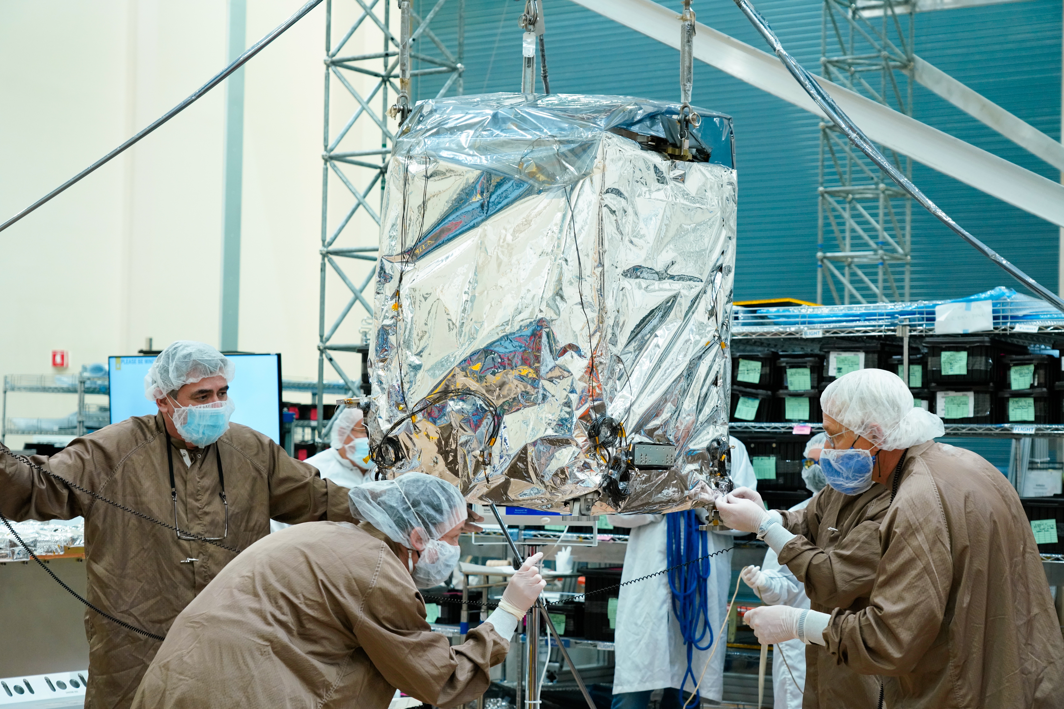
TEMPO Status
  Instrument delivery by Ball Aerospace in Nov. 2018
  Host satellite provider: Maxar selected in July 2019
  Host: Intelsat 40e (IS-40e) selected on Feb 2020
  TEMPO sensor integrated onto IS-40e on Nov. 17, 2021. Electrical integration & post-integration testing started in Dec. 2021.
  TEMPO Ground Systems to be ready in August 2022
  Operation/Mission Readiness Review (ORR/MRR) in Sep. 2022
  Launch on SpaceX Falcon 9 on Dec. 7, 2022
Courtesy from Ball Aerospace
Courtesy from Maxar
Courtesy from Maxar

Slide 4

TEMPO
  Imaging grating spectrometer measuring solar backscattered Earth radiance
    2 channels (1 focal plane but with 2 2-D 2 k x 1k detectors ): ~293-494 + 538-741 nm
    ~0.6 nm FWHM, ~0.2 nm sampling
~293-494 nm
~538-741 nm
Examples of spectra based on GOME

Slide 5

TEMPO
  Operate on geostationary communications satellite Intelsat 40e (IS-40e) at 91.1 ∘ W
Nominal: Scan FOR in 1 hour with 10 granules
~ 2K N/S pixels x 1226 steps/hr, ~ 2.5 M pixels/hr, # spatial pixels ~TROPOMI
2 x 4.75 km² @center of FOR, from 8 km² at Mexico City to 21 km² at Canadian Tar Sands
FOR: N/S +/-210 pixels,
E/W +230/160 pixels
Optimized scan: in the early morning and late afternoon, daylight portion of FOR, higher temporal resolution
High-time scan (up to 25%): selected portion of FOR at higher temporal resolution (e.g., <= 10 mins)
Field of regard is optimized to cover both Puerto Rico and Canadian tar sands.
S5p-TROPOMI NO2 product oversampled by Kang Sun.

Slide 6
Baseline and Threshold
Products (Variables) & Requirements
Species/Products | Required Precision | Temporal Revisit*
0-2 km O₃ (Selected Scenes) Baseline only | 10 ppbv | 2 hour
Tropospheric O₃ | 10 ppbv | 1 hour
Total O₃ | 3% | 1 hour
Tropospheric NO₂ | 1.0 × 10¹⁵ molecules cm⁻² | 1 hour
Tropospheric H₂CO | 1.0 × 10¹⁶ molecules cm⁻² | 3 hour
Tropospheric SO₂ | 1.0 × 10¹⁶ molecules cm⁻² | 3 hour
Tropospheric C₂H₂O₂ | 4.0 × 10¹⁴ molecules cm⁻² | 3 hour
Aerosol Optical Depth | 0.10 | 1 hour
* # of hours to be averaged to achieve required precision
Mission duration: 20 months for baseline, 12 mons for threshold
Spatial resolution: < 60 km² for baseline, < 300 km² for threshold
Aerosols (AOD, SSA, AAI), SO₂, C₂H₂O₂ were removed from baseline products during KDPC
  Proposed to bring them back to the operational products along with H₂O, BrO, UVB, and TEMPO/GOES-R synergistic products and produce NRT/off-line products for some species, pending on funding from Science Needs Working Group (SNWG) in late 2022 or 2023.

Slide 7
TEMPO Data Products
(Including Proposed Additional & NRT Products)
Level | Product | Algorithm | Major Outputs | Res km^{2 **} | Freq/Size
L0 | Digital counts | Raw to L0 | Reconstructed/reformatted digital counts | 2.0 x 4.75 | Daily/hourly
L1-b | Irradiance ^{NRT} | SAO L0-1 | Calibrated & quality flags |  | daily
 | Radiance ^{NRT} | SAO L0-1 | Geolocated, calibrated, viewing, geolocation & quality flags | 2.0 x 4.75 | Hourly, granule
L2 | Cloud ^{NRT} | OMI O2-O2* | Cloud fraction, cloud pressure | 2.0 x 4.75 | Hourly, granule
 | O₃ profile | SAO O3 profile | O₃ profile, total/strat/trop/0-2 km O₃ column, errors, a priori, AKs | 8.0 x 4.75*** | Hourly, granule
 | Total O₃ | TOMS V8.5 | Total O₃, AI, cloud fraction | 2.0 x 4.75 | Hourly, granule
 | NO₂ ^{NRT} | SAO trace gas, BU strat/trop sep. | SCD, strat./trop. VCD, error, shape factor, scattering weights | 2.0 x 4.75 | Hourly, granule
 | H₂CO ^{NRT} | SAO trace gas | SCD, VCD, error, shape factor, scattering weights | 2.0 x 4.75 | Hourly, granule
 | C₂H₂O₂ | SAO trace gas |  | 2.0 x 4.75 | Hourly, granule
 | H₂O | SAO trace gas |  | 2.0 x 4.75 | Hourly, granule
 | BrO | SAO trace gas |  | 2.0 x 4.75 | Hourly, granule
 | Aerosol ^{NRT} | OMAERUV + U. Iowa AOCH | AAI, UVAOD, UVSSA, AOCH, VISAOD | 8.0 x 4.75 | Hourly, granule
 | SO₂ ^{NRT} | OMSO2 PCA | SCD, VCD (PBL,TRL,TRM,TRU,STL) | 2.0 x 4.75 | Hourly, granule
 | TEMPO/GOES-R Synerg. product | GOES-R products on TEMPO pixels | Radiance, aerosol, cloud & mask, fire/hotspot, snow/ice, rainfall, precipitable water, land/sea surface T, lightning | 2.0 x 4.75 | Hourly, granule
L3 | Gridded L2 | SAO L2-3 | Same as L2 | 2 x 2 (?) | Hourly, scan
L4 | UVB | GEMS UVB | UV irradiance, erythemal irradiance, UVI | TBD | Hourly, scan
Nominal operation in April 2023
Plan to release initial L1b in ~4 months, and L2/3 in ~6 months.
∘
*Algorithm changed from NASA GSFC’s OMCLDRR to GSFC’s new O₂-O₂ cloud algorithm combined with SAO’s trace gas algorithm to retrieve O₂-O₂ SCDs. ** Spatial resolution at center of FOR. *** Might be at 8 x 9.5km²– 12x14.25km²
Black: at launch products, green/orange: additional products (additional funding being proposed)
^{NRT}: Include near-real-time and off-line products (if with additional NRT funding, otherwise produce 1 product as NRT as possible, within 3-4 hours)

Slide 8
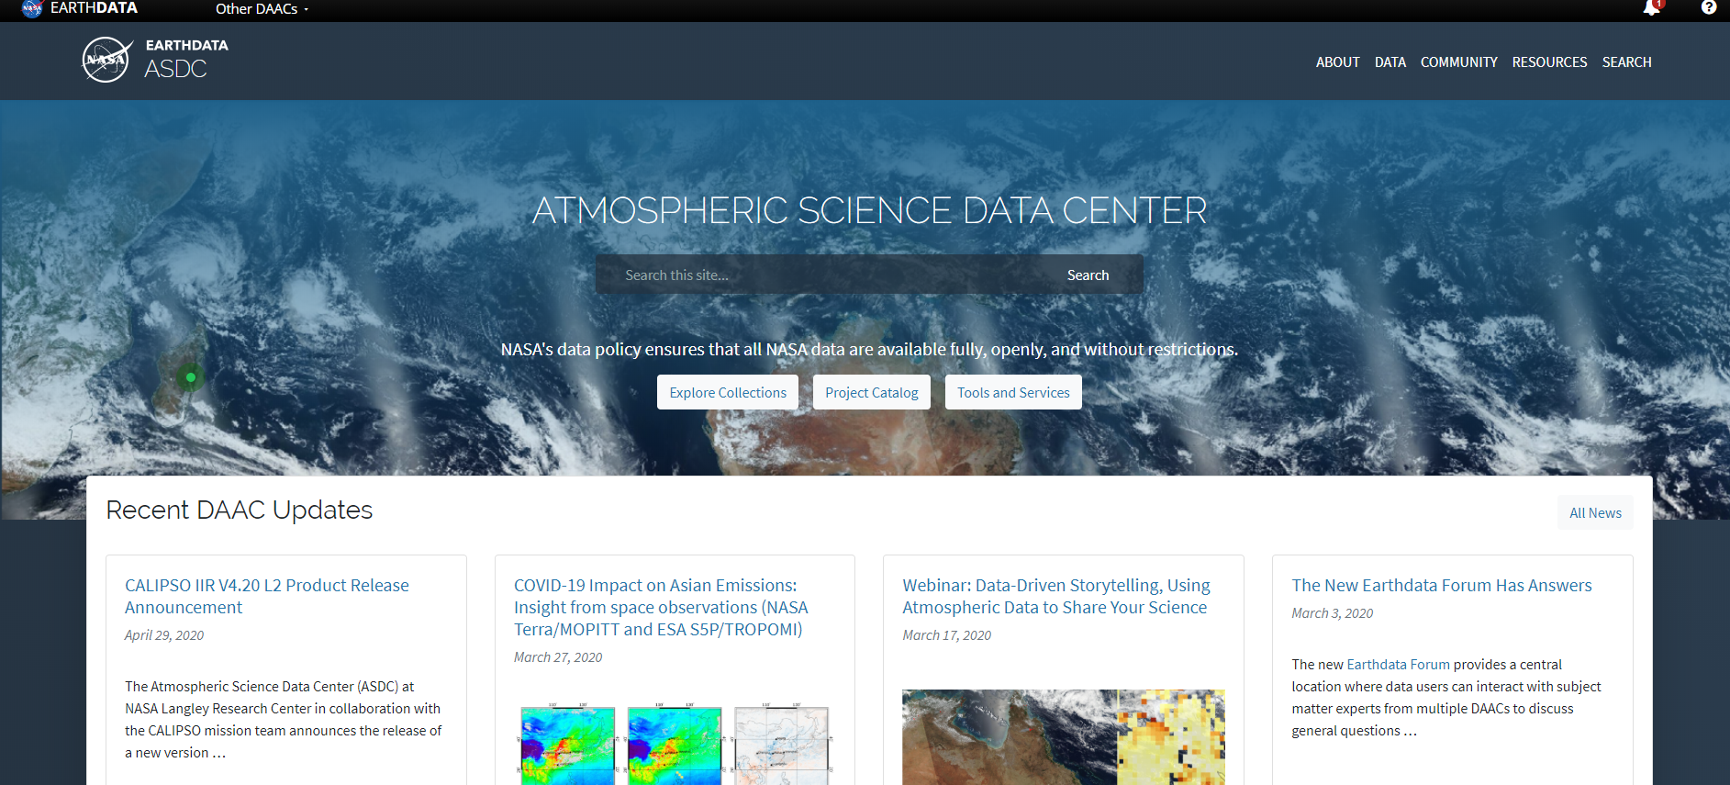



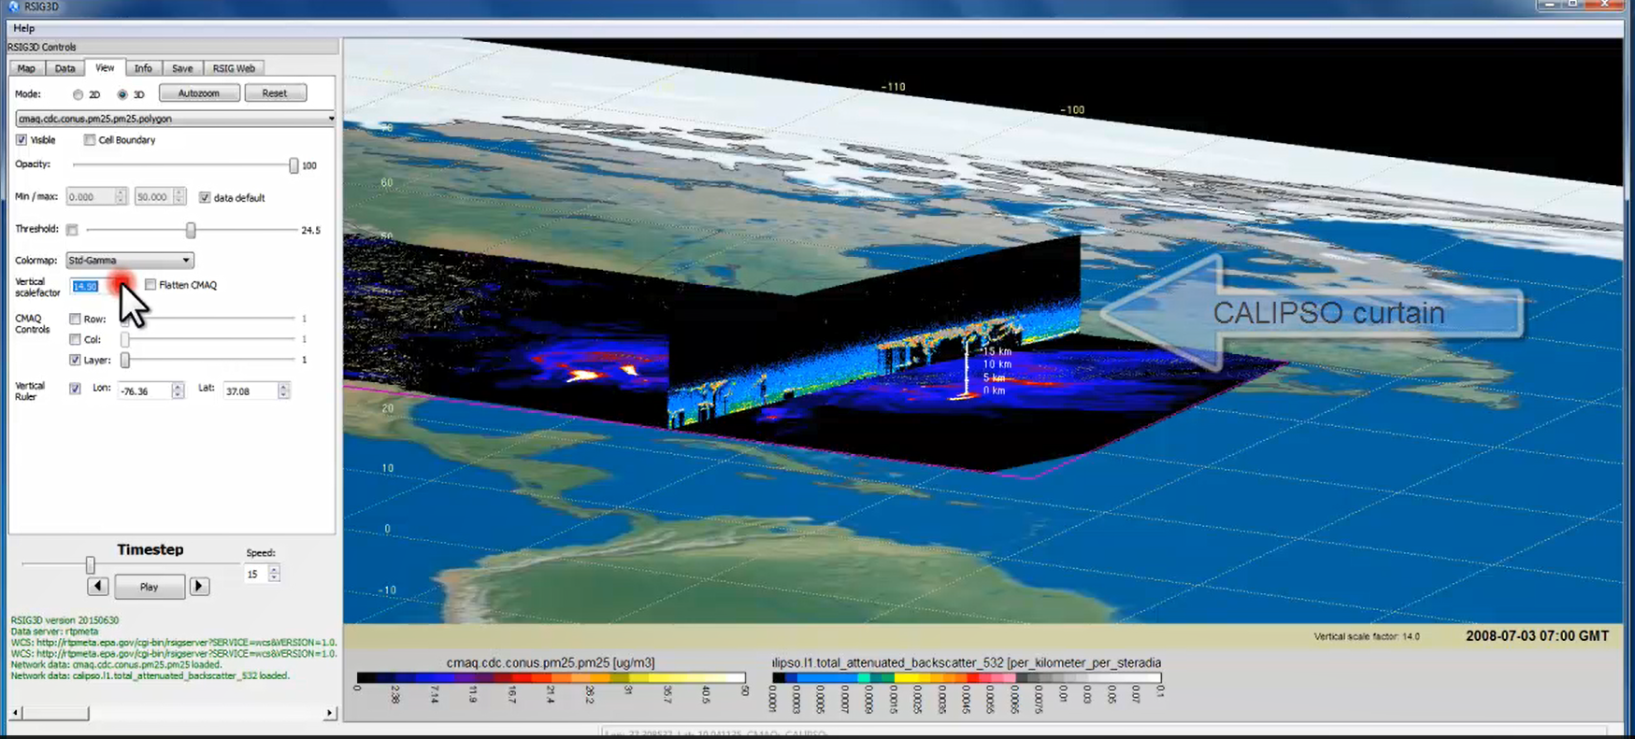
TEMPO Data Products Distribution
ASDC Data Archival & Distribution: Tools and Services
NASA Earthdata Search
  CMR Search ⚬ Metadata
NASA WorldView
  GIBS API ⚬ visualization
Harmony and OPeNDAP
  ⚬ transform ⚬ subsetting
  ⚬ reformatting ⚬ distribution
HTTPS data access
  ⚬ datapool
  ⚬ permanent URL/direct access
  ⚬ enables scripts/workflow
Geospatial Web Services
  ⚬ WCS ⚬ WMS ⚬ ArcGIS Image Service
Example scripts
  ⚬ Python/Jupyter Notebook
  ⚬ R scripts
  ⚬ contributed tutorials/scripts
EPA RSIG3D Gateway
TEMPO data can be served directly through the EPA RSIG. https://www.epa.gov/hesc/remote-sensing-information-gateway
User Support and Other Resources
Earthdata Login https://urs.earthdata.nasa.gov
Earthdata Forum https://forum.earthdata.nasa.gov/
ASDC User Support support-asdc@earthdata.nasa.gov
Slides from Jeff Walters, Tim Larson at TEMPO STM 2020 & EAWNov2021

Slide 9
Algorithm Development
V2 completed in Sep. 2020 and verified by Feb. 2021, V3 to be complete in July 2022
L0-1b developed from the scratch with some co-development with the GEMS team: T-dependent dark current correction, nonlinearity, smear correction, straylight correction, wavelength calibration, INR using GOES-R, polarization correction (John Houck, Xiong Liu, Dave Flittner, Nischal Mishra, Chris Chan Miller, Jim Carr)
L1-2 trace gas algorithms: OMI heritage algorithms with improvements, NetCDF-4, Metadata
Major L1-2 algorithm updates: see A11A-07 by Gonzalo Gonzalez Abad for more details
  CLDO4^{new}: SAO O₂-O₂ fitting + GSFC’s O₂-O₂ cloud at ~477/466 nm (Huiqun Wang, Eun-Su Yang, Alexander Vasilkov)
  NASA GMAO’s GEOS-CF trace gas profiles and meteorology (Emma Knowland and GMAO)
  Geometry-dependent Lambertian Equivalent Reflectivity (GLER) climatology (Christopher Chan Miller, Wenhan Qin, Zachary Fasnacht)
  Interactive Multi-sensor snow & ice mapping systems (IMS) (Gonzalo Gonzalez Abad)
Development of other products
  CHOCHO, H₂O, BrO: will use SAO’s trace gas algorithm
  SO₂: OMI PCA SO₂ algorithm has bben adapted for TEMPO demonstrating promising SO₂ retrievals from synthetic data (A24E-03, by Can Li)
  Aerosols: Omar Torres is adapting his latest OMI & TROPOMI aerosol algorithm for TEMPO, Jun Wang’s Aerosol Layer Height algorithm based on O₂-B from EPIC/TROPOMI is also ready to be adapted for TEMPO

Slide 10
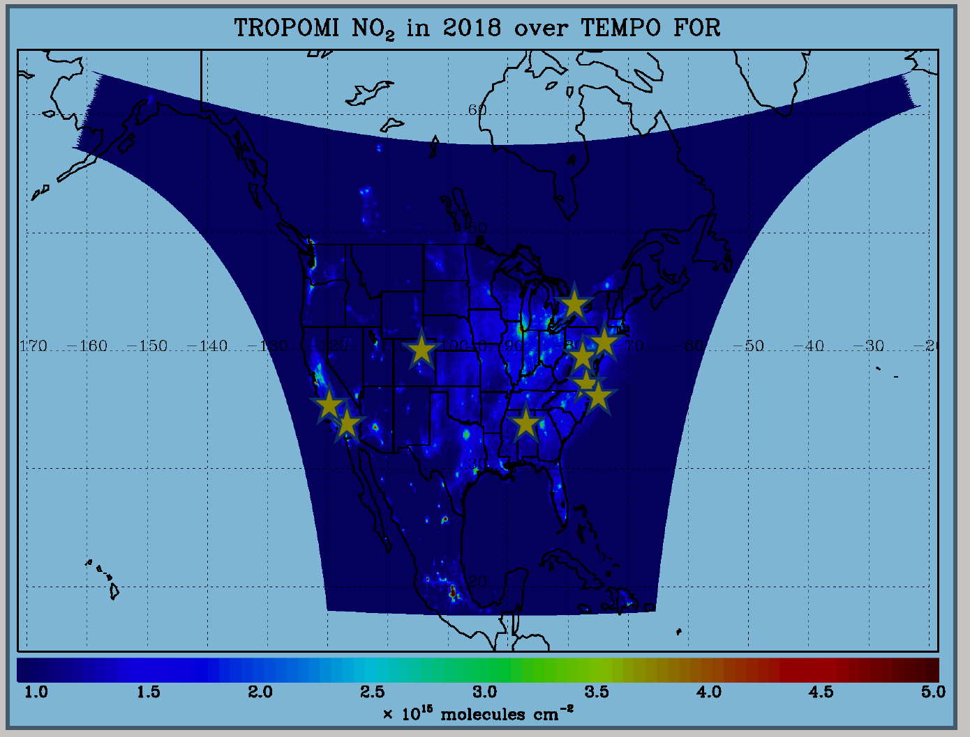
TEMPO Validation Plan
Use LEO and EPIC/DSCOVR for cross validations
Pandora & Pandonia Global Network (PGN): validate NO₂, HCHO, total O₃ and diurnal variation
  20+ PGNs in TEMPO FoR, ~10 to add by 2022.
LIDAR: 8 TOLNet instruments by time of launch to validate tropospheric O₃ & 0-2 km O₃ and diurnal variation
https://www-air.larc.nasa.gov/missions/TOLNet/
https://www.pandonia-global-network.org/
Nowlan et al. (2018) GCAS, DISCOVER-AQ, Texas, Sep 2013
Airborne instruments: GEO-TASO, GCAS, HSRL-2
Other instruments: ozonesonde, AERONET, …
Flight campaigns like TRACE-AQ, an integrated approach linking TEMPO Science, Applications, and Validation

Slide 11
TEMPO Early Adopters Program
Led by Aaron Naeger at UAH and NASA-SPoRT, funded by NASA Applied Sciences
User-centric program focused on broadening and enhancing applications of TEMPO data, with special attention to health & air quality
Please see A24E-11 by Aaron Naeger
Objective 1
Engage a broad spectrum of stakeholders & end users to expand use of TEMPO data and understand user needs
Objective 2
Use current sensors and proxy data to demonstrate TEMPO capabilities and develop applications
Objective 3
Better align TEMPO mission, products, and data interfaces to user needs and applications
TEMPO Launch
Early Adopters are individuals and groups who:
1) Have an interest or need for using TEMPO data
2) Have an existing or new application for TEMPO data
3) Work with end-users & understand their decision-making process
Inclusive from all end-users and stakeholders:
1) ~260 Early Adopters across TEMPO FoR
2) Includes federal, state, and local AQ agencies, Health Organization, NGOs, and international participation
3) Recent EA data tutorial/workshops in April/Nov 2021 have ~170 attendees
Overarching Goal
Maximize and accelerate the use of TEMPO data for societal benefits
Extend TEMPO mission lifetime
https: weather.msfc.nasa.gov/tempo/

Slide 12
Summary
TEMPO: NASA’s first EVI selected in 2012. It was built by Ball Aerospace and delivered in Nov. 2018. It was successfully integrated onto the Intelsat 40e (IS-40E) on Nov. 17, 2021.
We are currently on track for scheduled launch onto the GEO at 91.1∘W on Dec. 7, 2022 and produce at-launch products, to provide hourly measurements of atmospheric pollution at high spatial resolution over North America.
Thanks to NASA, BATC, Maxar, Intelsat and the TEMPO Science Team!
Thanks for your attention!
If you have any questions, please contact: xliu@cfa.harvard.edu

Slide 13







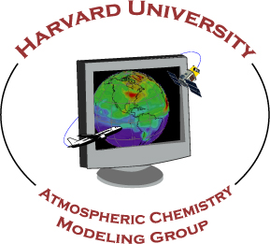




















Slide 14
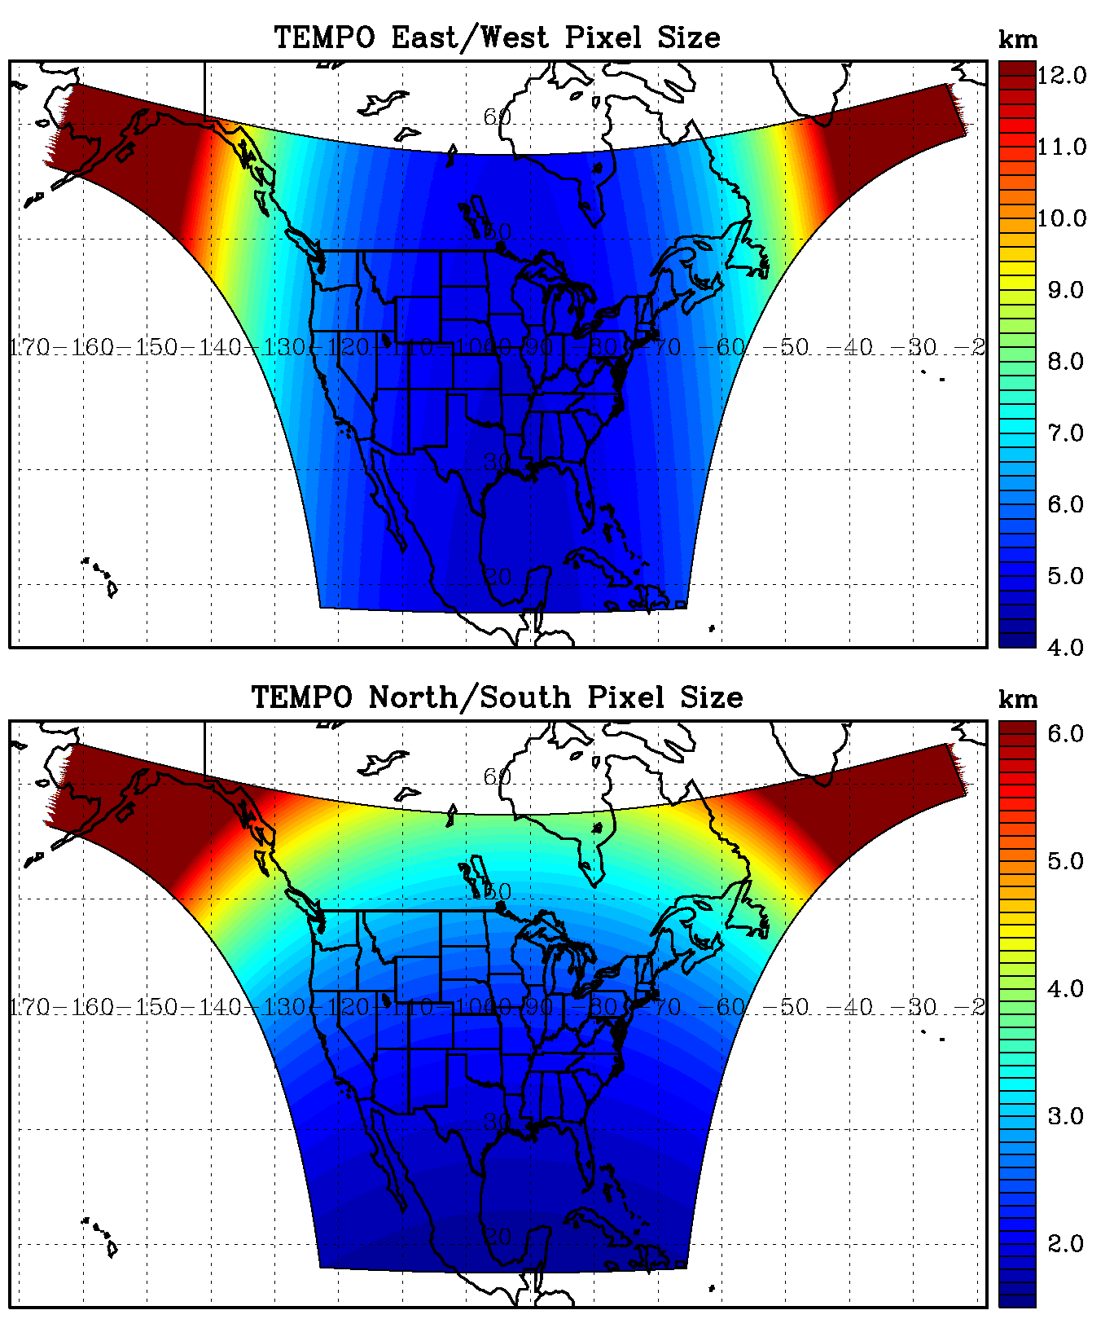
TEMPO footprint (GEO @90.9º W)
Location | N/S (km) | E/W (km) | GSA (km²) | VZA (º)
Boresight | 2.0 | 4.8 | 9.5 | 39.3
36.5ºN, 100ºW | 2.1 | 4.8 | 10.1 | 42.4
Washington, DC | 2.3 | 5.1 | 11.3 | 48.0
Seattle | 3.2 | 6.2 | 16.8 | 61.7
Los Angeles | 2.1 | 5.6 | 11.3 | 48.0
Boston | 2.5 | 5.5 | 13.0 | 53.7
Miami | 1.8 | 4.9 | 8.6 | 33.2
San Juan | 1.7 | 5.6 | 9.2 | 37.4
Mexico City | 1.6 | 4.7 | 7.7 | 23.9
Can. tar sands | 4.1 | 5.6 | 20.8 | 67.0
Juneau | 6.1 | 9.1 | 33.3 | 75.3

Slide 15
TEMPO Algorithm Teams
Operational Algorithm | Personnel
Raw to L0 | John Davis
L0-1b | John Houck, Xiong Liu, Dave Flittner, Nischal Mishra, Jim Carr, Chris Chan Miller
Ozone profile | Xiong Liu, Juseon Bak
Total ozone | Dave Haffner, Joanna Joiner
Nitrogen dioxide | Caroline Nowlan, Gonzalo González Abad, Jeff Geddes, Chris Chan Miller
Formaldehyde | Gonzalo González Abad, Caroline Nowlan, Chris Chan Miller
Glyoxal | Gonzalo González Abad, Chris Chan Miller
Clouds | Huiqun Wang, Alexander Vasilkov, Eun-Su Yang, Joanna Joiner
Sulfur dioxide | Can Li, Nickolay Krotkov
Aerosols | Omar Torres, Jun Wang
Operational implementation and IT support @ SAO Science Data Processing Center (SDPC) by John Houck

Slide 16
NRT vs. Off-line Trace Gas Products
(if with additional NRT funding)
Implementing both NRT and off-line trace gas products (e.g., NO₂, HCHO) for NO2, HCHO, aerosol, SO₂, cloud
Major potential differences between NRT and offline products
 | NRT | Off-line
Trace gas profiles/Met data | GEOS-CF | GEOS-CF Replay
Surface | GLER climatology | MODIS/VIIRS albedo/BRDF products
RTM | Look-up tables | On-line radiative transfer?
Aerosol correction | None | Improved aerosol fields?
Spectral fitting | Normal spectral fitting | Improve radiance reference & cross-track correction
L1B | Default Pol. Correction | Improved pol. Correction with L2 retrievals?
Data Latency | Within 2-3 hours upon receipt of raw data at SAO Ground System | + 8 days as MODIS BRDF is produced using data +/- 8 days

Slide 17
Research Products
TEMPO research products will greatly extend science and applications
  OClO, IO, HNO₂, NO₃, volcanic (SO₂ plume height and VCD)
  Additional/improved cloud with O₂-O₂ bands / O₂-B bands
  Additional aerosol products from hyperspectral spectra, O₂-B and O₂-O₂-bands, and TEMPO + GOES-R synergy at @U Iowa, NOAA, GSFC
  Vegetation products: solar Induced fluorescence (SIF)
  Diurnal out-going shortwave radiation and cloud forcing
  Night lights: allows discrimination between lightning types
  Higher-level products: Near-real-time pollution/AQ indices

Slide 18
TEMPO Green Paper:
Chemistry Experiments with TEMPO
NORMAL TIME RESOLUTION STUDIES | Volcanoes
Air quality and health | Socio-economic studies
Ultraviolet exposure | National pollution inventories
Biomass burning | Regional and local transport of pollutants
Synergistic GOES-16/17 Products | Sea breeze studies for Florida and Cuba
Advanced aerosol products | Transboundary pollution gradients
Soil NO_{x} after fertilizer application and after rainfall | Transatlantic dust transport
Solar-induced fluorescence from chlorophyll | HIGH TIME RESOLUTION EXPERIMENTS
Foliage studies | Lightning NO_{x}
Mapping NO₂ and SO₂ dry deposition at high resolution | Morning and evening higher-frequency scans
Crop and forest damage from ground-level ozone | Dwell-time studies and temporal selection to improve detection limits
Halogen oxide studies in coastal and lake regions | Exploring the value of TEMPO in assessing pollution transport during upslope flows
Air pollution from oil and gas fields | Tidal effects on estuarine circulation and outflow plumes
Night light measurements resolving lighting type | Air quality responses to sudden changes in emissions
Ship tracks, drilling platform plumes, and other concentrated sources. | Cloud field correlation with pollution
Water vapor studies | Agricultural soil NO_{x} emissions and air quality
Early Adopters are key to building the TEMPO Green Paper!
The TEMPO Green Paper living document at weather.msfc.nasa.gov/tempo/
Early Adopters can request high-time observations!

