Slide 1
TEMPO Mission Status and Algorithm/Product Overview
Xiong Liu, Kelly Chance, Raid Suleiman, John Davis, John Houck, Gonzalo Gonzalez Abad, Caroline R Nowlan, Christopher Chan Miller, Huiqun Wang, Juseon Bak, Ewan O’Sullivan, Hyeong-Ahn Kwon, Jeff Geddes,
Kevin J. Daugherty, David Flittner, Jassim A Al-Saadi, Nischal Mishra
Tim Larson, Aaron Robert Naeger, Mike Newchurch
Joanna Joiner, Scott Janz, Wenhan Qin, Eun-su Yang, Can Li,
Emma Knowland, Alexander Vasilkov, Dave Haffner, Omar Torres,
Zachary Fasnacht, Nickolay Krotkov, Jun Wang, Rob Spurr
and The TEMPO Team
11th GEMS International Workshop
November 22, 2021

Slide 2

Hourly daytime atmospheric pollution from geostationary Earth orbit over North America
NASA’s first Earth Venture Instrument (EVI) and first host payload
PI: Kelly Chance, Smithsonian Astrophysical Observatory
Deputy PI: Xiong Liu, Smithsonian Astrophysical Observatory
Instrument Development: Ball Aerospace
Instrument Project Management: NASA LaRC, current PM: Kevin Daugherty
Other Institutions: NASA GSFC, NOAA, EPA, NCAR, Harvard, UC Berkeley, St. Louis U, UAH, U Nebraska, Sitting Bull College, RT Solutions, Carr Astronautics
International collaboration: Mexico, Canada, Cuba, Korea, U.K., ESA, Spain
Mission Project Management: NASA LaRC, current PM: Kevin Daugherty
Host Satellite Provider: Maxar
Satellite Host: Intelsat
Launch: Space X
Provides hourly daylight observations to capture rapidly varying emissions & chemistry important for air quality
  UV/vis grating spectrometer to measure key elements in tropospheric O₃ and aerosol pollution
  Distinguishes boundary layer from free tropospheric & stratospheric O₃
Aligned with Earth Science Decadal Survey recommendations
  Makes many of the GEO-CAPE atmosphere measurements
  Responds to phased implementation recommendation of GEO-CAPE mission design team
  North American component of an international constellation for air quality observations

Slide 3
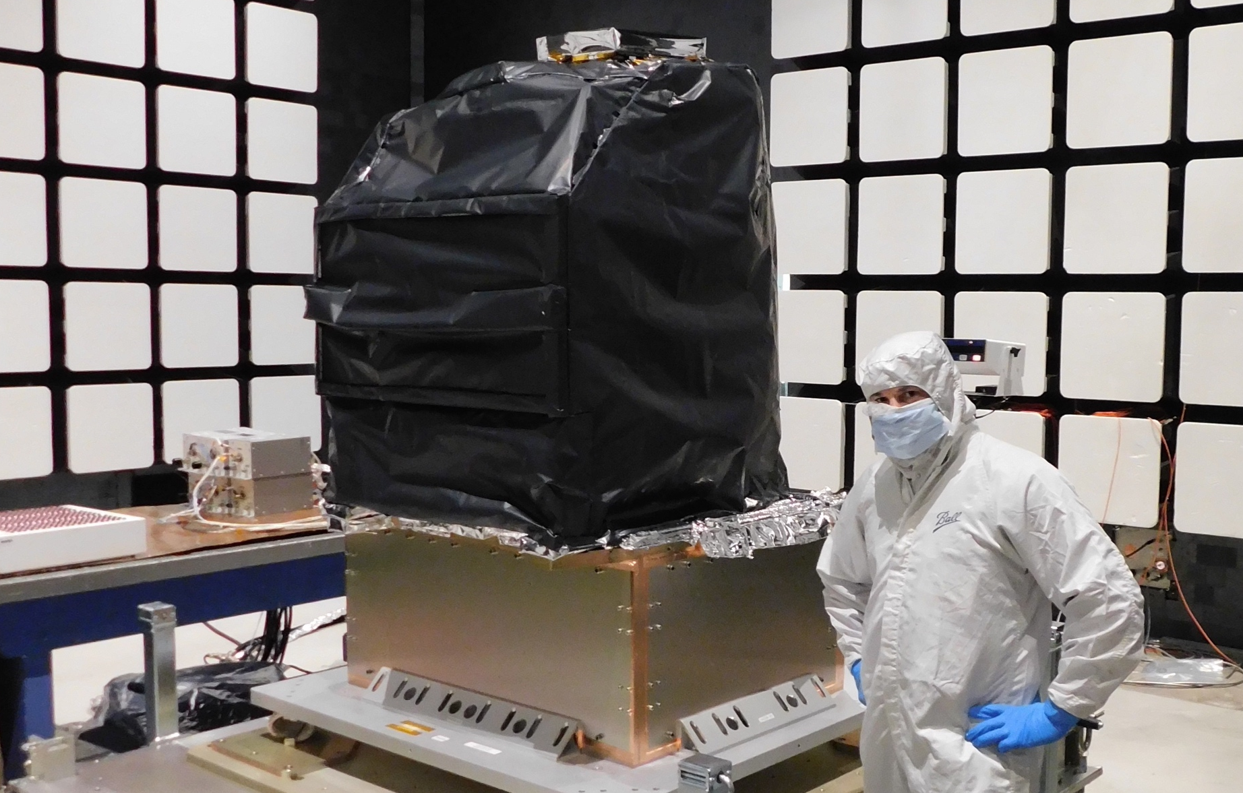
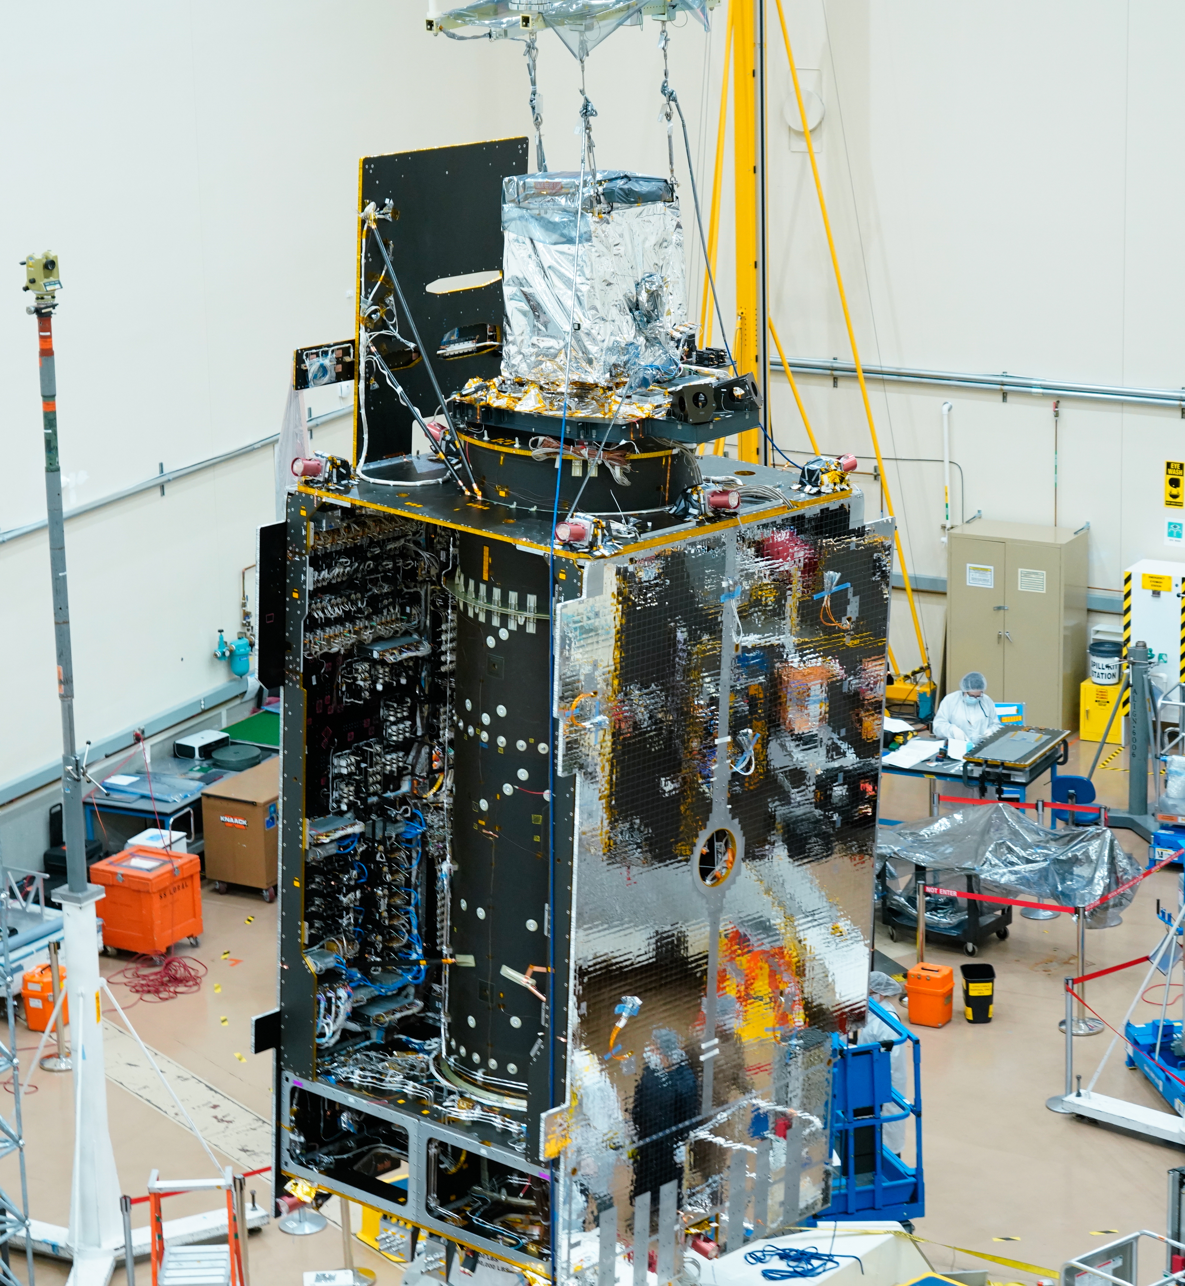
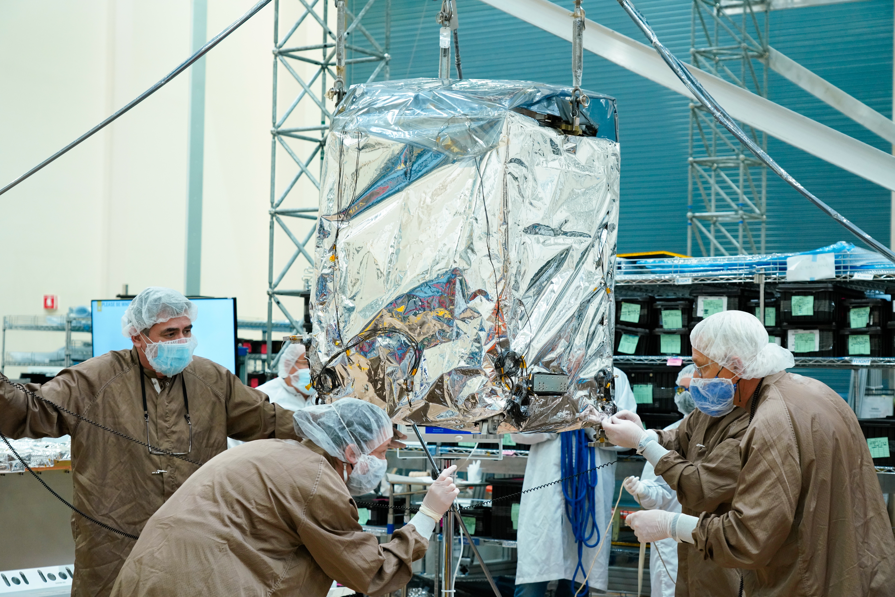
TEMPO Status
Selected Nov. 2012 as NASA’s first EVI and first host payload
  Instrument delivery in Nov. 2018
  Host satellite provider: Maxar selected in July 2019
  Host: Intelsat 40e at 90.9ºW selected on Feb 2020
  TEMPO ICE integrated in July 2021, sensor lift on Nov. 17, 2021, mechanical & electrical integration this week.
  TEMPO Ground Systems to be ready in August 2022
  Operation/Mission Readiness Review (ORR/MRR) in Sep. 2022
  Launch on Space X Falcon 9 on Dec. 7, 2022
Courtesy from Ball Aerospace
Courtesy from Maxar
Courtesy from Maxar

Slide 4


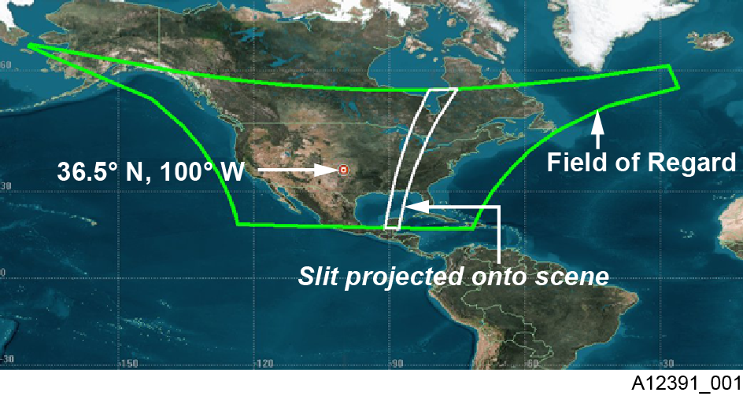
TEMPO
  Imaging grating spectrometer measuring solar backscattered Earth radiance
    2 channels (1 focal plane but with 2 2-D 2 k x 1k detectors ): ~293-494 + 538-741 nm
    ~0.6 nm FWHM, ~0.2 nm sampling
  Operating on geostationary Intelsat 40e (IS-40e) at longitude 90.9 ∘ W as a hosted payload, launch on Space X Falcon 9 on Dec. 7, 2022
  Great North America: Mexico City/Puerto Rico to Canadian tar sands, Atlantic to Pacific
  Instrument slit aligned N/S and sweep across the Field of Regard (FOR) in the E/W in 1 hour at ~2.0x4.75 km² at the center of FOR
~293-494 nm
~538-741 nm
X
x
λ
y(t)
y (t)

Slide 5

TEMPO Hourly Sweep
Boresight: 33.7ºN, 91.6ºW
Scan FOR in 1 hour with 10 granules
~ 2035 good N/S pixels, ~ 1226 steps/hr, ~ 2.5 M pixels/hr
# spatial pixels ~TROPOMI
2 x 4.75 km² @center of FOR, varying with viewing geometry (8 km² at Mexico City to 21 km² at Canadian Tar Sands)
FOR: N/S +/-210 pixels,
E/W +230/160 pixels
Optimized scan: in the early morning and late afternoon, daylight portion of FOR
High-time scan (up to 25%): selected portion of FOR at higher temporal resolution (e.g., <= 10 mins)
Field of regard is optimized to cover both Puerto Rico and Canadian tar sands.
S5p-TROPOMI NO2 product oversampled by Kang Sun.

Slide 6
Baseline and Threshold
Products (Variables) & Requirements
Species/Products | Required Precision | Temporal Revisit*
0-2 km O₃ (Selected Scenes) Baseline only | 10 ppbv | 2 hour
Tropospheric O₃ | 10 ppbv | 1 hour
Total O₃ | 3% | 1 hour
Tropospheric NO₂ | 1.0 × 10¹⁵ molecules cm⁻² | 1 hour
Tropospheric H₂CO | 1.0 × 10¹⁶ molecules cm⁻² | 3 hour
Tropospheric SO₂ | 1.0 × 10¹⁶ molecules cm⁻² | 3 hour
Tropospheric C₂H₂O₂ | 4.0 × 10¹⁴ molecules cm⁻² | 3 hour
Aerosol Optical Depth | 0.10 | 1 hour
* # of hours to be averaged to achieve required precision
Mission duration: 20 months for baseline, 12 mons for threshold
Spatial resolution: < 60 km² for baseline, < 300 km² for threshold
Aerosols (AOD, SSA, AAI), SO₂, C₂H₂O₂ were removed from baseline products during KDPC
  Proposed to bring them back to the operational products along with H₂O, BrO, UVB, and TEMPO/GOES-R synergistic products, pending on funding from Science Needs Working Group (SNWG) in late 2022 or 2023.
Cloud product (cloud fraction, cloud pressure): used in trace gas retrievals

Slide 7
TEMPO Data Products
(Inc. Proposed Additional & NRT Products)
Level | Product | Algorithm | Major Outputs | Res km^{2 **} | Freq/Size
L0 | Digital counts | Raw to L0 | Reconstructed/reformatted digital counts | 2.0 x 4.75 | Daily/hourly
L1-b | irradiance | SAO L0-1 | Calibrated & quality flags |  | daily
 | radiance | SAO L0-1 | Geolocated, calibrated, viewing, geolocation & quality flags | 2.0 x 4.75 | Hourly, granule
L2 | Cloud ^{NRT} | OMI O2-O2* | Cloud fraction, cloud pressure | 2.0 x 4.75 | Hourly, granule
 | O₃ profile | SAO O3 profile | O₃ profile, total/strat/trop/0-2 km O₃ column, errors, a priori, AKs | 8.0 x 4.75*** | Hourly, granule
 | Total O₃ | TOMS V8.5 | Total O₃, AI, cloud fraction | 2.0 x 4.75 | Hourly, granule
 | NO₂ ^{NRT} | SAO trace gas, BU strat/trop sep. | SCD, strat./trop. VCD, error, shape factor, scattering weights | 2.0 x 4.75 | Hourly, granule
 | H₂CO ^{NRT} | SAO trace gas | SCD, VCD, error, shape factor, scattering weights | 2.0 x 4.75 | Hourly, granule
 | C₂H₂O₂ | SAO trace gas |  | 2.0 x 4.75 | Hourly, granule
 | H₂O | SAO trace gas |  | 2.0 x 4.75 | Hourly, granule
 | BrO | SAO trace gas |  | 2.0 x 4.75 | Hourly, granule
 | Aerosol ^{NRT} | OMAERUV + U. Iowa AOCH | AAI, UVAOD, UVSSA, AOCH, VISAOD | 8.0 x 4.75 | Hourly, granule
 | SO₂ ^{NRT} | OMSO2 PCA | SCD, VCD (PBL,TRL,TRM,TRU,STL) | 2.0 x 4.75 | Hourly, granule
 | TEMPO/GOES-R Synerg. product | GOES-R products on TEMPO pixels | Radiance, aerosol, cloud & mask, fire/hotspot, snow/ice, rainfall, precipitable water, land/sea surface T, lightning | 2.0 x 4.75 | Hourly, granule
L3 | Gridded L2 | SAO L2-3 | Same as L2 | 2 x 2 (?) | Hourly, scan
L4 | UVB | GEMS UVB | UV irradiance, erythemal irradiance, UVI | TBD | Hourly, scan
Planned initial data release after on-orbit check-out: ~4 months for L1b, and ~6 months for L2 and L3 products
∘
*Algorithm changed from NASA GSFC’s OMCLDRR to GSFC’s new O₂-O₂ cloud algorithm combined with SAO’s trace gas algorithm to retrieve O₂-O₂ SCDs. ** Spatial resolution at center of FOR. *** Might be at 8 x 9.5km²– 12x14.25km²
Black: at launch products, green/orange: additional products (additional funding being proposed)
^{NRT}: Include near-real-time and off-line products (if with additional NRT funding, otherwise produce 1 product as NRT as possible, within 3-4 hours)

Slide 8
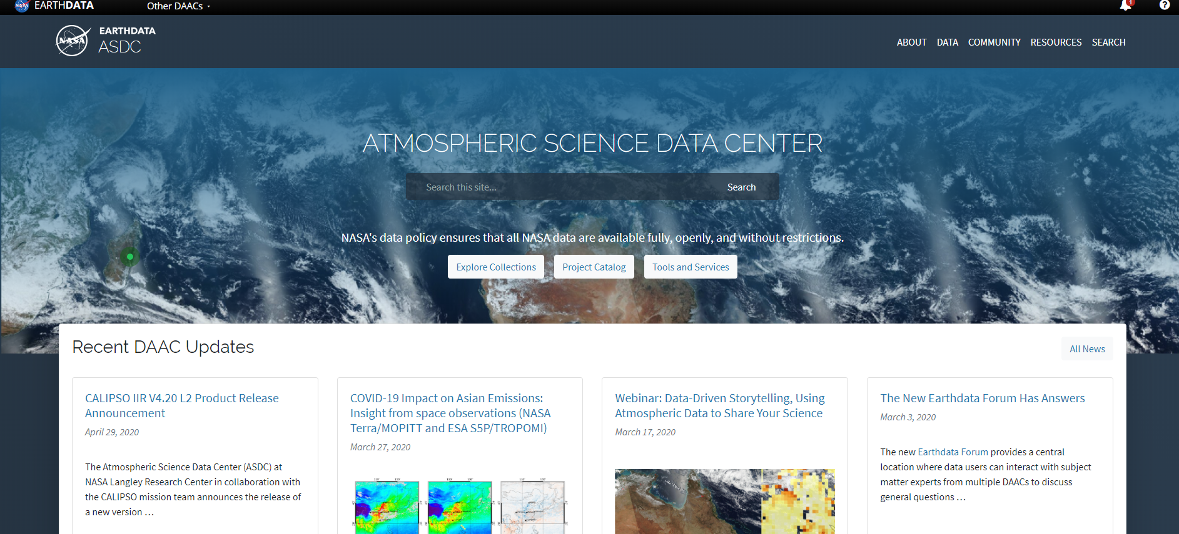



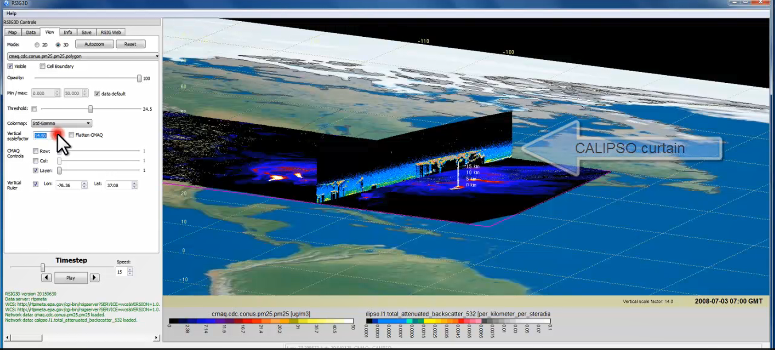
TEMPO Data Products Distribution
ASDC Data Archival & Distribution: Tools and Services
NASA Earthdata Search
  CMR Search ⚬ Metadata
NASA WorldView
  GIBS API ⚬ visualization
Harmony and OPeNDAP
  ⚬ transform ⚬ subsetting
  ⚬ reformatting ⚬ distribution
HTTPS data access
  ⚬ datapool
  ⚬ permanent URL/direct access
  ⚬ enables scripts/workflow
Geospatial Web Services
  ⚬ WCS ⚬ WMS ⚬ ArcGIS Image Service
Example scripts
  ⚬ Python/Jupyter Notebook
  ⚬ R scripts
  ⚬ contributed tutorials/scripts
EPA RSIG3D Gateway
TEMPO data can be served directly through the EPA RSIG. https://www.epa.gov/hesc/remote-sensing-information-gateway
User Support and Other Resources
Earthdata Login https://urs.earthdata.nasa.gov
Earthdata Forum https://forum.earthdata.nasa.gov/
ASDC User Support support-asdc@earthdata.nasa.gov
Slides from Jeff Walters, Tim Larson at TEMPO STM 2020 & EAWNov2021

Slide 9
Research Products
TEMPO research products will greatly extend science and applications
  OClO, IO, HNO₂, NO₃, volcanic (SO₂ plume height and VCD)
  Additional/improved cloud with O₂-O₂ bands / O₂-B bands
  Additional aerosol products from hyperspectral spectra, O₂-B and O₂-O₂-bands, and TEMPO + GOES-R synergy at @U Iowa, NOAA, GSFC
  Vegetation products: solar Induced fluorescence (SIF)
  Diurnal out-going shortwave radiation and cloud forcing
  Night lights: allows discrimination between lightning types
  Higher-level products: Near-real-time pollution/AQ indices

Slide 10
TEMPO Algorithm Teams
Operational Algorithm | Personnel
Raw to L0 | John Davis
L0-1b | John Houck, Xiong Liu, Dave Flittner, Nischal Mishra, Jim Carr, Chris Chan Miller
Ozone profile | Xiong Liu, Juseon Bak
Total ozone | Dave Haffner, Joanna Joiner
Nitrogen dioxide | Caroline Nowlan, Gonzalo González Abad, Jeff Geddes, Chris Chan Miller
Formaldehyde | Gonzalo González Abad, Caroline Nowlan, Chris Chan Miller
Glyoxal | Gonzalo González Abad, Chris Chan Miller
Clouds | Huiqun Wang, Alexander Vasilkov, Eun-Su Yang, Joanna Joiner
Sulfur dioxide | Can Li, Nickolay Krotkov
Aerosols | Omar Torres, Jun Wang
Operational implementation and IT support @ SAO Science Data Processing Center (SDPC) by John Houck

Slide 11
Algorithm Development
V2 completed in Sep. 2020 and verified by Feb. 2021, V3 to be complete in July 2022
L0-1b developed from the scratch with some co-development with the GEMS team: T-dependent dark current correction, nonlinearity, smear correction, straylight correction, wavelength calibration, INR using GOES-R, polarization correction, (John Houck, Xiong Liu, Dave Flittner, Nischal Mishra, Chris Chan Miller, Jim Carr)
L1-2 trace gas algorithms: OMI heritage algorithms with modifications /improvements, NetCDF-4, Metadata
  O₃ profile: SAO OE-based UV algorithm for OMI, adapted for TEMPO UV/VIS
  HCHO: SAO two-step trace gas algorithm
  NO₂: SAO spectral fitting algorithm + Strat./Trop. Separation (STS) adapted from NASA STS by (Geddes et al., 2018)
  Total ozone: OMTO3, LUT with extended Viewing Zenith Angle (VZA) to cover TEMPO, TEMPO spectral resolution
Major L1-2 algorithm updates:
  CLDO4^{new}: SAO spectral fitting of O₂-O₂+GSFC’s O₂-O₂ cloud at ~477/466 nm (Huiqun Wang, Eun-Su Yang, Alexander Vasilkov)
  NASA GMAO’s GEOS-CF trace gas profiles and meteorology: special product for TEMPO, defined format, developed climatology as backup (Emma Knowland and GMAO)
  Geometry-dependent Lambertian Equivalent Reflectivity (GLER) climatology (Christopher Chan Miller, Wenhan Qin, Zachary Fasnacht)
  Switched to Interactive Multi-sensor snow & ice mapping systems (IMS) (Gonzalo Glonzalez Abad)
Development of other products
  CHOCHO, H₂O, BrO: will use SAO’s trace gas algorithm
  SO₂: Can Li adapted his OMI PCA SO₂ algorithm for TEMPO and demonstrated promising SO₂ retrievals from synthetic data
  Aerosols: Omar Torres is adapting his latest TROPOMI & OMI aerosol algorithm for TEMPO, Jun Wang’s AOCH algorithm based on O₂-B from EPIC/TROPOMI ready to be adapted for TEMPO
  UVB: Prof. Jhoon Kim has offered to share with us the GEMS UVB algorithm

Slide 12
TEMPO Early Adopters Program
Led by Aaron Naeger at UAH and NASA-SPoRT, funded by NASA Applied Sciences
User-centric program focused on broadening and enhancing applications of TEMPO data, with special attention to health & air quality
Objective 1
Engage a broad spectrum of stakeholders & end users to expand use of TEMPO data and understand user needs
Objective 2
Use current sensors and proxy data to demonstrate TEMPO capabilities and develop applications
Objective 3
Better align TEMPO mission, products, and data interfaces to user needs and applications
TEMPO Launch
Early Adopters are individuals and groups who:
1) Have an interest or need for using TEMPO data
2) Have an existing or new application for TEMPO data
3) Work with end-users & understand their decision-making process
Inclusive from all end-users and stakeholders:
1) ~260 Early Adopters across TEMPO FoR
2) Includes federal, state, and local AQ agencies, Health Organization, NGOs, and international participation
3) Recent EA data tutorial/workshops in April/Nov 2021 have ~170 attendees
Overarching Goal
Maximize and accelerate the use of TEMPO data for societal benefits
Extend TEMPO mission lifetime

Slide 13
TEMPO Green Paper: Chemistry experiments with TEMPO
NORMAL TIME RESOLUTION STUDIES | Volcanoes
Air quality and health | Socio-economic studies
Ultraviolet exposure | National pollution inventories
Biomass burning | Regional and local transport of pollutants
Synergistic GOES-16/17 Products | Sea breeze studies for Florida and Cuba
Advanced aerosol products | Transboundary pollution gradients
Soil NO_{x} after fertilizer application and after rainfall | Transatlantic dust transport
Solar-induced fluorescence from chlorophyll | HIGH TIME RESOLUTION EXPERIMENTS
Foliage studies | Lightning NO_{x}
Mapping NO₂ and SO₂ dry deposition at high resolution | Morning and evening higher-frequency scans
Crop and forest damage from ground-level ozone | Dwell-time studies and temporal selection to improve detection limits
Halogen oxide studies in coastal and lake regions | Exploring the value of TEMPO in assessing pollution transport during upslope flows
Air pollution from oil and gas fields | Tidal effects on estuarine circulation and outflow plumes
Night light measurements resolving lighting type | Air quality responses to sudden changes in emissions
Ship tracks, drilling platform plumes, and other concentrated sources. | Cloud field correlation with pollution
Water vapor studies | Agricultural soil NO_{x} emissions and air quality
Early Adopters are key to building the TEMPO Green Paper!
The TEMPO Green Paper living document at weather.msfc.nasa.gov/tempo/
Early Adopters can request high-time observations!

Slide 14








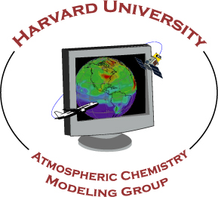



















Summary
The TEMPO instrument is being integrated onto Intelsat 40e by Maxar. The TEMPO team including the algorithm team is currently on track for launch on Space X Falcon 9 onto the geostationary orbit at 90.9W scheduled on Dec. 7, 2022 and produce at launch products.
Thanks to NASA, BATC, Maxar, Intelsat and the TEMPO Science Team

Slide 15
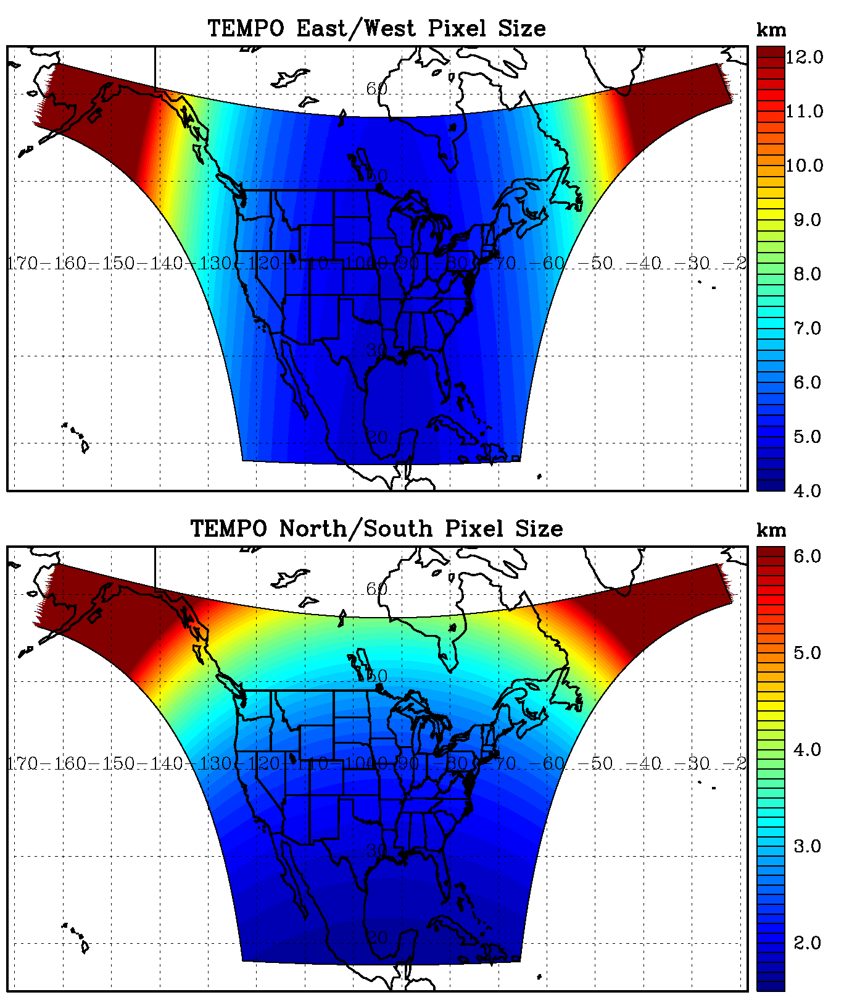
TEMPO footprint (GEO @90.9º W)
Location | N/S (km) | E/W (km) | GSA (km²) | VZA (º)
Boresight | 2.0 | 4.8 | 9.5 | 39.3
36.5ºN, 100ºW | 2.1 | 4.8 | 10.1 | 42.4
Washington, DC | 2.3 | 5.1 | 11.3 | 48.0
Seattle | 3.2 | 6.2 | 16.8 | 61.7
Los Angeles | 2.1 | 5.6 | 11.3 | 48.0
Boston | 2.5 | 5.5 | 13.0 | 53.7
Miami | 1.8 | 4.9 | 8.6 | 33.2
San Juan | 1.7 | 5.6 | 9.2 | 37.4
Mexico City | 1.6 | 4.7 | 7.7 | 23.9
Can. tar sands | 4.1 | 5.6 | 20.8 | 67.0
Juneau | 6.1 | 9.1 | 33.3 | 75.3

Slide 16
NRT vs. Off-line Trace Gas Products
(if with additional NRT funding)
Implementing both NRT and off-line trace gas products (e.g., NO₂, HCHO) for NO2, HCHO, aerosol, SO₂, cloud
Major potential differences between NRT and offline products
 | NRT | Off-line
Trace gas profiles/Met data | GEOS-CF | GEOS-CF Replay
Surface | GLER climatology | MODIS/VIIRS albedo/BRDF products
RTM | Look-up tables | On-line radiative transfer?
Aerosol correction | None | Improved aerosol fields?
Spectral fitting | Normal spectral fitting | Improve radiance reference & cross-track correction
L1B | Default Pol. Correction | Improved pol. Correction with L2 retrievals?
Data Latency | Within 2-3 hours upon receipt of raw data at SAO Ground System | + 8 days as MODIS BRDF is produced using data +/- 8 days

