Slide 1
Copernicus Sentinel-4 L2
Diego Loyola (German Aerospace Center, DLR)
and the Copernicus S4-L2 Team
Joint Geostationary STM
CFA, 27th August 2019

Slide 2
Sentinel-4 Geophysical (Level-2) Operational Products
S4 L2 Copernicus Products
  Development phase: ESA project with DLR as prime
  Operational phase: EUMETSAT
S4 L2 EUMETSAT AC-SAF Products
  Development phase: DLR
  Operational phase: DLR

Slide 3







Sentinel-4 – Geophysical (Level-2) Copernicus Products
 |  | COPERNICUS Applications
Species | Parameter | Air quality | Climate | Surface level UV radiation | Others
O₃ | Total column | ×
 | Tropospheric column
NO₂ | Total column | ×
 | Tropospheric column
SO₂ | Total column | × |  |  | Volcanic eruptions
HCHO | Total column | ×
CHOCHO | Total column | ×
Cloud | Cloud fraction |  | × | × | Ancillary product for other S4 products
 | Optical depth
 | Cloud height
Aerosol | Index | × |  |  | Ancillary product for other S4 products Volcanic eruptions
 | Optical depth
 | Layer Height
Surface reflectance | BRDF |  |  | × | Ancillary product for other S4 products
Notes:
DLR-IMF entwickelt bei S-4 sogar noch mehr Produkte als bei S-5P, vor allem auch NO2

Slide 4
Sentinel-4 L2 Copernicus Team
S4-L2
Project
D. Loyola (DLR)
Algorithm
Bread-boarding
R. Siddans (RAL)
Algorithm Team
BIRA, DLR, IUP, KNMI, LOA/Catalysts, RAL
Independent
Verification
T. Wagner (MPIC)
Verification Team
BIRA, DLR, IUP, KNMI, MPIC, RAL, Rayference
Processor
Suite
W. Zimmer (DLR)
Processor Team
Catalysts, DLR,
KNMI, RAL,
S&T

Slide 5
Sentinel-4 L2 Copernicus Team Organization
Algorithm Bread-boarding:
  Retrieval algorithms for all S4 target species
  Consolidated algorithm described in ATBDs
  Prototype coding in Geophysical Algorithm Modules
Independent Verification:
  Independently verify the performance of bread-boarding algorithms
  Generation of simulated test data sets
  Assess the performance of the ABB and IV algorithms
Processor Suite:
  Prototype S4 L2 processors to be integrated in ESA E2E
  Operational S4 L2 processors to be integrated in EUMETSAT L2PF
  Product User Manuals (PUMs)
CDR completed in Q2 2019
  ATBDs V2
  PUMs V2
Standalone completed
Inter-dependency and mis-registration to be ready in 2019
First version to be ready in 2020

Slide 6

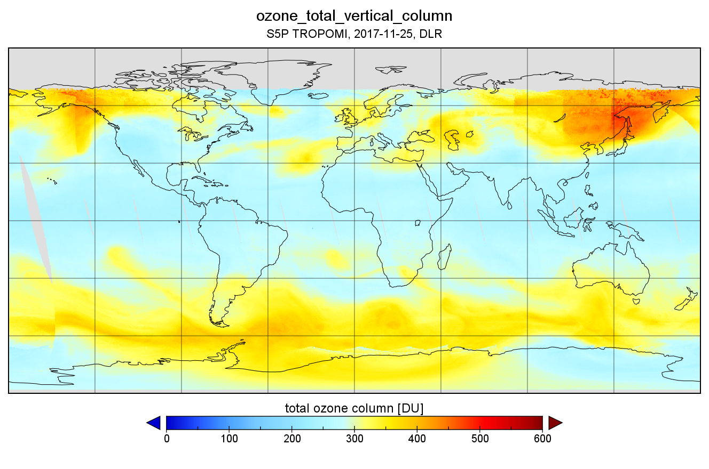
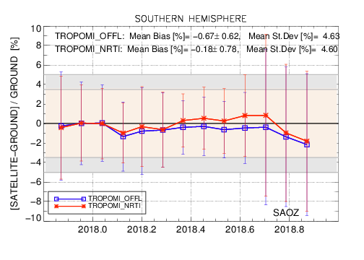
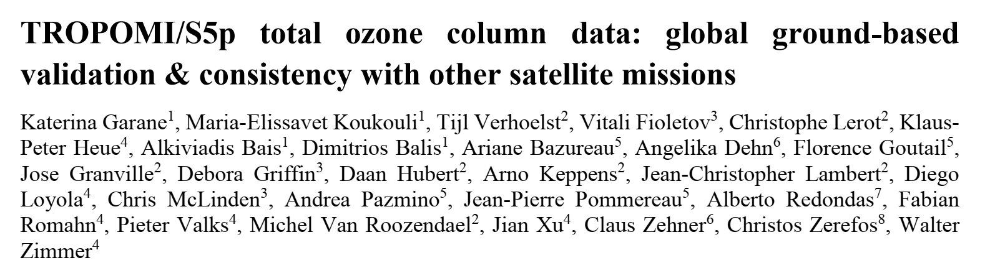

Sentinel-4 Copernicus – Total Ozone (O₃)
Heritage
  GOME/SCIA/GOME-2 4.x with DOAS plus iterative AMF/VCD (Van Roozendael et al., JGR 2006; Loyola et al., JGR 2011; Hao et al., AMT 2014)
  TROPOMI:
    OCRA/ROCINN Cloud as Layer (CAL)
      No need of ghost-columns
    Retrieval of surface properties, Loyola et al., AMTD 2019
S4 algorithm
  AMF computed using S4 BRDF and the S4 OCRA/ROCINN Cloud as Layer (CAL)

Slide 7

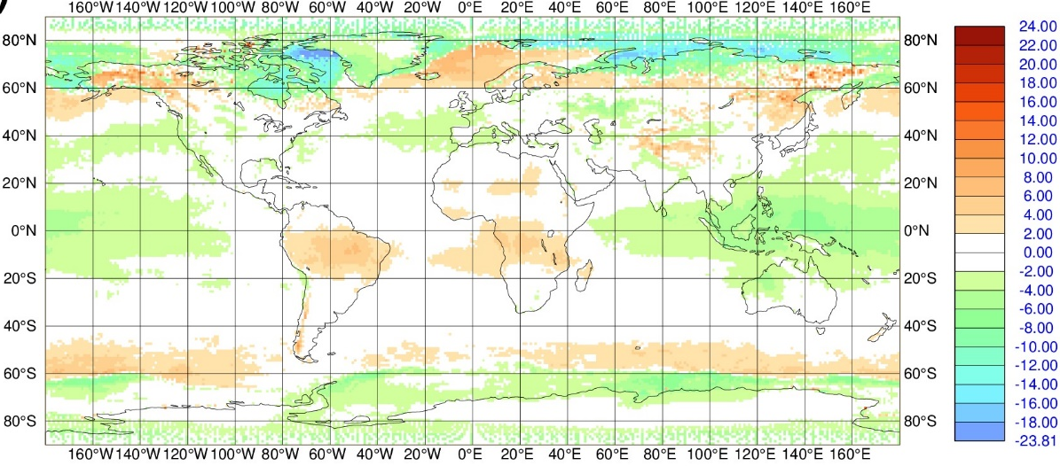
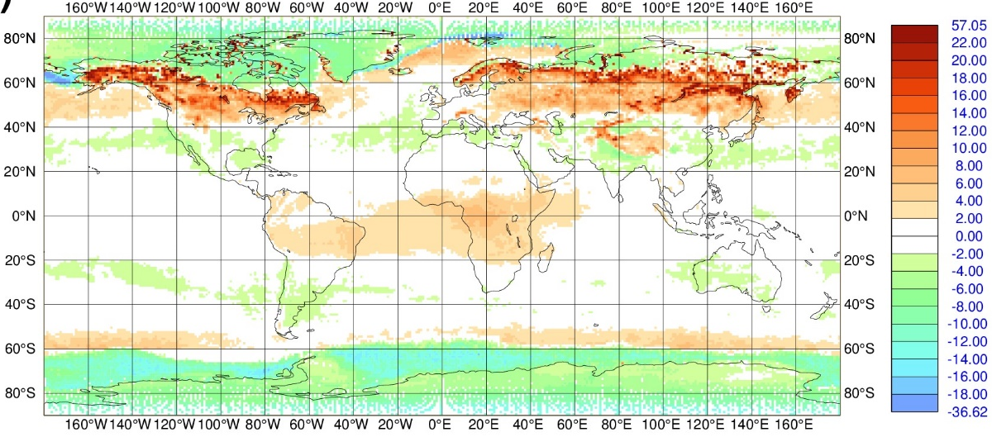
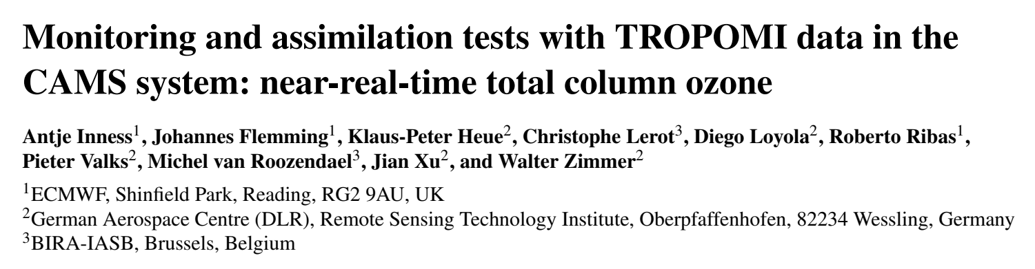

Sentinel-5 Precursor – O₃ Assimilation in CAMS/ECMWF
S5P - CAMS, Fall 2018
S5P - CAMS, Spring 2018

Slide 8
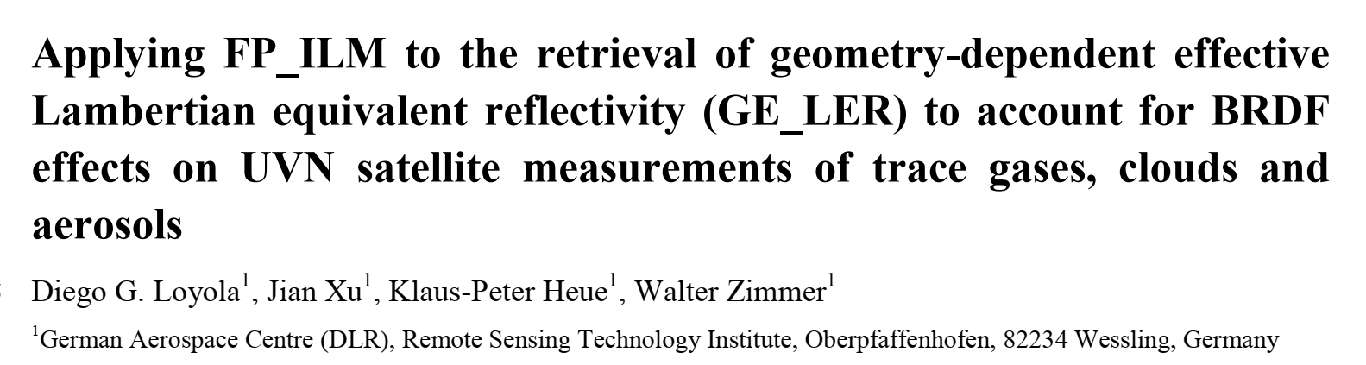
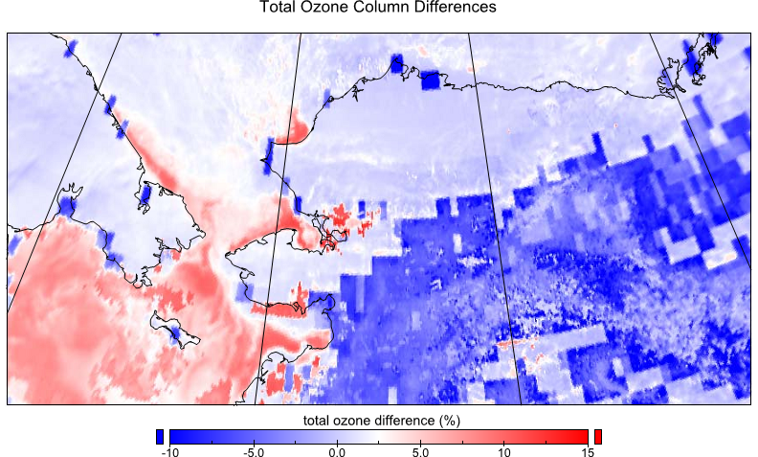
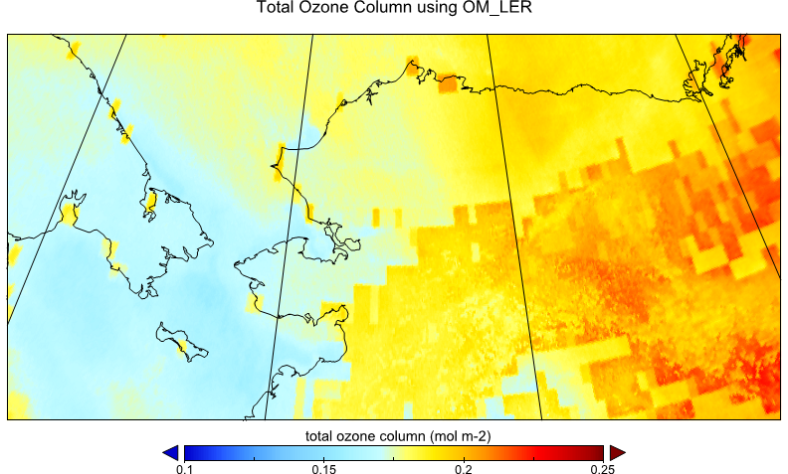
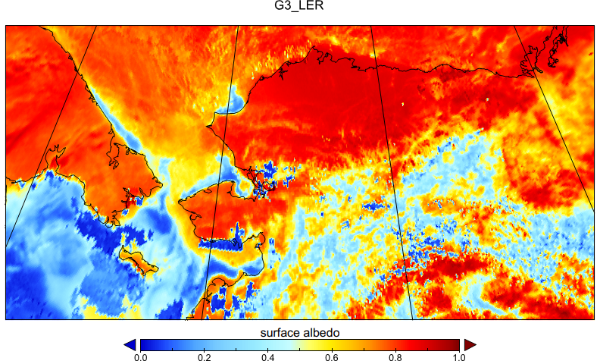
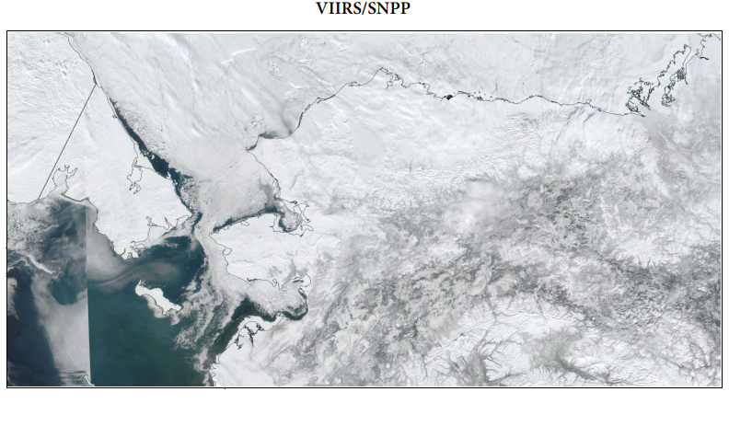
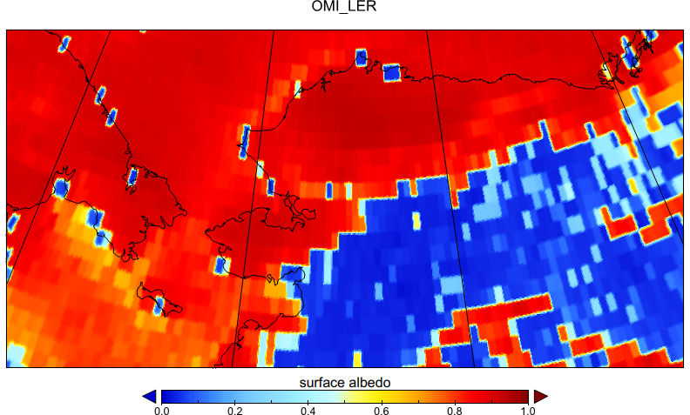
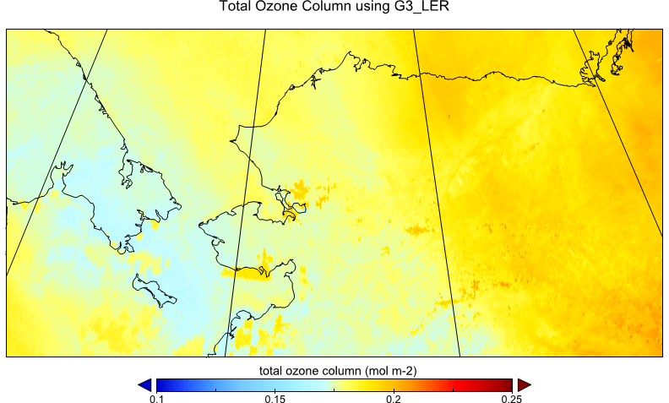
Sentinel-5 Precursor – FP_ILM Effective Scene Albedo

Slide 9

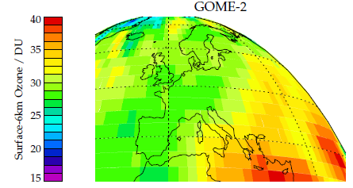
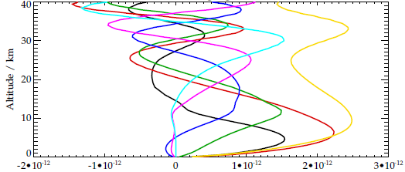
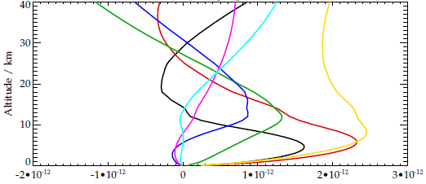
Sentinel-4 Copernicus – Tropospheric Ozone (O₃)
Heritage: ozone profile algorithm developed for GOME
  Specific emphasis on tropospheric ozone by exploiting the temperature dependence of the Huggins bands
ESA CCI-ozone selected this scheme to provide full record from GOME-1, SCIAMACHY, GOME-2 and OMI
S4 has no measurements of Hartley band below 305nm, which provides stratospheric profile information in all previous missions
S5
270nm+
S4
305nm+

Slide 10

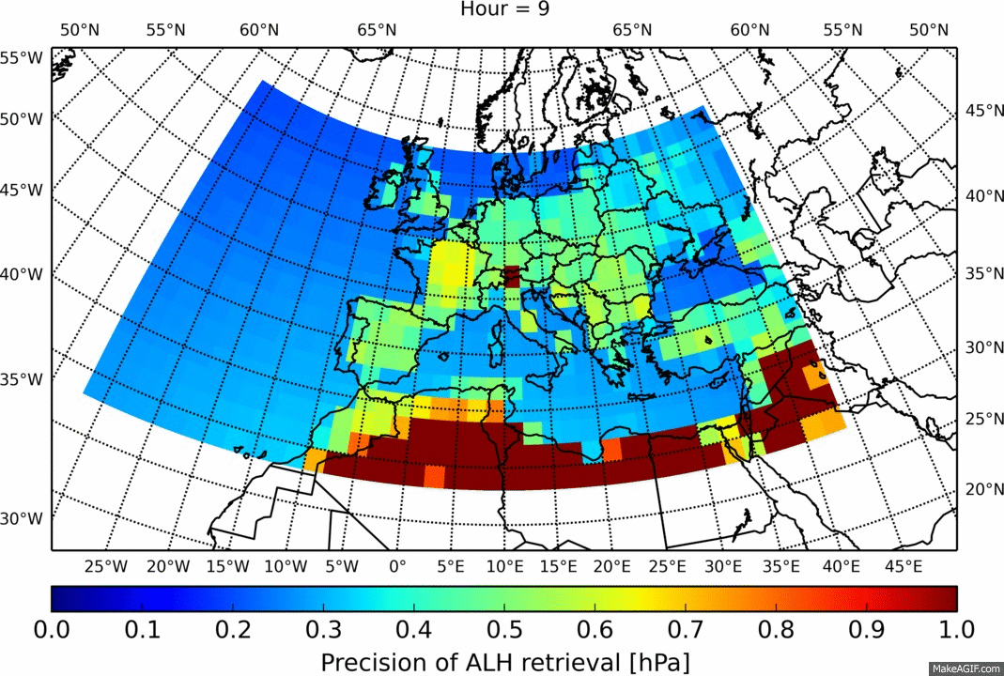
Sentinel-4 Copernicus – Aerosol Layer Height (ALH) and Aerosol Index (AI)
Heritage:
  ALH algorithm from S5P using information from the O2 A-Band
  AI algorithm from TOMS using two different pairs
ALH Diurnal Variability of the Retrieval Error

Slide 11

Sentinel-4 Copernicus – Geophysical Reference Data
High resolved (LOTOS EUROS)
RTM
S4 Instrument
TM5 1x1 everywhere else

Slide 12
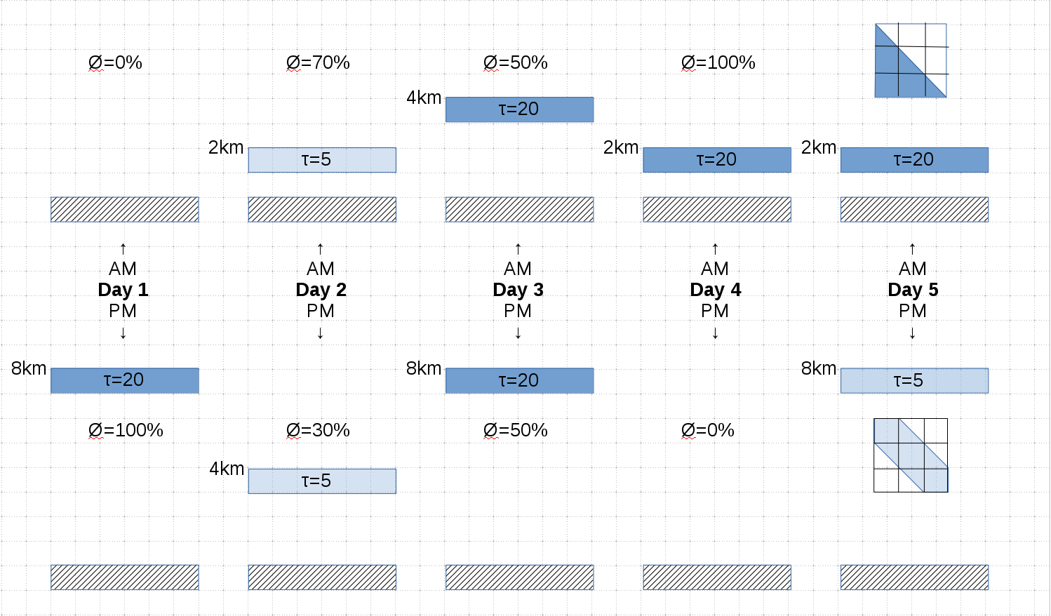
Sentinel-4 Copernicus – Geophysical Reference Data
2*5 days (summer + winter) with 3x3 pixel boxes
fully cloudy, partially cloudy, aerosol and SO2 scenarios
17 locations across FOV
Clouds with
  CTH= 2, 4, 8 km
  COT= 5, 20
  CF= varying

Slide 13
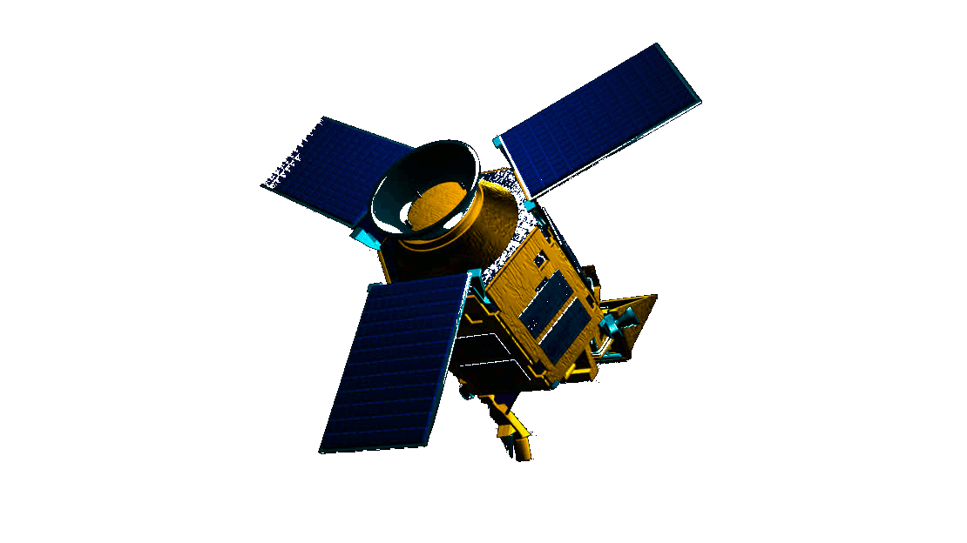

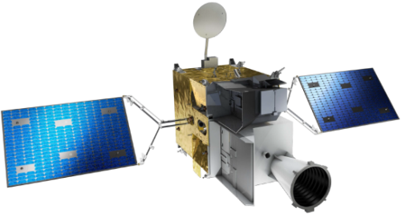
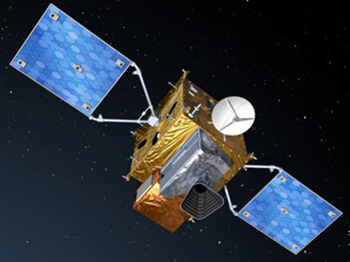

Interactions between Sentinel-4 and ECMWF, CAMS, FCI, and Sentinel-5P/-5
Sentinel-5P, -5
CAMS
L2
Global & Regional
L2
a-priori
Forecast
FCI
input
Sentinel-4
input

Slide 14
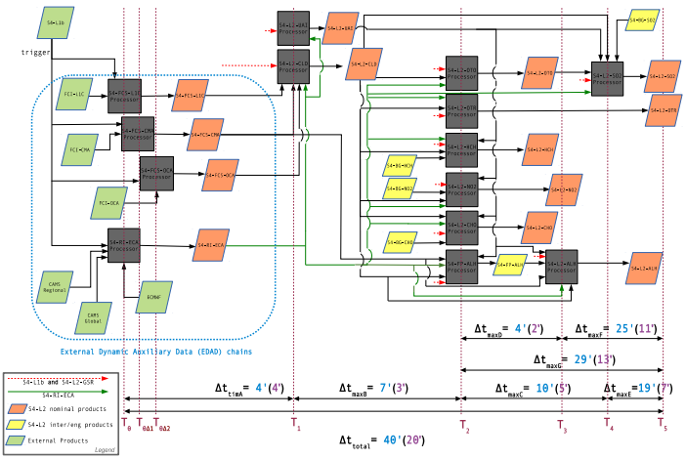
Sentinel-4 L2 Processor Interdependencies and Timelines

Slide 15








S4-L2 Copernicus Team
Richard Siddans
Andy Smith
Pepijn Veefkind
Henk Eskes
Martin de Graaf
Maurits Kooreman
Swadhin Nanda
Michael Aspetsberger
Petrut Cobarzan
Andreas Hangler
Anton Lopatin
Oleg Dubovik
Pavel Lytvynov
Diego Loyola
Athina Argyrouli
Pascal Hedelt
Klaus-Peter Heue
Ronny Lutz
Fabian Romahn
Sander Slijkhuis
Pieter Valks
Birgit Wunschheim
Jian Xu
Walter Zimmer
Michel Van Roozendael
Jeroen Van Gent
Christophe Lerot
Isabelle De Smedt
Nicolas Theys
Huan Yu
Thomas Wagner
Steffen Beirle
Janis Pukite
Simon Warnach
Andreas Richter
Leonardo Albarado
Heinrich Bovensmann
Luca Lelli
Daniele Fantin
Robin Skahjem-Eriksen
Yves Govaerts
Marta Luffarelli
Giorgio Bagnasco
Olivier LeRille
Ben Veihelmann
Norrie Wright

