Slide 1
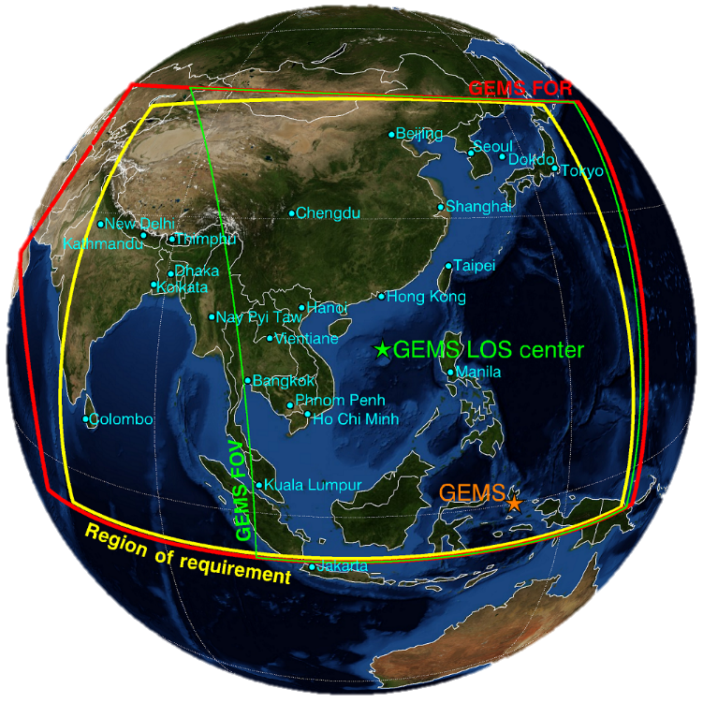
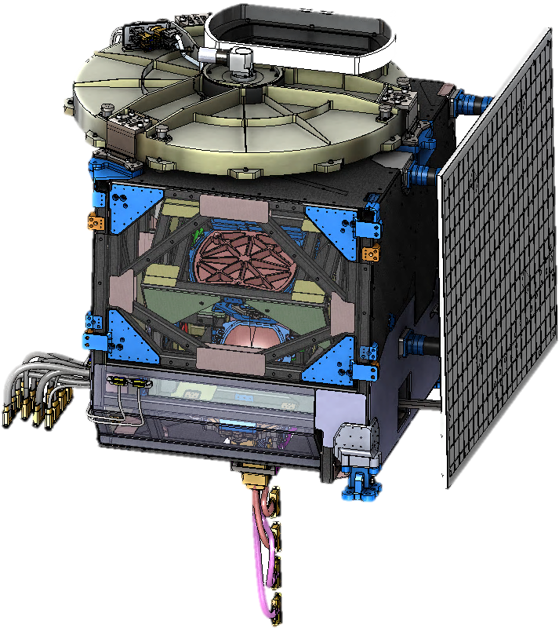


Geostationary Environment Monitoring Satellite (GEMS)
Jongmin Yoon and Kyung-Jung Moon
Environmental Satellite Center
NIER

Slide 2
Contents
01
Status of GEMS development
02
GEMS Level-2 data
03
GEMS ground system
04
Data validation plan
Notes:
.

Slide 3

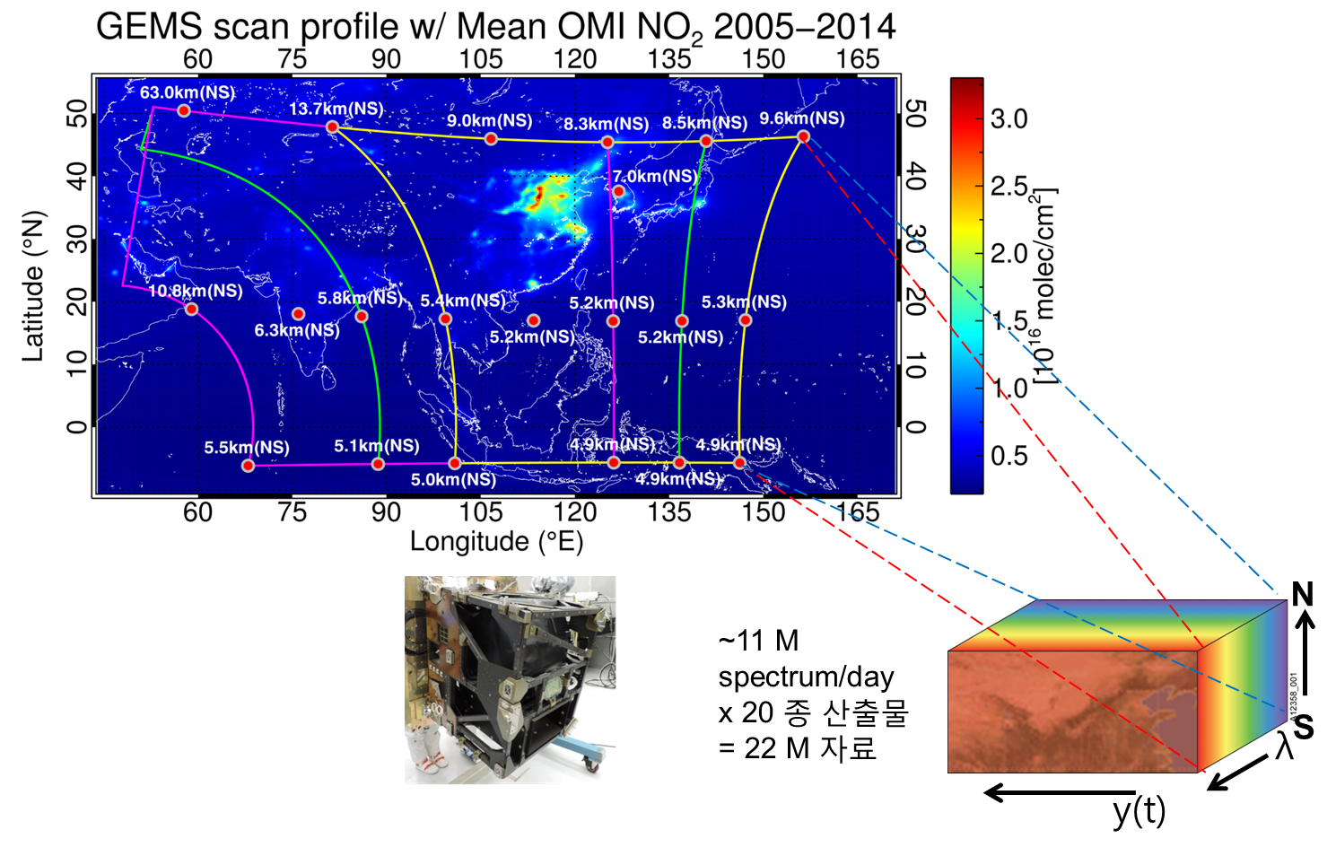
1
Status of GEMS
Measurement Concept
2000 N-S x 697 E-W
x 8 times/day
= 11,152,000 spectrum/day

Slide 4
1
Status of GEMS
Instrument tests
< Ready for vibration test >
< Result of vibration test >

Slide 5
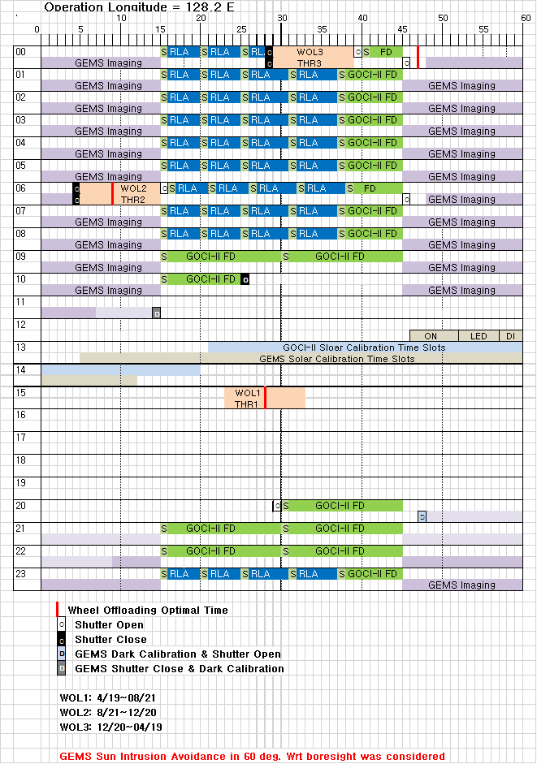
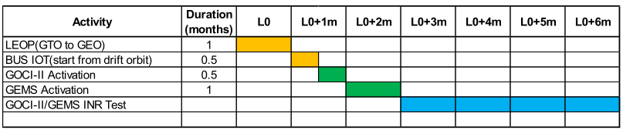
1
Status of GEMS
Measurement schedule and IOT plan
< Instrument activation and commissioning timeline >
GEMS-Specific Activation duration is 30 days out of 6 months of GK-2B IOT Phase to avoid the GEMS-GOCI II Mission Operation Confliction

Slide 6
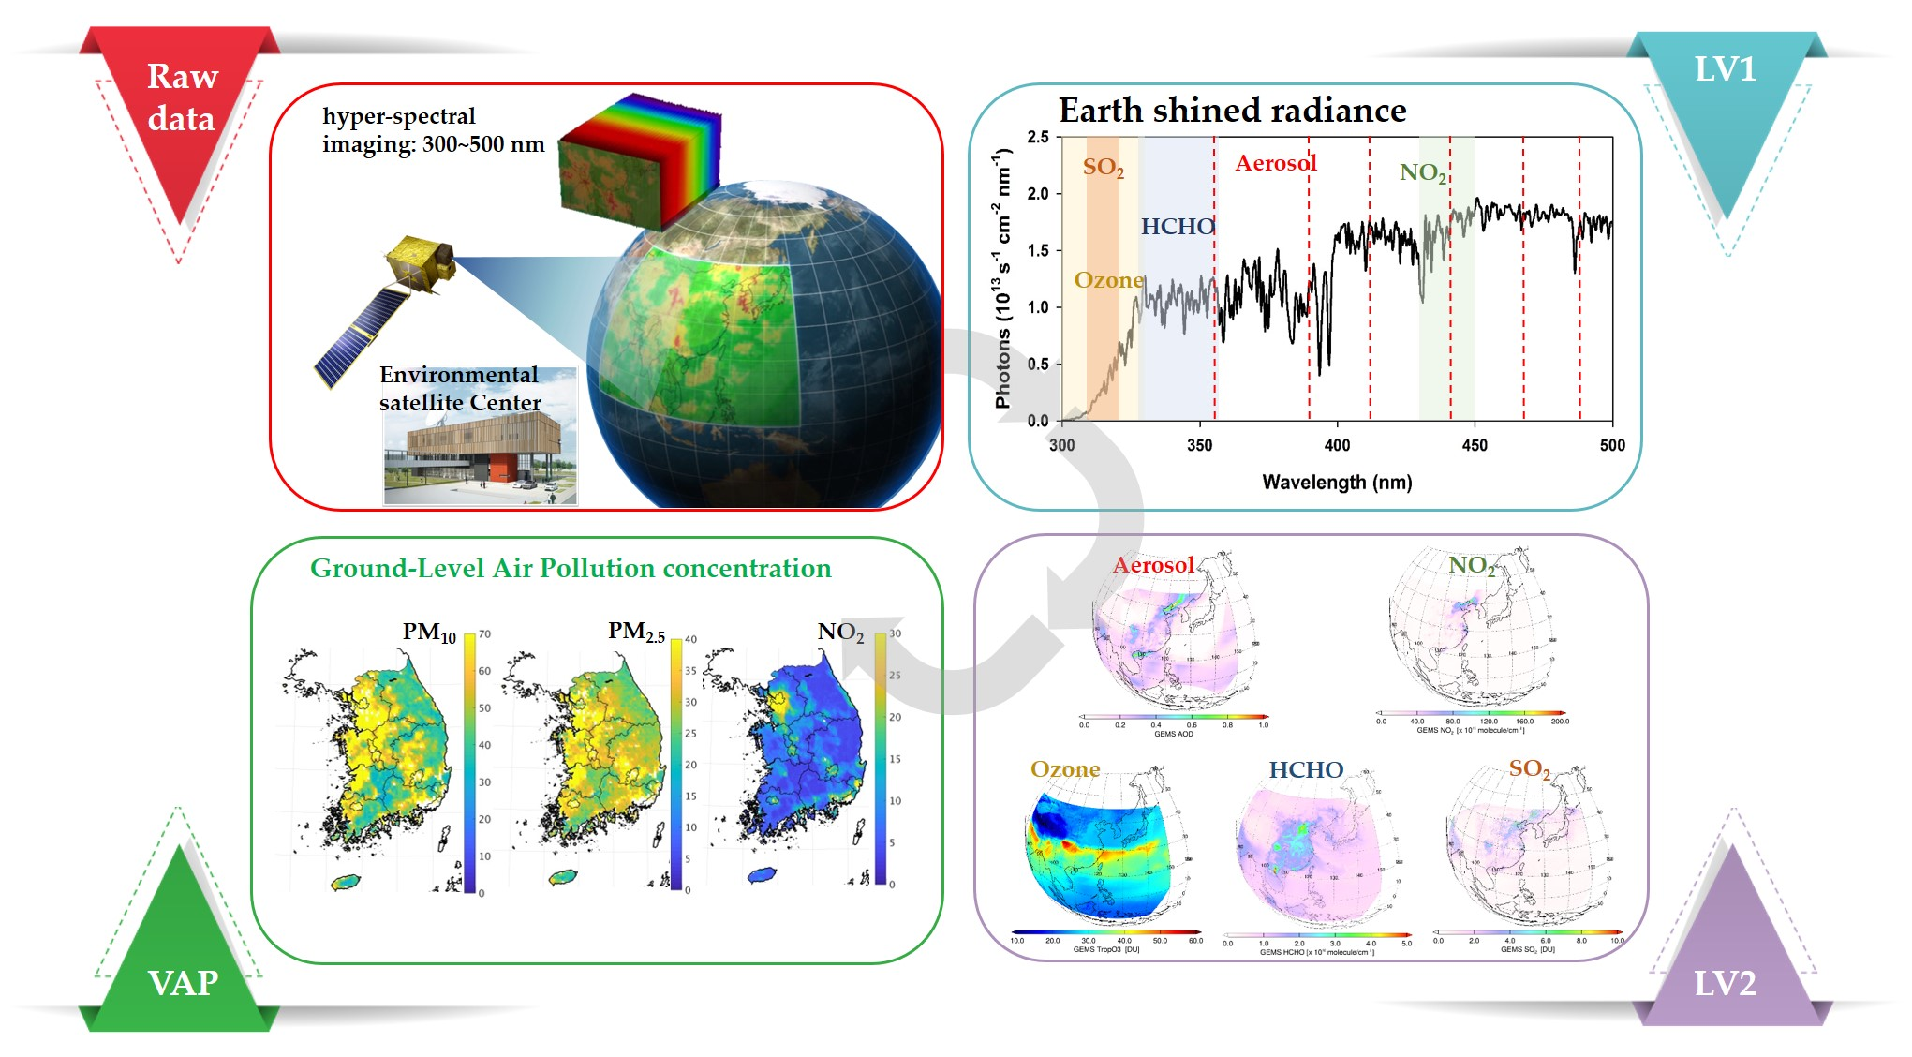
2
GEMS Level-2 data
GEMS algorithm development

Slide 7
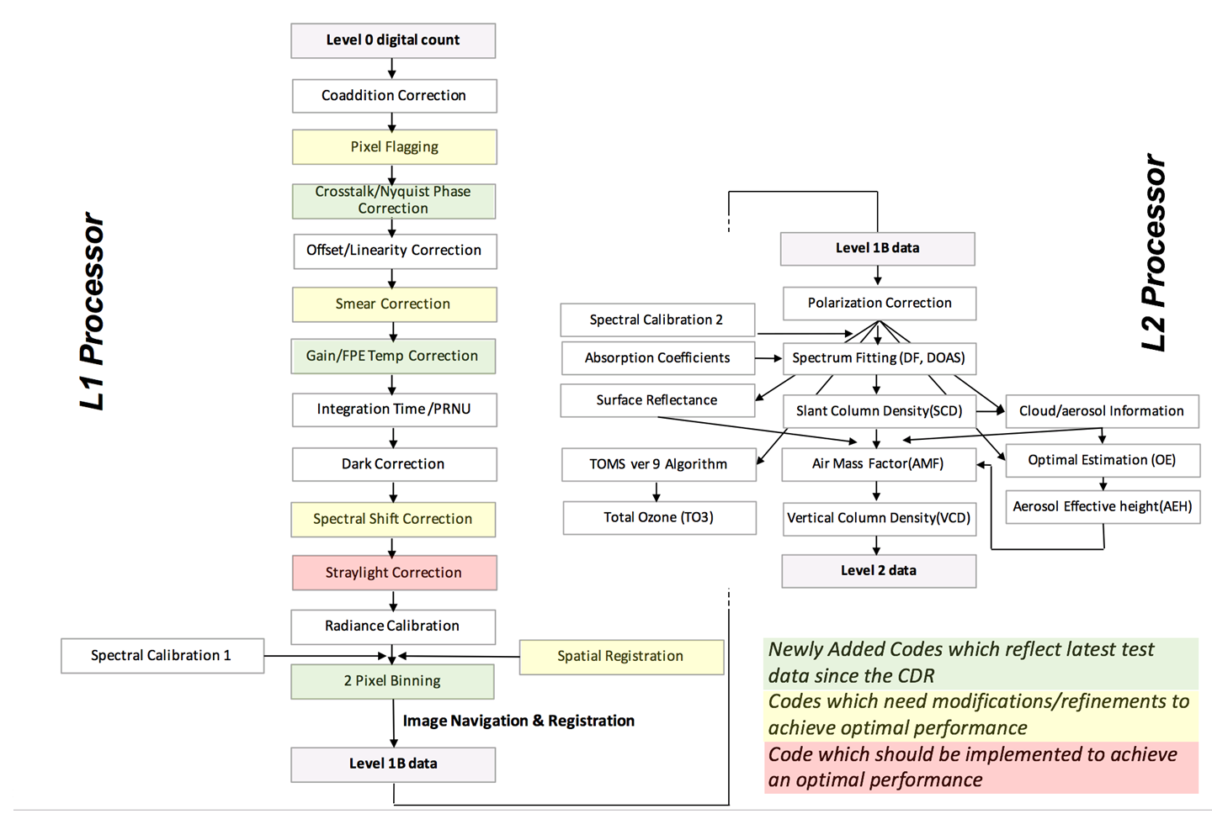
2
GEMS Level-2 data
Data Processing (L0-L1-L2)

Slide 8
2
GEMS Level-2 data
Level-2 Processor Interface
Processing step by step
Time limit (30 minutes)
Re-processing at night (TBD)

Slide 9
2
GEMS Level-2 data
Level-2 Main Products (20)
Num | Product | Importance | Min (cm⁻²) | Max (cm⁻²) | Nominal (cm⁻²) | Accuracy | Window (nm) | Spat Resol (km²)@Seoul | SZA (deg) | method
1 | Surface Prop. (LER, BRDF) | Environment | 0 | 1 | - | 20% | 300-500 | 3.5 x 8 | < 70 | Multi-l
3 | ECF CCP CRF | Retrieval Climate | 0 (COD) | 50 (COD) | 17 (COD) | 20% | 300-500 | 7 x 8 | < 70 | O₂O₂ RRS
4 | AOD AI SSA AEH | Air quality Climate | 0 (AOD) | 5 (AOD) | 0.2 (AOD) | 20% or 0.1@ 400nm | 300-500 | 3.5 x 8 | < 70 | Multi-l O₂O₂
3 | TropO₃ StratO₃ TotalO₃ | Oxidant Pollutant O₃ layer | 4x10¹⁷ | 2x10¹⁸ | 1x10¹⁸ | 3%(TOz) 5%(Stra) 20(Trop) | 300-340 | 7 x 8 | < 70 | OE TOMS
1 | HCHO | VOC proxy | 1x10¹⁵ | 3x10¹⁶ | 3x10¹⁵ | 1x10¹⁶ cm⁻² | 328.5-356.5 | 7 x 8 x 4 pixels | < 50 | DF
1 | CHOCHO |  | 1x10¹⁴ | 1x10¹⁵ | 5x10¹⁴ | 1x10¹⁵ cm⁻² | 435-461 | 7 x 8 x 4 px | < 50 | DF
2 | TropNO₂ StratNO₂ | O₃ precursor | 3x10¹³ | 1x10¹⁷ | 1x10¹⁴ | 1x10¹⁵ cm⁻² | 425-450 | 7 x 8 x 2 pixels | < 70 | DOAS
1 | SO₂ | Aerosol precursor Volcano | 6x10⁸ | 1x10¹⁷ | 6x10¹⁴ | 1x10¹⁶ cm⁻² | 310-330 | 7 x 8 x 4 pixels x 3 hours | < 50 | DOAS PCA
4 | UVI VitaD dose rate DNA dose rate Plant dose rate | Public health | 0 | 12 62 25 48 | 6.8 33 mW/m² 12 mW/m² 25 mW/m² | 20% | 300-360 | 7 x 8 | < 70 | Multi-l RTM

Slide 10
3
GEMS ground system
Main concept of ground system operation
Operational Concept | Explanation
Non-stop Operation | Non-stop Operating ground station for 24hours and 365days Securing stability and non-stop automation through active-active high stability multiplexing Constructing an operation system in emergencies and at all times Establishment of back-up system for each sub system
Real-time Service | Acquisition in real-time and distribution in near-real-time Distribution within 1hour after receiving RAW data Improvement of processing efficiency through algorithm parallelization
Operation for 10years | Operating 10 years according to designed duration of GK2B operation Considering expansion possibilities of hardware, software, network, and new facilities
Data archive | Archiving all data in main storage, that is received and produced Building storage system that can expand and meet storage requirements
Back-up system | Constructing back-up system for data reliability Non-stop Operating with rapid substitution in case of failure Establishment of back-up system to meet system operation concept and requirements
High Availability | Achieving 99% or more operational availability for high-speed processing and customized services with Hot backup system

Slide 11
3
GEMS ground system
Overview of ground system
External Network
Internal Network
Receiving system
  SDPS
  (Scientific Data
  Processing System)
  KARI
  PPS
  (data Pre-Processing
  System)
  DVS
  (Data Verification
  System)
DVS Client
(Data Verification
System Client)
  KIOST
DPS
  NMSC
PSS
(Product Service
System)
  DAS
  (Data Analysis
  System)
DAS Client
(Data Analysis
System Client)
INR
Related institutes
  E-Portal_out
  (Environment-Portal)
  E-Portal_in
  (Environment-Portal)
  DMS
  (Data Management System)
Individual users
  CMS
  (Control and Monitoring System)
Internal network
Internet
  KARI installation
  Basic
  system
Advanced system

Slide 12


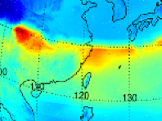




3
GEMS ground system
Data sharing
Data service to public
User
1. Search
2. Data request
Providing web-based service that is easy to access for general users
Data service web
4. Download
3. Data transmission
Data storage
Data service to institution
Prior consultation
(agreement) is required
2. Setting information
transmission
Providing sftp-based service for periodic/large data
1. Setting for data request
Data service web
3. Data request/transmission
Distribution module
Institution
4. (Periodic) data transfer

Slide 13
3
GEMS ground system
Road ahead
2019.09
2019.12
2020.03
2020.11
2021.03
Network construction
In-Orbit Test (pre-processing)
L2 IOT
(tuning/improvement)
L2 validation +
Use (step by step)
Pre-launch test
Webpage open and operation
IOT plan
GK2B launch
IOT end
L2 product
Establishment of regulation and guide for operation and data distribution

Slide 14
4
Data validation plan
Main products for validation

Slide 15
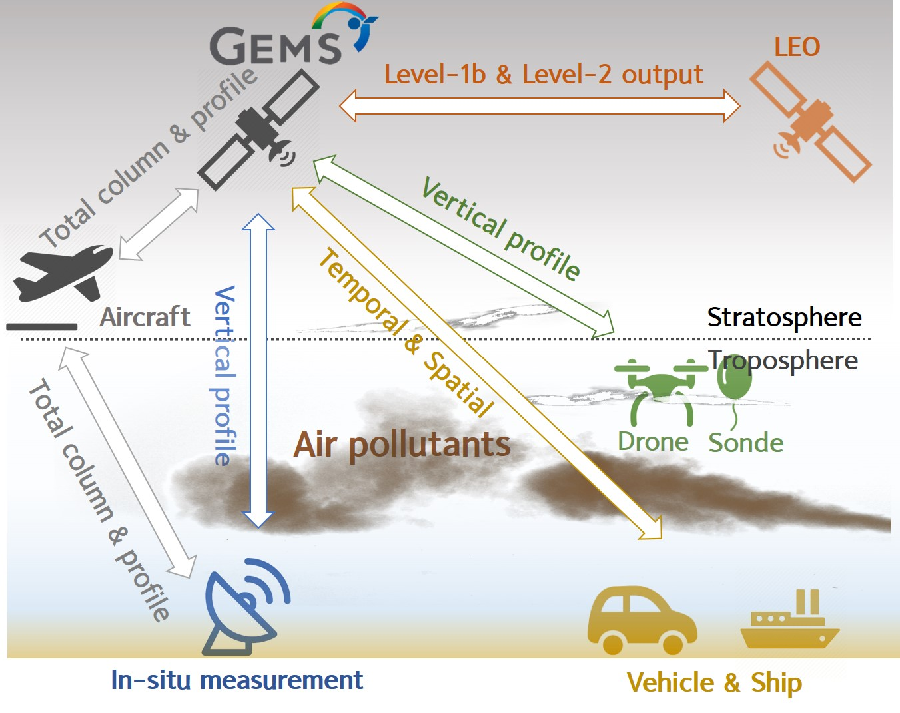
4
Data validation plan
Validation strategy

Slide 16
4
Data validation plan
Validation network within GEMS domain
[Kim et al., 2019]

Slide 17
4
Data validation plan
Pandora network
< Proposed Pandora network >
~2018 (4) : YSU, PNU, SNU, UNIST
2019 (2) : China, Japan (LTP project)
2020~2021 (6) : Korea (ESC, TBD)

Slide 18
4
Data validation plan
Announcement of Opportunity for GEMS
2019.8 : Outlines the CalVal requirements for GEMS AO
2019.9~11 : Draws up the first draft of GEMS AO and share it with GEMS science team
2019.11 : Opens the draft of GEMS AO at GEMS international science team meeting
~2020.1 : Completes the final version of GEMS AO
2020.1~2 : GEMS AO Call
2020.3~ : Launches GEMS and the GEMS CalVal activity

Slide 19
Thank you for your attention~!!

