Slide 1
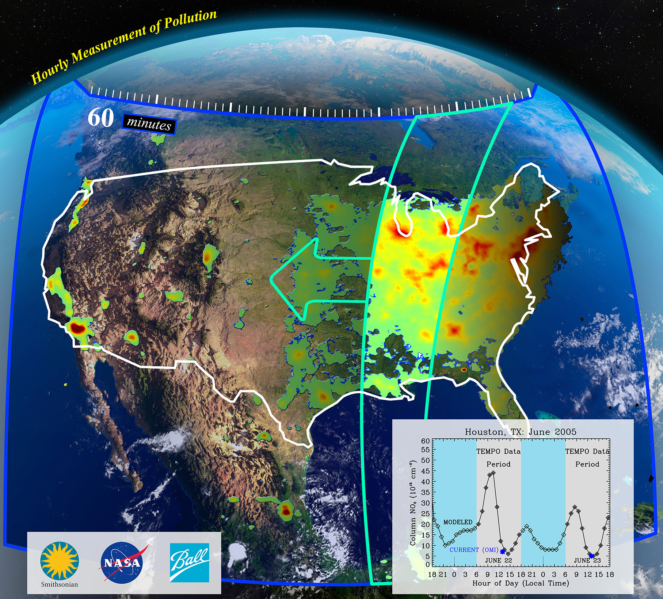




Tropospheric Emissions: Monitoring of Pollution
TEMPO Early Adopters Program
Aaron Naeger¹
Michael Newchurch², Susan Alexander³, Chris Chan Miller⁴, NASA SPoRT Team, TEMPO Team
¹University of Alabama in Huntsville / NASA SPoRT
²University of Alabama in Huntsville / Department of Atmospheric and Earth Science
³University of Alabama in Huntsville / College of Nursing
⁴Harvard-Smithsonian Center for Astrophysics
October 10, 2019
TEMPO Health Applications Conference
Huntsville, AL

Slide 2

TEMPO EA Meetings To Date
Early engagement with the TEMPO mission has been achieved through 2 EA meetings
1st TEMPO Applications Workshop in July 2016 at UAH
  156 registered attendees (80 in-person) from NASA and NOAA, national, academic regional, state, and local health and environmental departments, academia, and private sector
  Highlighted large spectrum of interest in the TEMPO mission
  Stressed 4 core application areas of TEMPO mission: (1) Air-Quality Forecasting; (2) Planning and Assessment; (3) Emissions; (4) Health, Agricultural, and Environmental
2nd TEMPO EA Workshop in April 2018 at Fort Collins
  In-person attendees included state, local, and federal AQ management agencies in the West
  Highlighted anticipated data delivery and display mechanisms for TEMPO, which included NASA SPoRT for transitioning real-time TEMPO data products to end users and development of tailored products into preferred display platforms
  End user thoughts on potential benefits of TEMPO data mostly stressed the 4 core application areas and regional and local benefits in the West
  AQ agencies noted strong need for real-time TEMPO data products, along with a translator between the science and end user communities for effectively preparing end users (HEALTH!) of TEMPO data
https://weather.msfc.nasa.gov/tempo/

Slide 3
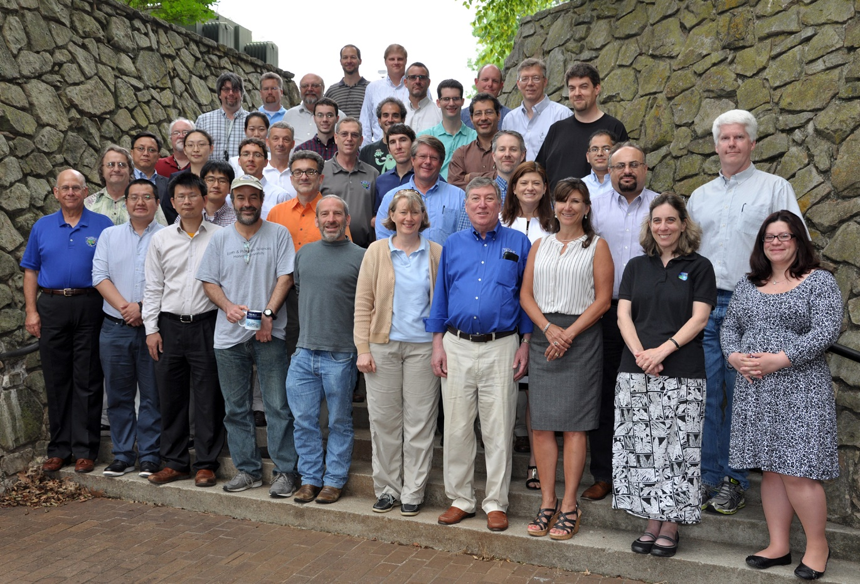
EA Team at UAH
1st TEMPO EA meeting in 2016 at UAH
https://weather.msfc.nasa.gov/tempo/

Slide 4
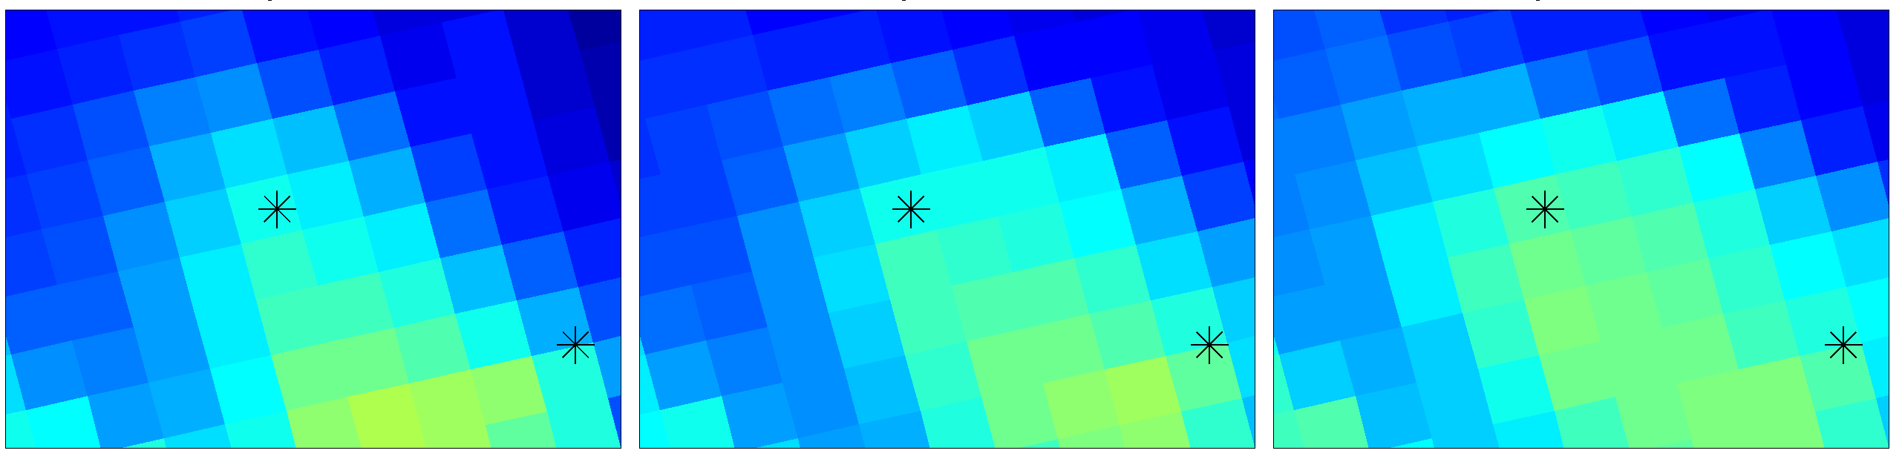
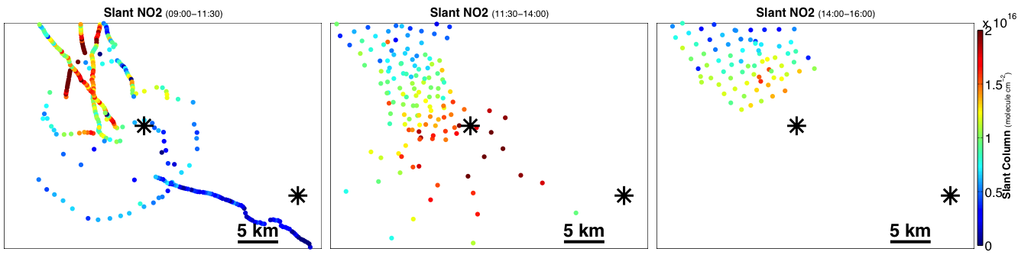
TEMPO temporal resolution
Morning
Mid-day
Afternoon
Transport of high NO₂ between morning and mid-day shows importance of monitoring trace gases throughout diurnal cycle
Polar-orbiter satellites with limited daytime scans over regions are incapable of resolving the evolution of trace gases and chemistry
Bakersfield
Bakersfield
Bakersfield
Wind
Data courtesy of NASA-GSFC (S. Janz)
Bakersfield
Bakersfield
Bakersfield
Courtesy of EPA/NERL/CED
L. Valin, 1st TEMPO Applications Workshop
https://weather.msfc.nasa.gov/tempo/

Slide 5
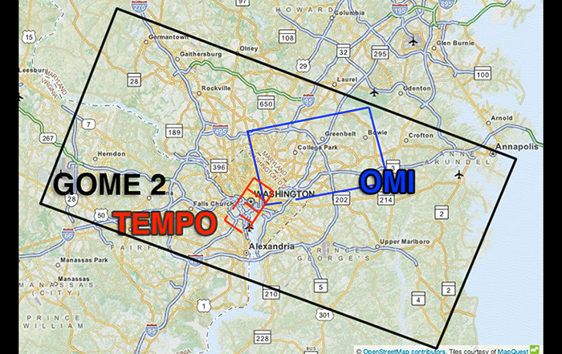
TEMPO spatial resolution
Valin et al. (ACP 2011)
NO₂
~1/300 of GOME-2
~1/30 of OMI
Spatial resolution of legacy AQ missions incapable of resolving fine-scale emissions
New-generation TROPOMI sensor can resolve fine-scale emissions but still limited in temporal resolution (polar-orbit)
TEMPO’s high spatial resolution (2.1 x 4.7 km²) will lead to drastic improvement in monitoring emission source regions
https://weather.msfc.nasa.gov/tempo/

Slide 6
TEMPO EA Meetings and Health
Pertinent health-related remarks from 2016 EA Meeting:
  High temporal resolution, expected accuracy, and spatial coverage of TEMPO data will benefit acute health effect studies of O₃ and NO₂
  Spatial resolution will also benefit studies of O₃, but not adequate for studying acute health effects of NO₂, so need to develop models to improve spatial resolution of TEMPO
  TEMPO tropospheric trace gas retrievals must be converted to surface-level concentrations for studying acute health effects
  Given its baseline mission length of less than 2 years, TEMPO observations will not be appropriate for studying chronic effects (e.g., heart attacks linked to long-term exposure)
    Importance of extending mission lifetime, TEMPO is built to last 10+ years!
  TEMPO spatial resolution is not adequate for health data which is characterized by county or zip code and lack of nighttime coverage of TEMPO could be a concern for NO₂
https://weather.msfc.nasa.gov/tempo/

Slide 7
TEMPO EA Meetings and Health
Pertinent health-related remarks from 2018 EA Meeting:
  TEMPO data will create a body of data describing surface-level characteristics and diurnal variations of criteria pollutants and UVB rays (associated with malignancies of the skin)
  TEMPO data is capable of improving the quality of research on the public health impact of pollutants by better addressing existing spatiotemporal confounders, while reducing gaps in the comprehension of pollutants and health relationships
  Special observations at higher temporal resolution will level the balance of health and AQ data in models used in epidemiological studies, which can improve research designs and increase our understanding of the relationships between surface-level exposures and public health indicators
  Baseline products will address questions that arise in caring for patients who may be susceptible to health changes associated with increased pollutants
  A public health workshop on TEMPO data was strongly encouraged!
4 core application areas of TEMPO mission: (1) Air-Quality Forecasting; (2) Planning and Assessment; (3) Emissions; (4) Health, Agricultural, and Environmental
  Due to tremendous capability of TEMPO for advancing health studies and applications, I recommend designating Health as a separate application area
https://weather.msfc.nasa.gov/tempo/

Slide 8
TEMPO Public Health Conference
Focused forum with following goals:
  Present TEMPO mission, data, and capabilities to health end users and stakeholders
  Define needs of health community for effectively using and applying TEMPO data
  Discuss necessary next steps for ensuring these needs are met during pre-launch phase of mission
Discuss synergy of TEMPO and MAIA missions for further advancing health studies and applications
Your input during pre-launch phase of mission is critical!
https://weather.msfc.nasa.gov/tempo/

Slide 9
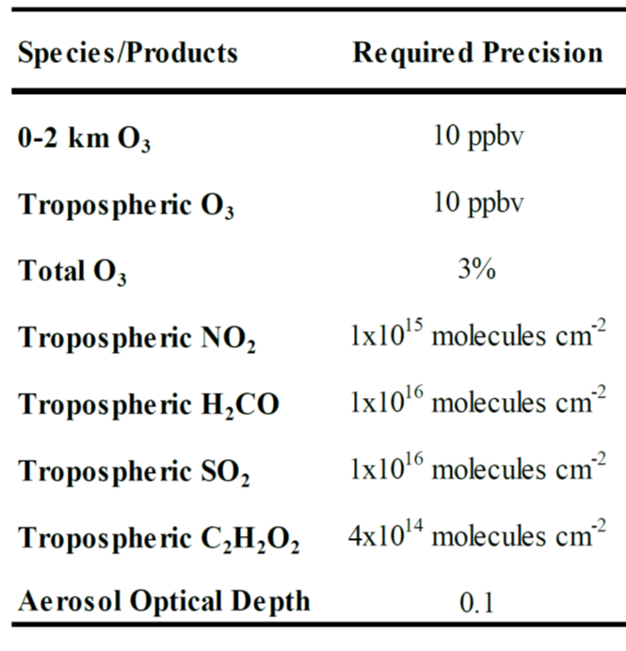
TEMPO EA Objectives (1)
Objective 1: Fully utilize synthetic TEMPO & operational GEMS data for realizing local and regional applications during pre-launch mission phase to accelerate operational use of products by AQ and public-health communities
Currently generating 1-year (July 2013-June 2014) of synthetic TEMPO L2 data products based on realistic gaseous and aerosol composition from GEOS-NR (source code from C. Chan Miller, SAO)
We will conduct analysis into extending synthetic dataset for more recent periods (2016, post-2017)
Leverage funded project with emphasis on assimilating operational GEMS data into regional model over South Asia to build model assimilation framework for TEMPO data
Closely engage with specific end users/stakeholders on their needs while realizing breadth of AQ and health issues across TEMPO FOR
Baseline L2 data products
https://weather.msfc.nasa.gov/tempo/

Slide 10
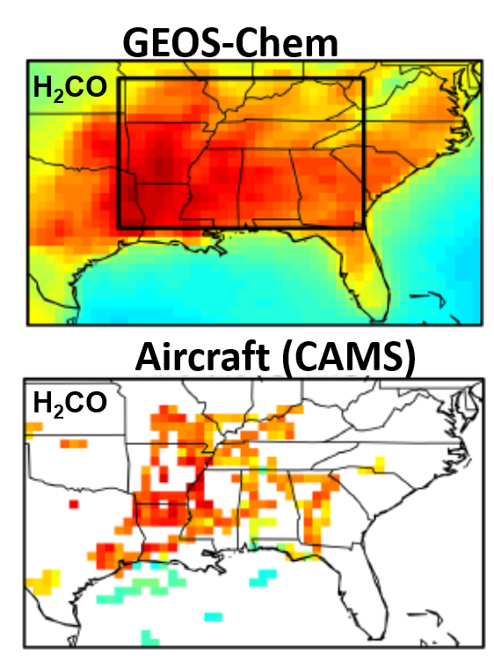
Synthetic TEMPO data
Synthetic TEMPO data generated from simulated gaseous and aerosol composition from GEOS-Nature Run (GEOS-NR)
GEOS-NR spatial resolution of ~12 x 12 km² spatiotemporally interpolated to finer TEMPO grid
Profiles and vertical column amounts of species obtained from interpolation and algorithm effects
Zhu et al. (ACP, 2014)
Original synthetic TEMPO Source code courtesy of C. Chan Miller
https://weather.msfc.nasa.gov/tempo/

Slide 11
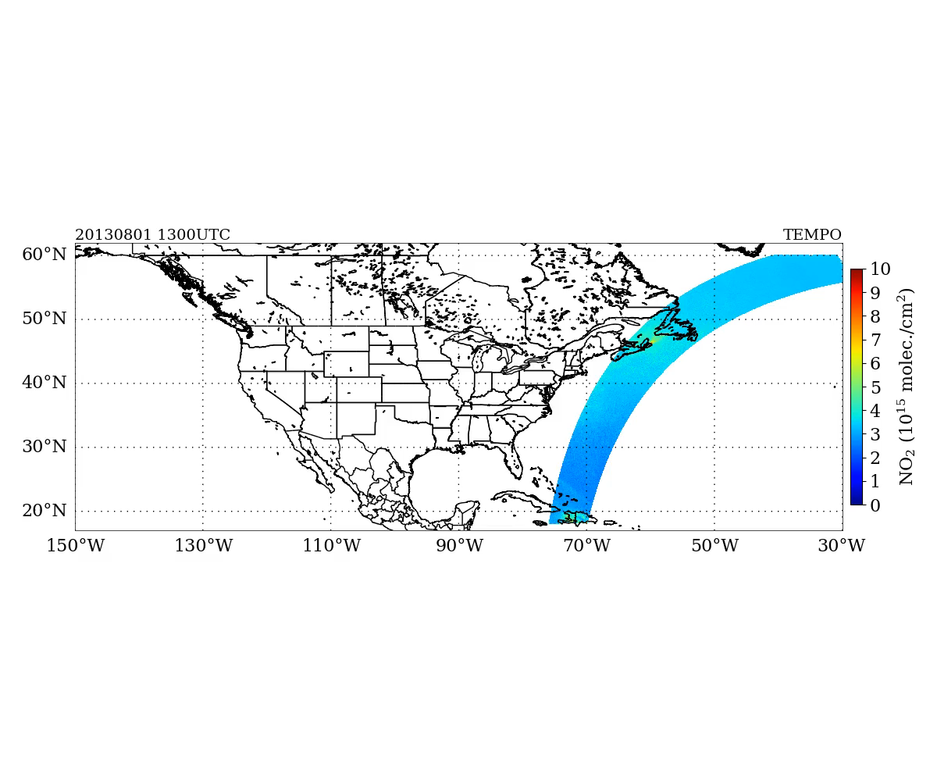
TEMPO Data Granules
TEMPO NO₂ - 1 Aug 2013
Column NO₂ (10¹⁵ molec./cm²)
E-W hourly scans over TEMPO FOR during daytime period
Individual netCDF files for each granule (10 total over hourly scan) and baseline product
https://weather.msfc.nasa.gov/tempo/

Slide 12
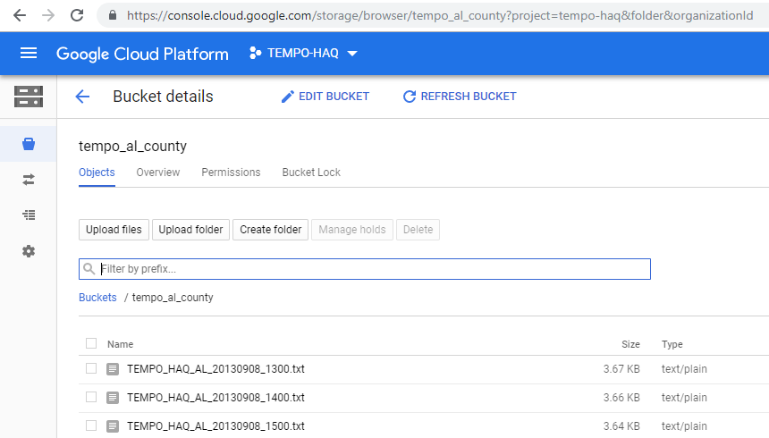
Tailored TEMPO data products
Formatted ASCII files of TEMPO L2 trace gas concentrations spatially interpolated to county level
Development of tailored/specialized TEMPO data products!
https://weather.msfc.nasa.gov/tempo/

Slide 13
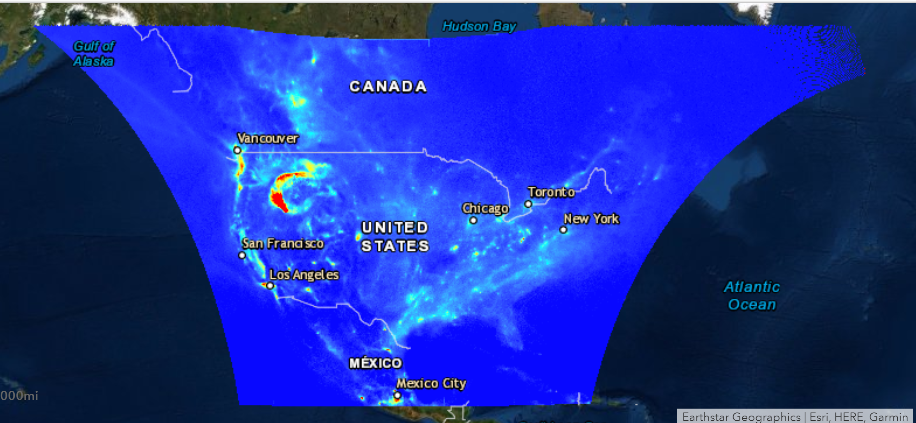
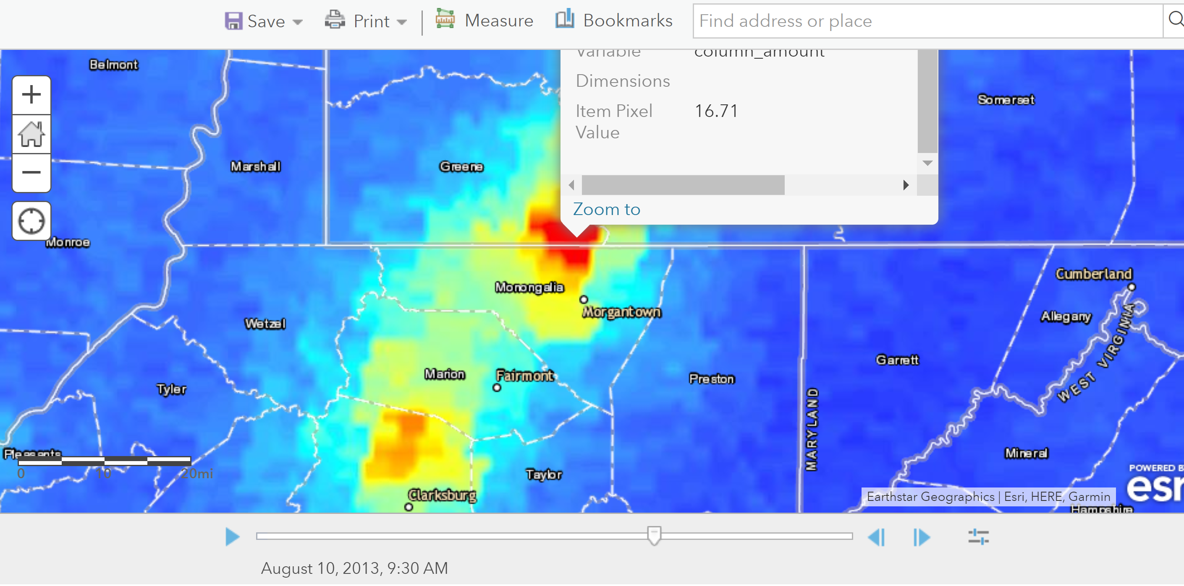
Display Platforms for TEMPO
Smoke plume and NO₂
High NO₂ from active coal plants
Esri platform includes point and click feature for retrieving raw geophysical variables at satellite pixel level for on-the-fly analysis
https://weather.msfc.nasa.gov/tempo/

Slide 14
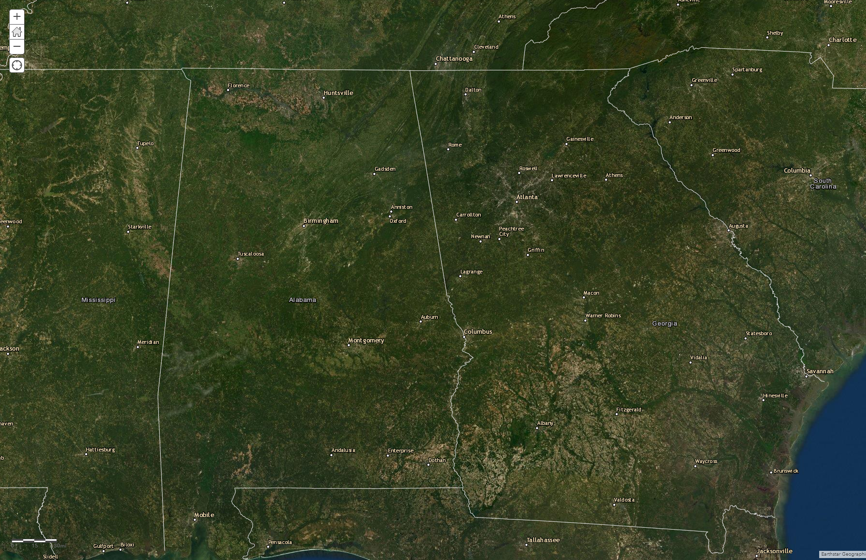
TEMPO EA Objectives (2 & 3)
Objective 2: Expand outreach to full spectrum of AQ and health end users/stakeholders from commercial and private agencies to maximize the utility and usability of TEMPO data products
Objective 3: Build framework for synthesizing TEMPO, GOES, and MAIA measurements for developing unprecedented merged Level 3 data products for advancing AQ and health applications
Huntsville
MAIA target area over Huntsville & Atlanta
Atlanta
https://weather.msfc.nasa.gov/tempo/

Slide 15
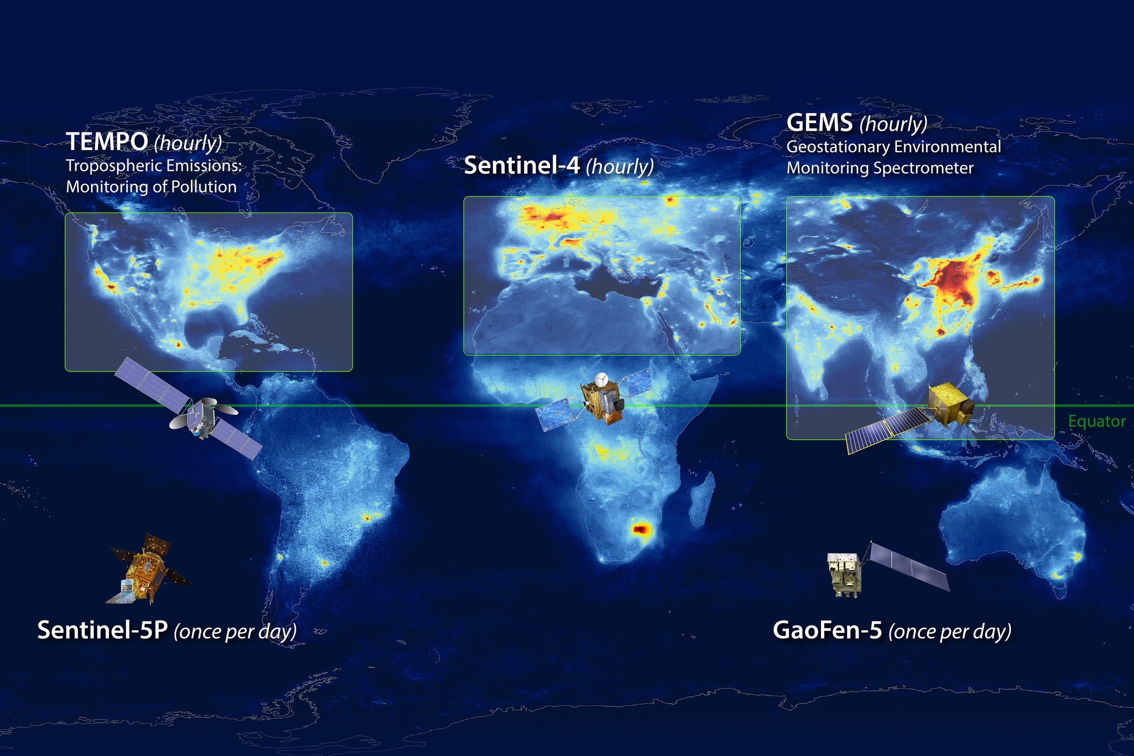
Constellation of Geostationary Spectrometers
Launch 2023
Launch early 2022
Launch early 2020
Image Credit: NASA LaRC
https://weather.msfc.nasa.gov/tempo/

Slide 16
Pre-launch R2O/O2R Activities
SPoRT has successfully transitioned unique observations from more than 40 satellite datasets to operational end users using established R2O/O2R paradigm that engages in solving forecast problems
This successful paradigm will be used to prepare the user community for TEMPO data
Keys to successful day 1 readiness
  Data in the end users’ display system
  Targeted training
  Assessments to gather feedback from users for the mission scientists
Pre-launch R2O/O2R activities can provide valuable input to mission scientists, algorithm developers, and guide products/capabilities
NASA SPoRT R2O/O2R paradigm
https://weather.msfc.nasa.gov/tempo/

Slide 17
Much more to come!
TEMPO launch date of early 2022 has been confirmed!
Unprecedented TEMPO capabilities will lead to wealth of impactful applications
  TEMPO Green Paper (https://www.cfa.harvard.edu/atmosphere/publications/TEMPO-Green-Paper-15jul2019.pdf)
  TEMPO EA site with additional highlights and updates on TEMPO applications (https://weather.msfc.nasa.gov/tempo/)
Actively engage with end users/stakeholders during pre-launch phase of TEMPO mission
Utilize GEMS for demonstrating potential applications of TEMPO mission
Diagnose regional and local applications of TEMPO data and recognize tailored products for specific end users/stakeholders
Expand outreach to the commercial and private sectors
TEMPO and MAIA marriage for developing unprecedented merged products for AQ and health applications
TEMPO EA Meeting in 2020!
https://weather.msfc.nasa.gov/tempo/

Slide 18
Thanks!
Questions/Comments
Aaron Naeger
Deputy Program Applications (DPA) Lead of TEMPO Mission
aaron.naeger@nasa.gov
https://weather.msfc.nasa.gov/tempo/

