Slide 1
Land and Ocean Monitoring with TEMPO
Joanna Joiner (Moderator, NASA GSFC),
Nickolay Krotkov (NASA GSFC),
Alexei Lyapustin (NASA GSFC),
Antonio Mannino (NASA GSFC),
Maria Tzortziou (CCNY),
Peter Zoogman (Minerva University),
Jennifer Johnson (Carnegie Institution for Science),
Dirk Aurin (NASA GSFC)

Slide 2
Discussion Questions
What information will TEMPO provide for ocean monitoring science?
What information will TEMPO provide for land surface and vegetation science?
How can TEMPO monitor and address red tide issues?
How can GLIMR use the trace gas, aerosol, and radiance information from TEMPO to test and enhance GLIMR products?
How can TEMPO benefit from GLIMR?
How can TEMPO address the impacts of ozone on agriculture and crops?
GLIMR is a sibling of TEMPO (second born of GEO-CAPE, a coastal ocean color imager) to be launched ~2027 that will be followed by OCX, sibling of ACX

Slide 3
A few thoughts
One person’s signal is another person’s headache, but we can help each other; challenge -> opportunity
  Atmospheric retrievals need good characterization of the surface including BRDF effects
  Ocean retrievals need good characterization of gaseous absorption (e.g., NO₂, H₂O, O₂, and O₃) and aerosol optical properties
  Land surface reflectance retrievals also need atmospheric correction
TEMPO will be the first GEO instrument to measure chlorophyll fluorescence over land throughout the day
TEMPO is the only GEO sensor with coverage in green wavelengths covering CONUS
  will miss an important region for land sensing (Photochemical Reflectance Index – PRI that needs 531 nm, affected by the xanthophyll cycle)
  green wavelengths could be important for early stress detection, but won’t resolve fields
TEMPO data will be available for 3+ years before GLIMR launch.
  Would it be helpful to simulate GLIMR data using TEMPO for testing algorithms
  Would it be helpful to develop and deliver some ocean products at lower spatial resolution to engage the coastal ocean user community?
Funding needed as new products are not part of the standard TEMPO suite of products

Slide 4
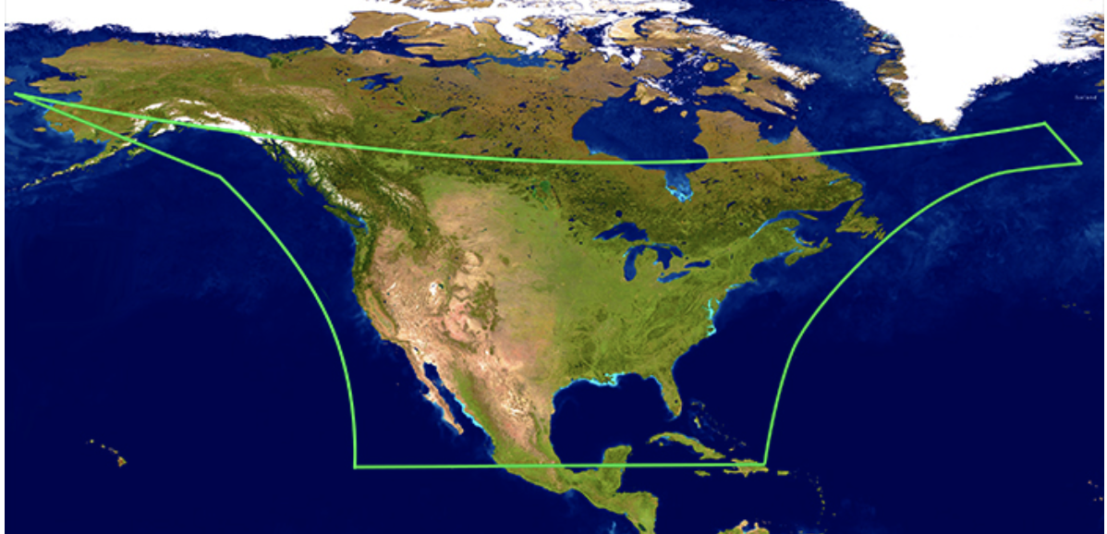
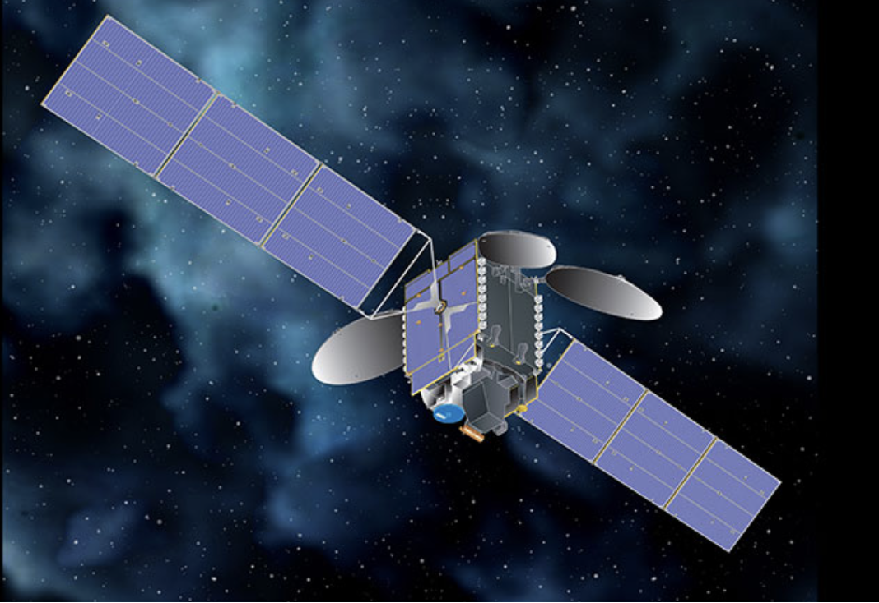
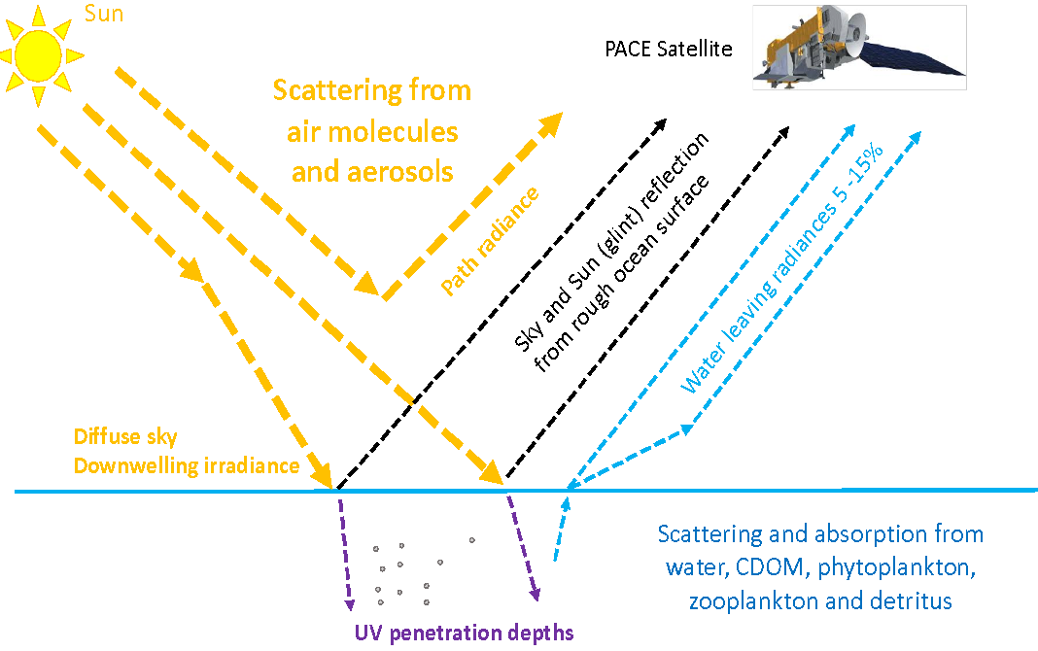
What information will TEMPO provide for ocean monitoring science?
R_{rs} (𝛌) = L_{w}(𝛌) /E_{s}(𝛌)
E_{S} (𝛌)
E_{d} (𝛌,Z)
Hyperspectral surface (Es) and underwater (Ed) hyperspectral irradiance (developing products for OMI)
Hyperspectral water leaving radiance and Remote Sensing reflectance, Rrs
Phytoplankton fluorescence

Slide 5
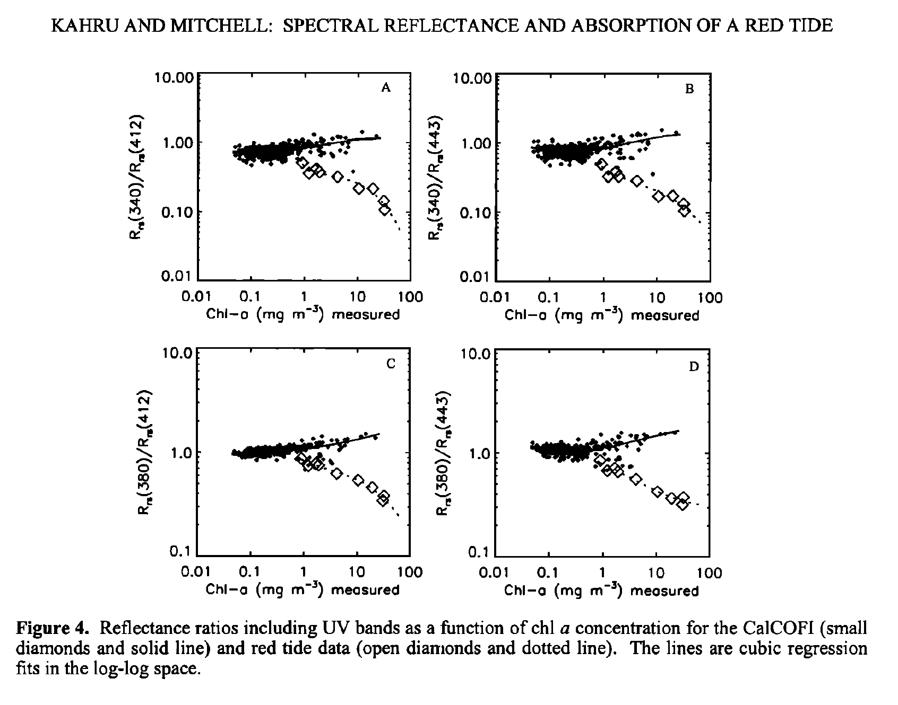
How can TEMPO monitor and address red tide issues?
In-situ spectral reflectance and absorption of a massive red tide in March 1995 off southern California (open diamonds) were compared to a "baseline” of bio-optical measurements from the California Cooperative Oceanic Fisheries Investigations (CalCOFI).
Ratios of Rrs at 340 nm (or 380 nm) and 412 nm (or 443 nm) provided differentiation of the red tide (open diamonds) from diatoms (black diamonds)
TEMPO hyperspectral UV-VIS Rrs retrievals would allow more accurate speciation of phytoplankton types
Kahru and Mitchell, JGR https://agupubs.onlinelibrary.wiley.com/doi/pdfdirect/10.1029/98JC01945?download=true

Slide 6
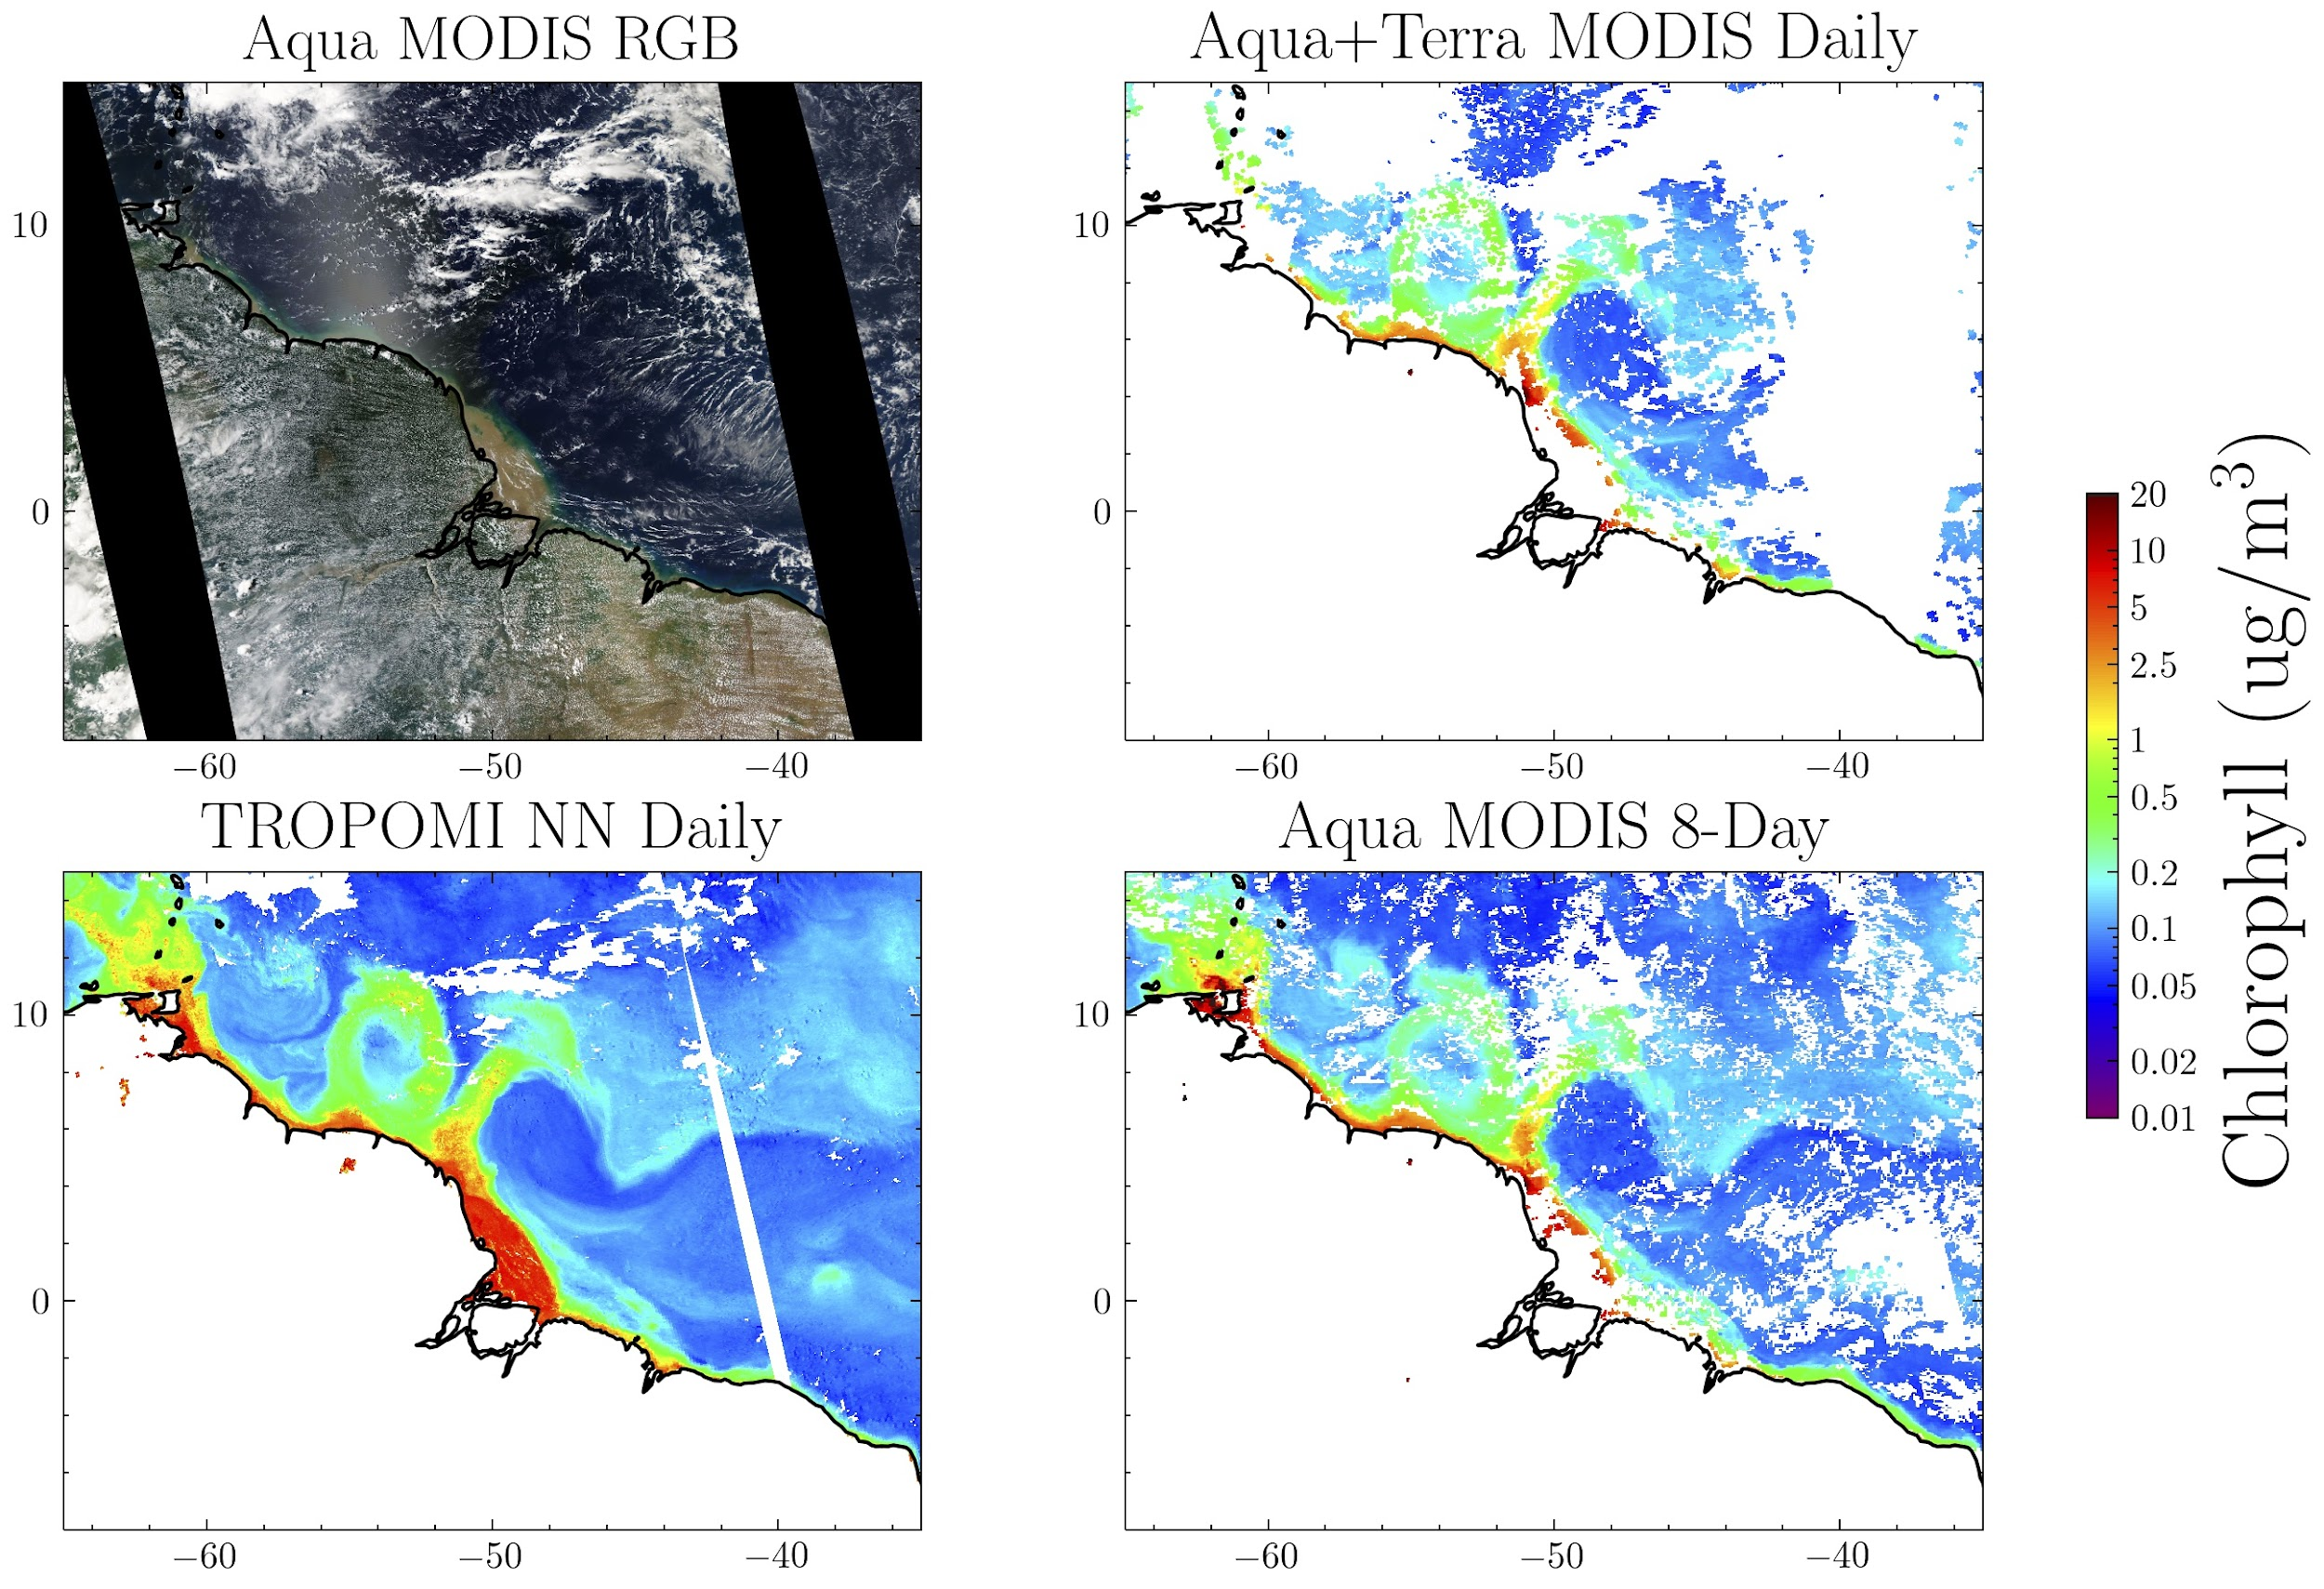
Applying machine learning (ML) approach to estimate chlorophyll
in cloud-, aerosol-, and glint-contaminated conditions
ML approach used to separate the spectral signatures of clouds, aerosol, glint, and trace-gases from those of water leaving radiance (in light to moderate amounts of cloud)
Right: ML approach applied to NE coast of South America
  TROPOMI (UV and blue spectra) provides enhanced spatial coverage compared with MODIS in cloud and sun glint conditions
  Some features not captured in 8-day MODIS composite but are captured with our TROPOMI data.
  TEMPO will give similar data, but hourly!
Chlorophyll on 15 Oct. 2020
See Poster by Fasnacht, et al., Using Machine Learning to Retrieve Ocean Products from TEMPO
Fasnacht, Z., Joiner, J., Haffner, D., Qin, W., Vasilkov, A., Castellanos, P., and Krotkov, N., Using Machine Learning for Timely Estimates of Ocean Color Information From Hyperspectral Satellite Measurements in the Prescence of Clouds Aerosols, and Sun glint, Frontiers in Remote Sensing, 2022

Slide 7
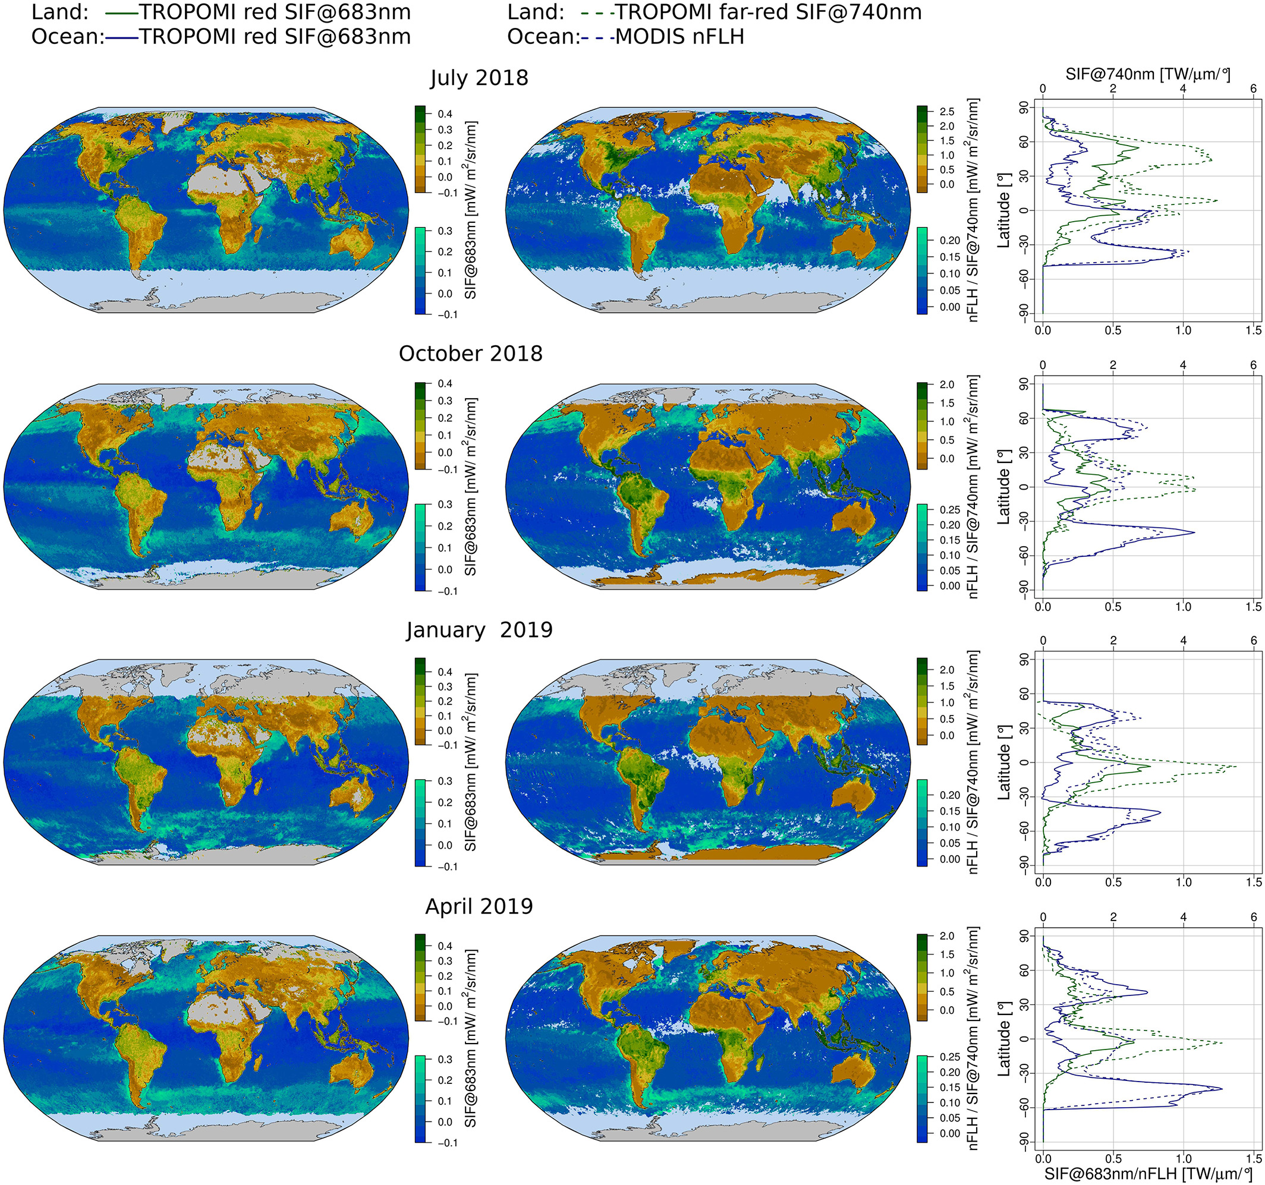
Solar-Induced Fluorescence (SIF) over land and ocean
Two peaks in land SIF: ~680 nm (red); ~740 nm (far_red)
Over land, red SIF resembles the spatial distribution of far-red SIF, but smaller signal (noisy!)
Far-red SIF from TEMPO will be difficult due to limited spectral range
Over the ocean, red SIF agrees with MODIS Fluorescence Line Height observations and provides better coverage in lightly clouded conditions
Hourly observations of land and ocean fluorescence of great interest, related to productivity, diurnal stress impacts, and carbon cycle.
Koehler et al. (2020) Geophysical Research Letters, 47, DOI: (10.1029/2020GL087541)

Slide 8
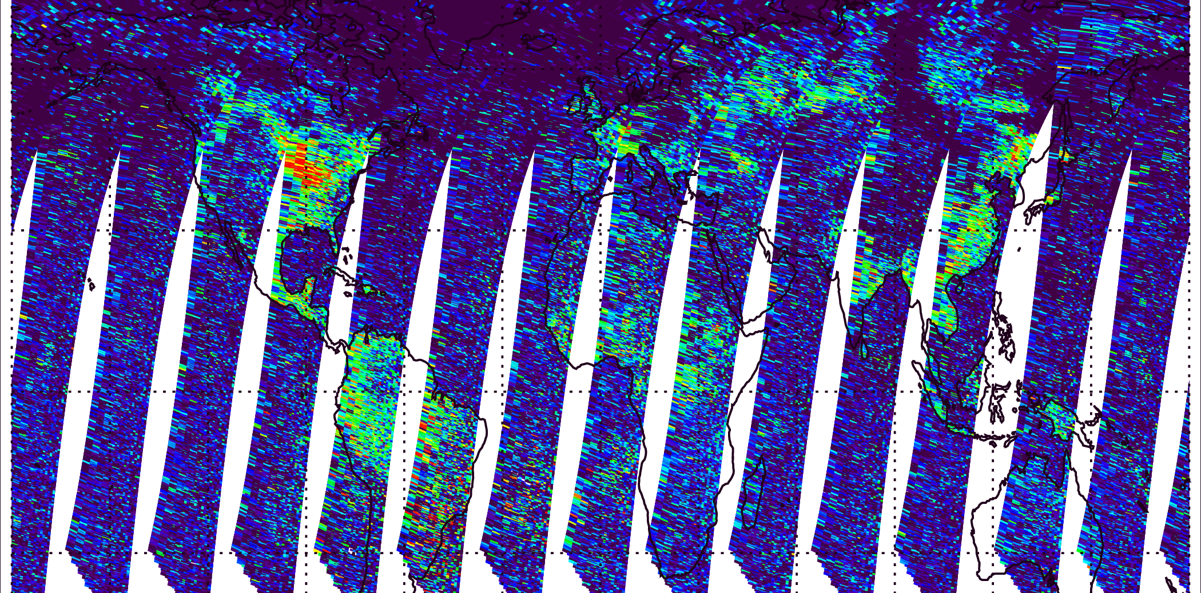
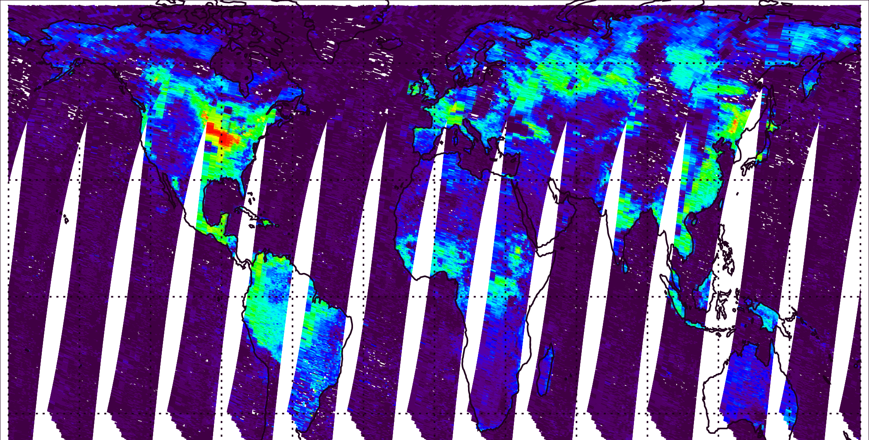
Using machine learning to reduce noise (SIF)
Machine learning (neural network)
Output/Target
Inputs/
Features
Train
Coefficients of leading principal components of spectral reflectances
Noisy daily satellite-based fluorescence from GOME-2
Cleaner satellite product
Apply
Use enough leading principal components to capture basic features of retrievals without reproducing noise
Joiner et al., Atmos. Meas. Tech. (2023), also in prep (2023)

Slide 9
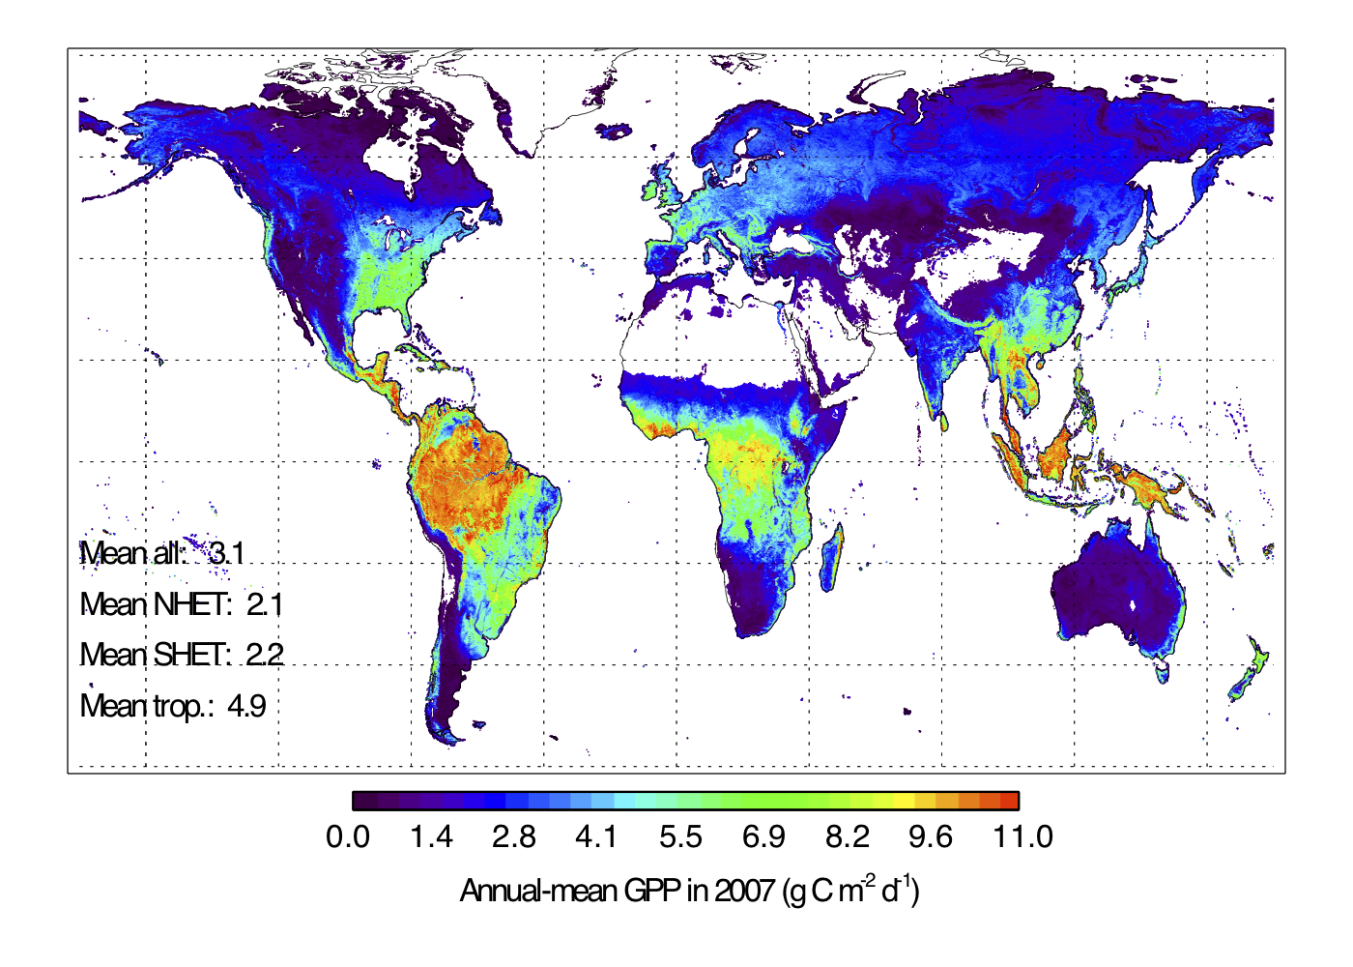

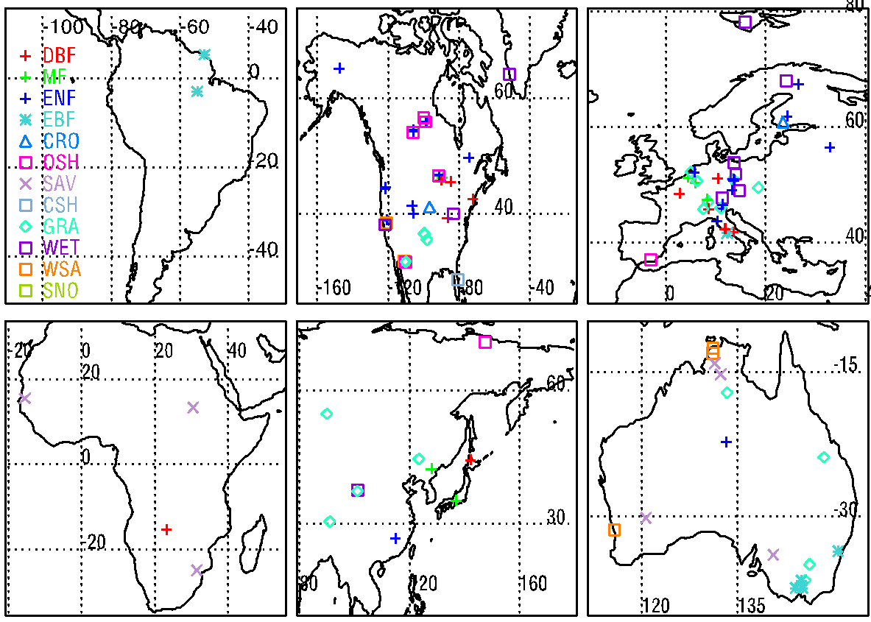
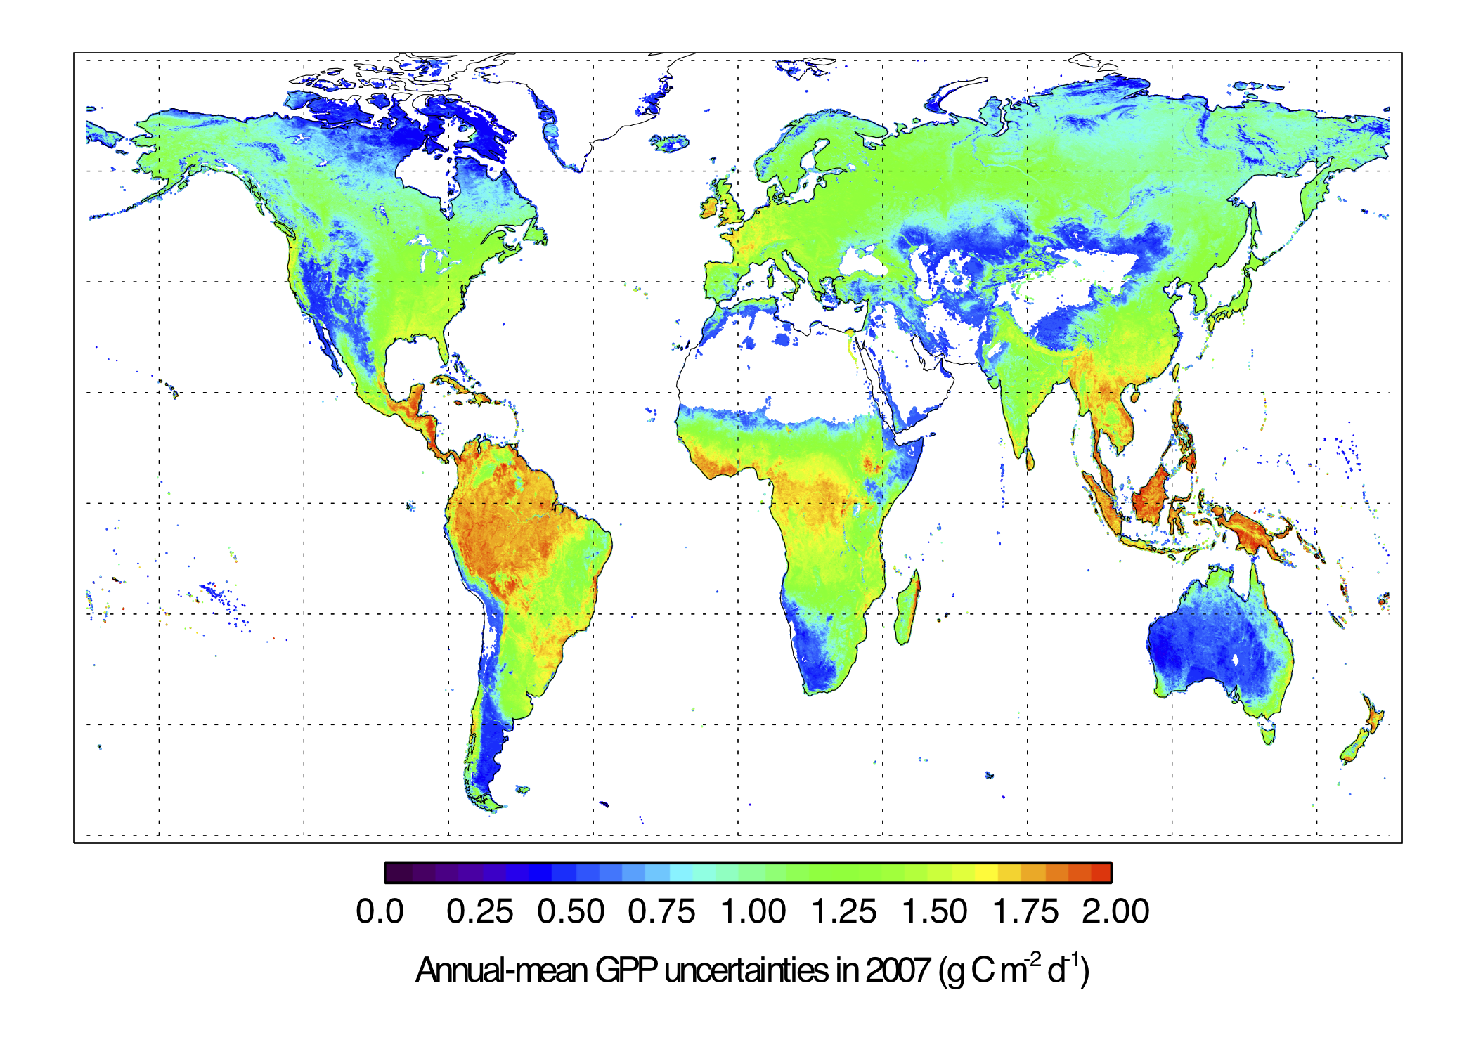
Estimating global uptake of CO₂ from plants using AI and ground-based measurements
Annual mean gross primary production (GPP) in 2007 (g C m⁻² d⁻¹)
Global “upscaling” with 7 MODIS bands
Annual mean uncertainty in GPP in 2007 (g C m⁻² d⁻¹)
Joiner et al., Rem. Sens. (2018); Joiner and Yoshida, Agricult. Forest Meteorol. (2020)

Slide 10
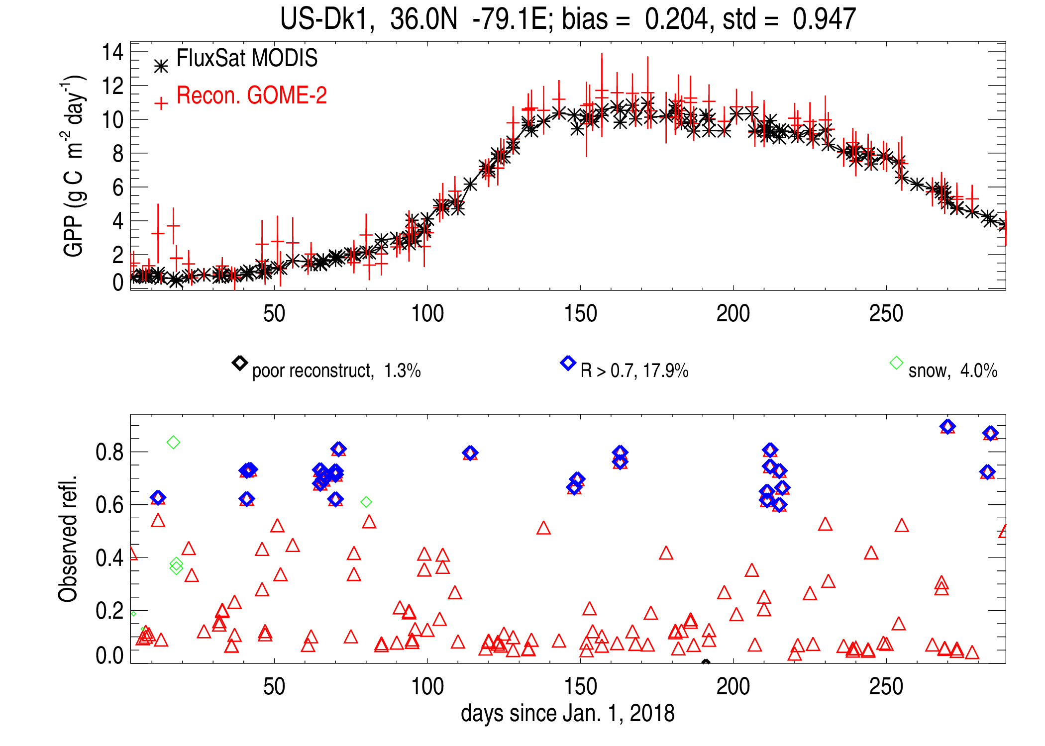
Near-real-time gross primary production (GPP) with TEMPO using machine learning
We can estimate GPP (gross carbon taken up by plants) efficiently even in cloudy conditions (can be a “day 1” product; MODIS/VIIRS products typically not available until 2 weeks after overpass due to large amount of processing needed).
Using GOME-2 (400-800 nm) as a proxy for TEMPO, GPP can be estimated even in cloudy conditions (see figure on right).
  shallow neural network does atmospheric correction, BRDF adjustments, and cross calibration.
  trained on a MODIS-based GPP product that was in turn trained on many years of collocated eddy-covariance data
Too cloudy
}
}
Cloudy

Slide 11
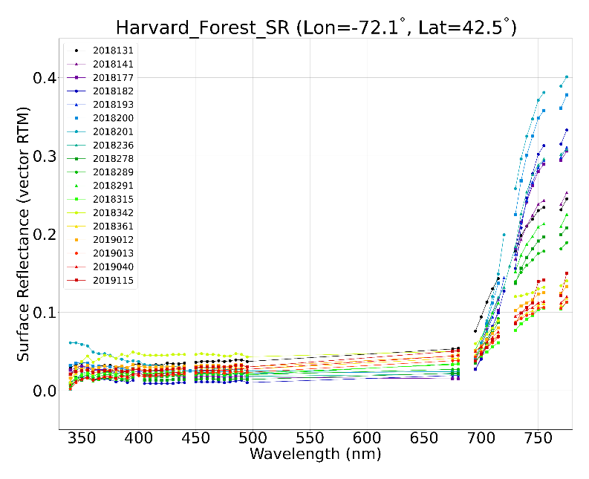
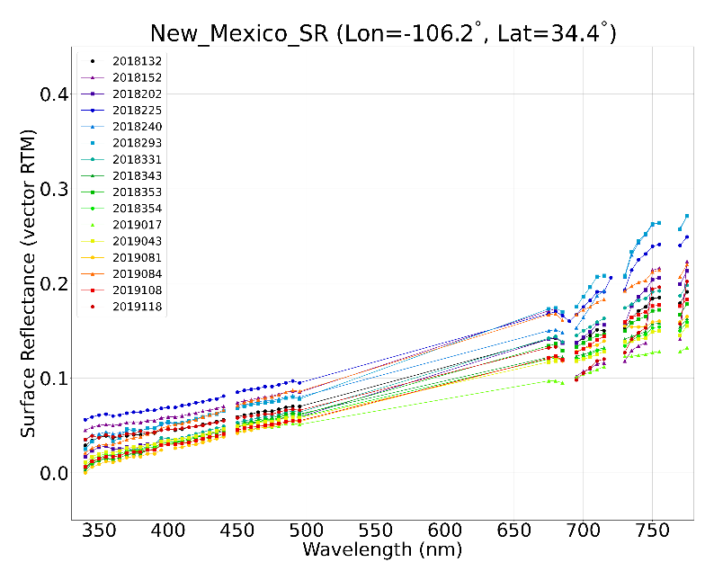
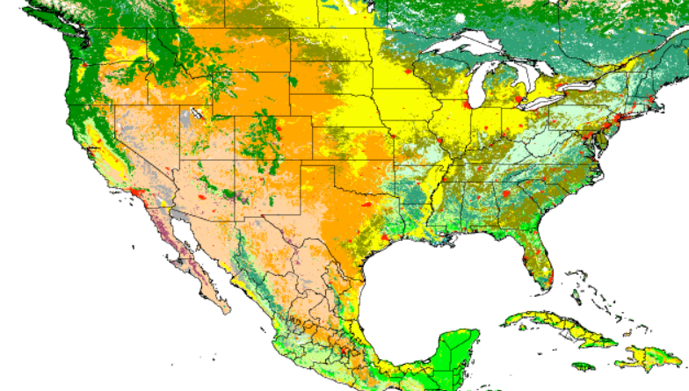
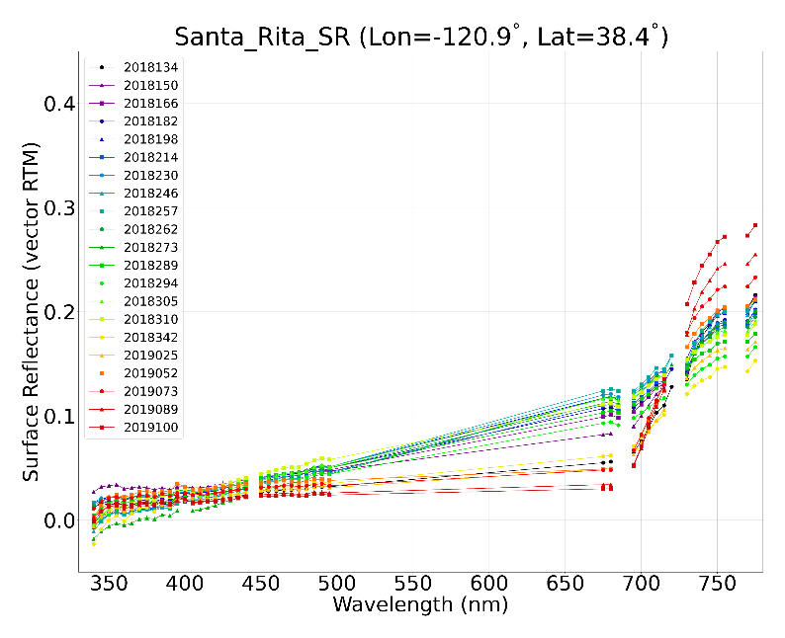
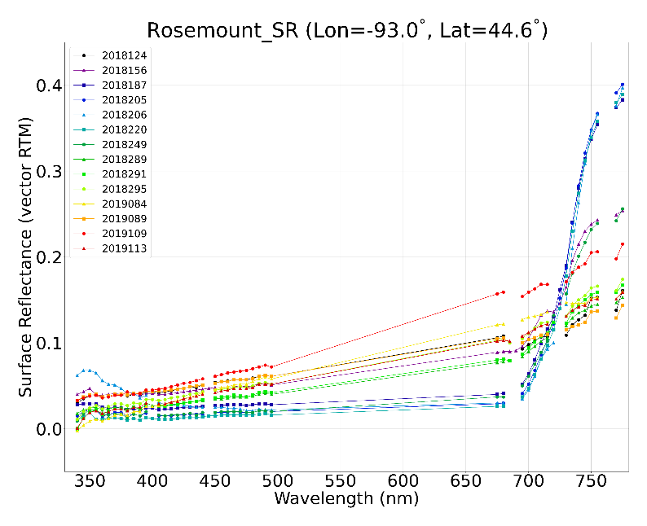
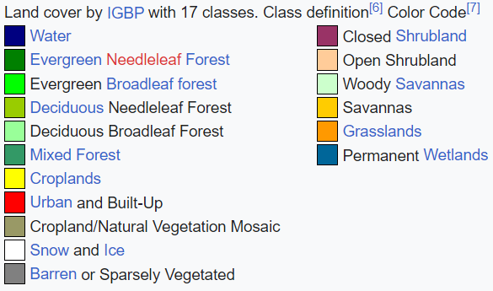
Hyperspectral surface reflectance from TROPOMI (can be applied to TEMPO): seasonal variation
Atmospherically corrected hyperspectral surface reflectance is shown over FluxNet sites.
The hyperspectral surface reflectance over vegetated temperate regions shows smooth spectra from blue to NIR, and shows expected seasonality of green-up, maturity and senescence.
Occasional negative surface reflectance in UV should be related to a known TROPOMI low calibration bias (about -5% at 340-400nm compared to OMPS).
Land cover by IGBP with 17 classes (https://en.wikipedia.org/wiki/Land_cover)
Applications: plant nitrogen, leaf pigments → improved land modeling and carbon cycle

Slide 12
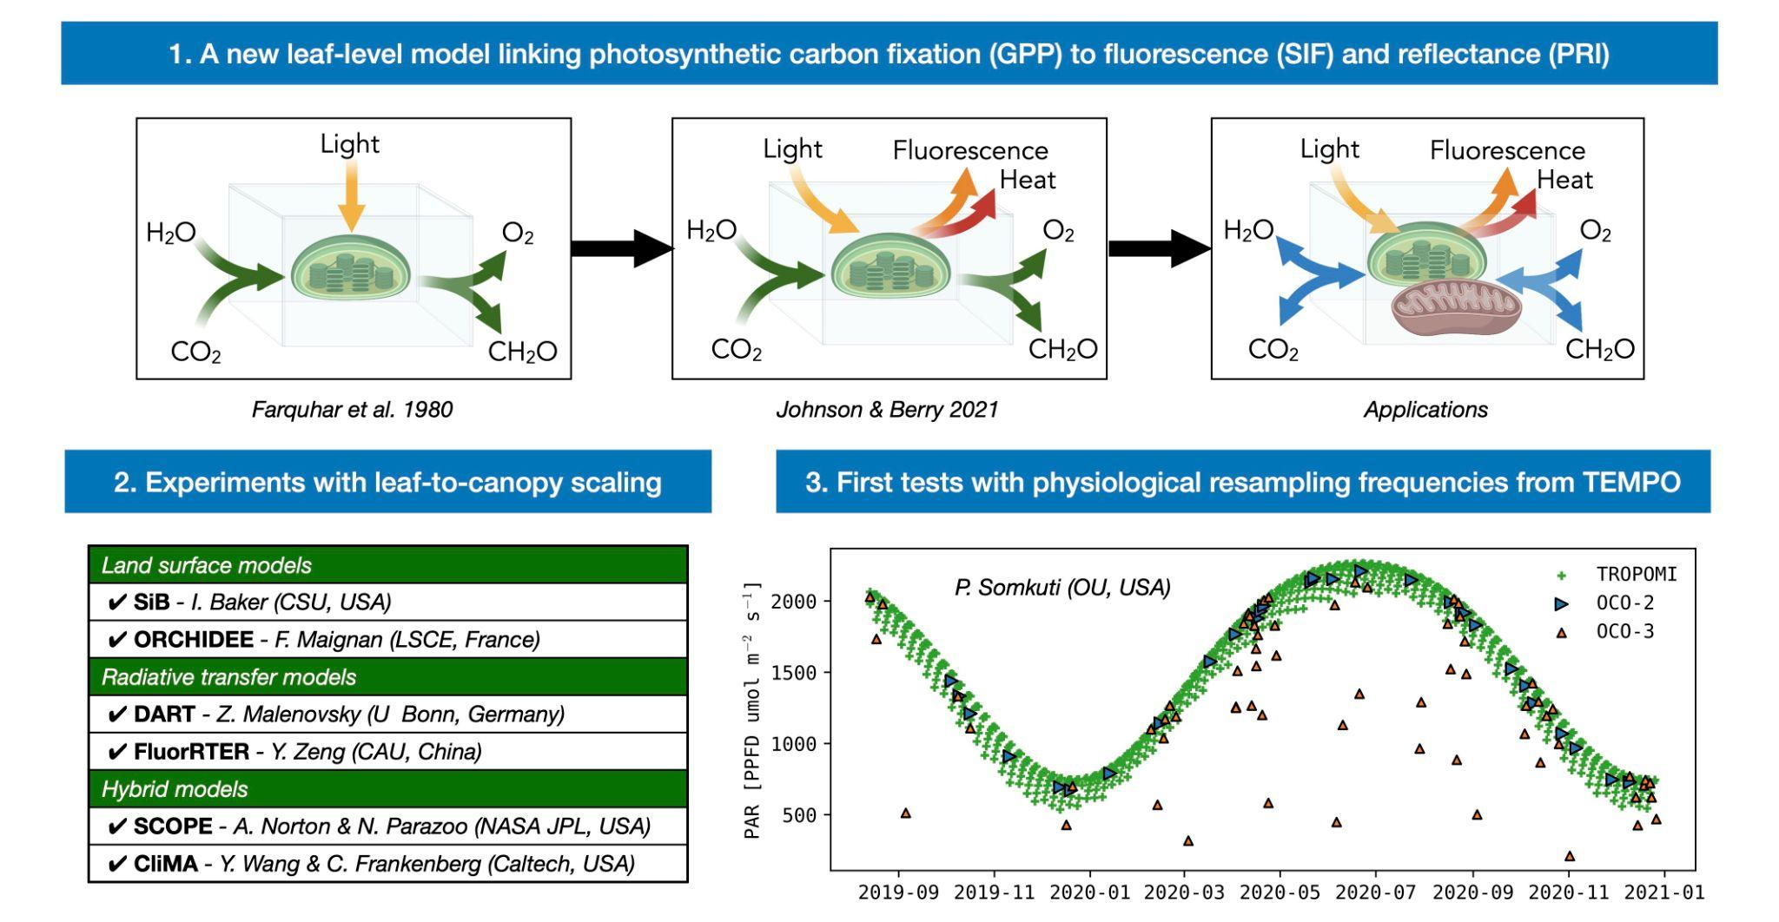
Understanding photosynthesis
on our rapidly changing planet
Reliable monitoring and prediction of photosynthesis has proven to be one of the most intractable problems in Earth system science.
What is the root of this problem, and how are we going to solve it?
Jennifer E. Johnson
Carnegie Institution, Stanford, CA
NASA New Investigator Program Award #20-NIP20-0242

Slide 13
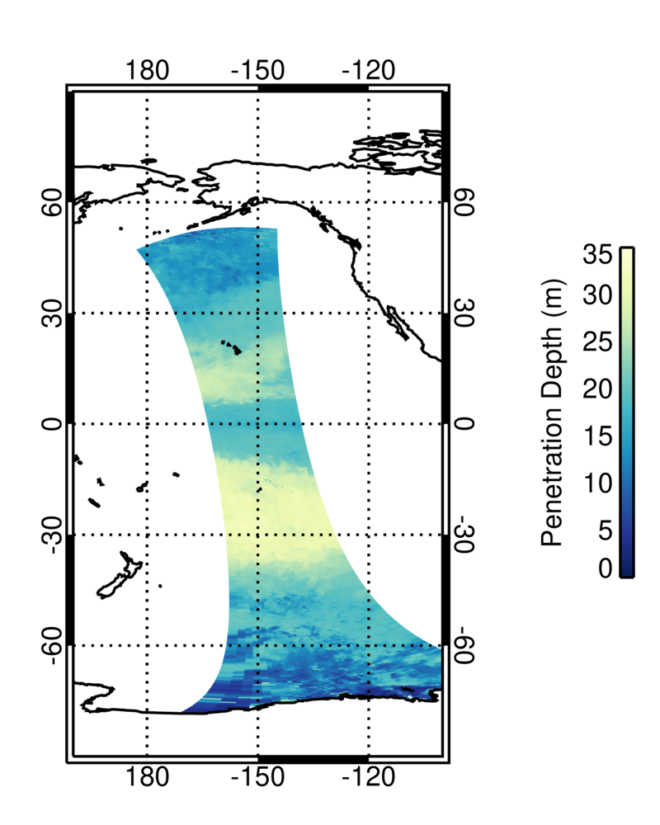
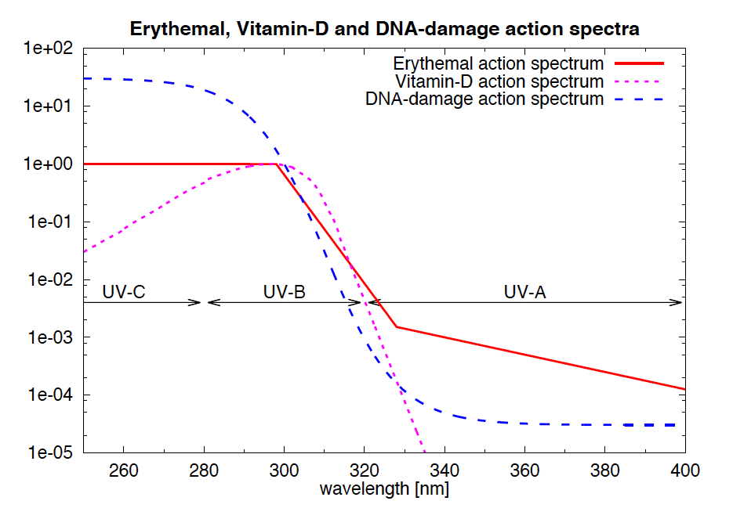
UV penetration depths (z₁₀) using action spectra A(𝛌)
Action spectra A(𝛌)
Users can convolve spectra E_{d}(z) with an action spectrum A(𝛌) to calculate UV dose rate D(z) and penetration depth, e.g., at 10% surface level (Z₁₀), for different biological processes, e.g., DNA damage, Phytoplankton photoinhibition, etc.
10% penetration depth (Z₁₀) for DNA damage.
Vasilkov A. P., et al., Estimates of hyperspectral surface and underwater UV planar and scalar irradiances from OMI measurements and radiative transfer calculations, Remote Sensing, 14, 2278. https://doi.org/10.3390/rs14092278, 2022.

Slide 14
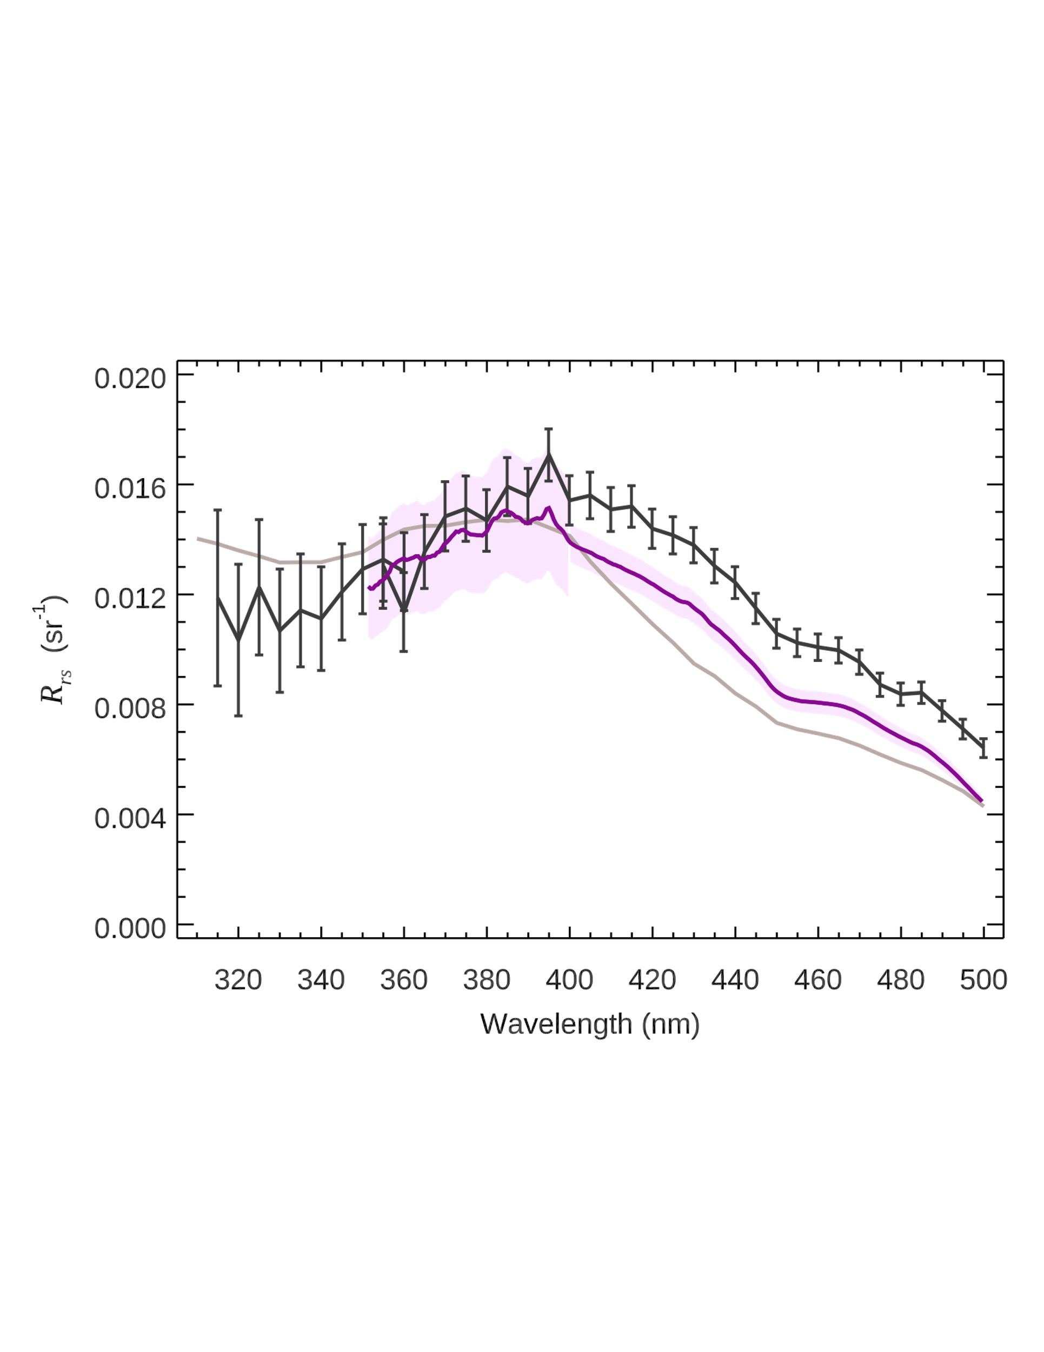
In-Situ Hyperspectral R_{rs} retrievals compared with OMI measurements
OMI R_{rs} on Feb 10, 2005 over MOBY
We retrieve R_{rs} from 315-500 nm using OMI data at 5 nm spectral resolution.
Atmospheric correction is on-line using VLIDORT coupled ocean-atmosphere RT with aerosol & O₃ data from MERRA-2 & OMI.
Ocean water IOP based on Vasilkov et al. (Applied Optics, 2005) semi-empirical parameterization for pure water, Chl and CDOM.
OMI retrieved at 5 nm
MOBY smoothed at 5 nm
Theory (IOP based on Vasilkov et al., 2005)
Notes:
We retrieve R_{rs} from 315-500 nm using OMI data at OCI spectral resolution.
Atmospheric correction is on-line using VLIDORT coupled ocean-atmosphere RT with aerosol & O₃ data from MERRA-2 & OMI.
Ocean water IOP based on Vasilkov et al. (Applied Optics, 2005) semi-empirical parameterization for pure water, Chl and CDOM.

Slide 15
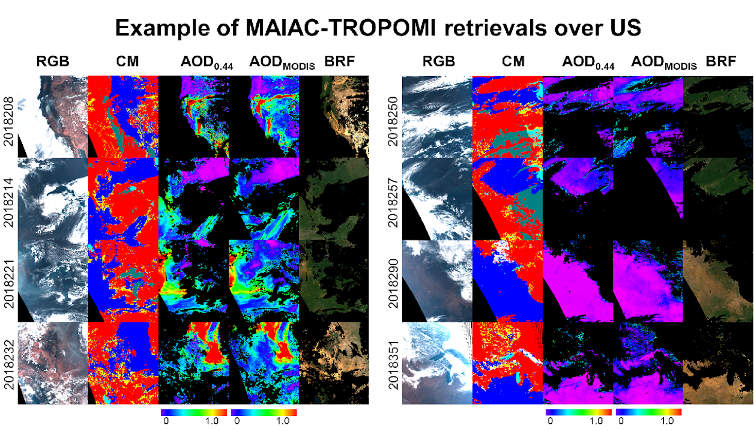
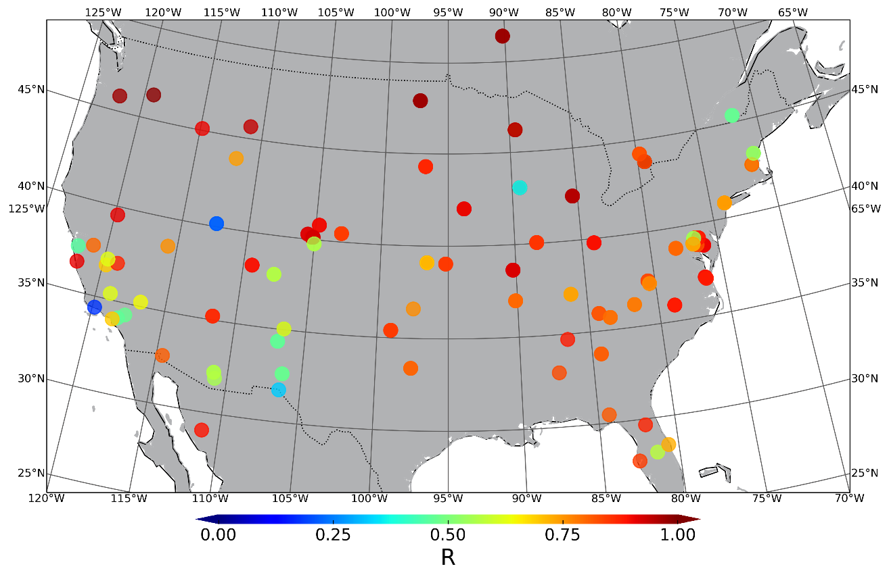
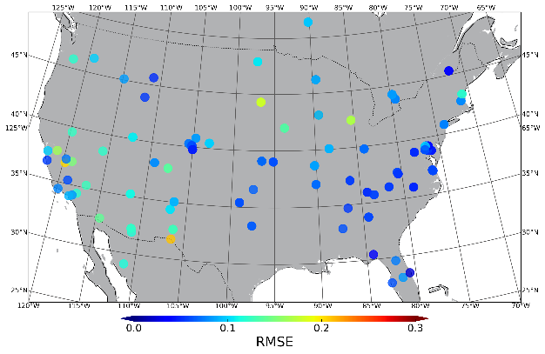
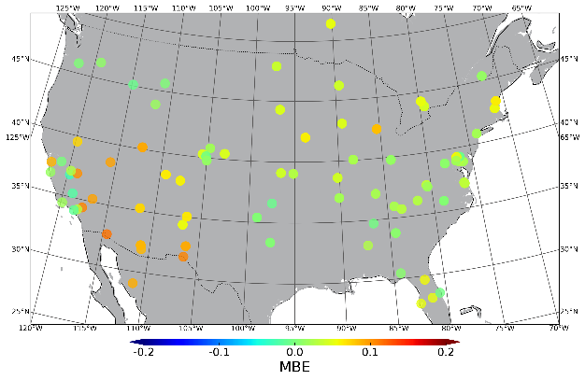
Prototyping PACE AC: Example of MAIAC-TROPOMI retrievals over US
[1-yr AOD dataset validation against AERONET]
Correlation coefficient (R)
RMSE
MBE
(Left) MAIAC aerosol optical depth (AOD) from TROPOMI agrees well with MAIAC MODIS Aqua AOD 443nm
MAIAC MODIS AOD has a high 1km spatial resolution vs 7km for TROPOMI and resolves AOD between clouds.
(Right) Validation periods: 2018.04.30 – 2019.04.30.
Notes:
We retrieve R_{rs} from 315-500 nm using OMI data at OCI spectral resolution.
Atmospheric correction is on-line using VLIDORT coupled ocean-atmosphere RT with aerosol & O₃ data from MERRA-2 & OMI.
Ocean water IOP based on Vasilkov et al. (Applied Optics, 2005) semi-empirical parameterization for pure water, Chl and CDOM.

Slide 16
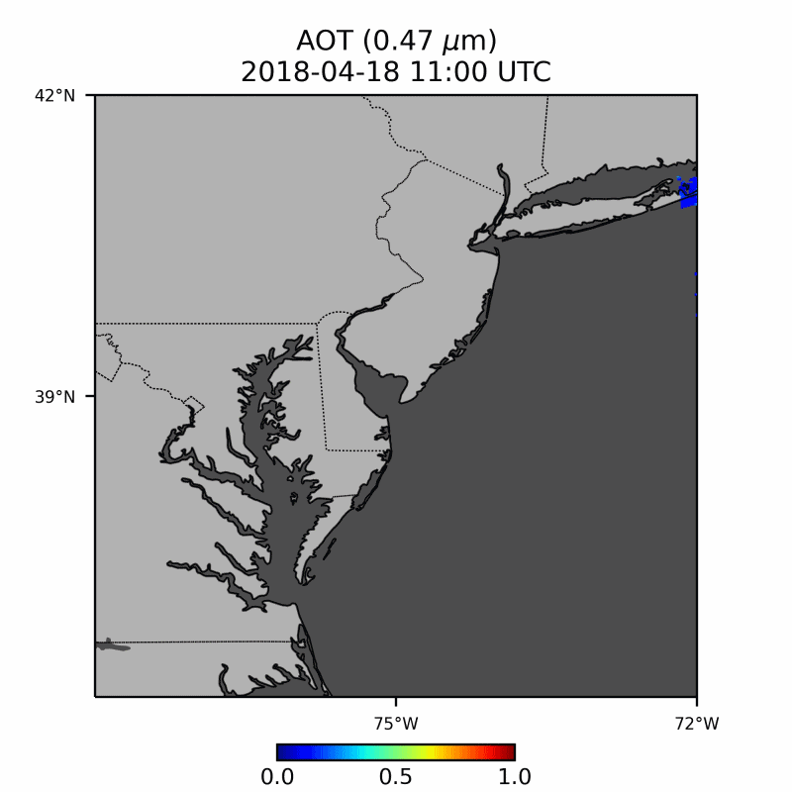
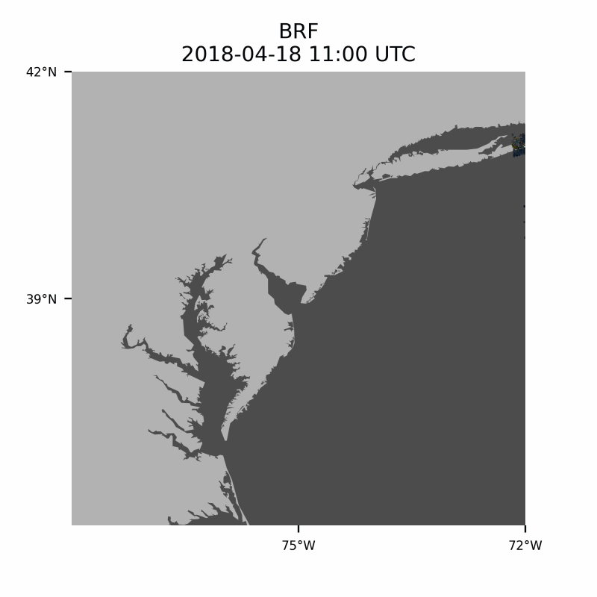
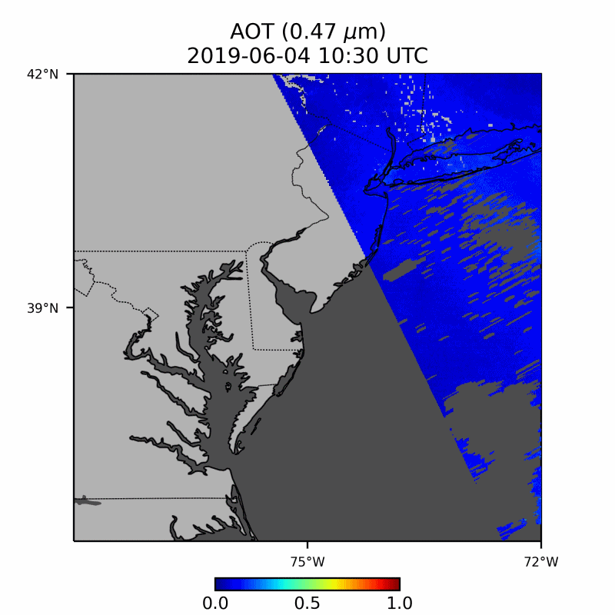
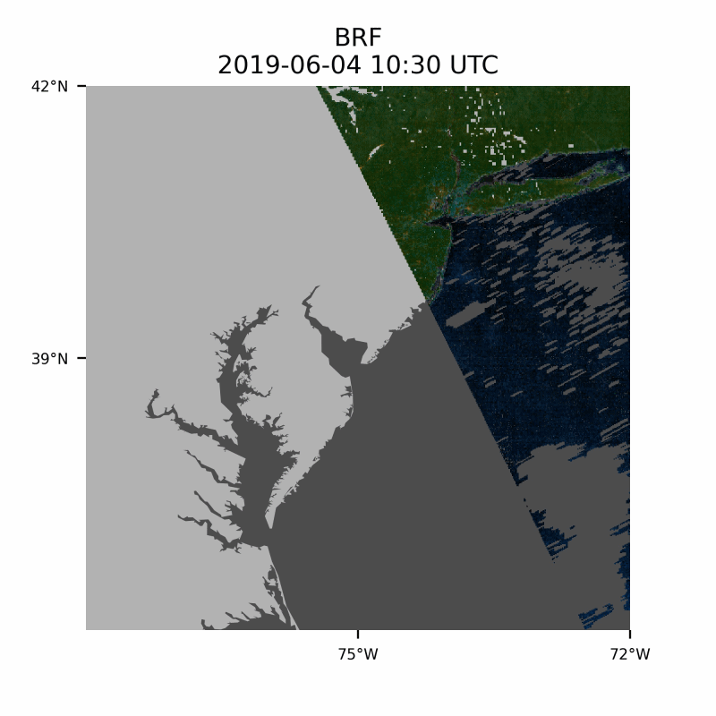
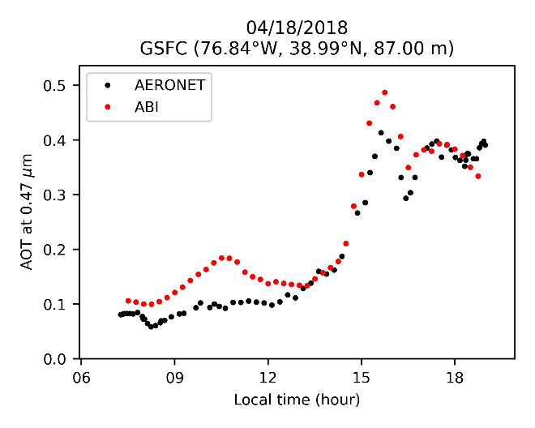
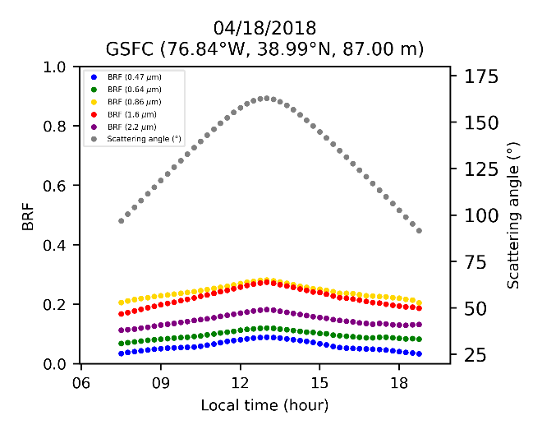
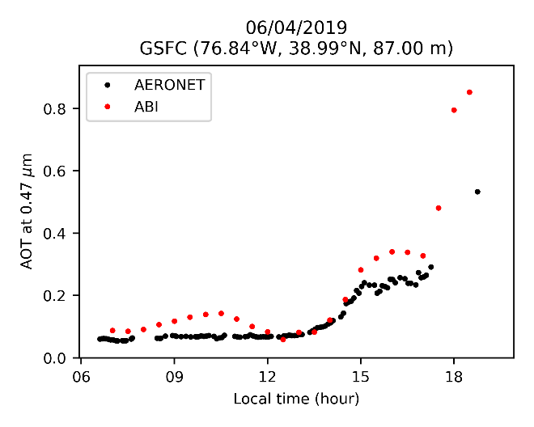
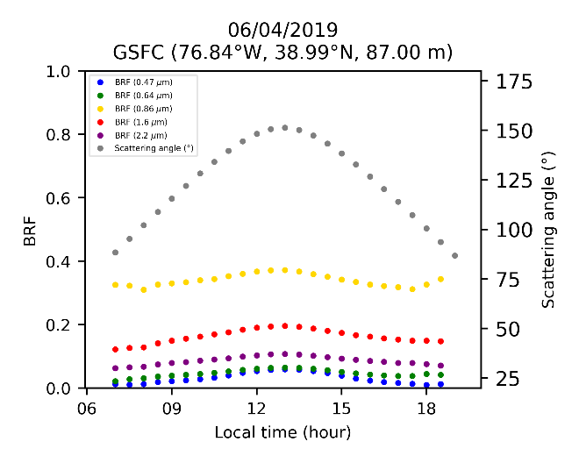
Synergy TEMPO – ABI - PACE
ABI – 1km cloud/shadow/snow mask; 1-2km AOD; BRDF shape function
TEMPO UV – detection of absorbing aerosols; advanced aerosol retrieval (AOD-spectral abs.-Height → Bc-BrC for smoke)
Tile h17v03 (DC/MD/VA/NC/DE/PA/NJ/NY areas)
AERONET AOD at 0.47 μm MAIAC AOT at 0.47 μm
Scattering angle (°) BRF at (0.47, 0.64, 0.86, 1.6, 2.2 μm)
Notes:
We retrieve R_{rs} from 315-500 nm using OMI data at OCI spectral resolution.
Atmospheric correction is on-line using VLIDORT coupled ocean-atmosphere RT with aerosol & O₃ data from MERRA-2 & OMI.
Ocean water IOP based on Vasilkov et al. (Applied Optics, 2005) semi-empirical parameterization for pure water, Chl and CDOM.

Slide 17





A glimpse into GLIMR
EVI-5 – Hyperspectral Ocean Color
  CDR in June; Launch in ~2027
Science Objectives
Phytoplankton Growth and Physiology
  Study rapid changes in growth rate and community composition at their intrinsic timescales
Short Term Coastal Processes
  Quantify high frequency fluxes of materials between and within coastal ecosystems and how these regulate productivity and health of coastal ecosystems.
Hyperspectral
340-1040 nm
<2 to <10 nm spectral resolution across UV-Vis
<1 to <5 nm sampling UV-Vis
High Temporal
~hourly scans of Gulf of Mexico (6x/day)
2x to 3x/day other regions
3x/day HAB target sites
High Spatial
300 m nadir Ground Sample Distance (GSD)
~328 m Gulf of Mexico
<500 m over coastal continental US
High SNR
Requirements at Ocean Ltyp
> 420 for 360-380 nm *
>650 for 380-415
> 1000 for 415-580 nm
> 750 for 580-650 nm
> 580 for 650-880 nm ^
GLIMR will enable us to move beyond studying the effects of the process, and into the study of the processes themselves.
Adaptive Scheduling & Targeting
Flexibility to target episodic events & hazards

Slide 18
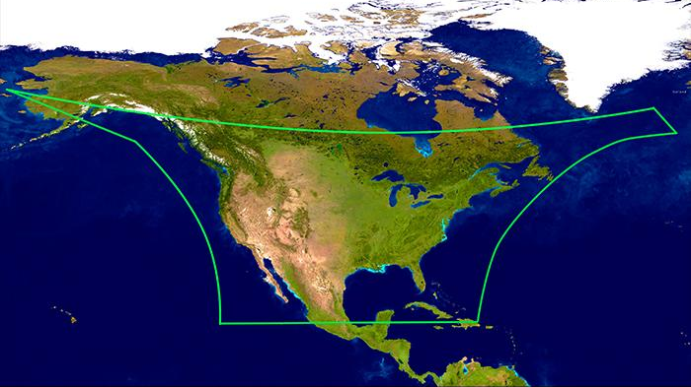
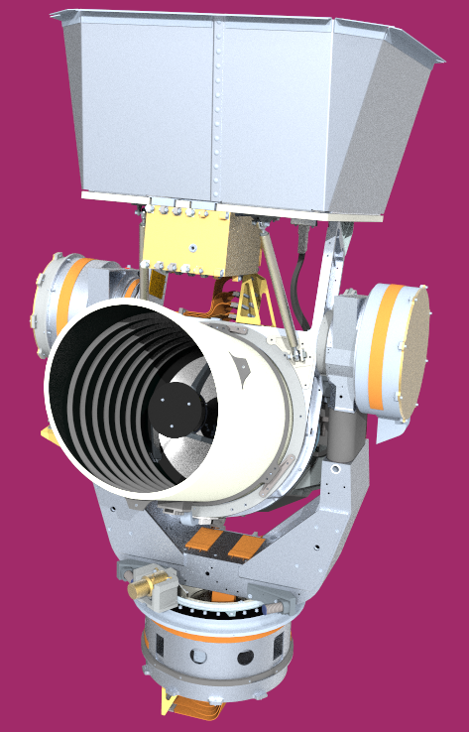
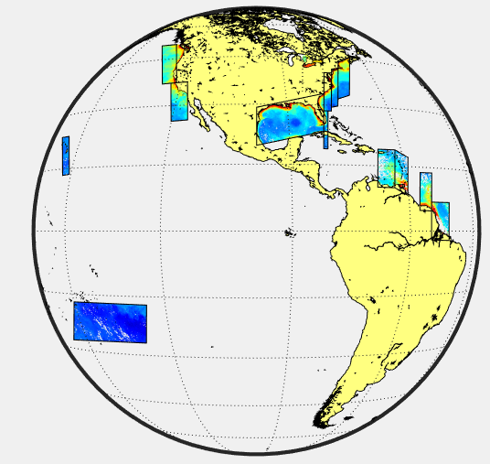
Synergies
TEMPO extends GLIMR’s ocean monitoring
Ocean color observations further offshore and at high frequency
Surface currents
TEMPO to study ocean biogeochemical dynamics
Evaluate GLIMR algorithms including rates and fluxes
Diurnal Primary Production & impacts from pollution
Diurnal Photochemistry (CDOM and DOC)
Surface and vertical export production
Combining with GLIMR data benefits TEMPO science
Finer spatial scales of distributions and transport of aerosols and possibly NO₂
Impacts of pollutants on ocean ecosystems
GLIMR instrument image courtesy of Raytheon

Slide 19
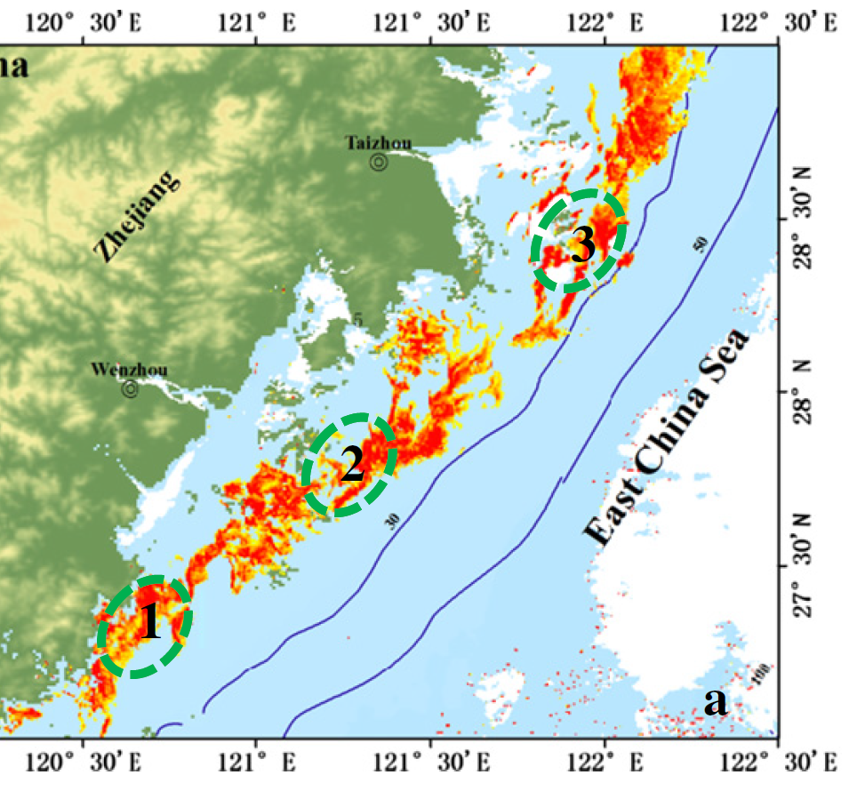
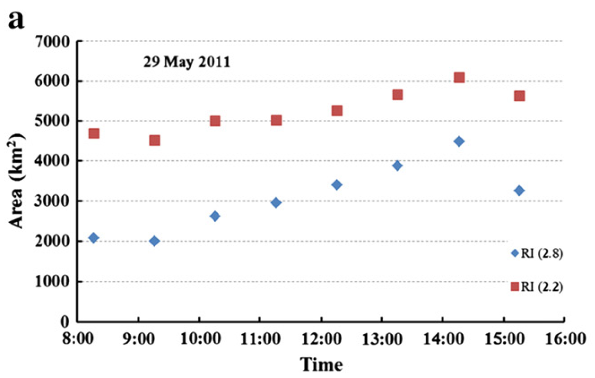
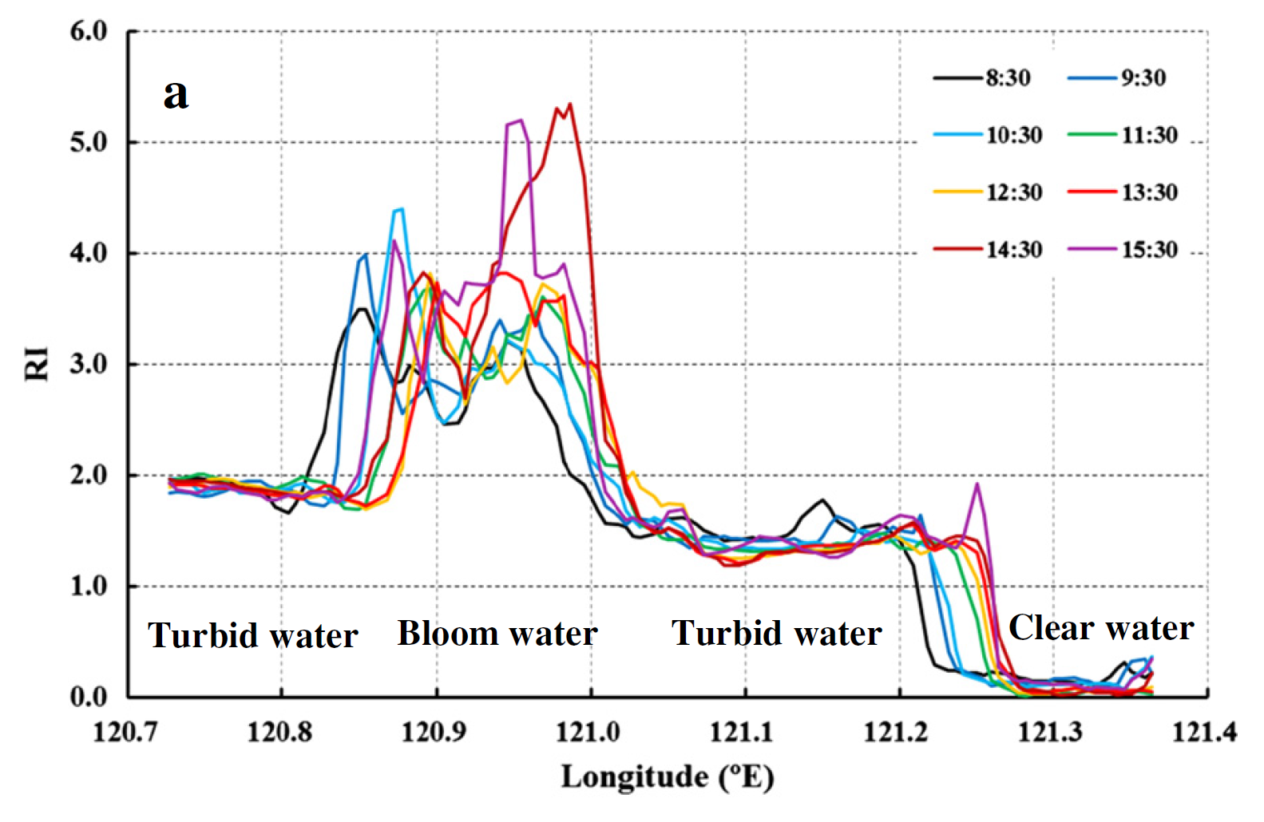
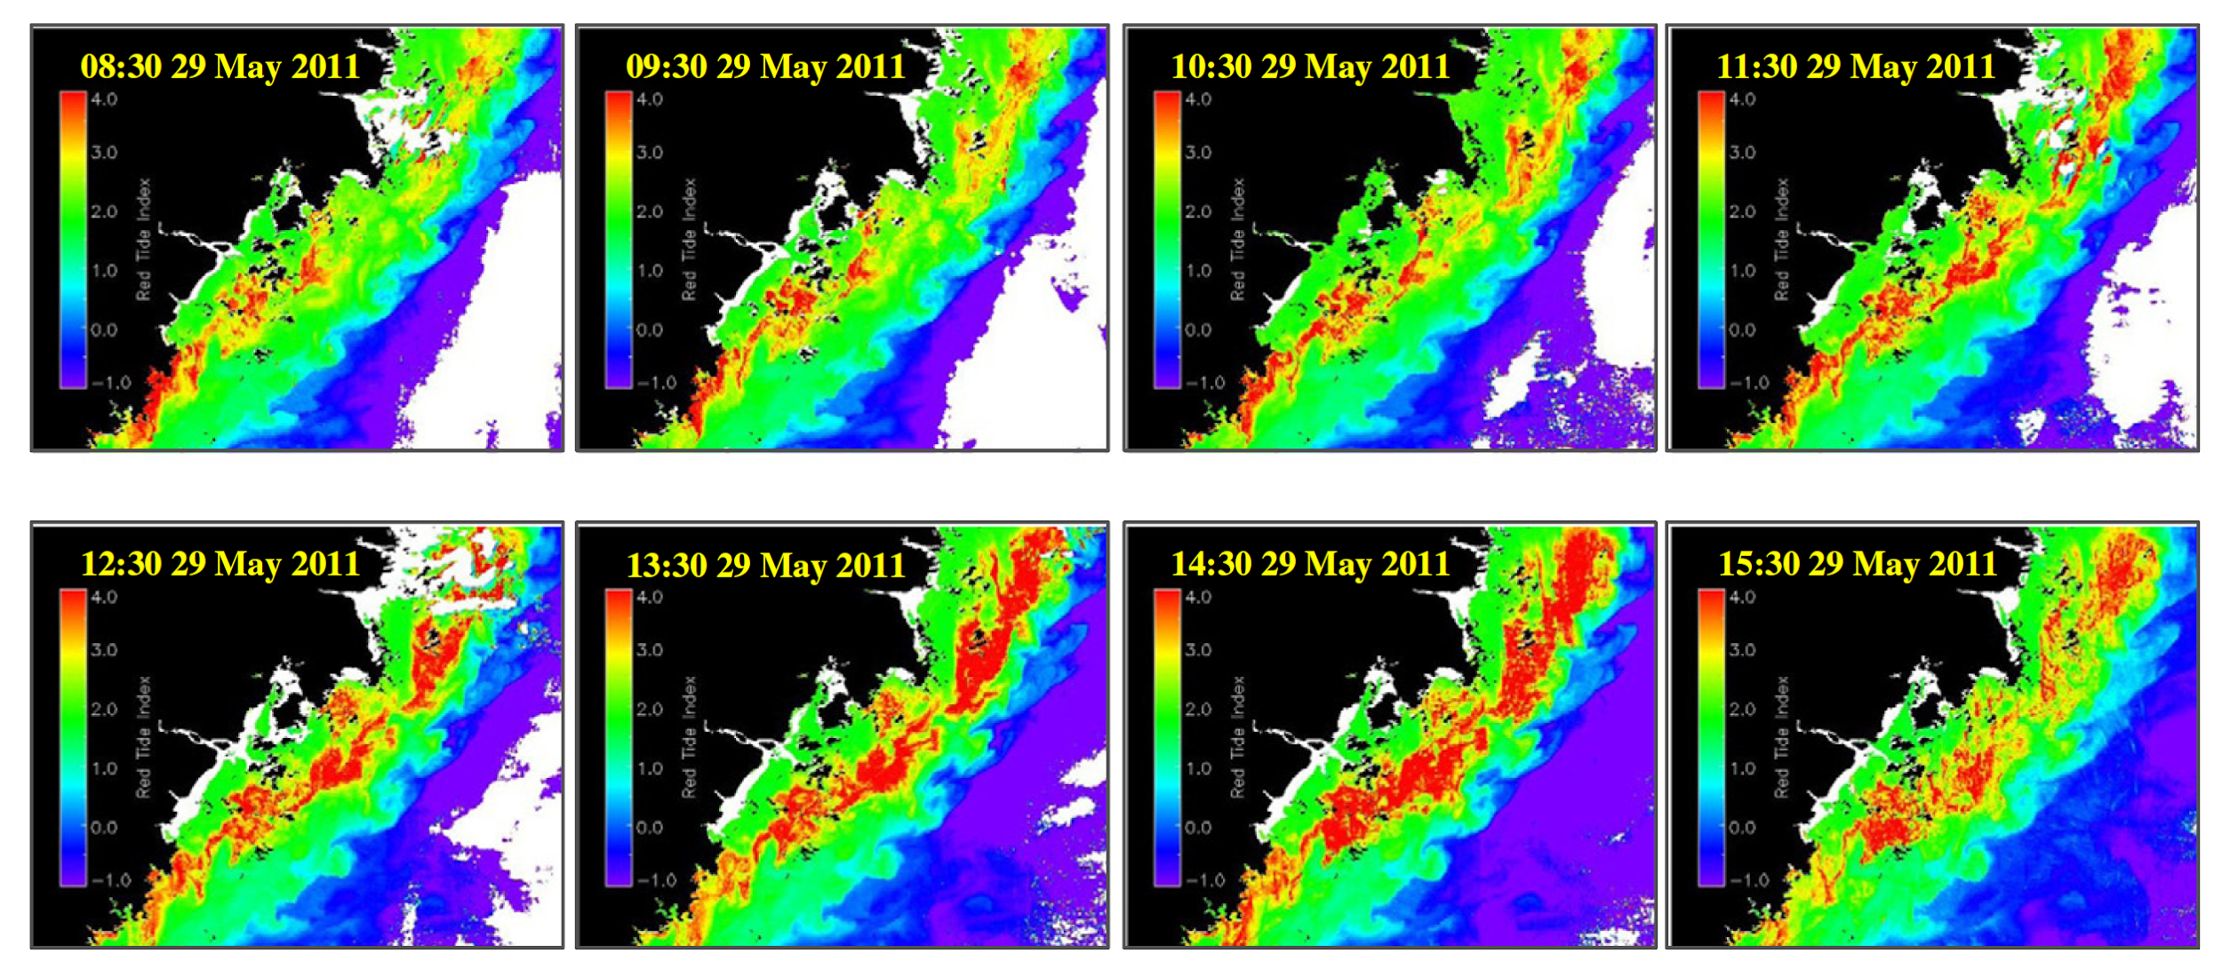
How can TEMPO monitor and address red tide issues?
Change in RI with time and space (5/29/2011)
Change in bloom size with time (5/29/ 2011)
Red-Tide Prorocentrum bloom off Zhejiang coast, size: 2,000-4,500 km²
TEMPO temporal and spatial resolution will be useful to examine large phytoplankton bloom evolution in time and space
TEMPO’s hyperspectral capabilities would allow to develop more advanced algorithms to study changes in phytoplankton community composition
Change in size and intensity of Prorocentrum donghaiense bloom off Zhejiang coast. Red-Tide Index (RI, from GOCI Rrs at 443, 490, 555 nm) is shown here on 29 May 2011.
Lou, X. and Hu, C., 2014. Remote Sensing of Environment, 140, pp.562-572

Slide 20
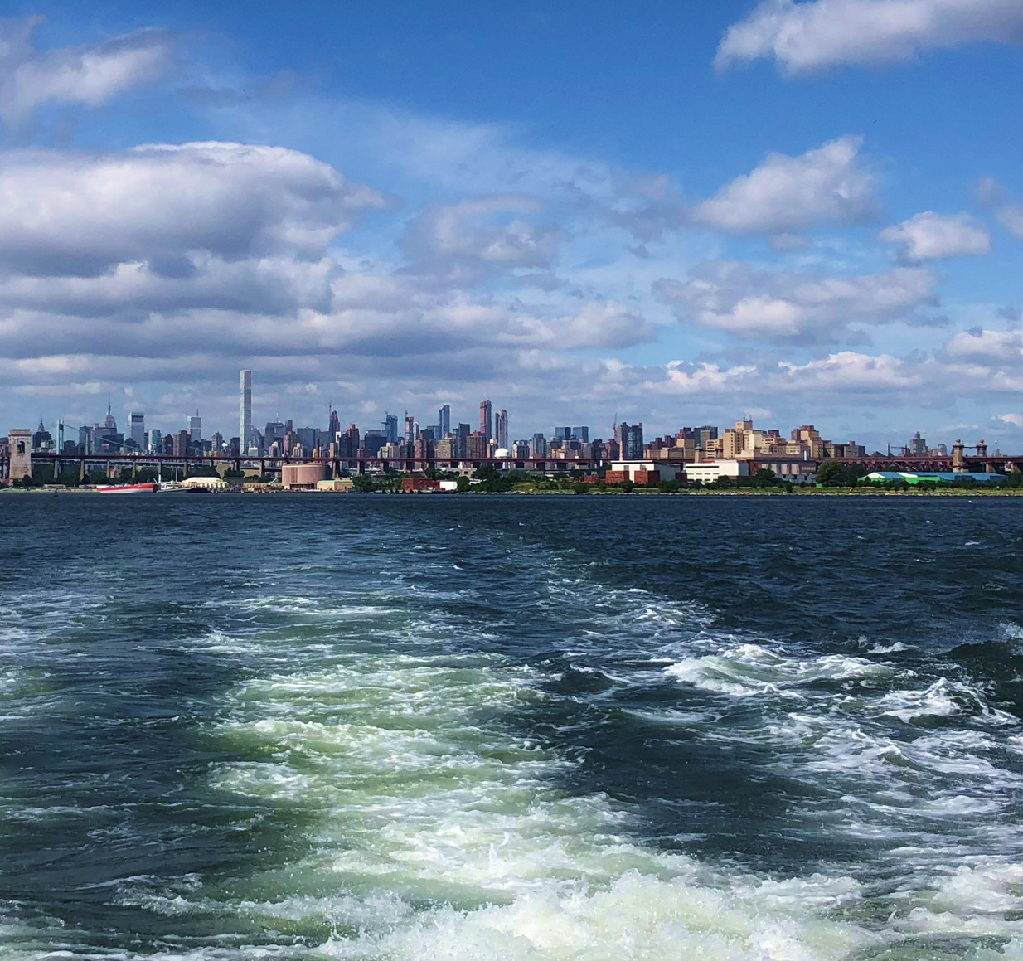
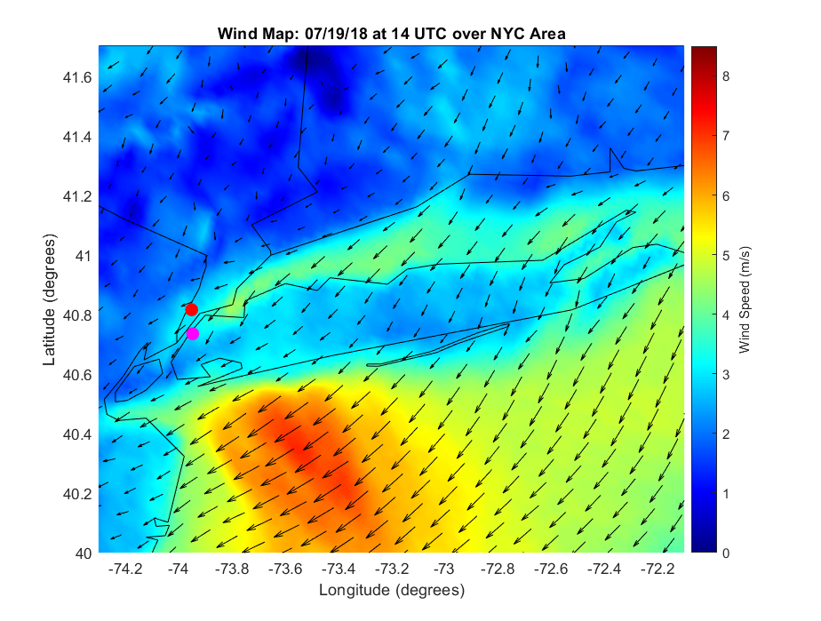
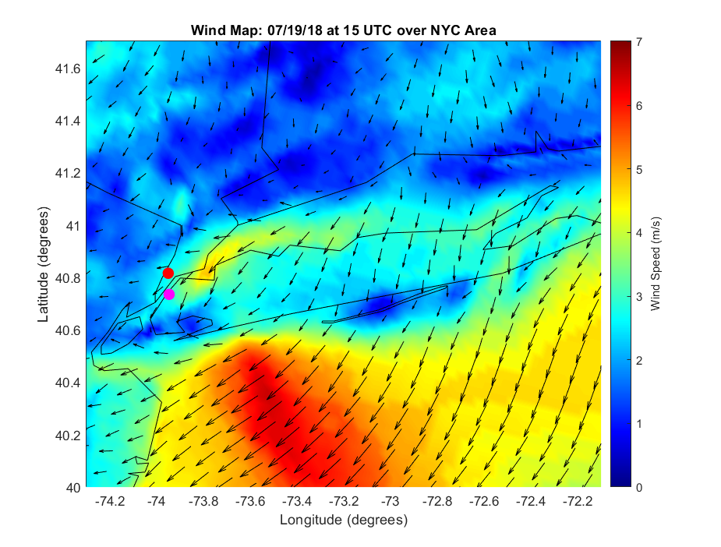
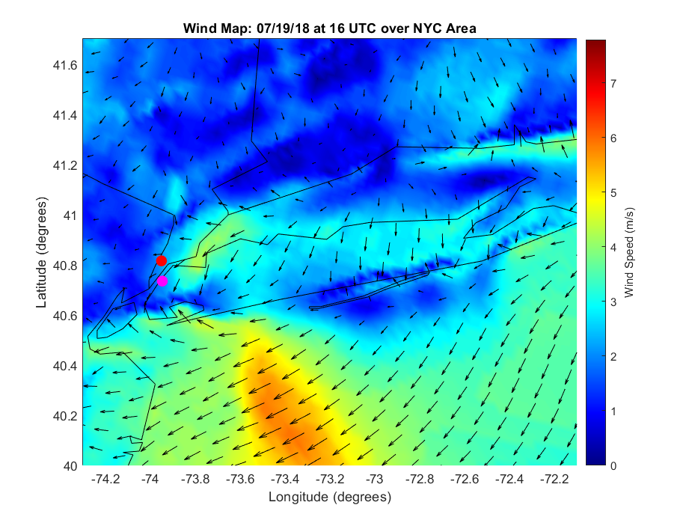
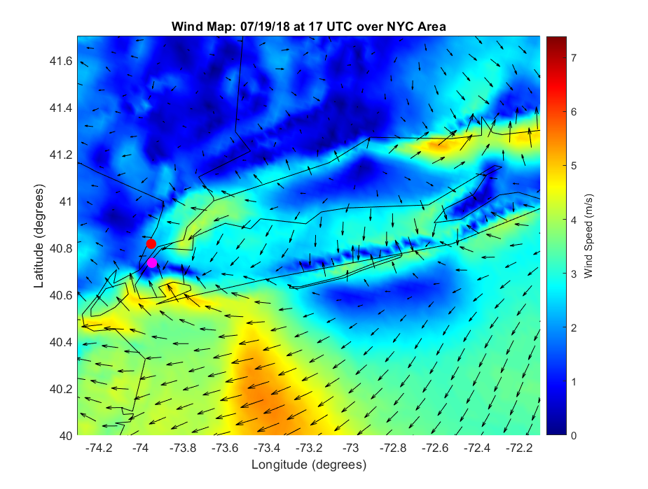
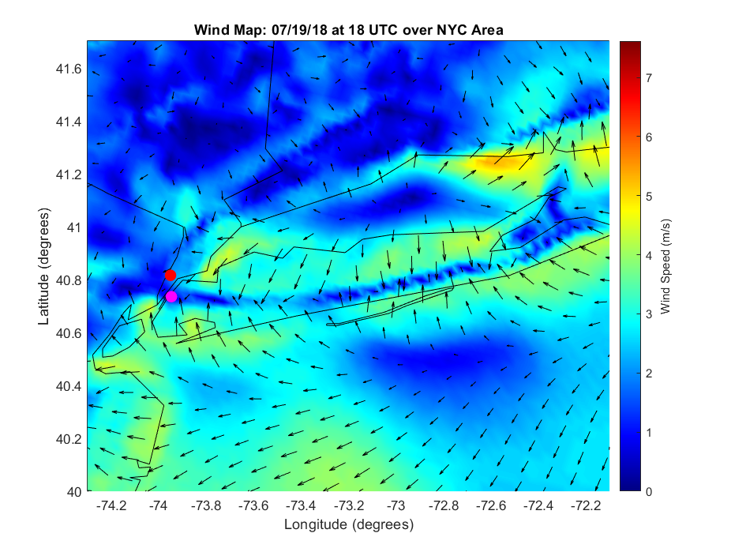
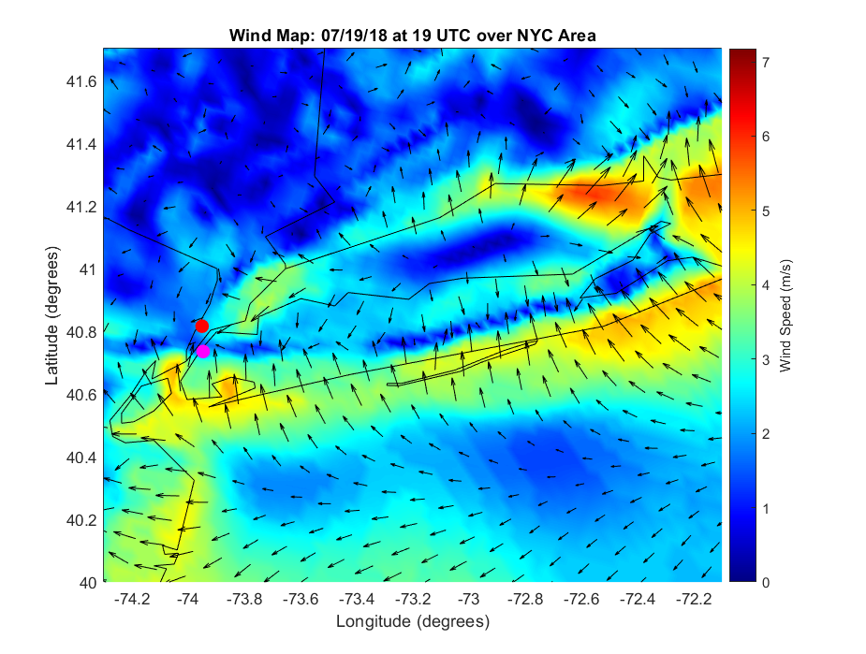
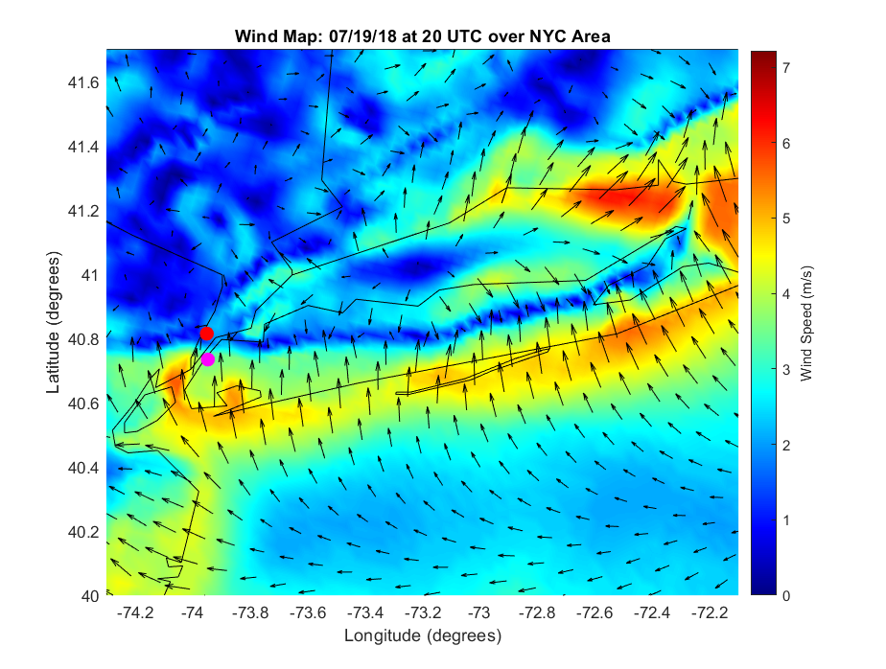
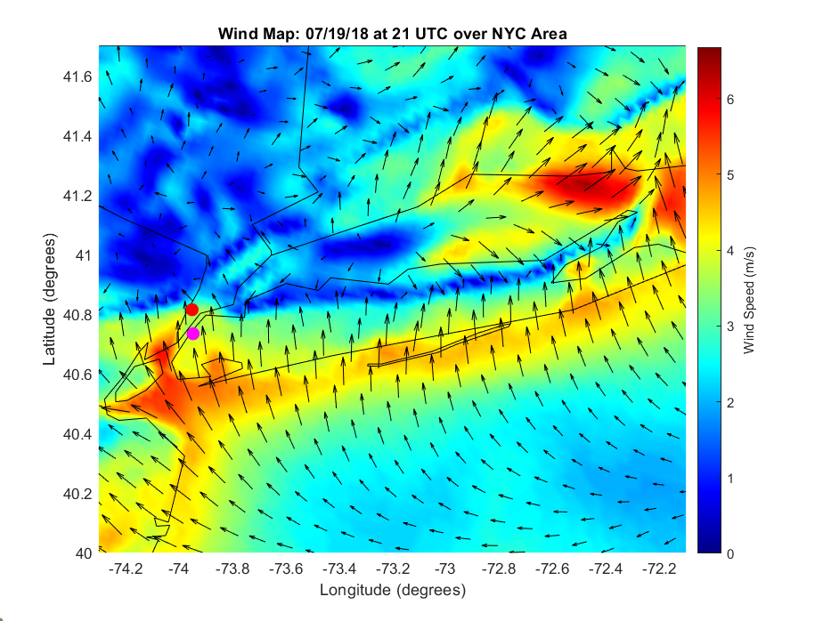






How can TEMPO help track air quality changes in estuaries
High-Resolution Rapid Refresh model
TCNO₂, 7/19/2018
High and highly dynamic NO₂ in coastal and estuarine waters - linked to urban emissions and meteorological processes (e.g., sea breezes) – impact ocean color retrievals in nearshore waters.
TEMPO will allow to capture these rapid transitions in NO₂ behavior, for improved atmospheric correction of ocean color.
Ocean color (e.g., surface reflectance) measurements will be useful to improve assumptions in TEMPO trace gas/aerosol retrievals over coastal waters.
Aircraft GCAS TCNO₂, 7/19/2018
TROPOMI TCNO₂, 7/19/2018
11:54-13:36 UTC
PSI#135, CCNY
PSI#140, Queens
PSI#24, LIS
13:36-15:30 UTC
17:54-18:36 UTC
18:36-20:24 UTC
TCNO2 DU
Tzortziou et al, 2023 In Revision, Science of the Total Environment

Slide 21



A Few Land Surface Topics
Boundary Conditions
Independent
Synergistic
Zoogman et al. [2016]
Surface Reflectance/BRDF as a key input for trace gas retrievals
Visible indicators as providing additional information on vegetation health/crop yield
Visible indicators of vegetation health – ozone damaged crops exhibit significantly modified visible reflectance spectra

