Slide 1
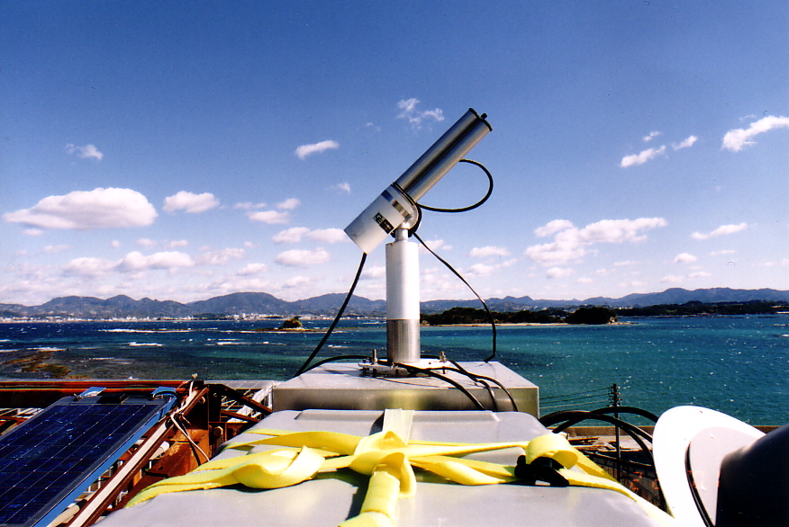
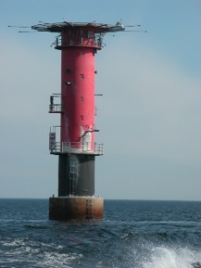
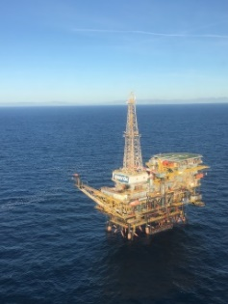
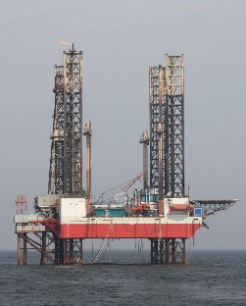
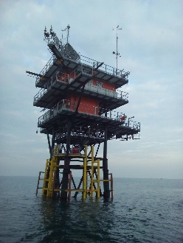
AERONET Aerosol Robotic Network:
30 Years of Observations and Research
https://aeronet.gsfc.nasa.gov
Pawan Gupta and Elena Lind (GSFC)
(pawan.gupta@nasa.gov)
AERONET: Optical, microphysical, and radiative properties for aerosol
AERONET-OC: Normalized Water Leaving Radiances
MAN: AOD over oceans/land
SolRad-Net-solar flux network
Research: Network algorithms, validation, aerosol properties
Mission: Support Missions: MODIS, VIIRS, MISR, GOES, TEMPO, PACE, MAIA AOS, EOS

Slide 2
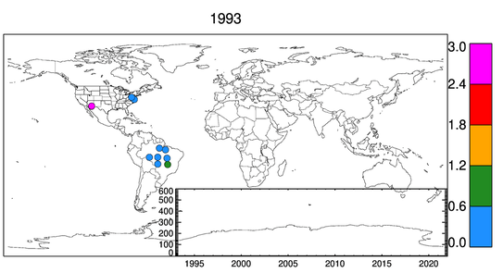
30 Years of Aerosol Measurements
Since 1993
Network of Networks
~538 Active Stations
~ 1500 All time stations with ~1.7 million days of data
102 countries and territories
Pawan Gupta (GSFC), Joint Science Meeting for TEMPO, GeoXO ACX, & TOLNet, May 1-5, 2023, Huntsville, AL

Slide 3
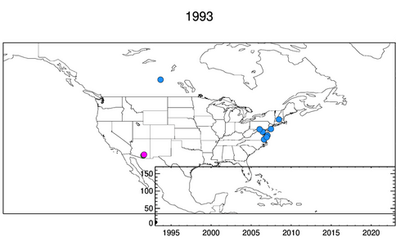
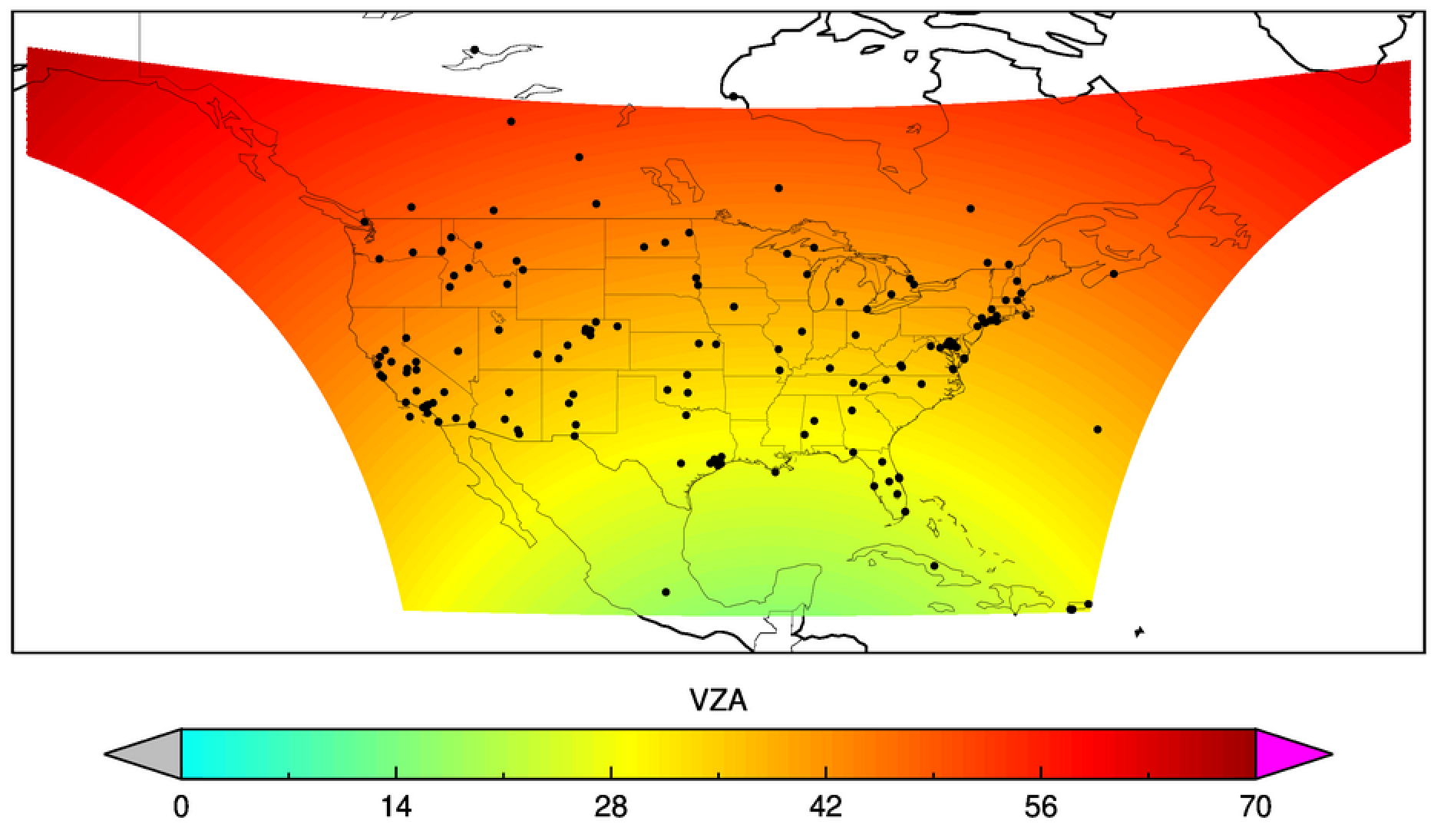
AERONET for TEMPO
~160 active sites in 2022
~140 in US covering 37 states
~10 MSI sites coming up
Multiple sites to support upcoming field campaigns (STAQS, MAGPI, SARP-East, AEROMMA, GOTHAAM)
Pawan Gupta (GSFC), Joint Science Meeting for TEMPO, GeoXO ACX, & TOLNet, May 1-5, 2023, Huntsville, AL
Notes:
Active sites in 2022 – site which has data in 2022. – 160 sites

