Slide 1
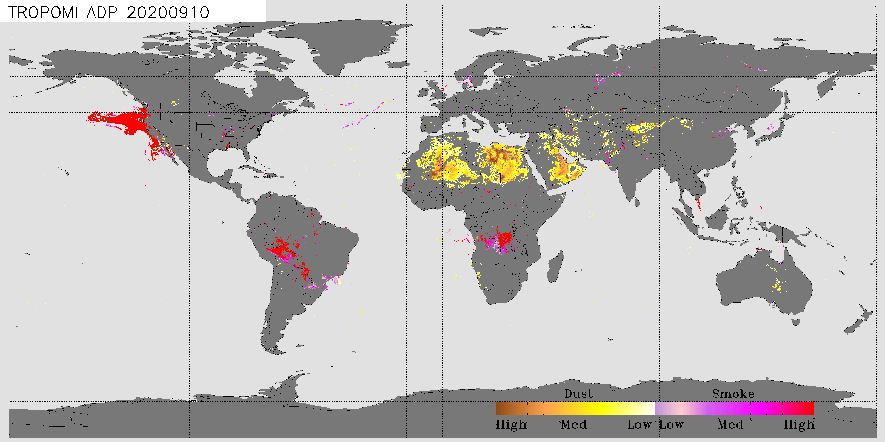
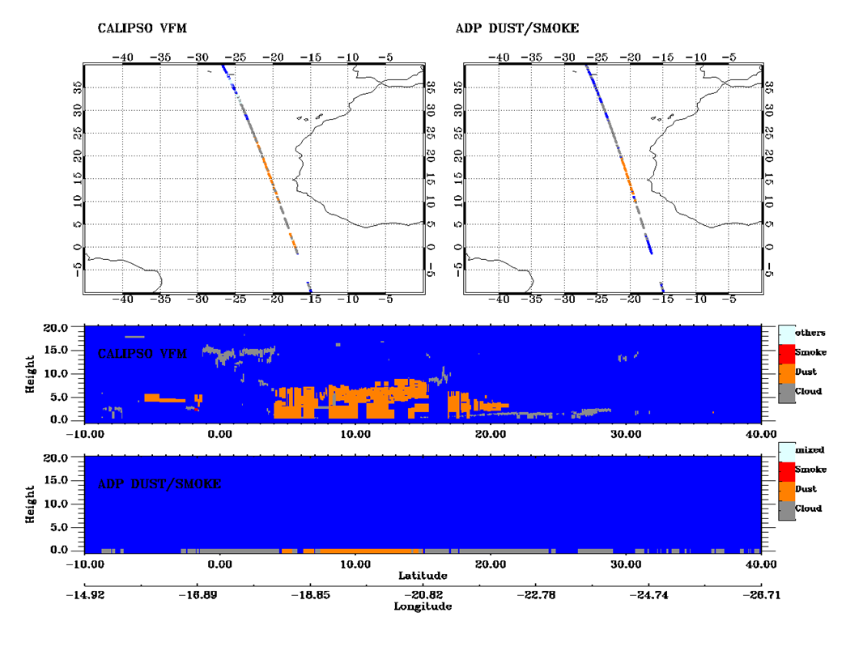
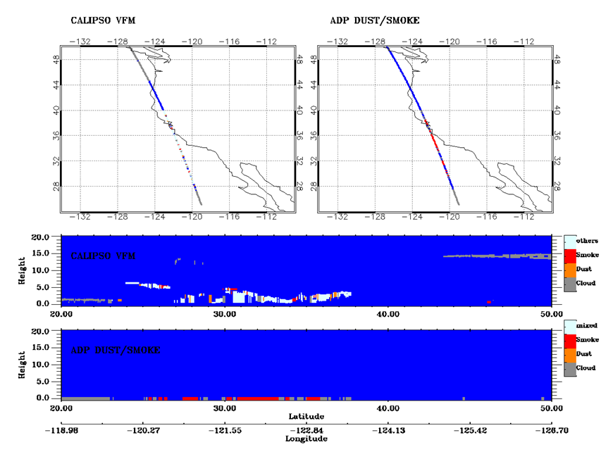
NOAA TEMPO Aerosol Detection Algorithm
Hybrid approach taking into account the synergy between an Imager and a spectrometer
Temporally coincide
Spectrally complement
Spatially overlap
Enterprise approach that lets the algorithm work on any given imager and spectrometer
Imagers: ABI, FCI, AHI, AMI, VIIRS, METImage
Spectrometers: TEMPO, Sentinel-4, GEMS, TROPOMI, UVN
CALIOP VFM
TROPOMI ADP
CALIOP VFM
TROPOMI ADP
Jan 08, 2018
Nov 10, 2018
Comparison of TROPOMI ADP with CALIOP aerosol type for a dust case (left) and a smoke case (right)

Slide 2
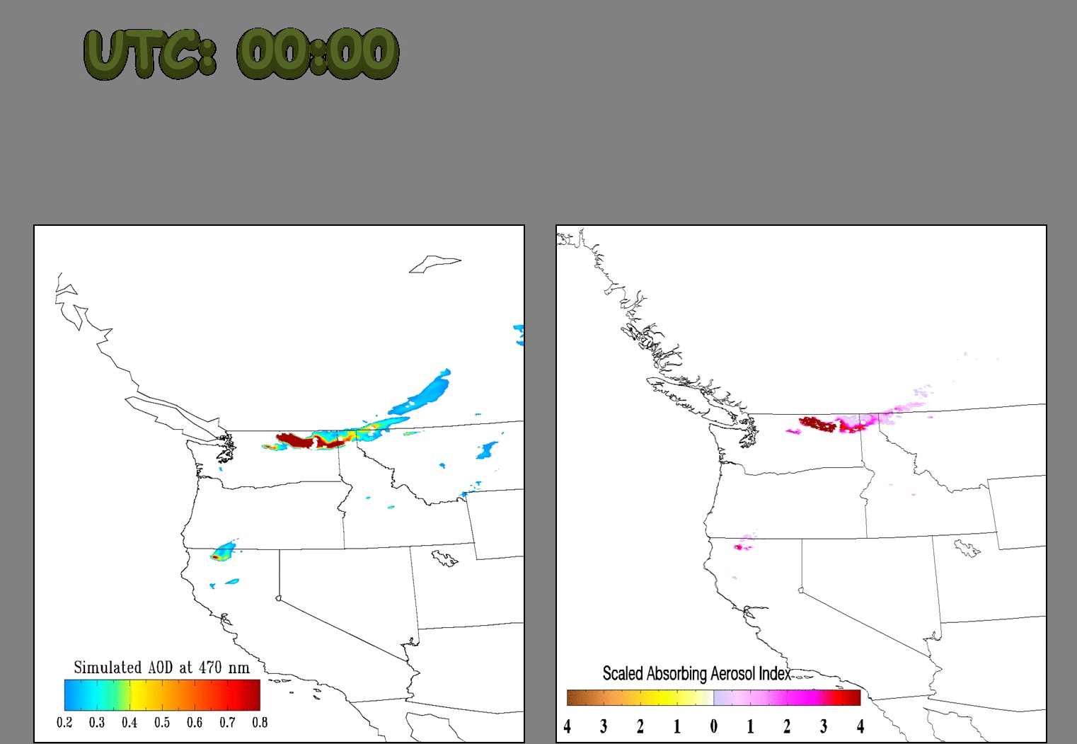
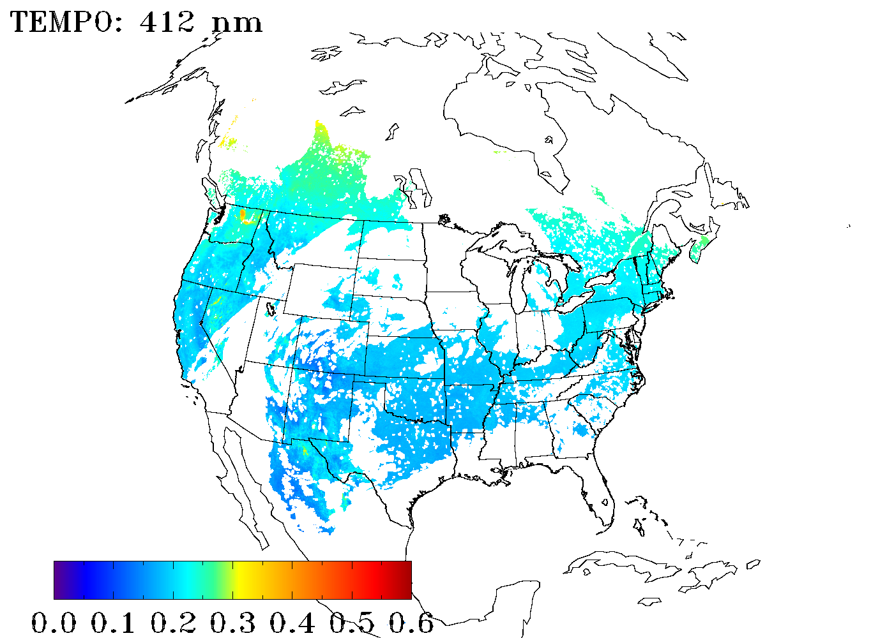
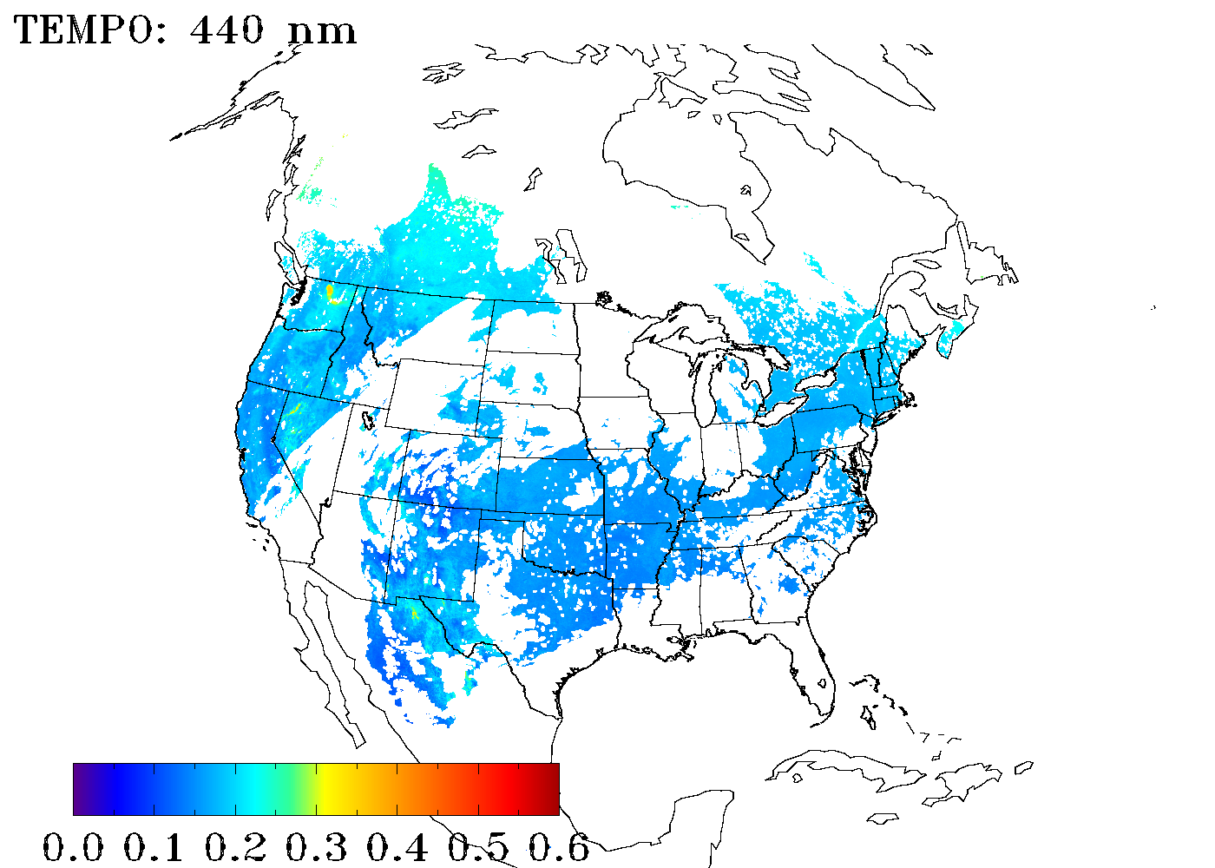
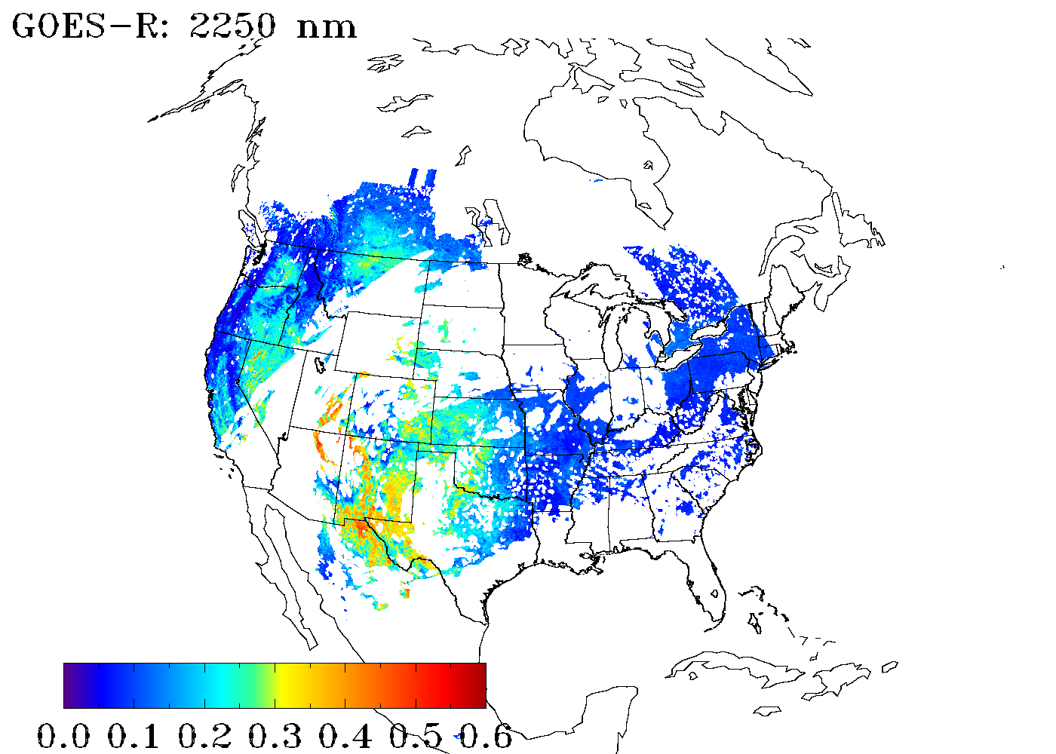
TEMPO/GOES-R Hybrid Algorithm for Smoke and Dust Detection from TEMPO using Simulated Data
NASA generated synthetic radiances for smoke cases
Hourly, 7-km nature run for 22 cases; smoke case for August 7, 2006 used in this study
Simulated radiances for GOES-R and TEMPO footprints using VLIDORT
Aerosol optical properties from OPAC data base
August 07, 2006
Retrieved Smoke using Simulated TEMPO and GOES-R Radiances
GEOS-5 Simulated AOD for A Smoke Event
Smoke plume retrieved with 90% accuracy
Smoke plume retrieved with 90% accuracy
TEMPO: 412 nm
TEMPO: 440 nm
ABI: 2250 nm
Dust Smoke
Absorbing Aerosol Index
AAI = -100[1og₁₀(R₄₁₂/R₄₄₀) – log₁₀(R’₄₁₂/R’₄₄₀)]
Castellanos P, Da Silva AM, Darmenov AS, Buchard V, Govindaraju RC, Ciren P, Kondragunta S. A Geostationary Instrument Simulator for Aerosol Observing System Simulation Experiments. Atmosphere. 2019; 10(1):2. https://doi.org/10.3390/atmos10010002
Dust Smoke Discrimination Index
DSDI = -10[1og₁₀(R₄₁₂/R₂₂₅₀)]

Slide 3
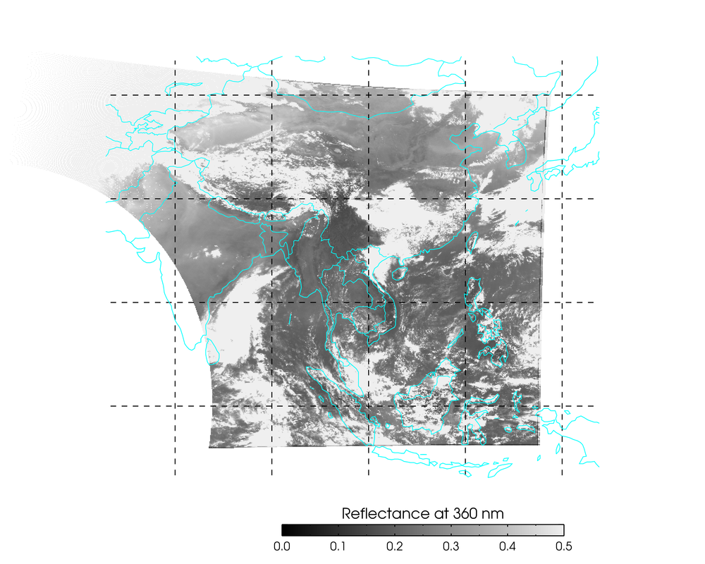
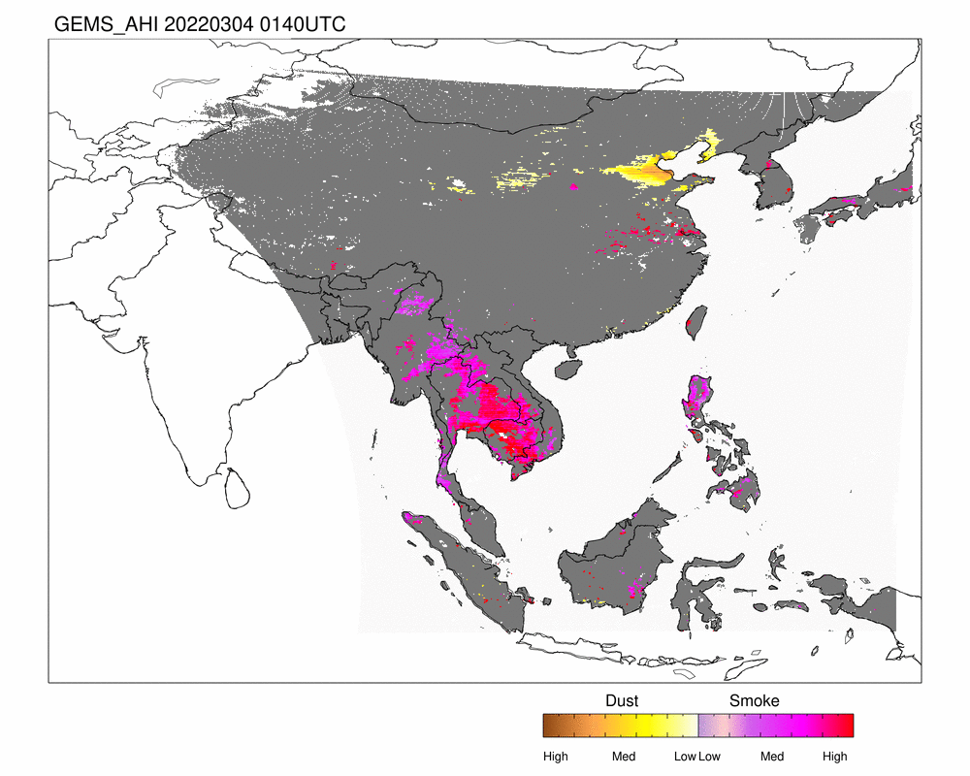
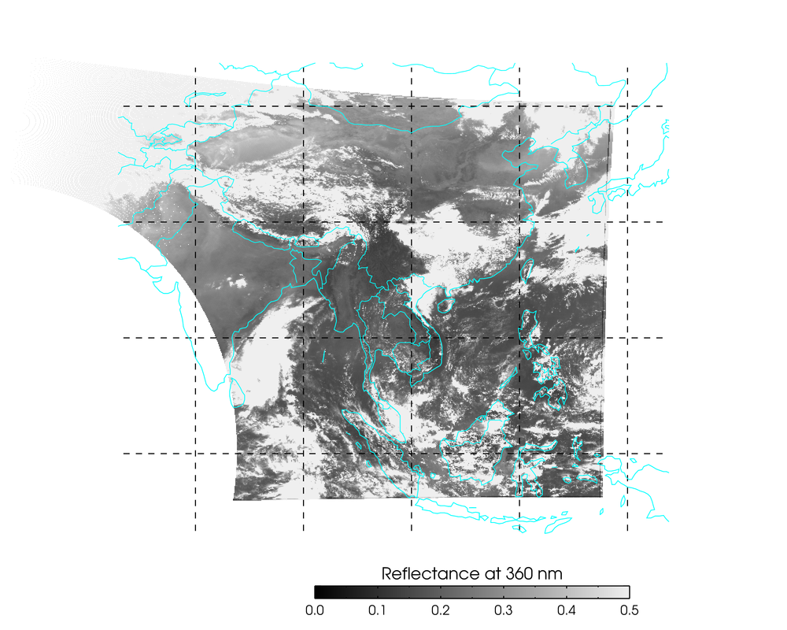
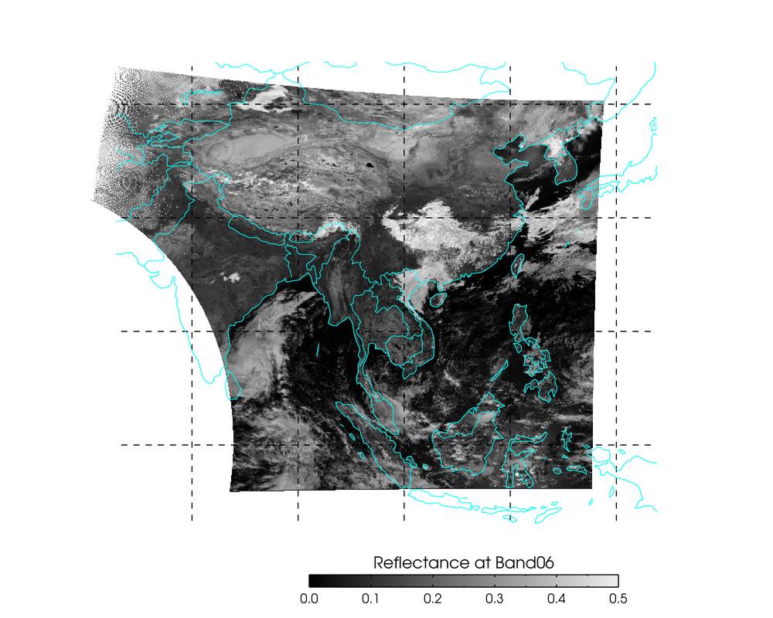
TEMPO/GOES-R Hybrid Algorithm Tested using GEMS and AHI Data
GEMS: 412 nm
03/04/2020
GEMS: 440 nm
Absorbing Aerosol Index
AAI = -100[1og₁₀(R₄₁₂/R₄₄₀) – log₁₀(R’₄₁₂/R’₄₄₀)]
Dust Smoke Discrimination Index
DSDI = -10[1og₁₀(R₄₁₂/R₂₂₅₀)]
AHI: 2250 nm
Reflectance
0.0 0.1 0.2 0.3 0.4 0.5

