Slide 1
Questions
Omar
What are some demonstrated applications wrt air quality monitoring and forecasting of OMI or TROPOMI retrievals of UV absorption AOD?
In the GeoXO science team session on Monday, we discussed what role TEMPO can play in Hazards monitoring. We know when we have a chemical property explosion or a tire factory burning, black smoke that is released, we cannot do an AOD retrieval in the visible. Have you looked at some of those cases in the UV?
Pawan
What are some of the advances in AERONET retrievals wrt aerosol properties etc.
How do you envision TEMPO algorithms using AERONET AOD etc. in validation of its retrievals
Pubu
How can advance your smoke/dust detection with UV AI?
Your hybrid algorithm uses only one Imager and spectrometer. What is the value of adding two imagers and one spectrometer?
Jhoon
Hai Zhang from my team developed a bias correction algorithm to correct diurnal bias in the retrievals. Would you like to test it on your retrievals and test how it compares to your ML based correction? Though ours is an empirical correction, it is based on physical aspect of identifying errors in surface characterization
You have AOCH from O2-O2 absorption as well as OE based retrieval. Which one do you recommend?
Jun
What are some of your concerns regarding validation of your ALH retrievals, especially when there are multiple stratified aerosol layers in the atmosphere

Slide 2
Aerosol Layer Height Retrieval and Validation Challenges
NIER GEMS vs. CALIOP January 01,2021 – September 30, 2022
Scenario | Bias (km) | Precision (km) | RMSE (km)
AOD < 0.4 | 0.48 | 1.42 | 1.50
0.4 < AOD < 0.8 | 0.11 | 1.31 | 1.32
AOD > 0.8 | -0.33 | 1.32 | 1.32
Single vertical aerosol layer | 0.07 | 1.33 | 1.34
Multiple stratified vertical aerosol layers | 0.77 | 1.41 | 1.60
GEMS ALH Algorithm Reference
Kim M, Kim J, Torres O, Ahn C, Kim W, Jeong U, Go S, Liu X, Moon KJ, Kim D-R. Optimal Estimation-Based Algorithm to Retrieve Aerosol Optical Properties for GEMS Measurements over Asia. Remote Sensing. 2018; 10(2):162. https://doi.org/10.3390/rs10020162
U Iowa TROPOMI vs. CALIOP September 2020
All data (UVAI > 1.0) | -1.20 | 1.91 | 2.26
Over Land (UVAI > 1.0) | -1.24 | 1.88 | 2.25
Over Ocean (UVAI > 1.0) | -1.03 | 2.05 | 2.30
TROPOMI ALH Algorithm Reference
Chen X, Wang J, Xu X, Zhou M, Zhang H, Garcia L-C, Colarco P, Janz S J, Yorks J, McGill M, Reid J R, de Graaf M, Kondragunta S,
First retrieval of absorbing aerosol height over dark target using TROPOMI oxygen B band: Algorithm development and application for surface particulate matter estimates,
Remote Sensing of Environment, Volume 265, 2021

Slide 3
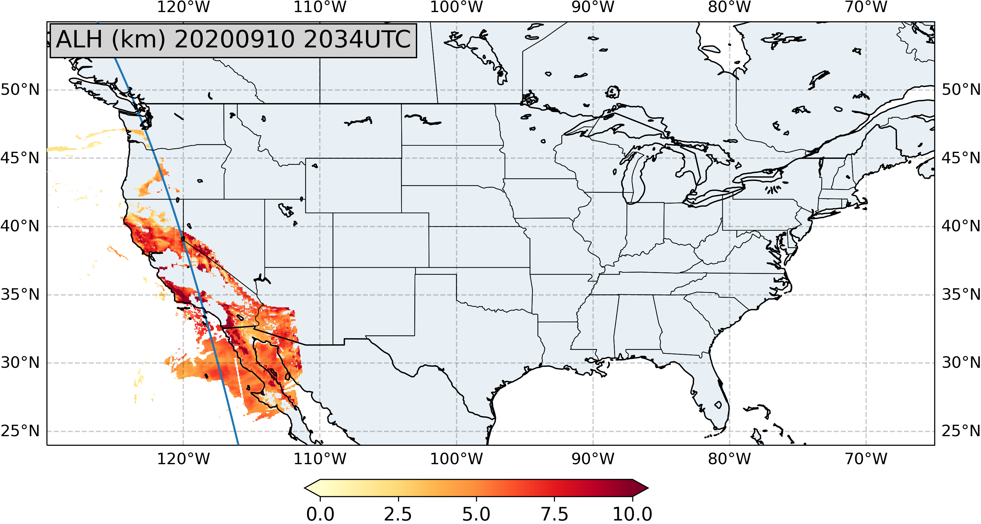
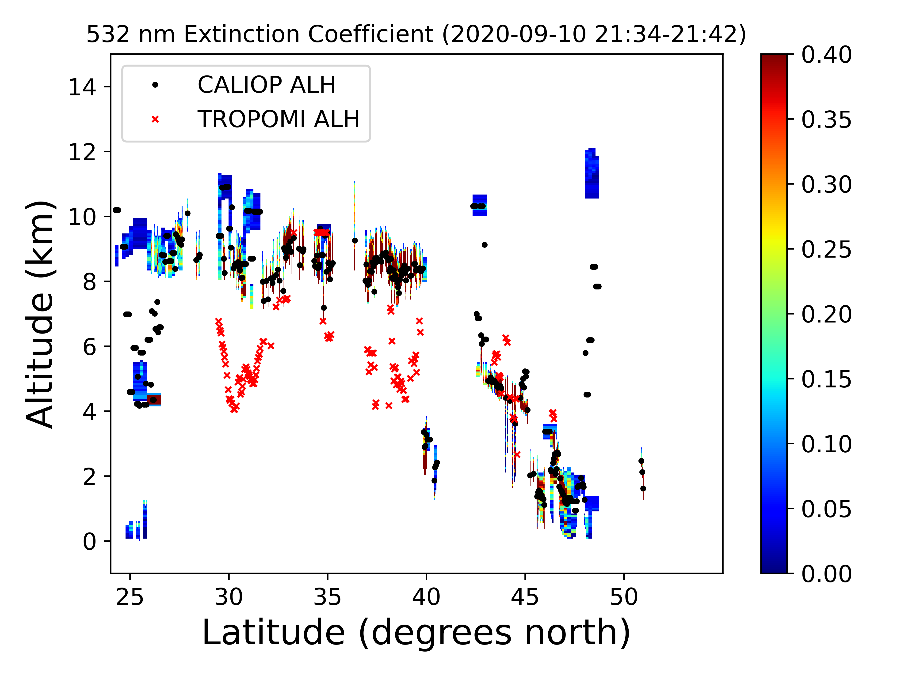
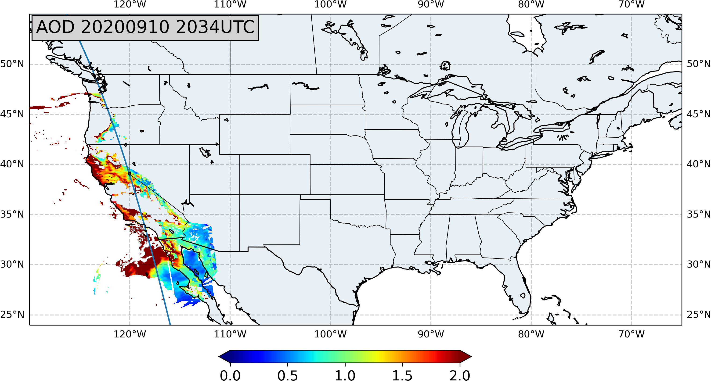
Source Region Aerosol
CALIOP data from NASA

Slide 4
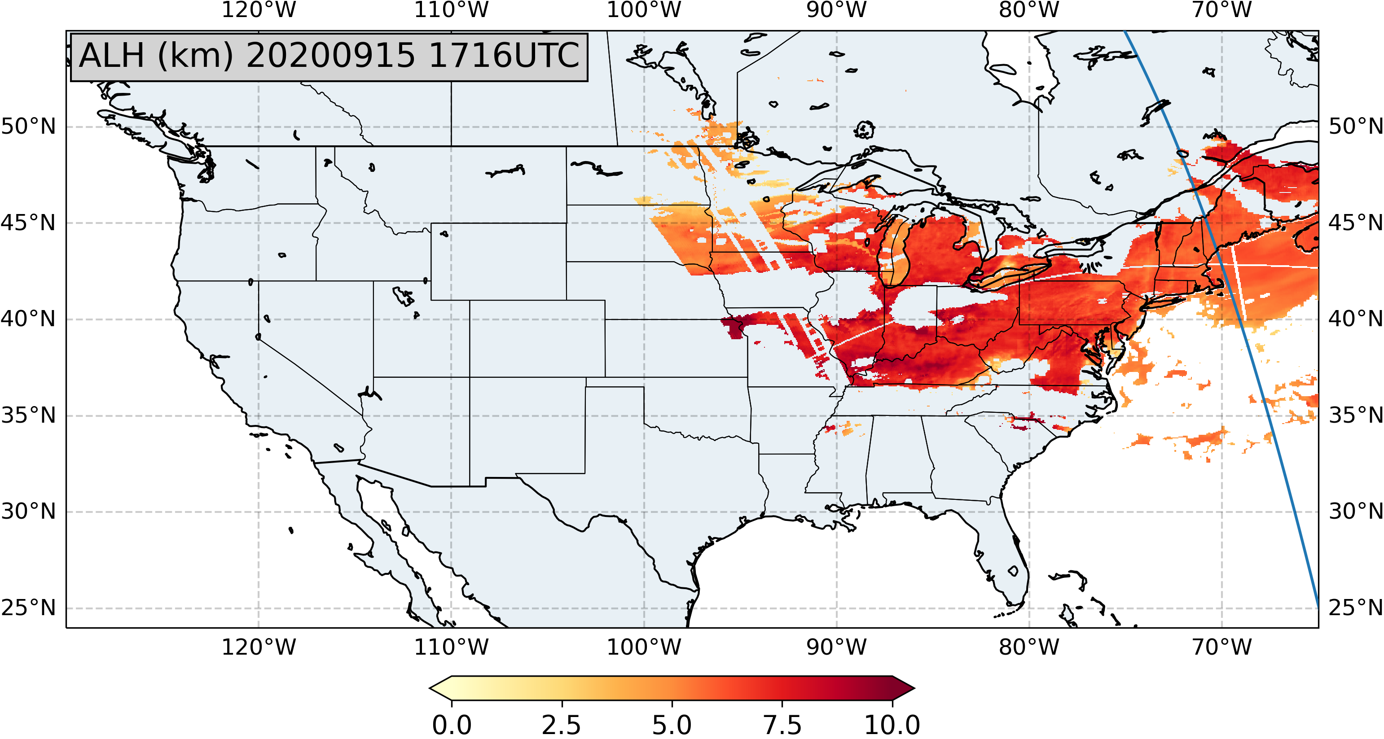
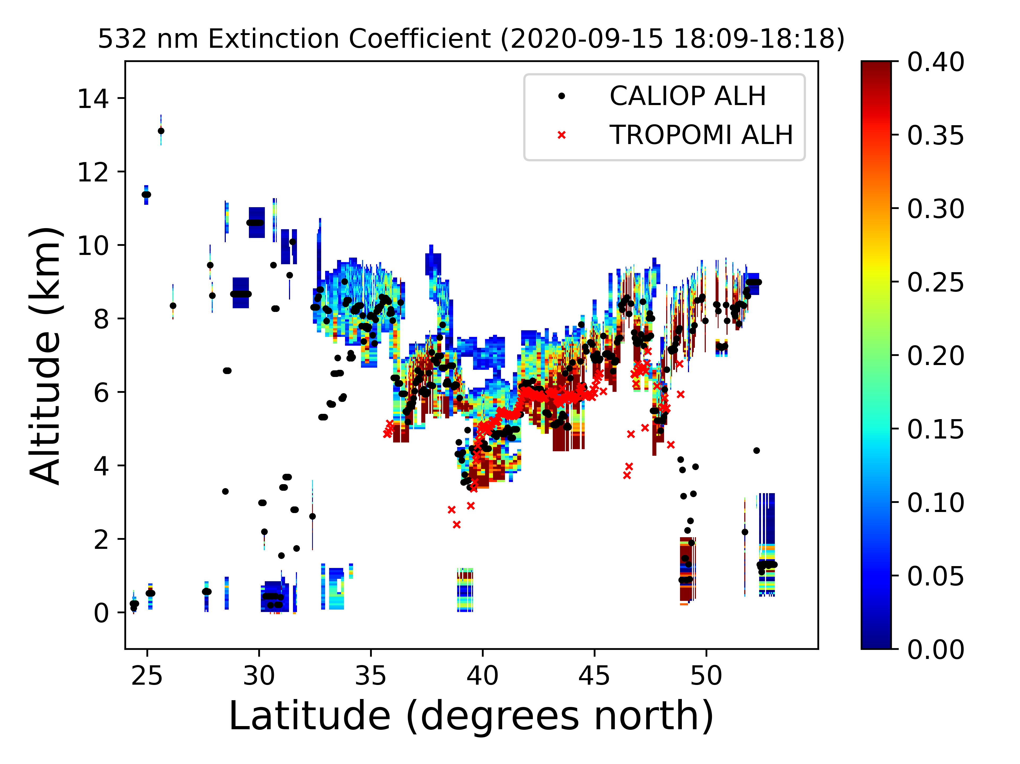
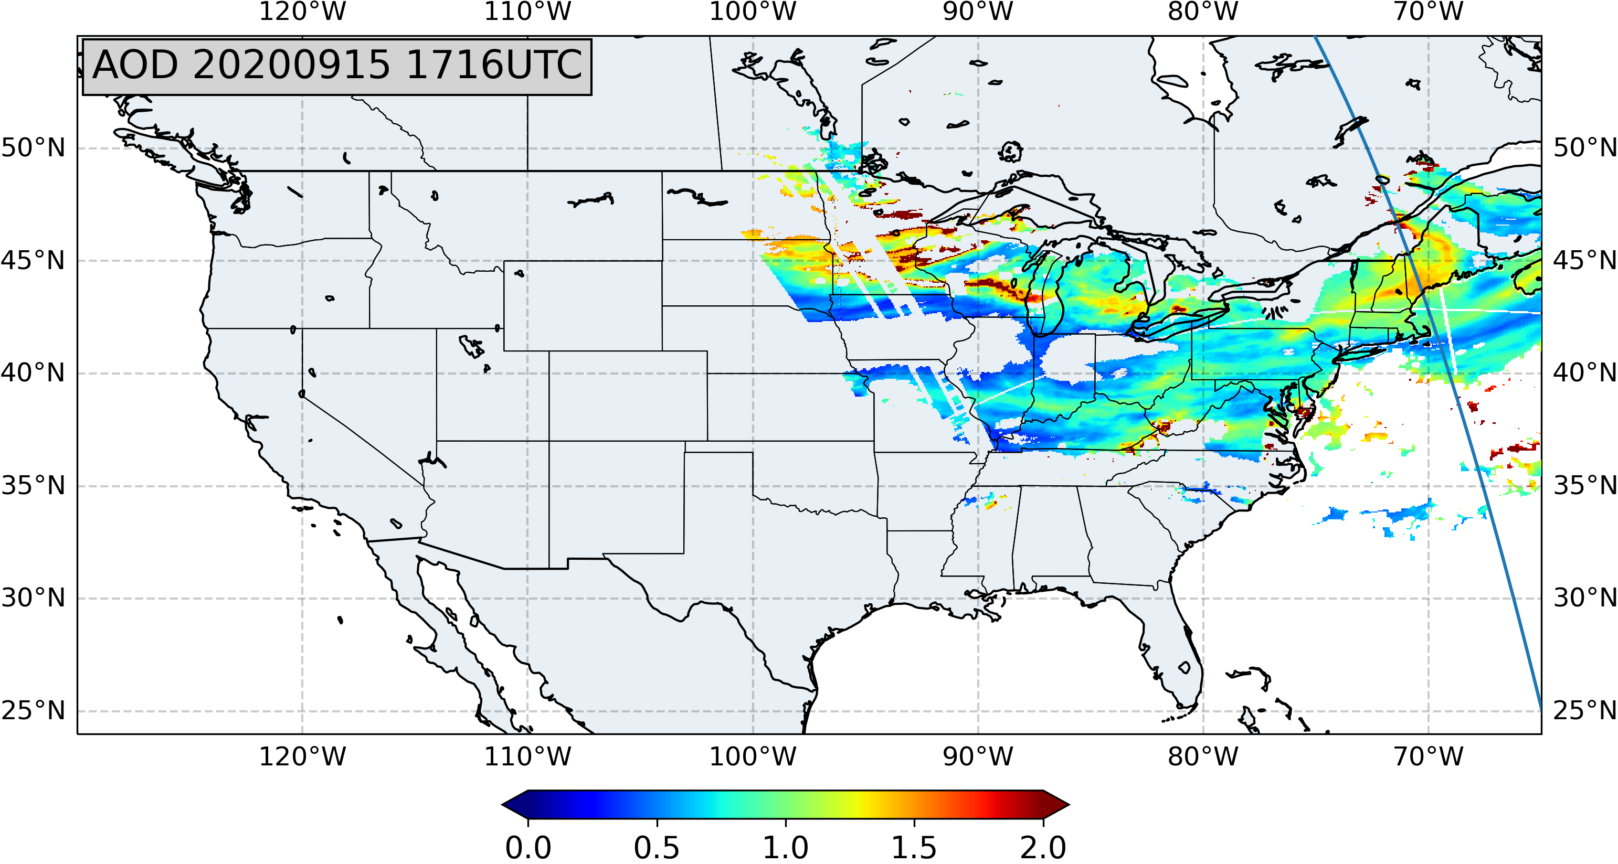
Transported Region Aerosol
CALIOP data from NASA

Slide 5
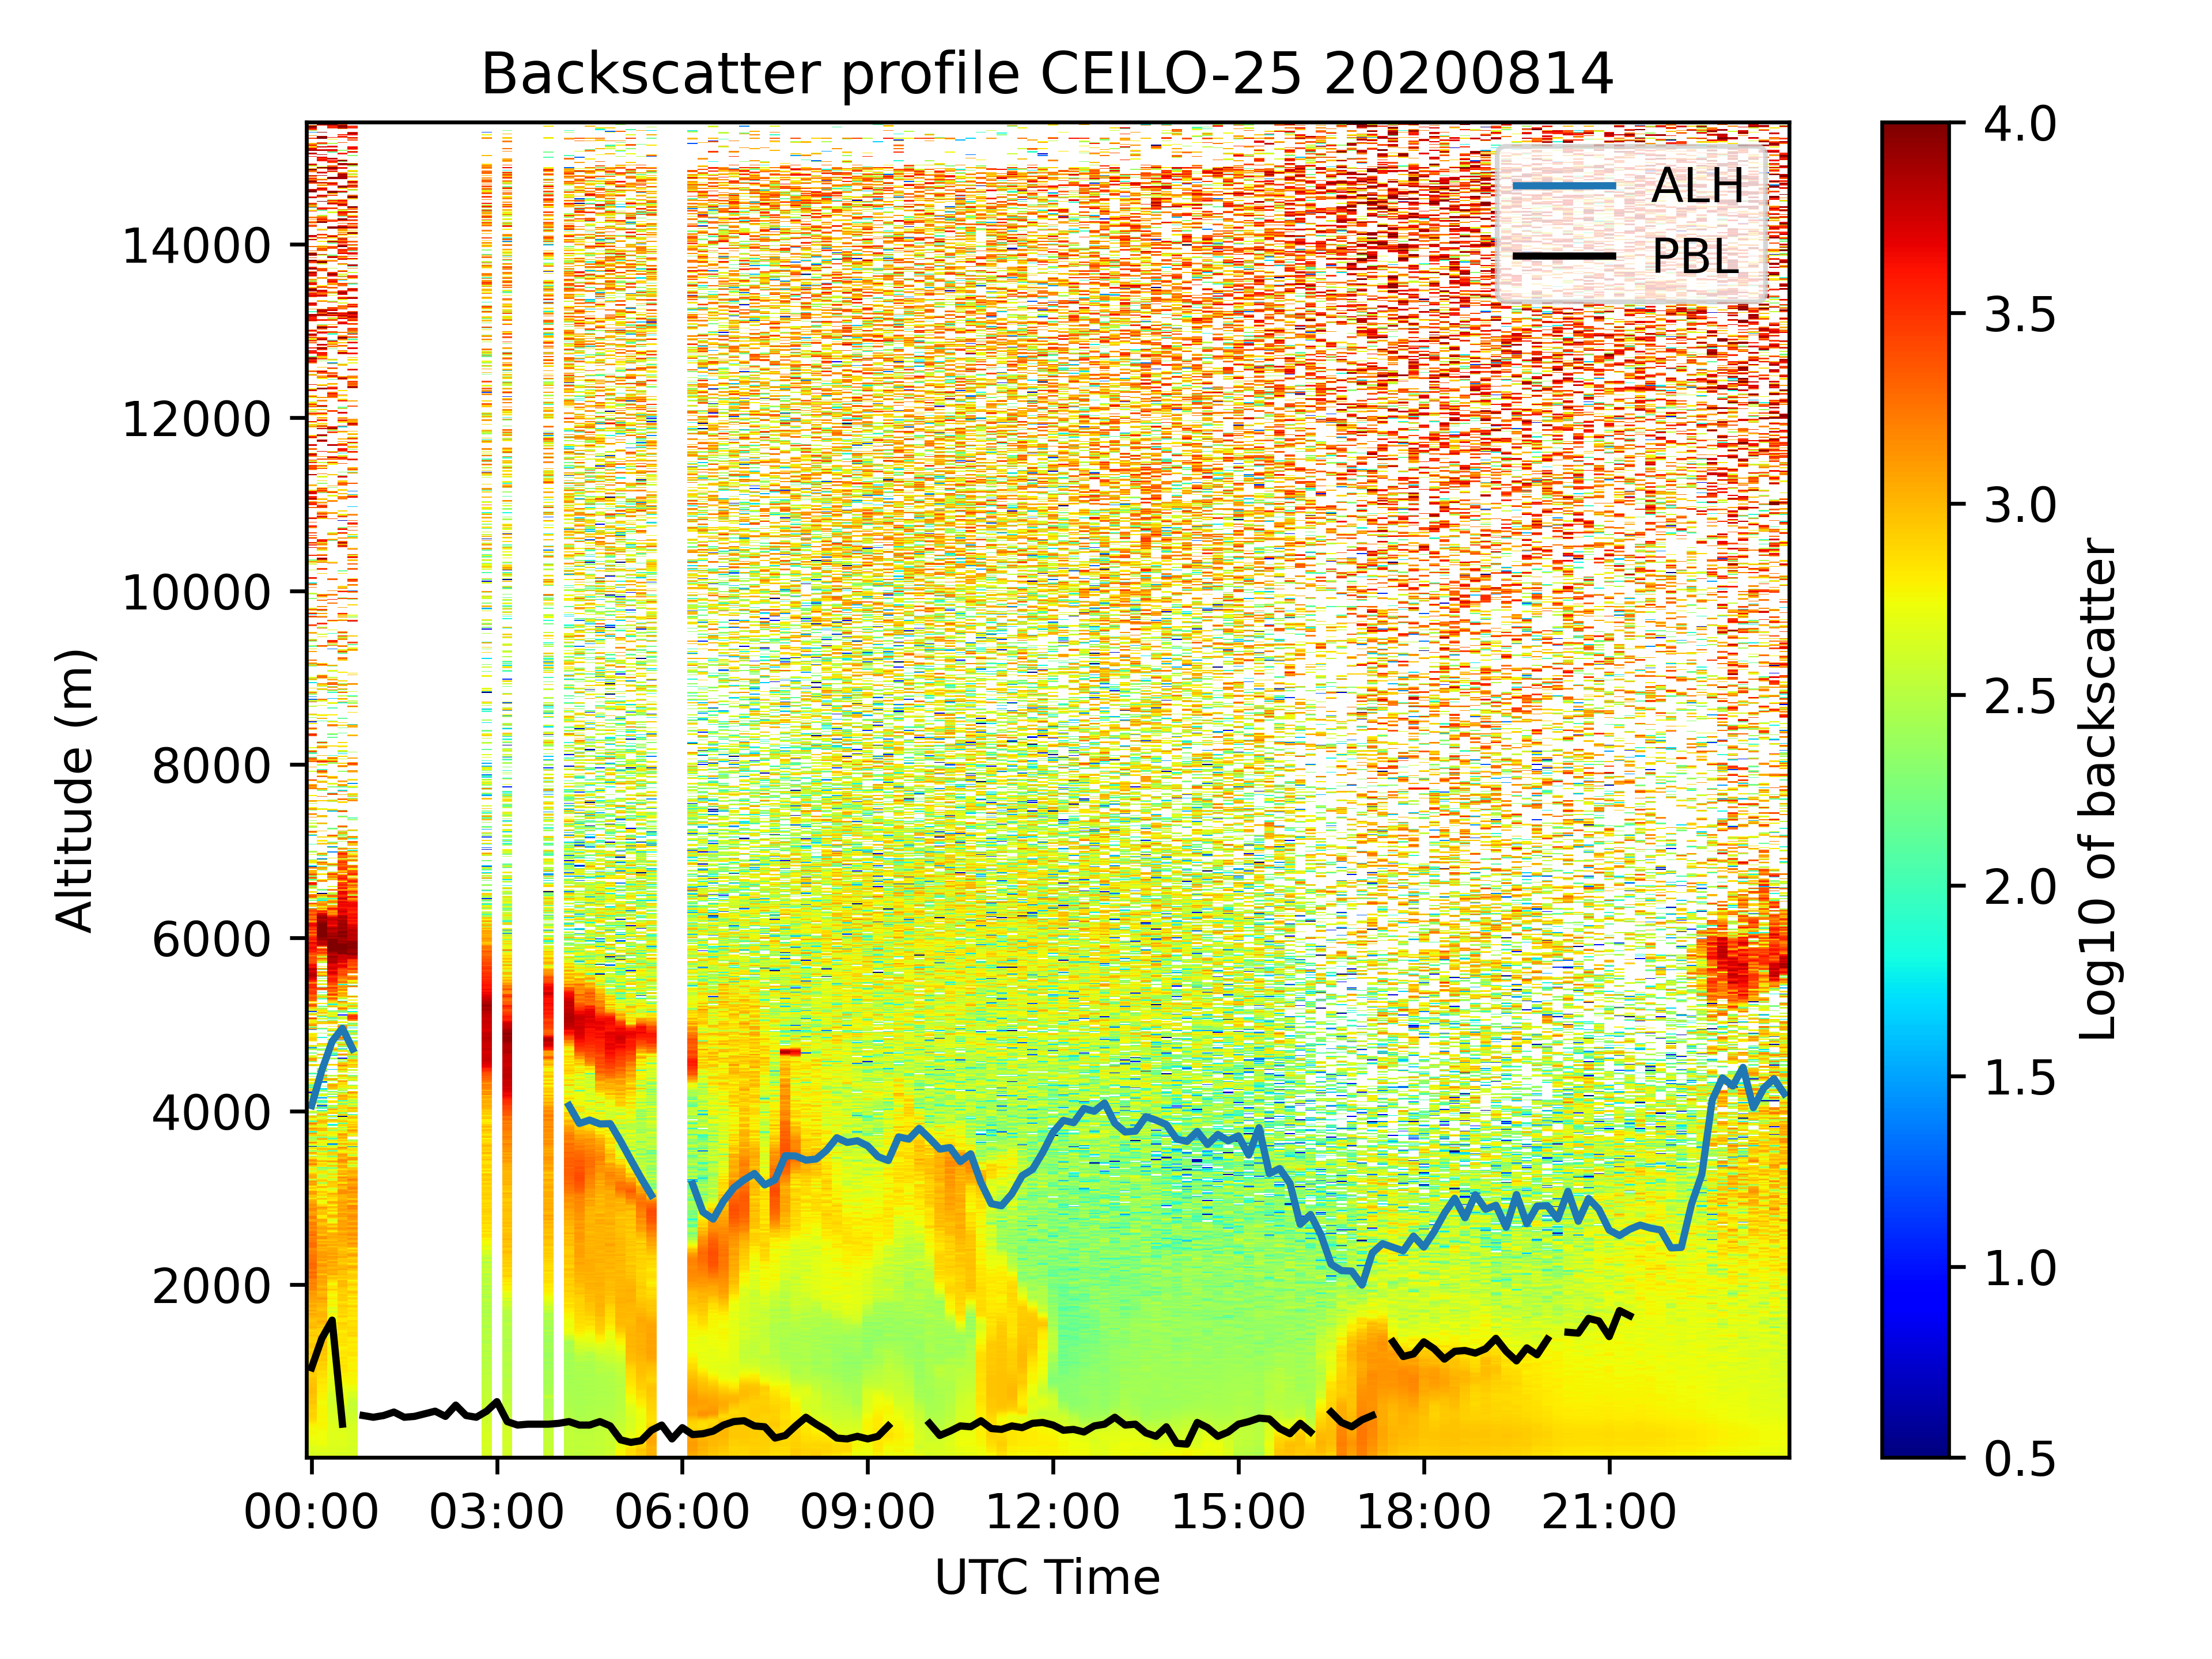
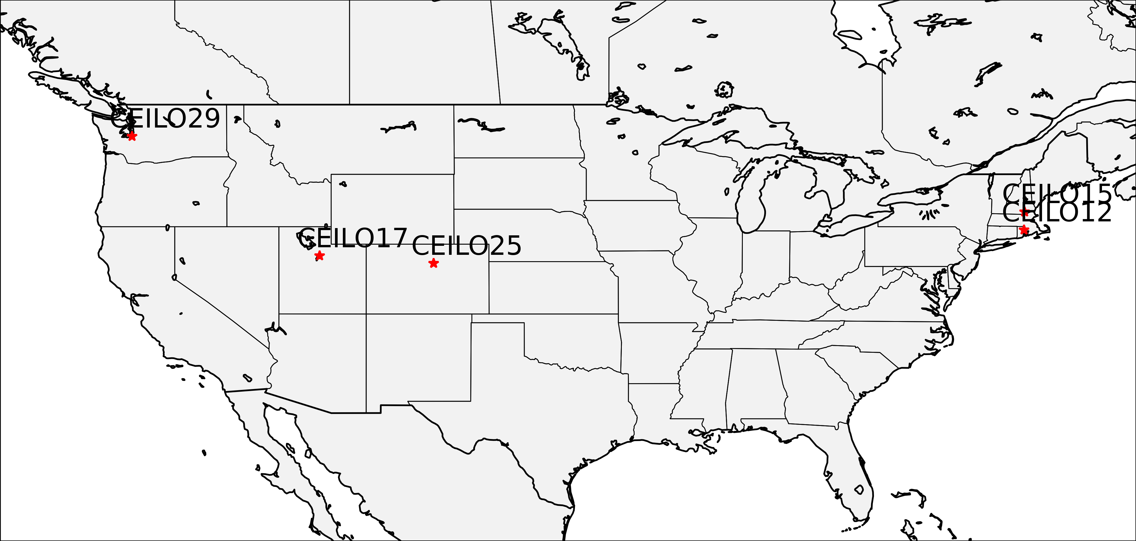



$$ALH=\frac{\sum_{i=1}^{n}{β_{i }Z_{i}}}{\sum_{i=1}^{n}{β_{i }}}$$
Caicedo, V., R. Delgado, R. Sakai, T. Knepp, D. Williams, K. Cavender, B. Lefer, and J. Szykman, 2020: An Automated Common Algorithm for Planetary Boundary Layer Retrievals Using Aerosol Lidars in Support of the U.S. EPA Photochemical Assessment Monitoring Stations Program. J. Atmos. Oceanic Technol., 37, 1847–1864, https://doi.org/10.1175/JTECH-D-20-0050.1.

Slide 6
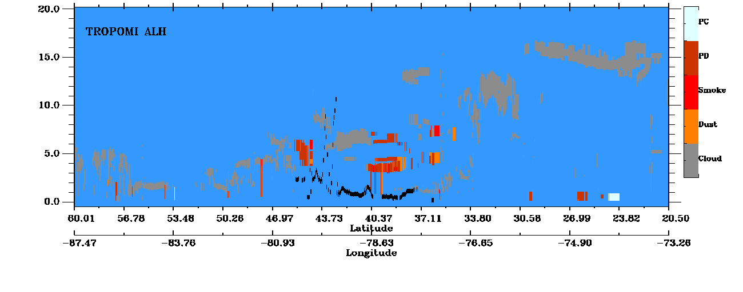
Flight Track
Sentinel 5P TROPOMI aerosol layer height (ALH) and CALIOP/CALIPSO Vertical Feature Mask (VFM) overpasses occurred during University of Maryland flight track spiral through the transported smoke plume on September 16, 2020 northeast of Baltimore, Maryland
TROPOMI ALH derived using O2 A-band absorption reported the smoke at much lower altitude (1Km) than aircraft observations (peak at 3.1 km)
CALIOP/CALIPSO VFM observed two stratified smoke plumes, one around 3-4 km and one at 5-6 km.
Flight track
black carbon
aerosol scattering
TROPOMI aerosol layer height
North
South

