Slide 1
Demonstration of AOCH for air quality studies
Air quality forecast is needed by the state/local communities to make advisories/decisions for mitigating public exposure to air pollution.
Aerosol layer height is one of the most needed information air quality mangers wants (based on HAQST group discussion on air quality forecast in smoke conditions).

Slide 2
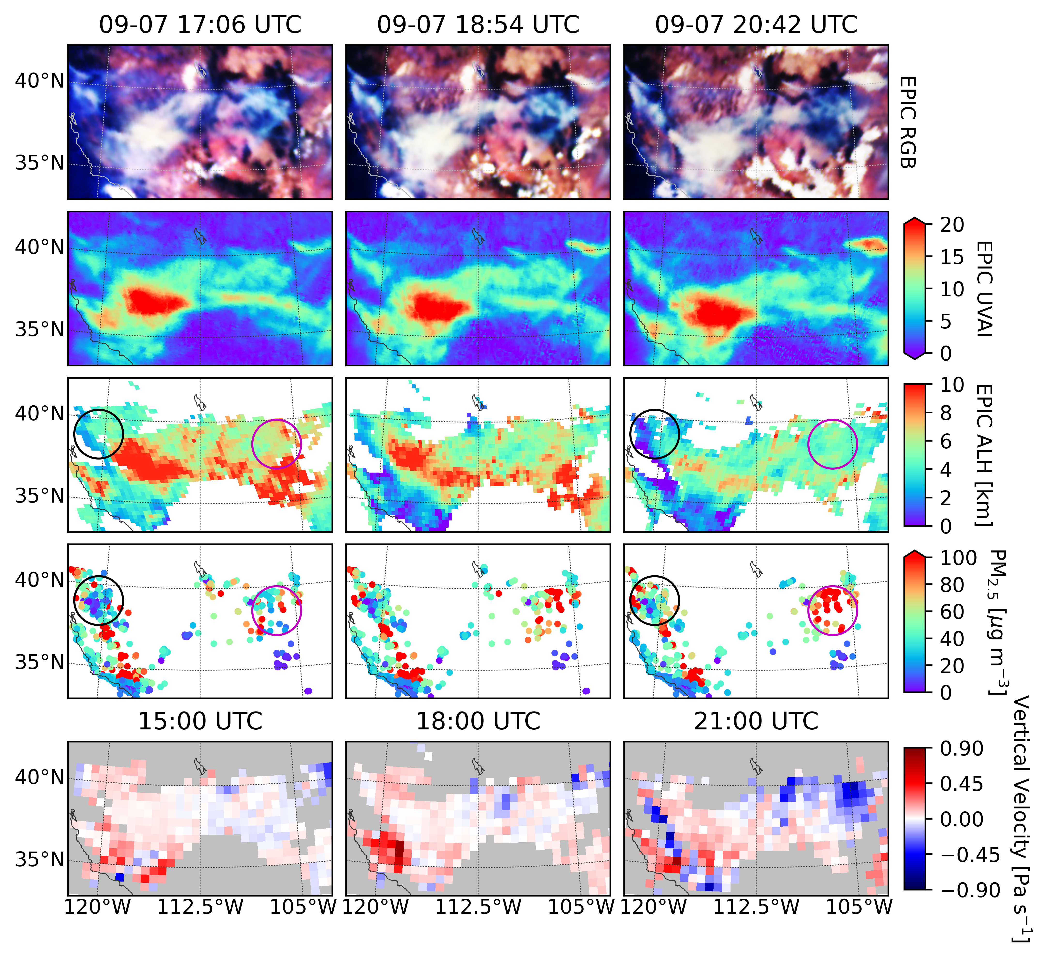
Hourly mapping of smoke height
Algorithm Revisions
vicarious calibration based on TROPOMI data
adjust cloud mask so that thick smokes would not be misclassified as clouds
Descending smoke heights lead to increasing PM_{2.5}
Positive vertical pressure velocity indicates descending air motion
UVAI
AOCH
PM_{2.5}
Lu, Z. et al., 2022; In collaboration with Shobha Kondragunta @ NOAA
V. V
Notes:
mark on the figure: AOCH, PM2.5
UVAI no info.

Slide 3
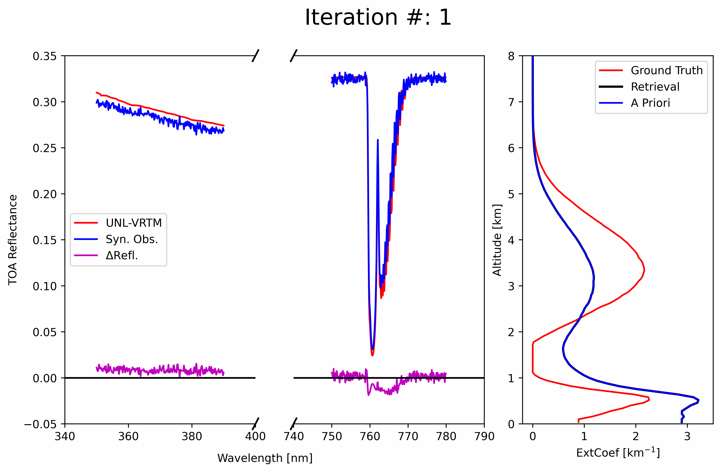
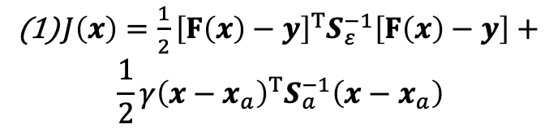

Beyond aerosol optical centroid height: retrieve vertical profile of aerosol extinction
PCA of CALIPO aerosol extinction profile; derive major PCs that represent the basic modes of vertical change of aerosol extinction profile.
Use CALIPSO aerosol extinction profile climatology as the prior, and retrieve the weights the basic PC
We show that 2-3 PCs can be sufficient to represent 80-90% of the variability in change of aerosol extinction vertical profile
We develop the theoretical basis and codes for retrieving aerosol vertical profile
$J\left(x\right)=\frac{1}{2}{\left[F\left(x\right)−y\right]}^{T}S_{ε}^{−1}\left[F\left(x\right)−y\right]+$
$$\frac{1}{2}γ{\left(x−x_{a}\right)}^{T}S_{a}^{−1}\left(x−x_{a}\right)$$
(2) $\frac{∂I}{∂w}=\frac{∂I}{∂β_{ext}}\frac{∂β_{ext}}{∂w}=\frac{∂I}{∂β_{ext}}E$
(3) $A=\frac{∂\hat{x}}{∂x}={\left(K^{T}S_{ε}^{−1}K+S_{a}^{−1}\right)}^{−1}K^{T}S_{ε}^{−1}K$

