Slide 1
Assessing Diurnal Emissions with TEMPO
Panel Talk
Ken Pickering
University of Maryland

Slide 2
Diurnal Variation of Emissions for Air Quality Modeling
Air quality models (e.g., CMAQ, CAMx, etc.) require emissions to be distributed realistically by hour of the day. EPA SMOKE-MOVES software contains diurnal emission profiles for various source types. How accurate are they?
Can TEMPO data be used to evaluate and improve these diurnal emission distributions?
- Hourly tropospheric columns of NO₂ will be available each day during daylight hours at 2 x 4.75 km spatial resolution
- Should enable estimates of emission variation for major sources, major roadways, area sources
Small EGUs
Prescribed
Fires
Airports
Onroad Vehicles
Examples of diurnal NO_{x} emission profiles
from SMOKE-MOVES

Slide 3
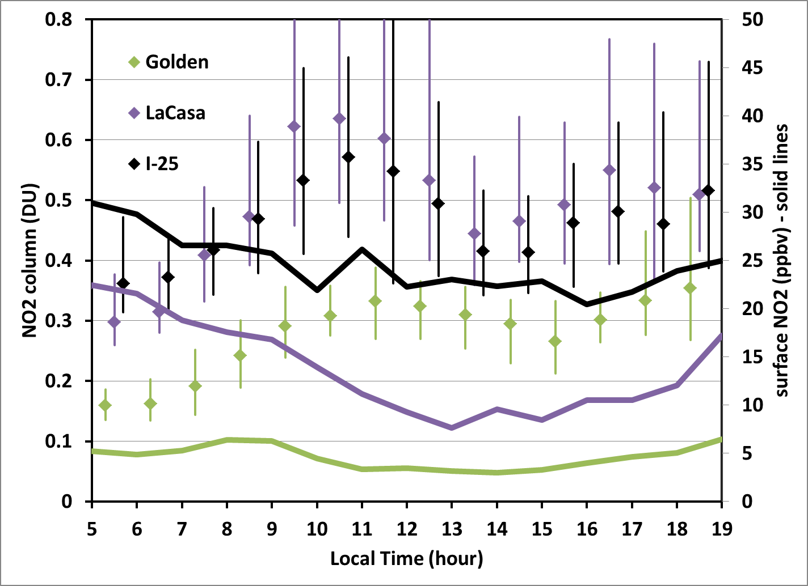
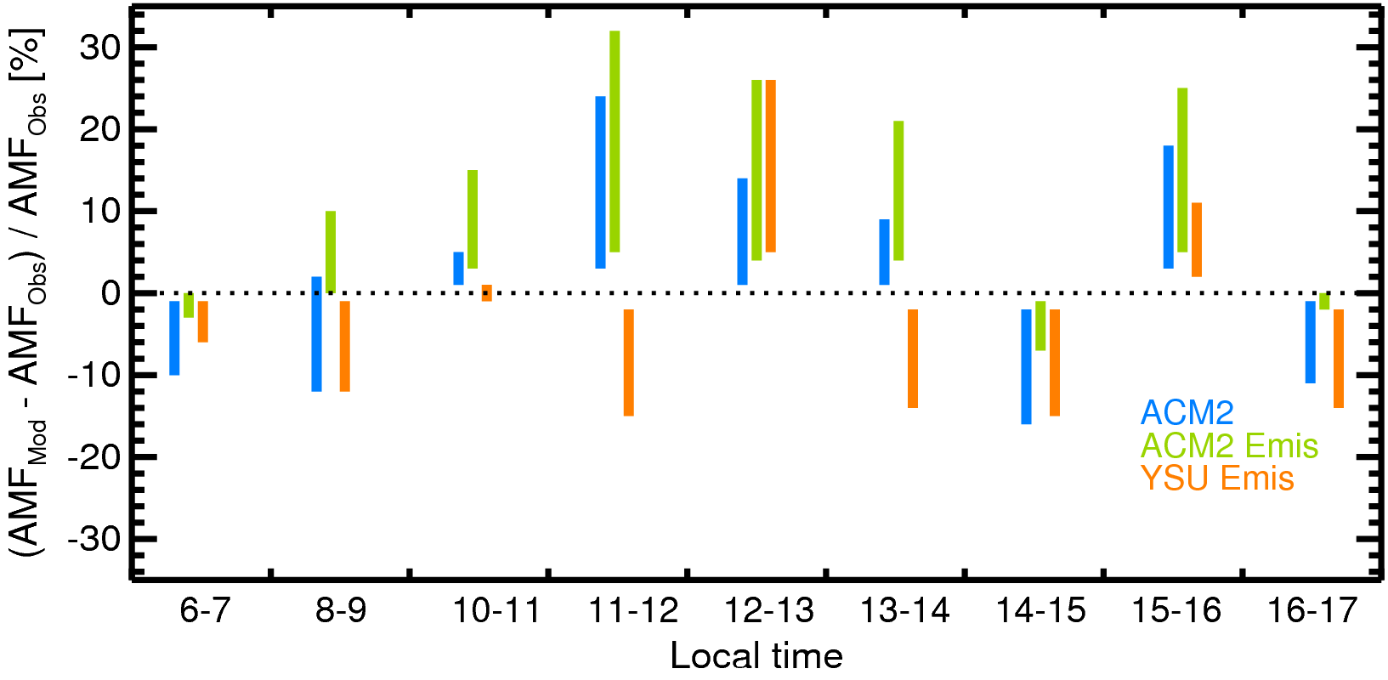
Issues with Use of Tropospheric Columns in Estimating Emissions
DISCOVER-AQ
Colorado
Ranges displayed result from variation of
surface reflectivity, solar zenith angle,
and aerosol optical depth
Lok Lamsal
Jim Crawford
DISCOVER-AQ data often showed surface
and column NO₂ not well correlated. Vertical
mixing rate throughout the morning may
exceed emission rate, allowing columns to
increase, but surface NO₂ to decrease.
Column increases should reflect magnitude
of emissions.
Challenge for TEMPO:
NO₂ tropospheric column retrievals are highly sensitive to
diurnal variation in model-derived a-priori profile shapes.
Model vertical mixing scheme plays a large role in determining
profile shapes.

Slide 4
Free Tropospheric NO₂ Complicates Satellite Emission Estimates
As anthropogenic NOx emissions have declined substantially over North America in the last 20 years, the fraction of the tropospheric column NO₂ due to these emissions has also decreased, causing greater uncertainty in linking surface emissions to satellite-derived NO₂ columns.
The need for accurate information on free tropospheric sources of NO₂ (lightning, aviation, elevated wildfire plumes, aerosol nitrate photolysis) has therefore increased in importance (Silvern et al., 2019; Qu et al., 2021; Shah et al., 2023; Dang et al., 2023)
Wildfire contribution episodic, but has increased in the last decade; aviation contribution varies with economy
Lightning contribution: both diurnal variation and episodic occurrence; global long-term variation very small except 2020
Diurnal Variation of Lightning Flashes
Beirle et al, 2014
Füllekrug et al. (2022)
OMI, TROPOMI, GCAS NO₂ data have been used in estimates of lightning NO_{x} production per flash (Pickering et al., 2016;
Bucsela et al., 2019, Allen et al., 2019; Allen et al., 2021a; Allen et al., 2021b).
TEMPO “Green Paper” Lightning NO_{x} Experiment in Summer 2023 – high time and spatial resolution; will reduce uncertainties
such as NO_{x} lifetime in near field of convection; background NO₂; diurnal variation of UT NO₂

