Slide 1
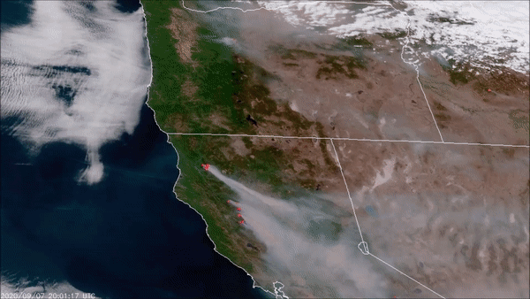
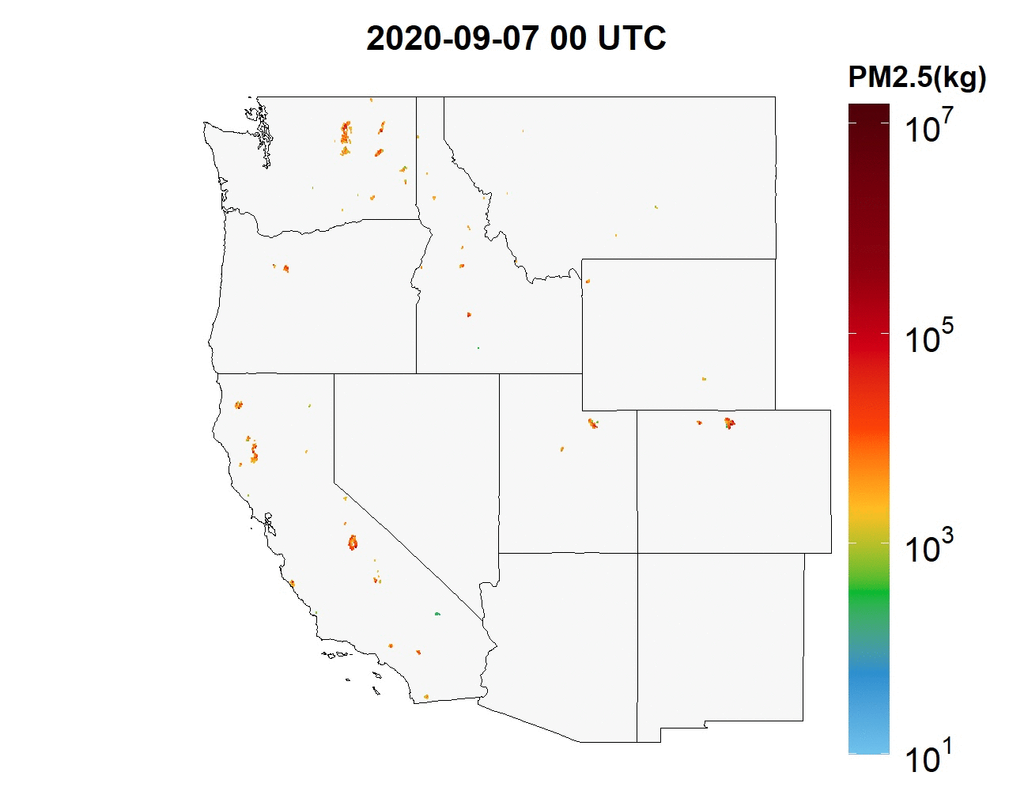
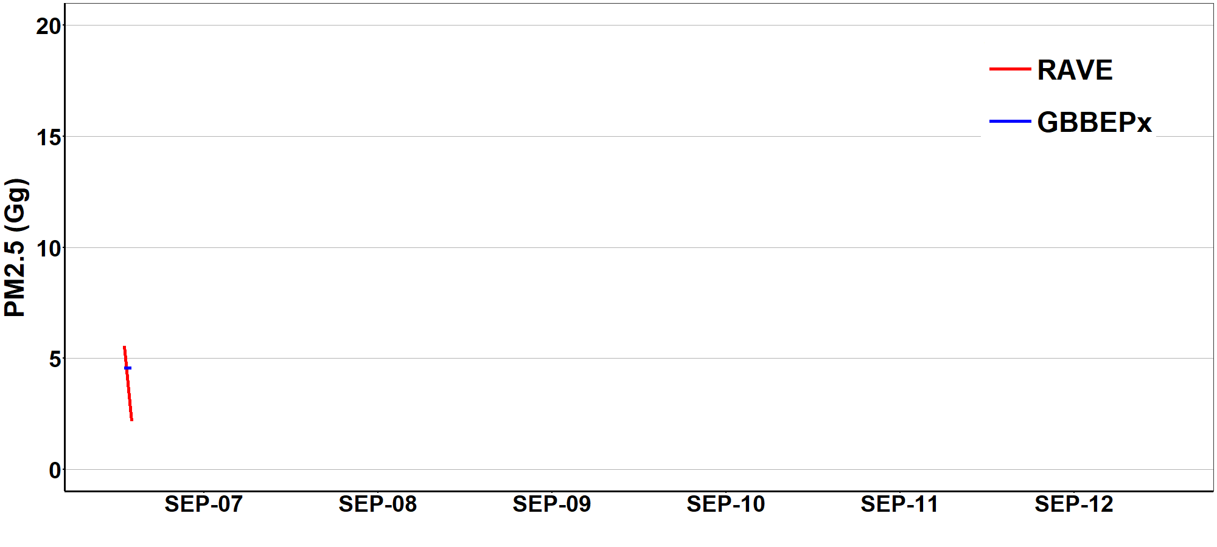
Regional ABI and VIIRS based fire Emissions (RAVE)
Hourly fire emissions by fusing GOES-R ABI and VIIRS fire radiative power (FRP)
RAVE product provides hourly 3km emissions for 11 species (CO2, CO, PM_{2.5}, BC, OC, SO₂, NO_{x}, NH₃, VOCs, TPM, and CH₄)
Operational RAVE product supports several NOAA air quality forecast models.
Li, F., X. Zhang, S. Kondragunta, X. Lu, I. Csiszar, and C. Schmidt, Hourly biomass burning emissions product from blended geostationary and polar-orbiting satellites for air quality forecasting applications, RSE, 2022

Slide 2
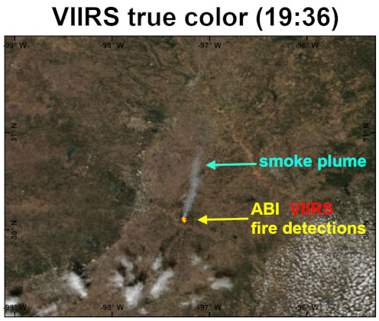
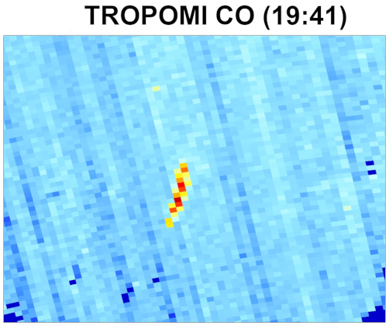
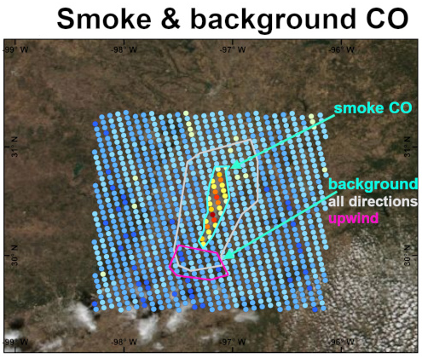
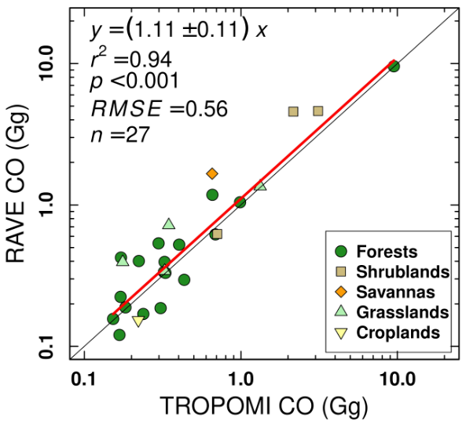
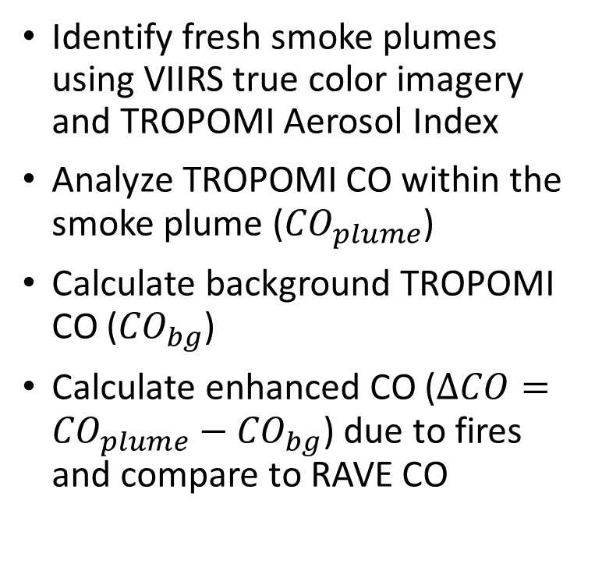
RAVE Emissions Evaluated using TROPOMI CO
Identify fresh smoke plumes using VIIRS true color imagery and TROPOMI Aerosol Index
Analyze TROPOMI CO within the smoke plume (${CO}_{plume}$)
Calculate background TROPOMI CO (${CO}_{bg}$)
Calculate enhanced CO ($∆CO={CO}_{plume}−{CO}_{bg}$) due to fires and compare to RAVE CO
Li, F., X. Zhang, S. Kondragunta, X. Lu, I. Csiszar, and C. Schmidt, Hourly biomass burning emissions product from blended geostationary and polar-orbiting satellites for air quality forecasting applications, RSE, 2022

Slide 3
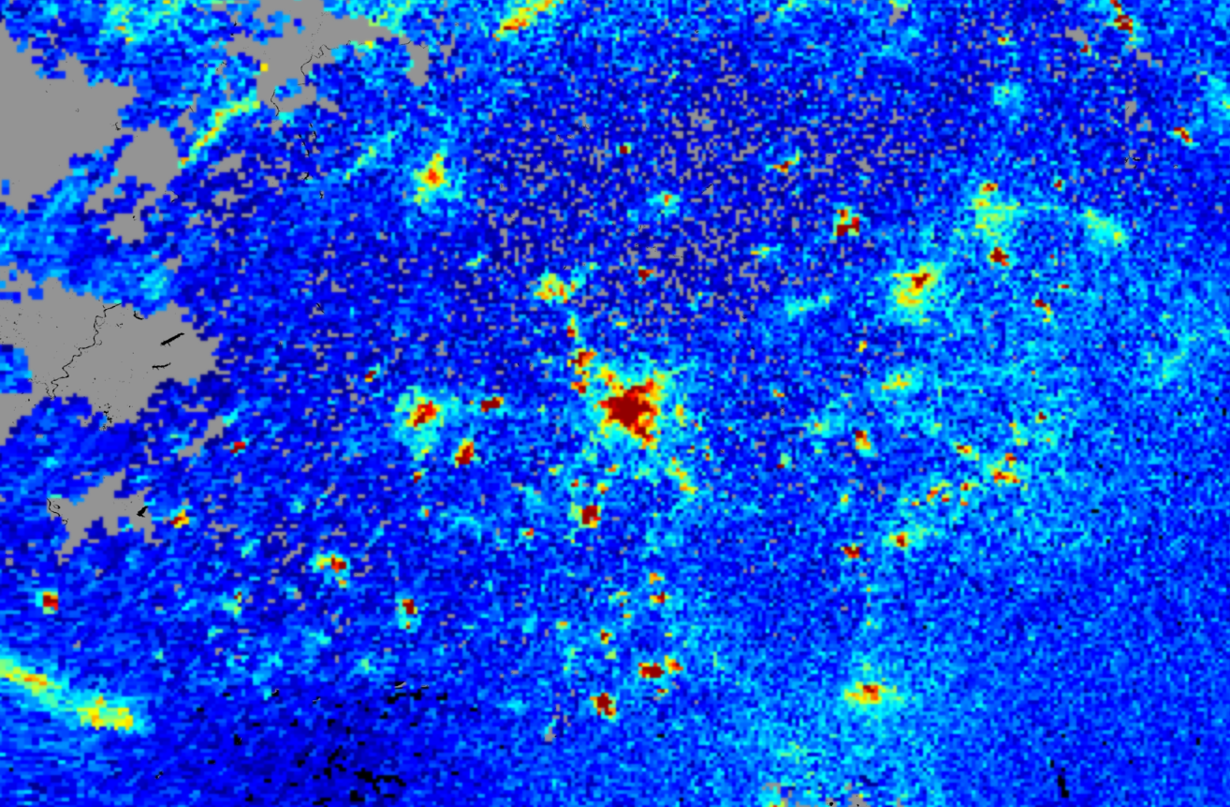
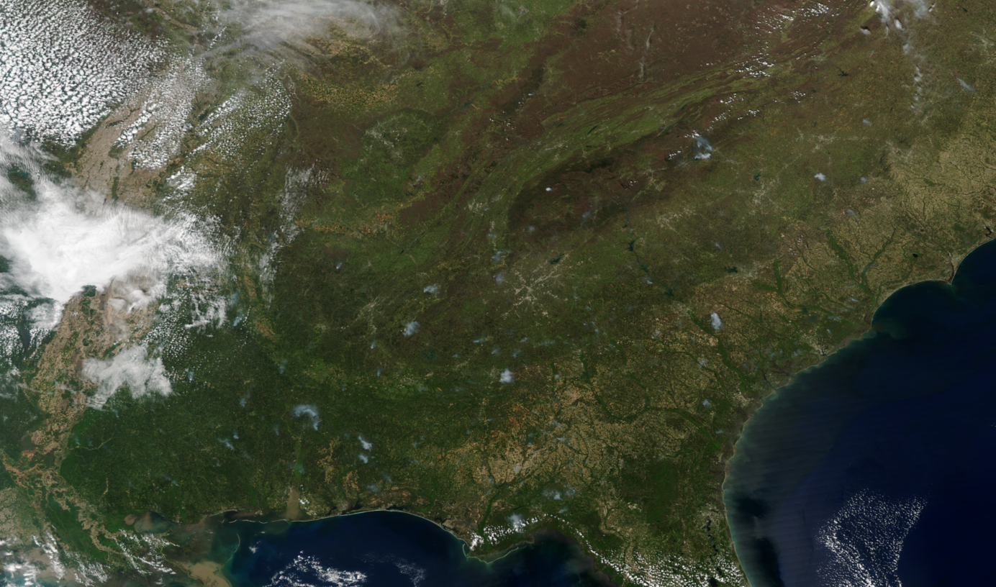

Opportunities: Hourly TEMPO NO₂
TROPOMI NO₂
Suomi NPP VIIRS
April 5th, 2021
2:30 PM
2:25 PM
Apply hourly TEMPO NO₂ observations to evaluate daytime hourly RAVE NO_{x} emissions in a similar way as with TROPOMI CO observations.
Unlike CO, NO₂ is not long-lived and amount of NO₂ emitted depends on fuel type and fuel consumption.
Analysis of TROPOMI and TEMPO NO₂ data will be carried for different types of fires prior to using in RAVE validation work.

