Slide 1
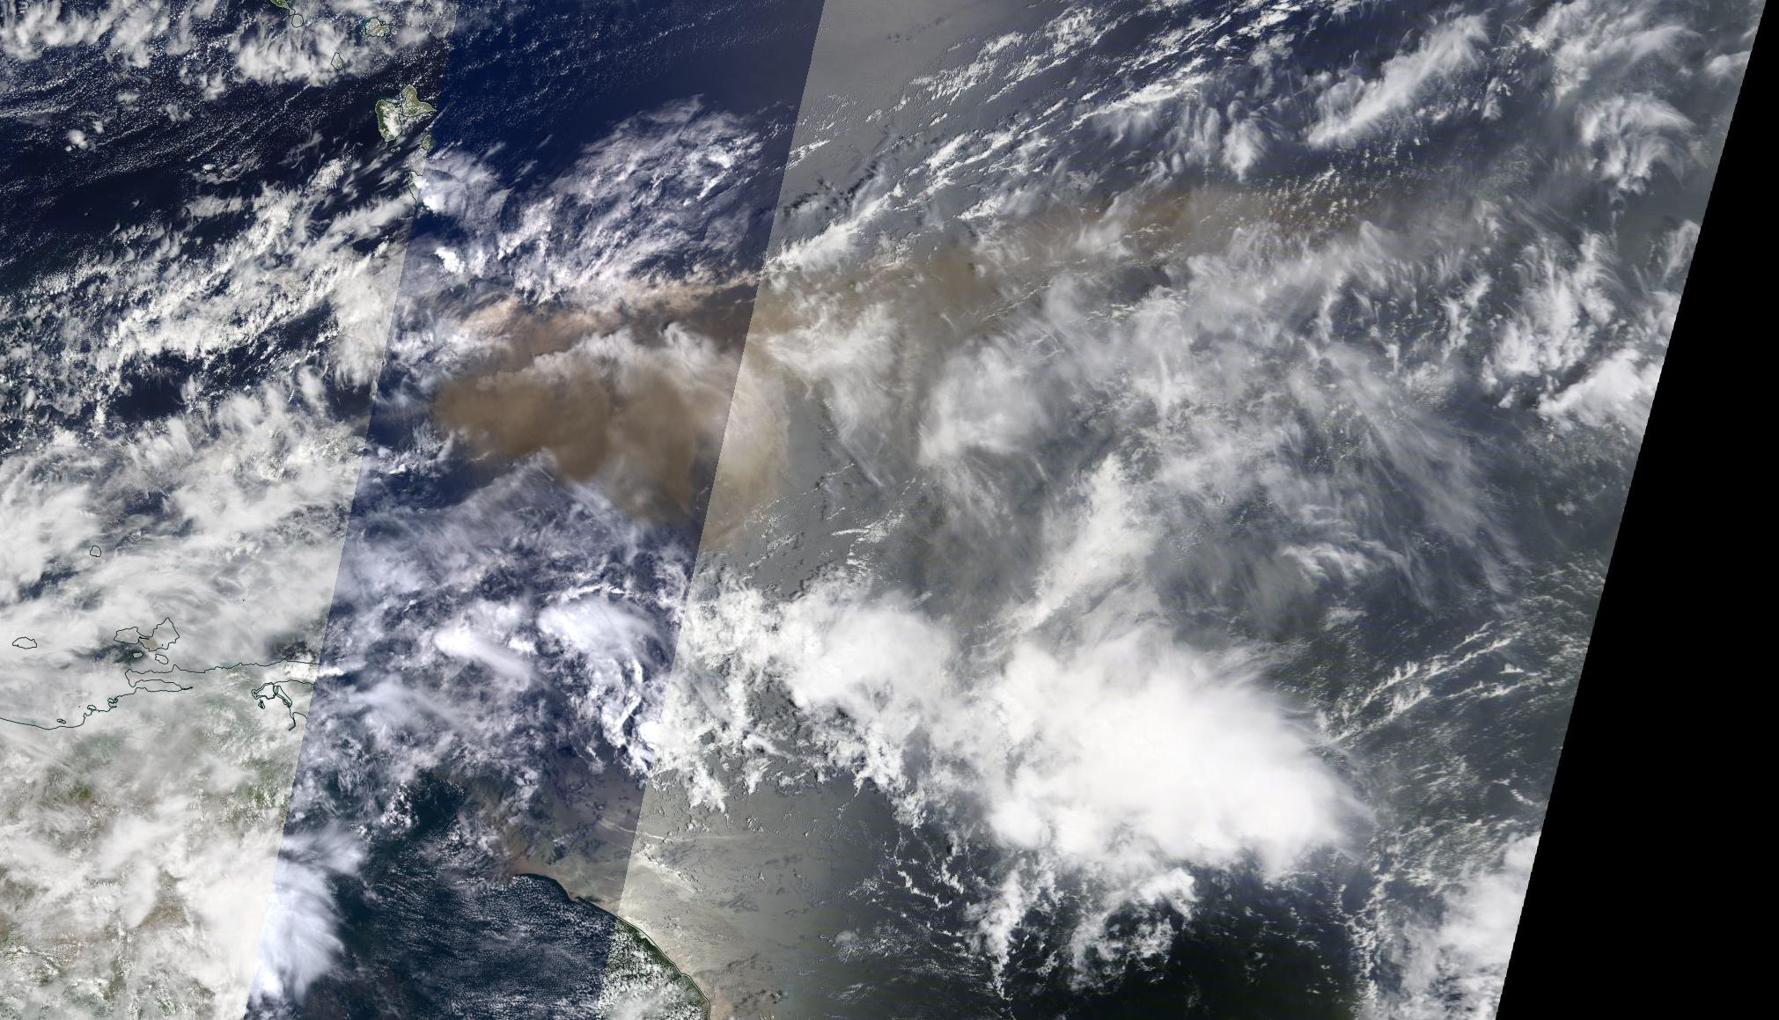
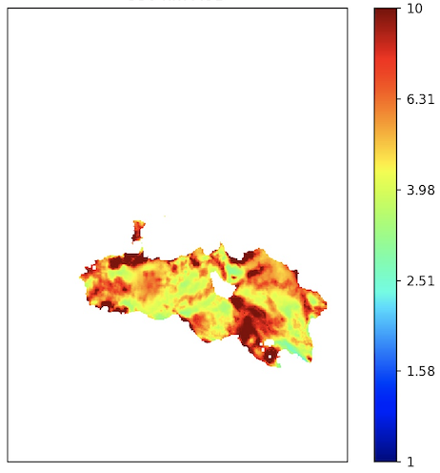
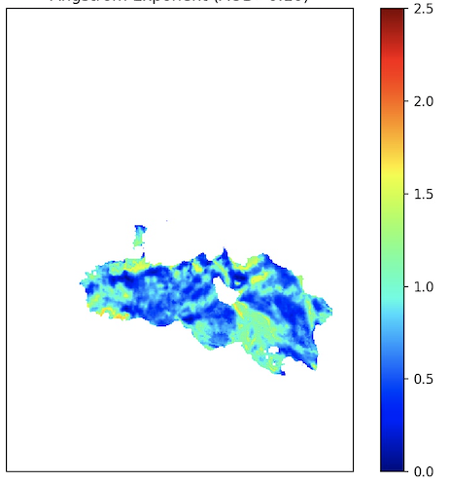
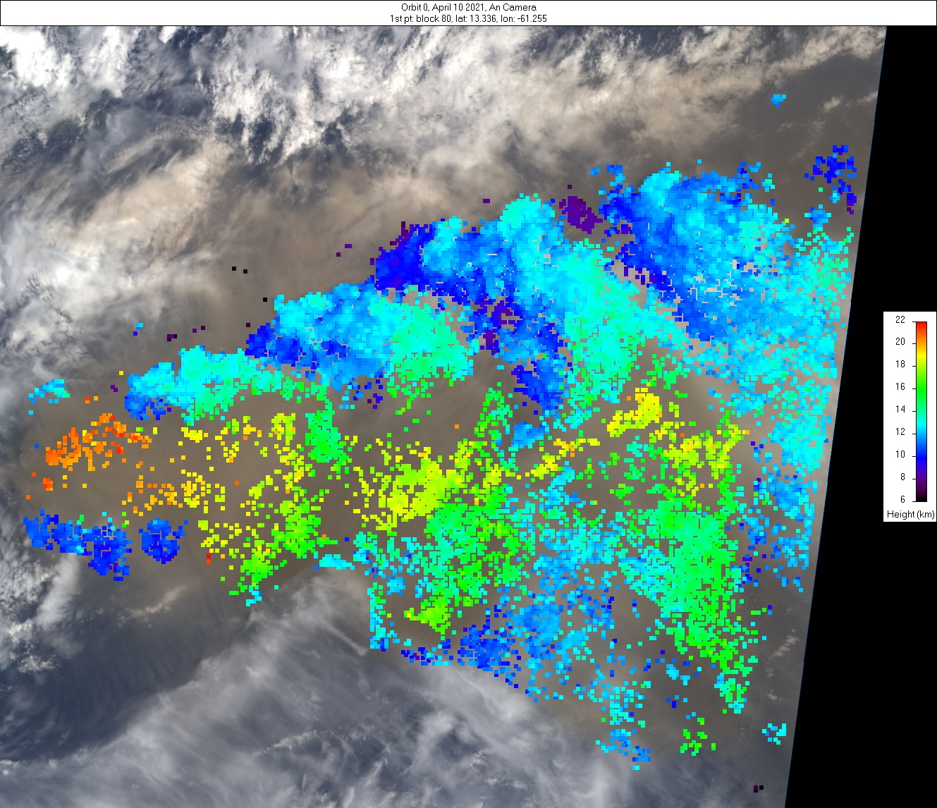
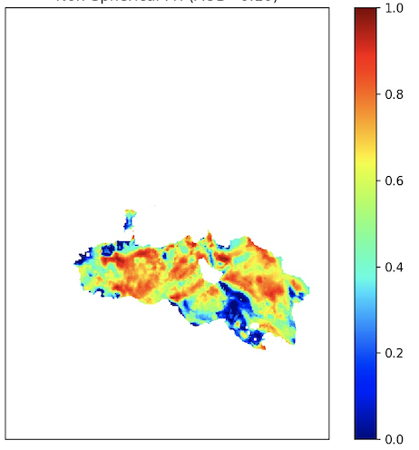
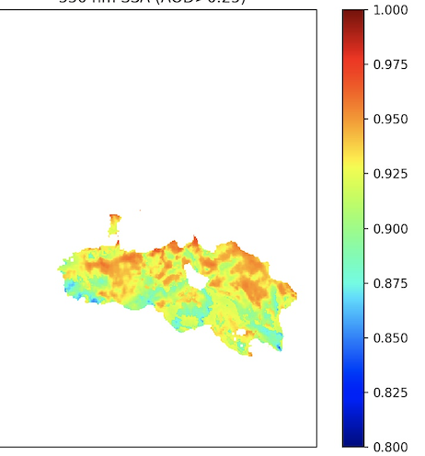
Volcanic eruption plume from La Soufriere Volcano, St. Vincent
MISR Active Aerosol Plume-Height (AAP) Project 10 April 2021
MISR Research Algorithm – Aerosol Amount and Type Retrievals
La Soufriere, St Vincent
The explosive eruption of La Soufriere volcano began on 9 April 2021. On 10 April MISR observed a large plume from the volcano, reaching an altitude of ~18-20 km at its core, with fringes transported at ~12 km. The plume was transported to the east with significant lateral spreading. Visual characteristics indicate ash components. Activity continued for at least several more days, with ongoing eruptions potentially causing regional hazards to populations and aviation.
A
B
Particle
Amount
Particle
Size
Plume region
MISR
MODIS Context Image
AOD (550 nm)
Angstrom Exp.
The plume is visible among significant meteorological cloud, with mid-visible AOD>3; Fig. A) and is dominated by large sizes (Angstrom Exp. ~0.5; Fig B).
C
Particle
Shape
D
Particle
Brightness
The plume shows evidence of non-spherical particles (fraction >0.7; Fig. C) that are light-absorbing (dark) (SSA~0.92; Fig. D). In summary, the MISR Research Aerosol (RA) retrieval algorithm indicates large, non-spherical, light-absorbing (brown) particles, an ash-rich volcanic plume.
Fr. Non-Sph.
SSA (550 nm)
MISR Plume Heights (ASL)
J. Limbacher, V. Flower, R. Kahn / NASA GSFC

Slide 2
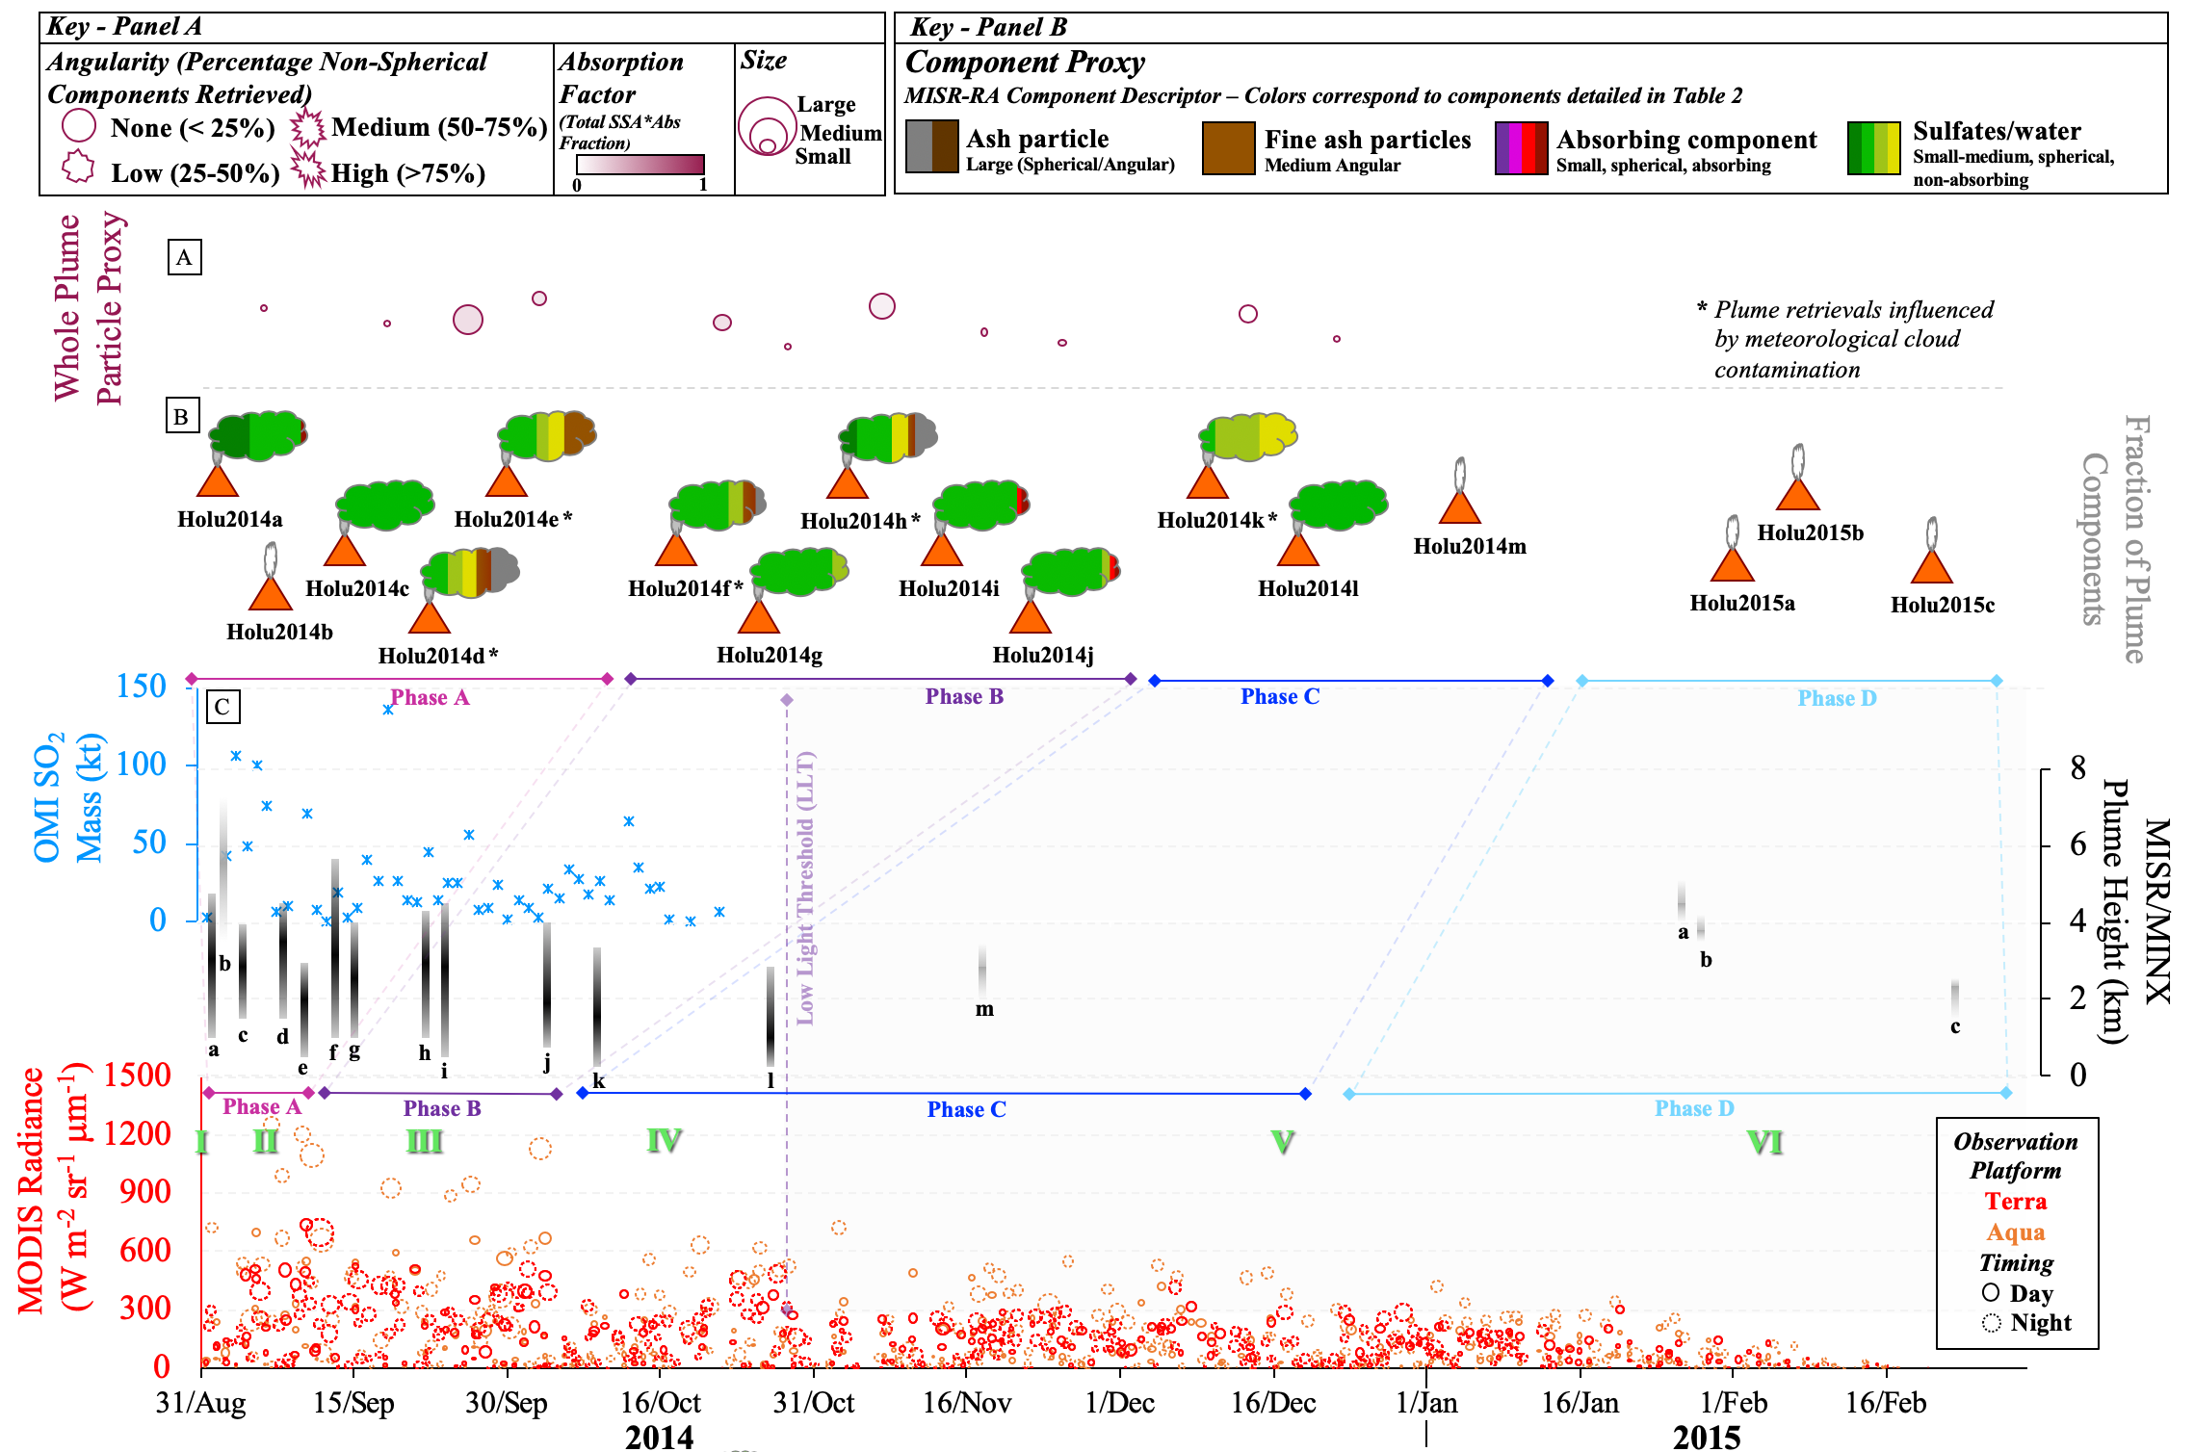
Timeline of Plume Observations – Holuhraun
Aug 2014-Feb 2015
Multi-sensor eruption assessment
Particle properties relatively constant as the eruption progressed (minor variations due to cloud contamination)
Retrievals dominated by small, spherical, non-absorbing components
As the eruption progressed there were decreases in:
plume detection and height
SO₂ emission
lava flow detection
Overall higher thermal radiance and large flow area than observed at Eyjafjallajökull
Flower & Kahn JGR., 2020
Notes:
Known to be a sulfate

Slide 3
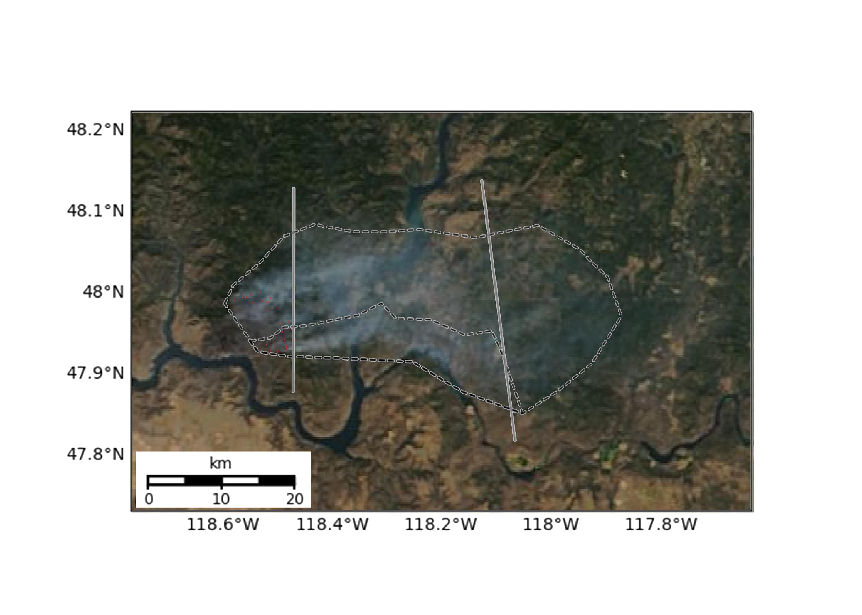
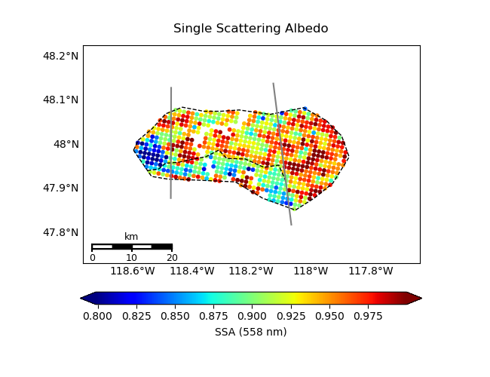
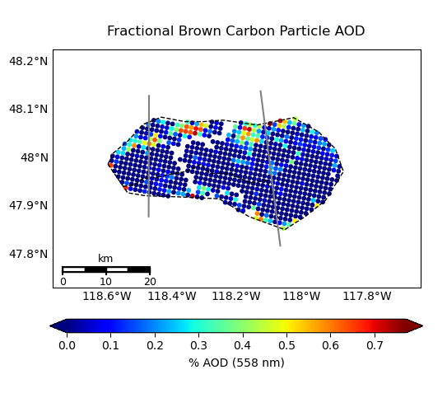
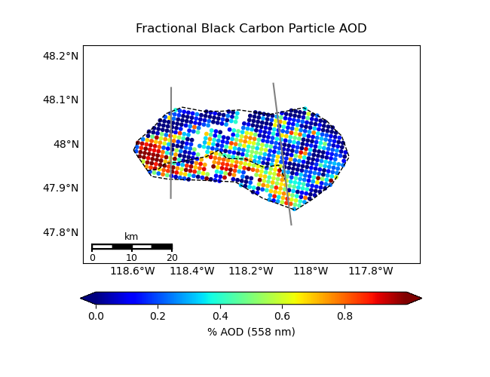
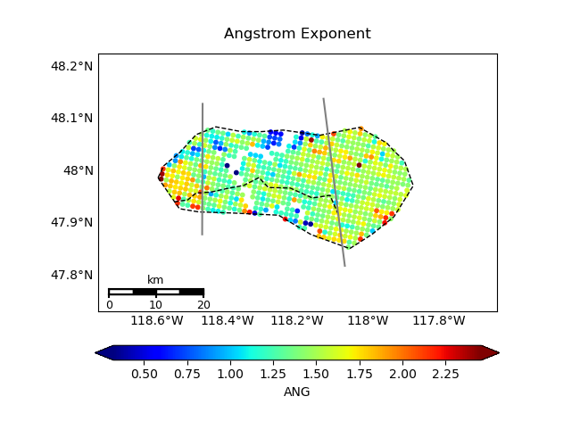
Williams Flats Fire Complex, Washington
06 August 2019 (FIREX-AQ Campaign)
From Particle Type, can infer:
Processes & Timescales
~33 mins aged
~140 mins aged
~200 mins aged
SSA ~ particle brightness
• Oxidation progressively along plume
• Region II: Coagulation or hydration
• Region III: Gravitational settling
• Region IV: More BC from SW fire
• Validated w/FIREX in situ data
• Can now use MISR data globally,
where field data are lacking
II
I
III
IV
Terra/MODIS 19:07 UTC
Brown Smoke AOD Fraction
Black Smoke AOD Fraction
ANG ~ 1/particle size
Junghenn-Noyes, Kahn, et al. 2020

Slide 4
Backup Slides

Slide 5
Variables of Interest will depend on the composition and elevation of the eruption plume…
TEMPO Variables Likely of Use
Aerosol: AOD, AAOD, UV-AI
Plume Height: UV-B
Related Volcanic Gases: SO₂, H₂O
Related Wildfire Gases: H₂C=O (Formaldehyde);
possibly C₂H₂O₂ (Glyoxal)
Other Space-based Resources Likely to Contribute
Fire, Volcano Hotspots: MODIS/VIIRS 4-micron thermal anomaly
Aerosol Particle Size, Shape (ash/sulfate): MISR; PACE HARP-2
Plume Extent; Height; Particle Properties: GOES ABIs

Slide 6
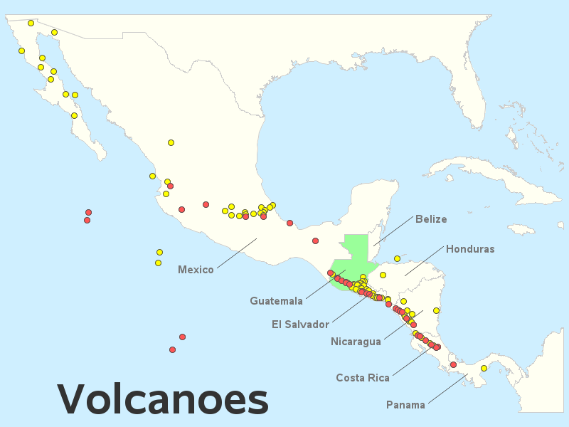
Green Paper – Central American Volcanic Plumes:
TEMPO High-Temporal-Resolution Aerosol & Gas Observations
Ralph Kahn¹, Verity Flower², James Limbacher³, Kathleen McKee⁴, Katherine Noyes¹, Aaron Naeger⁵
¹NASA Goddard Space Flight Center, ²U. of Stirling, ³NOAA, ⁴Vanderbilt U., ⁵U. Alabama Huntsville
Note: Pixel resolution becomes higher toward the equator
17.5°N
15.5°N
Eruption Observed
Eruption Credible
Can we extend the southmost scan operations even further,
to cover as many potentially active volcanoes as possible?

