Slide 1
Direct estimates of biomass burning NO_{x} emissions from satellite observations
Xiaomeng Jin
Rutgers University

Slide 2
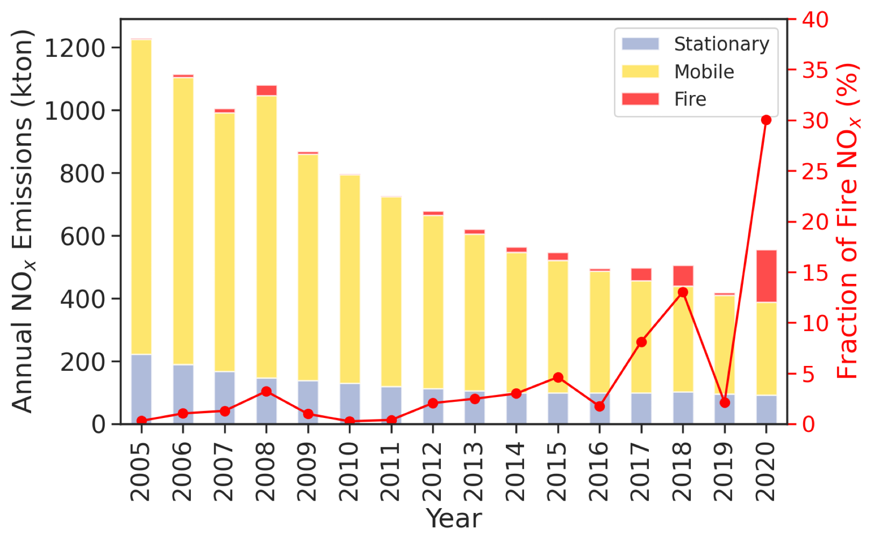
The increasing importance of wildfires to NO_{x} emissions in California
Jin et al., in prep

Slide 3
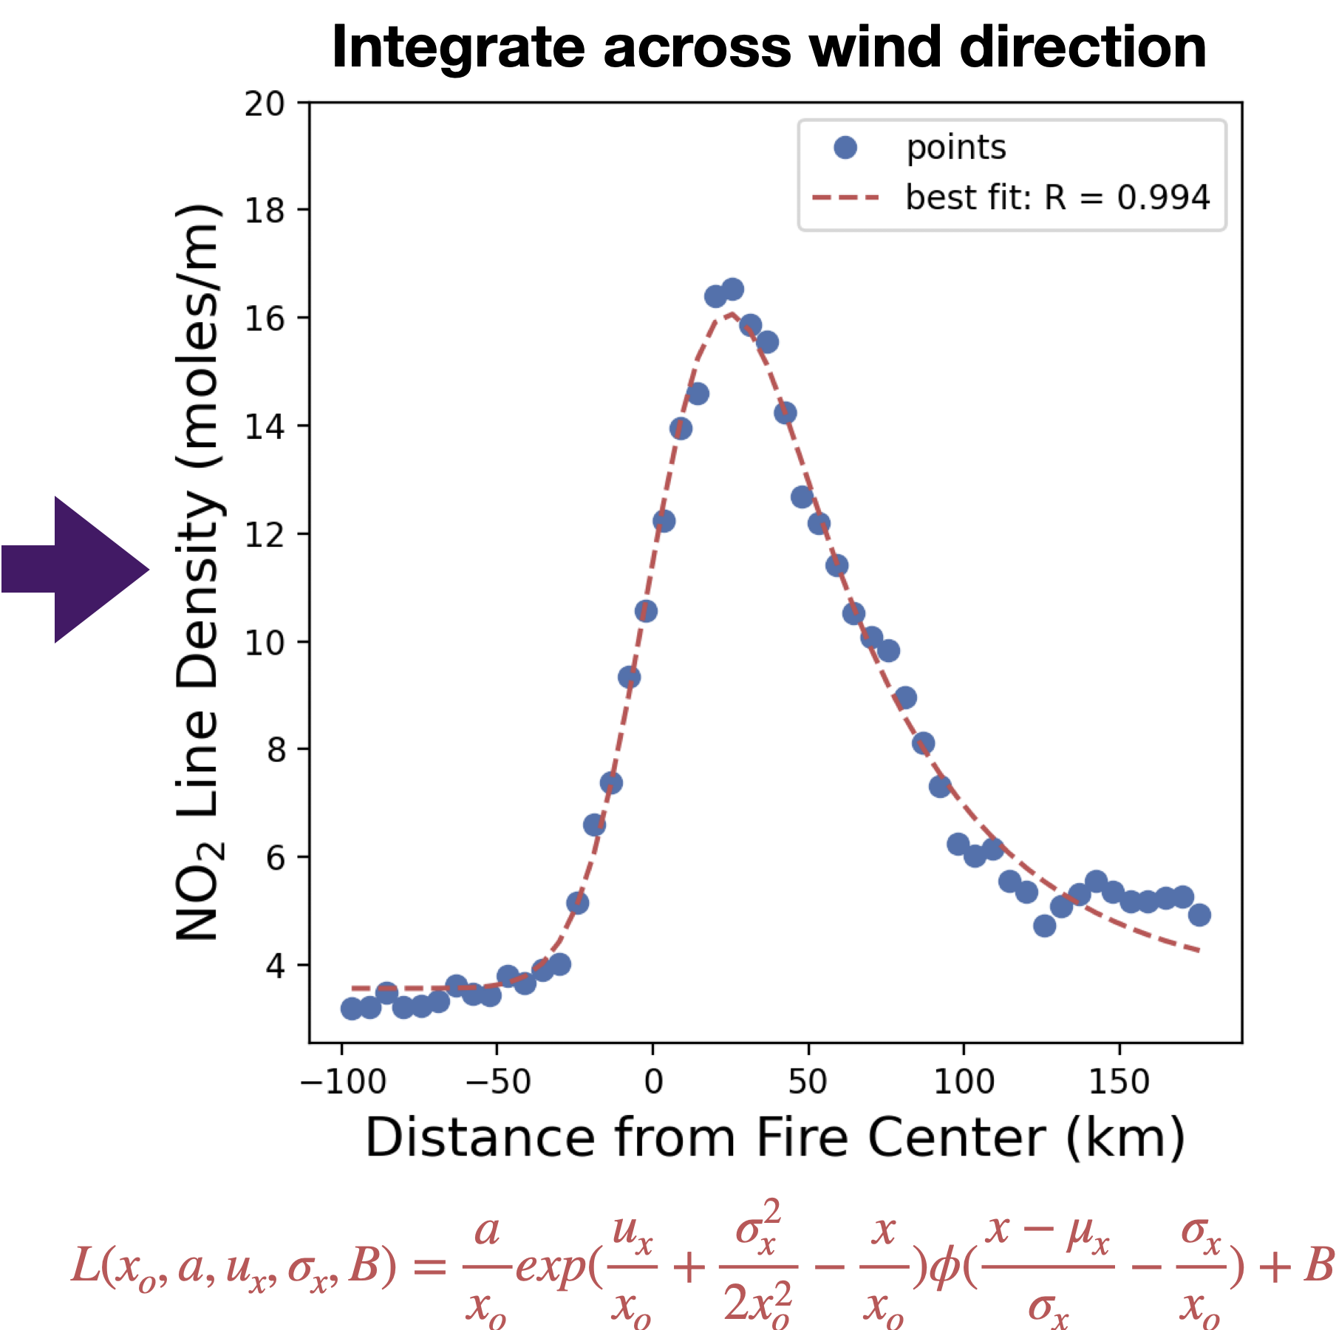
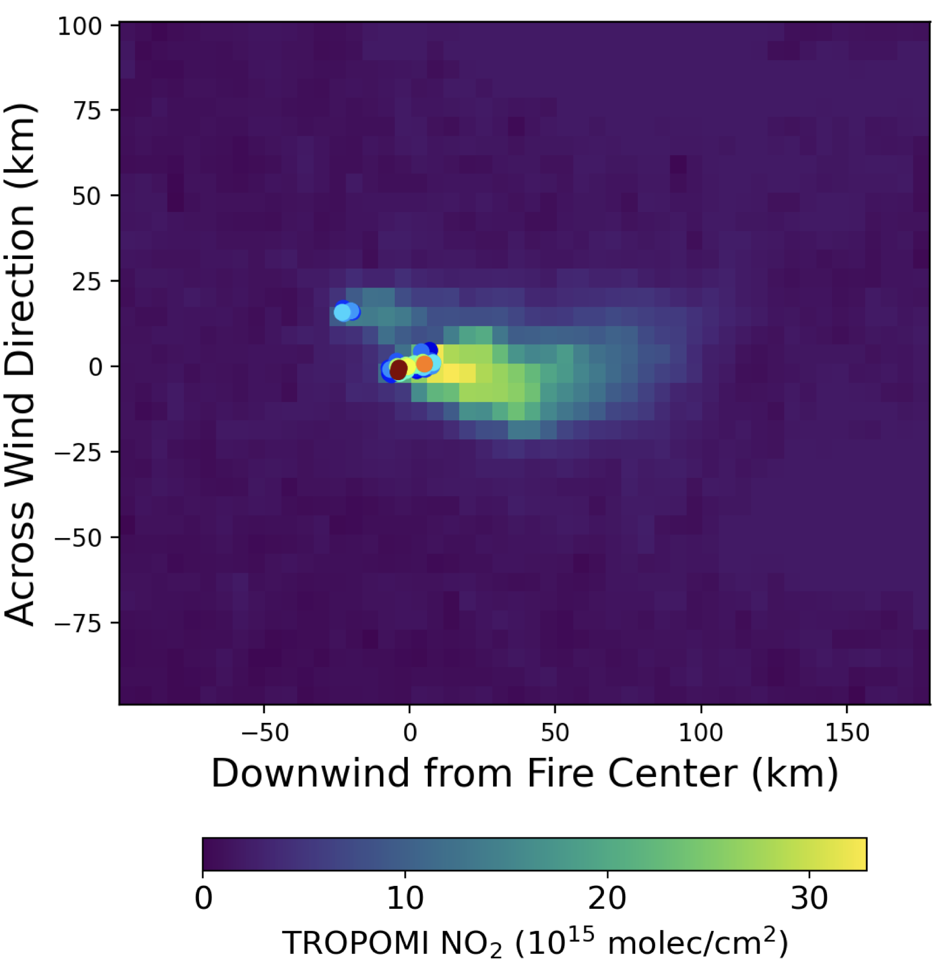
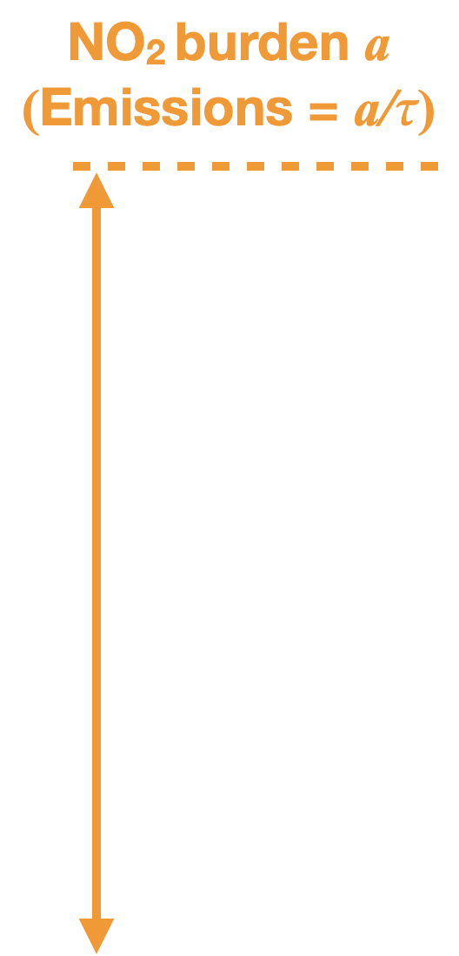
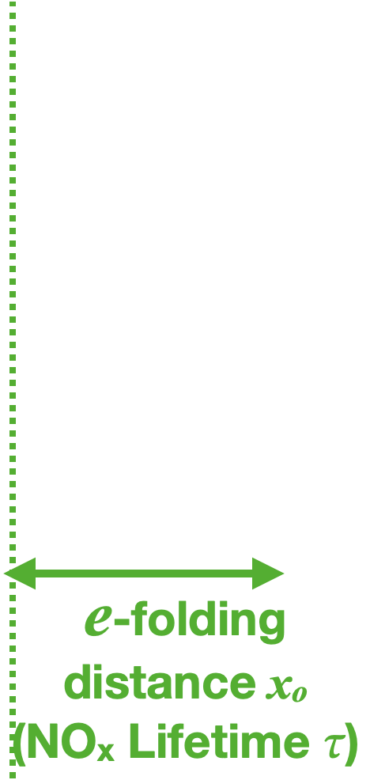
Direct estimates of NO_{x} emissions and lifetimes from daily TROPOMI observations
Rotated TROPOMI NO₂ along wind direction
Jin et al., 2021

Slide 4
TEMPO offers continuous observations of fire plumes: Opportunities and Challenges
Opportunities:
Emission changes with fire progression.
Evolution of reactive nitrogen from fires.
More fires will be detectable from space.
Challenges:
Optimal observational frequency for fast-changing processes.
Uncertainties of satellite retrievals (effects of smoke aerosol, injection height, cloud).
How should we use satellite NO₂ to improve biomass burning emission inventories?

