Slide 1
Science with steep horizontal gradients
Moderator: Ron Cohen, UC Berkeley
What new science can be done with observations of steep gradients in column O₃, NO₂, H₂CO, aerosol or in the expected PBL ozone product?
How well can TEMPO resolve steep horizontal gradients in trace gases and aerosols?
Urban/rural, Coastlines, within an urban area?
Do we need to do better than the standard algorithms for O₃, NO_{x}, H2CO or aerosol? (please suggest a possible metric for the improvement and a path to achieving that goal).

Slide 2
TEMPO Data Products Baseline + SNWG 2020 NRT + SNWG 2022 NRT/Enhanced
Level | Product | Algorithm | Major Outputs | A Priori (L2) | Res km^{2 *} | Freq/Size
L0 | Digital counts | Raw to L0 | Reconstructed/reformatted digital counts |  | 2.0 x 4.75 | Daily/hourly
L1-b | Irradiance ^{NRT} | SAO L0-1 | Calibrated & quality flags |  |  | daily
 | Radiance ^{NRT} | SAO L0-1 | Geolocated, calibrated, viewing, geolocation & quality flags |  | 2.0 x 4.75 | Hourly, granule
L2 | Cloud ^{NRT} | OMI O₂-O₂ | Cloud fraction, cloud pressure | GEOS-CF | 2.0 x 4.75 | Hourly, granule
 | O₃ profile | SAO O₃ profile | O₃ profile, total/strat/trop/0-2 km O₃ column, errors, a priori, AKs | Climatology + GEOS-CF | >= 8.0 x 4.75** | Hourly, granule
 | Total O₃ | TOMS V8.5 | Total O₃, AI, cloud fraction | Climatology | 2.0 x 4.75 | Hourly, granule
 | NO₂ ^{NRT} | SAO trace gas, BU strat/trop sep. | SCD, strat./trop. VCD, error, shape factor, scattering weights | GEOS-CF | 2.0 x 4.75 | Hourly, granule
 | HCHO ^{NRT} | SAO trace gas | SCD, VCD, error, shape factor, scattering weights | GEOS-CF | 2.0 x 4.75 | Hourly, granule
 | C₂H₂O₂ | SAO trace gas |  | GEOS-CF | 2.0 x 4.75 | Hourly, granule
 | H₂O | SAO trace gas |  | GEOS-CF | 2.0 x 4.75 | Hourly, granule
 | BrO | SAO trace gas |  | GEOS-CF | 2.0 x 4.75 | Hourly, granule
 | Aerosol ^{NOAA NRT} | OMAERUV/UI AOCH | AAI, UVAOD, UVSSA, AOCH, VISAOD |  | 8.0 x 4.75 | Hourly, granule
 | SO₂ ^{NRT} | OMSO2 PCA | SCD, VCD (PBL,TRL,TRM,TRU,STL) |  | 2.0 x 4.75 | Hourly, granule
 | UVB | GEMS/GSFC UVB | UV irradiance, erythemal irradiance, UVI |  | 2.0 x 4.75 | Hourly, scan
L3 | Gridded L2 | SAO L2-3 | Same as L2 |  | 2 x 2 (?) | Hourly, scan
* Spatial resolution at center of FOR. ** Might be at 8 x 9.5 km²
Satellite Needs Working Group (SNWG) will fund TEMPO NRT products (L2 products < 3 hours from observation time): 6/1/2023-5/30/2025
SNWG 2022 Survey has selected to produce TEMPO NRT/Enhanced Productions starting in 2025

Slide 3
Panel
Jun Wang
Tim Juliano
Mike Newchurch
Kai Yang
Angela Dickens
Jeff Geddes
Gonzalo Gonzalez Abad
Chi Li
Sally Pusede

Slide 4

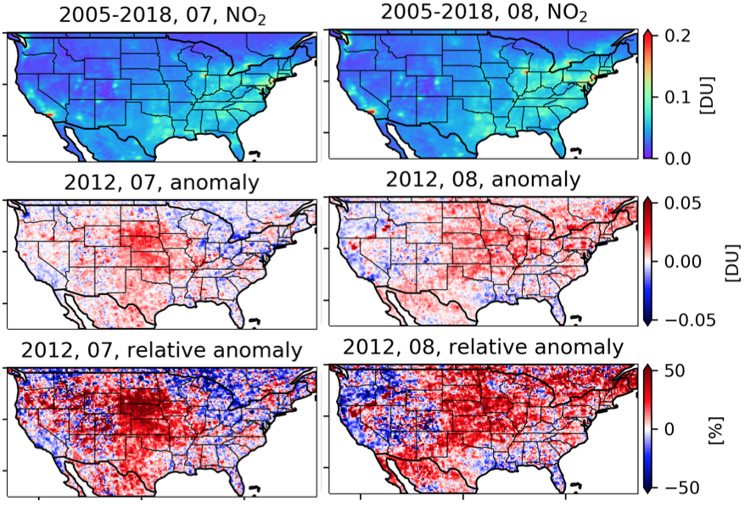
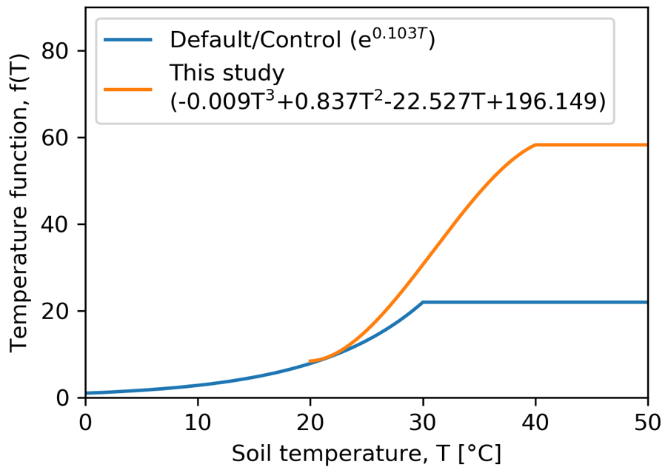
Observation-based insights of emission process dependence of soil NOx emission on temperature
OMI
NO₂
new scheme
old scheme
Wang et al., 2021
Environ. Res. Lett.

Slide 5
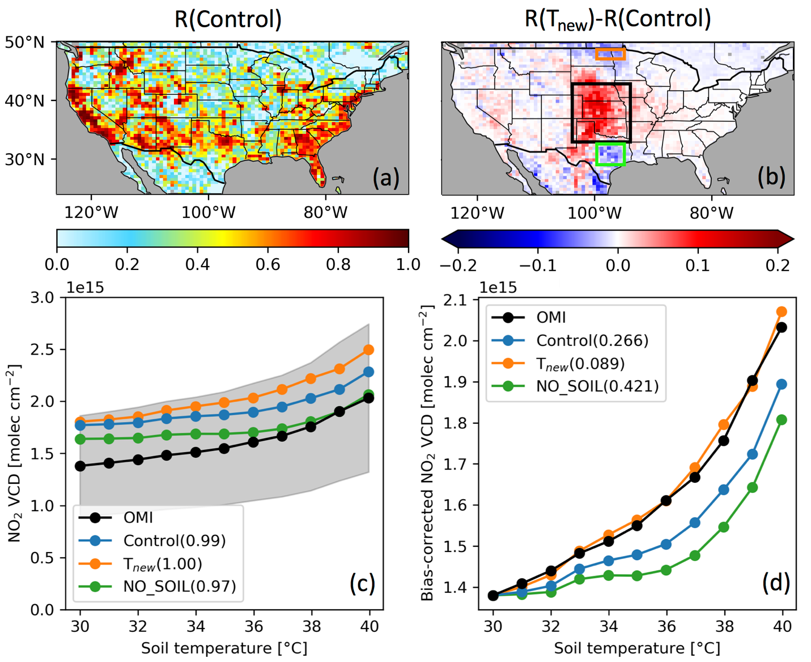
Improved simulation of soil NOx emission
Based on data in 2005–2019 data
Soil and lightning NOx combined emissions trends change from −3.95% a⁻¹ during 2005–2009 to 0.60% a⁻¹ from 2009 to 2019, thereby rendering the abrupt slowdown of total NOx emissions reduction.
Non-linear inter-annual variations explain 6.6% of the variance of total NOx emissions.
Inter-annual variations of either soil or lightning are comparable (slightly larger than anthropogenic sources.
Wang et al., 2021, ERL

Slide 6
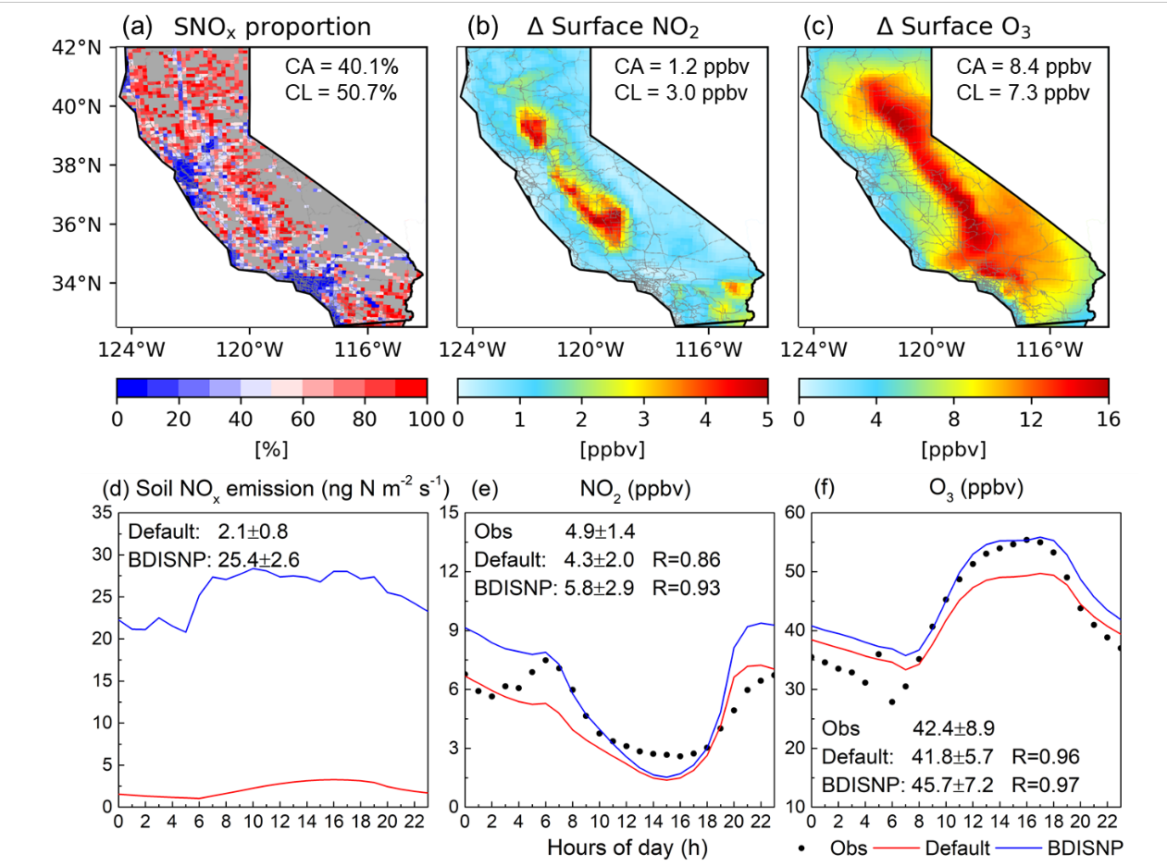
At regional scale, urban vs. rural
SNO_{x} exceed anthropogenic sources over croplands which accounts for 50.7% of NO_{x} emissions
Such considerable SNO_{x} enhance the monthly mean NO₂ columns by 34.7% (53.3%) and surface NO₂ concentrations by 176.5% (114.0%), leading to an additional 23.0% (23.2%) of surface O₃ concentration in California (cropland).
Tong et al., 2021. EST

Slide 7
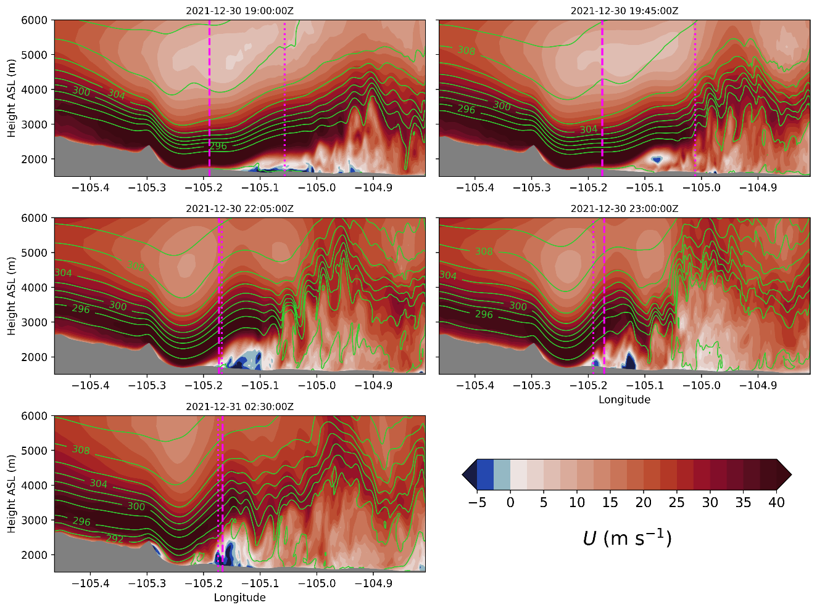
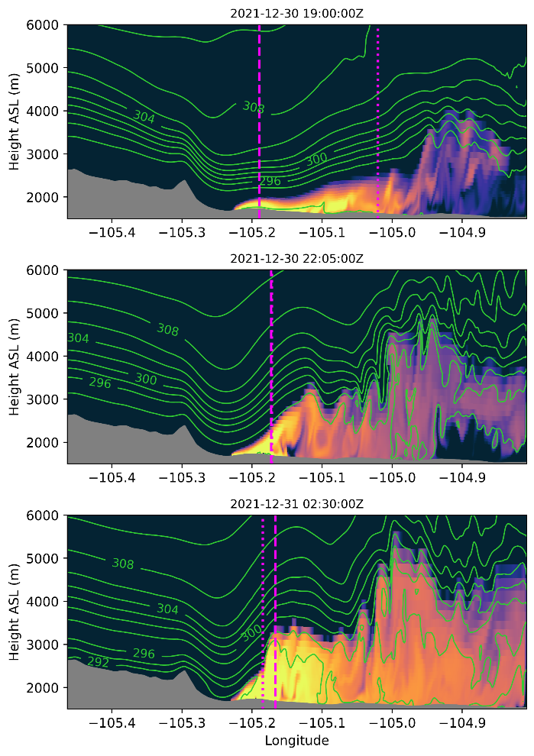
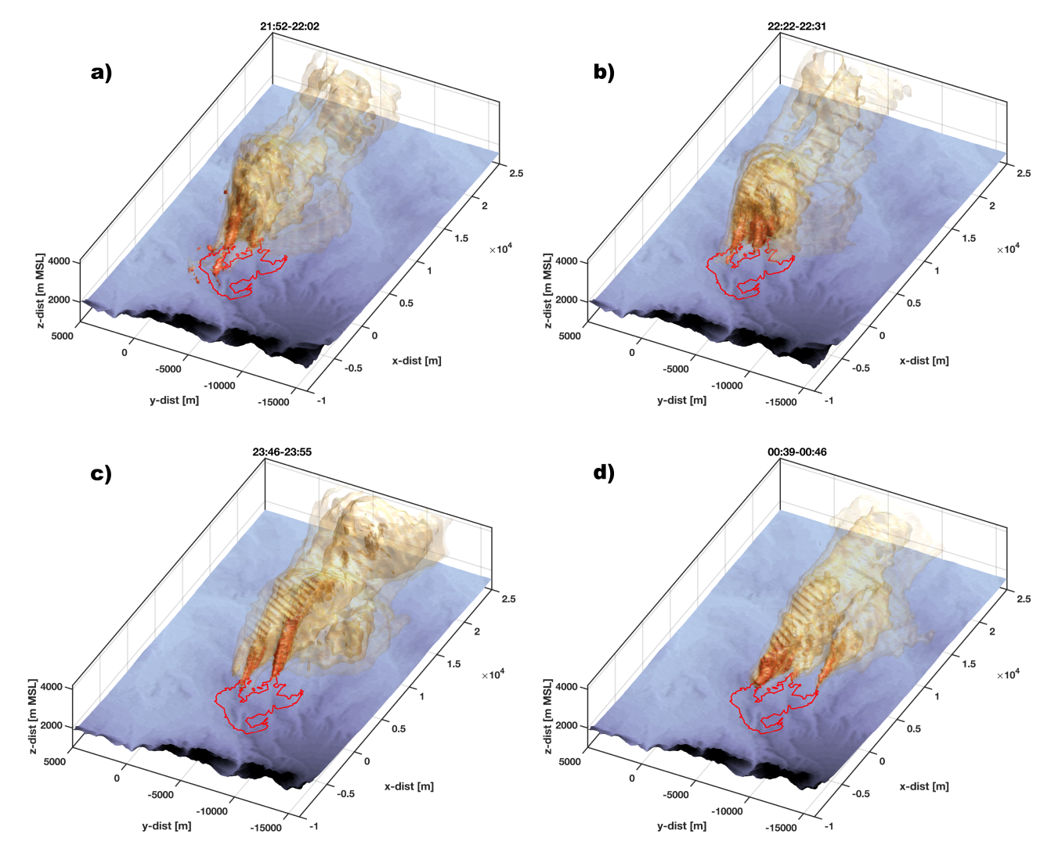

Radar observations and turbulence-resolving simulations of the Marshall Fire show steep gradients in smoke due to flow dynamics
Doppler on Wheels measurements
WRF-LES simulations
T. W. Juliano, N. Lareau, M. E. Frediani, K. Shamsaei, M. Eghdami, K. Kosiba, J. Wurman, A. DeCastro, B. Kosovic, H. Ebrahimian

Slide 8
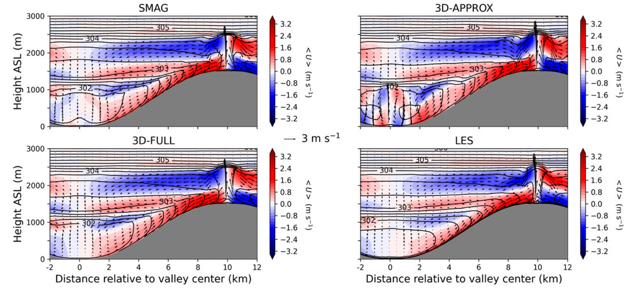
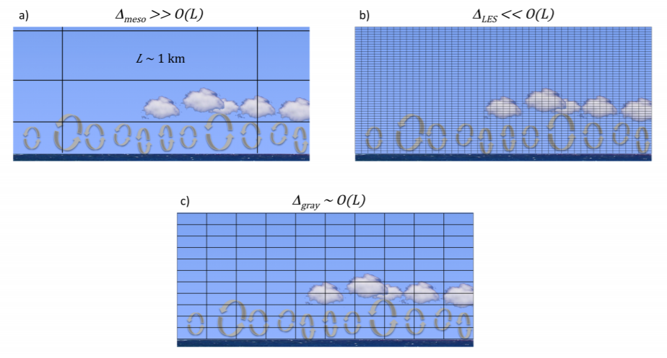
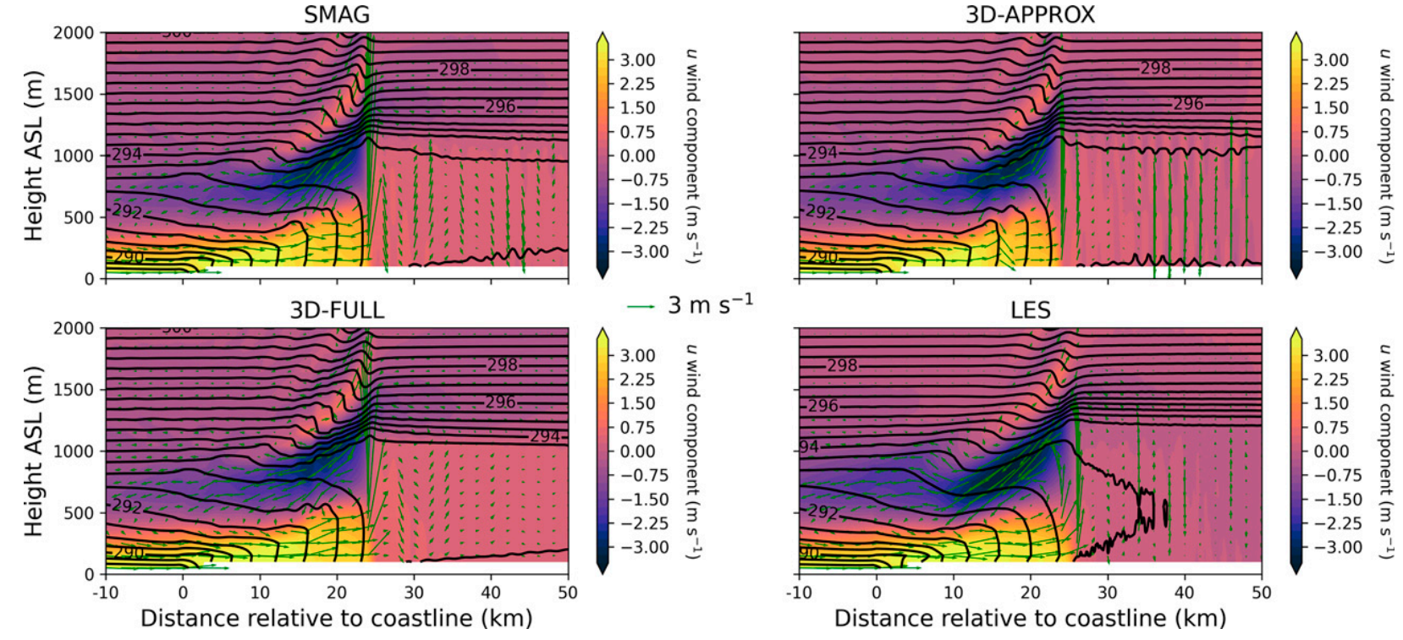
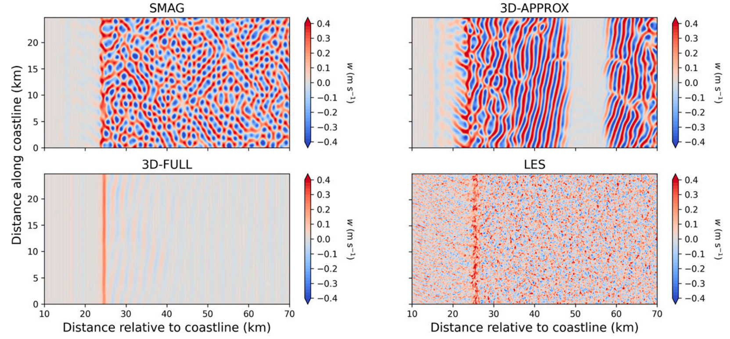
High-resolution mesoscale modeling challenge: “gray zone” turbulence
Two classic examples of BL circulations that generate sharp gradients, with varying characteristics depending on PBL scheme
Mountain-valley circulation
Δ → horiz. grid spacing
L → eddy length scale
Chow et al. (2019)
T. W. Juliano, B. Kosovic, P. A. Jimenez, M. Eghdami, S. E. Haupt, A. Martilli
Sea breeze front circulation (top down view)
Sea breeze front circulation (vertical cross-section view)

Slide 9
Model validation and development, especially in challenging environment where our numerical models often struggle, can be enhanced by TEMPO retrievals
Such rich DOW measurements are typically unavailable for wildfires (also no information about chemistry). Given that we are becoming more reliant on numerical simulations for predicting wildfire behavior (including smoke production, transport, and dispersion), we need to better understand the capabilities and limitations of current coupled fire-atmosphere models. Thus, for wildfires, and especially those in the wildland-urban interface, TEMPO retrievals of smoke chemistry/aerosol will be important.
Parameterizations intended for high-resolution mesoscale modeling, such as those for PBL turbulence, require resolving sharp gradients. However, their development/improvement is often hindered by available measurements. TEMPO retrievals in complex urban and mountainous regions may be very useful to better inform current state-of-the-art model parameterizations, as well as highlight needs for future model developments.

Slide 10
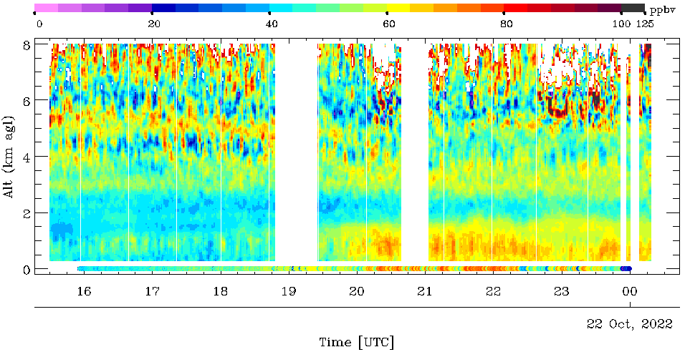
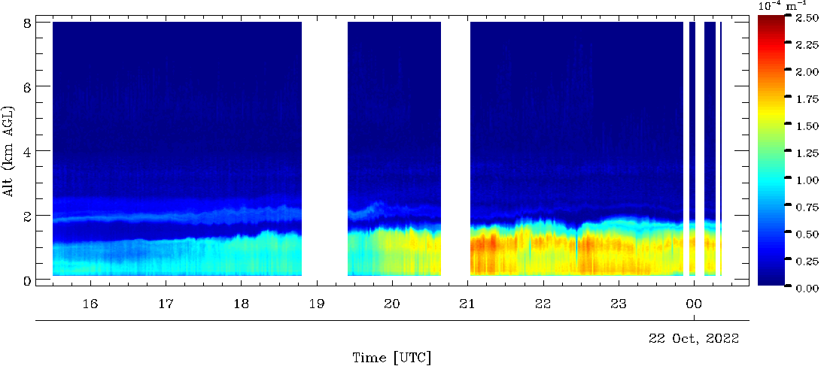
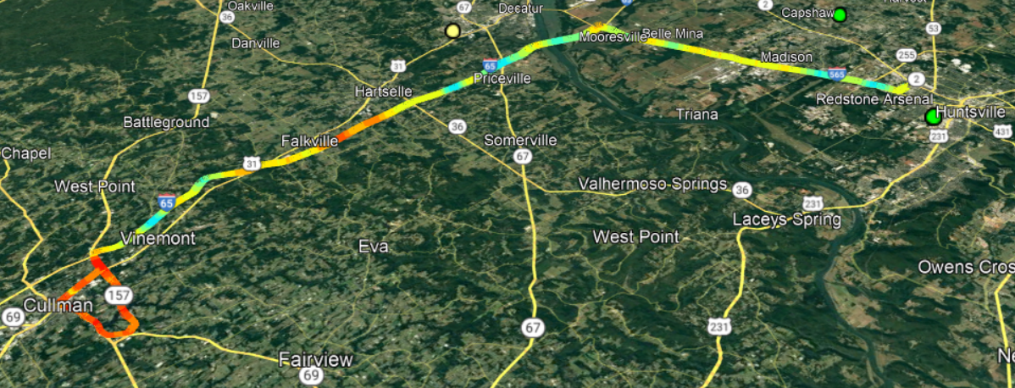
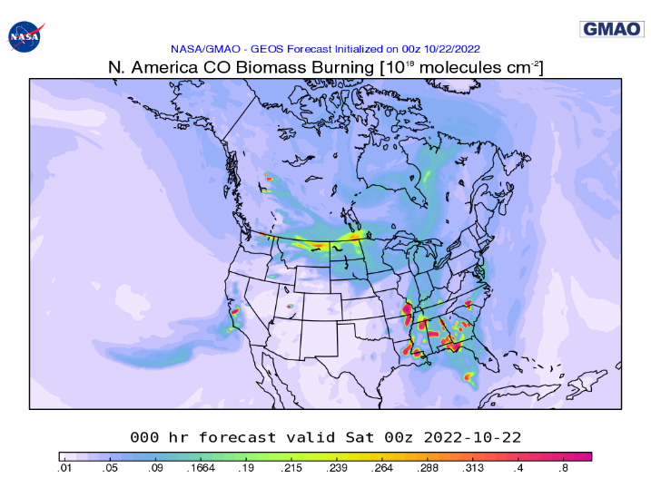
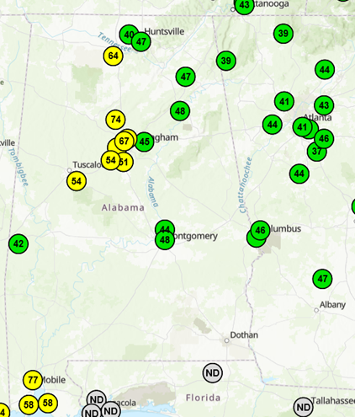
Steep Horizontal Gradients in PBL due to Fire Smoke
M Newchurch, S Kuang, T McKinney, D Stevenson
TOLNet mobile lidar O₃ and aerosol products suggest horizontal gradients in PBL due to local fire burns. The air quality impact from local agriculture fires can be addressed by high-resolution TEMPO products.
PBL dynamics strongly influence the surface impact of PBL ozone and aerosol concentrations.
Interpretation of the relationship between TEMPO PBL O₃ retrievals and surface O₃ will require significant correlative study.
On-road Lidar Aerosol
On-road Lidar O₃
Falkville
Surface O₃
Time (UTC)
Huntsville
Decatur
Return
Cullman
Decatur
On-road Surface O₃
NOAA GMAO BB CO @00z 10/22/22
EPA AQI
10km
North
Airnow O₃ AQI 20z 10/21/22

Slide 11
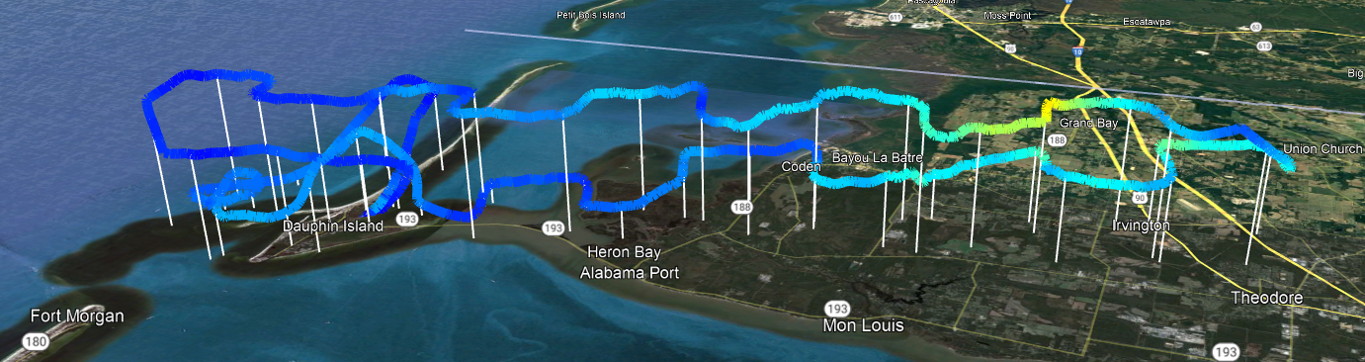
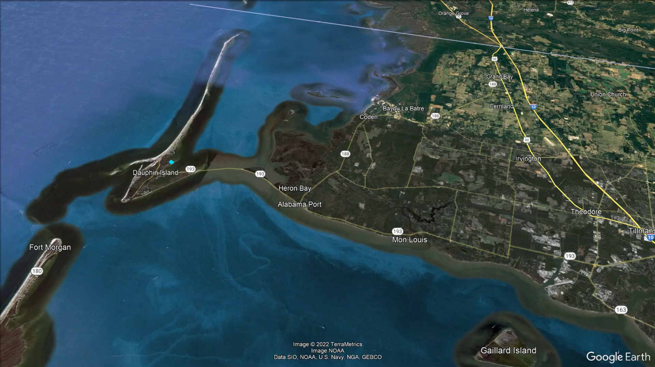

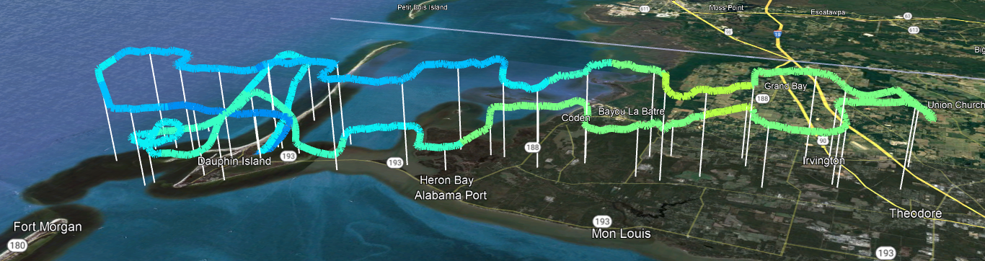
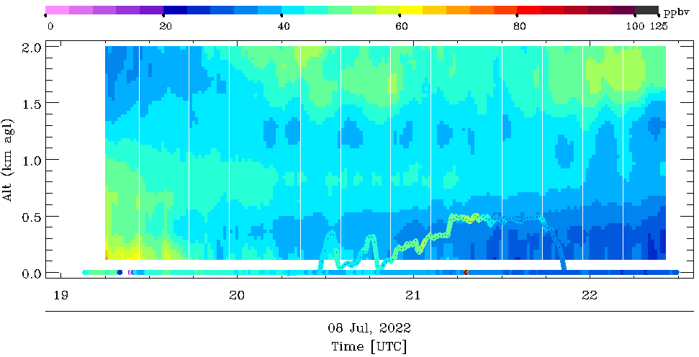
Steep Horizontal Ozone and Aerosol Gradients due to Sea Breeze
M Newchurch, S Kuang, T McKinney, D Stevenson of UAH
Air pollutant removal and enhancement due to sea/gulf breeze have been observed at coastal sites. We should quantify the ability of TEMPO to measure the steep horizontal gradients resulting from these smaller-than-synoptic-scale processes.
The combination of surface instruments, lidars, and aircraft measurements provides critical information to assess TEMPO precision, accuracy, and application to air-quality diagnoses and forecasting.
We should expect to find steep gradients in many constituents at TEMPO and sub-TEMPO scales.
SeaRey PM2.5, Dauphin Island, AL, 7/8/2022
x10 µg m⁻³
SeaRey O₃
0.5km
0km
5km
SeaRey O₃
Flying direction
Lidar O₃
SeaRey O₃
Wind
Lidar location
North
Surface O₃
Notes:
Notes: Alt axis timed factor of 10.

Slide 12



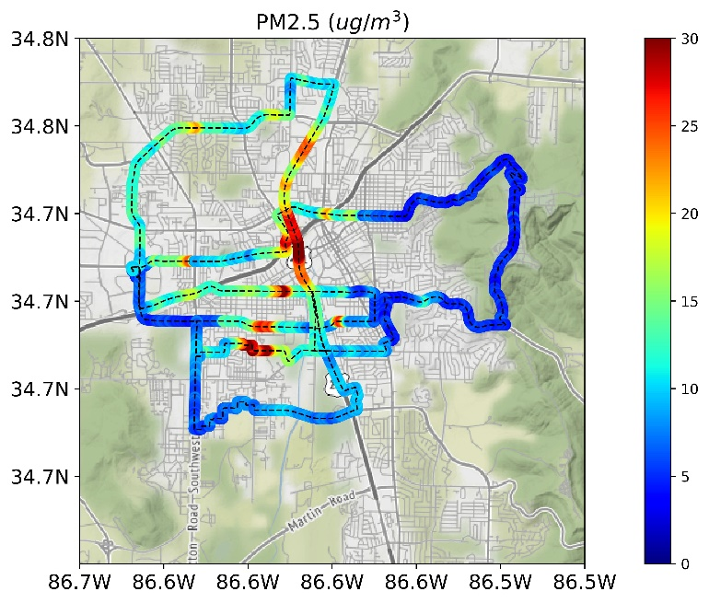
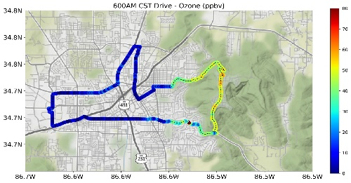
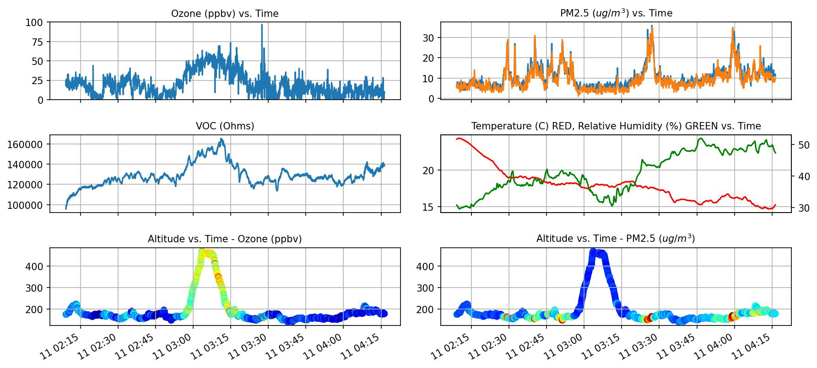
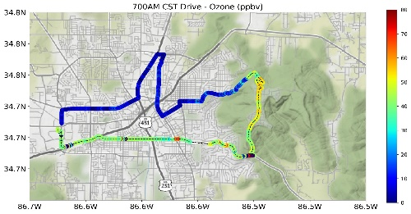
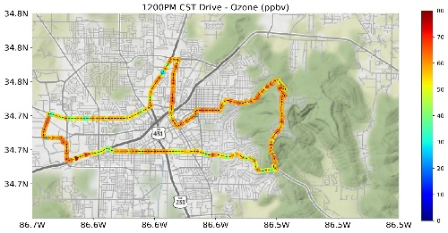
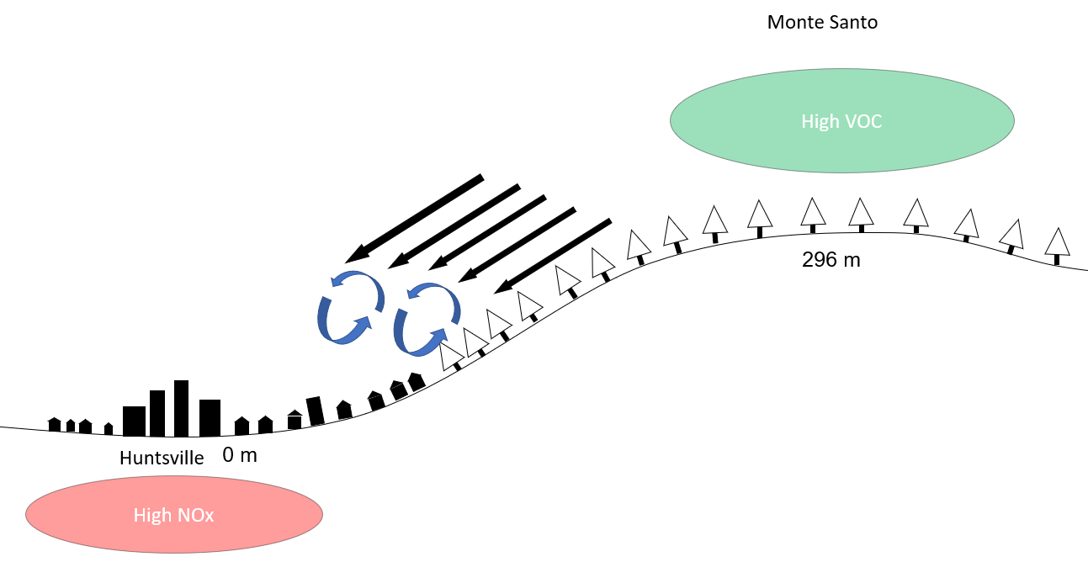


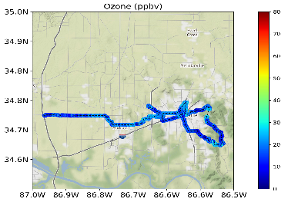
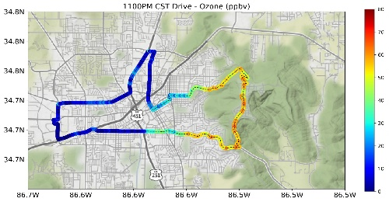


Exploring Spatial and Temporal Air Quality Gradients using a Mobile Vehicle – The Road to TEMPO Evaluation
Team RO3QET at University of Alabama at Huntsville has measured gradients in air quality at fine scales from a mobile vehicle. These measurements offer precise insight into the planetary boundary layer (PBL) air quality and spatio-temporal structures that will be measured by TEMPO.
$, {{{\text{Todd} \text{McKinney}}^{1}\text{,}{ \text{Mike} \text{Newchurch}}^{1}\text{, }\text{Shi} \text{Kuang}}^{1} }^{ },{\text{Susan} \text{Alexander}}^{1}, {\text{Paula} \text{Tucker}}^{1}, {\text{Darby} \text{Stevenson}}^{1},$
${\text{Mason} \text{Mills}}^{1}$, ${\text{Nick} \text{Perlaky}}^{1}$
(1) Department of Atmospheric and Earth Science, The University of Alabama in Huntsville
Urban Plumes in Stable Layers
In Huntsville, during the night, urban pollution is trapped at the surface by stable layers, resulting in the common occurrence of urban plumes. These plumes have been observed to descend on urban regions at varying times and locations, often without predictability.
NOx vs. VOC Regimes
We have shown the presence of spatial and temporal gradients in the Huntsville area, which can be attributed to the differences in VOC and NOx dominated regimes between the city and higher forested elevations to the east, respectively.
from 11 April 2023 Campaign:
(a)
1 km
(a)
1 km
(b)
1) Gradient in ozone mixing ratios between Monte Santo and Huntsville; same gradient that was mensurated at 6AM was measured 17 hours latter at 11PM LT.
2) Higher ozone and VOC on Monte Santo. Higher ozone remains even after evening transition.
Figure 2: (a) PM2.5 measurements made during night time in Huntsville 11 April 2023, (b) PM2.5 vs. time (UTC) of drive with plumes notated with arrows.
Homogenized PBL
Apart from measuring steep gradients, we also aim to assess the accuracy and precision of TEMPO measurements within well-defined columns by measuring homogenized, well-mixed layers.
(b)
1 km
Figure 1: (a) Ozone data collected from 11 April 2023 drives at different times, (b) Concept of mountainous winds blowing VOC dominated air into NOx dominated regimes
Figure 3: Ozone data during a clean day on 14 April 2023 after rain showers.
Joint Science Meeting for TEMPO, GeoXO ACX, & TOLNet in Huntsville, AL USA May 1-5, 2023

Slide 13
Resolution Enhancement with Spatial Downscaling
Kai Yang and Xinzhou Huang
University of Maryland College Park
A pixel value represents the mean value within the footprint ( e.g., ~ 2.1 x 4.5 km² for TEMPO). Spatial variation inside a pixel cannot be observed from a single measurement.
Enhanced resolution (smaller footprint size) may be obtained when relative spatial distribution is known.

Slide 14
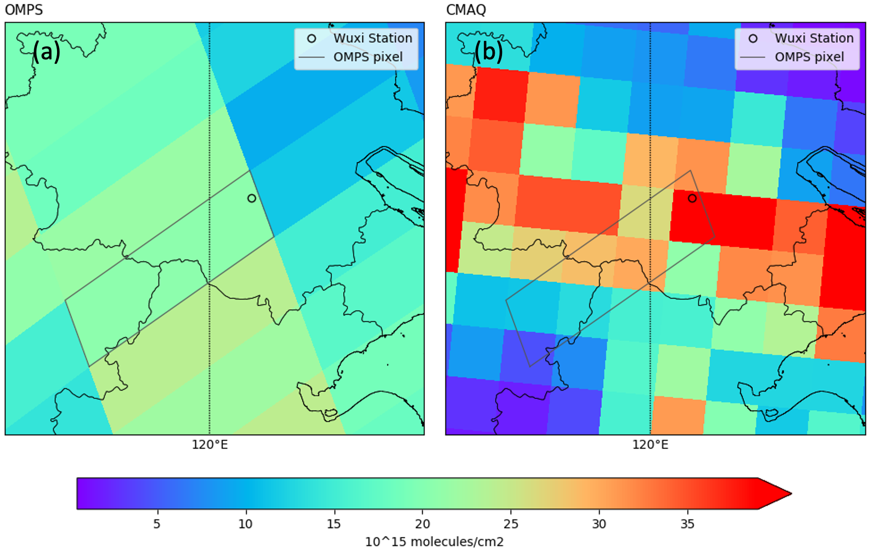
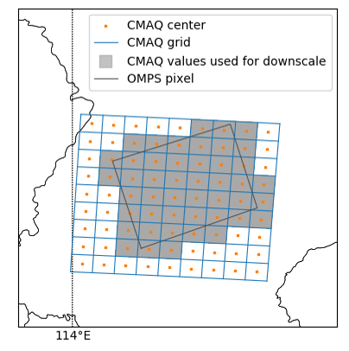
An Example: SNPP OMPS NO₂
50 km x 50 km @ nadir 30 km x 30 km
Generate a reconstructed OMPS pixel with finer structure.

Slide 15
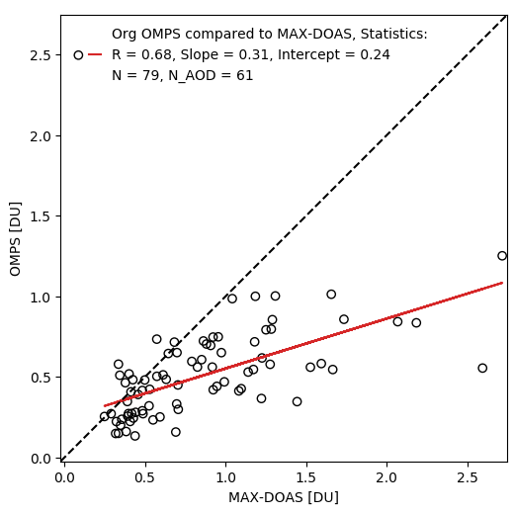
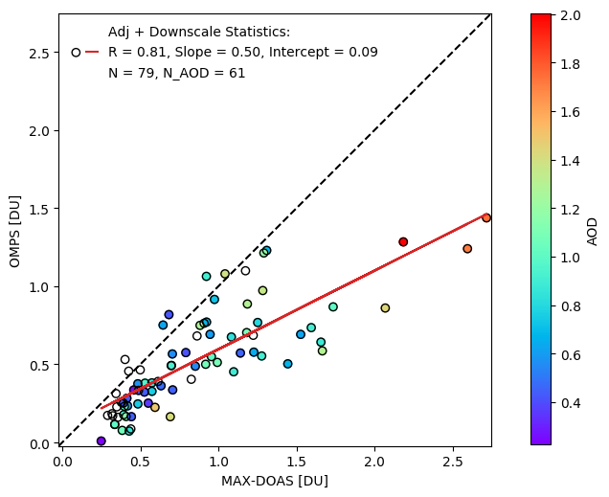
Improved agreement with enhanced resolution
Wuxi station
Jan, Mar, Jul, Oct of 2014

Slide 16


Steep Gradients in NO₂ and Ozone in the
Great Lakes Region
Angela Dickens, Ph.D.
Mark Janssen and Zac Adelman
Lake Michigan Air Directors Consortium
Brad Pierce
University of Wisconsin-Madison

Slide 17
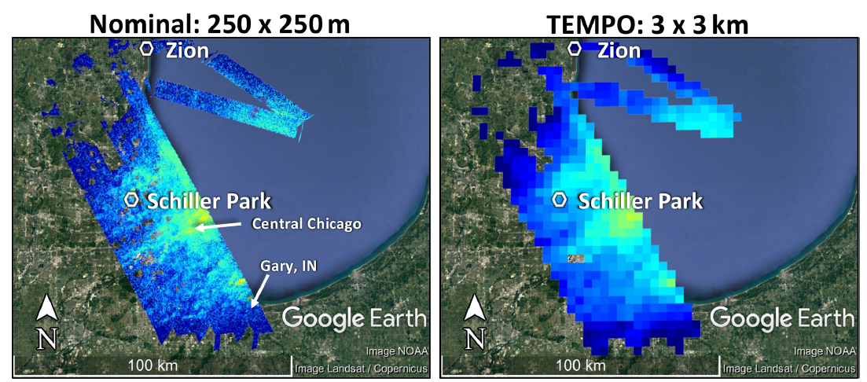
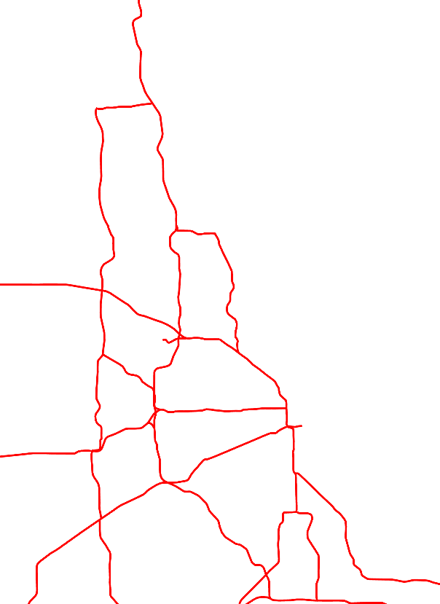
Urban NO₂ Gradients: Distinguishing Contributions from Traffic and Land Use Patterns
Presence/absence of sharp gradients in NO₂ along highways from GeoTASO flights suggests under-estimates of heavy-duty vehicle emissions
Neighborhood-scale gradients in NO₂ could identify disparate ambient pollution emission sources
Relevant to non-point inventories as well as environmental justice
Very important to resolve this to improve inventories
Judd et al., 2019, Atmos. Meas. Tech.
Notes:
Actual resolution: 2.1 km N-S x 4.5 km E-W

Slide 18
Urban NO₂ Gradients: Distinguishing Contributions from Traffic and Land Use Patterns
(≈ 2.1 x 4.5 km)
With oversampling of TEMPO retrievals, should be able to capture these gradients
Diurnal measurements will help constrain emissions
Judd et al., 2019, Atmos. Meas. Tech.
Notes:
Actual resolution: 2.1 km N-S x 4.5 km E-W

Slide 19
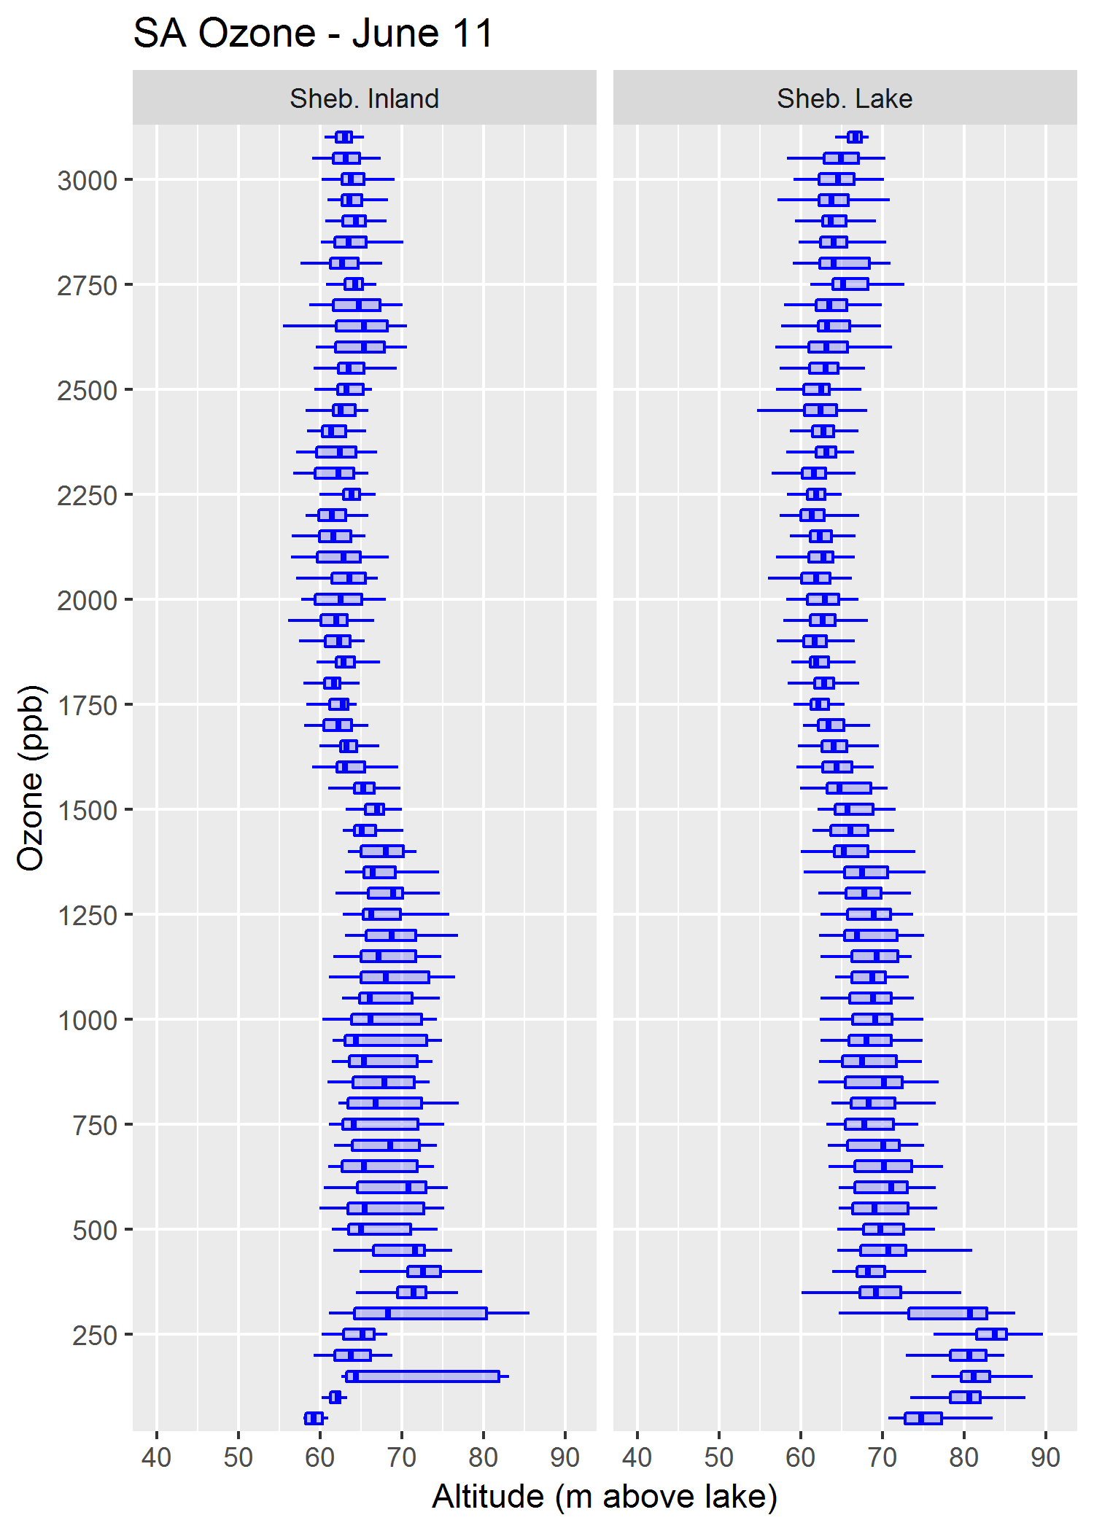
Observing Steep Gradients in PBL Ozone
Aircraft spirals during LMOS 2017
Sheboygan, WI (June 11, 2017)
Have sharp horizontal and vertical gradients in ozone near the Lake MI lakeshore
ΔO₃ @ ground ~ 15 ppb over ~5 km
Vertical gradients will make it difficult to observe horizontal gradients
Inland
Near-Lake
Lake breeze ozone enrichment confined to lowest several 100 m
Total column enhancement (0-2000 m) is only ~3% in the lakeshore vs inland profiles*
0-2000 m
Altitude (m above lake)
→ Satellite would need to be able to resolve differences of ~3% to be useful resolving horizontal gradients along the lakeshore
*Comparing ~65 ppb for inland profiles to a weighted average of 67 ppb for the lakeshore profiles (~80 ppb for 0-300 m + ~65 ppb for 300-2000 m)
Ozone (ppb)

Slide 20
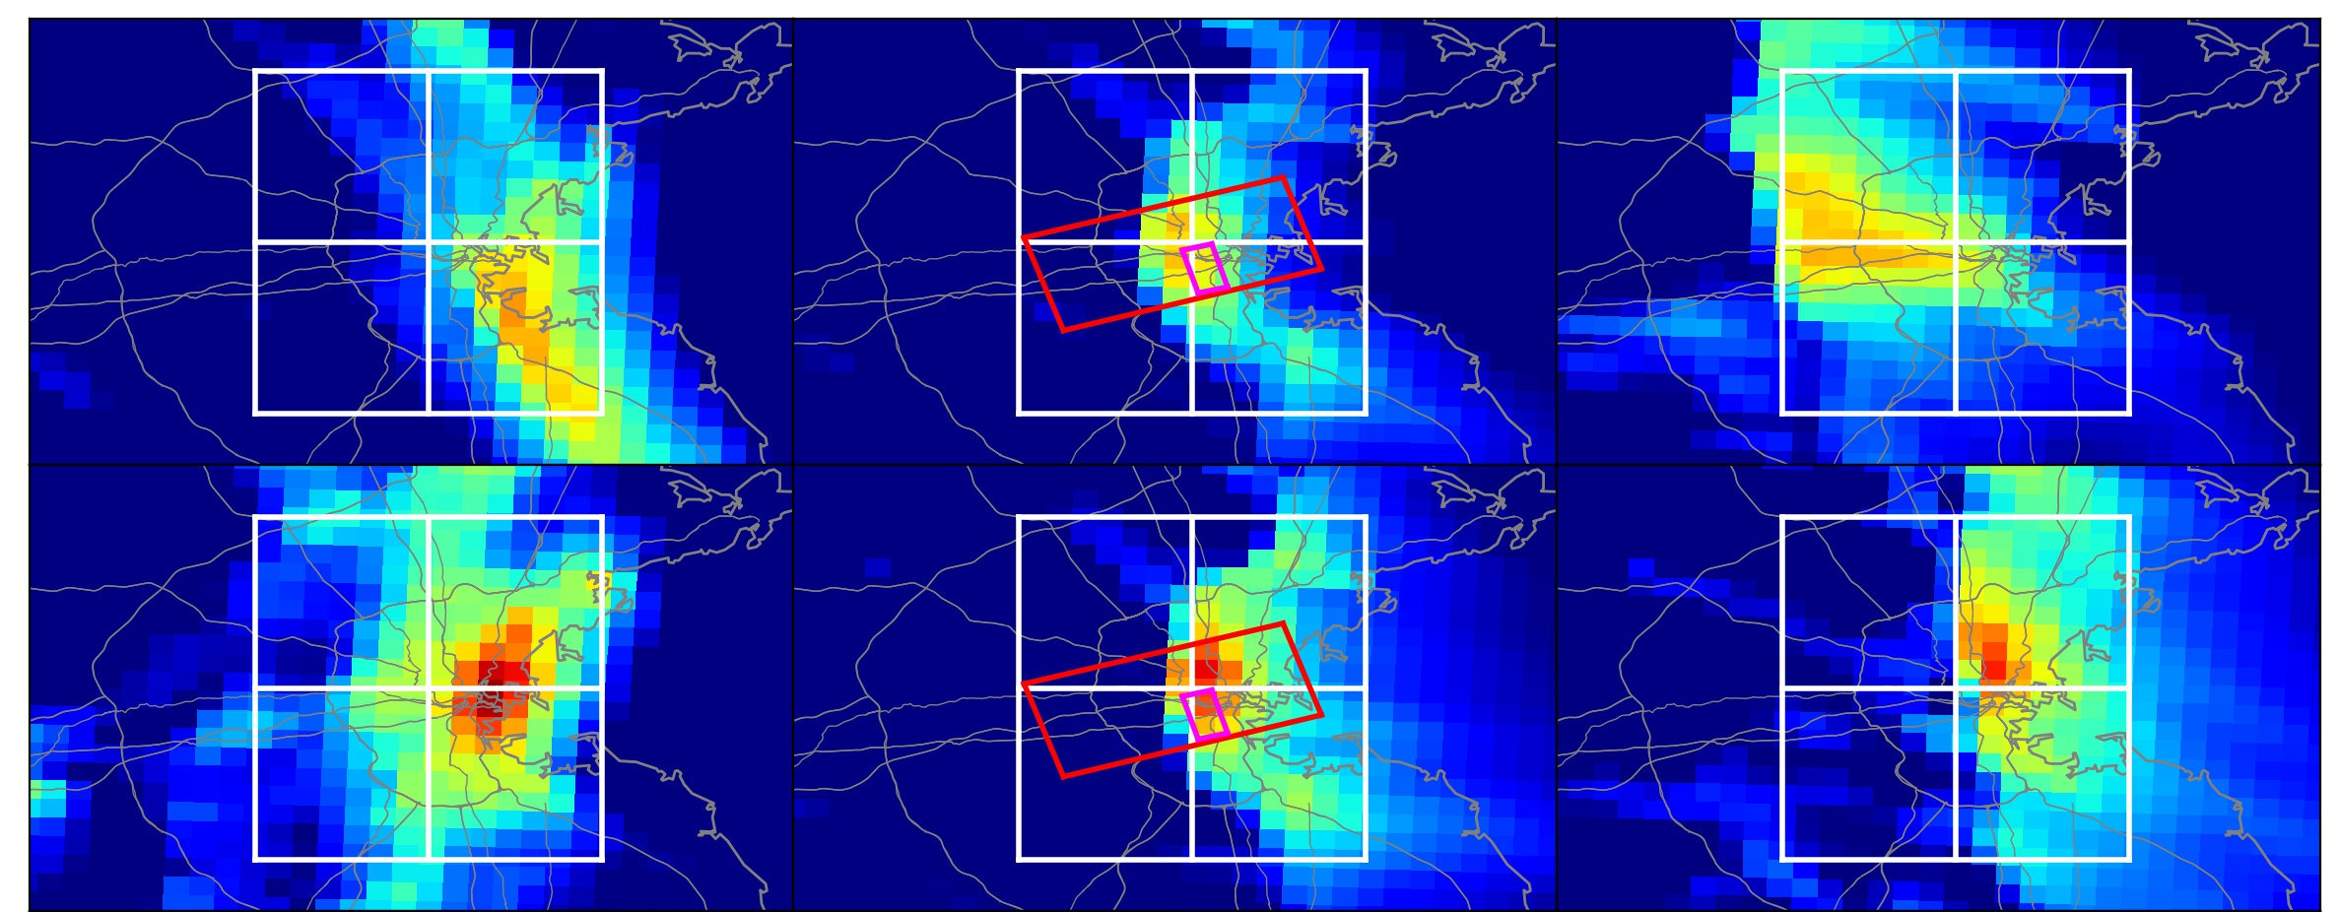
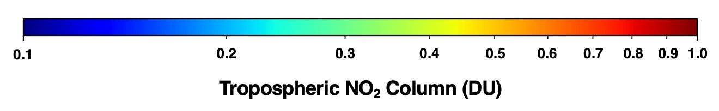
Observing Steep Gradients: Results from Boston
How well can TEMPO resolve steep horizontal gradients in trace gases and aerosols?
WRF-Chem
10 AM
2 PM
6 PM
GEOS-CF
OMI
Sea-breeze
2019 June 24
TROPOMI
Sea-breeze
2019 June 28
Observations from TEMPO should be capable of resolving and tracking steep gradients associated with sea breeze fronts (*if retrieval is adequate)
Wang et al. (in press)

Slide 21
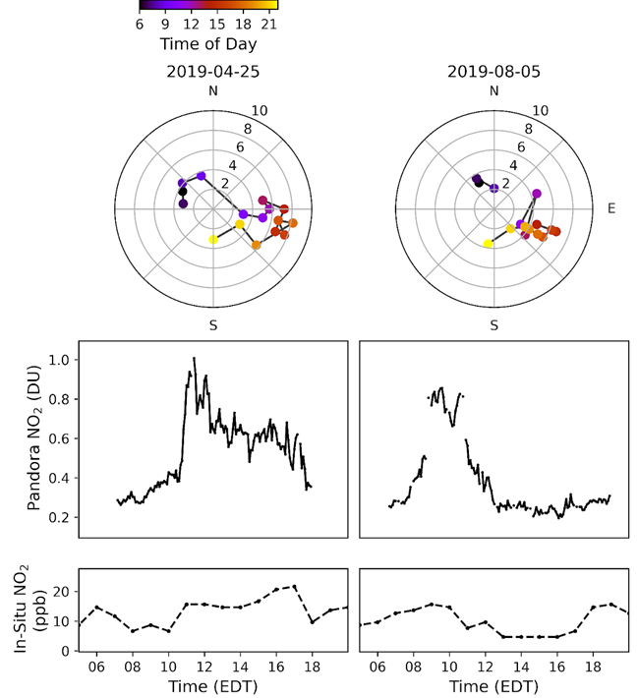
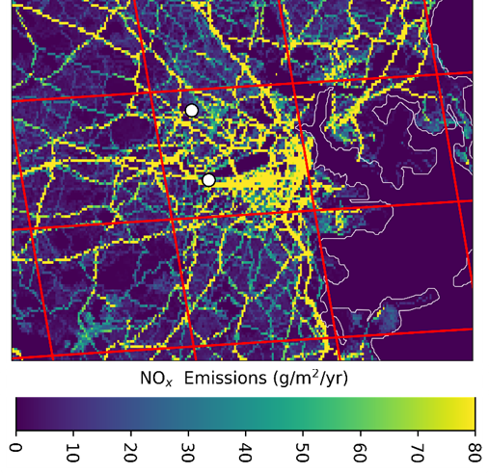
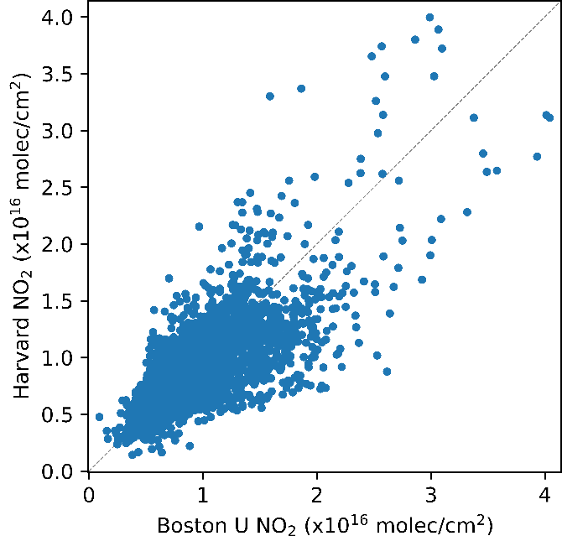
Observing Steep Gradients: Results from Boston
How well can TEMPO resolve steep horizontal gradients in trace gases and aerosols?
< 3 km scale gradients in total NO₂ column observed between Harvard and BU
Adams et al. (under review)
Pollutant plume passage at Boston University often occurs on sub-hourly time scales

Slide 22
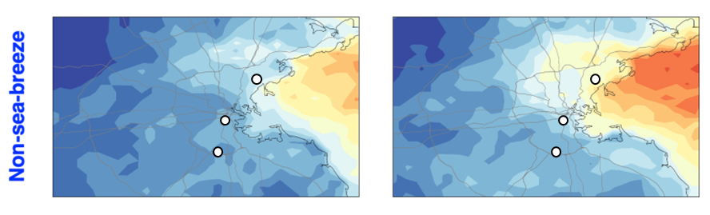
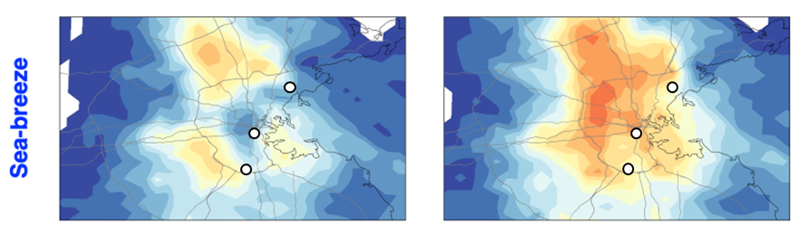
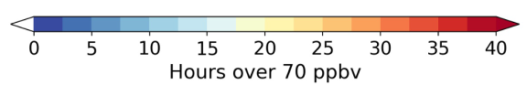
Observing Steep Gradients: Results from Boston
What new science can be done with observations of steep gradients in O₃, NO₂, H₂CO or aerosol?
O₃
Ox
Non-Sea Breeze Days
Current O₃ monitoring tends to be focused in urban areas where O₃ is often suppressed. Will TEMPO PBL O₃ products capture the urban-rural gradients in PBL O₃?
Sea Breeze Days
Wang et al. (in press)

Slide 23
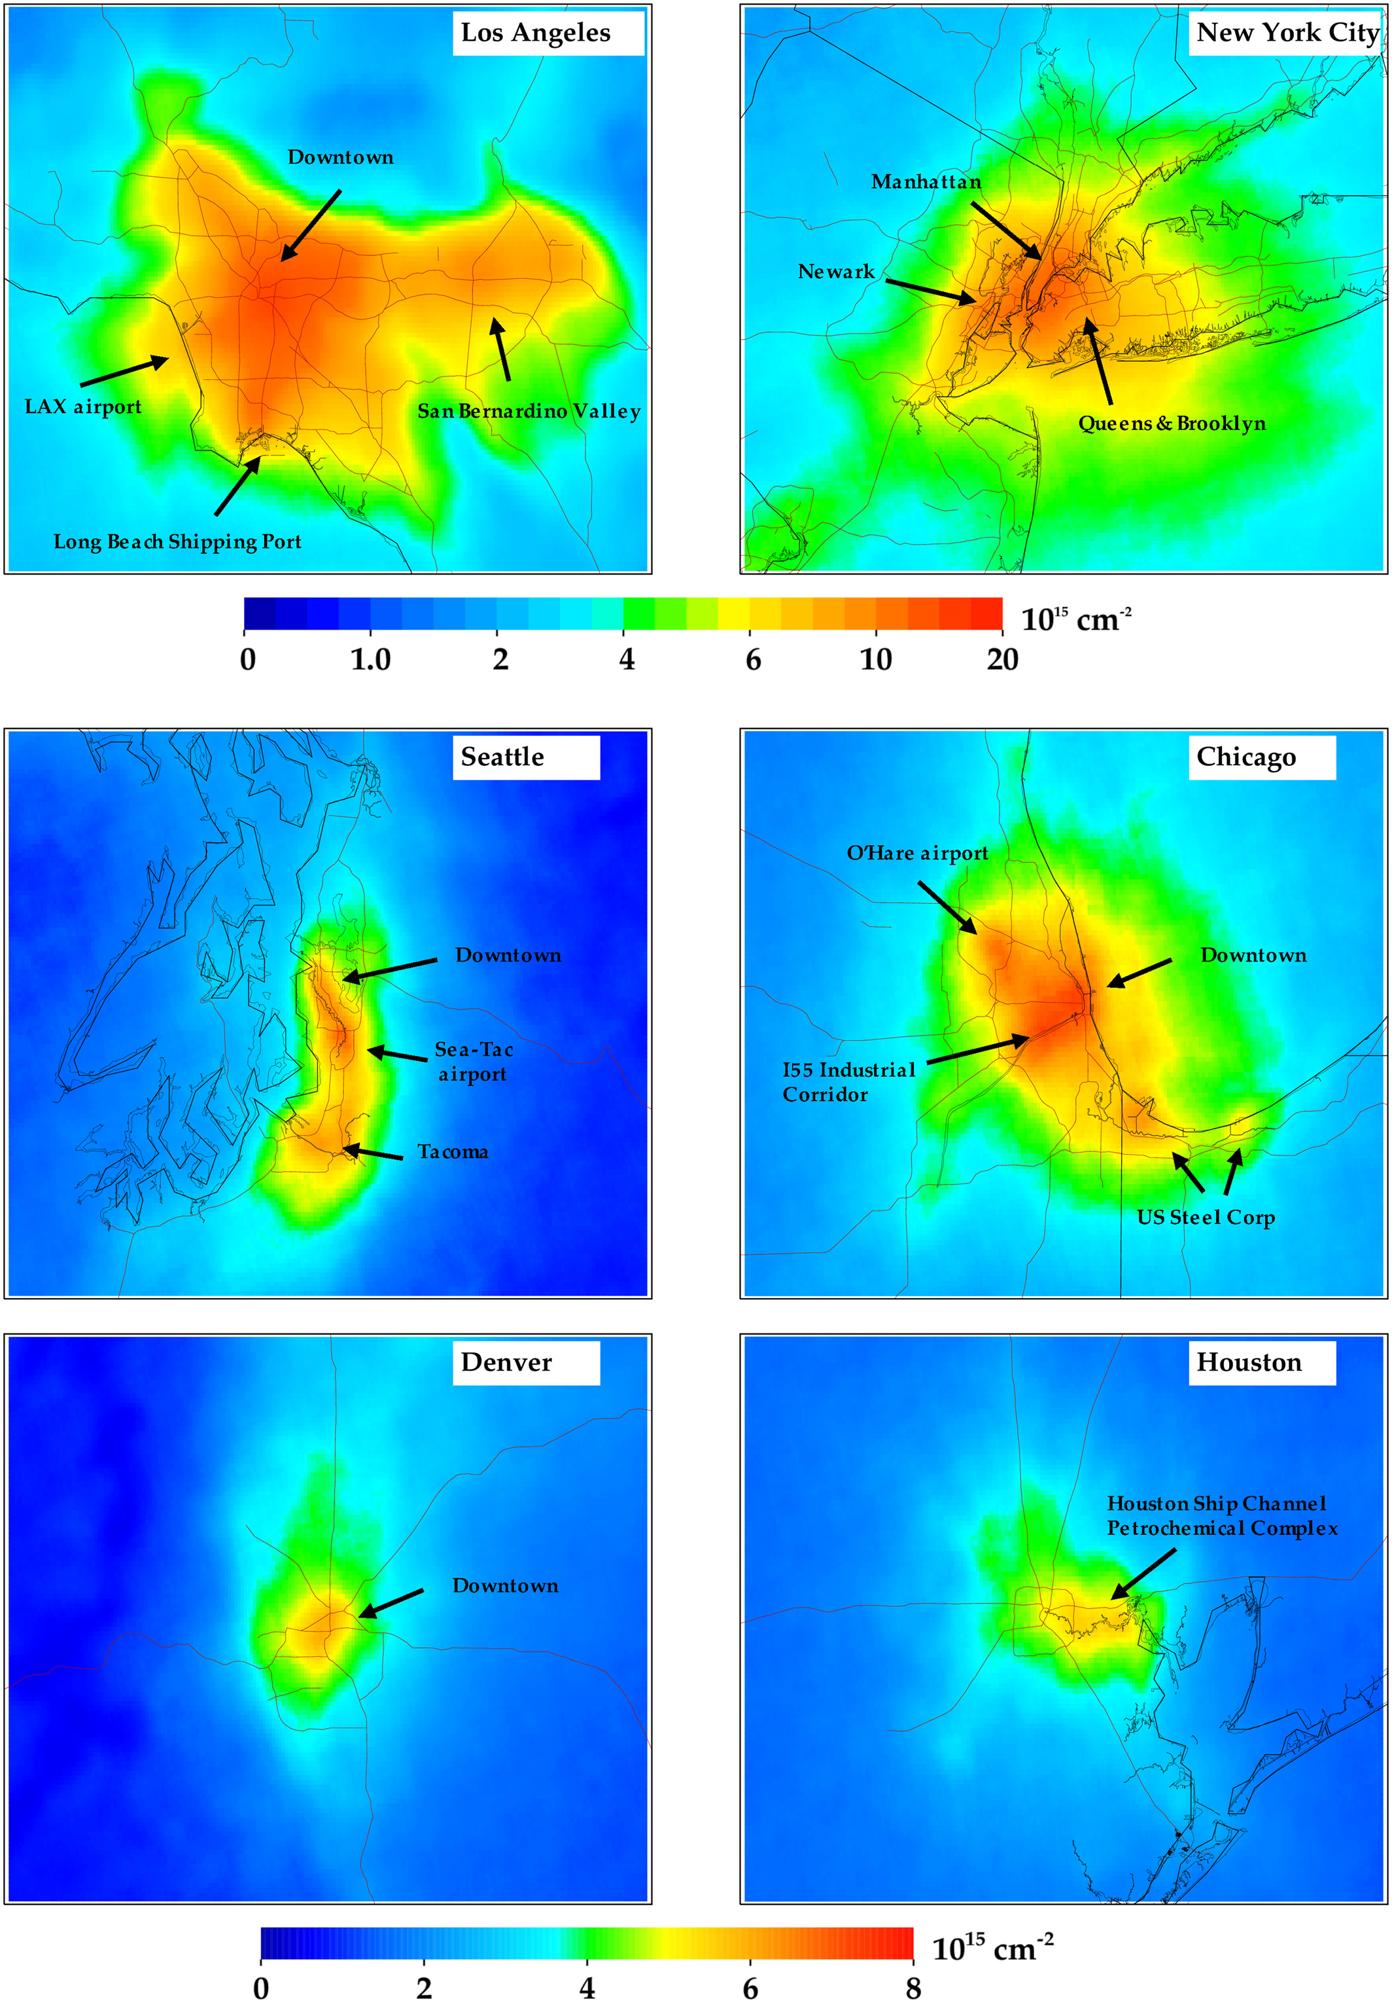
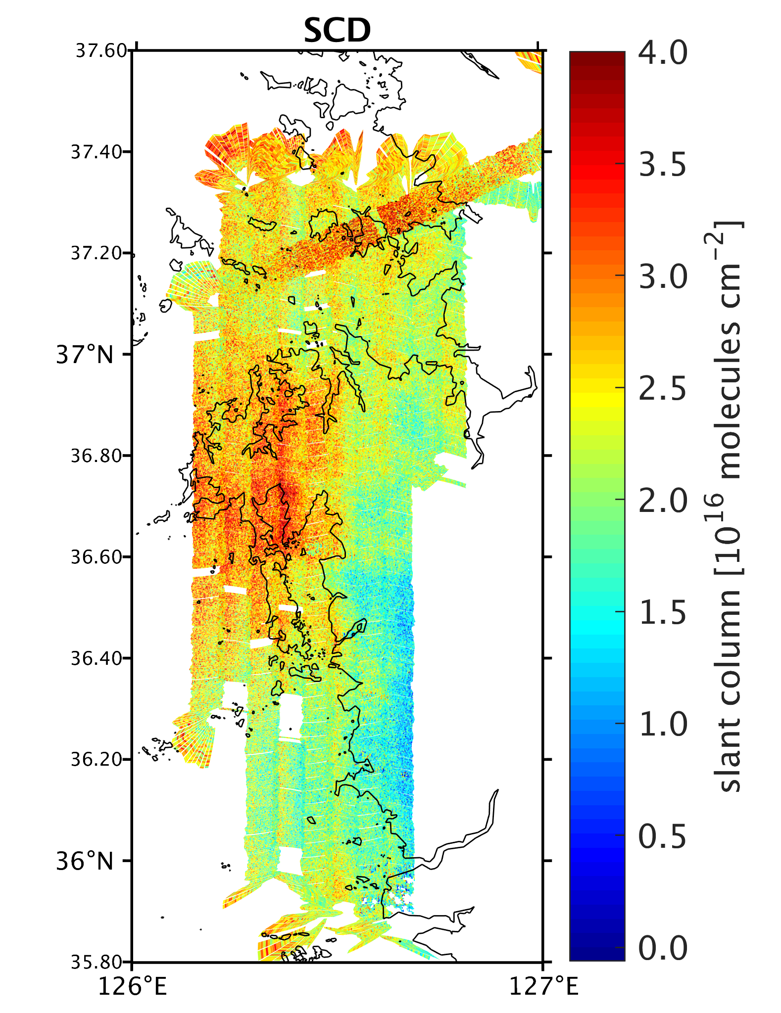
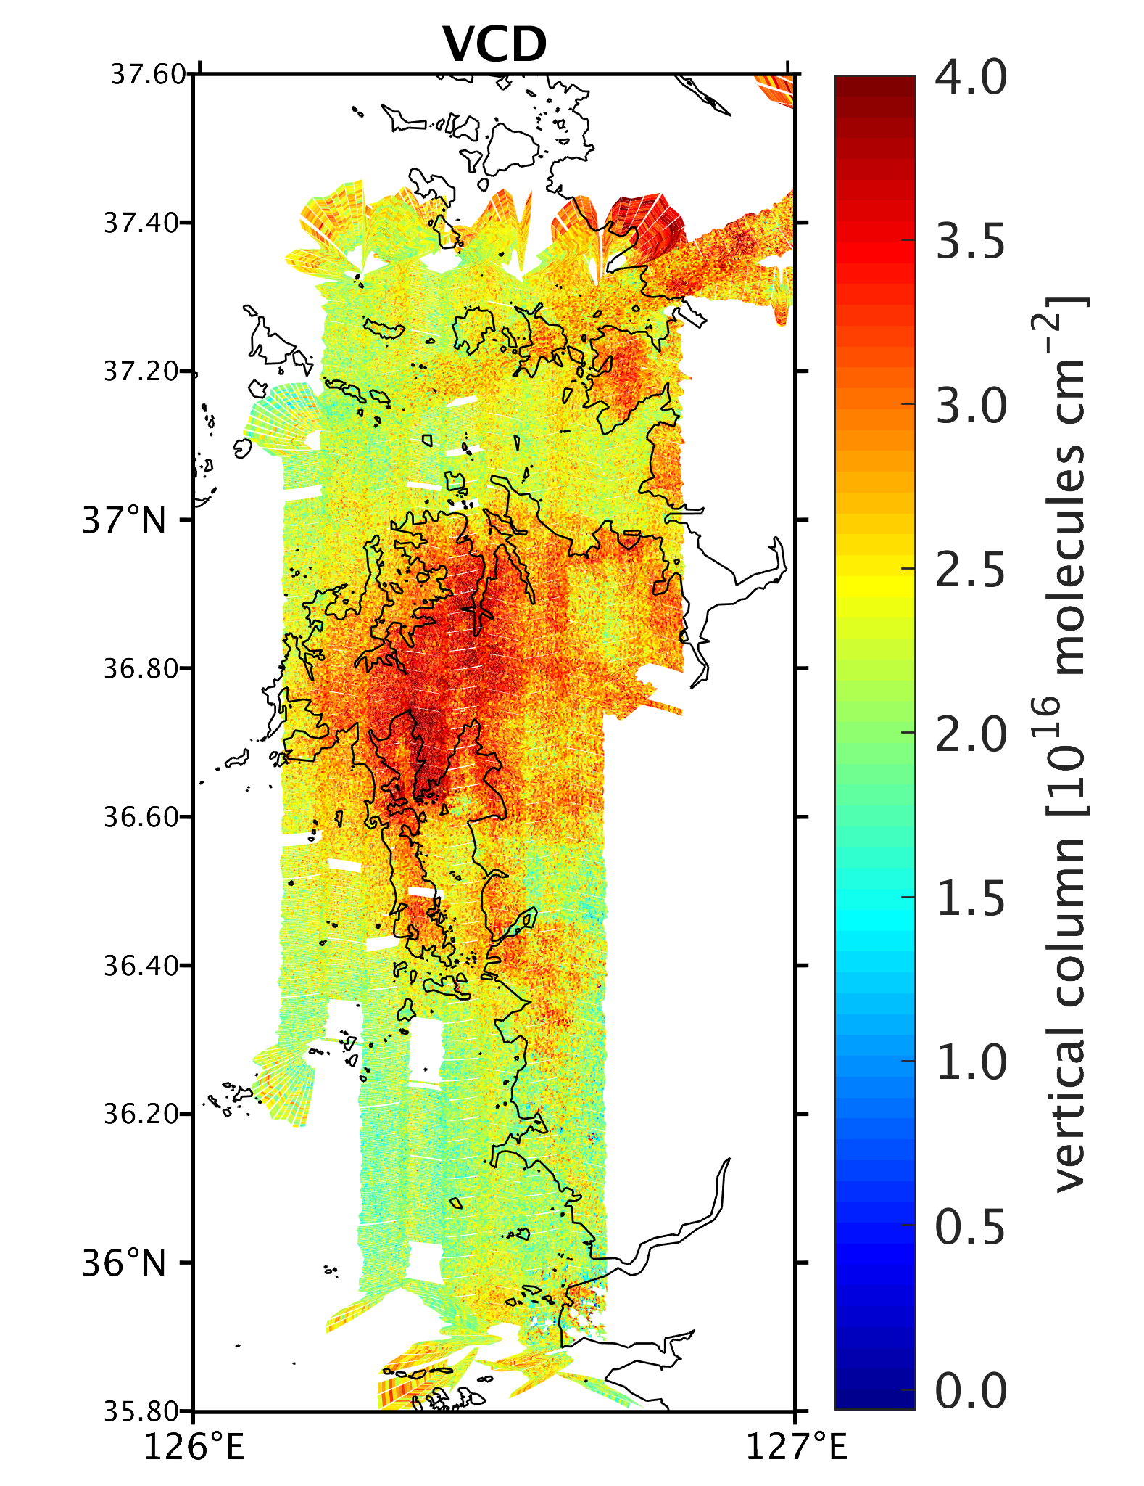
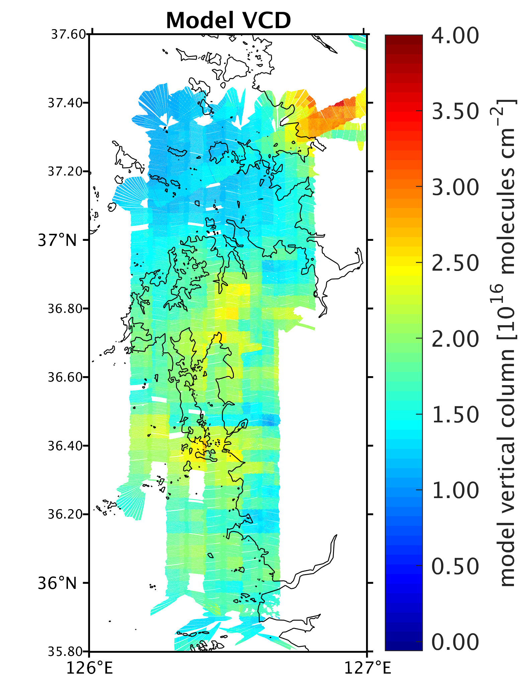
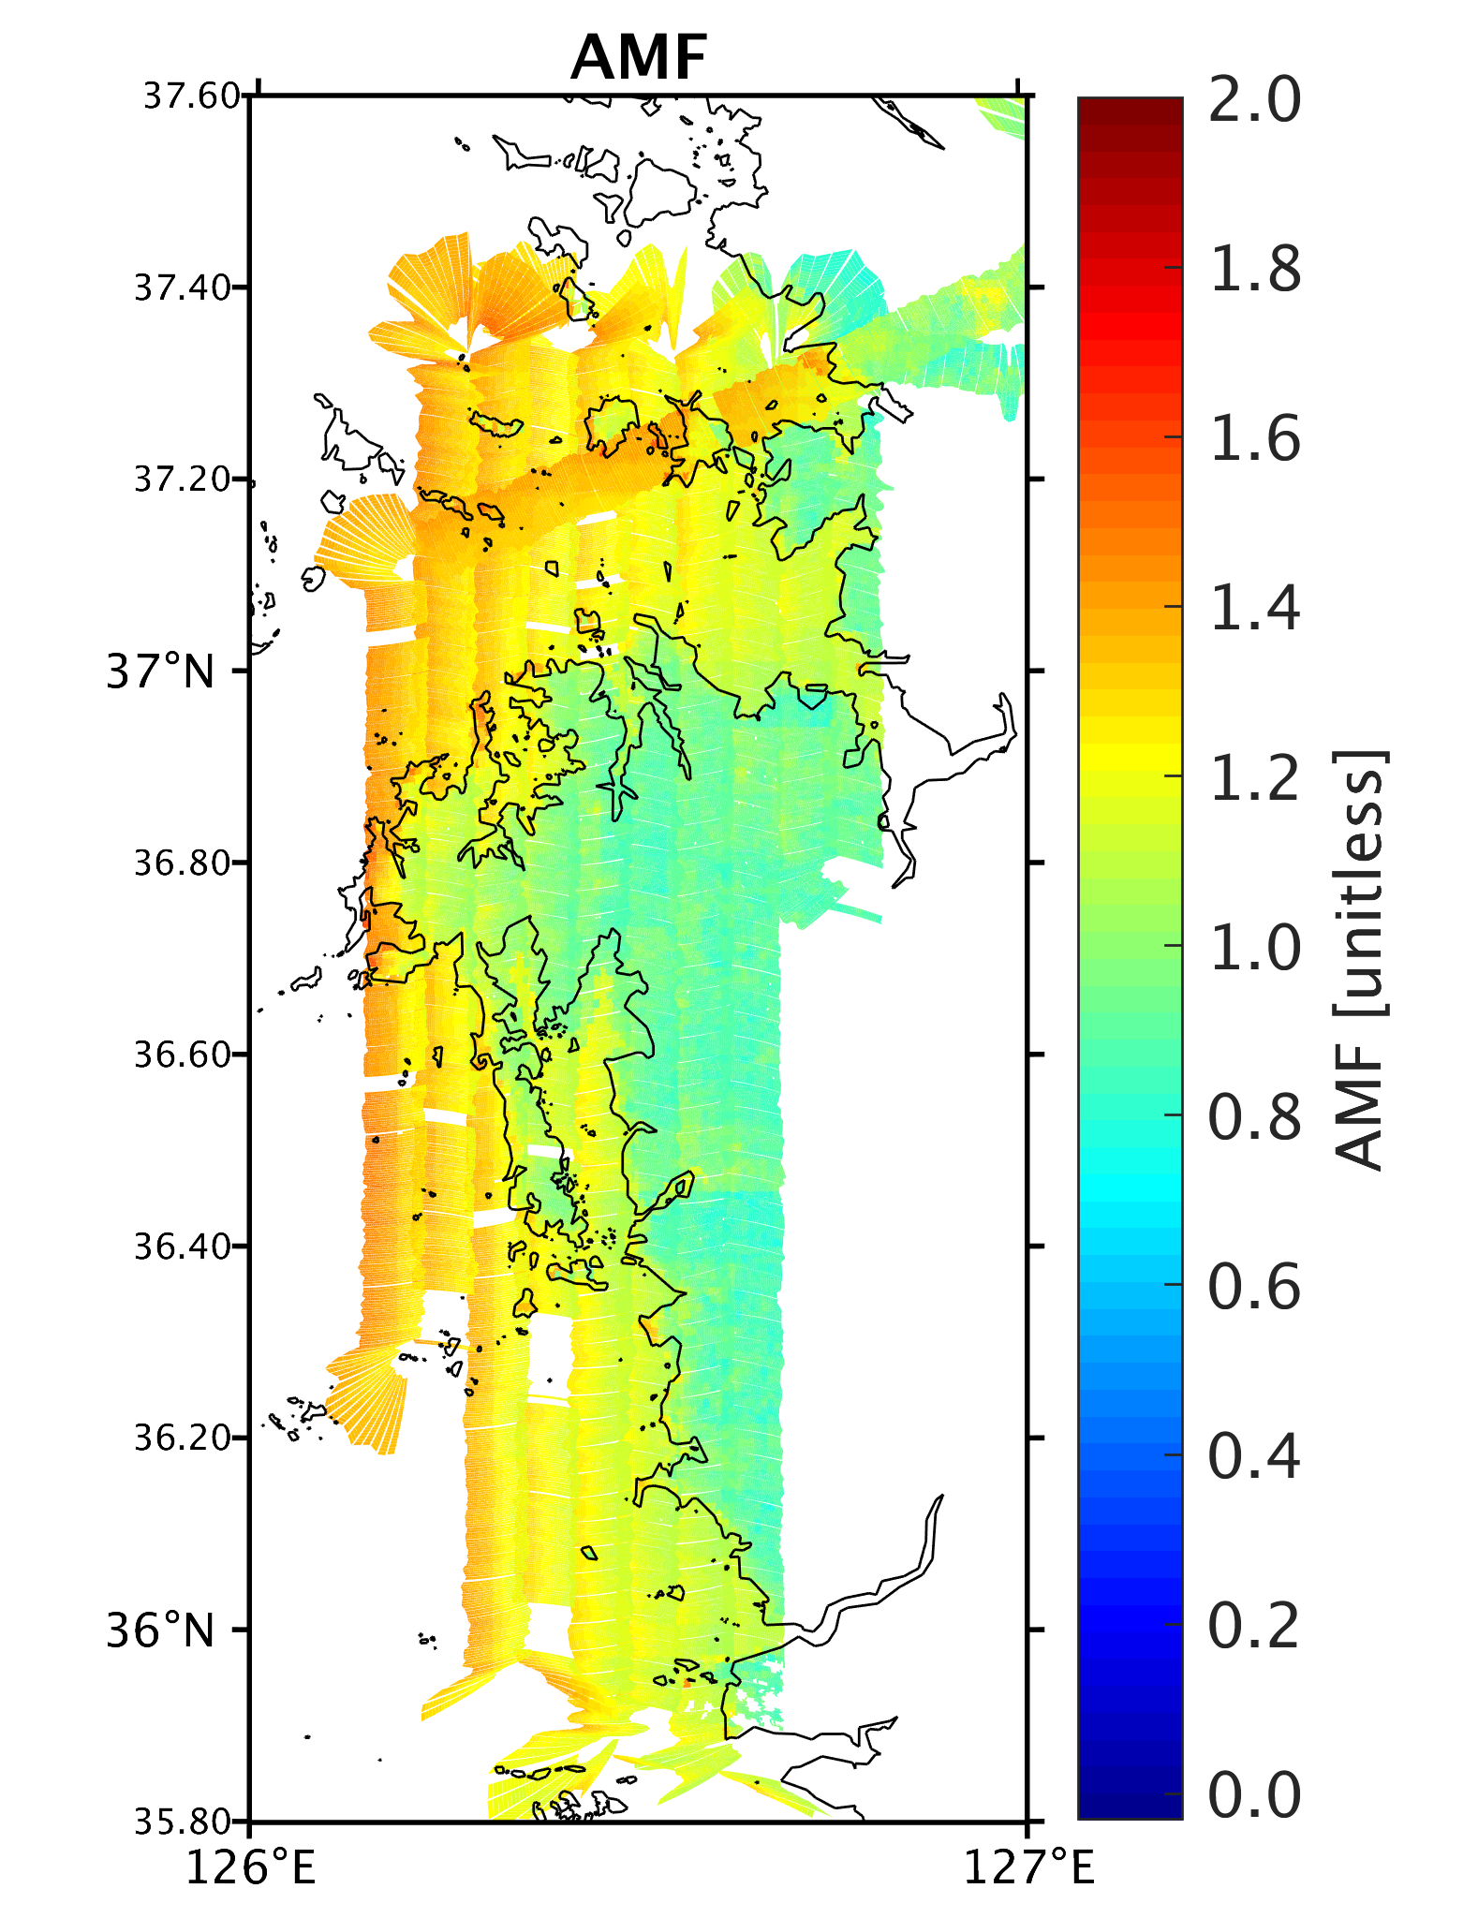
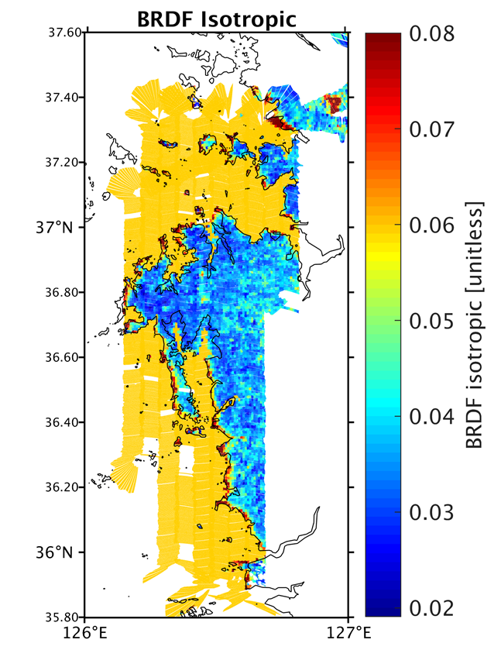
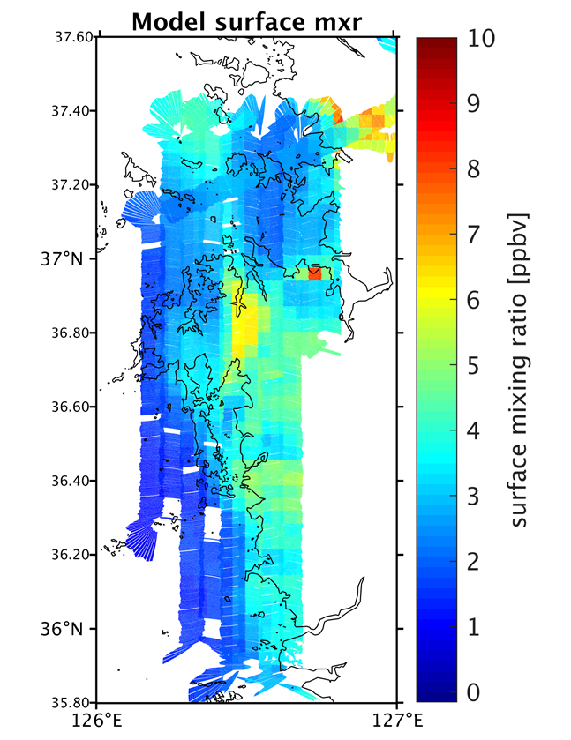
Sharp gradients in retrieved columns, always real?
Gonzalo Gonzalez Abad
TROPOMI NO₂ zoomed into six US cities (Figure 2: Golberg et al., 2021).
GeoTASO KORUS-AQ formaldehyde observations for June 5, 2016. Images courtesy of Caroline Nowlan
Notes:
Figure 2 of Golberg et al., 2021: TROPOMI NO2 in the United States: A Detailed Look at the Annual Averages, Weekly Cycles, Effects of Temperature, and Correlation With Surface NO2 Concentrations, https://doi.org/10.1029/2020EF001665. TROPOMI NO2 oversampled to 0.01° × 0.01° spatial resolution during 1 May 2018–31 December 2019. Only pixels exceeding a quality assurance flag of 0.75 are included.) Color bar has been adjusted to better differentiate spatial heterogeneities on a local scale.

Slide 24
Sharp gradients in retrieved columns, always real?
How can we evaluate the truthiness of the signal imposed by the a priori information?
I suggest to develop metrics derived using chemical and physical certainties.
Notes:
Figure 2 of Goldberg et al., 2021: TROPOMI NO2 in the United States: A Detailed Look at the Annual Averages, Weekly Cycles, Effects of Temperature, and Correlation With Surface NO2 Concentrations, https://doi.org/10.1029/2020EF001665. TROPOMI NO2 oversampled to 0.01° × 0.01° spatial resolution during 1 May 2018–31 December 2019. Only pixels exceeding a quality assurance flag of 0.75 are included.) Color bar has been adjusted to better differentiate spatial heterogeneities on a local scale.

Slide 25


Sharp gradients in retrieved columns, always real?
Another example, OMPS-NPP BrO retrievals over Konstatina Bay. The effect of neglecting land fraction when sea ice and snow are present resulted in artificial signals in coast pixels.
Such a suspicious feature granted further investigation resulting in the correction of the land fraction oversight.
Images courtesy of Heesung Chong.

Slide 26


But what about sharp temporal gradients?
Figure 1 from Penn and Holloway, 2020: Evaluating current satellite capability to observe diurnal change in nitrogen oxides in preparation for geostationary satellite missions
Figure 6 Kim et al., 2023:First-time comparison between NO2 vertical columns from GEMS and Pandora measurements

Slide 27


What gradients of satellite observed trace gas can inform us — ozone formation sensitivity
Jin et al., EST, 2020
Decreasing NO₂ and increasing HCHO/NO₂
Ozone formation peaks where HCHO/NO2 reaches transition regime (grey).
TEMPO will:
increase sampling between 0-20 km
add spatially continuous PBL ozone information
decipher morning vs. afternoon

Slide 28
What gradients of satellite observed trace gas can inform us — OH vs NO₂
OMI NO₂ and HCHO are fundamental in these OH estimates at ~10 km resolution
Zhu et al., PNAS, 2022
Slope of OH/NO₂ derived within ~100 km near city center, indicative of decadal changes of chemical regime
TEMPO will:
verify and extend such understanding at ~3km resolution and during the course of the day

Slide 29




Promise of machine learning for operational retrieval of steep gradients
Neural-network based retrieval
NO₂-sensitive spectral information at 390-500 nm
Application to
TROPOMI (Li et al., JRS, 2022) and OCI (Joiner et al., AMT, 2023)
With unprecedented data volume, TEMPO will exceptionally benefit from ML

Slide 30
Observing steep gradients for environmental justice decision-making
Sally Pusede

Slide 31


How well can TEMPO resolve steep horizontal gradients?
Distance-decay gradients in primary pollutants like NO₂ are driven by dispersion. Gradients can be as steep as 100s of meters to 1–2 km
New York City–Newark Urbanized Area
Number of Observations
Airborne remote sensing (250m x 250m)
Single TROPOMI scene
Mean Pixel Area
Lose 0–30% of information in census tract-scale inequalities
Inequalities are insensitive to pixel areas between 20 and 60 km²
Mean daily inequalities equal/exceed those based on columns first oversampled to 1 km x 1 km. At least as far as our work is concerned, we do not gain spatial information with oversampling
TEMPO fills the above gap in resolution
Dressel et al., Environ. Sci. Technol., 2022

Slide 32

How well can TEMPO resolve steep horizontal gradients?
NO_{x} sources are often clustered, leading to spatial scales in intraurban NO₂ gradients that are longer than distance-decay lengths
Houston, Texas
Challenge: distinguish sources and chemistry within areas of dense emissions
Understand observations in the morning/evening before applying them
TROPOMI observations evaluated using airborne observations that do resolve dispersion gradients and variability in urban segregation structure
Observations inform environmental decision-making; census tract-scale inequalities are one of multiple approaches for with assessing intraurban variability
All pixels
High NO₂ pixels
Low NO₂ pixels
Number of Pixels
Pixel-to-Pixel Correlation Length (km)
Dressel et al., Environ. Sci. Technol., 2022

Slide 33

How well can TEMPO resolve steep horizontal gradients?
Temporal variability in the gradients will be important to their evaluation and interpretation, as well as informing new science
52 U.S. Cities
A 60% reduction in diesel NO_{x} emissions causes a 40% reduction in inequalities
New York City–Newark
𝝆 = –0.63
r = 0.96 (summer)
r = 0.72 (winter)
NO₂ Inequality (molecules cm^{–2})
Weekend NO₂ Inequality
(molecules cm^{–2})
Surface Winds (knots)
Weekday NO₂ Inequality
(molecules cm^{–2})
Dressel et al., Environ. Sci. Technol., 2022
Demetillo et al., Geophys. Res. Lett., 2021

Slide 34
Science with steep horizontal gradients?
Well established that OMI slant column resolution is degraded by use of a prior with lower resolution than the observed pixels. Effects are systematic biases of order 20-30%.
(e.g. Laughner, J. L., A. Zare, and R. C. Cohen. "Effects of daily meteorology on the interpretation of space-based remote sensing of NO₂." Atmos. Chem. Phys., 16, 15247--15264, 2016)
Much less work (any?) on TROPOMI.
What is needed to characterize aliasing of the prior into the TEMPO products?

Slide 35
Discussion
What new science can be done with observations of steep gradients in column O₃, NO₂, H₂CO, aerosol or in the expected PBL ozone product?
How well can TEMPO resolve steep horizontal gradients in trace gases and aerosols?
Urban/rural, Coastlines, within an urban area?
Do we need to do better than the standard algorithms for O₃, NO_{x}, H2CO or aerosol? (please suggest a possible metric for the improvement and a path to achieving that goal).

