Slide 1
Large Scale Multi-Agency / Platform Sub-Orbital Activities
Xiong Liu, Luke Valin, Jim Szykman*
Steve Brown, Laura Judd
Ron Cohen, Tom Hanisco, Pawan Gupta Michel Grutter Chris McLinden*
*virtual

Slide 2
Large Scale Multi-Agency / Platform Sub-Orbital Activities
Xiong Liu, Luke Valin, Jim Szykman*
Steve Brown, Laura Judd
Ron Cohen, Tom Hanisco, Pawan Gupta Michel Grutter Chris McLinden*
*virtual

Slide 3




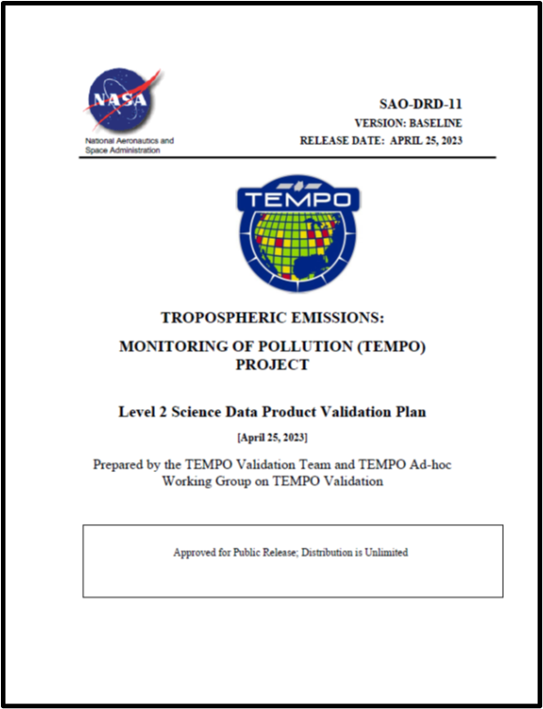
TEMPO (Tropospheric Emissions: Monitoring Pollution) mission Validation Plan
Outlines a best-efforts validation approach for the ozone, nitrogen dioxide, and formaldehyde data products.
Leverages a comprehensive set of existing measurements (ground-based and satellite) for routine validation enhanced by episodic field mission and modeling efforts.
Describes a structure for the geophysical data product maturity progression and discusses specific metrics to be generated to provide a ‘fit for purpose’ applications framework.

Slide 4
What are the fundamental validation metrics/needs and plans?
TEMPO mission Level 2 data product (variable) requirements
Product Name | Product Horizontal Resolution N/S x E/W @ center of FOR | Product Precision | Frequency
Total Column O₃ | 2.0 x 4.75 km² | 3% | 1 hour
Tropospheric Column O₃ | 8.0 x 4.75 km² (4 N/S across-track pixels coadded) | 10 ppbv | 1 hour
0-2 km O₃ selected scenes | 8.0 x 4.75 km² (4 N/S across-track pixels coadded) | 10 ppbv | 2 hours
Total Column NO₂ | 2.0 x 4.75 km² | 1.0 × 10¹⁵ molecules cm⁻² | 1 hour
Tropospheric Column NO₂ | 2.0 x 4.75 km² | 1.0 × 10¹⁵ molecules cm⁻² | 1 hour
Tropospheric column CH₂O | 2.0 x 4.75 km² | 1.0 × 10¹⁶ molecules cm⁻² | 3 hours
Note that the spatial resolution for the precision requirement is with 4 native pixels coadded, not the actual product resolution listed below.

Slide 5
What are the fundamental validation metrics/needs and plans?
Validation maturity of TEMPO Level 2 products is described by three levels: Beta, Provisional, and Full validation.
Beta: the product is minimally validated but may still contain significant errors; based on product quick looks using the initial calibration parameters. Publication of research based on Beta maturity products is not recommended and highly discouraged.
Provisional: product performance has been demonstrated through a large, but still (seasonally or otherwise) limited number of independent measurements. The analysis is sufficient for limited qualitative determinations of product fitness-for-purpose, and the product is potentially ready for testing by operational users and may be suitable for scientific publication.
Full: product performance has been demonstrated over a large and wide range of representative conditions, with comprehensive documentation of product performance, including known anomalies and their remediation strategies. Products are ready for systematic use and covering the full range of scientific and application use and publication.

Slide 6
Product Specific Performance Indicators (PSPIs)
L2 Geophysical Data Beta Maturity Level -Product Specific Performance Indicators
NO₂ | CH₂O | O₃
NO₂-01: Distinguish high NO₂ urban areas from nearby rural areas for three select urban-rural scene combinations. NO₂-02: Assess bias and precision for at least one month of retrievals in comparison to independent correlative measurements to convey an initial characterization to the user community. The assessment should evaluate TEMPO’s capability to observe diurnal variations. NO₂-03: Identify two radiatively homogenous, cloud-clear, low tropospheric NO₂ background scenes over a dark surface (e.g., water) and over a bright surface (e.g., snow, desert) under different solar zenith angles and compute point-to-point variability (1-σ) as an empirical estimate for fitting uncertainty. Compare and communicate empirical estimates with those derived from the spectral fitting process. | CH₂O-01: Distinguish high CH₂O concentrations from background concentrations. Given CH₂O retrieval noise levels, these qualitative evaluations may use spatial or temporal averaging. CH₂O-02: Assess bias for at least one month of retrievals, including the diurnal cycle, of comparison to independent correlative measurements to convey an initial characterization to the user community. The assessment should evaluate TEMPO’s capability to observe diurnal variations. CH₂O -03: Identify two radiatively homogenous, cloud-clear, low CH₂O scenes over a dark (e.g., water) and over a bright surface (e.g., snow, desert) under different solar zenith angles and compute point-to-point variability (1-σ) as an empirical estimate for fitting uncertainty. Compare and communicate empirical estimates with those derived from the spectral fitting process. | O₃-01: Distinguish high tropospheric O₃ areas resulting from stratospheric intrusion or pollution transport or pollution from nearby normal or low O₃ areas for three select high-low O3 scene combinations. O₃-02: Assess bias and precision for at least one month of retrievals in comparison to independent correlative measurements to convey an initial characterization to the user community. The assessment should evaluate TEMPO’s capability to observe diurnal variations. O₃-03: Identify two homogenous, cloud-clear, normal tropospheric O₃ background scenes over a dark (e.g., water) and over a bright surface (e.g., snow, desert) under different solar zenith angles and compute point-to-point variability (1-σ) as an empirical estimate for retrieval uncertainty. Compare and communicate empirical estimates with those derived from the spectral fitting process.

Slide 7
Product Specific Performance Indicators (PSPIs)
L2 Geophysical Data Provisional Maturity Level -Product Specific Performance Indicators
NO₂ | CH₂O | O₃
NO₂-04: Assess performance metrics (bias/precision/uncertainty) of the tropospheric NO₂ product across the CONUS for 1 month period in two seasons, preferably summer and winter, that includes a range of column densities. NO₂-05: Conduct deep-dive analyses for an episode with relatively poor product performance, identify the root cause and recommend algorithm improvements. | CH₂O-04: Assess performance metrics (bias/precision/uncertainty) of CH₂O product across the CONUS for 1 month period in two seasons, preferably winter and summer, including a range of column densities. This assessment must evaluate the capability of TEMPO to observe diurnal variations of CH₂O. CH₂O-05: Conduct deep-dive analyses for an episode with relatively poor product performance, identify the root cause of the discrepancy and recommend algorithm improvements. | O₃-04: Assess performance metrics (bias/precision/uncertainty) of O₃ products across the CONUS for 1 month period in two seasons, preferably winter and summer, that includes a range of column densities. This assessment must evaluate the capability of TEMPO to observe diurnal variations of O3 products. O₃-05: Conduct deep-dive analyses for several episodes with relatively poor product performance, identify the root cause of the discrepancy and recommend algorithm improvements.

Slide 8
Product Specific Performance Indicators (PSPIs)
L2 Geophysical Data Full Maturity Level -Product Specific Performance Indicators
NO₂ | CH₂O | O₃
NO₂-06: Assess bias, precision, and uncertainty of the tropospheric NO2 product across the CONUS for a wide range of representative conditions over a period of at least one year. NO₂-07: Assess bias, precision, and uncertainty of the tropospheric NO2 product over areas of interest using data gathered during targeted field campaigns. | CH₂O-06: Assess bias, precision, and uncertainty of the CH₂O product across the CONUS for a wide range of representative conditions over a period of at least one year. CH₂O-07: Assess bias, precision, and uncertainty of the CH₂O product over areas of interest using data gathered during targeted field campaigns. | O₃-06: Assess bias, precision, and uncertainty of the O₃ product across the CONUS for a wide range of representative conditions over a period of at least one year. O₃-07: Assess bias, precision, and uncertainty of the tropospheric product over areas of interest using data gathered during targeted field campaigns.

Slide 9
Large Scale Multi-Agency / Platform Sub-Orbital Activities
Xiong Liu, Luke Valin, Jim Szykman*
Steve Brown, Laura Judd
Ron Cohen, Tom Hanisco, Pawan Gupta Michel Grutter Chris McLinden*
*virtual

Slide 10

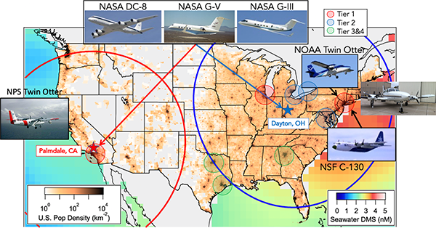




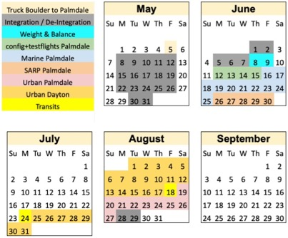
AEROMMA: Atmospheric Emissions and Reactivity Observed from Megacities to Marine Areas
Principal Investigators
Urban Flights
Marine Flights
Rebecca
Schwantes
Carsten
Warneke
Patrick
Veres
Andrew
Rollins
DC-8 Schedule
Marine Flights, Palmdale CA, June 16-25
  Remote marine atmosphere, sulfur cycle and feedbacks on climate
Urban Flights, Palmdale CA (Jun 26-30; Aug 19-27), Dayton OH (Jul 25-Aug17)
  New paradigms in emissions and the future of urban air quality
  Validation and new science with geostationary remote sensing
NOAA Chemical Sciences Laboratory Deployment on NASA DC-8 Supported by NESDIS through GeoXO Program

Slide 11
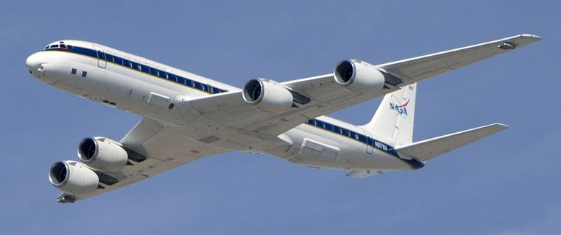
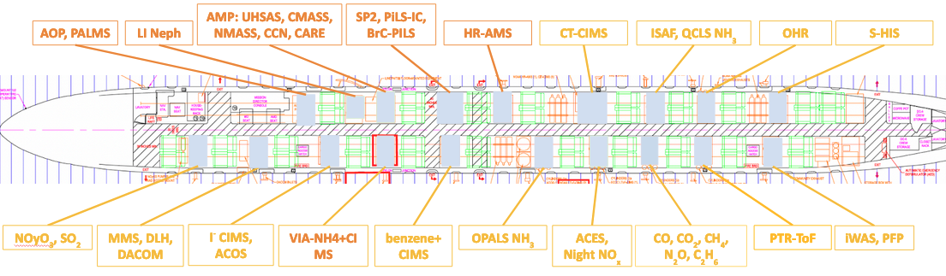
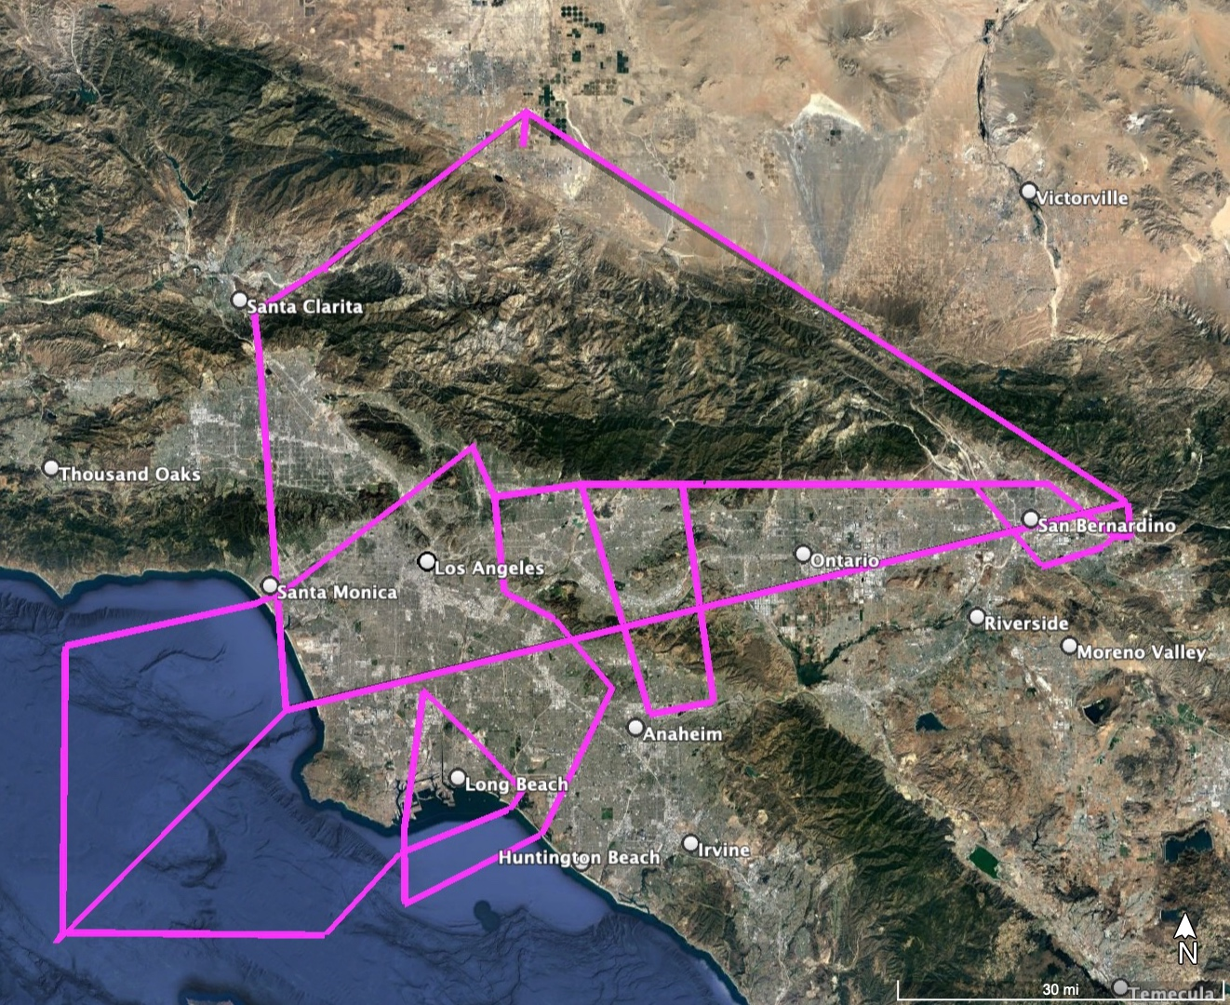
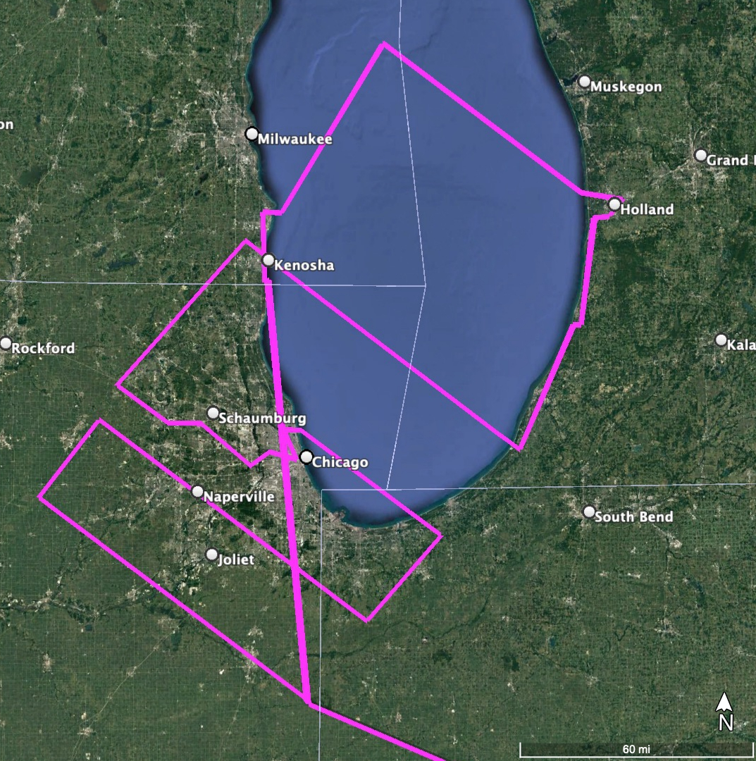
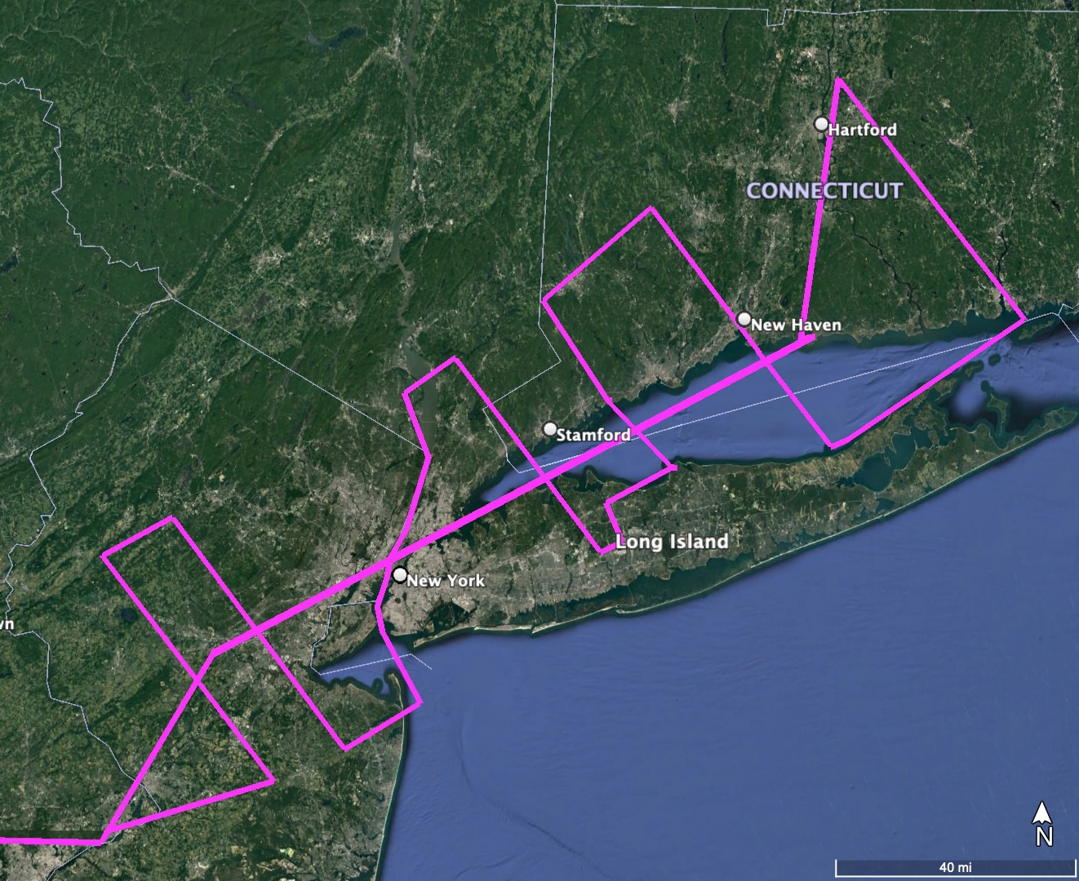
AEROMMA: Atmospheric Emissions and Reactivity Observed from Megacities to Marine Areas
NASA DC-8 Instrumentation
Comprehensive suite for VOCs, NO_{x}, GHG, aerosols (composition, size, optics), radiation, remote sensing, etc.
Instruments from NOAA CSL, NASA, external collaborators (NOAA AC4)
Urban Flight Plans – Los Angeles, Chicago, New York
Los Angeles
Chicago
New York
Repeated flight patters over each major target city
Boundary layer legs < 1 km AGL
3-7 spirals per flight leg to ~ 6 km
Transits at 10-11 km

Slide 12



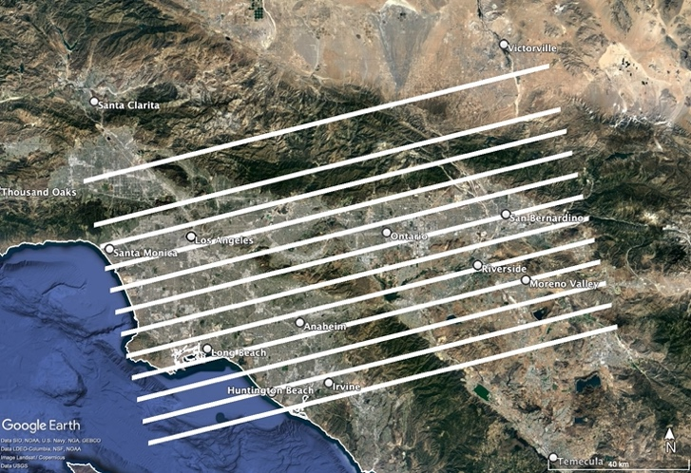
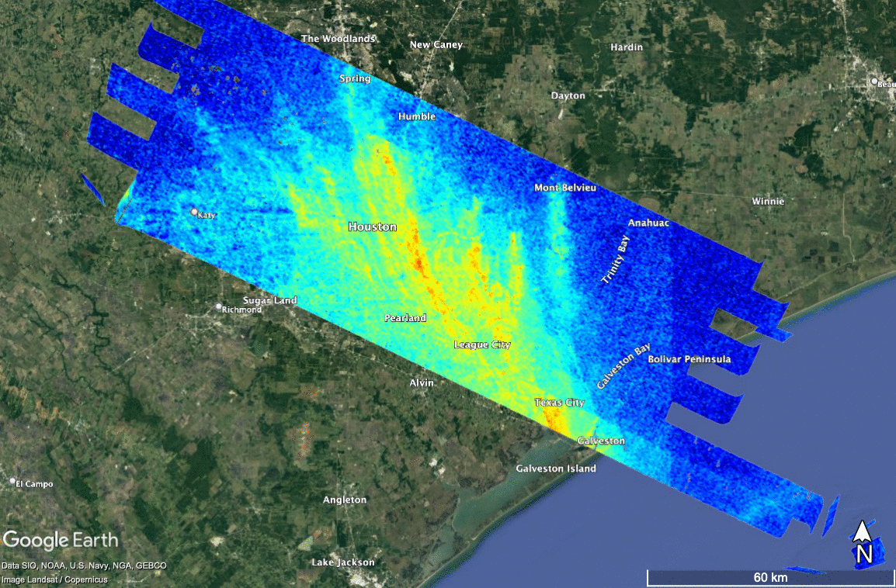
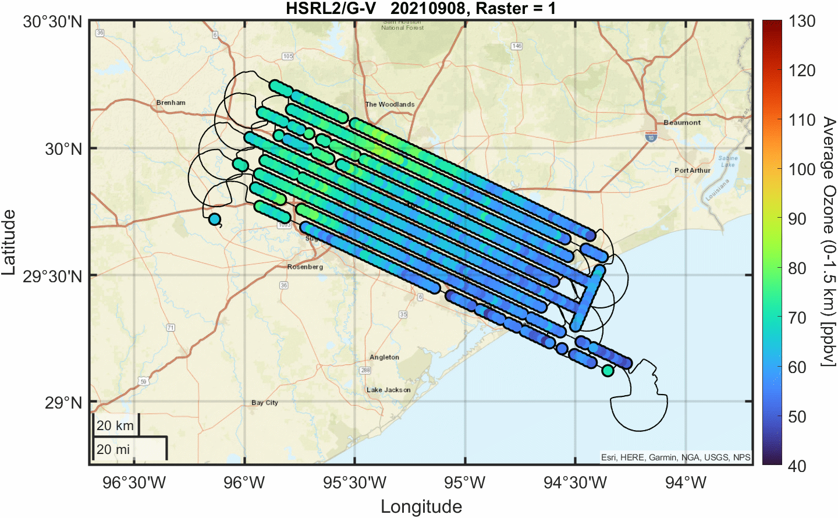
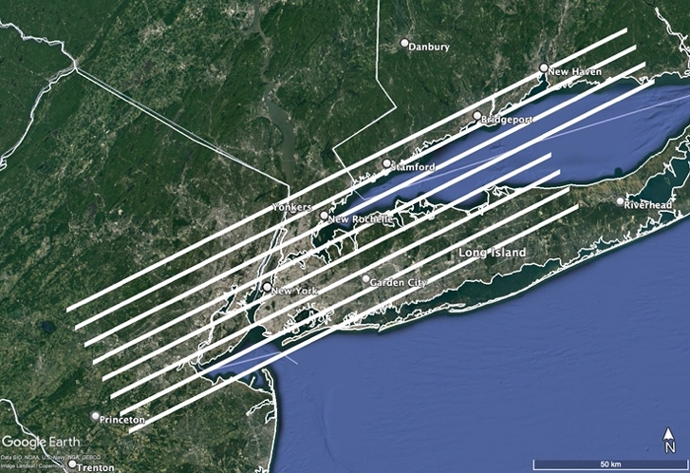
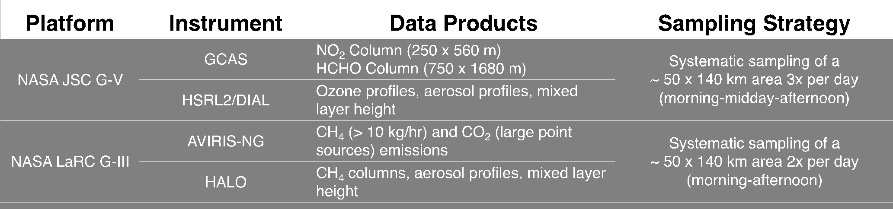
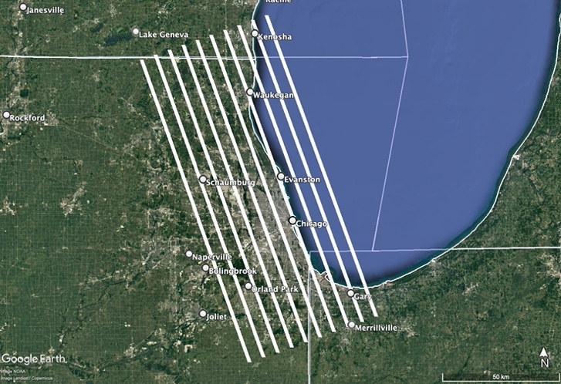
Synergistic TEMPO Air Quality Science (STAQS)
In Summer 2023, STAQS seeks to integrate TEMPO observations with traditional and enhanced air quality monitoring to improve the understanding of air quality science for increased societal benefit.
Los Angeles
Laura Judd
airborne lead
John Sullivan
ground lead
New York City
Aiming for ~4 flight days in each city
(+1 Toronto flight)
Chicago

Slide 13
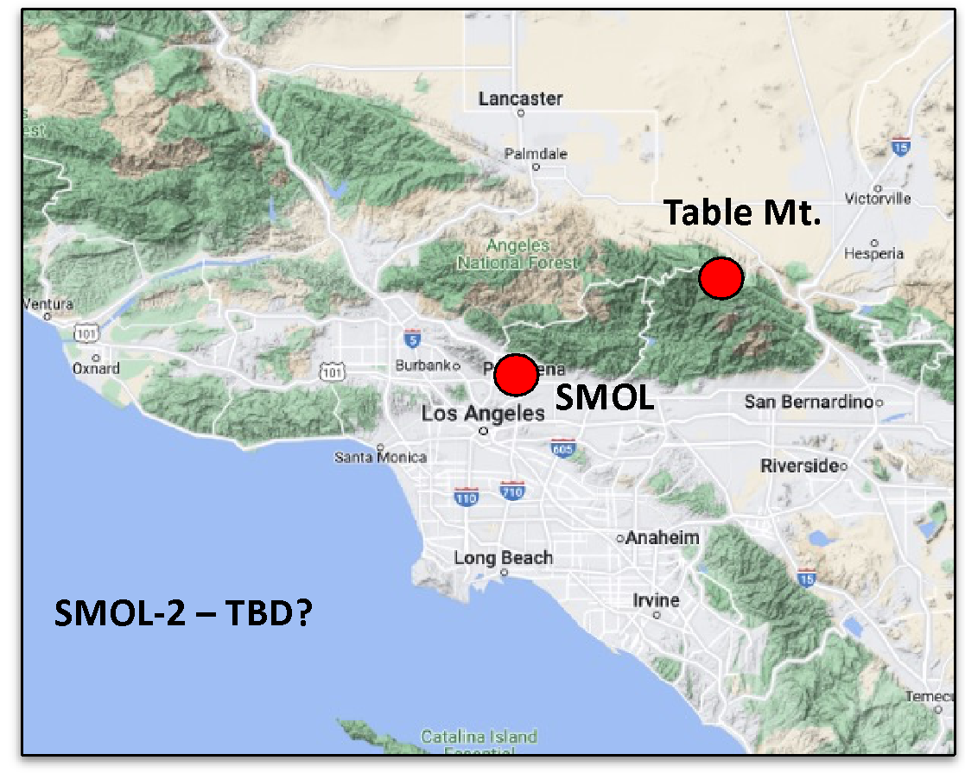
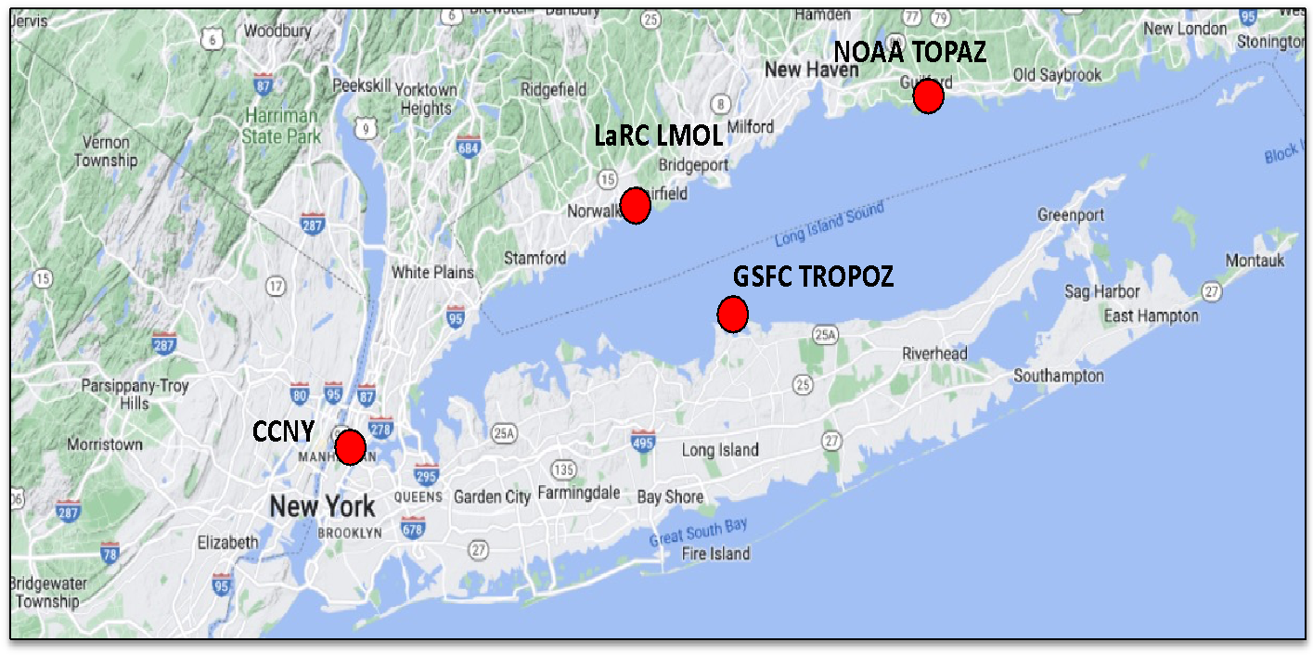
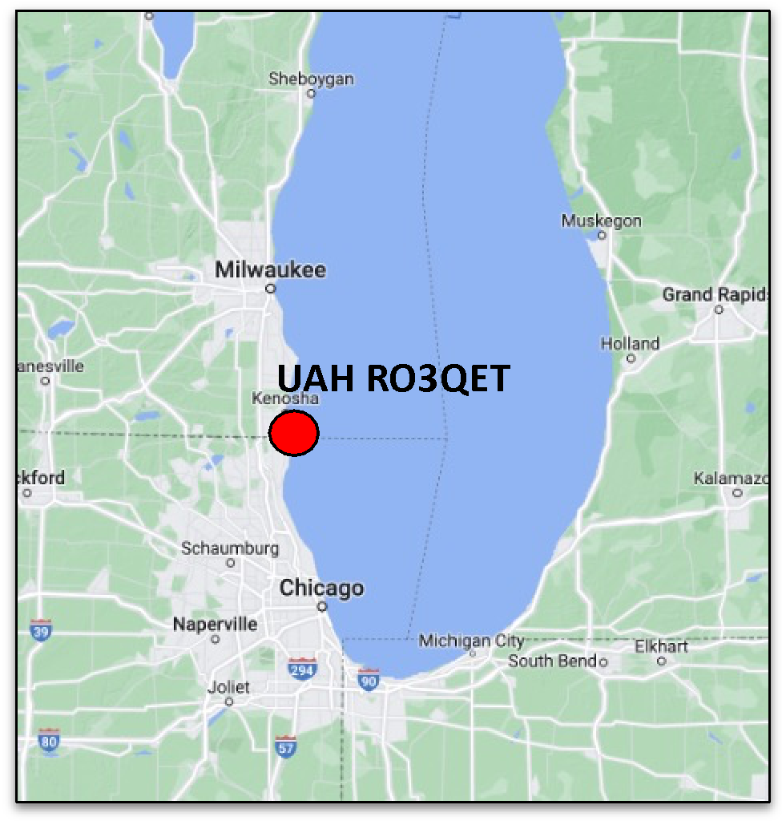

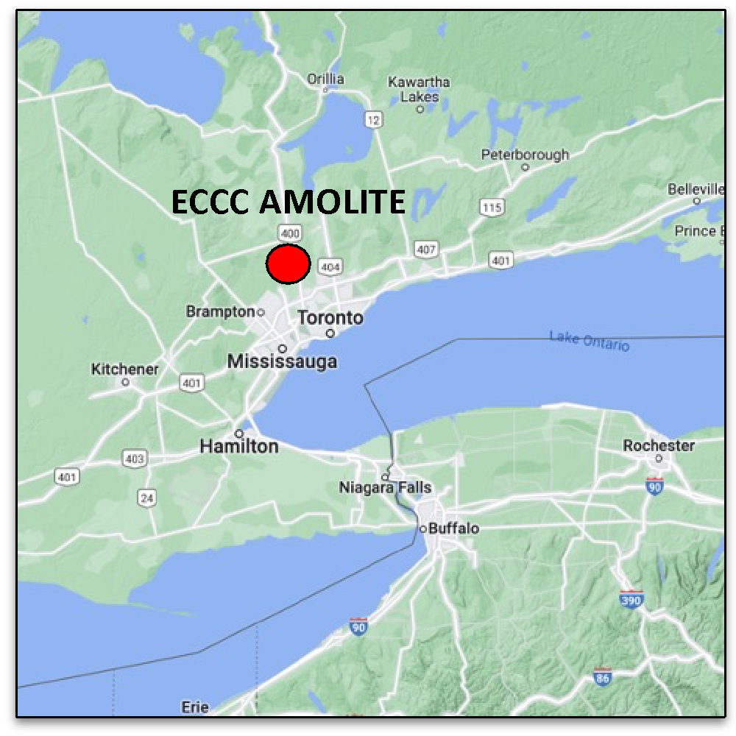
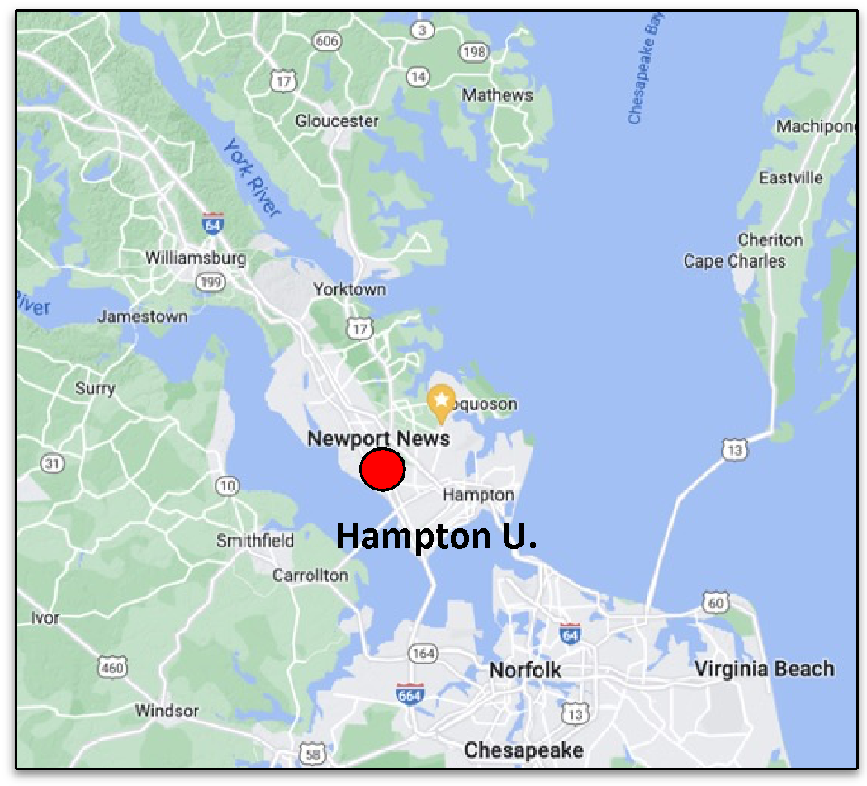
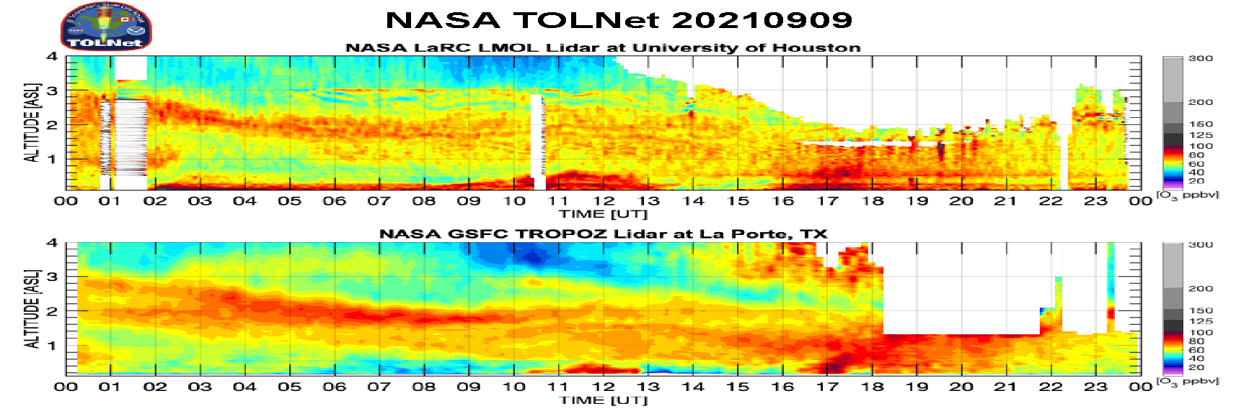
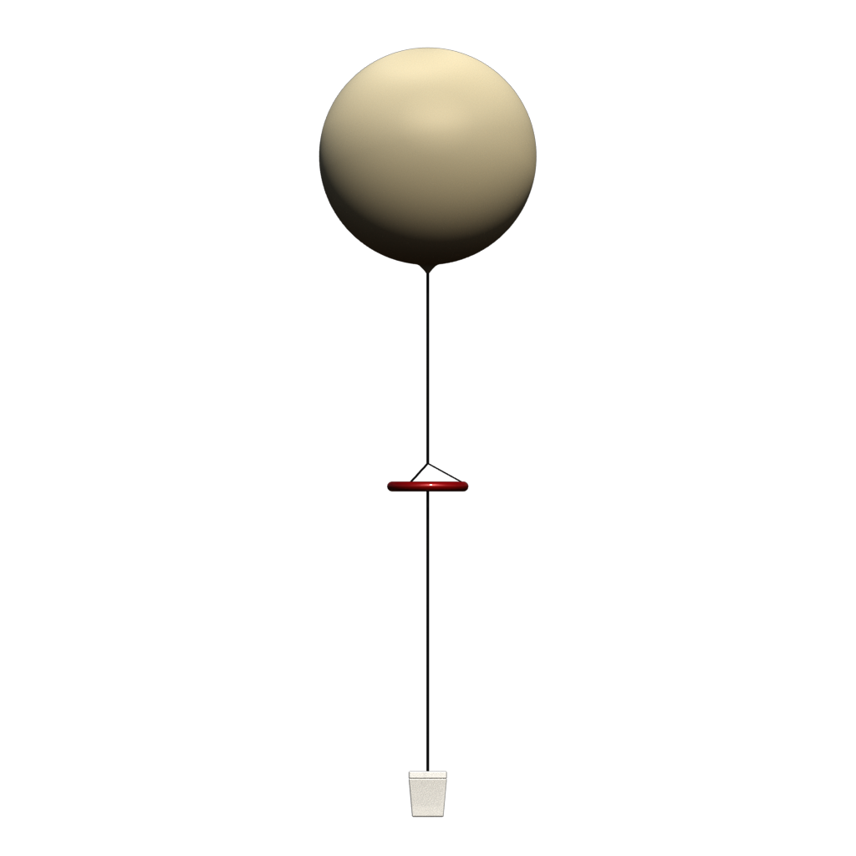
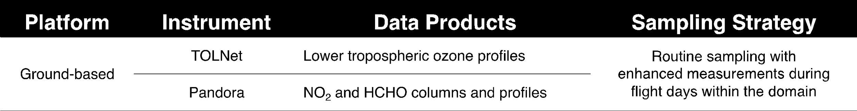
Synergistic TEMPO Air Quality Science (STAQS)
In Summer 2023, STAQS seeks to integrate TEMPO observations with traditional and enhanced air quality monitoring to improve the understanding of air quality science for increased societal benefit.
Laura Judd
airborne lead
John Sullivan
ground lead
(*CUPiDS)
66+ in TEMPO FOR
2 in Chicago
2 in LA
13 in NYC/Philly/CT
Ozonesondes will also be available in some locations

Slide 14

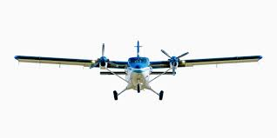


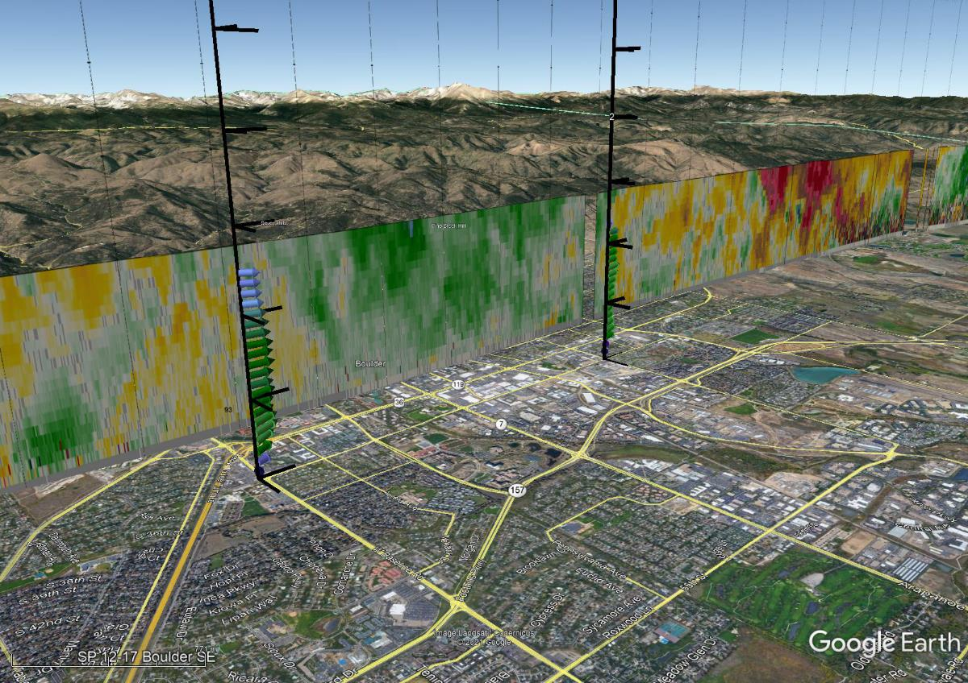
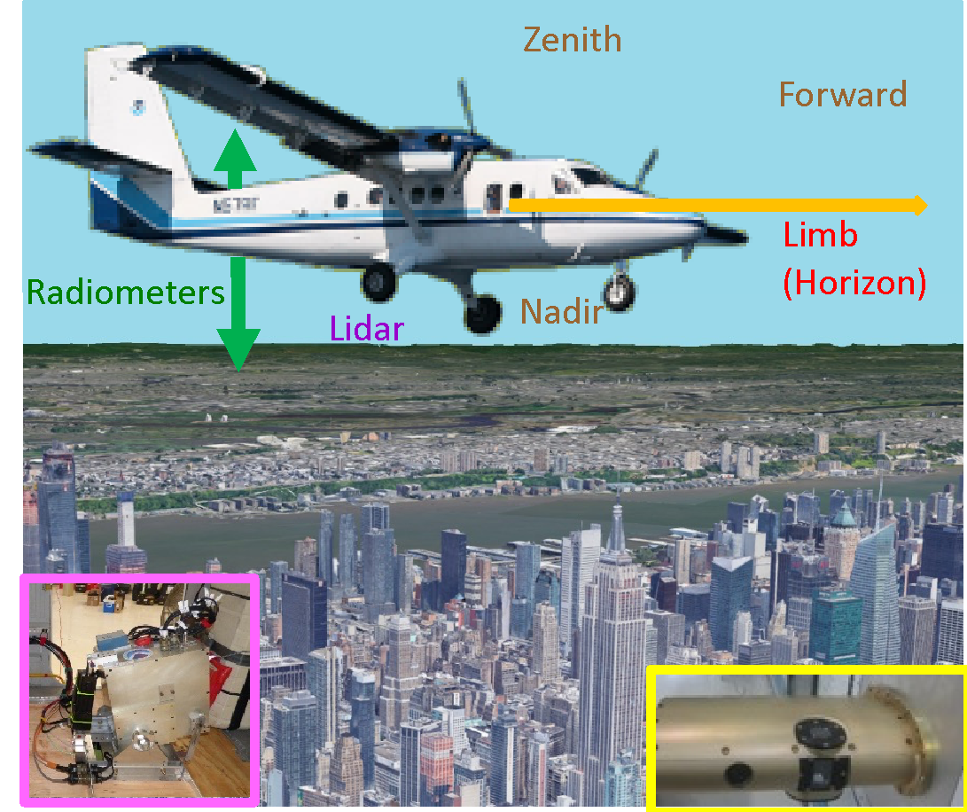
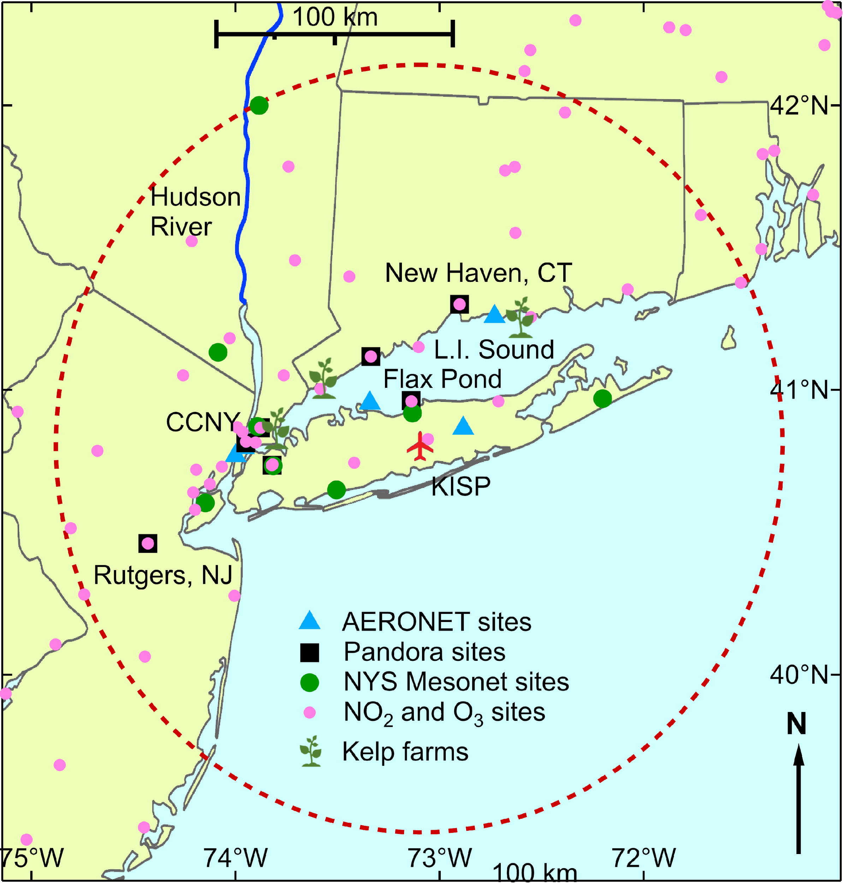
CUPiDS: Coastal Urban Plume Dynamics Study
NOAA Twin Otter
Principal Investigators
July 5 – August 15, 2023, Long Island MacArthur Airport, 175 total flight hours
Emissions and chemistry within complex coastal transport environment
Sunil Baidar
Alan Brewer
Scanning Doppler Lidar (CSL)
Wind, Turbulence and Aerosol profiles
Boundary Layer Depth
MAX-DOAS (CU – AC4 supported)
NO₂, Formaldehyde, Glyoxal, IO profiles
Surface albedo
In-Situ Airborne (CSL,GML)
GHG, NO2, NO, NOY, ozone
Temp, Press, RH

Slide 15
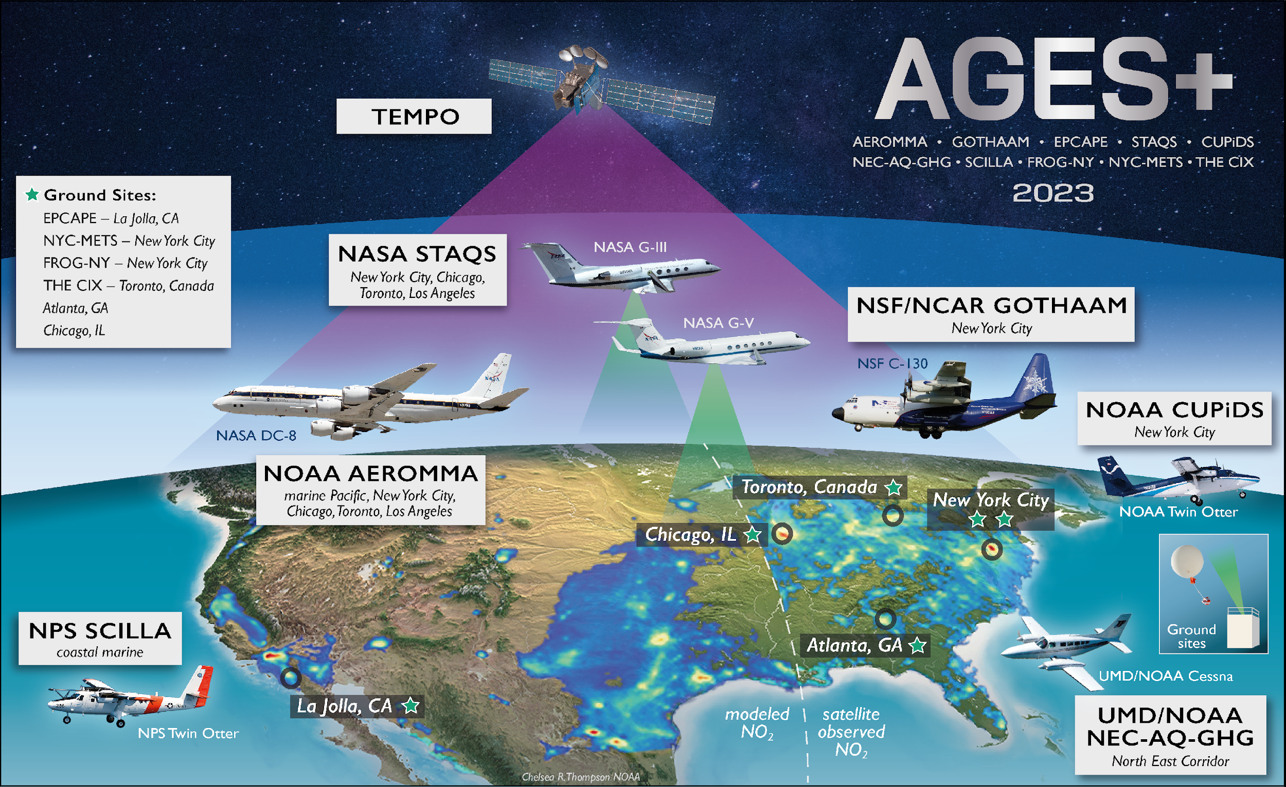
https://csl.noaa.gov/projects/ages/
Image Credit: Chelsea Thompson/NOAA

Slide 16
Large Scale Multi-Agency / Platform Sub-Orbital Activities
Xiong Liu, Luke Valin, Jim Szykman*
Steve Brown, Laura Judd
Ron Cohen, Tom Hanisco, Pawan Gupta
Michel Grutter Chris McLinden*
*virtual

Slide 17
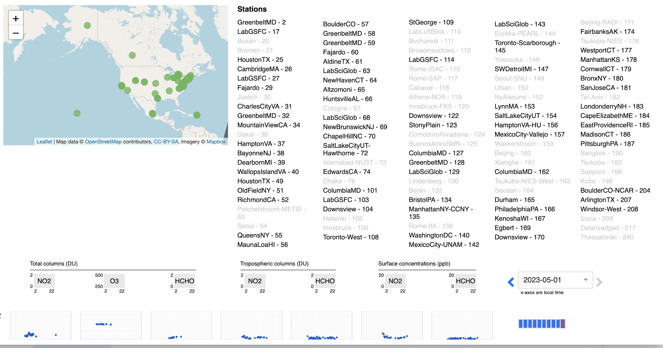
66+ instruments in TEMPO FOV
Adding 13+ in 2023 (IPMSI)
Adding 10+ in 2024 (SNWG USDA)
NEW “Out of the Box” data
Total Column (DU)
Trop Column (DU)
Surface Concentration (ppb)

Slide 18
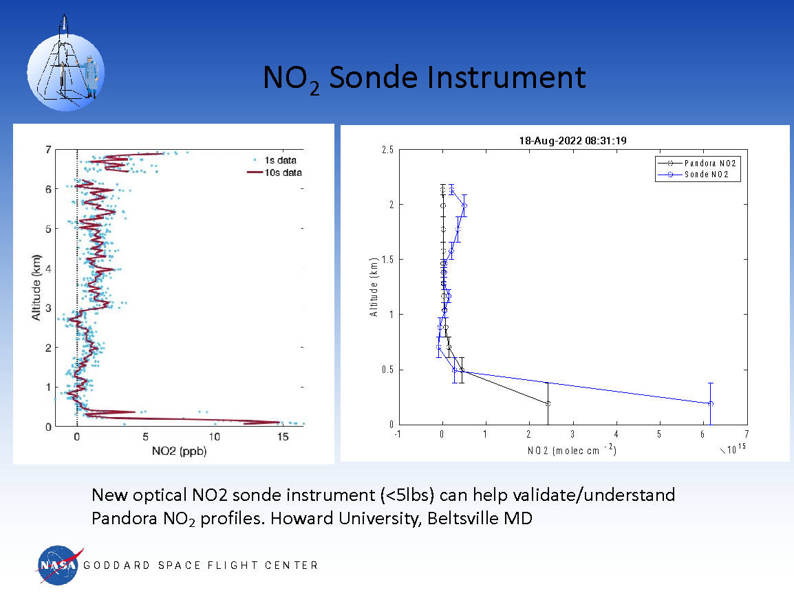

Slide 19
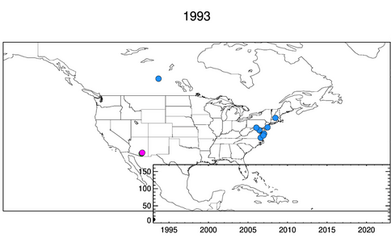
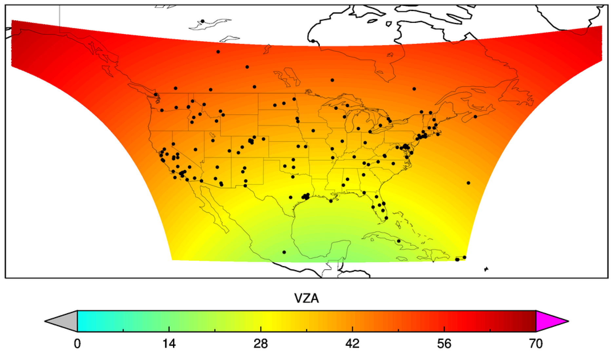
AERONET for TEMPO
~160 active sites in 2022
~140 in US covering 37 states
~10 MSI sites coming up
Multiple sites to support upcoming field campaigns (STAQS, MAGPI, SARP-East, AEROMMA, GOTHAAM)
Pawan Gupta (GSFC), Joint Science Meeting for TEMPO, GeoXO ACX, & TOLNet, May 1-5, 2023, Huntsville, AL
Notes:
Active sites in 2022 – site which has data in 2022. – 160 sites
Missing states includes MS, SC, IN

Slide 20

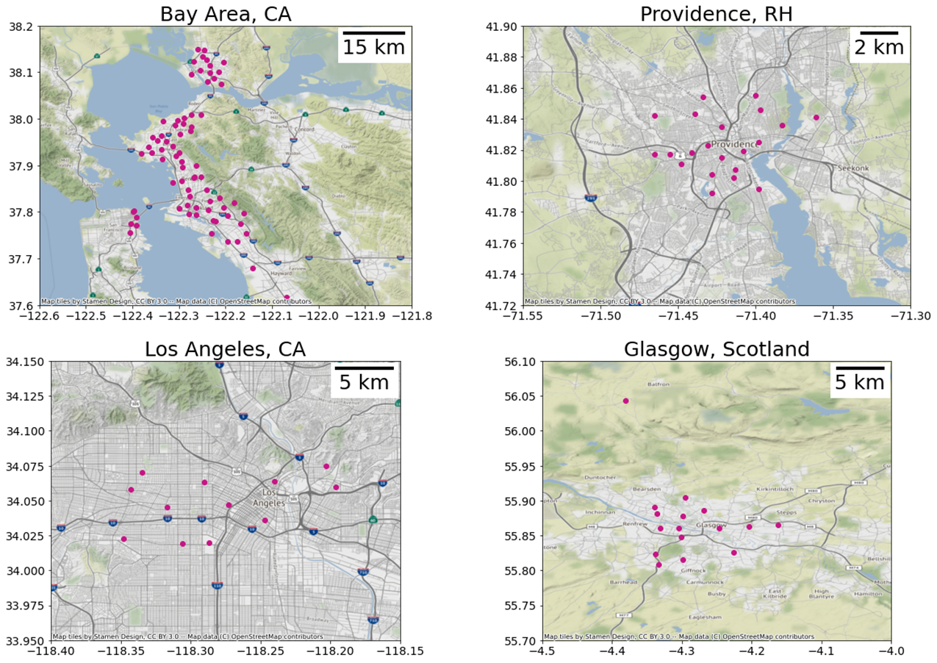
One example of other activities
BEACO₂N in 3 U.S. urban centers. Many other “low cost” sensor networks are being deployed.
NO₂, O₃, PM2.5
Also CO₂, NO, CO

Slide 21
Large Scale Multi-Agency / Platform Sub-Orbital Activities
Xiong Liu, Luke Valin, Jim Szykman*
Steve Brown, Laura Judd
Ron Cohen, Tom Hanisco, Pawan Gupta
Michel Grutter, Chris McLinden*
*virtual

Slide 22
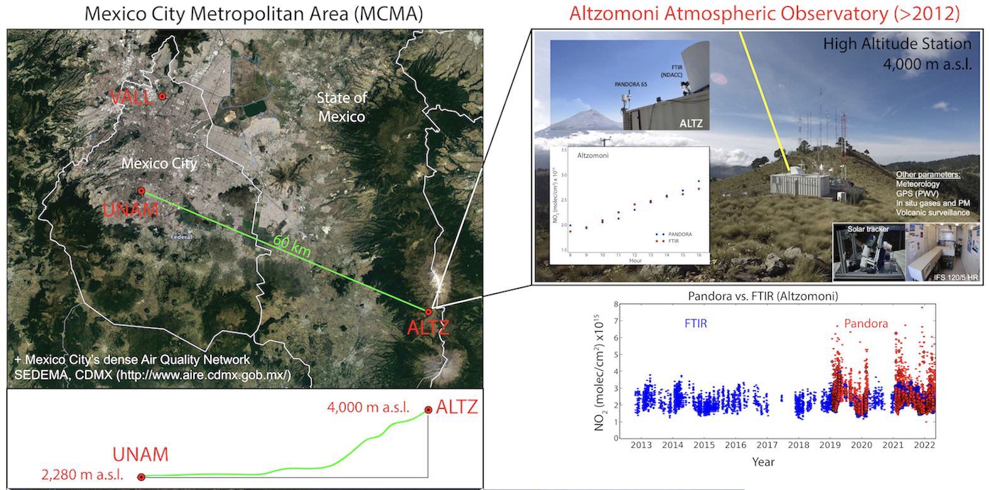
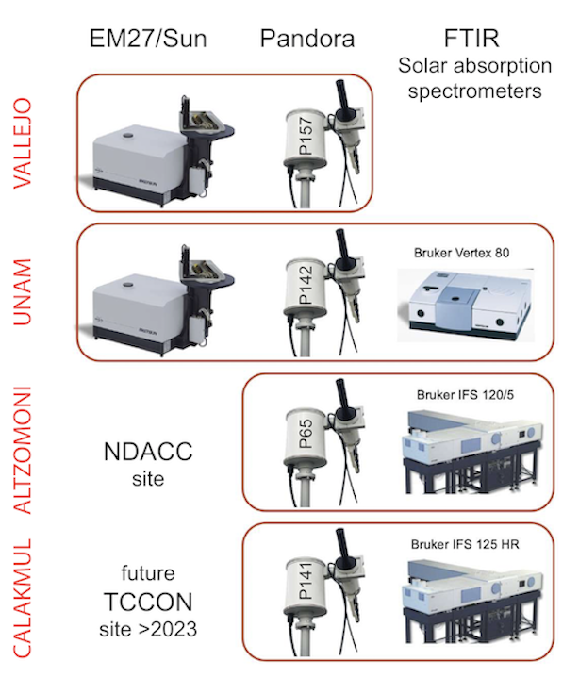


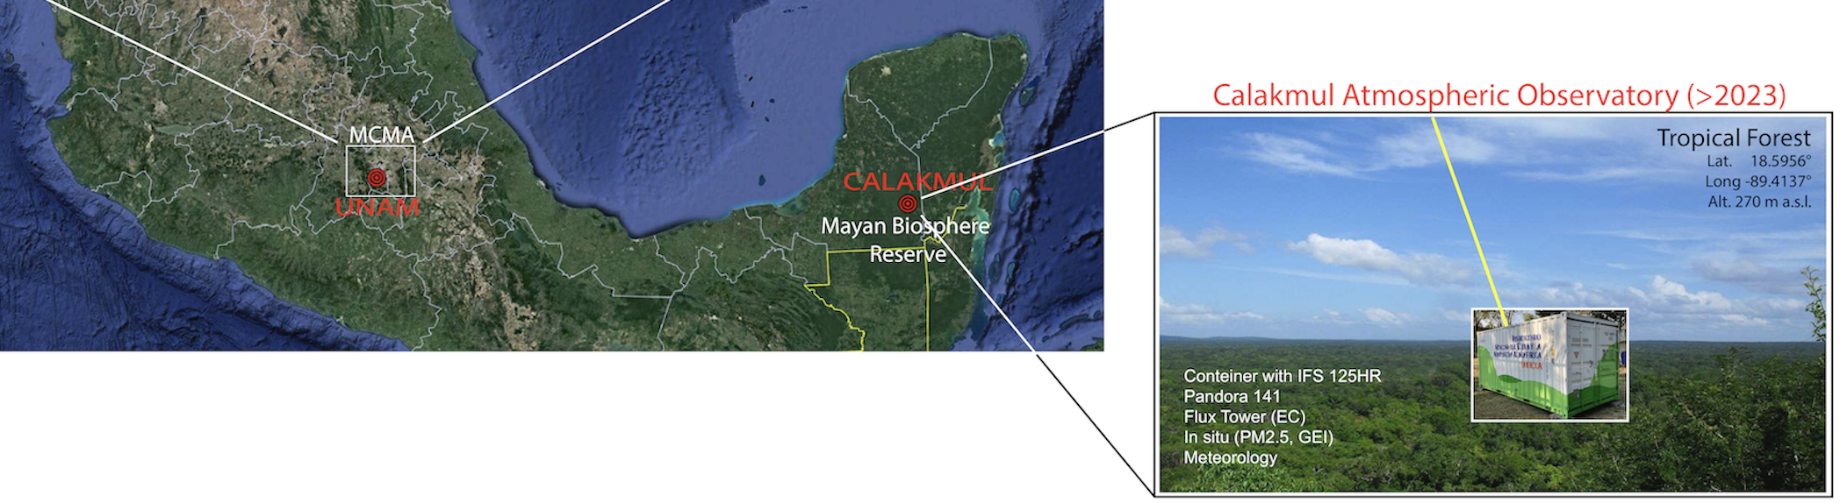
Validation capacities in Mexico
11 years
of operation
Starting > 2023

Slide 23
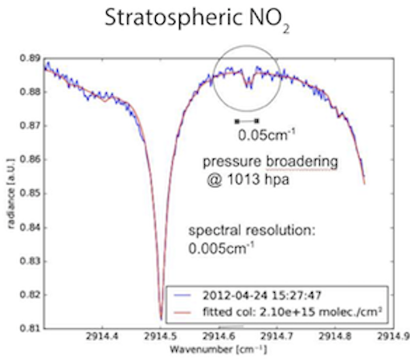
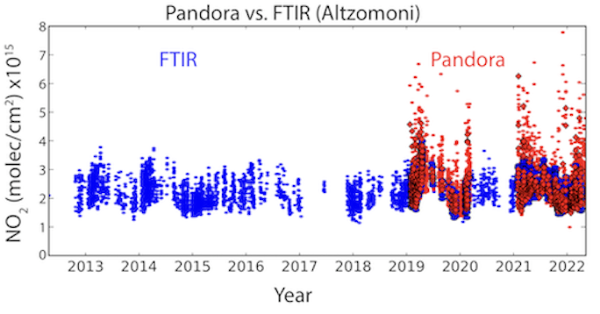
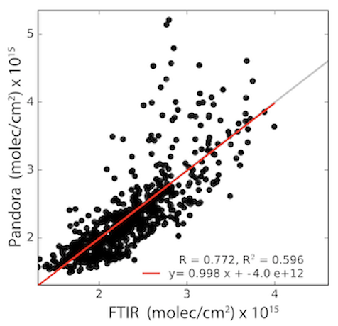
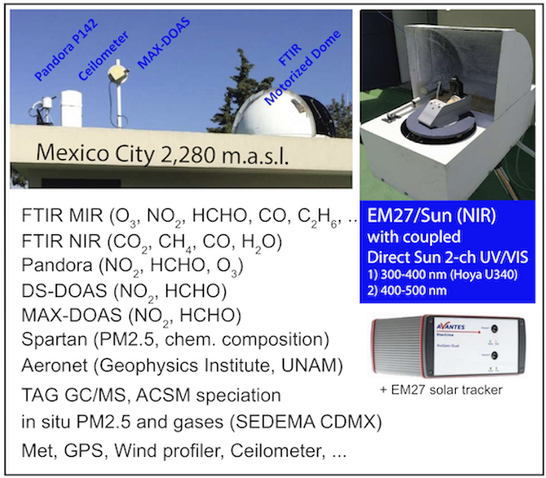
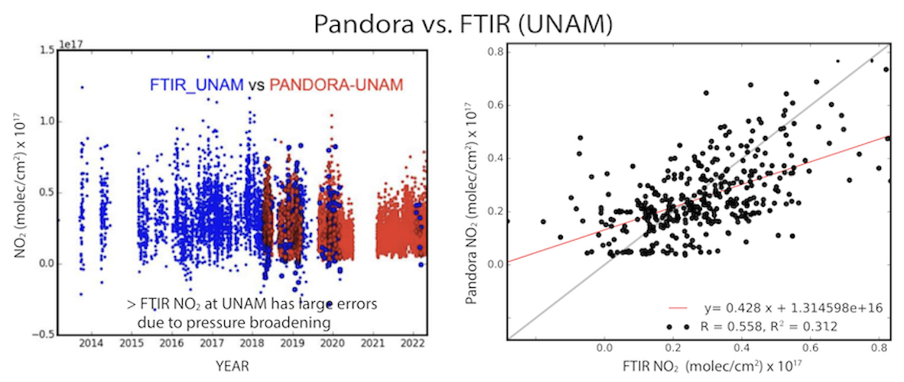
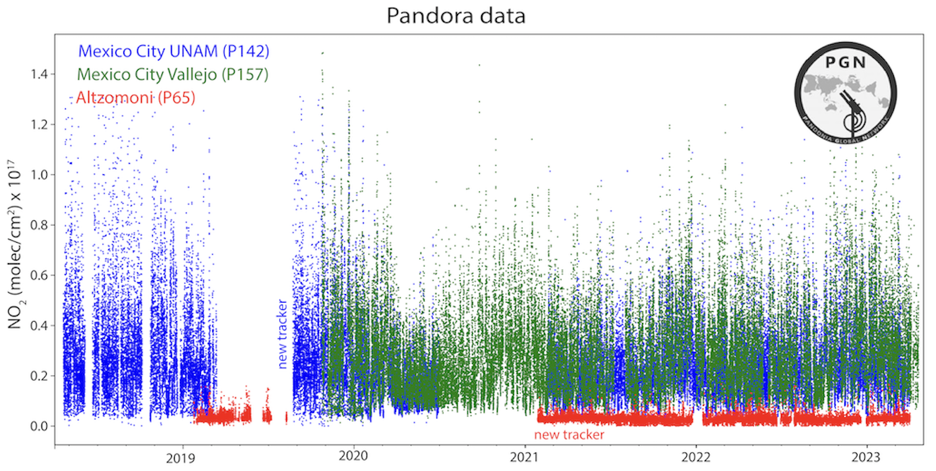
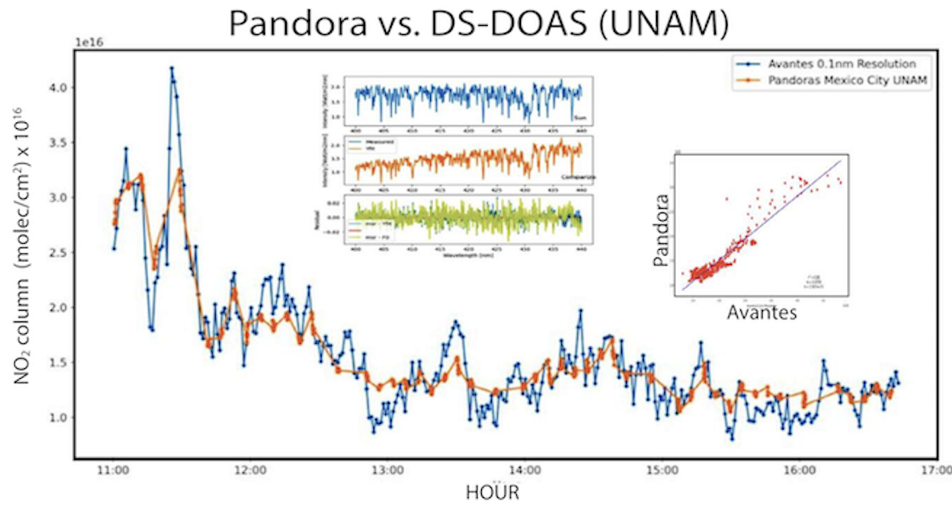
Validation capacities in Mexico
The UNAM Atmospheric Obsertvatory
Combining
IR and UV/Vis
Instruments

Slide 24
Key messages
Importance of longtime measurements with ground-based remote sensors through international network efforts
Validation (high spatial resolution), trend and variability of atmospheric composition
Proper treatment of sensitivites among different RS techniques
Joint air pollution and GHG investigations
Other species: CO, NH₃, CH₄, HCN, C₂H₆ …
Importance to measure boundary layer evolution also from the ground (Doppler Lidar, Ceilometer)

Slide 25
Validation Activities at ECCC
Chris McLinden and collaborators

Slide 26
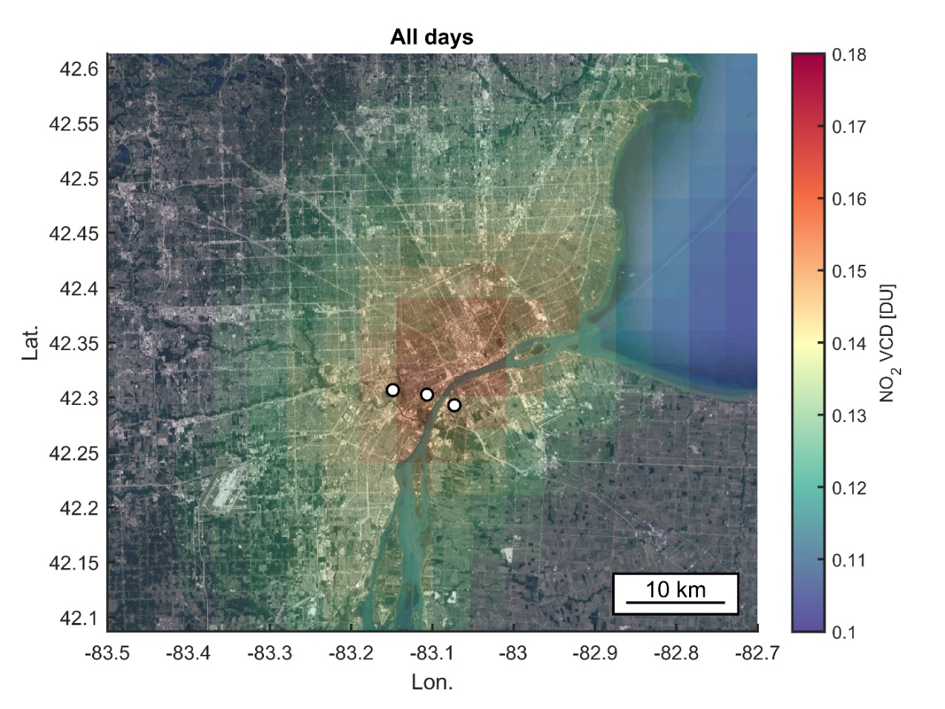
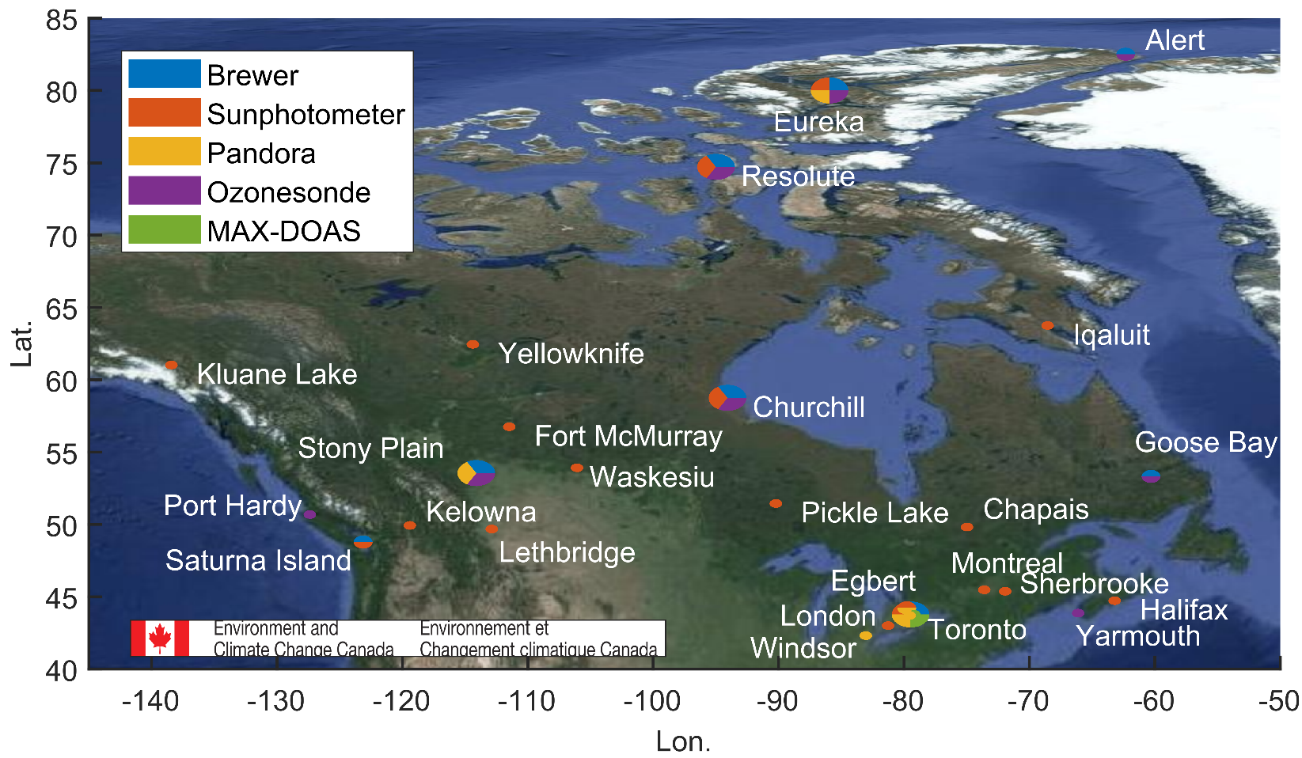
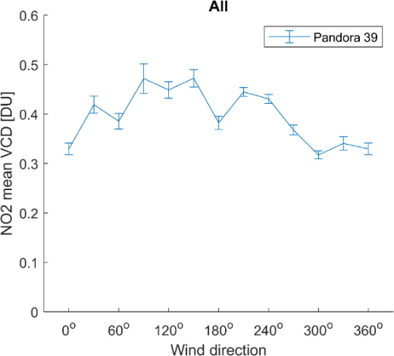
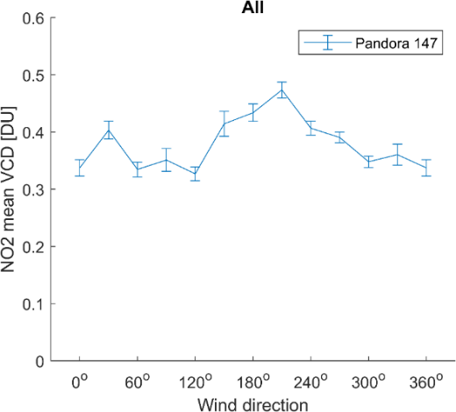
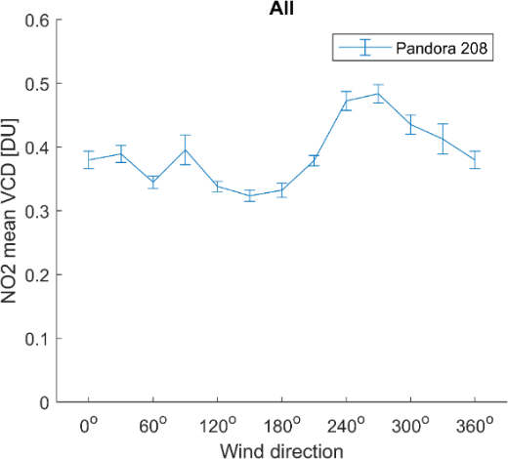
Planned sites:
ECCC future site
In collaboration with UofT
Ultra-high-density Pandora “Sub-pixel” sites
4 km
DearbornMI
Windsor-West
SWDetroitMI
Cambridge Bay
ECCC, NASA, and US-EPA Pandora sites in Detroit-Windsor region
ECCC Remote Sensing Sites
DearbornMI
130º
SWDetroitMI
180º
Windsor-West
240º

Slide 27
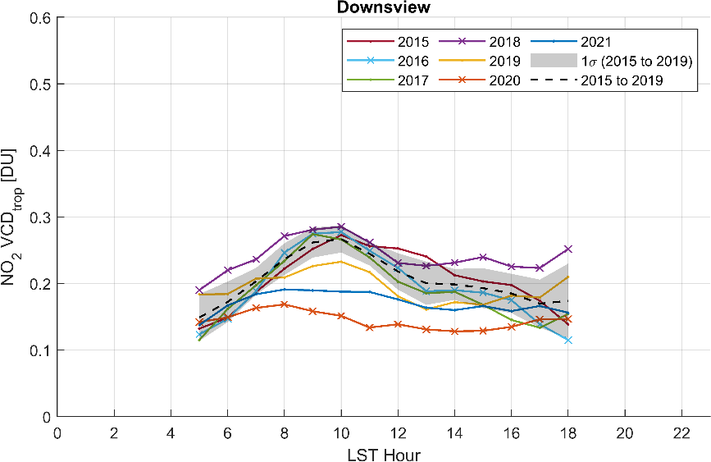
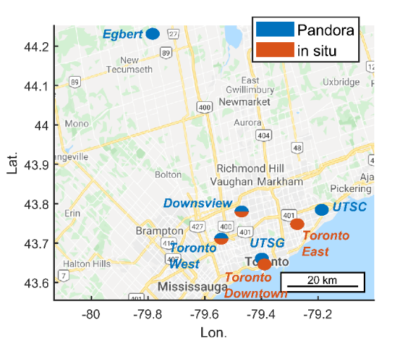

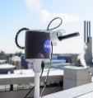


Air quality monitoring in GTA
Morning rush hour emissions changes
TROPOMI overpass time
TEMPO sampling
2015-2019
2021
2020
Zhao et al., 2022
Temporal changes; data binned by LST hours
9:00 am
10:00 am
…
4:00 pm
~300 m
Pre-pandemic
Pandemic
Spatial changes; data binned by wind directions
CN Tower: New vertical profiling experimental site
The NO₂ changes are inhomogeneous in space and time
TEMPO observations are needed to reveal such diurnal changes

Slide 28

Other Validation Activities
Calculate alternative AMFs for NO₂ and HCHO
  Based on ECCC 2.5 km or 250 m model profiles; treatment of snow/albedo
  U of Saskatchewan group has alternative 2D AMF to help with large viewing angles
SWAPIT campaign (2024), others tbd
Ongoing paired surface-HCHO + Pandora observations
Evaluate TEMPO-based surface NO2 vmr product (developed using TROPOMI) from machine learning methods
Evaluation of TEMPO’s ability to capture spatial and diurnal gradients using in-situ and remote ground-based networks; mobile MAX-DOAS
Early prototype:
Surface NO2 using TROPOMI VCD & Machine learning
North America, individual co-incidences

Slide 29
Panel Questions
a) How will each of the correlative instruments assess the precision and accuracy of the TEMPO metrics?
b) Utility of "At Home" Validation vs. Field Observations
What is best for validation?– this summer acts as continued avenue for joint multi-agency field campaigns
c) What are the plans/ideas for for activities in 2024 and 2025?
How can we leverage Green Paper efforts as a sounding board for next validation campaign?
Product Name | Product Horizontal Resolution N/S x E/W @ center of FOR | Product Precision | Frequency
Total Column O₃ | 2.0 x 4.75 km² | 3% | 1 hour
Tropospheric Column O₃ | 8.0 x 4.75 km² (4 N/S across-track pixels coadded) | 10 ppbv | 1 hour
0-2 km O₃ selected scenes | 8.0 x 4.75 km² (4 N/S across-track pixels coadded) | 10 ppbv | 2 hours
Total Column NO₂ | 2.0 x 4.75 km² | 1.0 × 10¹⁵ molecules cm⁻² | 1 hour
Tropospheric Column NO₂ | 2.0 x 4.75 km² | 1.0 × 10¹⁵ molecules cm⁻² | 1 hour
Tropospheric column CH₂O | 2.0 x 4.75 km² | 1.0 × 10¹⁶ molecules cm⁻² | 3 hours

