Slide 1
TEMPO STM Day 2 Session I: Air Quality Modeling
Discussion Questions:
How will we use models for TEMPO validation?
  Indirect validation and evaluation of initial TEMPO column retrievals using multiple modeling frameworks
  Account for retrievals with respect to a priori information and AMF calculations
  Quantify uncertainties in retrieved values and in physical conditions (albedo, profile shape, sza, etc.)
  Quantify fraction of gradients retrieved (horizontal, vertical, temporal)
How will we assimilate TEMPO column/profile retrievals into AQ forecast models?
  Deal with vertical distribution within the columns
  Relate total/partial columns to surface concentrations
  Quantify fundamental spatial/temporal resolution information content (state, region, neighborhood)
Preparing Air Quality Modeling Systems for TEMPO Data
Moderator: Matthew Johnson
Panelist: Brad Pierce, Emma Knowland, Arthur Mizzi, Daniel Jacob, Gabi Pfister, Barron Henderson

Slide 2
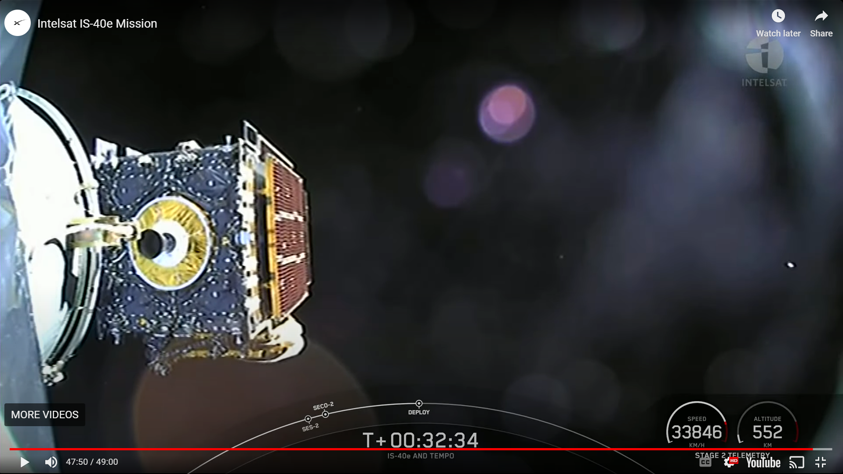

Day 2 Session I:
Air Quality Modeling
Brad Pierce
University of Wisconsin - Madison
Joint Science Meeting for TEMPO, GeoXO ACX, & TOLNet, May 1-5, 2023, University of Alabama in Huntsville

Slide 3
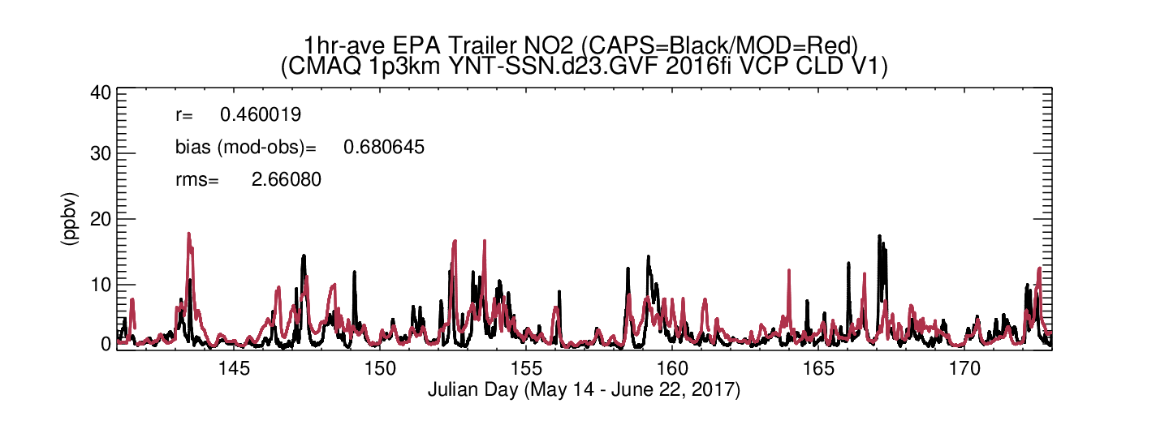
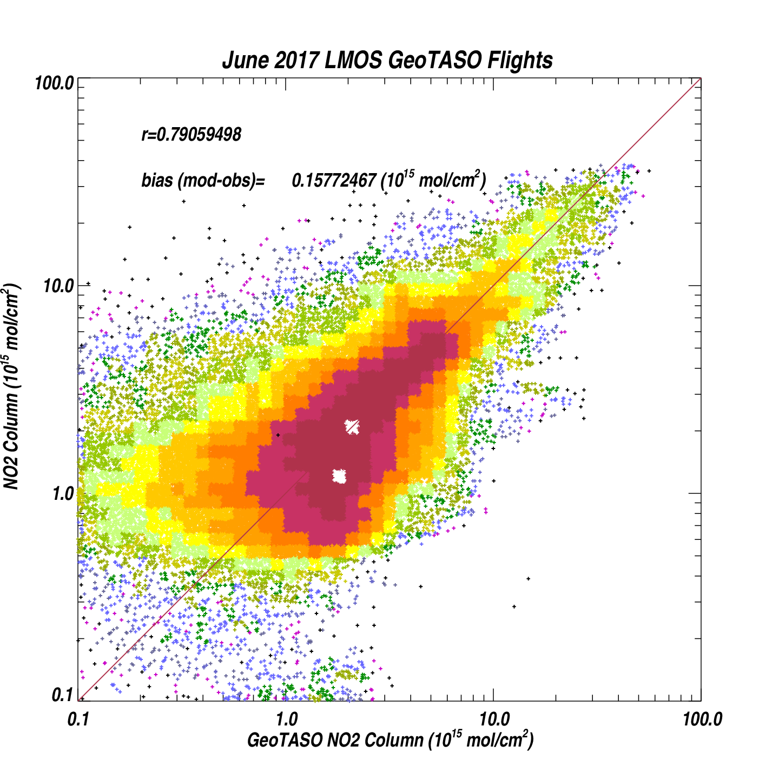
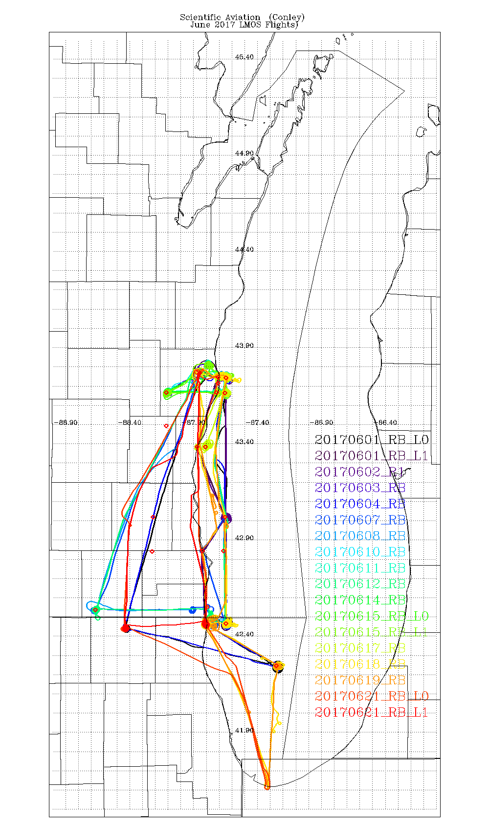
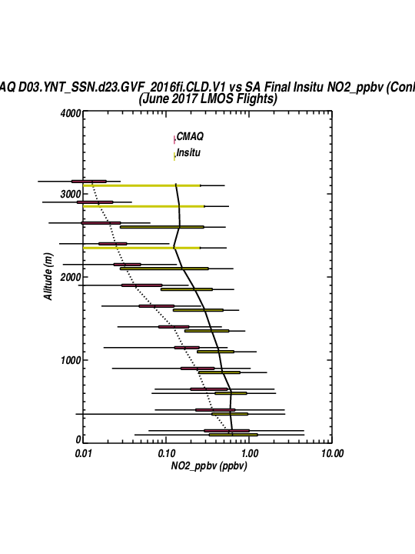
How will we use models for TEMPO validation?
Indirect validation and evaluation of initial TEMPO column retrievals
Stanier, C. O., and Coauthors, 2021: Overview of the Lake Michigan Ozone Study 2017. Bull. Amer. Meteor. Soc., 102, E2207–E2225, https://doi.org/10.1175/BAMS-D-20-0061.1.

Slide 4
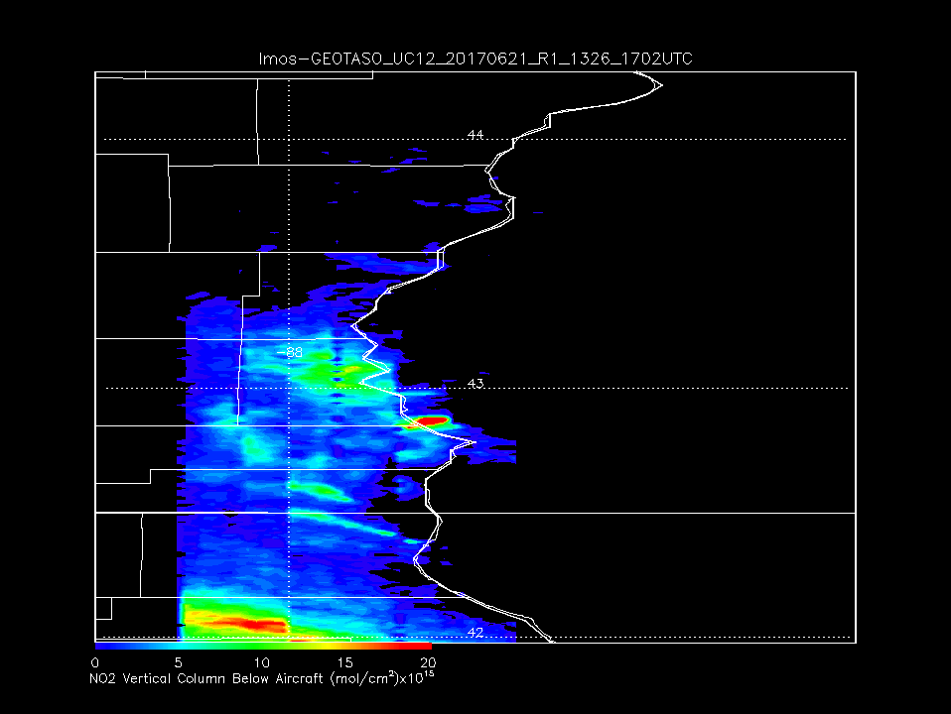
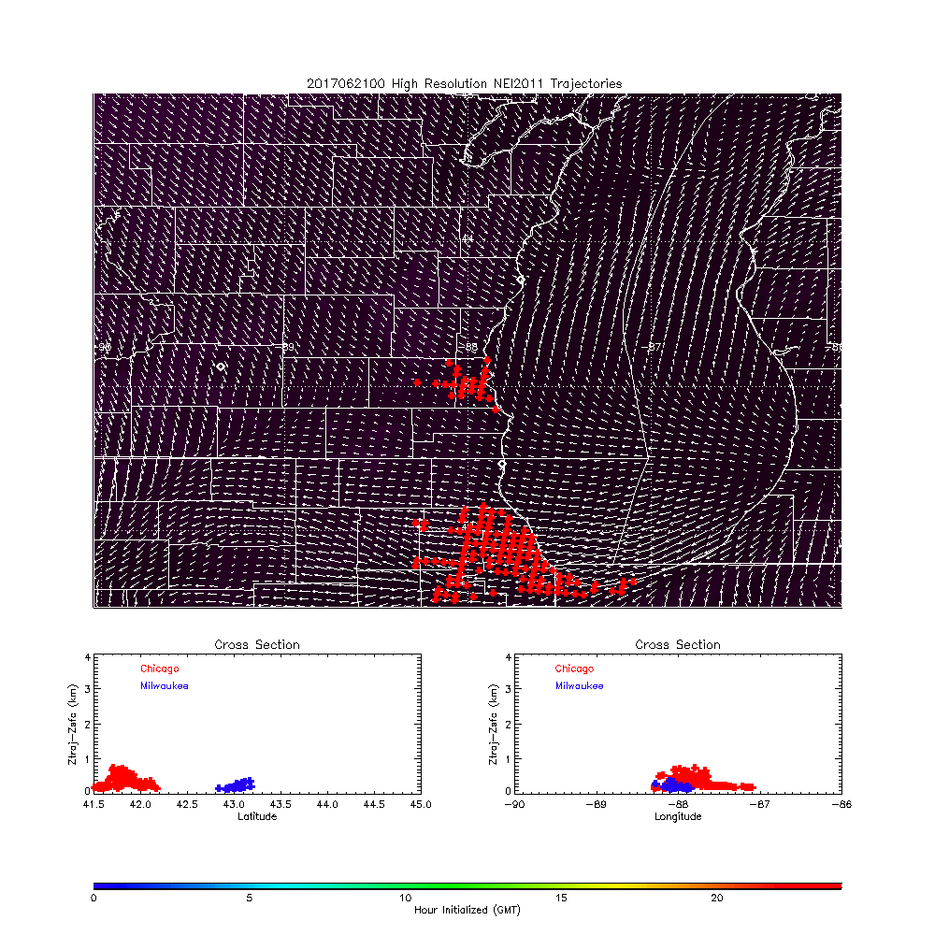
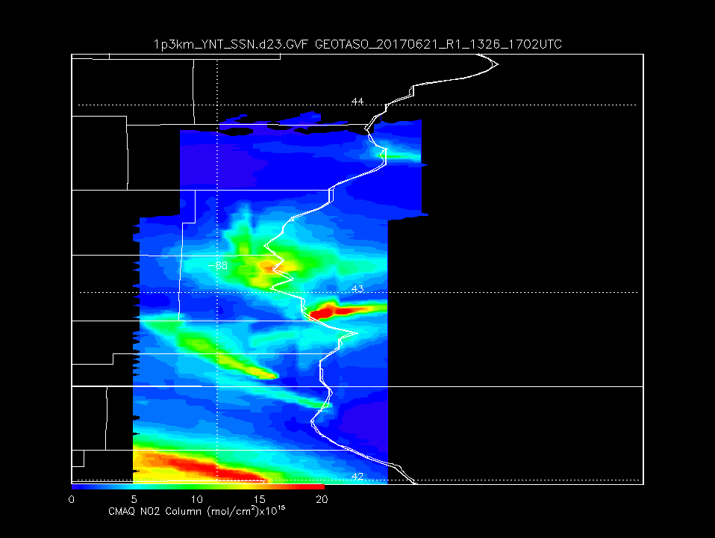
How will we assimilate TEMPO retrievals into AQ forecast models?
Trajectory Based Iterative Mass Balance Emission Inversion
NAM 3km Emission Trajectories 06/21/2017
1km GEOTASO
LMOS
06/21/2017
High resolution (plume resolving) modeling is needed to use TEMPO data to support emission control strategies
High resolution NO2 column enhancements are often downwind from emission sources
Trajectories are one way to link plumes to emission sources
Next step in mass-balance based emission inversion
Milwaukee
Oak Creek
Chicago Plume
Milwaukee
1.3km CMAQ
LMOS
06/21/2017
Oak Creek
Chicago Plume
Pierce, R. B., Harkey, M., Lenzen, A., Cronce, L. M., Otkin, J. A., Case, J. L., Henderson, D. S., Adelman, Z., Nergui, T., and Hain, C. R.: High resolution CMAQ simulations of ozone exceedance events during the Lake Michigan Ozone Study, EGUsphere [preprint], https://doi.org/10.5194/egusphere-2023-152, 2023.

Slide 5

NASA GEOS Composition Forecast system: GEOS-CF
K. Emma Knowland
Morgan State University/GESTAR-II
NASA Global Modeling and Assimilation Office (GMAO)
Co-author: Christoph Keller (MSU/GESTAR-II, NASA GMAO), Viral Shah (SSAI, NASA GMAO), Pam Wales (MSU/GESTAR-II, NASA GMAO), Lesley Ott (NASA GMAO), Steven Pawson (NASA GMAO)
In collaboration with many other scientists from NASA Goddard Space Flight Center and our partners
3 May 2023

Slide 6
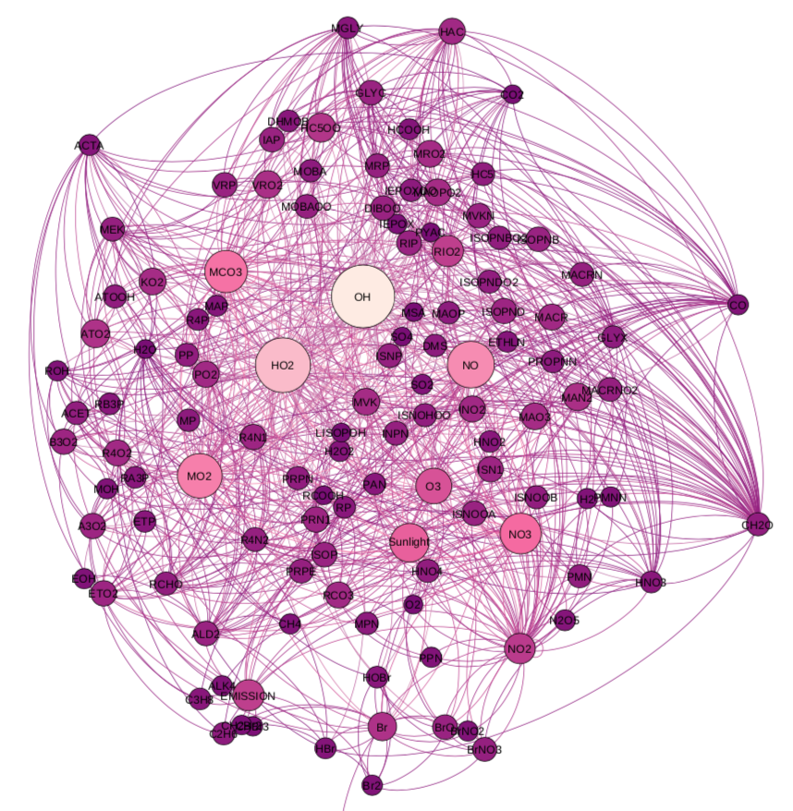
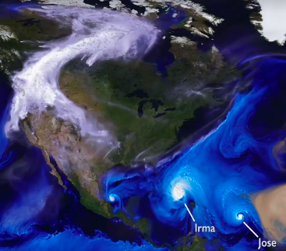

GEOS with Coupled GEOS-Chem chemistry
G5NR - Chem
GEOS - CF
GEOS NWP
GEOS - Chem
Hu, L., Keller, C. A., et al (2018). Global simulation of tropospheric chemistry at 12.5 km resolution: performance and evaluation of the GEOS-Chem chemical module (v10-1) within the NASA GEOS Earth system model (GEOS-5 ESM). Geosci. Model Dev., 11, 4603–4620, https://doi.org/10.5194/gmd-11-4603-2018.
Keller, C. A., Knowland, K. E., et al. (2021). Description of the NASA GEOS composition forecast modeling system GEOS-CF v1.0. Journal of Advances in Modeling Earth Systems, 13, e2020MS002413. https://doi.org/10.1029/2020MS002413
Knowland, K. E., Keller, C. A., et al. (2022). NASA GEOS Composition Forecast Modeling System GEOS‐CF v1.0: Stratospheric Composition. JAMES https://doi.org/10.1029/2021MS002852
https://gmao.gsfc.nasa.gov/weather_prediction/GEOS-CF/
k.e.knowland@nasa.gov

Slide 7
GEOS with Coupled GEOS-Chem chemistry
G5NR-Chem
GEOS-CF
1 July 2013 – 1 July 2014
  Meteorological “replay”
  c720 (0.125 °,~12.5 x 12.5 km²)
  72 model layers
  GEOS-Chem v10-01 Tropospheric-only mode
  Default GEOS-Chem emissions
  1-hour, 29 species
1 January 2018 - present
  1-day replay + 5-day forecast
  c360 (0.25°, ~25 x 25 km²)
  72 model layers
  GEOS-Chem v12.0.1, with UCX
  Tropospheric & Stratospheric
  HTAP v2.2
  1-hour 2D & 3D output, including specific TEMPO file for retrievals
  Knowland et al., 2022. "File Specification for GEOS-CF Products." GMAO Office Note No. 17 (Version 1.2), available from http://gmao.gsfc.nasa.gov/pubs/office_notes
https://gmao.gsfc.nasa.gov/weather_prediction/GEOS-CF/
k.e.knowland@nasa.gov
7

Slide 8
TEMPO specific collection: “sat_inst_1hr_r721x361_v72”
Regional Chemistry and Meteorology Diagnostics to support TEMPO satellite
Frequency: hourly instantaneous from 00:00 UTC
Spatial Grid: 3D, model-level, subset region of full horizontal resolution
Dimensions: longitude=721, latitude=361, every 0.25º
longitude: 0º to -180º
latitude: 0º to 90º
vertical level: 72 layers
Granule Size: ~258 MB per file
Start date: 00 UTC 1 January 2022
Mode: Replay only; Forecasts available based on mission requirements
Knowland et al., 2022. "File Specification for GEOS-CF Products." GMAO Office Note No. 17 (Version 1.2), available from http://gmao.gsfc.nasa.gov/pubs/office_notes
Name | Dim | Description | Units
BrO | tzyx | Bromine monoxide (BrO, MW = 96.00 g mol-1) volume mixing ratio dry air | mol mol-1
FRSEAICE | tyx | ice covered fraction of tile | 1
FRSNO | tyx | fractional area of land snowcover | 1
GLYX | tzyx | Glyoxal (CHOCHO, MW = 58.00 g mol-1) volume mixing ratio dry air | mol mol-1
HCHO | tzyx | Formaldehyde (CH2O, MW = 30.00 g mol-1) volume mixing ratio dry air | mol mol-1
HNO2 | tzyx | Nitrous acid (HNO2, MW = 47.00 g mol-1) volume mixing ratio dry air | mol mol-1
IO | tzyx | Iodine monoxide (IO, MW = 143.00 g mol-1) volume mixing ratio dry air | mol mol-1
NO2 | tzyx | Nitrogen dioxide (NO2, MW = 46.00 g mol-1) volume mixing ratio dry air | mol mol-1
O3 | tzyx | Ozone (O3, MW = 48.00 g mol-1) volume mixing ratio dry air | mol mol-1
OClO | tzyx | Chlorine dioxide (OClO, MW = 67.00 g mol-1) volume mixing ratio dry air | mol mol-1
PHIS | tyx | surface geopotential height | m+2 s-2
PS | tyx | surface pressure | Pa
Q | tzyx | specific humidity | kg kg-1
SNODP | tyx | snow depth | m
SNOMAS | tyx | Total snow storage land | kg m-2
SO2 | tzyx | Sulfur dioxide (SO2, MW = 64.00 g mol-1) volume mixing ratio dry air | mol mol-1
T | tzyx | air temperature | K
TROPPB | tyx | tropopause pressure based on blended estimate | Pa
U2M | tyx | 2-meter eastward wind | m s-1
V2M | tyx | 2-meter northward wind | m s-1
ZPBL | tyx | planetary boundary layer height | m
https://gmao.gsfc.nasa.gov/weather_prediction/GEOS-CF/
k.e.knowland@nasa.gov

Slide 9
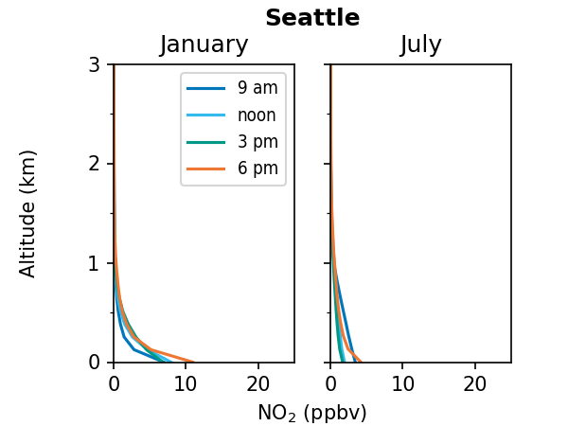
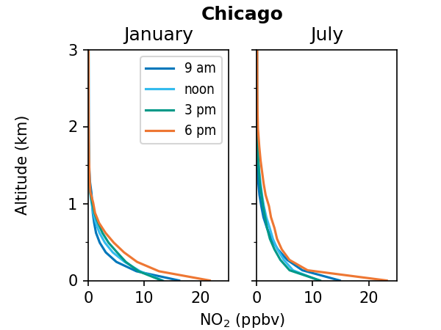
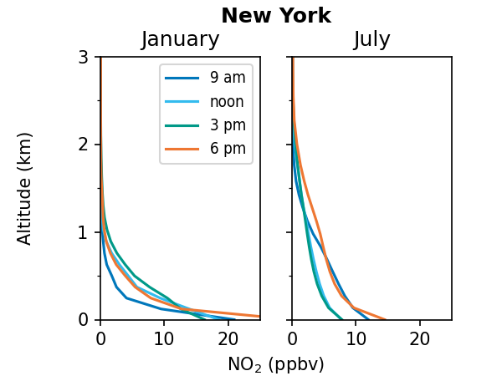
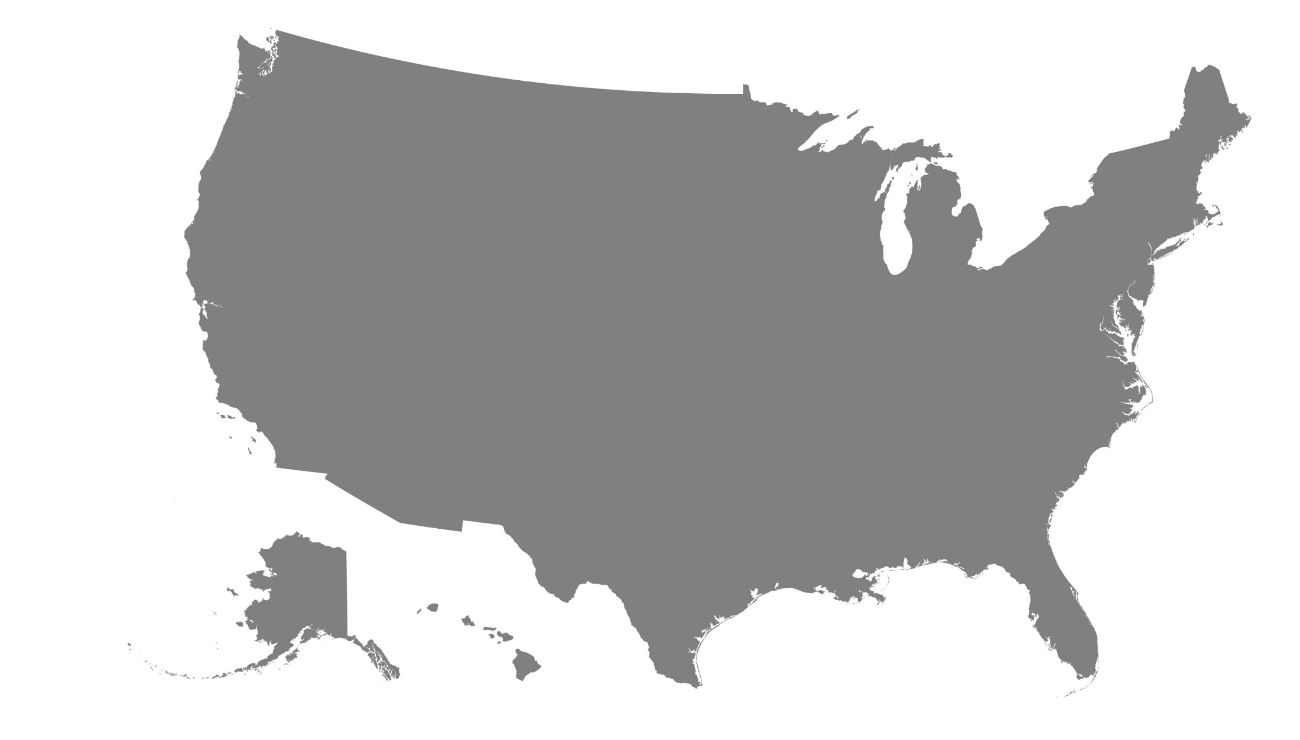
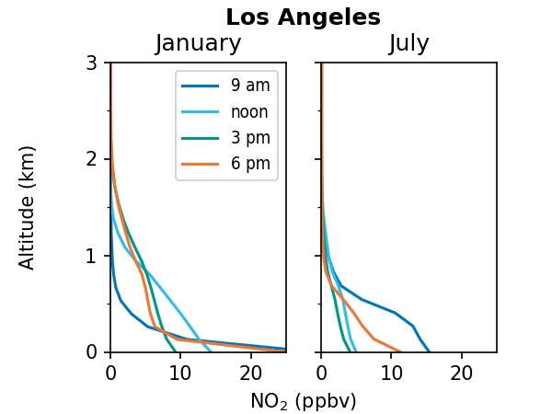
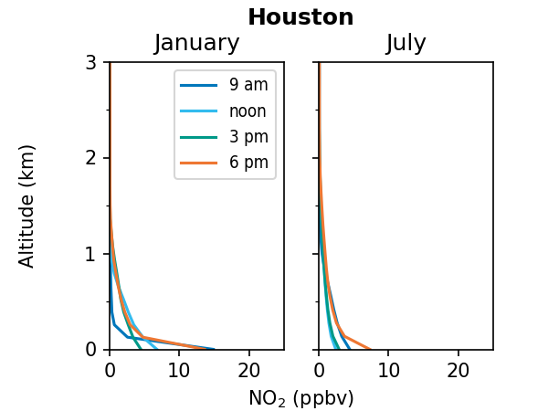
Seasonal & hourly variations in NO₂ profiles
Figure produced by Viral Shah
https://gmao.gsfc.nasa.gov/weather_prediction/GEOS-CF/
k.e.knowland@nasa.gov
Notes:
This is for 2021

Slide 10
Spinning up GEOS-CF version 2
Model update to GEOS-Chem v14.0
GEOS AGCM update
CEDS emission inventory (latest release through 2019)
Constituent Data Assimilation System (CoDAS)
  Multi-constituent assimilation with O₃, NO₂, SO₂
We will provide new climatology to TEMPO retrieval team
https://gmao.gsfc.nasa.gov/weather_prediction/GEOS-CF/
k.e.knowland@nasa.gov

Slide 11




Wildfire Emissions Estimation, Transport and Air Quality Monitoring
with WRF-Chem / DART
A. Mizzi, M. Johnson, A. Naeger, C.-H. Hsu, D. Henze,
B. McDonald, R. Kumar, and ARC NEX Group
NASA Ames Research Center/BAERI
Earth Science Division
May 1 - 5, 2023
Joint STM for TEMPO, GeoXO
ACX, and TOLNET
Univ. of Alabama - Huntsville
Huntsville, AL. USA
Notes:
Purpose – To communicate Ames capabilities, ongoing work and roadmap to find common ground, goals, purpose in modeling, data assimilation, etc.. .

Slide 12
Discussion Points: Preparing AQ Modeling Systems for TEMPO Data
BACKGROUND: At NASA Ames, NOAA CSL, and CU-Boulder, we are using WRF-Chem/DART to jointly assimilate:
Proxy TEMPO O₃ profile and NO₂ tropospheric column retrievals;
MOPITT CO profile, TROPOMI CO total column, O₃ profile, NO₂ and SO₂ tropospheric column, MODIS AOD total column retrievals; and
In situ AQS measurements (CO, O₃, NO₂, SO₂, PM₁₀, and PM_{2.5});
We are expanding this to include TROPOMI HCHO, CH₄; CrIS CO, O₃, NO₂, SO₂, CH₄,‘CO₂’; and retrievals from other satellite platforms like TES, GOME2a, SCIAMACHY, and MLS;
With this system we jointly constrain concentrations, emissions and aerosols.
The next two slides illustrate some of our results. These results are also presented in one of the hallway posters on WRF-Chem/DART.

Slide 13
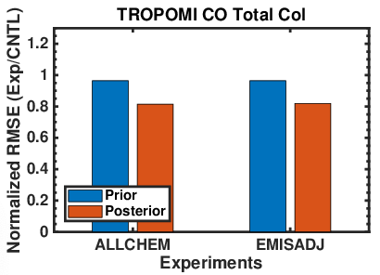
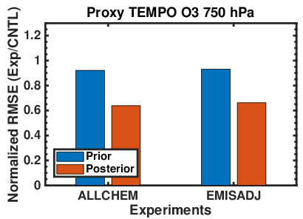
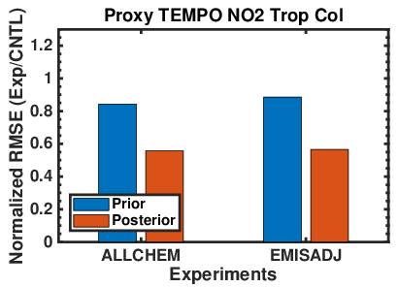
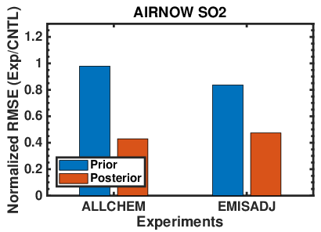
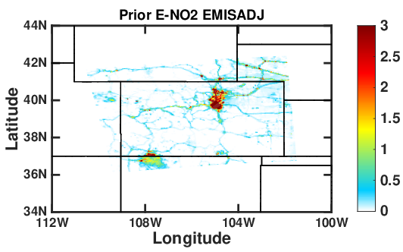
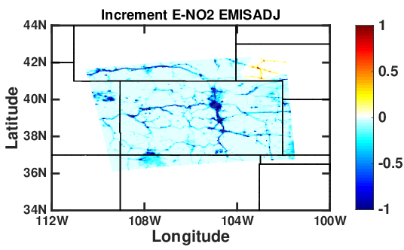
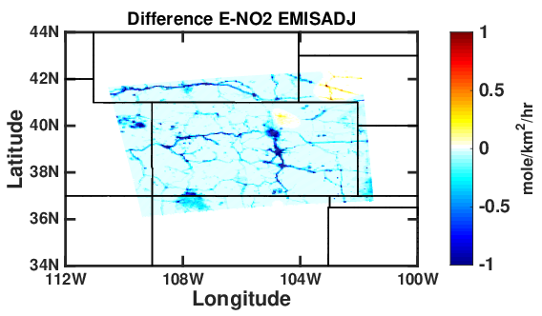
Normalized RMSE for TEMPO O₃, NO₂, TROPOMI CO, and AQS SO₂
NO₂ Emissions for July 11, 2020 at 18 UTC
Upper row: RMSE normalized by CONTROL EX RMSE. Results show: (i) impact of chemical data assimilation on forecasts relative to CONTROL EX; and (ii) impact of assimilating TEMPO O₃ profile and NO₂ tropospheric column retrievals. Expected greater difference between ALLCHEM EX and EMISADJ EX.
Lower row: NO₂ Assimilation prior, increment, and difference to CONTROL EX. Result suggest that there is a general overestimation of NO₂ emissions (urban and mobile sources).
Notes:
NOTE: the experimental period was limited by the availability of proxy TEMPO O3 profile retrievals. We are working with Aaron Naeger to an additional seven to ten days of proxy TEMPO data.
Generally, same type of improvements for ALLCHEM and EMISADJ compared to CONTROL as seen for the medium resolution experiments (FRAPPE).
EXCEPT:
MOPITT CO – due to interaction with the assimilation of TROPOMI CO
TROPOMI and proxy TEMPO NO2 have larger skill increases than OMI NO2. The AIRNOW NO2 skill increases are comparable.
MODIS AOD has greater skill improvements than for FRAPPE and the PM improvements are mixed.
For some observation types (MOPITT CO, and MODIS AOD), ALLCHEM has greater skill than EMISADJ.
EXPLANATION:
Investigating the potential MOPITT / TROPOMI CO conflict.
Suspect that the AOD and PM difference are related to their being diagnostic quantities (as prognostic quantities like CO, O₃, NO2, and SO2).
3

Slide 14
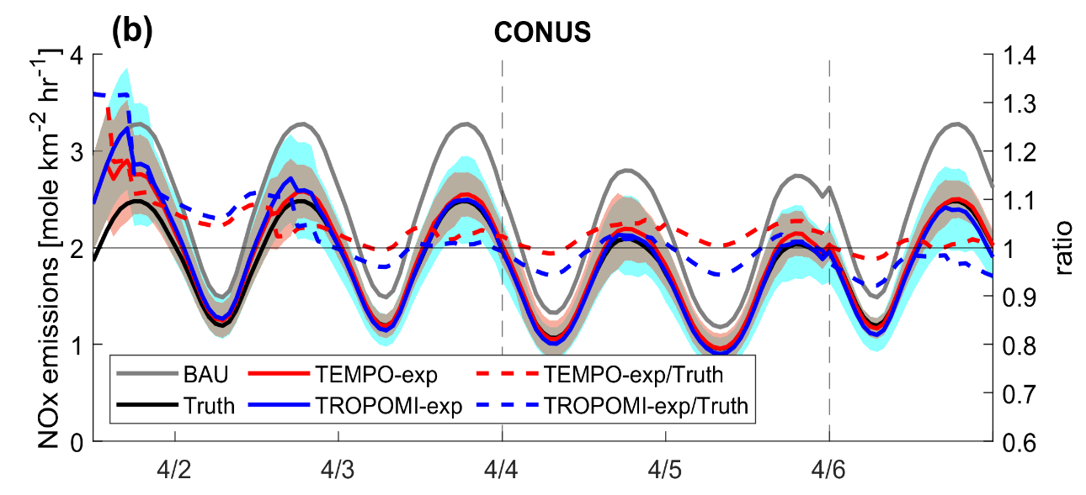
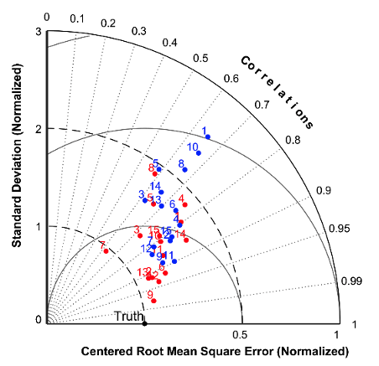
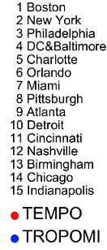
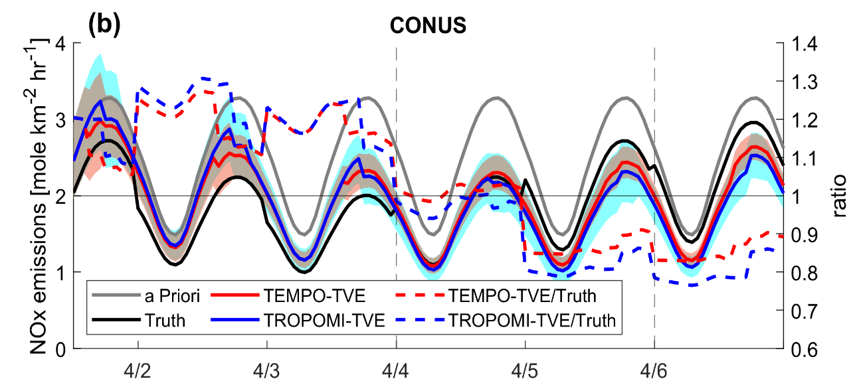
TEMPO/TROPOMI NO₂ OSSE for NOAA GeoXO ACX (Hsu et. al., 2023)
NO₂ Emissions Timeseries
Taylor Diagram
(selected urban areas)
Case 1
Case 2
Left panels: Results show that: (i) TEMPO EX recovers COVID emissions twice as fast as TROPOMI EX; and (ii) TEMPO EX also performs better with temporal variations in the diurnal pattern.
Right panel: Results show that TEMPO EX has greater emissions recovery skill in most urban areas.

Slide 15
Discussion Points: Preparing AQ Modeling Systems for TEMPO Data
DISCUSSION POINTS:
How to account for the ‘retrieval priors’ and ‘air mass factors’ (AMF)? Use ‘quasi-optimal retrievals’ – subtract the prior term and use ‘slant column retrievals’ – do not need the AMFs.
How to deal with vertical distributions within retrieved column? Use ensemble correlations between expected observations and state variable profile elements to determine the vertical distribution impacts. This can be expanded to use more sophisticated statistical and machine learning methods to identify the correlations and impacts.
How to relate retrieved column to surface concentrations? Use methods similar to those used for the previous discussion point.
How to quantify the fundamental spatial/temporal resolution information content at regional and local scales? We have previously discussed the ‘information content’ benefits of special observing periods and oversampling. We can apply those strategies and then use existing ‘information content’ metrics for quantification of the content. As a concrete example, we all know that averaging kernel matrices for retrieval profiles are severely rank deficient, i.e., the matrix rank is significantly less that the matrix dimension. That means that the information density (the ratio of the rank to the dimension) is very small. We use linear phase space transformations to compress the averaging kernels and profiles to obtain information densities of one (the maximal information density). The next slide presents an application of this idea to proxy TEMPO O₃ profile retrievals.

Slide 16
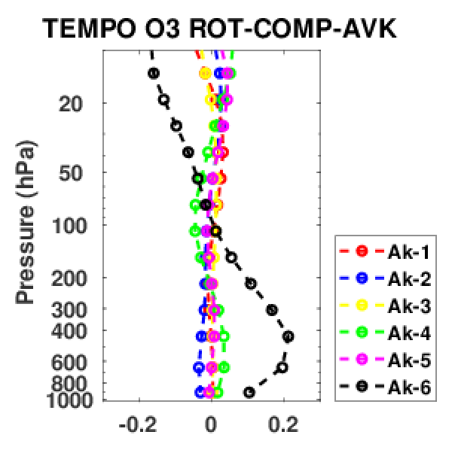
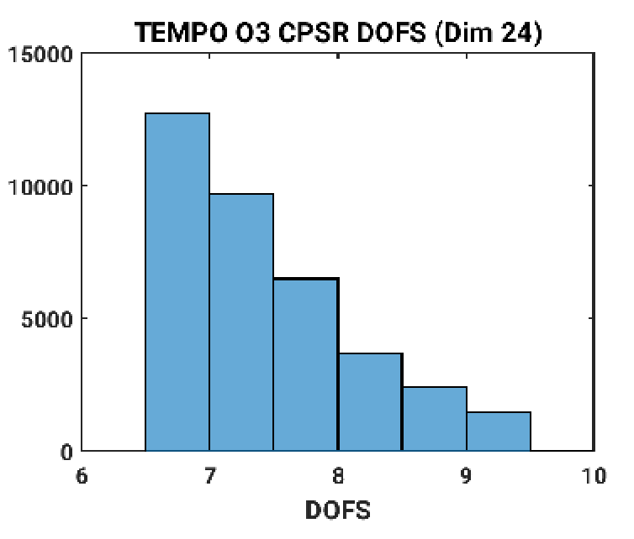
Computation Saving with TEMPO O₃ CPSRs
TEMPO O₃ DOFS Histogram
(24 Vertical Layers)
TEMPO O₃ DOFS Histogram
(24 Vertical Layers)
Our work with proxy TEMPO suggests that observation thinning is necessary. Otherwise, the computational costs are prohibitive.
Left panel shows that most common DOFS is six or seven. Thus, the CPSR computational savings is 75%.
Right panel shows that compressed and rotated averaging kernels Ak-2, Ak-4, and Ak-6 have sensitivity in the mid- to lower troposphere. The rotation transform normalizes the transformed averaging kernels by the effective observation error. Thus, Ak-6 has the greatest sensitivity because it has the smallest observation error because the rotation transform ranks the transform vectors by the observation error.

Slide 17
Day 2 Session I:
Air Quality Modeling
Daniel Jacob
Harvard University
Joint Science Meeting for TEMPO, GeoXO ACX, & TOLNet, May 1-5, 2023, University of Alabama in Huntsville

Slide 18
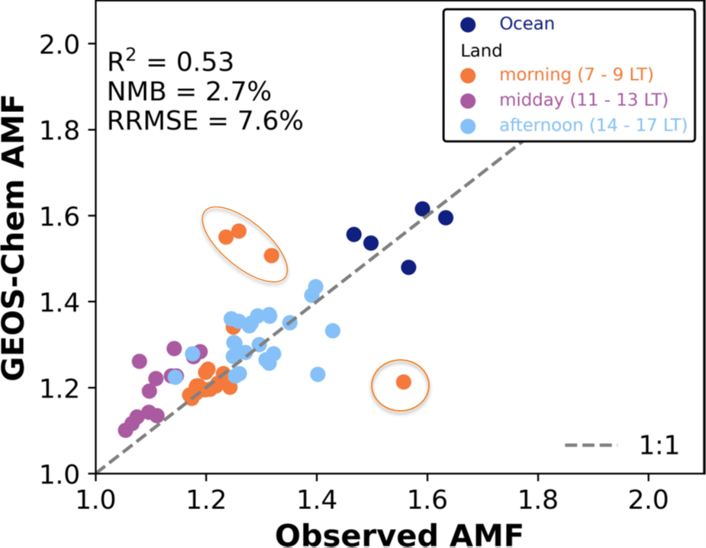

Accurate modeling of mixed layer dynamics is key to retrieving diurnal cycles of pollutants
Diurnal variations in vertical profiles as mixed layer grows affects air mass factors (AMFs) for column retrievals
Problem is most acute in morning hours when mixed layer grows rapidly but models may not have the timing right
Local time, hours | AMF_{G} |  | AMF
8-9 | 3.09 | 0.38 | 1.19
12-13 | 2.42 | 0.46 | 1.11
15-16 | 2.77 | 0.46 | 1.27
KORUS-AQ NO₂ observations
Daniel Jacob
Yang, L.H., et al., Atmos. Chem. Phys., 23, 2465–2481, 2023.

Slide 19
Use machine learning to produce blended TEMPO+TROPOMI+GEMS product
Enable validation, correction, and use of early TEMPO data
Cover much wider range of conditions than traditional validation
Method presently used to validate GEMS with TROPOMI
Construct consistent TEMPO-TROPOMI-GEMS dataset
Example: correction of TROPOMI methane with GOSAT
TEMPO
X₁ + retrieval
parameters x₁
TROPOMI
X₂
collocated data subset
improve
retrievals
Train ML model for
Δ(X₁ – X₂) = f(x₁)
full dataset
ML correction
Create blended product
X₁₊₂ = X₁ – f(x₁)
Daniel Jacob
Balasus, N., et al., submitted to Atmos. Meas. Tech., 2023

Slide 20

A Few Thoughts on TEMPO for Regional
Air Quality Modeling and Forecasting
Gabriele Pfister
April 2023

Slide 21
Challenges, Opportunities & Needs
GEO higher spatial and temporal resolution will help with:
      Improving diurnal cycle of emissions
      Enhancing spatial accuracy of emissions (e.g. DA, rescaling based on proxy data)
      Timely information on anthropogenic emission changes and emissions due to extreme/unexpected events.
⇒ Operationalize rapid emission updates
⇒ Coupled DA - constraining emissions and concentrations simultaneously
⇒ Challenge remains how to deal with unobserved species
⇒ Increased errors in chemistry and transport at urban scales (PBL) - needs careful
characterization in forward model
EMISSIONS
      Improved forecast evaluation
      Observations at scales more representative of typical model resolution
⇒ Develop common practices and frameworks for evaluating and comparing models
⇒ Retrieval algorithms also rely on models and are not a ground truth
EVALUATION
SCALE UNIFICATION
      Detailed information over selected regions of the globe on top of LEO
      ⇒ Models need to seamlessly represent scales of polar orbiting & GEO satellites

Slide 22
Challenges, Opportunities & Needs
GEO higher spatial and temporal resolution will help with:
      Significantly larger set of observations for analysis, model improvements,
      assimilation, fusion and evaluation
      Making special techniques employed for accuracy and efficiency (e.g. oversampling,
      bias correction, ensemble forecasting, DA, post-simulation data fusion) and for
      connecting surface to column (e.g. Neural network trained on in-situ observations
      to model connection to satellite columns) more powerful
⇒ New and innovative technologies and approaches to deal with the wealth of data and improve computational efficiency of models and DA. Includes adoption of advanced
data science (Machine Learning, Artificial Intelligence, Neural Networks, …).
⇒ Develop ensemble approaches that are practical to run (e.g. using clustering
techniques)
INNOVATIVE TECHNOLOGIES
OTHER POINTS
Can GEO help with bringing regional AQ towards urban scale resolutions truly representative of human exposure?
Increase use of satellite-based information for model inputs - NRT emissions, vegetation data, etc.
Chemical Re-Analysis! (Consistency between retrieval methodologies!)
With decreasing emissions, background NO2 becomes even more relevant – implications for emission inversion, a priori etc.
Closer collaboration with weather community
            Are there lessons we can learn from weather community?
            GEO chemical products might have potential to improve winds – improve weather and AQ simultaneously

Slide 23
Day 2 Session I:
Air Quality Modeling
Barron Henderson
US Environmental Protection Agency
Joint Science Meeting for TEMPO, GeoXO ACX, & TOLNet, May 1-5, 2023, University of Alabama in Huntsville

Slide 24
Models for TEMPO Validation
Model Vertical and Slant Columns are going to be important
  The updates in TropOMI from v1 to v2 were big and not immediate.
  Given the initial TEMPO timeframe, we need to catch anything like that early.
  Comparing both ways highlights features that are only evident one way.
We need to be rapidly comparing between models.
  Model Vertical Columns often have features that are obscured from space
  Lower scattering weight near the surface or smoke seen as clouds
Qualitative feature identification can be just as useful as quantitative analysis for this purpose.

Slide 25
Cross-Sensor Comparison
We need to be rapidly comparing to other remote sensors
  OMI has a mature and well understood result, but how long will it overlap
  TropOMI should be mature enough now for comparison
  Pandora is the only non-AMF feature.
We can use models as a mediator for comparison normalize the AMF
Synthetic 1pm overpass products
  What is the impact of TEMPO assimilation compared to TropOMI?
  How does TEMPO assimilation vary if only sampled according to the TropOMI overpass schedule?

Slide 26
Horizontal Gradient Retrieval
Horizontal gradients and models are closely intertwined.
This complicates validation of horizontal gradients.
  Emissions lead to near surface-weighted AMF (small AMF near emissions)
  Small AMF near emissions increases the horizontal gradient.
  So, TEMPO picks up a horizontal gradient…
Geometrically Corrected Slant Columns
  Less sensitive to emissions, but less circularly dependent.
  We can use models to construct comparable products to identify where the satellite product can be evaluated clearly.

Slide 27
Open Discussion

Slide 28
Extra Slides

Slide 29
CPSRs: Full Retrieval Profiles
Mizzi et al. (2016): The retrieval equation is
$y_{r}=Ay_{t}+\left(I−A\right)y_{a}+E_{m}$. (1)
After removing the retrieval prior contribution, we get
$y_{r}−\left(I−A\right)y_{a}−E_{m}=Ay_{t}$ (2)
$where A$ is singular, and its leading left singular vectors span its range. The quantity on the left side is called the “quasi-optimal retrieval”.
Do an SVD of $A$, set the “zero” singular values and vectors to zero so that $A=ΩΣΨ^{T}$= $Ω_{0}Σ_{0}Ψ_{0}^{T} and$project (2) onto the singular vectors
$Ω_{0}^{T}(y_{r}−{\left(I−A\right)y}_{a}−E_{m}$) = $Σ_{0}Ψ_{0}^{T}y_{t}$. (3)
This is the “Compression Transform.” The compressed retrieval error covariance $\tilde{E_{m}^{2}}=Ω_{0}^{T}E_{m}^{2}Ω_{0}$ is still non-diagonal.
Notes:
29

Slide 30
CPSRs: Full Retrieval Profiles cont.
Do an SVD of ${\tilde{E}}_{m}^{2}$ so that ${\tilde{E}}_{m}^{2}=ΠΛΘ^{T}$and project (3) onto the singular vectors
$Π^{T}Λ^{{−1}/2}Ω_{0}^{T}(y_{r}−\left(I−A\right)y_{a}−E_{m}$)=$Π^{T}Λ^{{−1}/2}Σ_{0}Ψ_{0}^{T}y_{t}.$(4)
This is the “Diagonalization Transform.” Together the “Compression” and “Diagonalization” Transforms are the “CPSR Transform.”
For a given retrieval profile, the CPSR Transform reduces the number of observations from the dimension of $A$ to the rank of $A$.
The associated assimilation computational savings is significant because: (i) the difference between the dimensions and rank of $A$is large (~70% MOPITT CO, ~85% IASI CO, and ~90% IASI O3); and (ii) the number of retrieval profiles is large O(100k).
Notes:
30

