Slide 1
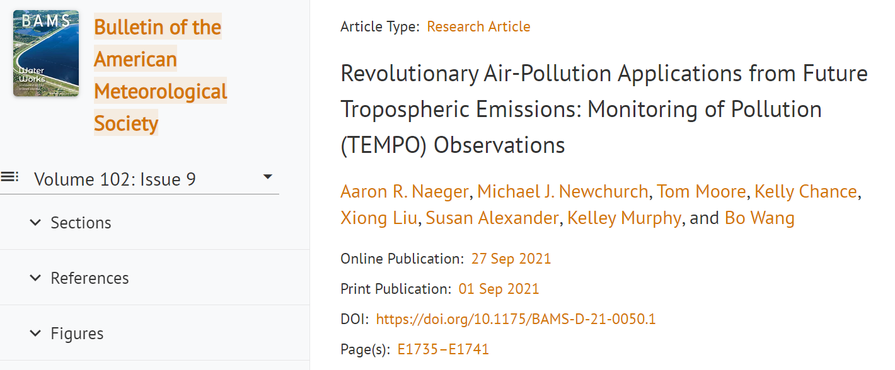
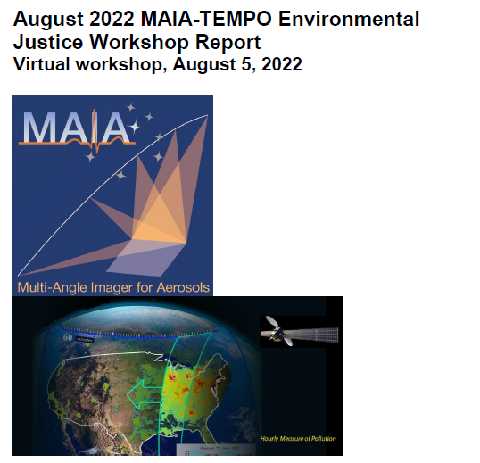
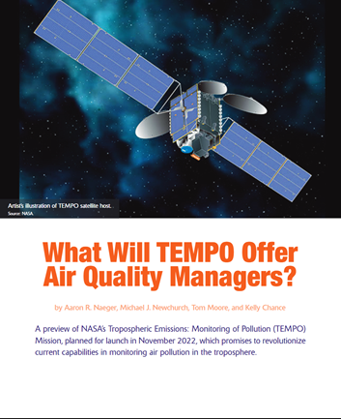
How best can we shift from Early Adopters to Pathfinders?
GeoXO & Pathfinders are off to a great start! Assessing end-user & stakeholder needs and insights early in mission lifecycle is critical for broadening & enhancing applications and societal impacts of satellite data.
We have done a lot of work to document needs and insights from the TEMPO Early Adopters in workshop reports and publications. GeoXO and Pathfinders Program can leverage this information.
Leverage growing list of super users in TEMPO Early Adopters Program, especially as the program shares impact stories from their application of operational TEMPO data.
TEMPO Early Adopters Program in conjunction with Satellite Needs Working Group will continue to assess end-user and stakeholder needs during nominal operations of TEMPO. Provide this feedback to GeoXO and Pathfinder team.
1

Slide 2
How best can we shift from Early Adopters to Pathfinders?
The Early Adopters Program started off with mostly NASA and Academia partners. Participation from U.S. State, local, and tribal air agencies has grown dramatically in past several years.
Pathfinders Program should closely engage these critical air agency partners along with private & commercial partners early in mission lifecycle to tailor products and tools to end-users / stakeholders
I envision our GEO air quality satellite data being used to the same degree as satellite data in the weather forecasting community now. Integrating those operational partners in the Pathfinders Program will help achieve this!
Provide funding for Pathfinders! Can an initiative similar to NASA HAQAST be integrated into the GeoXO and Pathfinder program in early mission phase.
~ 420 Early Adopters (as of early April 2023), includes federal, state, local, & tribal air agencies, health organizations, and NGOs
2

Slide 3
How best can we shift from Early Adopters to Pathfinders?
Operational Water Vapor Assimilation
Multi-Pollutant Data Assimilation
AQ Forecast Support & Evaluation
Build off applications and Green Paper experiments in the TEMPO Early Adopters Program
We have a number of Early Adopters in each of these application areas.
Highlight impact stories from use of TEMPO data in each of these application areas and share with GeoXO and Pathfinders Program.
Forecasting Weather Disasters
Weather Analysis & Forecasting
Air Quality Modeling & Forecasting
Harmful Algal Blooms
Estimating Emissions
Vegetation & Ocean Monitoring
Air Pollution Emissions & Monitoring
Monitoring Air Quality Disasters
Ozone-induced crop damages
Public Health
Regulatory Science
Exceptional Event Demonstrations
Short-term Exposure Assessments
Daily UV Exposures
Assessing Long-term Pollutant Trends
3

