Slide 1
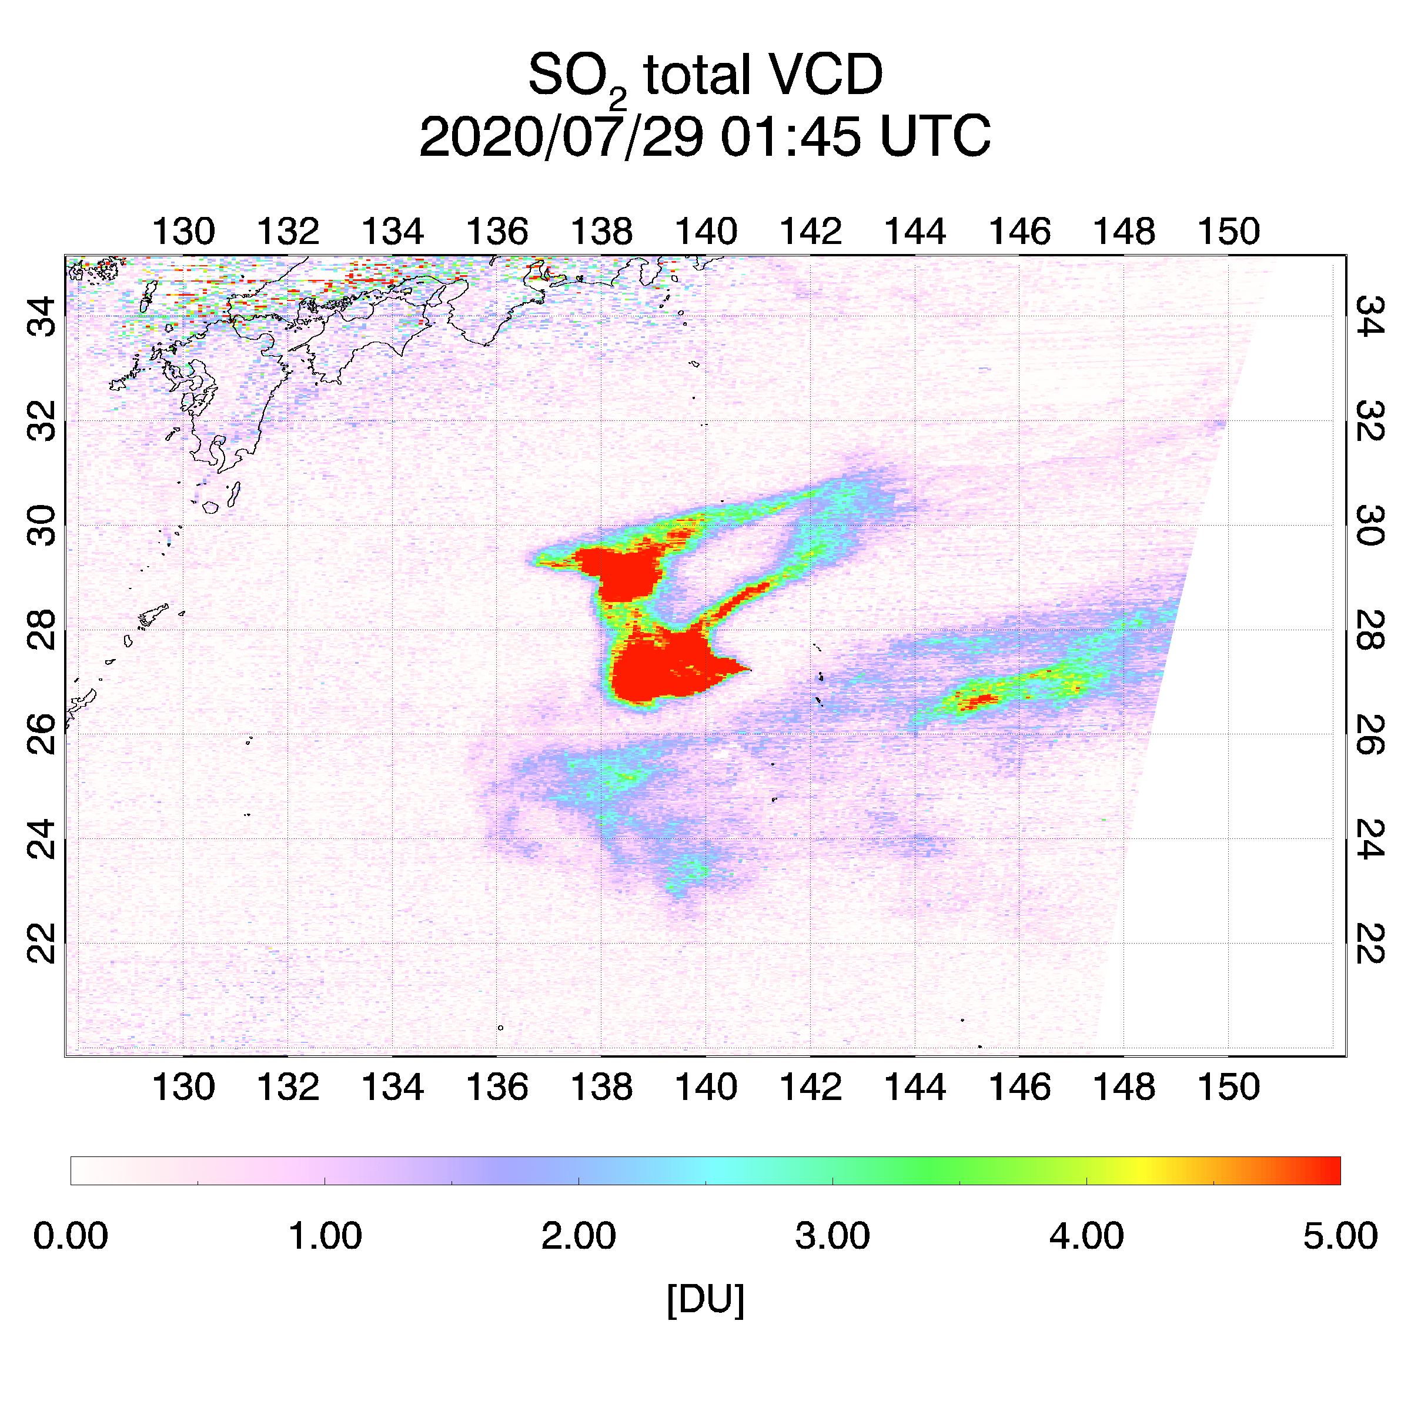
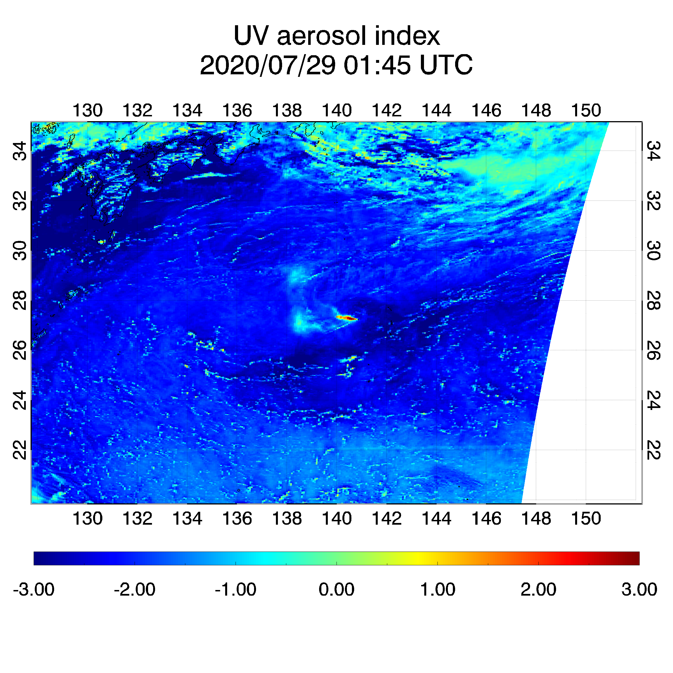
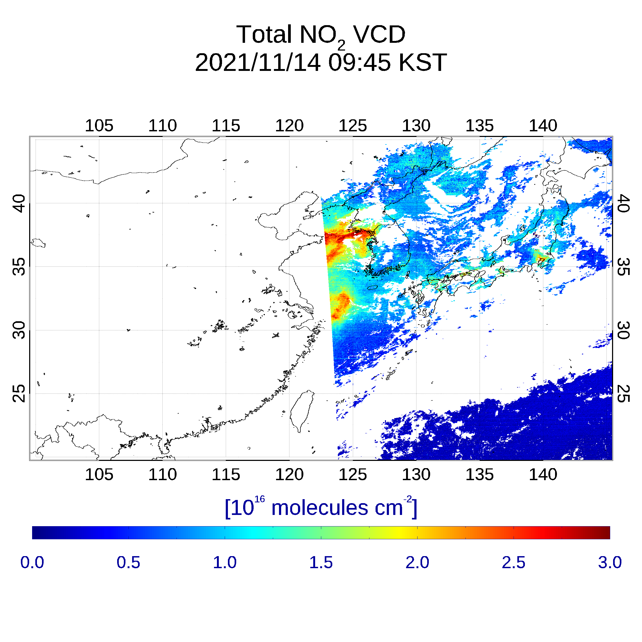
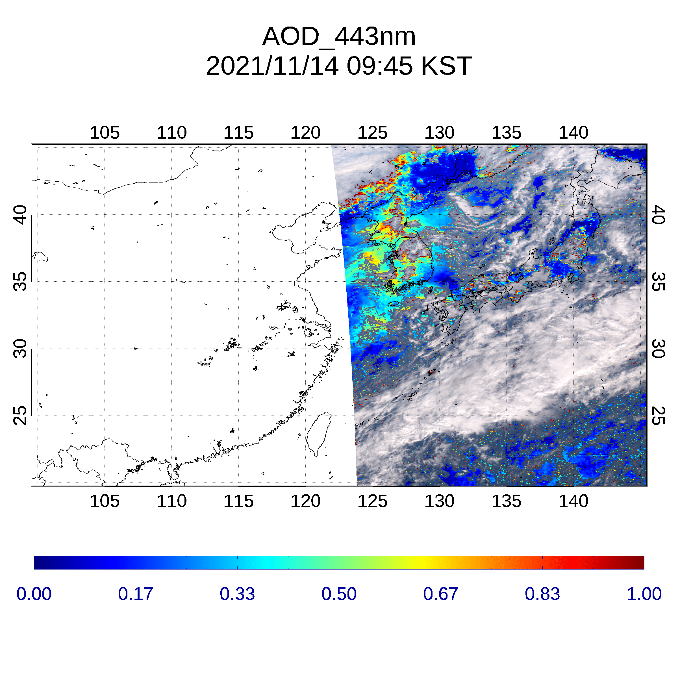
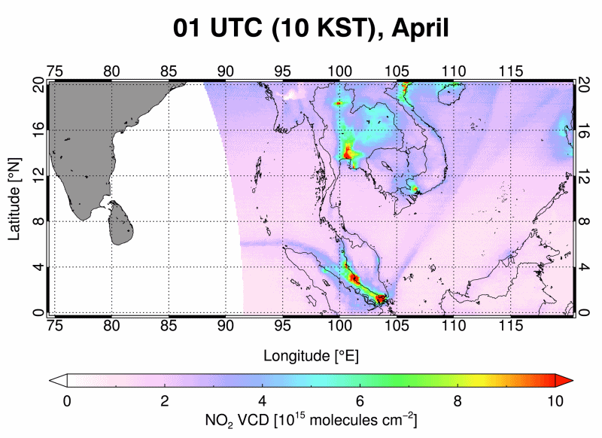
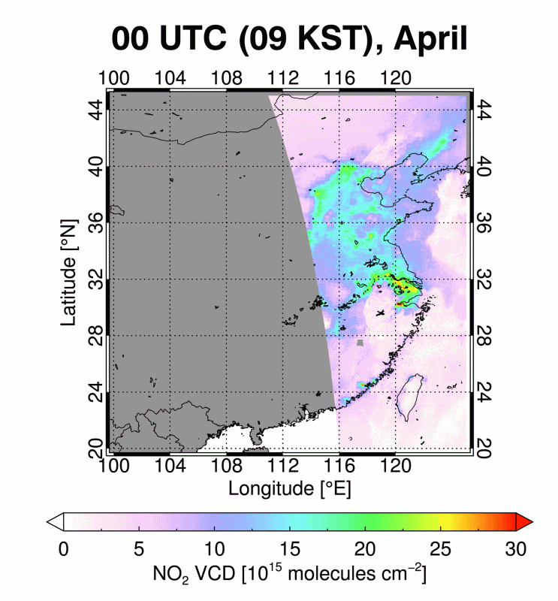
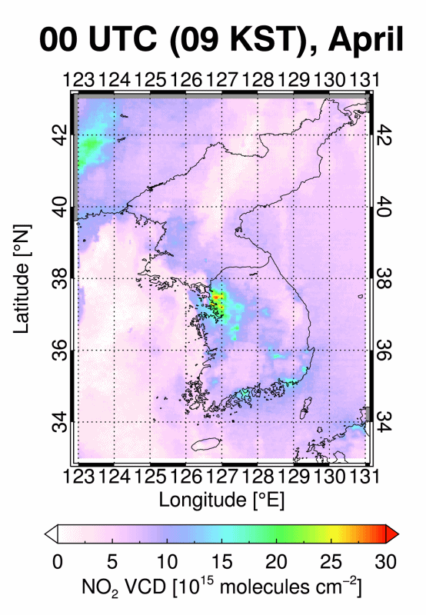
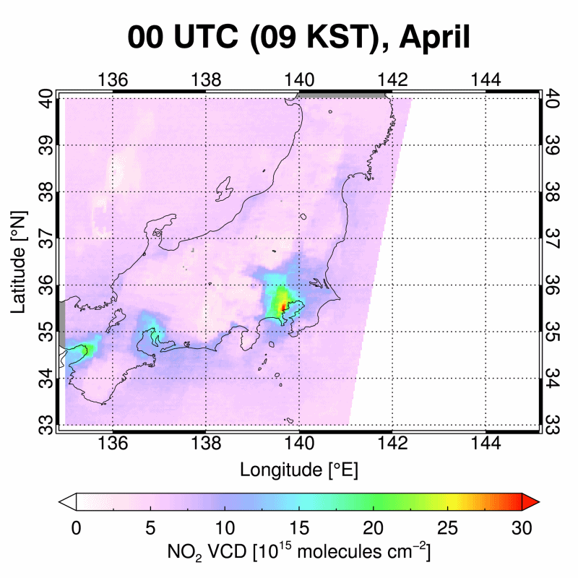
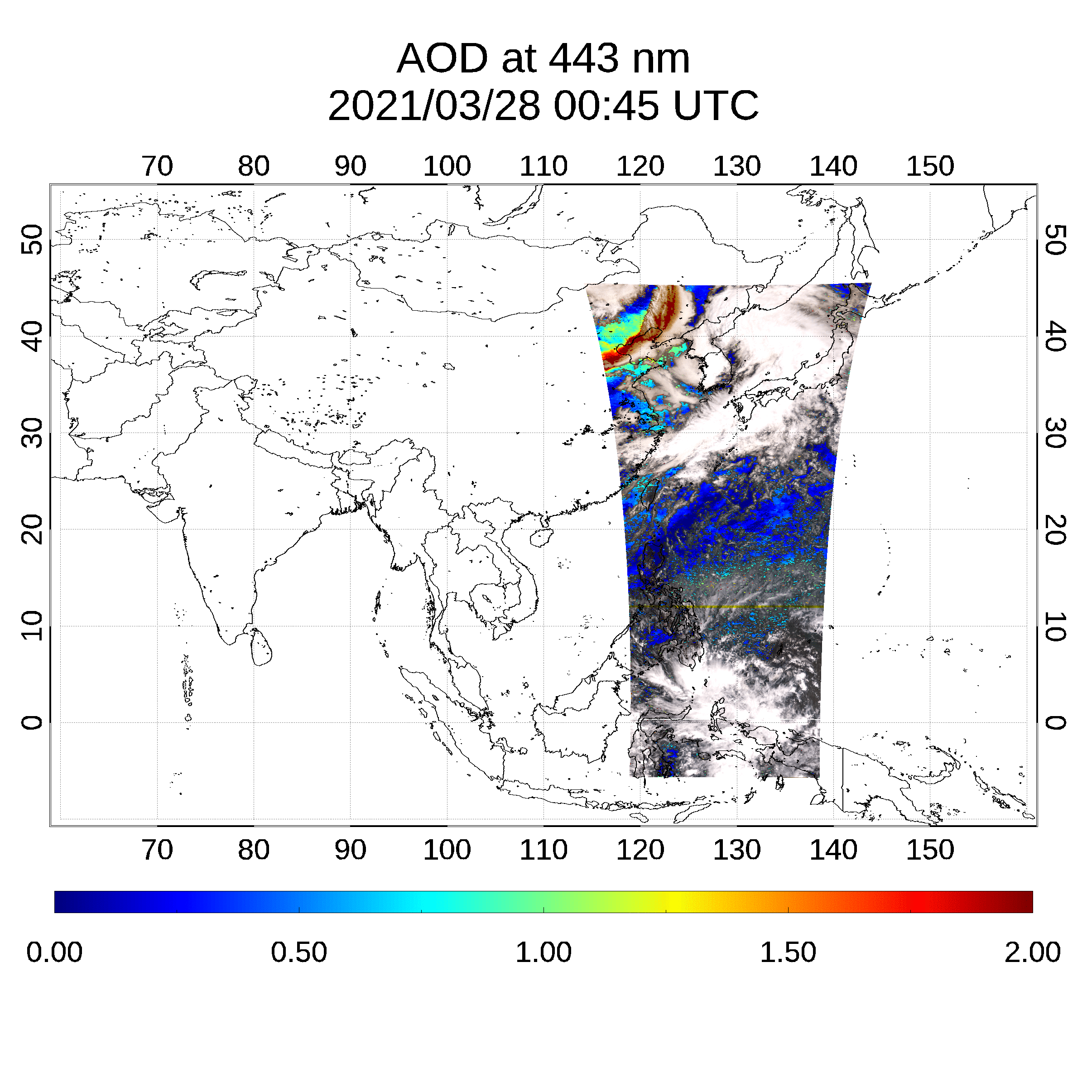
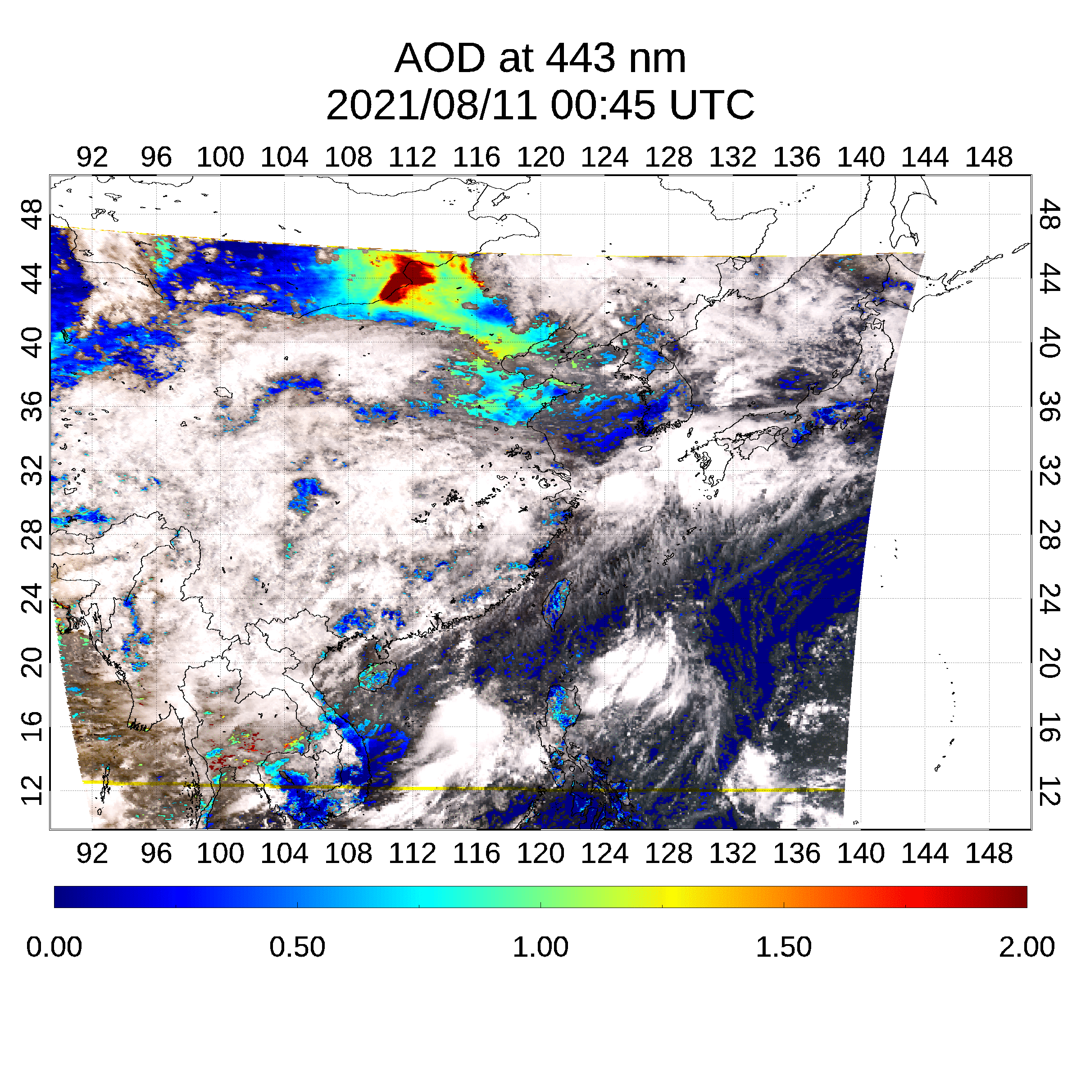
Air quality observations from GEMS
Volcanic eruption on Jul 29, 2020
(SO₂ & aerosols)
Long-range transport on Nov 14, 2021
(NO₂ & aerosols)
Ship emissions in Apr 2021
(NO₂)
Port Klang
(Malaysia)
Singapore
Megacity emissions
(NO₂)
Dust event on Mar 28, 2020
(Aerosols)
Wildfire on Aug 11, 2021
(Aerosols)
Beijing
Shanghai
Seoul
Nagoya
Hongkong
Tokyo
Osaka

Slide 2
Development of satellite remote sensing instruments
week
OMI(1)
VIIRS(1)
TROPOMI(1)
OMPS(1)
MODIS(1)
CrIS(1)
AIRS(1)
LEO
SGLI(3)
3MI(1)
GMI(5)
SCIAMACHY(3)
EMI(1)
GOME-2(1.5)
day
GOSAT
GOME(3)
OCO-2,
TANSAT
MISR(9)
TOMS(1)
MAIA(T)
TES(16)
MOPITT(5)
TEMPO
IASI (1)
SeaWiFS(1)
GeoCarb
GOCI
GEMS
EPIC(L)
Temporal Resolution
hr
GOCI-2
Sentinel-4
GEO
SEVIRI
INSAT-3D
(IMAGER)
Aerosol
Purple : UV-Vis
Yellow : Vis/NIR
Gray : single Vis
AGRI
AHI
ABI
AMI
min
FCI
MTSAT
GOES-8 (IMAGER)
Trace Gases
GeoXO
Purple : UV-Vis
Yellow : Vis/NIR
Red : IR
White : UV-IR
MI
(T): target area observations
(L): Lagrangian point (L1)
Italic & dashed line: to be launched
GHG(CH₄,CO₂)
0.1
1
10
100
1000
Spatial Resolution (km)
[Kim et al. (BAMS 2020)]

Slide 3
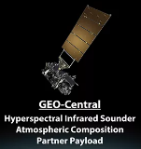
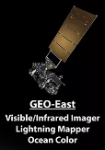
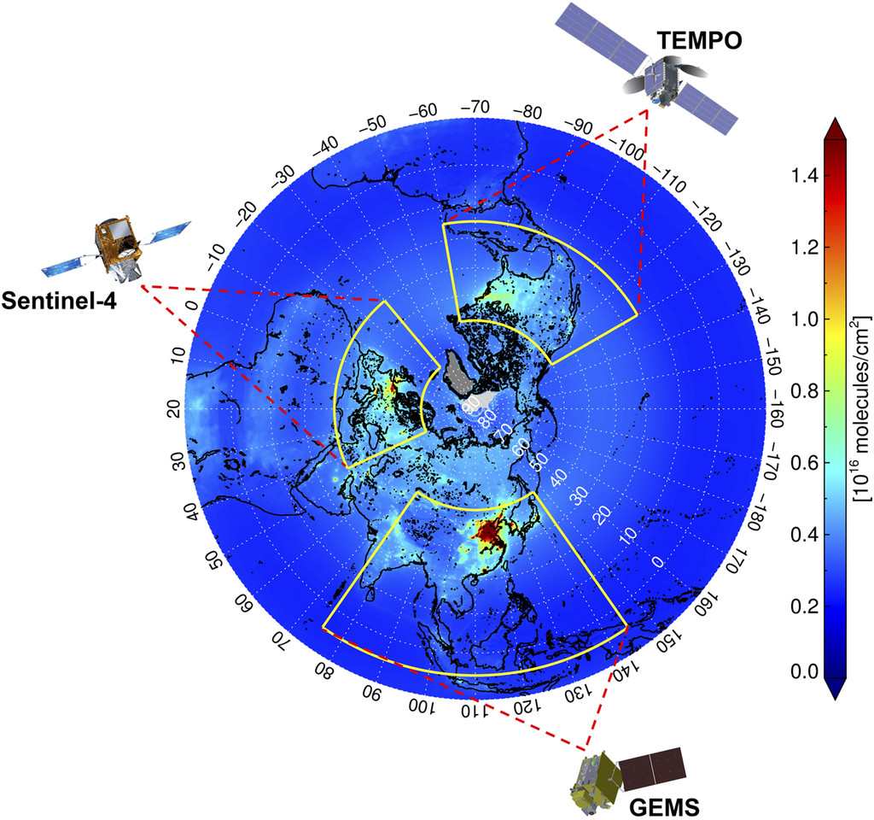
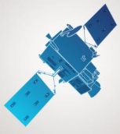
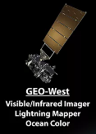
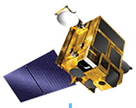

GEO Air Quality + Met + OC Constellation
Era of GeoXO & TEMPO 2
Wider spatial coverage including Southern Hemisphere
Higher spatial resolution up to < 1 km
Higher spectral coverage including IR
- TEMPO + IASI + GeoCarb
capability
Higher temporal resolution up to 5 minutes
Air Quality + Met + OC
+ Public Health
Faster & frequent update of top-down emission inventory
Revolutionize physical & chemical weather forecast, early warning system etc,
GeoXO E
GeoXO C
MTG
MFG..
FCI
GeoXO W
[Kim et al. (BAMS 2020)]
GOCI3
AMI2
2

