Slide 1

Air Quality Impacts at NPS units from Oil and Gas Activities Across Multiple Basins in the Western U.S.
Barkley C. Sive - Air Resources Division
Lisa Devore - Intermountain Region
National Park Service

Slide 2
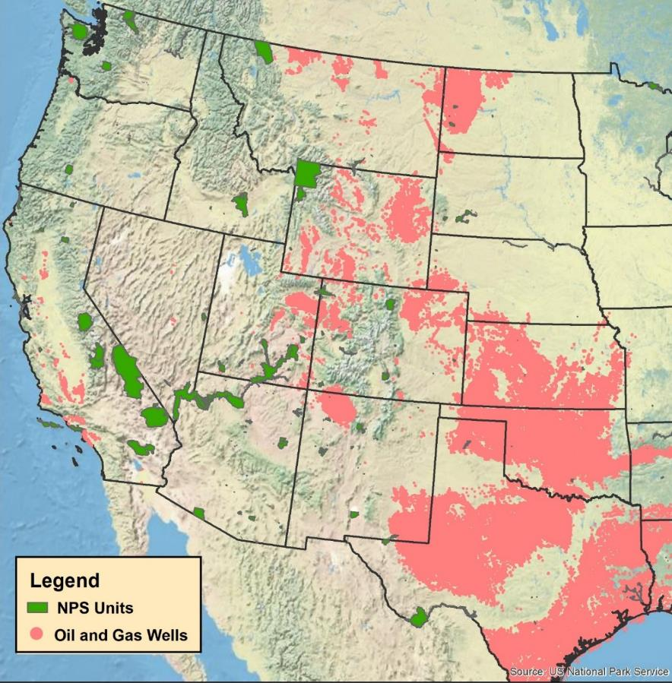
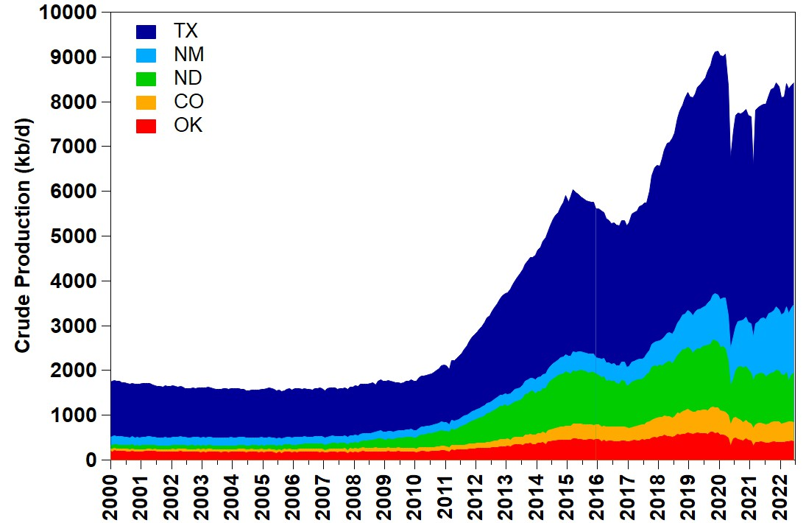
Extensive Oil & Gas Activities throughout Midwest & West
Crude production from 5 states with tight oil
NM increasing
Source: EIA

Slide 3
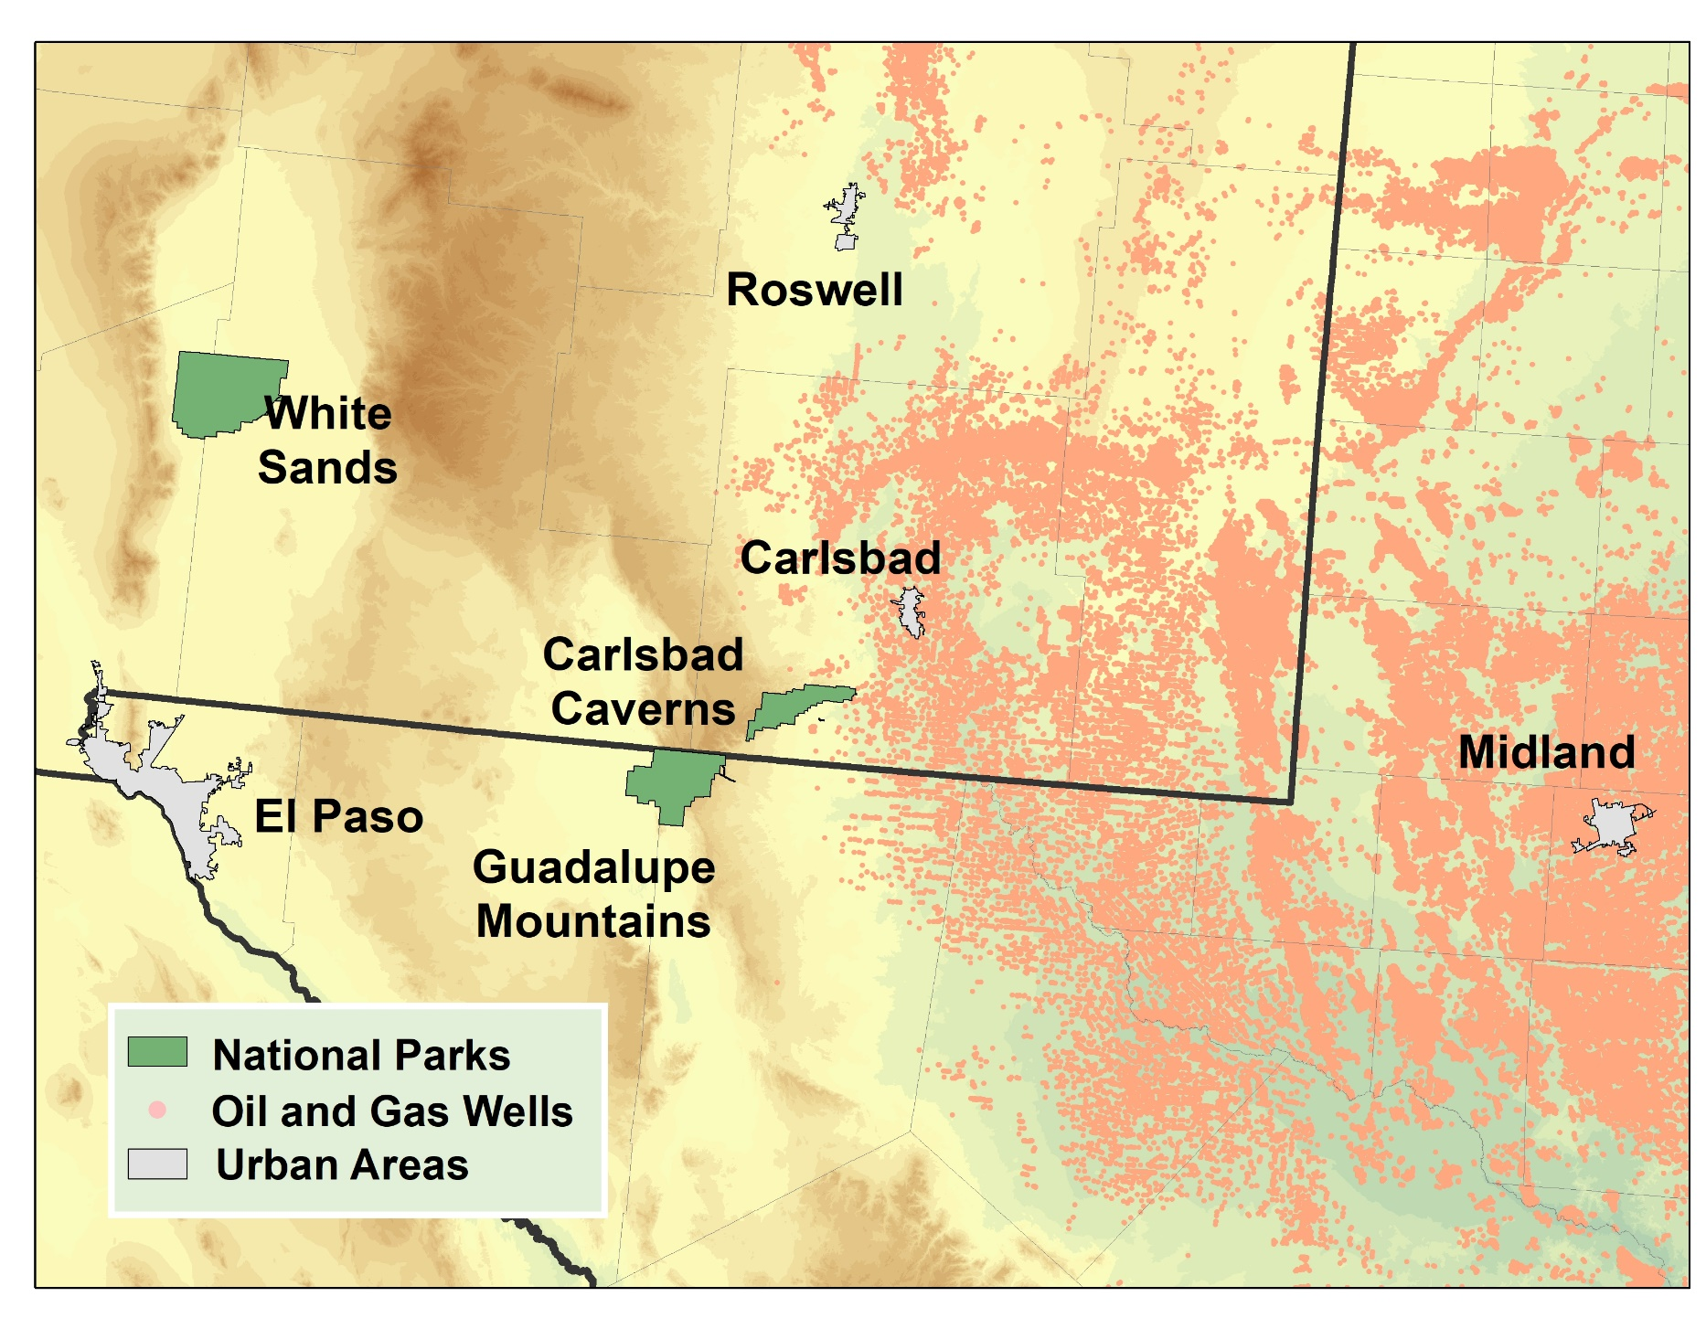
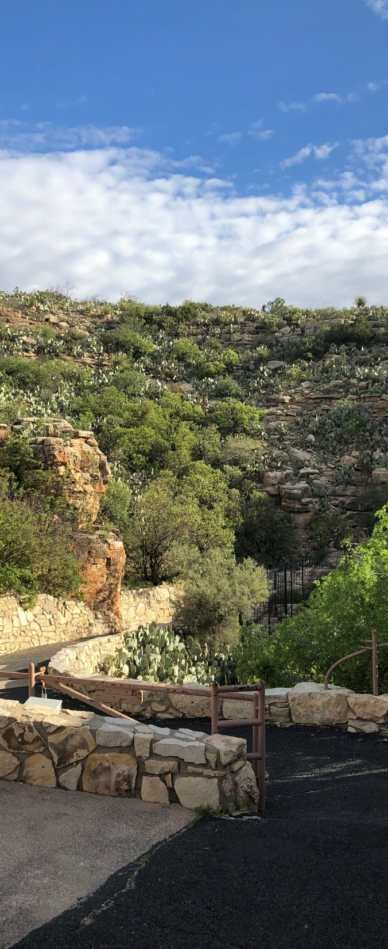
Wells Near Carlsbad Caverns NP*
*Dec 2022

Slide 4
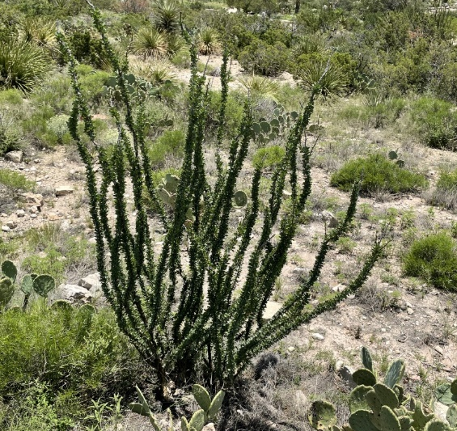
Ozone Exceedances & Design Values
Through
Oct 3, 2019
Through
Oct 1, 2021
Through
Sept 23, 2022
CAVE Ozone 2021
1-hr max: 85 ppb
8-hr 4th high: 77 ppb
GUMO Ozone 2021
1-hr max: 78 ppb
8-hr 4th high: 71 ppb
4 exceedances
8-hr O₃ DV Years | CAVE | Carlsbad, NM | DFW | Houston
2014-2016 | 67 | 67 | 80 | 79
2015-2017 | 66 | 68 | 79 | 81
2016-2018 | 71 | 74 | 76 | 78
2017-2019 | 74 | 79 | 77 | 81
2018-2020 | 73 | 78 | 76 | 79
2019-2021 | 74 | 77 | 76 | 77
2020-2022* | 77 | 77 | 77 | 74
*Preliminary and incomplete

Slide 5
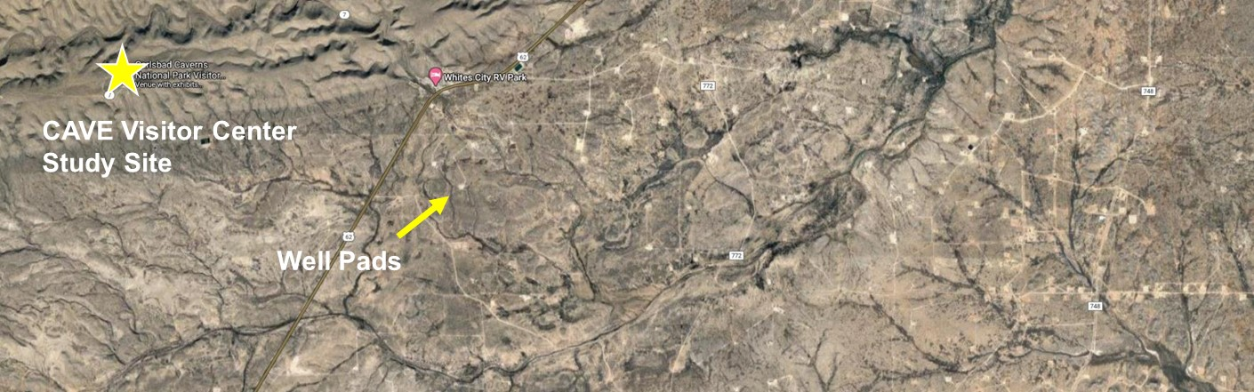
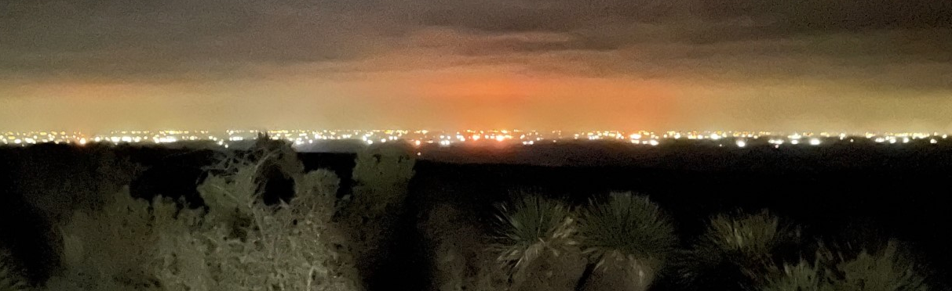

Slide 6
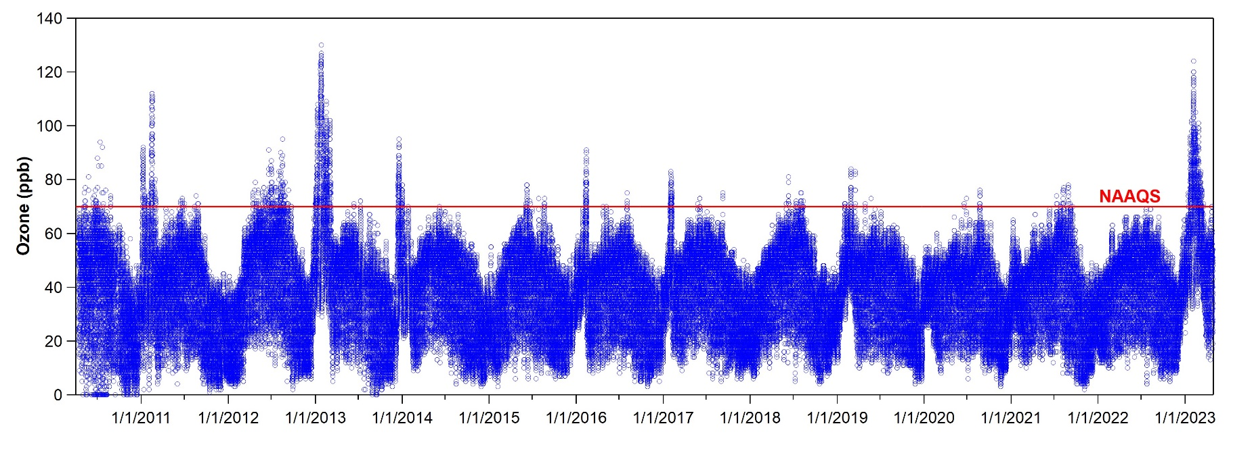
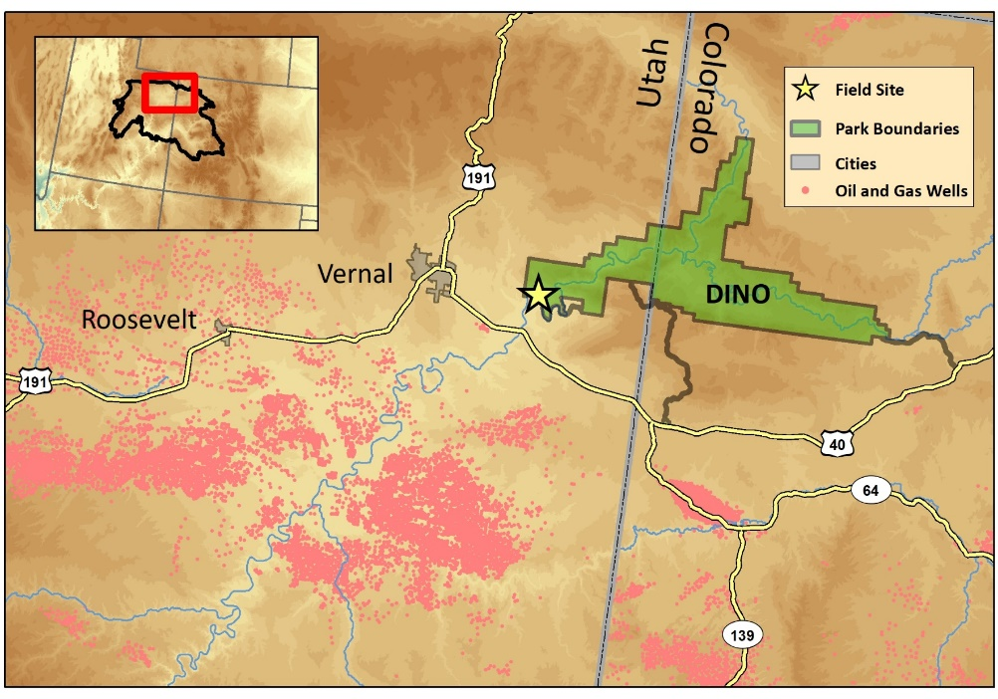
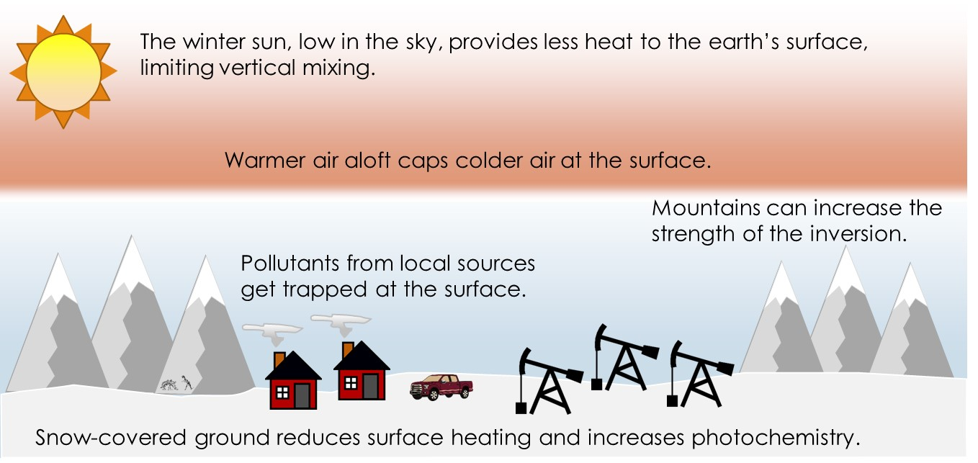
DINO - Elevated Ozone Levels in Winter
Warmer air at higher altitudes.
DINO Ozone 2023
1-hr max: 124 ppb
8-hr max: 119 ppb
8-hr 4th high: 98 ppb
Colder air at the surface.

Slide 7
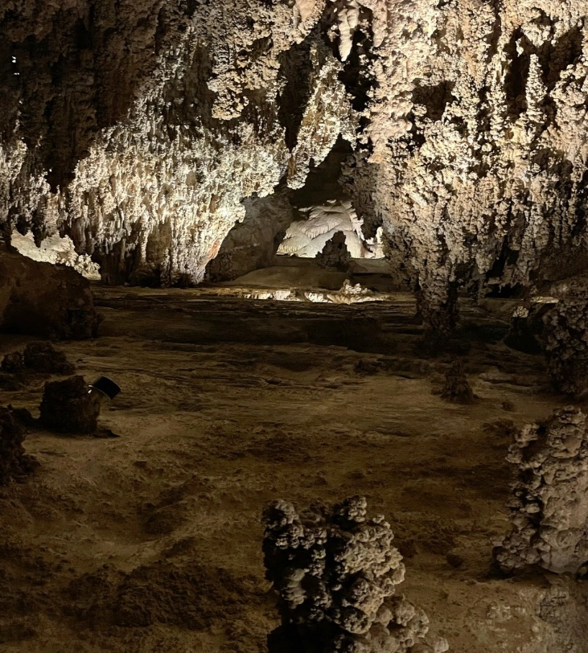
Desired Products:
High-frequency O₃ data
1-10 minute resolution TEMPO data over NPS locations & surrounding communities
Couple with the 1-minute O₃ & meteorological data from NPS & CASTNET sites
NO₂, HCHO, C₂H₂O₂, SO₂ & aerosol measurements
These will aid the NPS significantly in rapidly identifying the magnitude and extent of pollution events centered on O&G activities western US O&G basins
Carlsbad Caverns NP
nps.gov/air
Live Data
Ozone & Meteorology
Particulate Matter
Webcams
Conditions & Trends
National Data
By Park
epa.gov/castnet

