Slide 1
Benefits of Coastal and Over-Water TEMPO Products
Ryan M. Stauffer¹, John T. Sullivan¹, Anne M. Thompson^{1,2}, Debra E. Kollonige^{1,3}, Niko M. Fedkin^{1,3}
¹NASA/Goddard Space Flight Center, ²Univ. Maryland-Baltimore County, ³Science Systems and Applications, Inc.

Slide 2
Coastal/Over-Water TEMPO Measurement Needs
Coastal areas are often a confluence of high population and emissions, and thus AQ issues
TEMPO hourly (or faster) tropospheric NO₂ and O₃ measurements have the potential to greatly advance our understanding of coastal AQ science
How accurate and useful will TEMPO coastal measurements be? Need to validate with campaign data (past locations shown as #’s →)
From Sullivan et al., (2023; under review for AGU Earth’s Future)

Slide 3
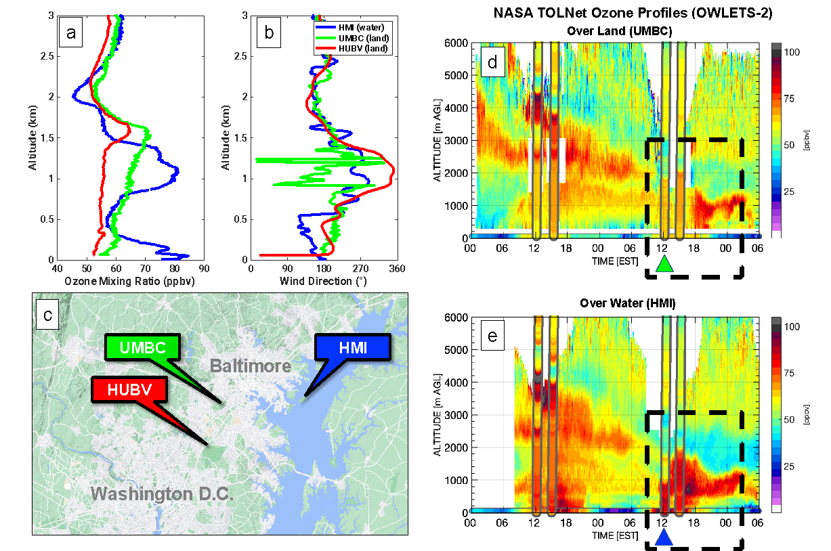
Coastal/Over-Water TEMPO Measurement Needs
Several previous campaigns (OWLETS-2 shown) demonstrate the complexities of coastal AQ
Emissions and high surface ozone confined to shallow, over-water layers that are transported to populated costal regions
Essential to understand the value of over-water TEMPO measurements near e.g., Gulf Coast, Long Island, Mid-Atlantic, Lake Michigan
0-2 km ozone, Trop. NO₂
From Sullivan et al., (2023; under review for AGU Earth’s Future)

Slide 4
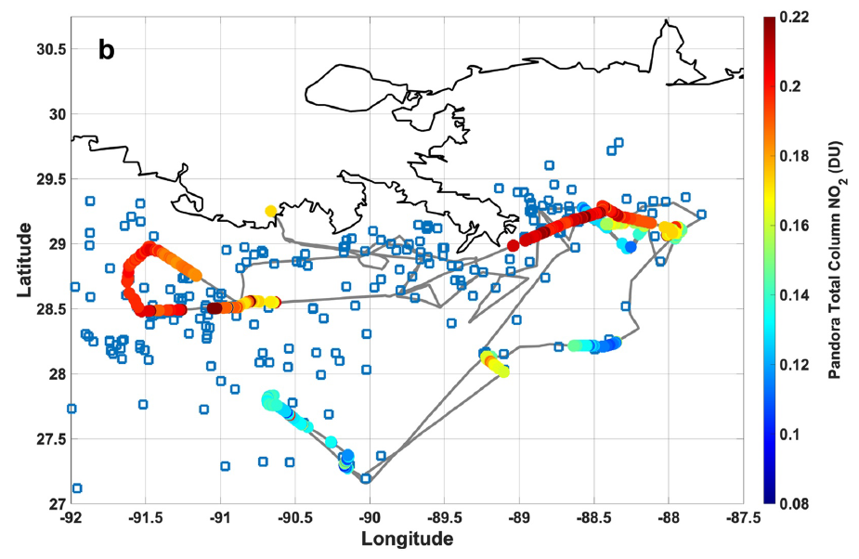
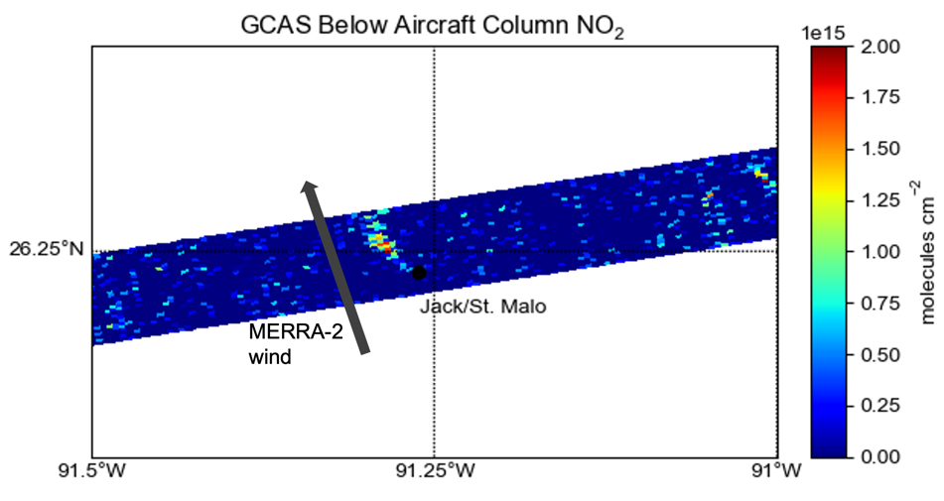
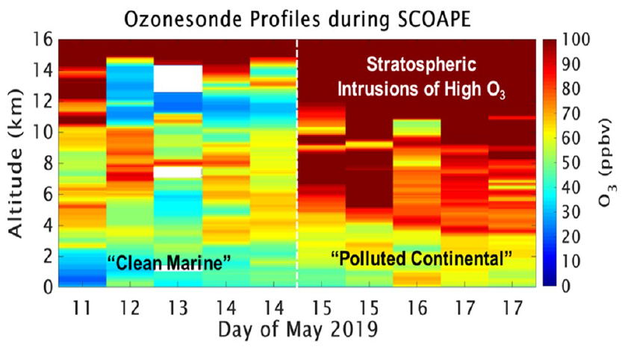
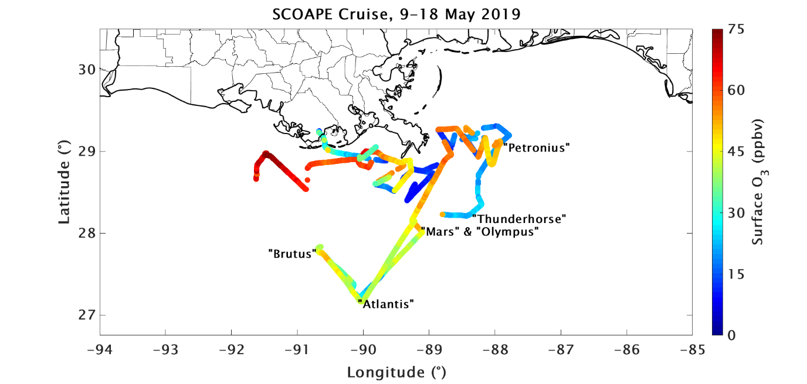
Opportunities for June 2024 SCOAPE-II Special Experiment
Over-water tropospheric NO₂ validation →
Over-water tropospheric and 0-2 km O₃ validation →

Slide 5
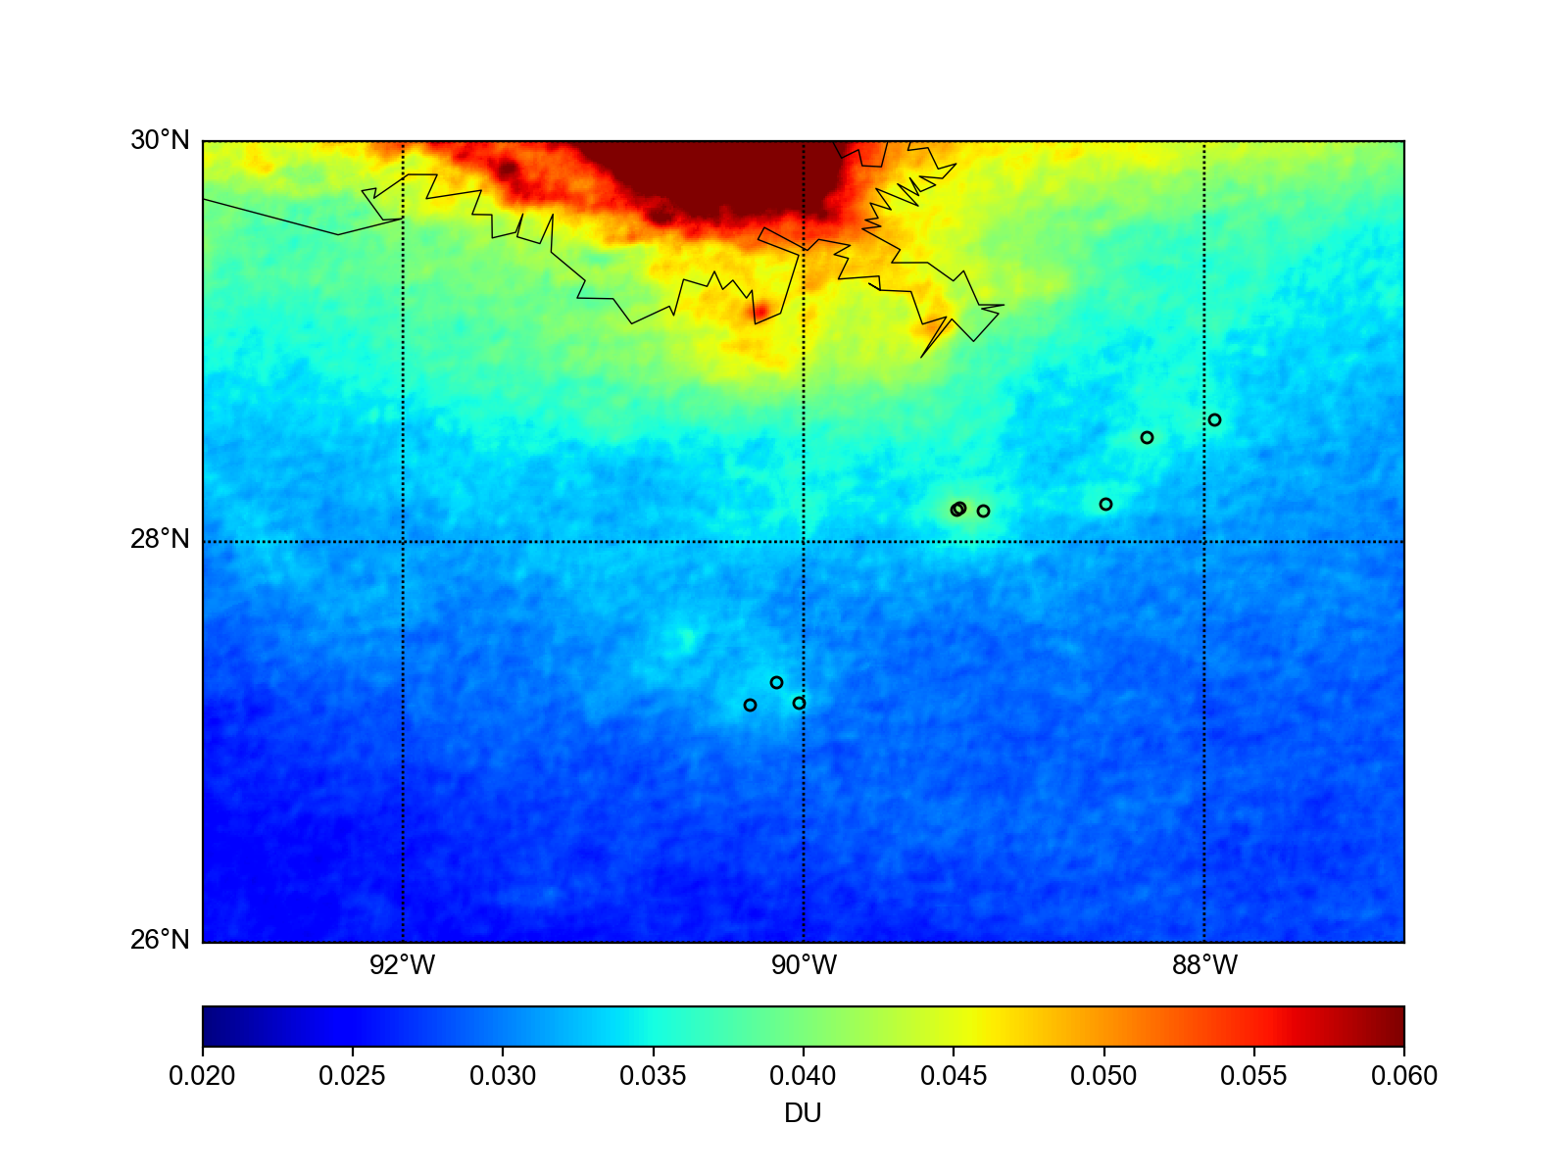
Opportunities for June 2024 SCOAPE-II Special Experiment
We know where the Gulf of Mexico oil and gas NO₂ hotspots are, but when and how often are they emitting at high volumes?
~10 minute TEMPO data will help us find and understand the impact of gas flaring events during the 2024 SCOAPE-II cruise
With a ship, product availability by next day is sufficient for decision-making, but SCOAPE-II GCAS NO₂ measurements would benefit from lower latency. How soon can NRT imagery be posted to a website?
Nakika
Appomattox
Mars/Olympus
Ursa
Thunderhorse
SHENZI-TLP
Mad Dog
Atlantis

