Slide 1
Evaluating TEMPO observations for air pollution-related environmental justice decision-making
Sally Pusede

Slide 2
Observational requirements for air pollution-related environmental justice decision-making
Measurements resolve neighborhood-level NO₂ differences
(2) Spatial patterns in NO₂ columns reflect pollutant patterns at the surface
Demetillo et al. Environ. Sci. Technol. 2020 (oversampled TROPOMI)
Demetillo et al. Geophys. Res. Lett. 2021 (oversampled TROPOMI)
Dressel et al. Environ. Sci. Technol. 2022 (daily TROPOMI)
New York City–Newark Urbanized Area
Daily TROPOMI observations resolve most NO₂ inequalities, >82% (relative) and >76% (absolute), compared to high-resolution airborne spectrometers (250 m x 250 m)
Inequalities are insensitive to pixel areas <60 km²
Mean daily inequalities equal/exceed those based on observations first oversampled to 1 km x 1 km
TEMPO fills this gap in resolution. We need to understand the observations in the morning and evening before applying them
Typical NO₂ distance decay gradients are 100s of meters to 1–2 km
Number of Observations
Mean Pixel Area

Slide 3
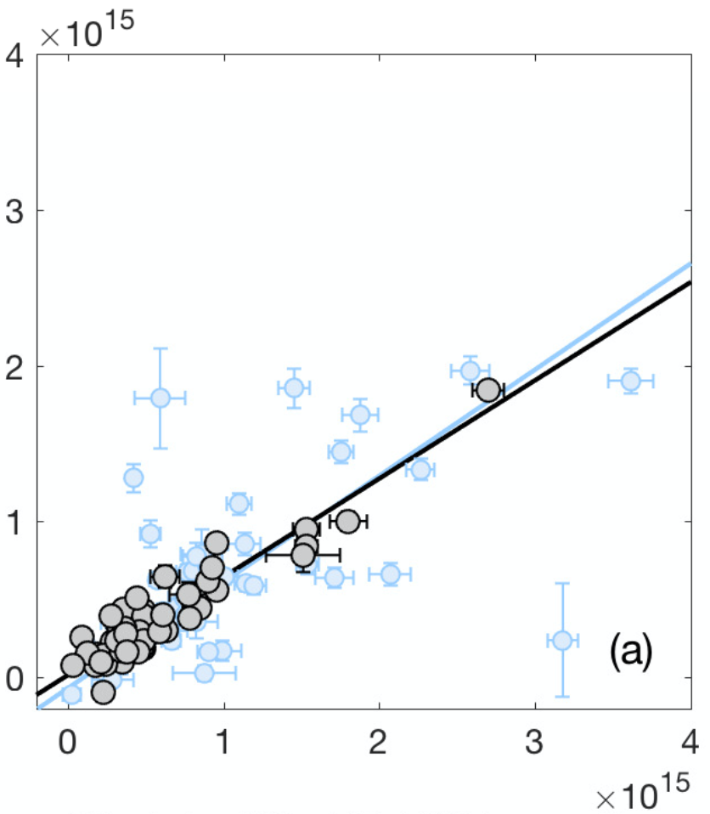
Observational requirements for air pollution-related environmental justice decision-making
Measurements resolve neighborhood-level NO₂ differences. Do they resolve issues of community concern?
(2) Spatial patterns in NO₂ columns reflect pollutant patterns at the surface
With Air Alliance Houston, can we observe the impacts of unpermitted air releases to neighborhoods in the Houston Ship Channel?
52 U.S. cities
Unpermitted NO_{x} releases occur on 30–40% of days each year. They are most likely to occur on Mondays
Hourly data may be sufficient; most events <1 h in duration
Unpermitted NO_{x} releases also emit CO and particles, which can also be seen from space
Release events can be large and typically occur in the dense source region of the Ship Channel––high signal but high noise.
Any special op sampling should occur in the summer when changes in columns reflect changes in emissions
r = 0.96 (summer)
r = 0.72 (winter)
Weekend NO₂ Inequality
(molecules cm^{–2})
Weekday NO₂ Inequality
(molecules cm^{–2})

