Slide 1
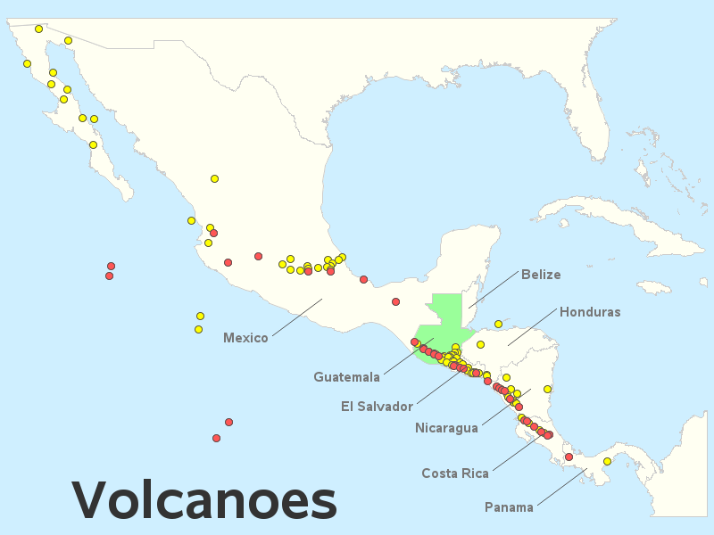
Green Paper – Central American Volcanic Plumes:
TEMPO High-Temporal-Resolution Aerosol & Gas Observations
Ralph Kahn¹, Verity Flower², James Limbacher³, Kathleen McKee⁴, Katherine Noyes¹, Aaron Naeger⁵
¹NASA Goddard Space Flight Center, ²U. of Stirling, ³NOAA, ⁴Vanderbilt U., ⁵U. Alabama Huntsville
Note: Pixel resolution becomes higher toward the equator
17.5°N
15.5°N
Eruption Observed
Eruption Credible
Can we extend the southmost scan operations even further,
to cover as many potentially active volcanoes as possible?

Slide 2
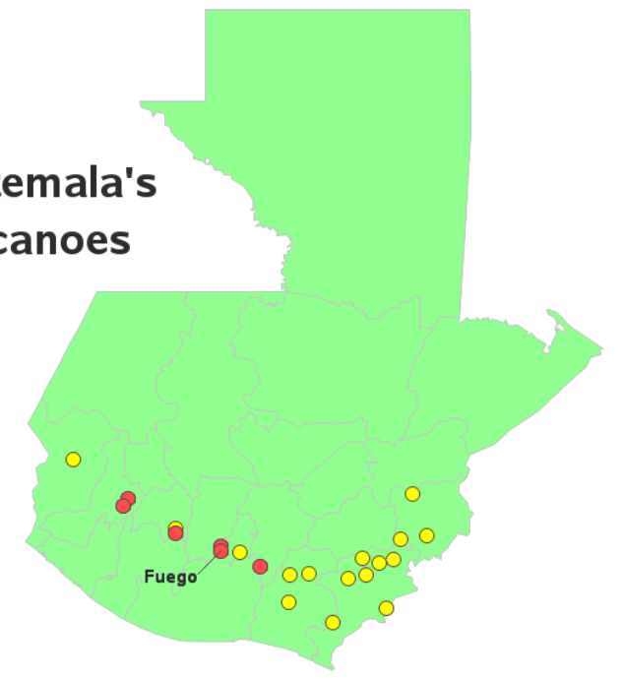
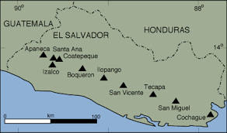
Volcanoes of Guatemala
Volcanoes of El Salvador
Almolonga
Atitlán
Acatenango
Santa María
Pacaya
Eruption Observed
Eruption Credible
Name | N Lat | W Lon | Type | Last Erupt.
Santa Ana | 13.85 | 89.63 | stratovolcano | 1993
Name | N Lat | W Lon | Type | Last Erupt.
Almolonga | 14.80 | 91.52 | Stratovolcano | 1818
Santa María | 14.76 | 91.55 | Stratovolcano | 2022
Atitlán | 14.58 | 91.19 | Stratovolcano | 1853
Acatenango | 14.50 | 90.88 | Stratovolcano | 1976
Fuego | 14.43 | 90.88 | Stratovolcano | 2022
Pacaya | 14.38 | 90.60 | Complex | 2021
Recent Eruptions

Slide 3
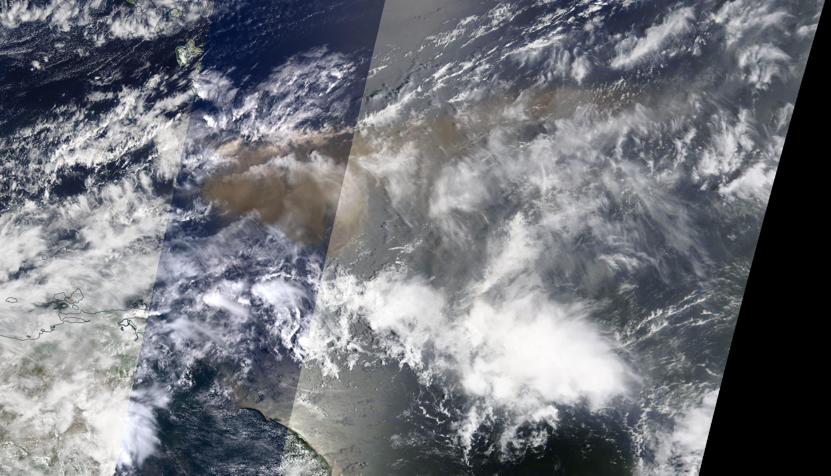
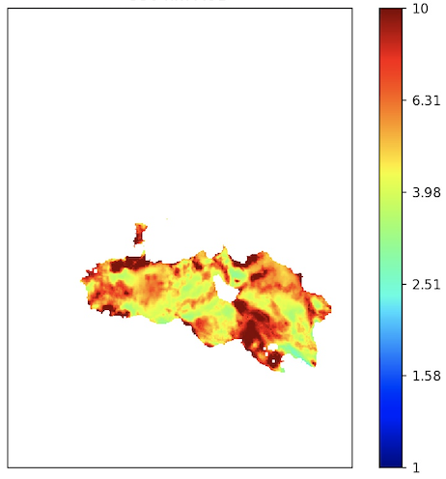
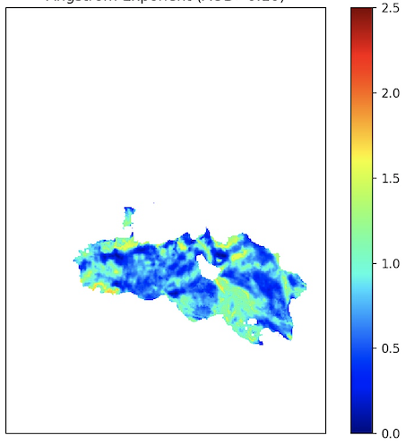
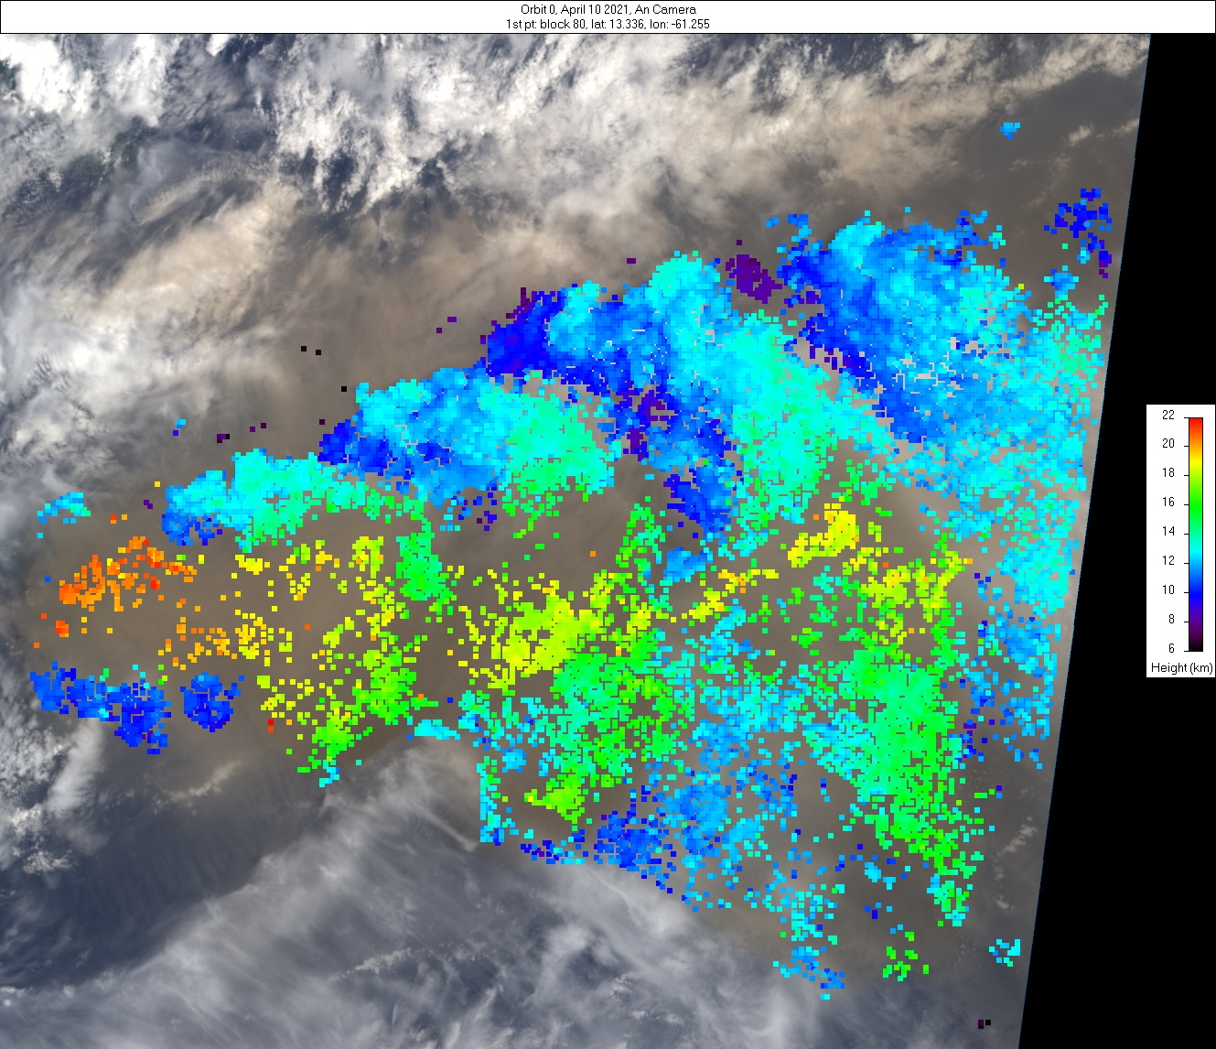
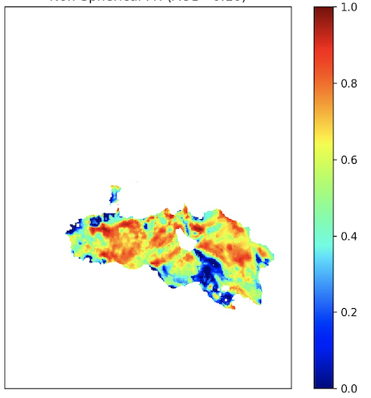
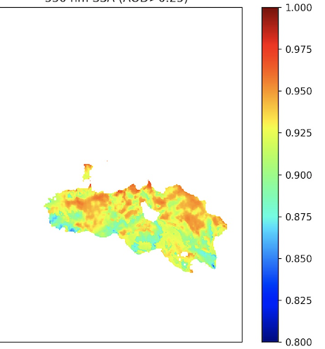
Volcanic eruption plume from La Soufriere Volcano, St. Vincent
MISR Active Aerosol Plume-Height (AAP) Project 10 April 2021
MISR Research Algorithm – Aerosol Amount and Type Retrievals
La Soufriere, St Vincent
The explosive eruption of La Soufriere volcano began on 9 April 2021. On 10 April MISR observed a large plume from the volcano, reaching an altitude of ~18-20 km at its core, with fringes transported at ~12 km. The plume was transported to the east with significant lateral spreading. Visual characteristics indicate ash components. Activity continued for at least several more days, with ongoing eruptions potentially causing regional hazards to populations and aviation.
A
B
Particle
Amount
Particle
Size
Plume region
MISR
MODIS Context Image
AOD (550 nm)
Angstrom Exp.
The plume is visible among significant meteorological cloud, with mid-visible AOD>3; Fig. A) and is dominated by large sizes (Angstrom Exp. ~0.5; Fig B).
C
Particle
Shape
D
Particle
Brightness
The plume shows evidence of non-spherical particles (fraction >0.7; Fig. C) that are light-absorbing (dark) (SSA~0.92; Fig. D). In summary, the MISR Research Aerosol (RA) retrieval algorithm indicates large, non-spherical, light-absorbing (brown) particles, an ash-rich volcanic plume.
Fr. Non-Sph.
SSA (550 nm)
MISR Plume Heights (ASL)
J. Limbacher, V. Flower, R. Kahn / NASA GSFC

Slide 4
Backup Slide

Slide 5
Variables of Interest will depend on the composition and elevation of the eruption plume…
TEMPO Variables Likely of Use
Aerosol: AOD, AAOD, UV-AI
Plume Height: UV-B
Related Volcanic Gases: SO₂, H₂O
Related Wildfire Gases: H₂C=O (Formaldehyde);
possibly C₂H₂O₂ (Glyoxal)
Other Space-based Resources Likely to Contribute
Fire, Volcano Hotspots: MODIS/VIIRS 4-micron thermal anomaly
Aerosol Particle Size, Shape (ash/sulfate): MISR; PACE HARP-2
Plume Extent; Height; Particle Properties: GOES ABIs

