Slide 1





Tropospheric Emissions:
Monitoring of Pollution
TEMPO Science Overview
Xiong Liu¹, Kelly Chance¹, Raid M. Suleiman¹, Kevin J. Daugherty²,
David E. Flittner², John Houck¹, John E. Davis¹,
Gonzalo Gonzalez Abad¹, Caroline Nowlan¹, Huiqun Wang¹,
Chistopher Chan Miller^{1,3}, Juseon Bak⁴, Hyeong-Ahn Kwon^{1,5},
Jim Carr⁶, Weizhen Hou¹, Hee-sung Chong¹, Mike Newchurch⁷,
Jim Szykman⁸, Aaron Naeger⁷, The TEMPO Team
¹CfA | Harvard & Smithsonian ²NASA LaRc
³Harvard University ⁴Pusan National University
⁵U. Suwon, ⁶Carr Astronautics ⁷UAH ⁸EPA
xliu@cfa.harvard.edu
TEMPO Science Team Meeting
Huntsville, AL
May 2, 2023

Slide 2
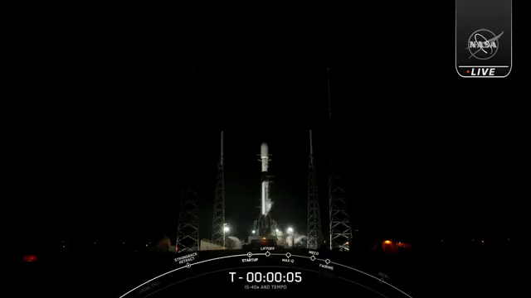
Outline
Science Overview
Measurement Requirements
Data Products (Baseline + SNWG NRT Solution)
Commissioning timeline, Distribution, and Data Release Plan

Slide 3
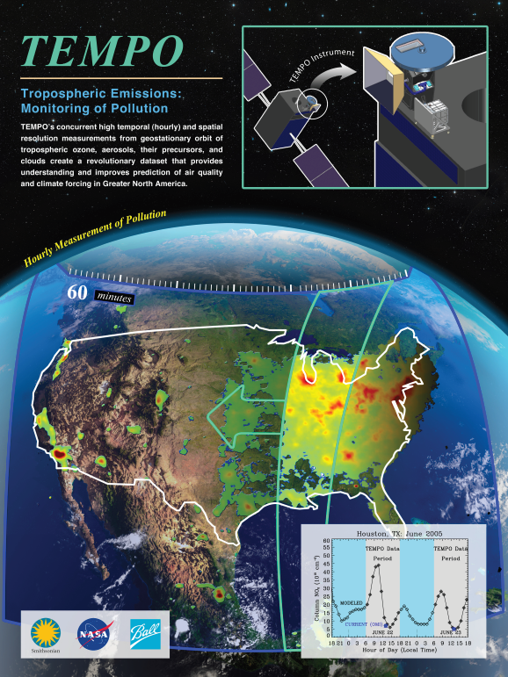
Hourly daytime atmospheric pollution over North America from the GEO
NASA’s first Earth Venture Instrument (EVI) selected in 2012 & first hosted payload
PI: Kelly Chance, Smithsonian Astrophysical Observatory (SAO): Science team, ground systems, science data processing center
Instrument Development: Ball Aerospace
Instrument Project Management: Kevin Daugherty, NASA LaRC
Other Institutions: NASA GSFC, NOAA, EPA, NCAR, Harvard, UC Berkeley, St. Louis U, UAH, U Iowa, Sitting Bull College, RT Solutions, Carr Astronautics
International collaboration: Mexico, Canada, Cuba, Korea, U.K., ESA, Spain
Mission Project Management: Kevin Daugherty, NASA LaRC
Host Satellite Provider: Maxar Technologies
Satellite Host: Intelsat (IS-40e)
Launch: SpaceX
Provides hourly daylight observations to capture rapidly varying emissions and chemistry important for air quality
UV/visible grating spectrometer to measure key elements in tropospheric ozone and aerosol pollution
Distinguishes boundary layer from free tropospheric & stratospheric ozone
Aligned with Earth Science 2007 Decadal Survey recommendations
Makes many of the GEO-CAPE atmospheric measurements
Responds to the phased implementation recommendation of GEO-CAPE mission design team

Slide 4
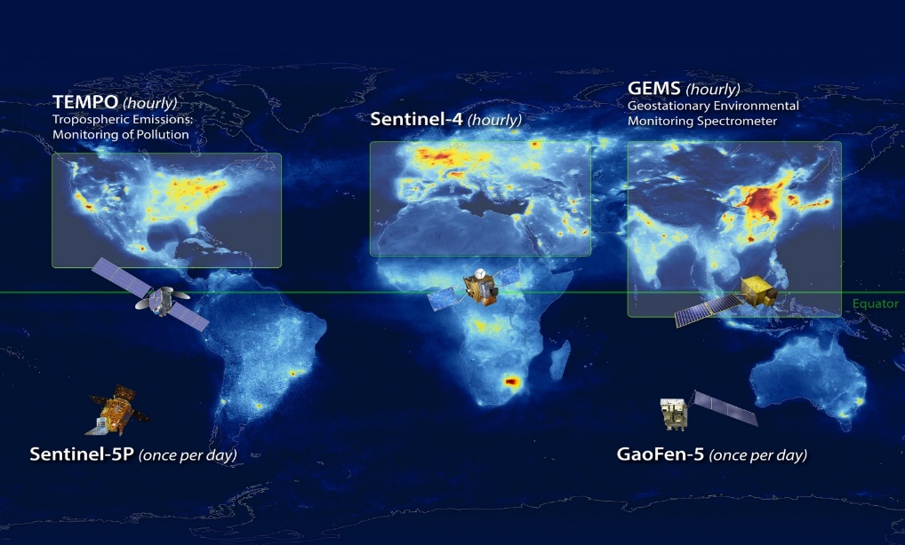
North American Component of an International Geostationary Air Quality Constellation
Launched April 2023
Launch late 2024
Launched Feb 2020
Image Credit: NASA LaRC

Slide 5
TEMPO Science Questions
What are the temporal and spatial variations of emissions of gases and aerosols important for air quality and climate?
How do physical, chemical, and dynamical processes determine tropospheric composition and air quality over scales ranging from urban to continental, diurnally to seasonally?
How does air pollution drive climate forcing and how does climate change affect air quality on a continental scale?
How can observations from space improve air quality forecasts and assessments for societal benefit?
How does intercontinental transport affect air quality?
How do episodic events, such as wildfires, dust outbreaks, and volcanic eruptions, affect atmospheric composition and air quality?

Slide 6
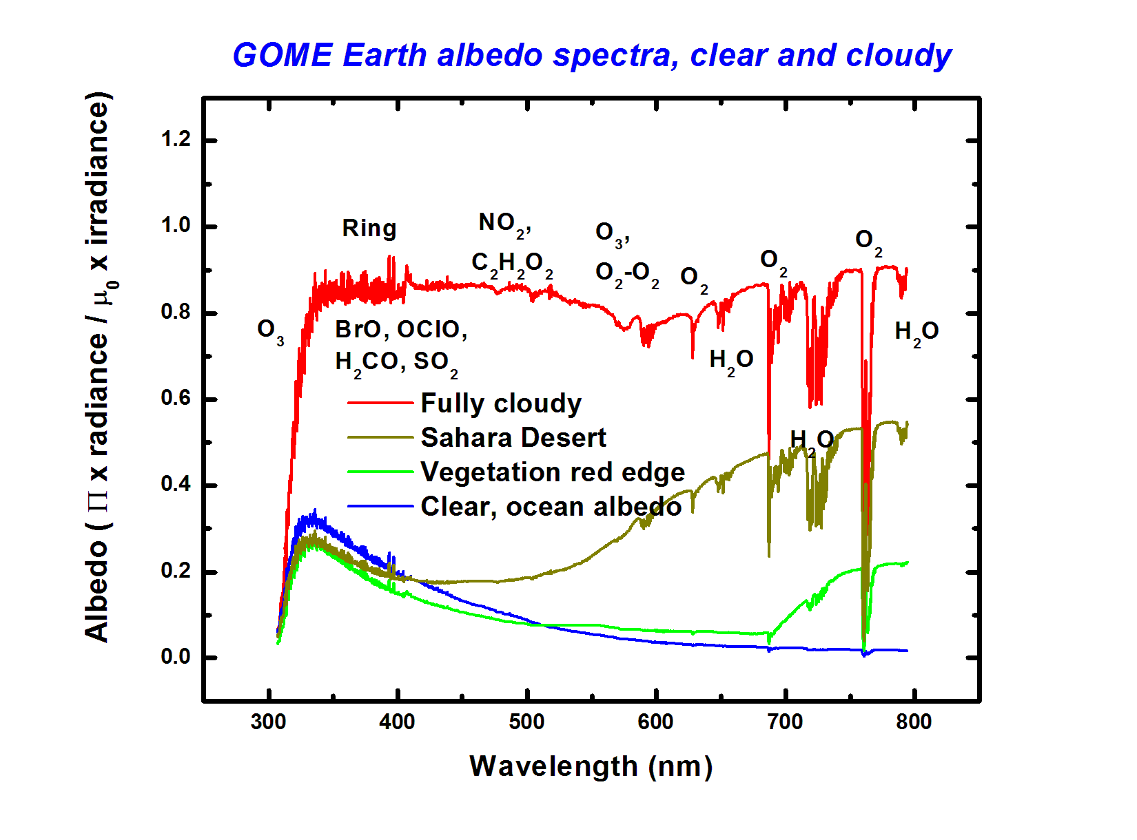

TEMPO Instrument
Imaging grating spectrometer measuring solar irradiance and solar backscattered Earth radiance
2 channels (1 focal plane but with 2 2-D 2 k $×$1k detectors ): ~293-494 + 538-741 nm
~0.6 nm FWHM, ~0.2 nm sampling
~293-494 nm
~538-741 nm
Examples of spectra based on GOME

Slide 7
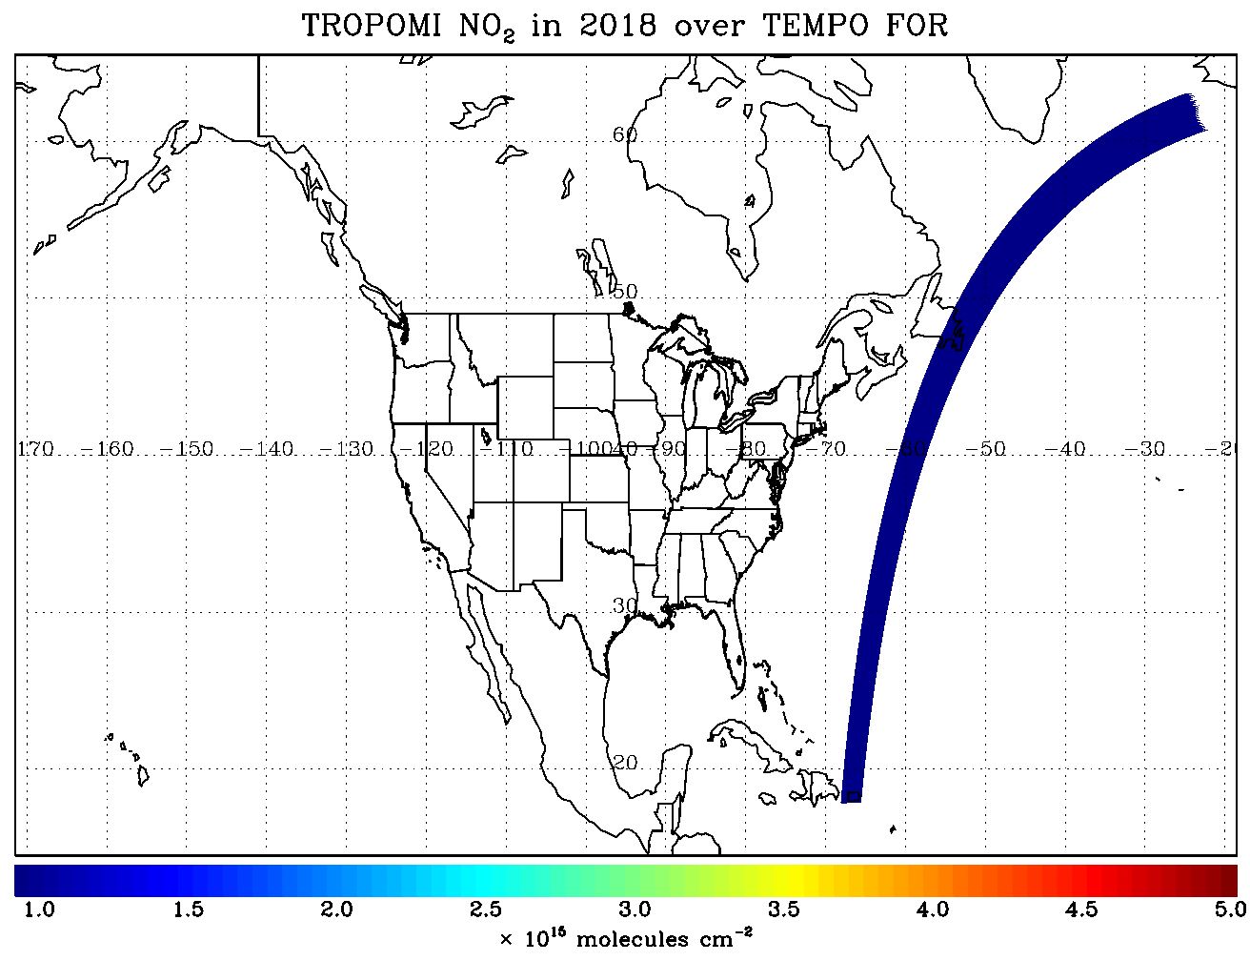
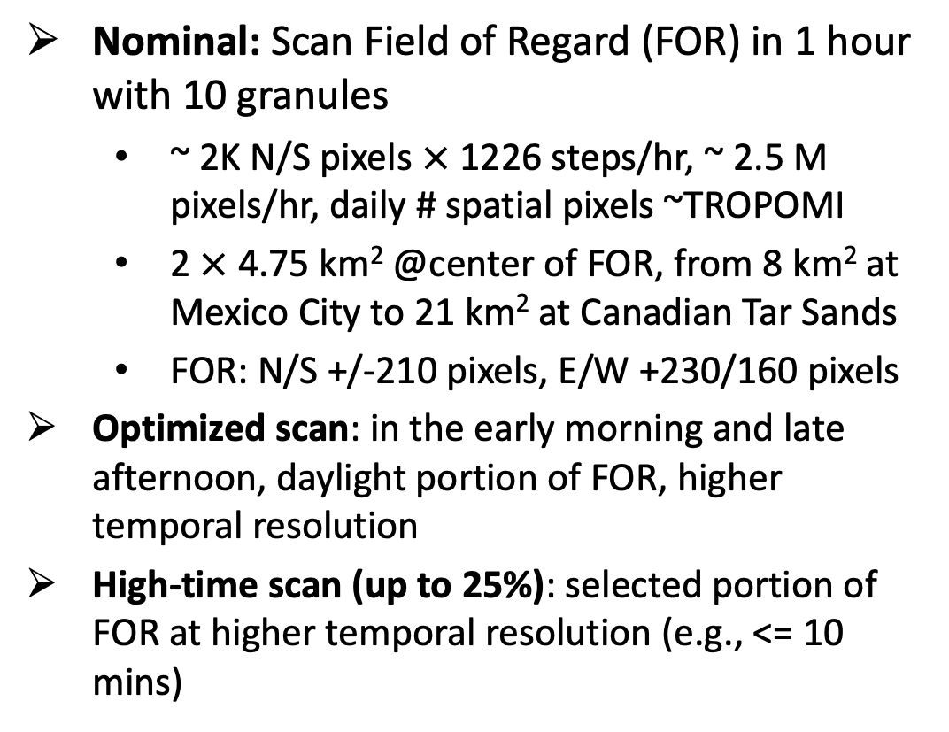
TEMPO Operation
Operate on geostationary communications satellite Intelsat 40e (IS-40e) at 91 ∘ W
Nominal: Scan Field of Regard (FOR) in 1 hour with 10 granules
~ 2K N/S pixels $×$ 1226 steps/hr, ~ 2.5 M pixels/hr, daily # spatial pixels ~TROPOMI
2 $×$ 4.75 km² @center of FOR, from 8 km² at Mexico City to 21 km² at Canadian Tar Sands
FOR: N/S +/-210 pixels, E/W +230/160 pixels
Optimized scan: in the early morning and late afternoon, daylight portion of FOR, higher temporal resolution
High-time scan (up to 25%): selected portion of FOR at higher temporal resolution (e.g., <= 10 mins)
Field of regard is optimized to cover both Puerto Rico and Canadian tar sands.
S5p-TROPOMI NO₂ product oversampled by Kang Sun.

Slide 8
Baseline and Threshold Products (Variables) & Requirements
Species/Products | Required Precision | Temporal Revisit*
0-2 km O₃ (Selected Scenes) Baseline only | 10 ppbv | 2 hour
Tropospheric O₃ | 10 ppbv | 1 hour
Total O₃ | 3% | 1 hour
Tropospheric NO₂ | 1.0 × 10¹⁵ molecules cm⁻² | 1 hour
Tropospheric H₂CO | 1.0 × 10¹⁶ molecules cm⁻² | 3 hour
Tropospheric SO₂ | 1.0 × 10¹⁶ molecules cm⁻² | 3 hour
Tropospheric C₂H₂O₂ | 4.0 × 10¹⁴ molecules cm⁻² | 3 hour
Aerosol Optical Depth | 0.10 | 1 hour
* # of hourly measurements to be averaged to achieve required precision
Mission duration: 20 months for baseline, 12 months for threshold
Spatial resolution: < 60 km² for baseline (4 native pixels coadded), < 300 km² for threshold
Aerosols, SO₂, C₂H₂O₂ were removed from baseline products during KDPC
Cloud product (cloud fraction, cloud pressure): used in trace gas/aerosol retrievals

Slide 9
TEMPO Data Products
Level | Product | Algorithm | Major Outputs | A Priori (L2) | Res km^{2 *} | Freq/Size
L0 | Digital counts | Raw to L0 | Reconstructed/reformatted digital counts |  | 2.0 x 4.75 | Daily/hourly
L1-b | Irradiance | SAO L0-1 | Calibrated & quality flags |  |  | daily
 | Radiance | SAO L0-1 | Geolocated, calibrated, viewing, geolocation & quality flags |  | 2.0 x 4.75 | Hourly, granule
L2 | Cloud | OMI O₂-O₂ | Cloud fraction, cloud pressure | GEOS-CF | 2.0 x 4.75 | Hourly, granule
 | O₃ profile | SAO O₃ profile | O₃ profile, total/strat/trop/0-2 km O₃ column, errors, a priori, AKs | Climatology+GEOS-CF | >= 8.0 x 4.75** | Hourly, granule
 | Total O₃ | TOMS V8.5 | Total O₃, AI, cloud fraction | Climatology | 2.0 x 4.75 | Hourly, granule
 | NO₂ | SAO trace gas, BU strat./trop. sep. | SCD, strat./trop. VCD, error, shape factor, scattering weights | GEOS-CF | 2.0 x 4.75 | Hourly, granule
 | HCHO | SAO trace gas | SCD, VCD, error, shape factor, scattering weights | GEOS-CF | 2.0 x 4.75 | Hourly, granule
L3 | Gridded L2 | SAO L2-3 | Same as L2 |  | 2 x 2 (?) | Hourly, scan
* Spatial resolution at center of FOR. ** Might be at 8 x 9.5 km²
Launch-ready SDPC software has been developed to produce baseline products meeting PLRA

Slide 10
TEMPO Data Products Baseline + SNWG TEMPO NRT
Level | Product | Algorithm | Major Outputs | A Priori (L2) | Res km^{2 *} | Freq/Size
L0 | Digital counts | Raw to L0 | Reconstructed/reformatted digital counts |  | 2.0 x 4.75 | Daily/hourly
L1-b | Irradiance ^{NRT} | SAO L0-1 | Calibrated & quality flags |  |  | daily
 | Radiance ^{NRT} | SAO L0-1 | Geolocated, calibrated, viewing, geolocation & quality flags |  | 2.0 x 4.75 | Hourly, granule
L2 | Cloud ^{NRT} | OMI O₂-O₂ | Cloud fraction, cloud pressure | GEOS-CF | 2.0 x 4.75 | Hourly, granule
 | O₃ profile | SAO O₃ profile | O₃ profile, total/strat/trop/0-2 km O₃ column, errors, a priori, AKs | Climatology+GEOS-CF | >= 8.0 x 4.75** | Hourly, granule
 | Total O₃ | TOMS V8.5 | Total O₃, AI, cloud fraction | Climatology | 2.0 x 4.75 | Hourly, granule
 | NO₂ ^{NRT} | SAO trace gas, BU strat./trop. sep. | SCD, strat./trop. VCD, error, shape factor, scattering weights | GEOS-CF | 2.0 x 4.75 | Hourly, granule
 | HCHO ^{NRT} | SAO trace gas | SCD, VCD, error, shape factor, scattering weights | GEOS-CF | 2.0 x 4.75 | Hourly, granule
L3 | Gridded L2 | SAO L2-3 | Same as L2 |  | 2 x 2 (?) | Hourly, scan
* Spatial resolution at center of FOR. ** Might be at 8 x 9.5 km²
Satellite Needs Working Group (SNWG) will fund TEMPO NRT products (L2 products < 3 hours from observation time): 6/1/2023-5/30/2025, NOAA to produce NRT aerosol products

Slide 11
Commissioning Timeline, Distribution, and Data Release Plan
Nominal operation after Post Launch Acceptance Review (PLAR): ~10/2023
Baseline mission (Phase E, 20 months, 10/2023-5/2025), NASA senior/extension review
Data products sent to ASDC for archival and distribution
Plan for initial public release of baseline products at ASDC after algorithm verification, product validation, algorithm optimization/improvement: L1b, 2/2024; L2/3, 4/2024
Provide earlier access to validation team prior to the public release
Initial public release of NRT products at ASDC (~6 mos behind baseline products): ~10/2024
TEMPO
Power On
Launch
First Light
PLAR
L+0 (4/7/23)
L+60 days (6/6/23)
L+110 days (7/26/23)
L+178 days
(10/2/23)
Outgassing
S/C Activity (TEMPO Off)
TEMPO Commissioning
Nominal Operations
Activation
Instrument Characterization and Analysis
*Dates are as of 4/25/23 and are subject to change

Slide 12
Summary
TEMPO will provide revolutionary hourly daytime atmospheric pollution measurements at high spatial resolution over North America from the GEO via UV/visible imaging grating spectroscopic measurement technique
Launch-ready SDPC software has been developed to produce baseline products meeting PLRA. We were funded by SNWG to produce NRT products for L1b, cloud, NO₂, and HCHO products.
After 4 months of TEMPO commissioning and PLAR, nominal operation starts in 10/2023, kicking off a 20-month baseline mission. Baseline L2 products is planned to be released to the public from ASDC in ~1 year after launch.

Slide 13
























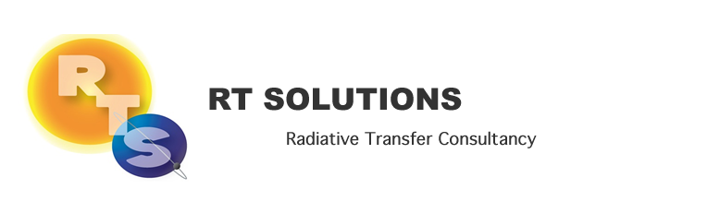






Slide 16
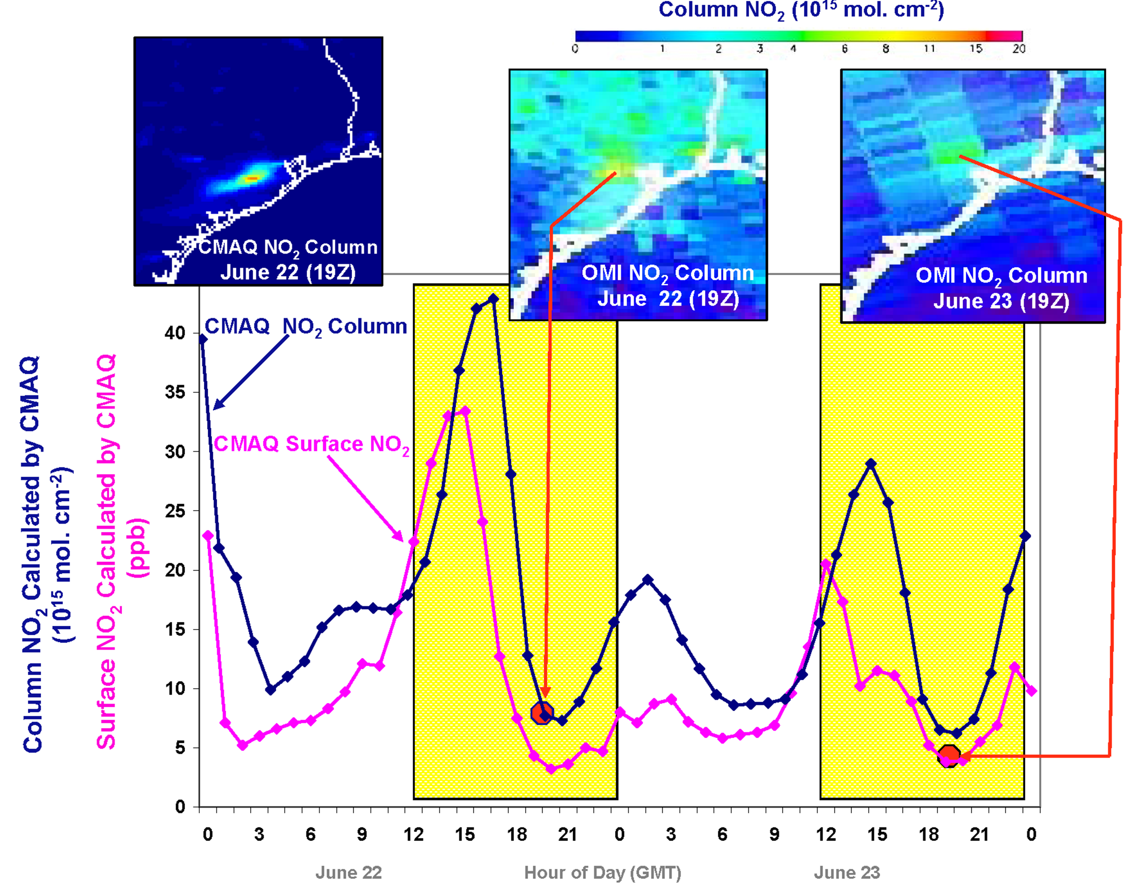
Why geostationary? High temporal and spatial resolution
Hourly NO₂ surface concentration and integrated column calculated by CMAQ air quality model: Houston, TX, June 22-23, 2005
June 22
Hour of Day (UTC)
June 23
LEO observations provide limited information on rapidly varying emissions, chemistry, & transport
GEO will provide observations at temporal and spatial scales highly relevant to air quality processes

Slide 17
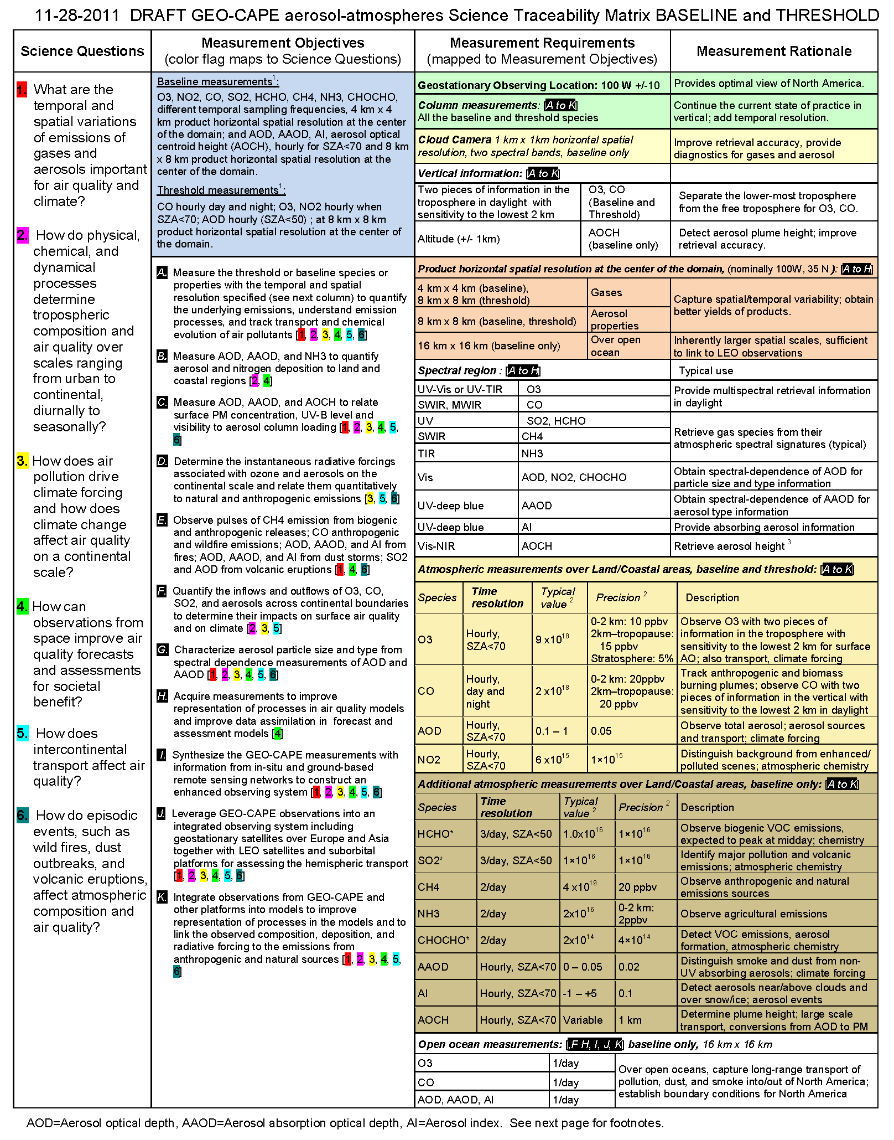
TEMPO Requirements and Science Questions are leveraged from the GEO-CAPE Science Traceability Matrix

Slide 18
TEMPO Science Traceability Matrix

Slide 19
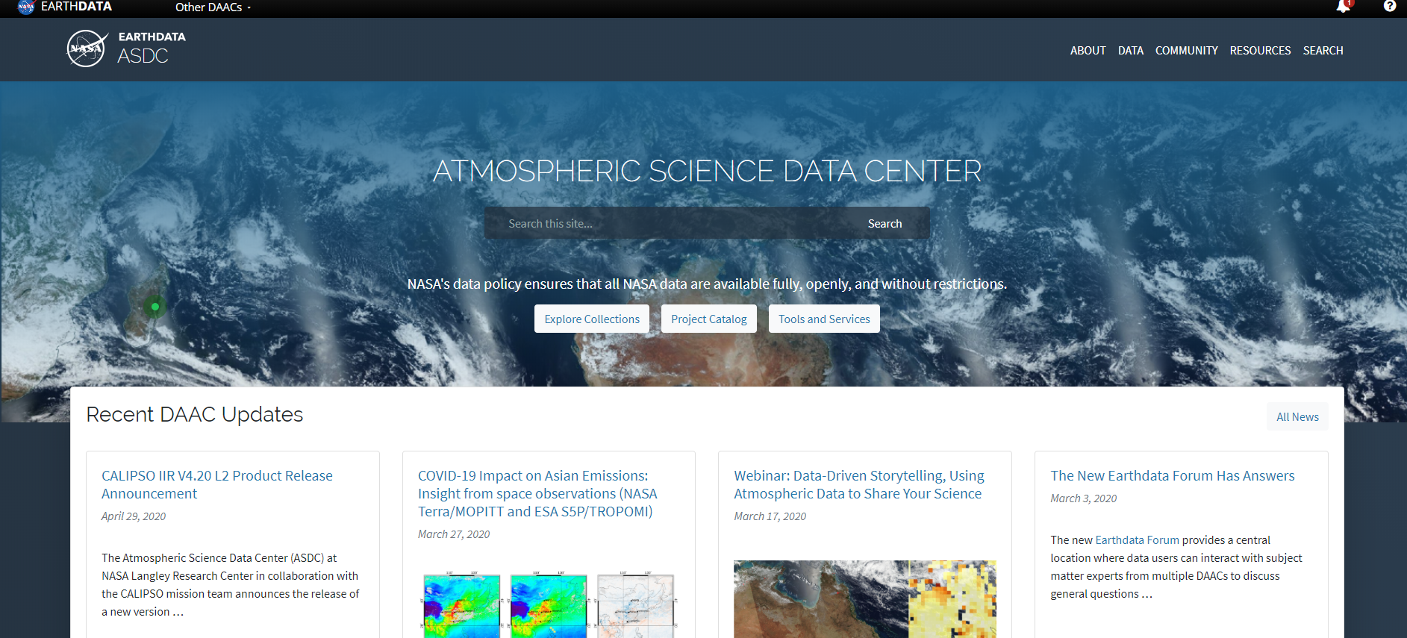



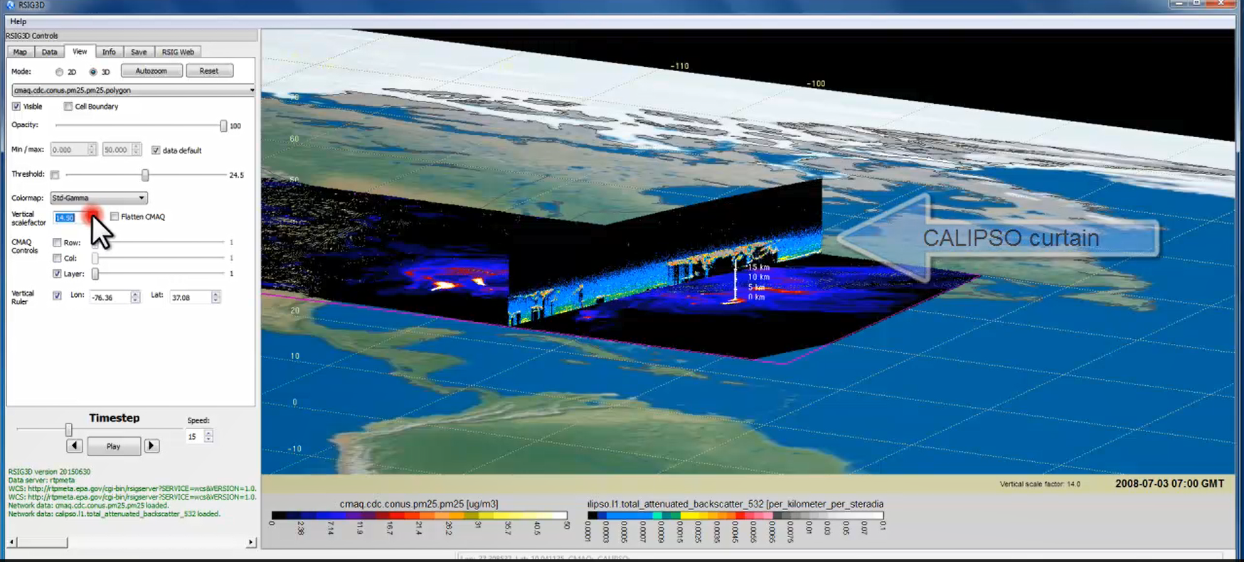

TEMPO Data Products Distribution
Slides from Jeff Walters, Tim Larson at TEMPO STM 2020 & EAWNov2021
ASDC Data Archival & Distribution: Tools and Services
NASA Earthdata Search
CMR Search ⚬ Metadata
NASA WorldView
GIBS API ⚬ visualization
Harmony and OPeNDAP
⚬ transform ⚬ subsetting
⚬ reformatting ⚬ distribution
HTTPS data access
⚬ datapool
⚬ permanent URL/direct access
⚬ enables scripts/workflow
Geospatial Web Services
⚬ WCS ⚬ WMS ⚬ ArcGIS Image Service
Example scripts
⚬ Python/Jupyter Notebook
⚬ R scripts
⚬ contributed tutorials/scripts
EPA RSIG3D Gateway
TEMPO data can be served directly through the EPA RSIG. https://www.epa.gov/hesc/remote-sensing-information-gateway
User Support and Other Resources
Earthdata Login https://urs.earthdata.nasa.gov
Earthdata Forum https://forum.earthdata.nasa.gov/
ASDC User Support support-asdc@earthdata.nasa.gov

Slide 20
TEMPO Green Paper: Chemistry Experiments with TEMPO
NORMAL TIME RESOLUTION STUDIES | Volcanoes
Air quality and health | Socio-economic studies
Ultraviolet exposure | National pollution inventories
Biomass burning | Regional and local transport of pollutants
Synergistic GOES-16/17 Products | Sea breeze studies for Florida and Cuba
Advanced aerosol products | Transboundary pollution gradients
Soil NO_{x} after fertilizer application and after rainfall | Transatlantic dust transport
Solar-induced fluorescence from chlorophyll | HIGH TIME RESOLUTION EXPERIMENTS
Foliage studies | Lightning NO_{x}
Mapping NO₂ and SO₂ dry deposition at high resolution | Morning and evening higher-frequency scans
Crop and forest damage from ground-level ozone | Dwell-time studies and temporal selection to improve detection limits
Halogen oxide studies in coastal and lake regions | Exploring the value of TEMPO in assessing pollution transport during upslope flows
Air pollution from oil and gas fields | Tidal effects on estuarine circulation and outflow plumes
Night light measurements resolving lighting type | Air quality responses to sudden changes in emissions
Ship tracks, drilling platform plumes, and other concentrated sources. | Cloud field correlation with pollution
Water vapor studies | Agricultural soil NO_{x} emissions and air quality
Early Adopters are key to building the TEMPO Green Paper!
High-time special observations can be requested at:
https://weather.msfc.nasa.gov/tempo/green_paper.html
The TEMPO Green Paper living document at http://tempo.si.edu/publications.html

Slide 21
Including Visible to Improve Tropospheric Ozone Retrieval Sensitivity
This example is for solar zenith angle =25, viewing zenith angle 45, relative azimuthal angle 86, Signal to noise Ratio (SNR) with 4 pixels coadded
Add visible to improve retrieval sensitivity in the lower troposphere and help separate free tropospheric O₃ from boundary layer O₃
Under ideal conditions: 3-5 total Degree of Freedom for Signal (DFS) with up to ~1.5 in the troposphere, and up to ~0.5 DFS in 0-2 km
Adapted from OMI (Liu et al., 2010): Spectral fitting + VLIDORT + Optimal Estimation (OE) from Fitting windows: 293-345 nm, 540-650 nm
Retrieve partial O₃ columns at ~24 layers (bottom layer is 0-2 km above the surface) as well as total, stratospheric, and tropospheric O₃ columns, other trace gases, and auxiliary parameters.
A priori: a combination of tropopause-based climatology (Bak et al., 2013) with diurnally-resolved GEOS-CF data

Slide 22
TEMPO Science Team, U.S.
Team Member | Institution | Role | Responsibility
K. Chance | SAO | PI | Overall science development; Level 1b, H₂CO, C₂H₂O₂
X. Liu | SAO | Deputy PI | Science development, data processing; O₃ profile, tropospheric O₃
J. Al-Saadi | LaRC | Deputy PS | Project science development
J. Carr | Carr Astronautics | Co-I | INR Modeling and algorithm
M. Chin | GSFC | Co-I | Aerosol science
R. Cohen | U.C. Berkeley | Co-I | NO₂ validation, atmospheric chemistry modeling, process studies
D. Edwards | NCAR | Co-I | VOC science, synergy with carbon monoxide measurements
J. Fishman | St. Louis U. | Co-I | AQ impact on agriculture and the biosphere
D. Flittner | LaRC | Project Scientist | Overall project development; STM; instrument cal./char.
J. Herman | UMBC | Co-I | Validation (PANDORA measurements)
D. Jacob | Harvard | Co-I | Science requirements, atmospheric modeling, process studies
S. Janz | GSFC | Co-I | Instrument calibration and characterization
J. Joiner | GSFC | Co-I | Cloud, total O₃, TOA shortwave flux research product
N. Krotkov | GSFC | Co-I | NO₂, SO₂, UVB
M. Newchurch | U. Alabama Huntsville | Co-I | Validation (O₃ sondes, O₃ lidar)
R.B. Pierce | NOAA/NESDIS | Co-I | AQ modeling, data assimilation
R. Spurr | RT Solutions, Inc. | Co-I | Radiative transfer modeling for algorithm development
R. Suleiman | SAO | Co-I, Data Mgr. | Managing science data processing, BrO, H₂O, and L3 products
J. Szykman | EPA | Co-I | AIRNow AQI development, validation (PANDORA measurements)
O. Torres | GSFC | Co-I | UV aerosol product, AI
J. Wang | U. Nebraska | Co-I | Synergy w/GOES-R ABI, aerosol research products
J. Leitch | Ball Aerospace | Collaborator | Aircraft validation, instrument calibration and characterization
D. Neil | LaRC | Collaborator | GEO-CAPE mission design team member

Slide 23
TEMPO Science Team, non-U.S.
Team Member | Institution | Role | Responsibility
R. Martin | Dalhousie U. | Collaborator | Atmospheric modeling, air mass factors, AQI development
Chris McLinden | Environment Canada | Collaborator | Canadian air quality coordination
Michel Grutter de la Mora | UNAM, Mexico | Collaborator | Mexican air quality coordination
Gabriel Vazquez | UNAM, Mexico | Collaborator | Mexican air quality, algorithm physics
Amparo Martinez | INECC, Mexico | Collaborator | Mexican environmental pollution and health
J. Victor Hugo Paramo Figeuroa | INECC, Mexico | Collaborator | Mexican environmental pollution and health
Brian Kerridge | Rutherford Appleton Laboratory, UK | Collaborator | Ozone profiling studies, algorithm development
Paul Palmer | Edinburgh U., UK | Collaborator | Atmospheric modeling, process studies
J. Kim | Yonsei U. | Collaborators, Science Advisory Panel | Korean GEMS, CEOS constellation of GEO pollution monitoring
C.T. McElroy | York U. Canada |  | CSA PHEOS, CEOS constellation of GEO pollution monitoring
B. Veihelmann | ESA |  | ESA Sentinel-4, CEOS constellation of GEO pollution monitoring

Slide 24
TEMPO Algorithm Teams
Operational Algorithm | Personnel
Raw to L0 | John Davis
L0-1b | John Houck, Xiong Liu, Dave Flittner, Weizhen Hou, Jim Carr, Chris Chan Miller
Ozone profile | Xiong Liu, Juseon Bak, Weizhen Hou
Total ozone | Dave Haffner, Joanna Joiner
Nitrogen dioxide | Caroline Nowlan, Gonzalo González Abad, Jeff Geddes, Chris Chan Miller
Formaldehyde | Gonzalo González Abad, Caroline Nowlan, Hyeong-Ahn Kwon, Chris Chan Miller
Glyoxal | Gonzalo González Abad, Hyeong-Ahn Kwon, Chris Chan Miller
Clouds | Huiqun Wang, Alexander Vasilkov, Eun-Su Yang, Joanna Joiner
Sulfur dioxide | Can Li, Nicolay Krotkov
Aerosols | Omar Torres, Jun Wang
Operational implementation and IT support @ SAO Science Data Processing Center (SDPC) by John Houck

Slide 25
NRT vs. Off-line Trace Gas Products (if with additional NRT funding)
Implementing both NRT and off-line trace gas products (e.g., NO₂, HCHO) for NO₂, HCHO, aerosol, SO₂, cloud
Major potential differences between NRT and offline
 | NRT | Off-line
Trace gas profiles/Met data | GEOS-CF | GEOS-CF Replay
Surface | GLER climatology | MODIS/VIIRS albedo/BRDF products
L1B | Skip wavelength calibration One-pass INR Default/No Pol. Correction | Two-pass Kalman Filter INR Improved pol. Correction with L2 retrievals?
L2 algorithms | Smaller fitting windows Avoid waiting for the entire hourly scan | More optimized fitting windows Improve radiance reference & cross-track correction
Data Latency | Within 2-3 hours upon receipt of raw data at SAO Ground System | + 8 days as MODIS BRDF is produced using data +/- 8 days

