Slide 1
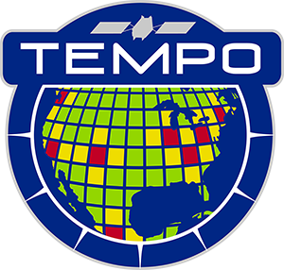




Tropospheric Emissions:
Monitoring of Pollution
TEMPO Products Updates
Xiong Liu¹, Kelly Chance¹, Raid M. Suleiman¹, Kevin J. Daugherty²,
David E. Flittner², John Houck¹, John E. Davis¹,
Gonzalo Gonzalez Abad¹, Caroline Nowlan¹, Huiqun Wang¹,
Chistopher Chan Miller^{1,3}, Juseon Bak⁴, Hyeong-Ahn Kwon^{1,5},
Jim Carr⁶, Weizhen Hou¹, Hee-sung Chong¹, Mike Newchurch⁷,
Jim Szykman⁸, Aaron Naeger⁷, The TEMPO Team
¹CfA | Harvard & Smithsonian ²NASA LaRc
³Harvard University ⁴Pusan National University
⁵U. Suwon, ⁶Carr Astronautics ⁷UAH ⁸EPA
xliu@cfa.harvard.edu
TEMPO Science Team Meeting
Huntsville, AL
May 2, 2023

Slide 2
Outline
Data Products (Enhanced & Research Data Products)
Algorithm Development Status
Test TEMPO algorithms with GEMS
Science Verification & Validation

Slide 3
Baseline and Threshold Products
(Variables) & Requirements
Species/Products | Required Precision | Temporal Revisit*
0-2 km O₃ (Selected Scenes) Baseline only | 10 ppbv | 2 hour
Tropospheric O₃ | 10 ppbv | 1 hour
Total O₃ | 3% | 1 hour
Tropospheric NO₂ | 1.0 × 10¹⁵ molecules cm⁻² | 1 hour
Tropospheric H₂CO | 1.0 × 10¹⁶ molecules cm⁻² | 3 hour
Tropospheric SO₂ | 1.0 × 10¹⁶ molecules cm⁻² | 3 hour
Tropospheric C₂H₂O₂ | 4.0 × 10¹⁴ molecules cm⁻² | 3 hour
Aerosol Optical Depth | 0.10 | 1 hour
* # of hourly measurements to be averaged to achieve required precision
Mission duration: 20 months for baseline, 12 months for threshold
Spatial resolution: < 60 km² for baseline (4 native pixels coadded), < 300 km² for threshold
Aerosols, SO₂, C₂H₂O₂ were removed from baseline products during KDPC
Cloud product (cloud fraction, cloud pressure): used in trace gas/aerosol retrievals

Slide 4
TEMPO Data Products
Baseline + SNWG 2020 NRT + SNWG 2022 NRT/Enhanced
Level | Product | Algorithm | Major Outputs | A Priori (L2) | Res km^{2 *} | Freq/Size
L0 | Digital counts | Raw to L0 | Reconstructed/reformatted digital counts |  | 2.0 x 4.75 | Daily/hourly
L1-b | Irradiance ^{NRT} | SAO L0-1 | Calibrated & quality flags |  |  | daily
 | Radiance ^{NRT} | SAO L0-1 | Geolocated, calibrated, viewing, geolocation & quality flags |  | 2.0 x 4.75 | Hourly, granule
L2 | Cloud ^{NRT} | OMI O₂-O₂ | Cloud fraction, cloud pressure | GEOS-CF | 2.0 x 4.75 | Hourly, granule
 | O₃ profile | SAO O₃ profile | O₃ profile, total/strat/trop/0-2 km O₃ column, errors, a priori, AKs | Climatology + GEOS-CF | >= 8.0 x 4.75** | Hourly, granule
 | Total O₃ | TOMS V8.5 | Total O₃, AI, cloud fraction | Climatology | 2.0 x 4.75 | Hourly, granule
 | NO₂ ^{NRT} | SAO trace gas, BU strat/trop sep. | SCD, strat./trop. VCD, error, shape factor, scattering weights | GEOS-CF | 2.0 x 4.75 | Hourly, granule
 | HCHO ^{NRT} | SAO trace gas | SCD, VCD, error, shape factor, scattering weights | GEOS-CF | 2.0 x 4.75 | Hourly, granule
 | C₂H₂O₂ | SAO trace gas |  | GEOS-CF | 2.0 x 4.75 | Hourly, granule
 | H₂O | SAO trace gas |  | GEOS-CF | 2.0 x 4.75 | Hourly, granule
 | BrO | SAO trace gas |  | GEOS-CF | 2.0 x 4.75 | Hourly, granule
 | Aerosol ^{NOAA NRT} | OMAERUV/UI AOCH | AAI, UVAOD, UVSSA, AOCH, VISAOD |  | 8.0 x 4.75 | Hourly, granule
 | SO₂ ^{NRT} | OMSO2 PCA | SCD, VCD (PBL,TRL,TRM,TRU,STL) |  | 2.0 x 4.75 | Hourly, granule
 | UVB | GEMS/GSFC UVB | UV irradiance, erythemal irradiance, UVI |  | 2.0 x 4.75 | Hourly, scan
L3 | Gridded L2 | SAO L2-3 | Same as L2 |  | 2 x 2 (?) | Hourly, scan
* Spatial resolution at center of FOR. ** Might be at 8 x 9.5 km²
Satellite Needs Working Group (SNWG) will fund TEMPO NRT products (L2 products < 3 hours from observation time): 6/1/2023-5/30/2025
SNWG 2022 Survey has selected to produce TEMPO NRT/Enhanced Productions starting in 2025

Slide 5
Research Products
TEMPO research products will greatly extend science and applications
  OClO, IO, HNO₂, NO₃, volcanic (SO₂ plume height and Vertical Column Density)
  Additional/improved cloud with O₂-O₂ bands / O₂ B band
  Additional aerosol products from hyperspectral spectra, O₂ B and O₂-O₂-bands, and TEMPO + GOES-R synergy at @U Iowa, NOAA, GSFC
  Vegetation/Ocean Color products: vegetation indices, Growth Primary Productivity (GPP), Solar Induced Fluorescence (SIF), ocean color
  Surface albedo/Bidirectional Reflectance Distribution Function (BRDF) products
  Diurnal out-going shortwave radiation and cloud forcing
  Night lights: allows discrimination between lighting types
  Higher-level products: Near-real-time pollution/Air Quality indices

Slide 6
Algorithm Development Status
Launch-ready Science Data Processing Center (SDPC) V4 software completed in Feb 2022
Algorithm mostly based on OMI heritage algorithms except for new L0-1b processor including Imagination Navigation and Registration (INR) using GOES-R by Carr Astronautics
L1-2 algorithms updates (O₃ profile, total O_{3,} NO₂, HCHO, cloud) include:
  Add visible spectrum to UV O₃ profile algorithm
  SAO trace gas algorithm with adapted NASA stratospheric/tropospheric separation for NO₂
  New CLDO4: SAO O₂-O₂ fitting + GSFC’s O₂-O₂ cloud at ~477/466 nm (H. Wang, E.-S. Yang, A. Vasilkov)
  NASA GMAO’s GEOS-CF trace gas profiles and meteorology (E. Knowland and GMAO)
  Hourly resolved monthly mean Geometry-dependent Lambertian Equivalent Reflectivity (GLER) climatology (C. Chan Miller, W. Qin, Z. Fasnacht)
Development of non-baseline products
  CHOCHO, H₂O, BrO: will use SAO’s trace gas algorithm
  SO₂: OMI PCA SO₂ algorithm adapted for TEMPO/GEMS from synthetic/GEMS data (Can Li)
  Aerosols: being adapted from OMI/TROPOMI AERUV algorithm (Omar’s team), from EPIC/TROPOMI Aerosol Layer Height algorithm using O₂-A/B (Jun Wang’s team, funded by NASA Applied Science Program)

Slide 7
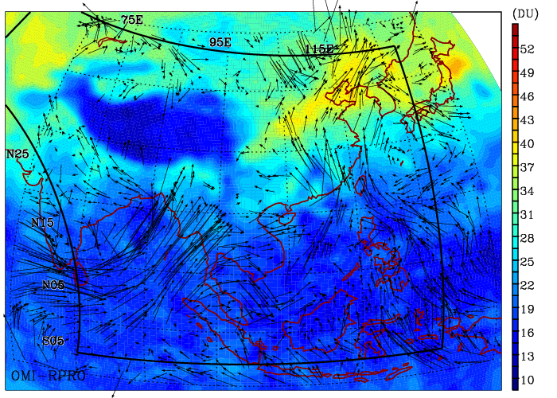
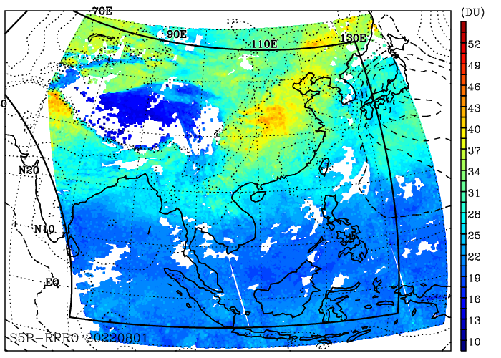
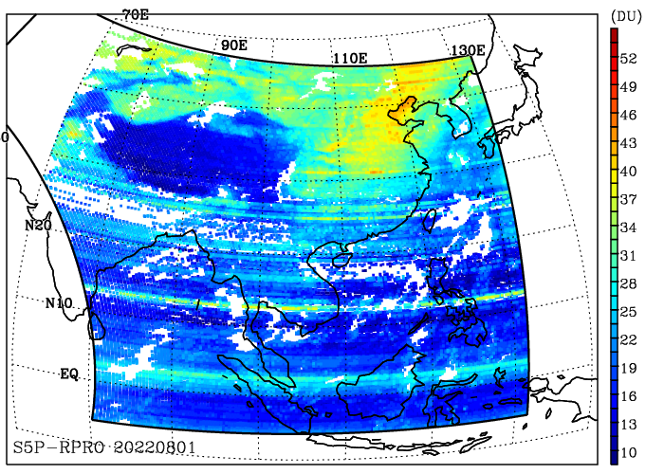
Test TEMPO-like O3PROF Algorithm with OMI/TOPOMI/GEMS Data
OMI-PROFOZ
3 days-mean
GEMS-PROFOZ
04:45 UTC
Daily S5P-PROFOZ
Credit: Juseon Bak
Comparison of tropospheric ozone column (950-300 hPa) from several products over the GEMS domain on August 1, 2022 including TEMPO-like algorithm OMPROFOZ V2 applied to OMI, and S5p-TROPOMI, and GEMS
Apply TEMPO algorithm (OMPROFOZ v2, UV only) to GEMS data without soft calibration (BTDF correction via wavelength calibration) works reasonably well. Cross-track stripes can be seen.

Slide 8
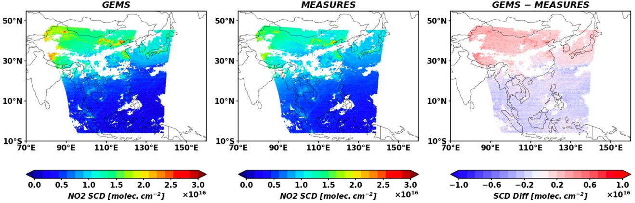
Test TEMPO NO2
Algorithm with GEMS Data
GEMS
GEMS
SAO MEASURES/TEMPO
GEMS-MEASURES
Credit: Hyeong-Ahn Kwon
NO₂ Slant Column Densities (SCDs) observed by GEMS (V1) on June 1, 2021 at 6:45 UTC are similar to SAO TEMPO NO₂ SCDs from the same GEMS data except for some known positive biases in the GEMS V1 operational retrievals.

Slide 9
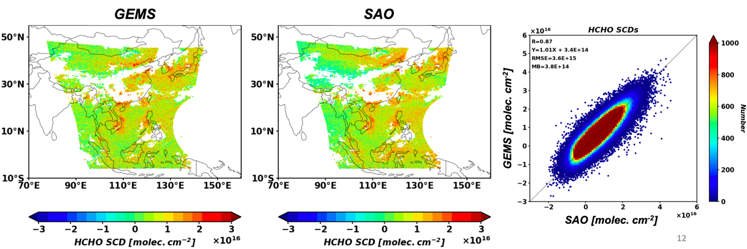
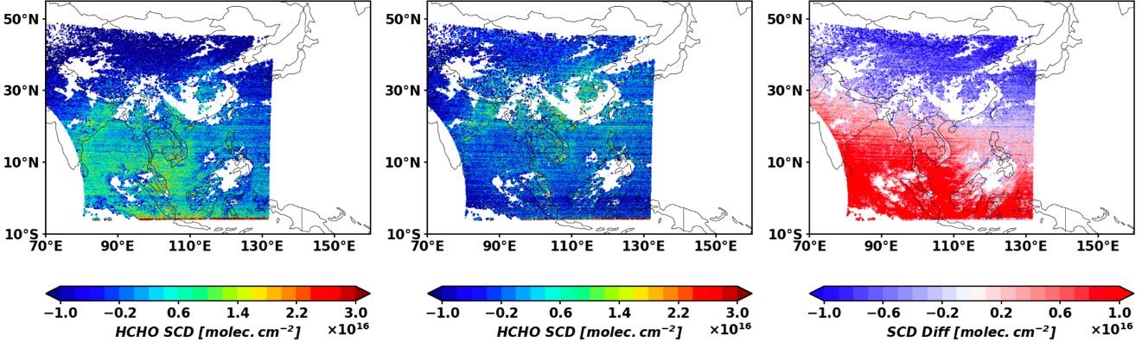
Test TEMPO HCHO Algorithm with GEMS Data
GEMS
SAO MEASURES
GEMS - MEASURES
GEMS V2 vs. SAO
HCHO SCDs
Credit: Hyeong-Ahn Kwon
SAO’s GEMS formaldehyde retrievals on June 1, 2021 at 6:45 UTC, compare quite well with GEMS V2 retrievals

Slide 10
Calibration and L1b Validation
Verify and update image correction steps in the L0-1 processing during Commissioning Phase (~L+1~L+3 months, ~90 days)
  System linearity, zero-input, relative gains, saturation blooming, dark current variation and temperature-dependent correction, check quality flags, evolution of solar diffuser, noise calculation, straylight
Assess wavelength calibration and its performance
  Will assess performance of routine processing (wavelength calibration in both L0-1b & L1-2 via high-resolution solar reference and atmospheric absorption)
  Pre-launch measured instrument line shape will be compared with that derived from solar irradiance
Assess radiometric calibration using a multi-pronged approach
  Internal assessment of images, Assess performance of routine processing
  Comparison solar irradiance with solar reference and correlative contemporaneous sensors (e.g., OMPS, TROPOMI, GOME-2, EPIC, MODIS, VIIRS)
  Comparison with radiative transfer simulation
Assess geo-location methodology with Image Navigation and Registration (INR) during commissioning phase, accuracy and uncertainty
  Imagery: assess registration offset of fiducial points not used in INR, using other reference imagery
  L2: assess bias and variance in registration offset of known point sources of NO₂

Slide 11
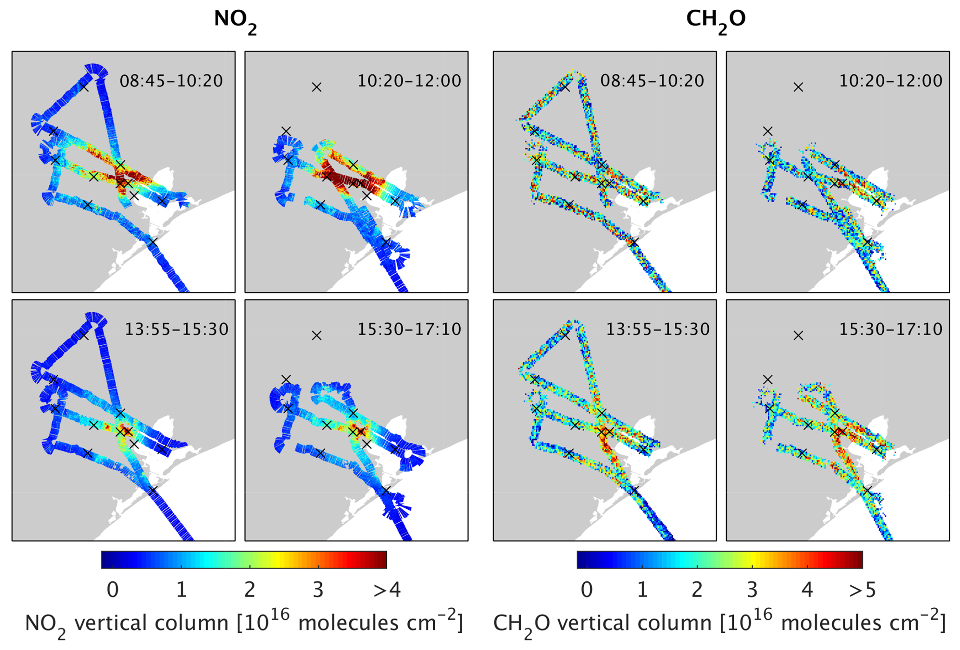
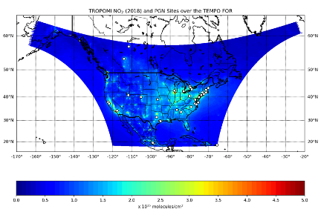
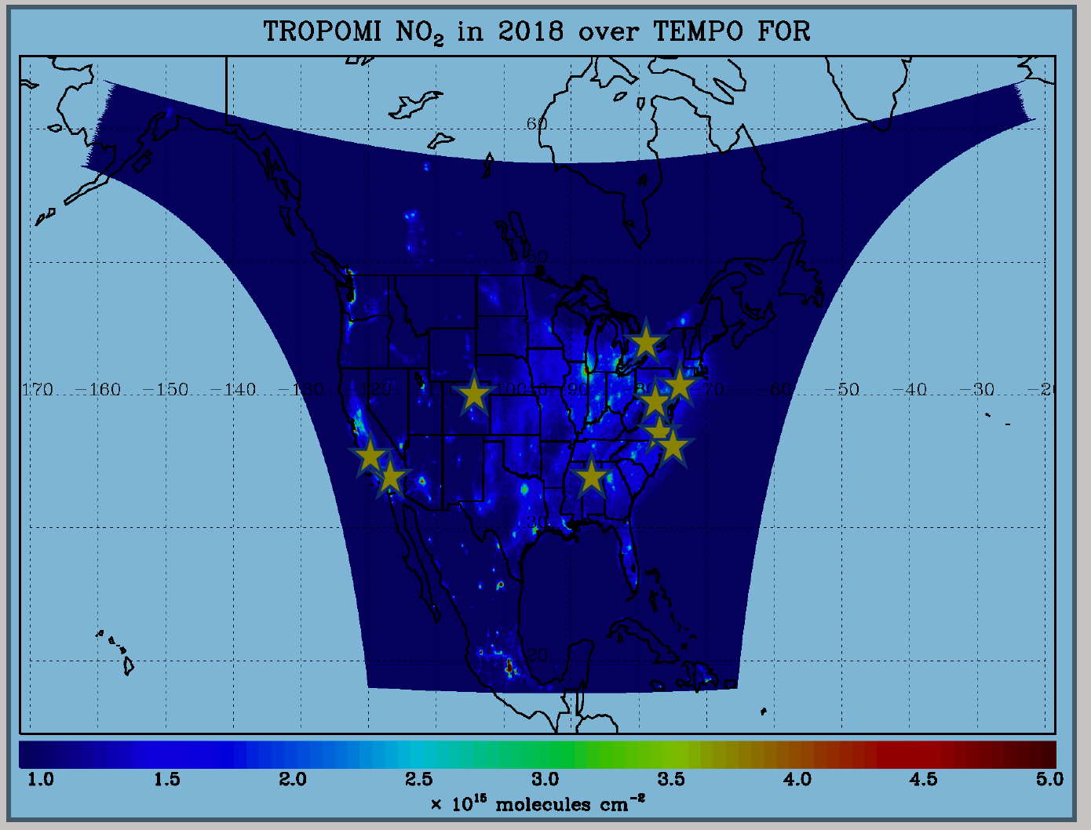
TEMPO L2 Science Validation Plan
TEMPO PLRA has a bare minimum validation requirements (3 Pandoras, 1 month per season)
Jim Szykman has led the development of best-efforts basis validation plan: beta, provisional, full
Use satellite observations (i.e., LEO and EPIC/DSCOVR) for cross validations
Pandora & Pandonia Global Network (PGN): validate NO₂, HCHO, total O₃ and diurnal variation
TOLNet: 8 LIDAR instruments by time of launch to validate tropospheric O₃ & 0-2 km O₃ and diurnal variation
Airborne instruments: GEO-TASO, GCAS, HSRL-2, IAGOS, SeaRey UAV
Other instruments: ozonesonde, Dobson/Brewer, MAXDOAS, FTIR, AERONET, …
Planned flight campaigns AGES+ (e.g., STAQS, AEROMMA+CUPiDS, GOTHAAM) during June-Aug 2003, provide integrated approaches linking TEMPO science, applications, and validation
Indirect evaluation with chemistry transport models and data assimilation.
https://www.pandonia-global-network.org/
www-air.larc.nasa.gov/missions/TOLNet/
Nowlan et al. (2018) GCAS, DISCOVER-AQ, Texas, Sep 2013
~60 PGNs in TEMPO FoR, ~20 to add in 2 years

Slide 12
Summary
Launch-ready SDPC software has been developed to produce baseline products meeting PLRA. Several major updates (new O₂-O₂ cloud, GEOS-CF, GLER) have been developed to significantly improve over heritage algorithms.
Applying our TEMPO algorithms to GEMS data agree quite well with operational GEMS products.
Post-launch science verification and validation activities have been planned to validate and improve the data products

Slide 13










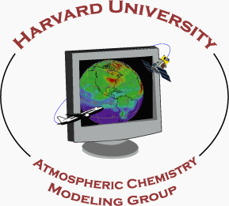













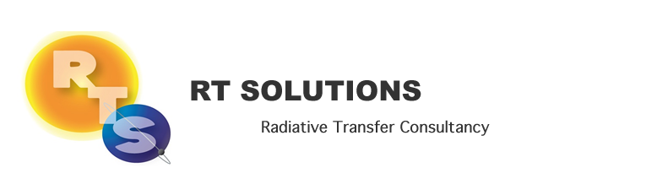






Slide 16
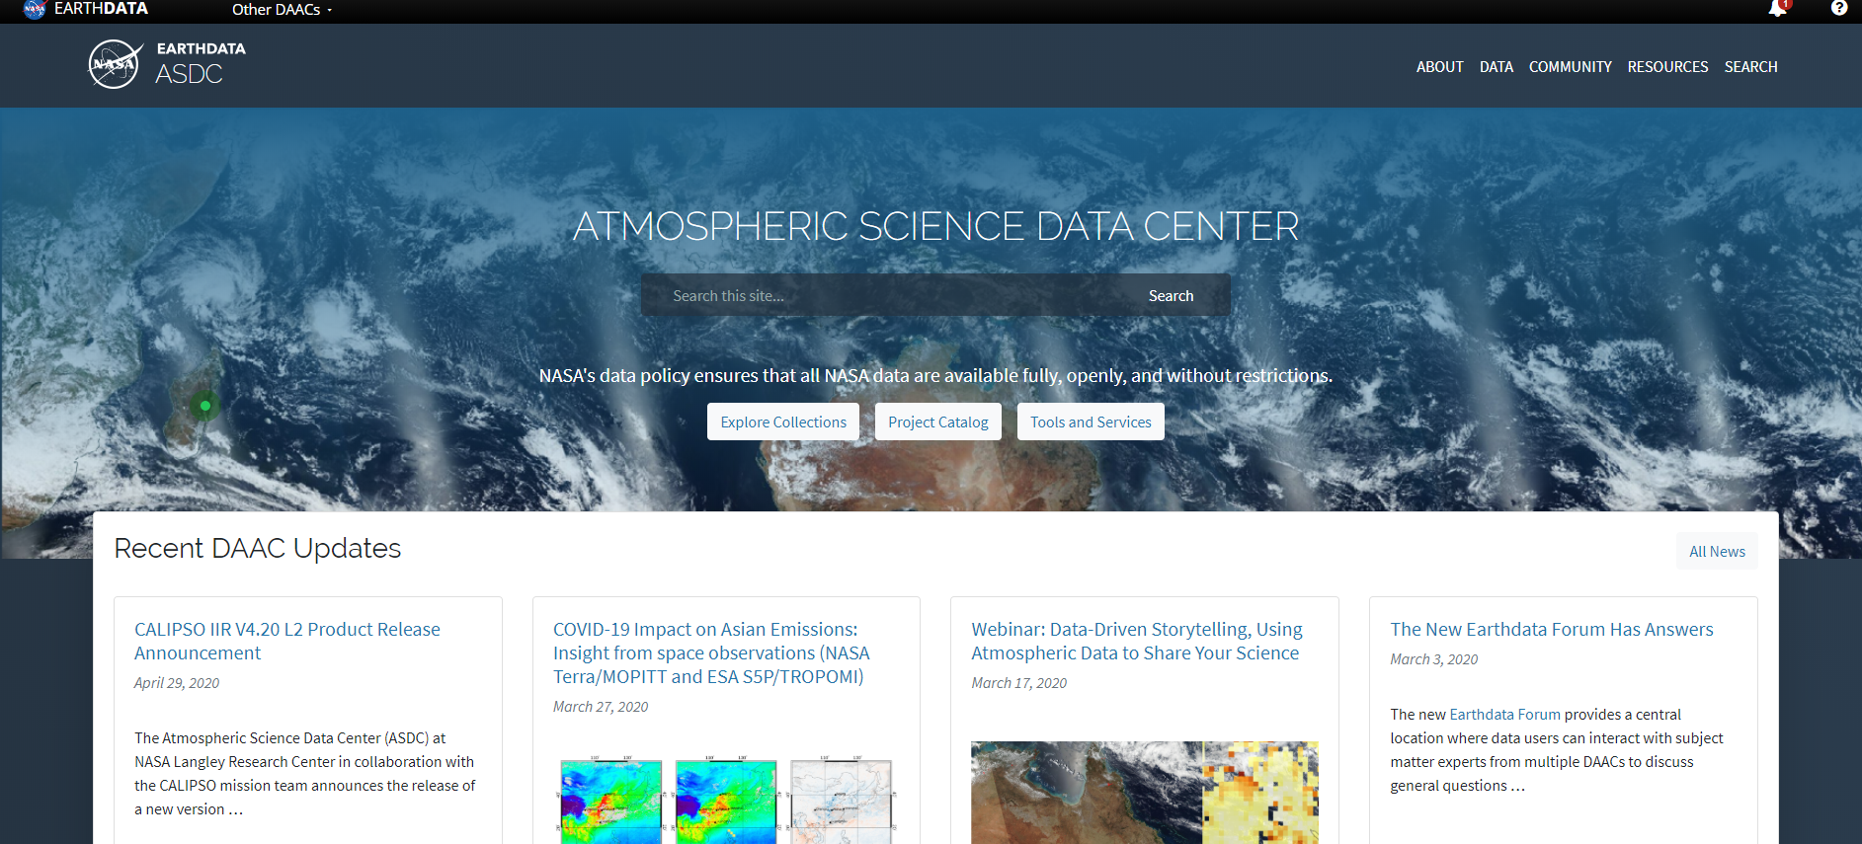



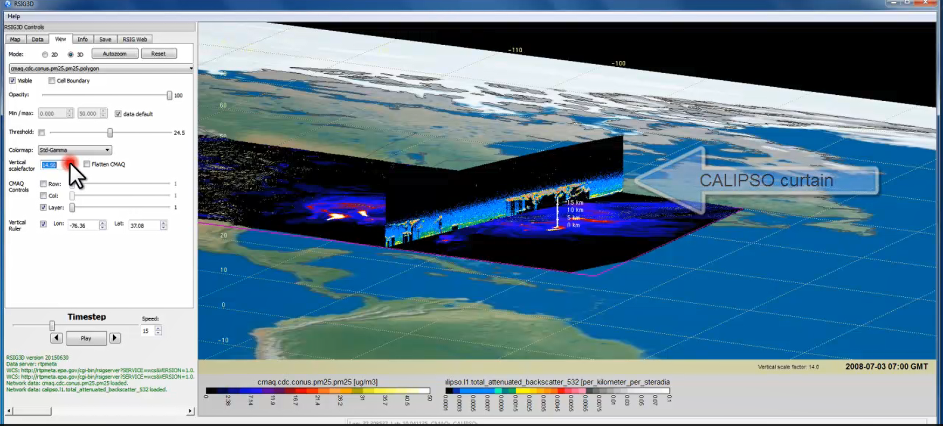

TEMPO Data Products Distribution
Slides from Jeff Walters, Tim Larson at TEMPO STM 2020 & EAWNov2021
ASDC Data Archival & Distribution: Tools and Services
NASA Earthdata Search
  CMR Search ⚬ Metadata
NASA WorldView
  GIBS API ⚬ visualization
Harmony and OPeNDAP
  ⚬ transform ⚬ subsetting
  ⚬ reformatting ⚬ distribution
HTTPS data access
  ⚬ datapool
  ⚬ permanent URL/direct access
  ⚬ enables scripts/workflow
Geospatial Web Services
  ⚬ WCS ⚬ WMS ⚬ ArcGIS Image Service
Example scripts
  ⚬ Python/Jupyter Notebook
  ⚬ R scripts
  ⚬ contributed tutorials/scripts
EPA RSIG3D Gateway
TEMPO data can be served directly through the EPA RSIG. https://www.epa.gov/hesc/remote-sensing-information-gateway
User Support and Other Resources
Earthdata Login https://urs.earthdata.nasa.gov
Earthdata Forum https://forum.earthdata.nasa.gov/
ASDC User Support support-asdc@earthdata.nasa.gov

Slide 17
TEMPO Green Paper:
Chemistry Experiments with TEMPO
NORMAL TIME RESOLUTION STUDIES | Volcanoes
Air quality and health | Socio-economic studies
Ultraviolet exposure | National pollution inventories
Biomass burning | Regional and local transport of pollutants
Synergistic GOES-16/17 Products | Sea breeze studies for Florida and Cuba
Advanced aerosol products | Transboundary pollution gradients
Soil NO_{x} after fertilizer application and after rainfall | Transatlantic dust transport
Solar-induced fluorescence from chlorophyll | HIGH TIME RESOLUTION EXPERIMENTS
Foliage studies | Lightning NO_{x}
Mapping NO₂ and SO₂ dry deposition at high resolution | Morning and evening higher-frequency scans
Crop and forest damage from ground-level ozone | Dwell-time studies and temporal selection to improve detection limits
Halogen oxide studies in coastal and lake regions | Exploring the value of TEMPO in assessing pollution transport during upslope flows
Air pollution from oil and gas fields | Tidal effects on estuarine circulation and outflow plumes
Night light measurements resolving lighting type | Air quality responses to sudden changes in emissions
Ship tracks, drilling platform plumes, and other concentrated sources. | Cloud field correlation with pollution
Water vapor studies | Agricultural soil NO_{x} emissions and air quality
Early Adopters are key to building the TEMPO Green Paper!
High-time special observations can be requested at:
https://weather.msfc.nasa.gov/tempo/green_paper.html
The TEMPO Green Paper living document at http://tempo.si.edu/publications.html

Slide 18
Including Visible to Improve
Tropospheric Ozone Retrieval Sensitivity
This example is for solar zenith angle =25, viewing zenith angle 45, relative azimuthal angle 86, Signal to noise Ratio (SNR) with 4 pixels coadded
Add visible to improve retrieval sensitivity in the lower troposphere and help separate free tropospheric O₃ from boundary layer O₃
Under ideal conditions: 3-5 total Degree of Freedom for Signal (DFS) with up to ~1.5 in the troposphere, and up to ~0.5 DFS in 0-2 km
Adapted from OMI (Liu et al., 2010): Spectral fitting + VLIDORT + Optimal Estimation (OE) from Fitting windows: 293-345 nm, 540-650 nm
Retrieve partial O₃ columns at ~24 layers (bottom layer is 0-2 km above the surface) as well as total, stratospheric, and tropospheric O₃ columns, other trace gases, and auxiliary parameters.
A priori: a combination of tropopause-based climatology (Bak et al., 2013) with diurnally-resolved GEOS-CF data

Slide 19
TEMPO Algorithm Teams
Operational Algorithm | Personnel
Raw to L0 | John Davis
L0-1b | John Houck, Xiong Liu, Dave Flittner, Weizhen Hou, Jim Carr, Chris Chan Miller
Ozone profile | Xiong Liu, Juseon Bak, Weizhen Hou
Total ozone | Dave Haffner, Joanna Joiner
Nitrogen dioxide | Caroline Nowlan, Gonzalo González Abad, Jeff Geddes, Chris Chan Miller
Formaldehyde | Gonzalo González Abad, Caroline Nowlan, Hyeong-Ahn Kwon, Chris Chan Miller
Glyoxal | Gonzalo González Abad, Hyeong-Ahn Kwon, Chris Chan Miller
Clouds | Huiqun Wang, Alexander Vasilkov, Eun-Su Yang, Joanna Joiner
Sulfur dioxide | Can Li, Nicolay Krotkov
Aerosols | Omar Torres, Jun Wang
Operational implementation and IT support @ SAO Science Data Processing Center (SDPC) by John Houck

Slide 20
NRT vs. Off-line Trace Gas Products
(if with additional NRT funding)
Implementing both NRT and off-line trace gas products (e.g., NO₂, HCHO) for NO₂, HCHO, aerosol, SO₂, cloud
Major potential differences between NRT and offline
 | NRT | Off-line
Trace gas profiles/Met data | GEOS-CF | GEOS-CF Replay
Surface | GLER climatology | MODIS/VIIRS albedo/BRDF products
L1B | Skip wavelength calibration One-pass INR Default/No Pol. Correction | Two-pass Kalman Filter INR Improved pol. Correction with L2 retrievals?
L2 algorithms | Smaller fitting windows Avoid waiting for the entire hourly scan | More optimized fitting windows Improve radiance reference & cross-track correction
Data Latency | Within 2-3 hours upon receipt of raw data at SAO Ground System | + 8 days as MODIS BRDF is produced using data +/- 8 days

Slide 21
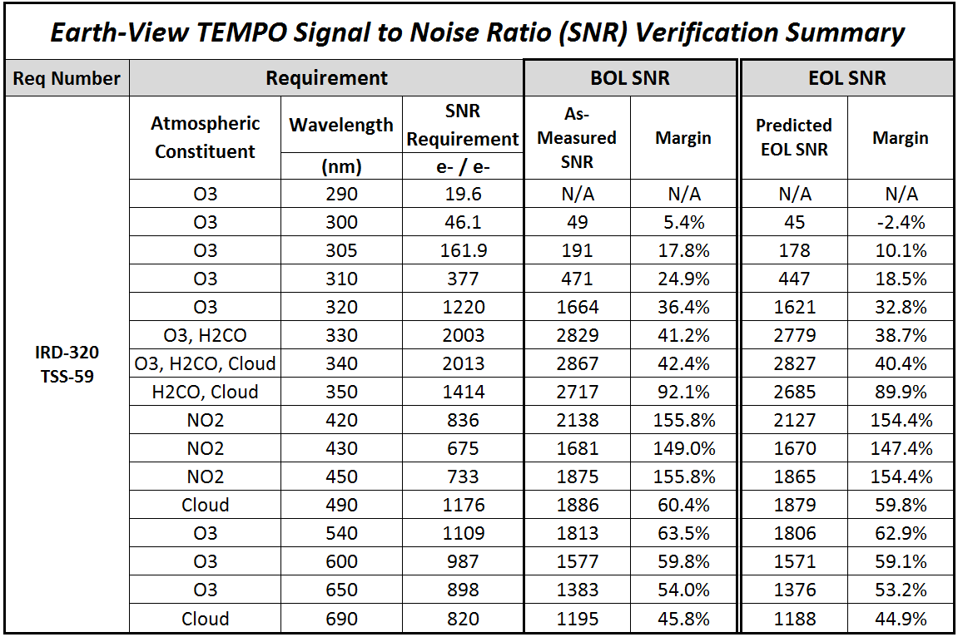
L1b Requirements
L1b products: Spectral Radiance, Irradiance and Uncertainty, Spectral Scale, Geo-location (lat/lon)
PLRA: no requirement for radiance or irradiance, geolocation accuracy < 4km
Instrument design & performance requirements were derived from L2 precision req.
Signal to Noise Ratio (SNR) was the dominate factor for radiance performance
Table of SNR req. and with Beginning of Life (BOL) as-built performance (4 Pixels coadded)
Radiometric Uncertainty: < 4% (1-sigma) for both irradiance & radiance
Albedo uncertainty: wavelength independent < 2%, dependent < 1%
Long-term (20 months) radiometric drift detection: < 0.9%
Nonlinearity: <2% of 98% well response, and knowledge (after corr.) < 0.5% from 2-98% of well response
Pre-launch Wavelength mapping uncertainty: < 0.02 nm
Spectral stability (within 24 hours): < 0.1 nm for radiance & irradiance
Spectral co-registration error: < 0.7 pixel between 2 bands, < 0.4 pixel within UV or visible bands

Slide 22
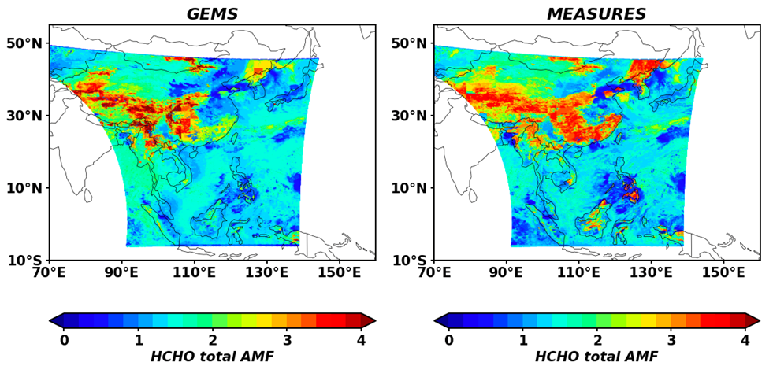
Test TEMPO Trace Gas
Algorithms with GEMS Data
Credit: Hyeong-Ahn Kwon
Comparison of GEMS HCHO Air Mass Factors (AMFs) with SAO calculated GEMS AMFs on June 1, 2021 at 6:45 UTC. Differences arise from using different a-priori profiles, and surface reflectance properties.

