Slide 1
Relevance of TEMPO to the upcoming SERVIR Central America hub
Betzy Hernández
Regional Science Coordination Lead - Central America
SERVIR Science Coordination Office
NASA MSFC

Slide 2
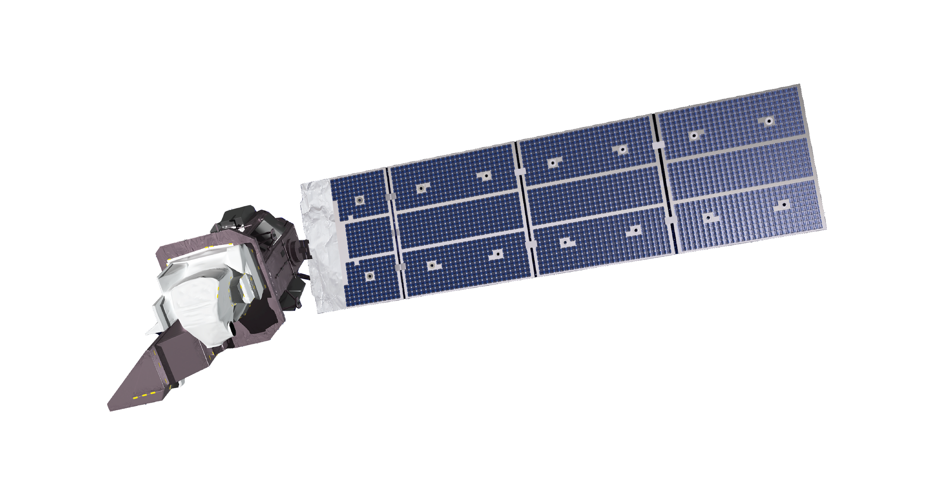













CONNECTING SPACE TO VILLAGE
SERVIR is a joint initiative of NASA, USAID, and leading geospatial organizations in Asia, Africa, and Latin America, that partners with countries and organizations in these regions to address critical challenges in climate change, food security, water and related disasters, land use, and air quality.
Using satellite data and geospatial technology, SERVIR co-develops innovative solutions through a network of regional hubs to improve resilience and sustainable resource management at local, national and regional scales.

Slide 3
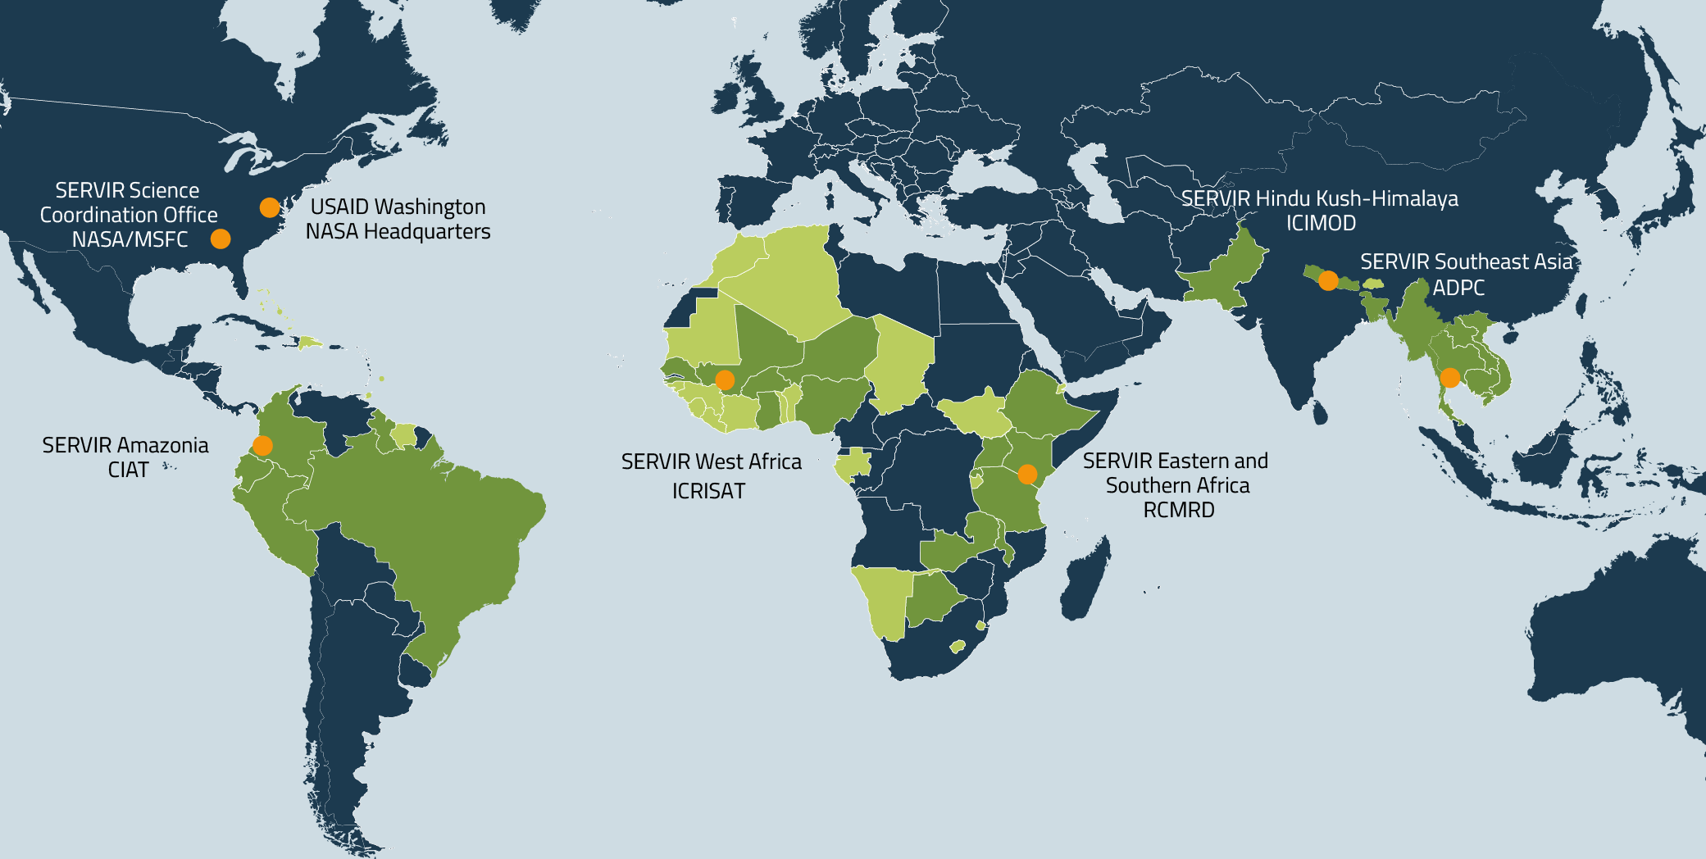
SERVIR Focuses on Countries in Asia, Africa, & the Americas
FOCUS COUNTRIES
ADDITIONAL OUTREACH

Slide 4


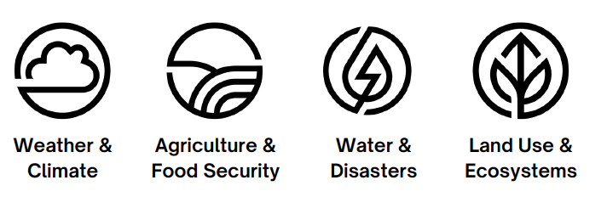
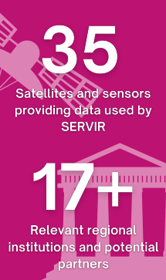
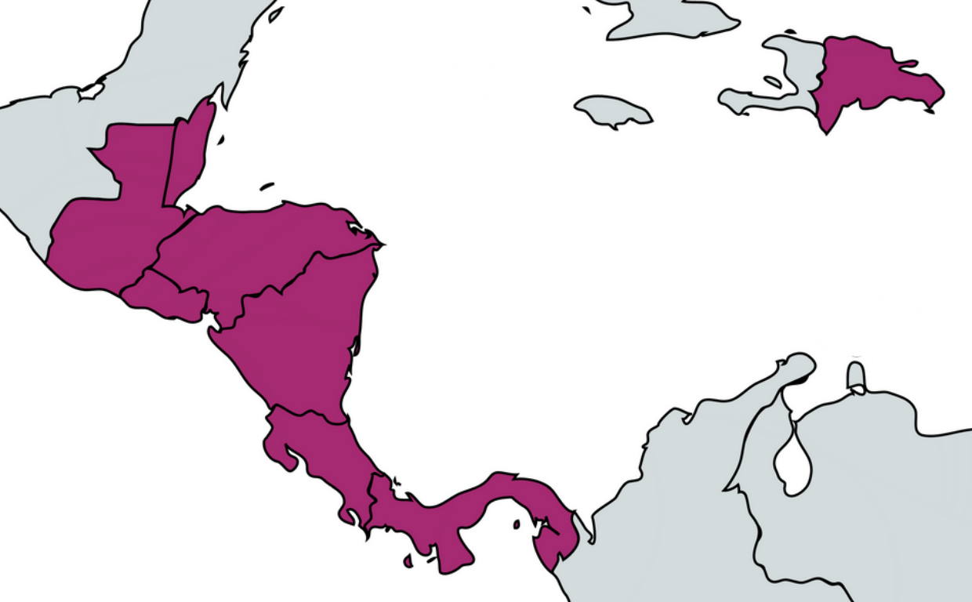

SERVIR Central America
OVERVIEW: SERVIR CA hub is a long-term initiative between the U.S.Agency for International Development, NASA, and relevant regional institutions. It will address regional climate mitigation, adaptation and resilience challenges through capacity development in the management of geospatial and remote sensing technologies.
VISION: SERVIR builds on the 2019 NASA-SICA joint statement with regional, national, and local institutions. The CA hub responds to the President’s Emergency Plan for Adaptation and Resilience (PREPARE) as a mechanism to increase resilience capacities and quality information to adapt to climate change impacts.
SERVIR four thematic service areas:
The SERVIR CA hub will also help build alliances with leading organizations in the region, taking advantage of existing initiatives, tools, and capacities in the region, minimizing duplication of efforts, and supporting the capacities of regional institutions.
Three-phase SERVIR CA design:
Phase 1 - Geospatial Assessment
Phase 2 - USAID/NASA IAA
Phase 3 - Establishment of SERVIR CA Hub

Slide 5
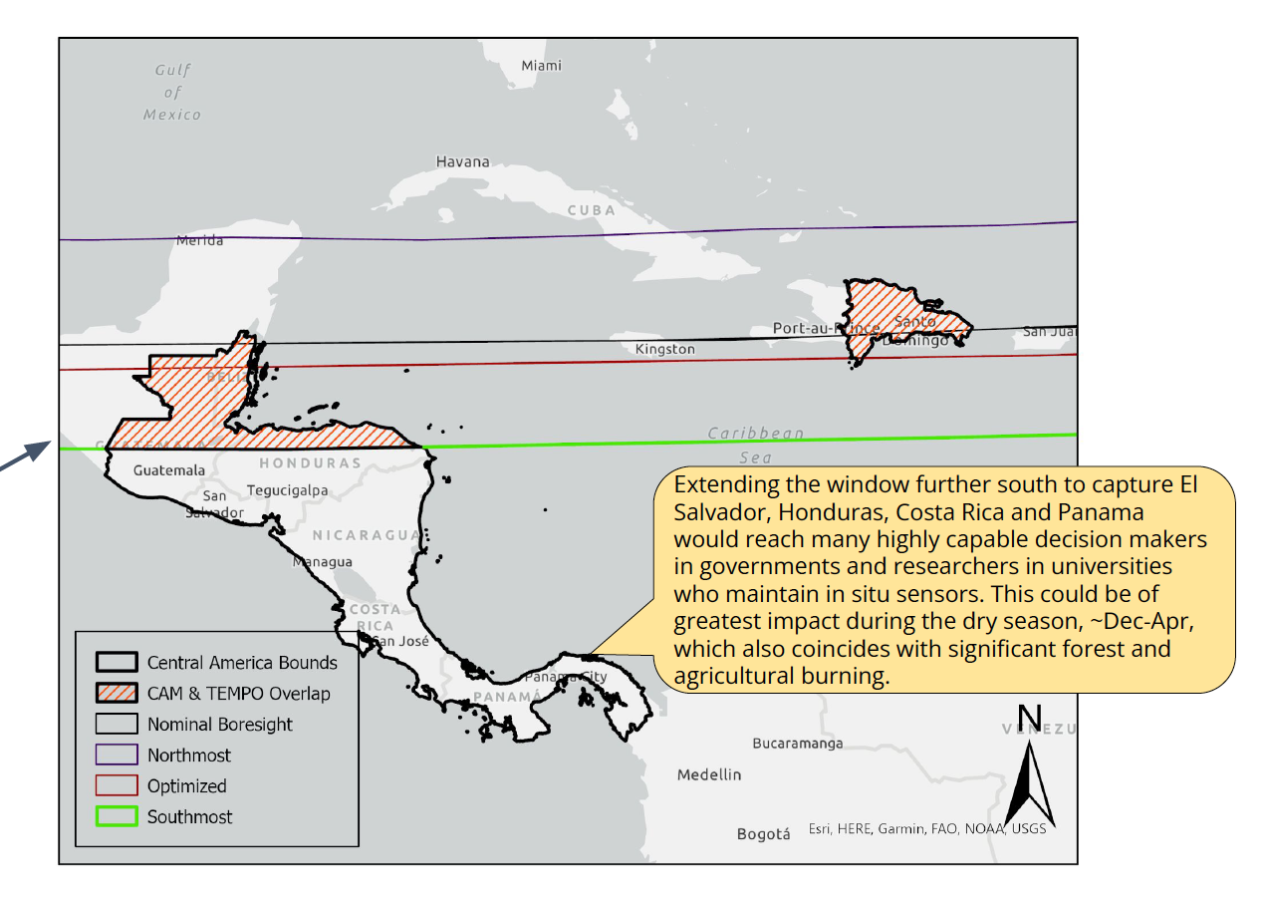
Central America synergies with TEMPO
Most critical TEMPO baseline or proposed products?
TEMPO data complementary to data (e.g., from GOES, MODIS, and VIIRS) that environmental + public health authorities in region already using
Likely interest in O₃, NO₂, SO₂, AOD, others
Value-added or research products?
Expanded domain to cover as much of Central America as possible
Early adopter activities to facilitate the collaboration?
CA representatives likely interested in participating as early adopters; have ground sensor data orig. funded by US EPA in ~2009, could potentially contribute for cal / val
Context: NASA and Central American Integration System (SICA) signed joint statement to collaborate on research, applications in 2019
SERVIR - including USAID CAM - could facilitate collaborations
Overlap between TEMPO and Central America domain (credit: Meryl Kruskopf / SERVIR)

