Slide 1
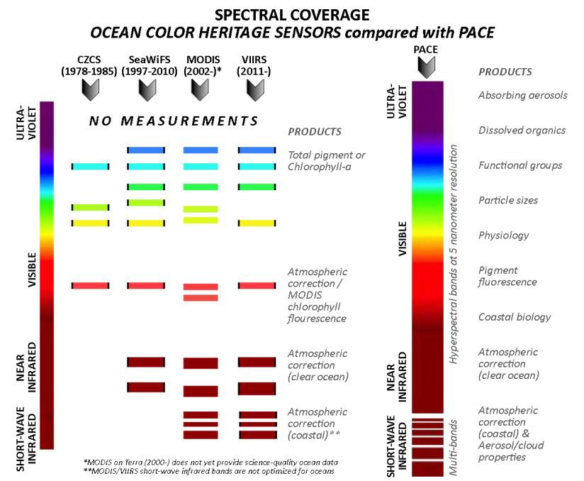
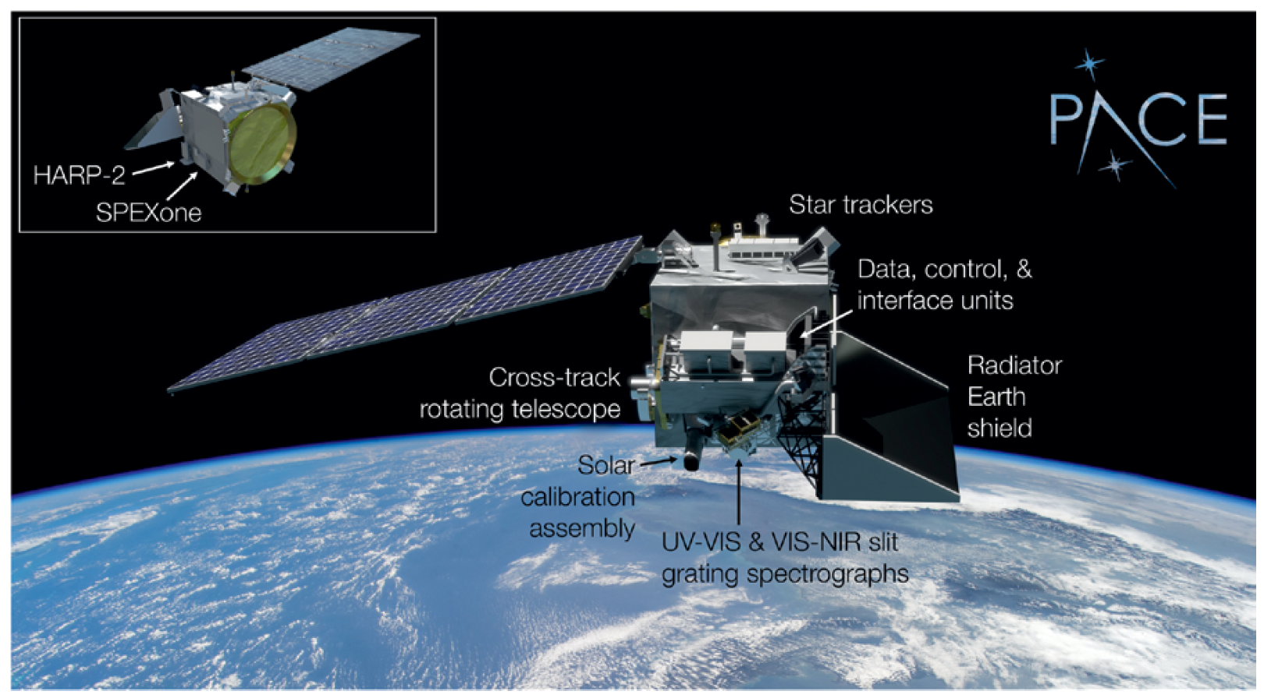
Plankton, Aerosol, Cloud, ocean Ecosystem (PACE) Observatory
Instruments:
  Hyperspectral imager: Ocean Color Instrument (OCI)- 5 nm for 340-890 nm at 2.5 nm steps
    2-day global coverage
    1 km² at nadir
  Two multi-angle polarimeters:
    HARP-2 (wide-swath, hyper-angular, 4 bands; 3km² nadir)
    SPEXone (Narrow swath, 5 viewing angles, hyperspectral (UV-NIR), 2.5km² nadir)
Data will be free & open to all
  Hosted at the GSFC Ocean Biology Distributed Active Archive Center (OB.DAAC)
Anticipated Launch: January 9, 2024
13:00 local Equatorial crossing; Global
3yr mission, BUT at least 10yrs of propellant
PACE is NASA’s next great investment to extend ocean biological, ecological, & biogeochemical data records, as well as cloud & aerosol data records!

Slide 2
Plankton, Aerosol, Cloud, ocean Ecosystem (PACE)
What products are of interest for a PACE – TEMPO synergy?
PACE Measurement | Applications
Aerosol/Trace Gas properties
Aerosol Optical Depth | Air Quality, Visibility, Public Health
Aerosol Size Distribution | Air Quality, Public Health
Aerosol type | Air Quality, Visibility
Aerosol layer height | Air Quality, Pollution Transport, Public Health
Aerosol absorption from UV | Air Quality, Public Health
Trace gases – Ozone, NO2, H₂O [Column measurements] | Air Quality, Public Health, Modeling
Solar Energy Availability | Renewable Energy (Cloud Products)
*Stratospheric aerosol concentration | Climate modeling
Disaster monitoring/response
Imagery | Disaster Monitoring/Hazard Warning
  Aerosol products:
    PACE retrievals could be used as a point of comparison to "anchor" *proposed* TEMPO aerosol retrievals in the large areas within the open USA where there aren't many AERONET sites. TEMPO would give diurnal cycle of aerosol amount and height, and PACE would provide a better (probably) and slightly finer spatial resolution reference around lunch time.
  NO2 (conceptually):
    TEMPO could be used to look at diurnal variations in emissions and with averaging, the PACE data may be used for downscaling to even higher spatial resolution around polluted areas. This could be helpful in assessing environmental inequities.
  Combining L1 observations to increase information content and retrieval capabilities
    Combining the hyperspectral measurements of TEMPO with the vis, swir, and TIR on the geostationary ABI GOES east and west platforms. Adding PACE would cover essentially the whole relevant spectrum, multi angles, polarization, etc. and could do some very well-constrained retrievals.
Notes:
Aerosol products:
PACE should be more capable due to the wider spectral range of OCI + polarimeters.
to stress that many algorithms are in development, and what will be available at launch will be different than a few years down the road

Slide 3

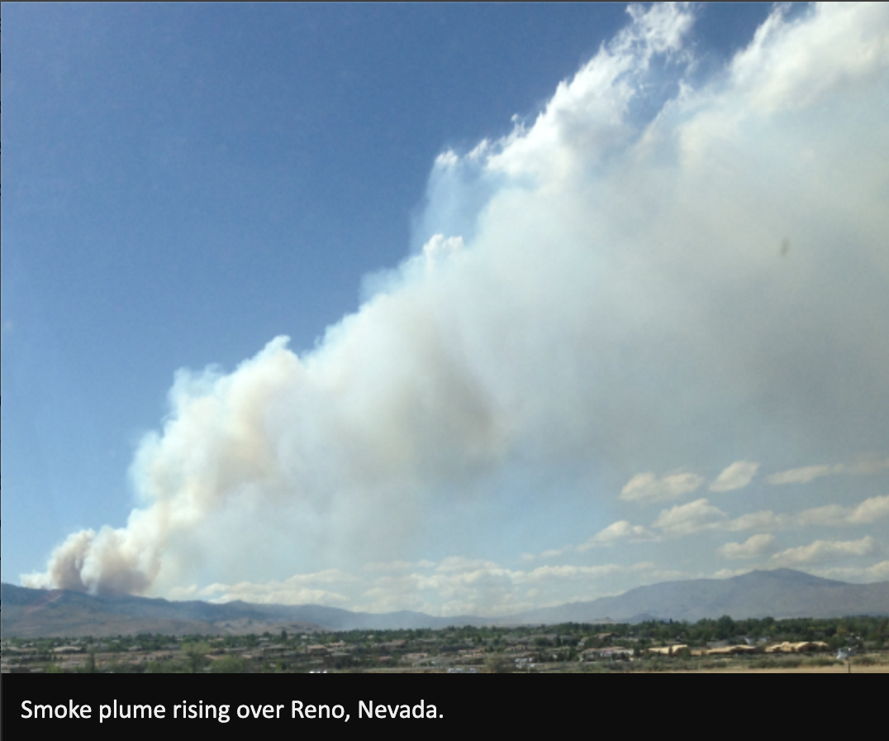
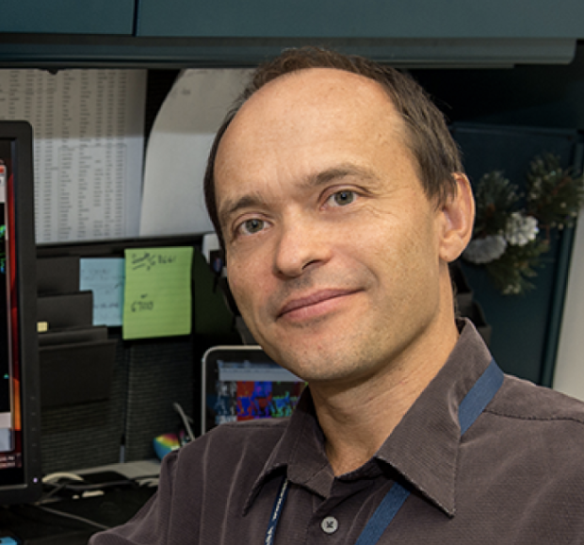
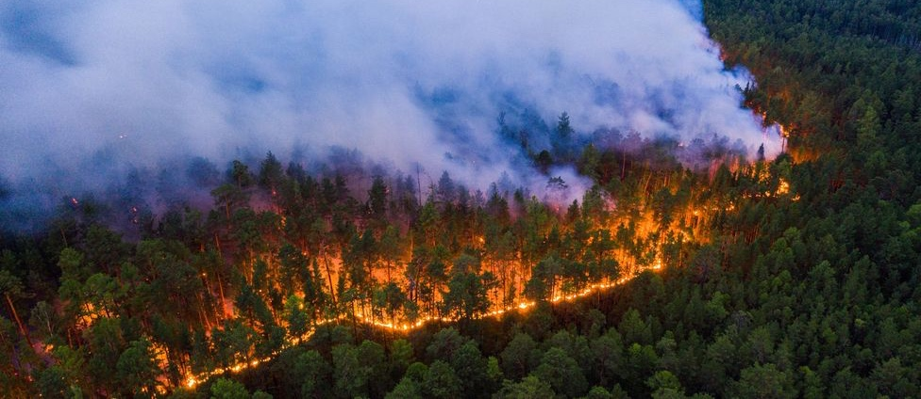
Smoke Plume Monitoring & Modeling
What are the enhanced applications that can be achieved by a PACE – TEMPO synergy?
Combining the high temporal resolution of TEMPO AOD with higher accuracy of PACE AOD data could improve the characterization of health assessments due to smoke exposure and allow a better characterization of the aerosol sources, distribution, and transport.
Tropospheric Ozone reduces visibility and affects human health. O3 can be produced by primary emissions in the troposphere from nitrogen oxide emissions and smoke can also form ozone through secondary formation. TEMPO data on gases could be fused with PACE aerosol information to infer and create maps of toxic ozone for local AQ agencies.
PACE mission has products such as absorption optical depth, and TEMPO has a smoke plume top. Combining both could help to understand the consequences of transport and aged smoke on human health.
PACE EA
Marcela Loria, PhD
University of Oklahoma
Toward Understanding the Effect of Aerosols on Regional Weather & Human Health in the SGP
(Credit: Marcella Loria/UO)
PACE SAT
Alexei Lyapustin, PhD
NASA GSFC
High Resolution Aerosol Retrievals and Atmospheric Correction
Smoke from fires in Siberia has blown as far as Alaska, Canada and US cities (Credit: Julia Petrenko/Greenpeace)
Notes:
(ex- Ozone has a higher impact on acute health cases than particulate matter & affects the visibility in many NPs).
The advantage of combining TEMPO and PACE retrievals is that many Air Quality local agencies are more trained to read spatial maps of O3 and particulate matter than the spectral picks of gases (expensive instruments).
Would the TEMPO special operations (e.g., < 10 min scans over slices of TEMPO Field of Regard) further enhance the mission or program synergy? How?
Not likely super useful to us. PACE would take about 20 mins to cross the TEMPO view area south to north. So you could get more precise time matchups but likely not a huge amount changes within 20 mins anyway (except clouds moving a few pixels)

