Slide 1
TEMPO’s Synergy with TROPICS
Patrick Duran, TROPICS Mission Applications Lead

Slide 2
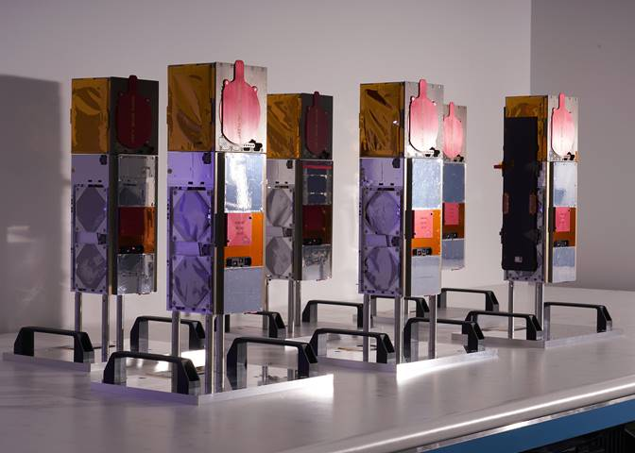
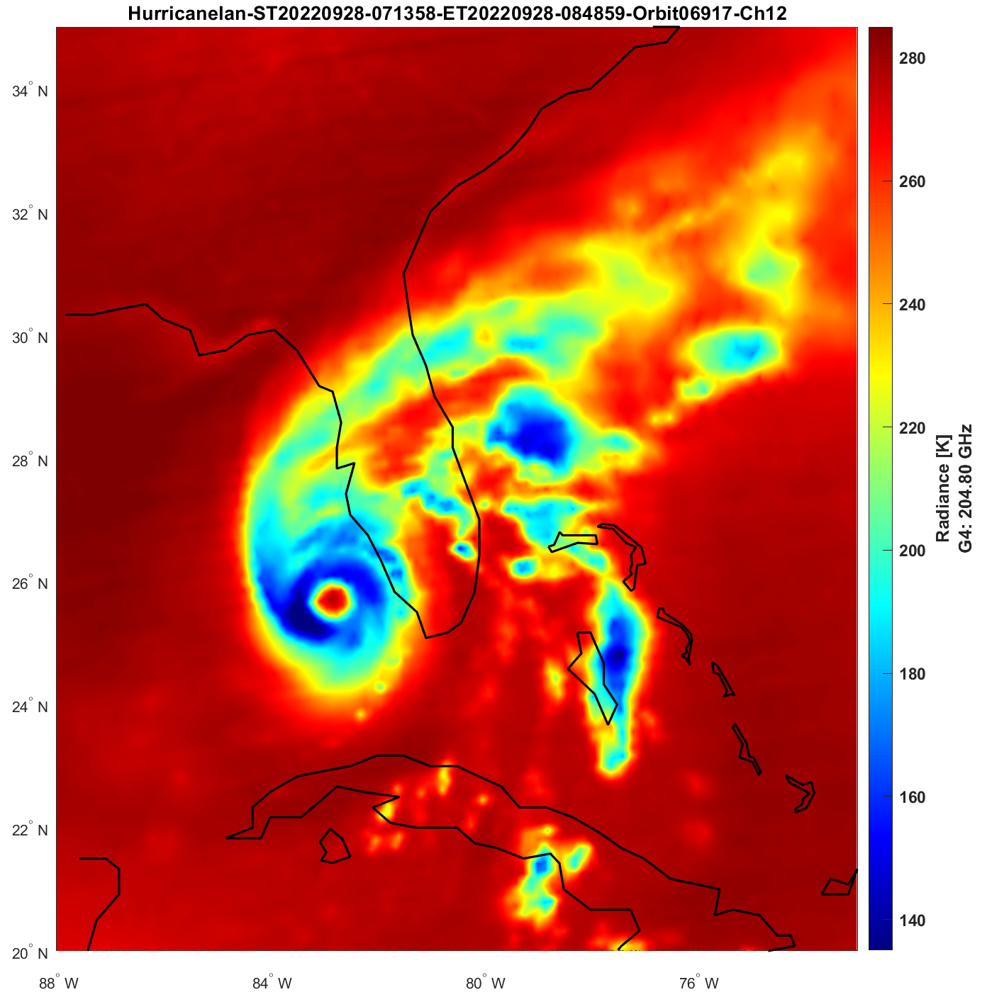
Time-Resolved Observations of Precipitation Structure and Storm Intensity with a Constellation of Smallsats
Constellation of four 3U CubeSats containing microwave radiometers with 12 channels (91-205 GHz)
Designed to provide high temporal resolution over the tropics, with a 60-minute median revisit rate
The TROPICS Pathfinder was launched June 30, 2021 into a sun-synchronous orbit
Remaining 4 satellites are set to be launched in May 2023 into a 30-degree inclined orbit
Primary products:
Brightness temperature (205-GHz image of Hurricane Ian observed by TROPICS Pathfinder shown on the right) →
Vertical profiles of temperature and humidity
Rain rate
Images of TROPICS satellites and Pathfinder image of Hurricane Ian (Courtesy Bill Blackwell, MIT LL, TROPICS PI)

Slide 3
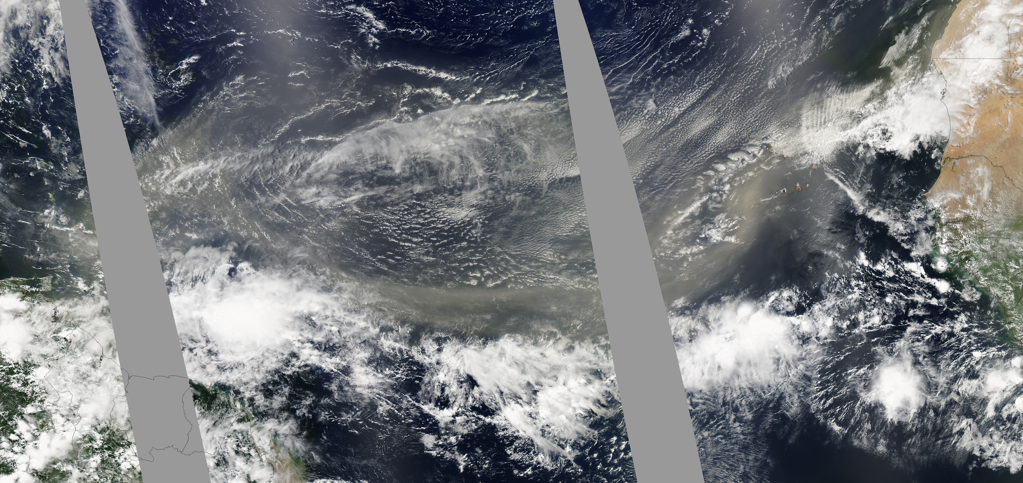
Time-Resolved Observations of Precipitation Structure and Storm Intensity with a Constellation of Smallsats
Synergies with TEMPO: Saharan Air Layer
The Saharan Air Layer (SAL) is a region of dry, dusty air that originates in the Sahara Desert and can extend across the Atlantic Ocean to the Caribbean and US.
Signifies a region of dry air that is important in predicting tropical cyclones and tropical convection.
TEMPO aerosol optical depth and aerosol optical centroid height, when combined with TROPICS vertical profiles of temperature and humidity, could yield a unique 4-dimensional view the SAL’s evolution.
Image courtesy NASA Earth Observatory

Slide 4
Time-Resolved Observations of Precipitation Structure and Storm Intensity with a Constellation of Smallsats
Synergies with TEMPO: Troposphere-Stratosphere Exchange
Atmospheric convection and radiative processes in tropopause-layer cirrus clouds can induce troposphere-stratosphere exchange.
Combining TEMPO’s vertical profiles of ozone with brightness temperatures and vertical temperature/humidity profiles from TROPICS could provide new insight into how deep convection and cirrus-radiative processes affect troposphere-stratosphere exchange.

