Slide 1

Can satellite-based surface PM_{2.5} estimates inform public policy?
H. Zhang¹, M. Cheeseman¹, P. Ciren¹, S. Kondragunta²
¹IMSG@NOAA | ²NOAA
Disclaimer: The scientific results and conclusions, as well as any views or opinions expressed
herein, are those of the author(s) and do not necessarily reflect those of NOAA or
the Department of Commerce.

Slide 2
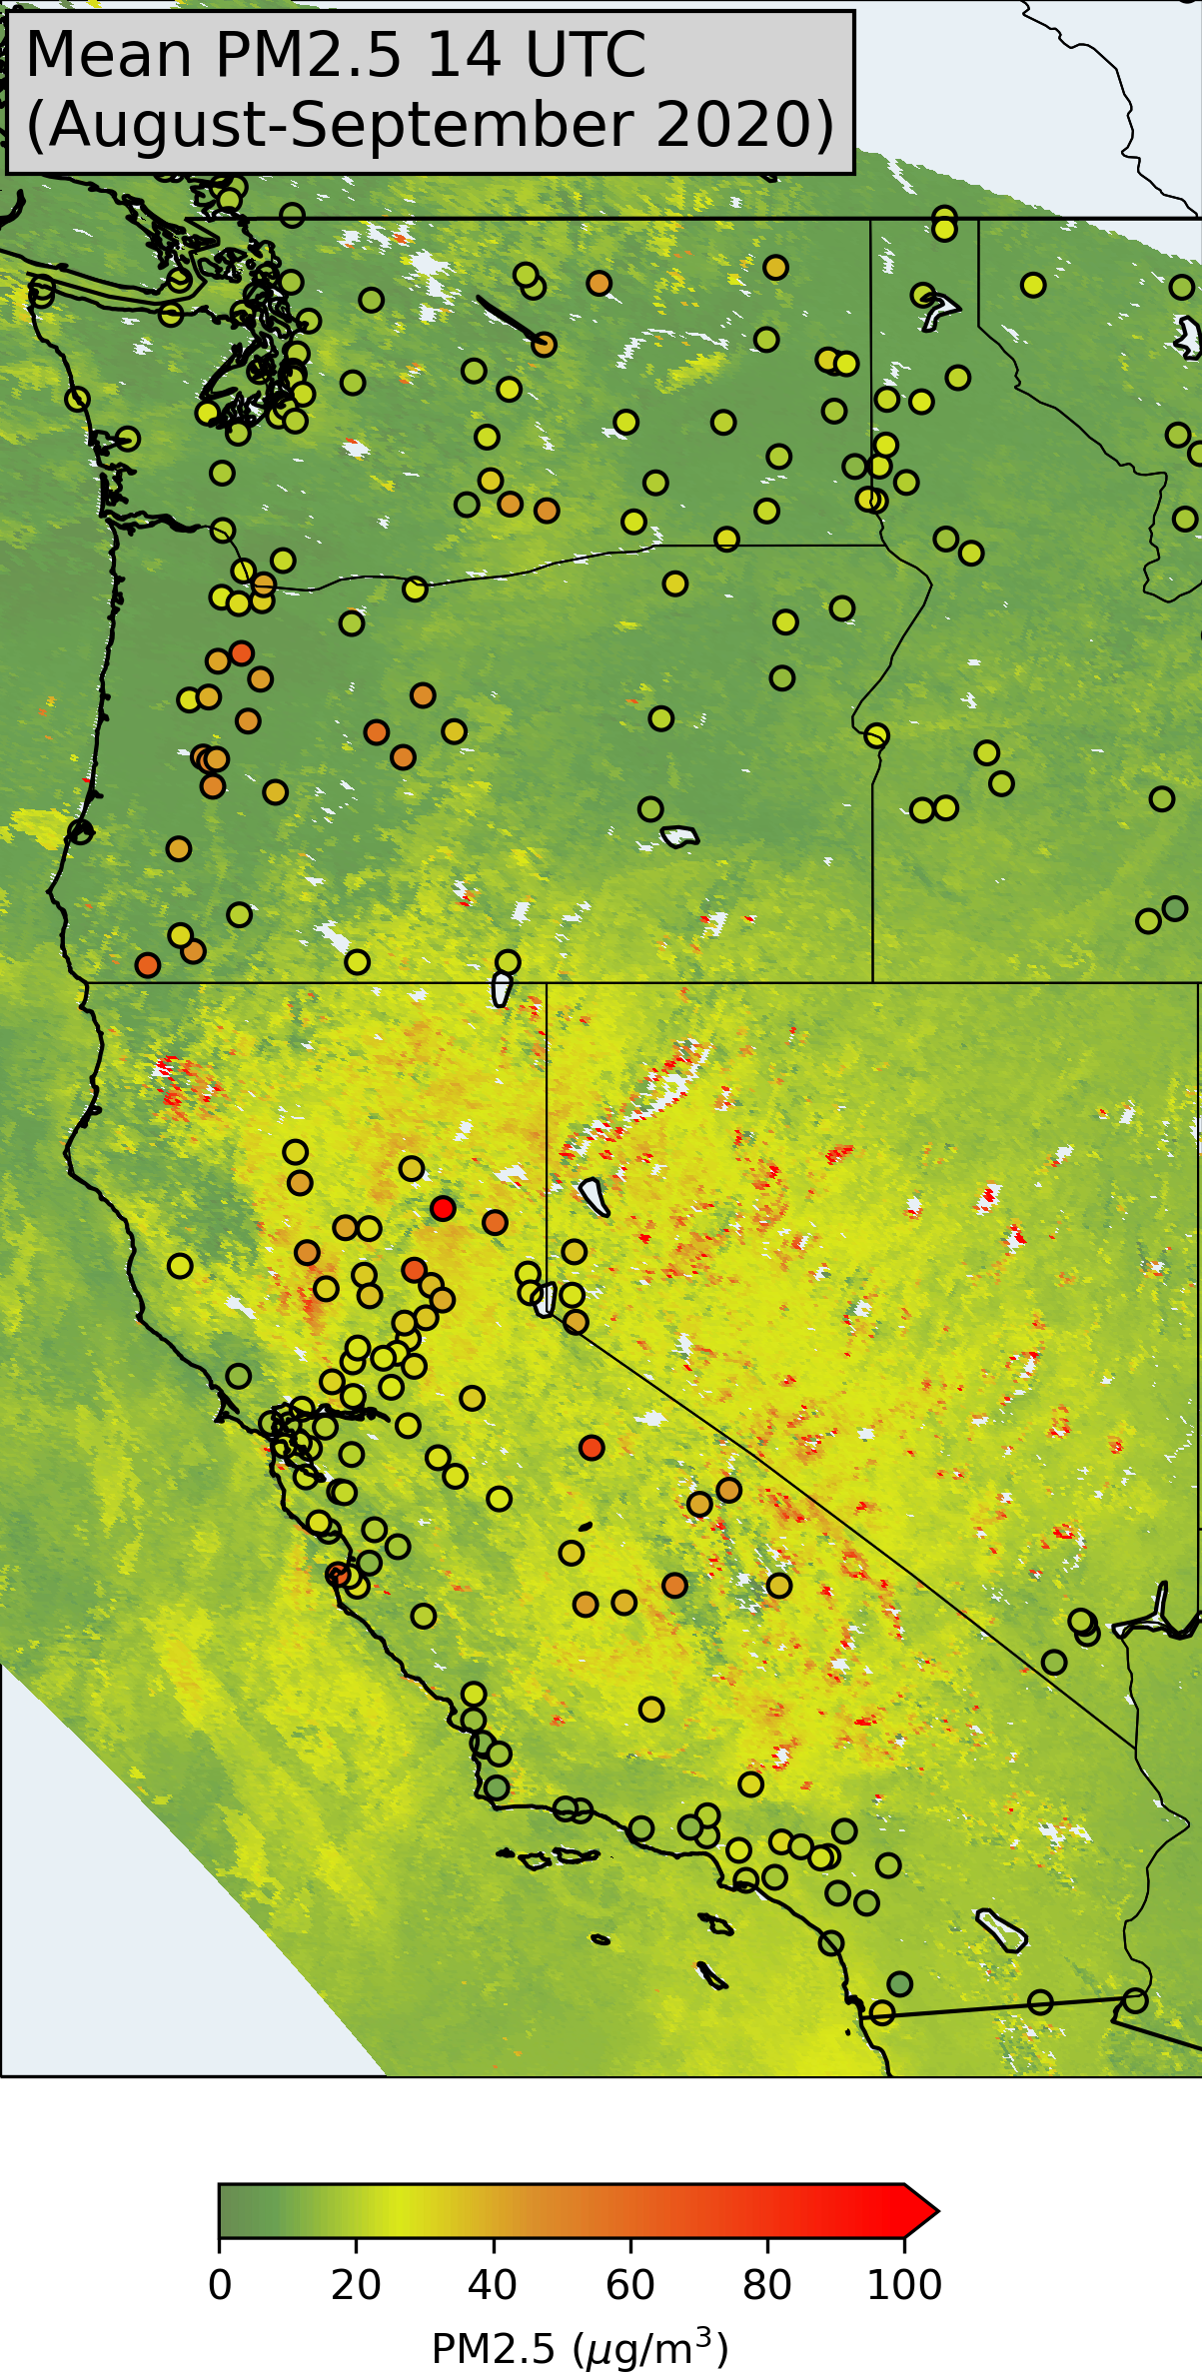
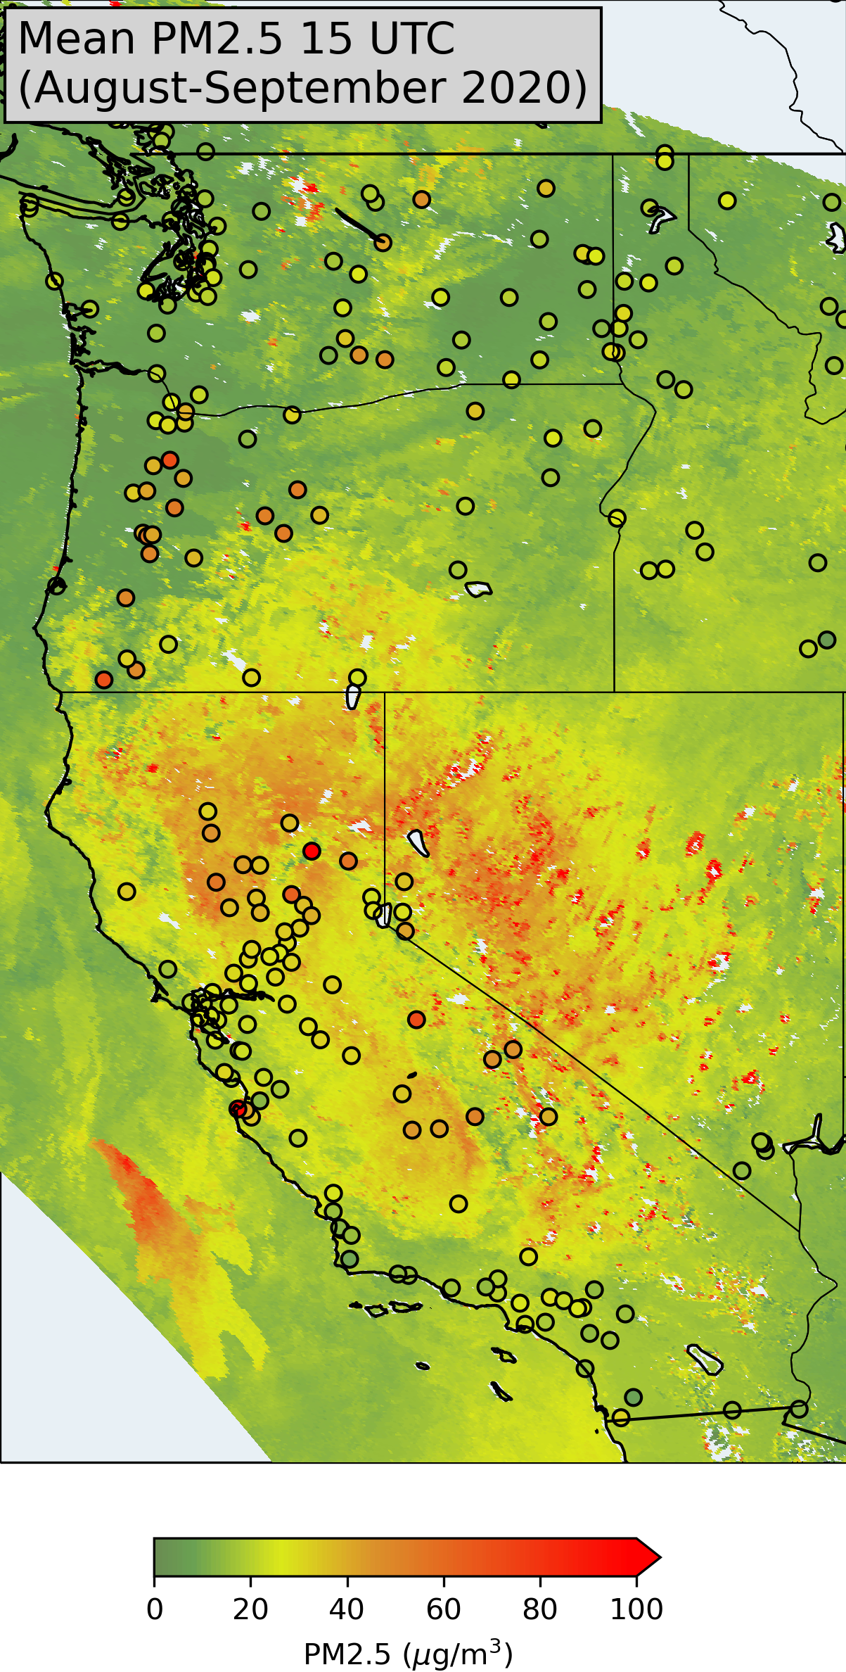
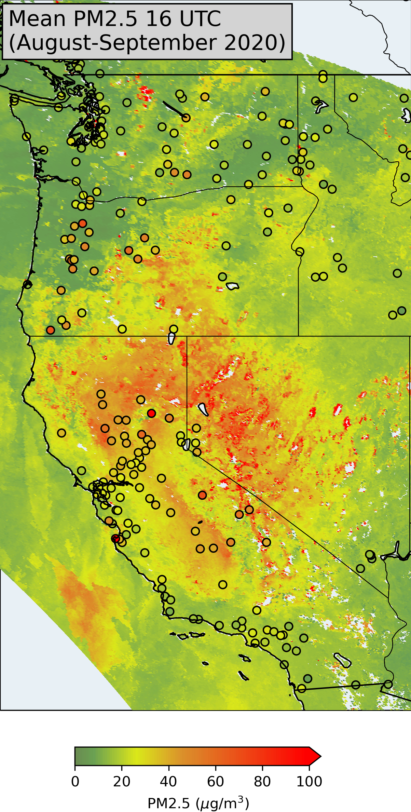
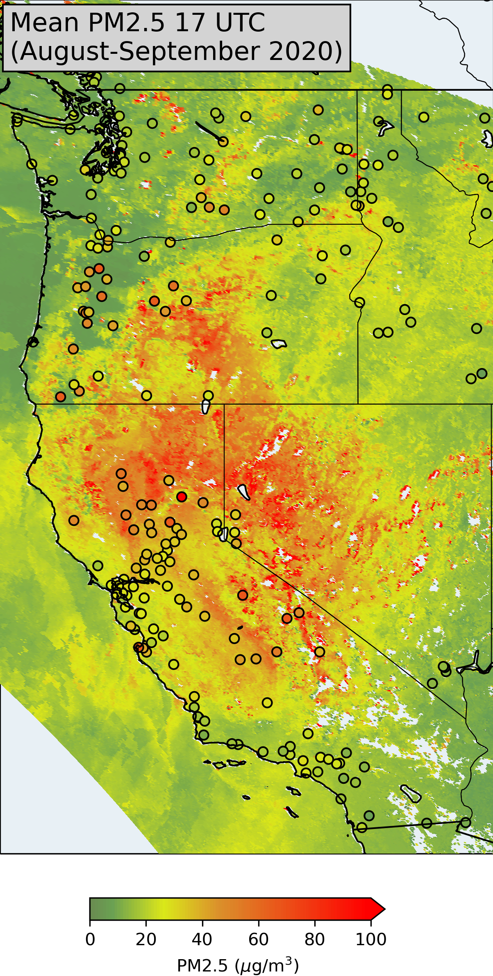
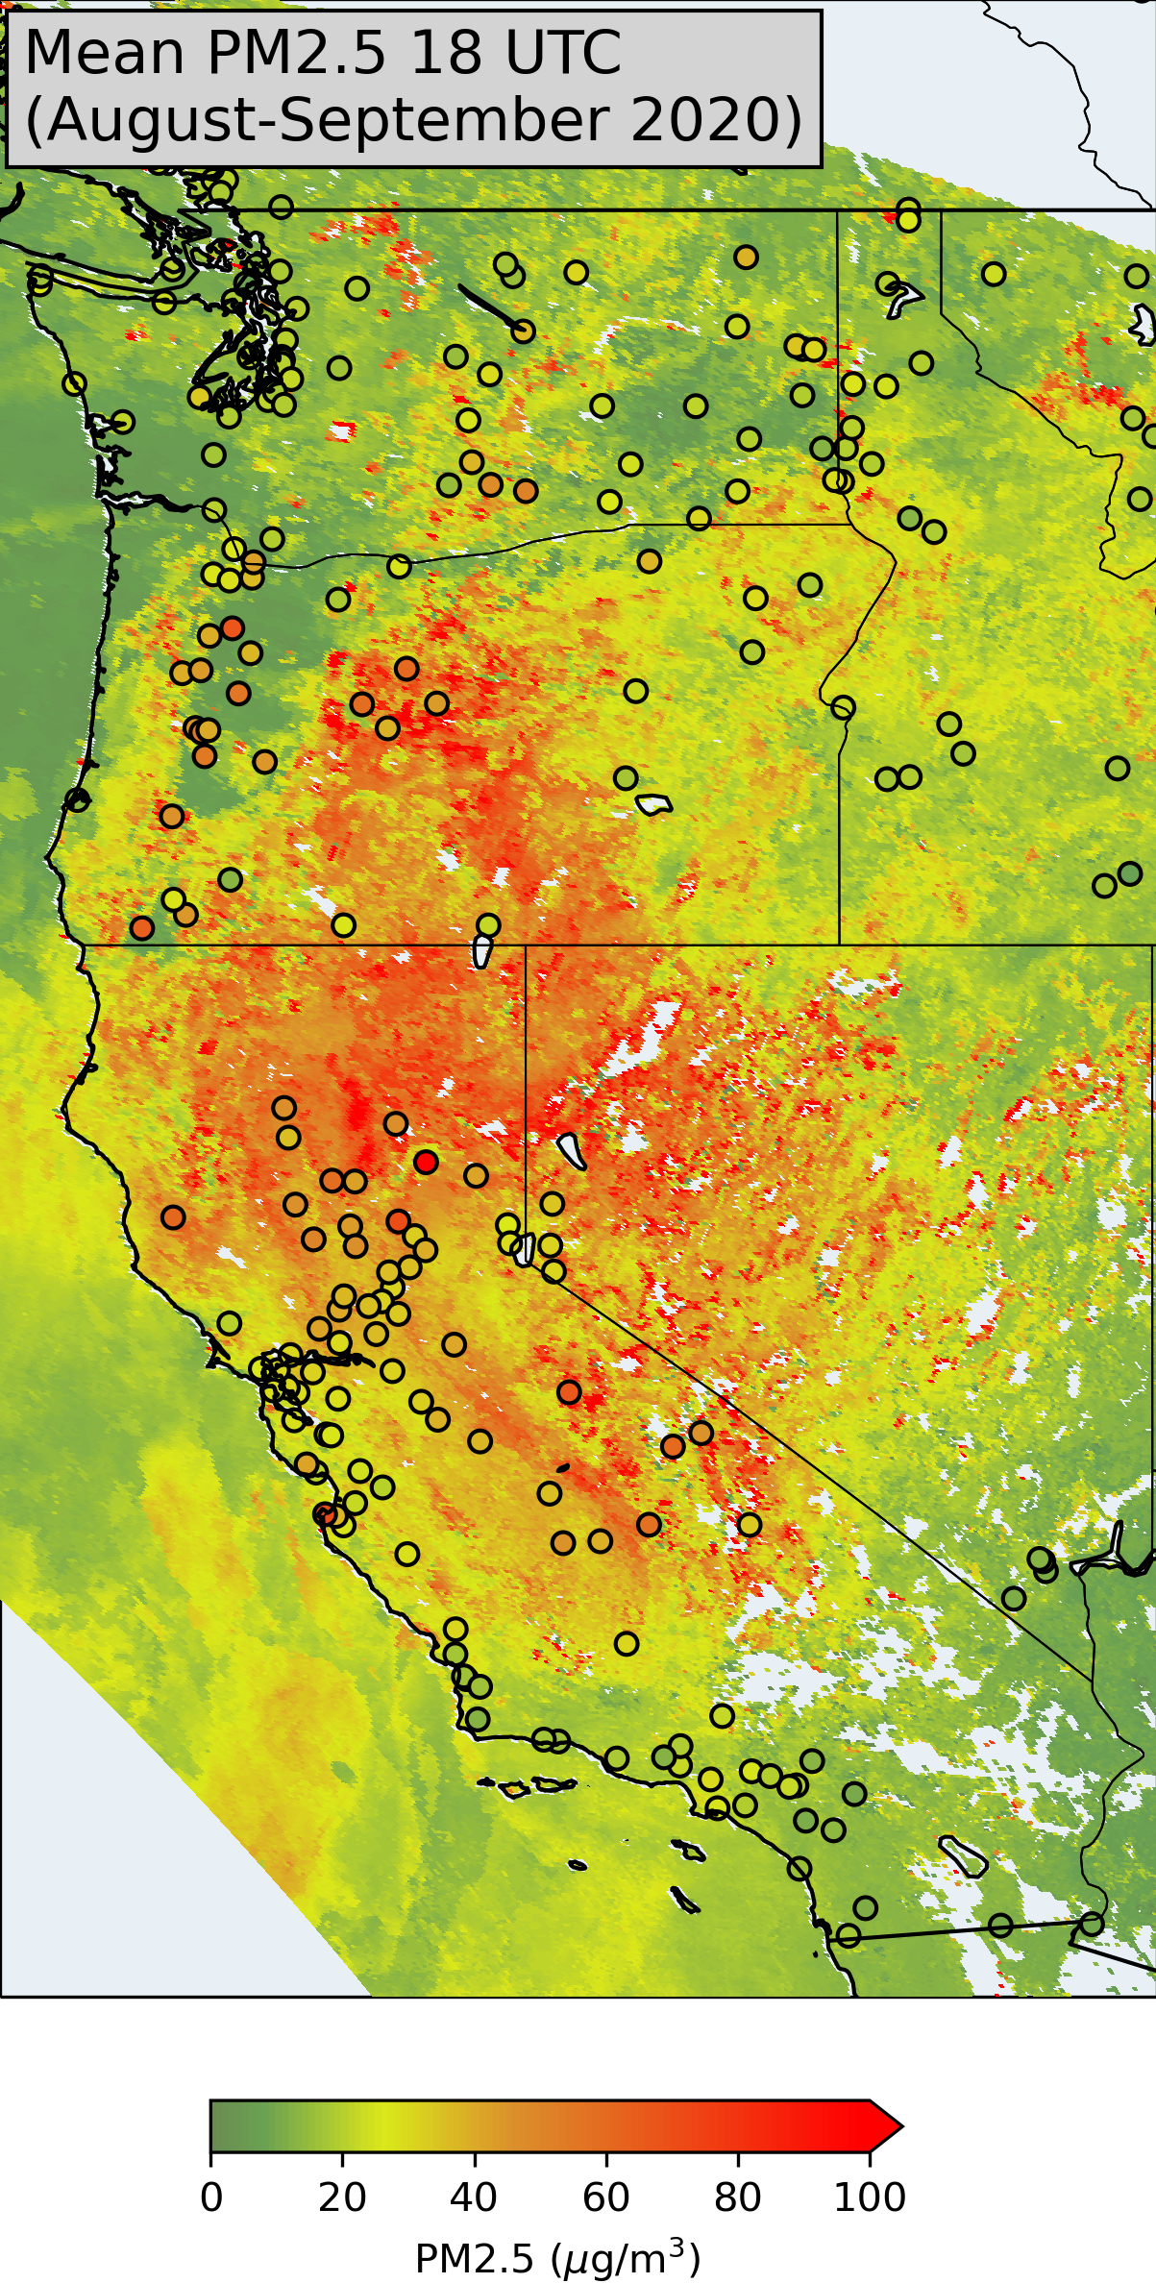
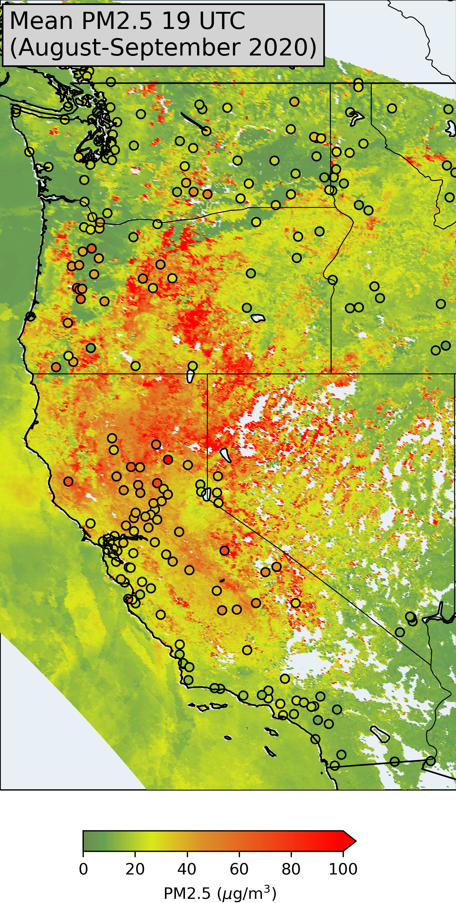
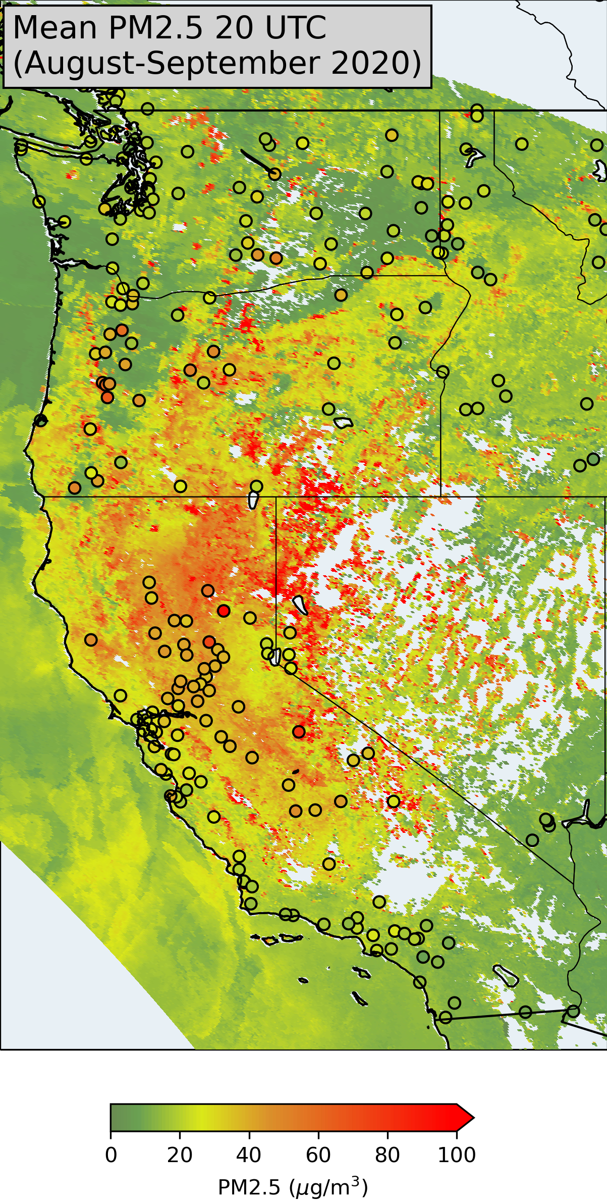
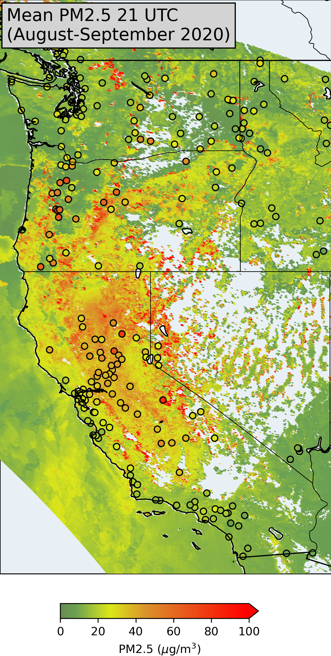
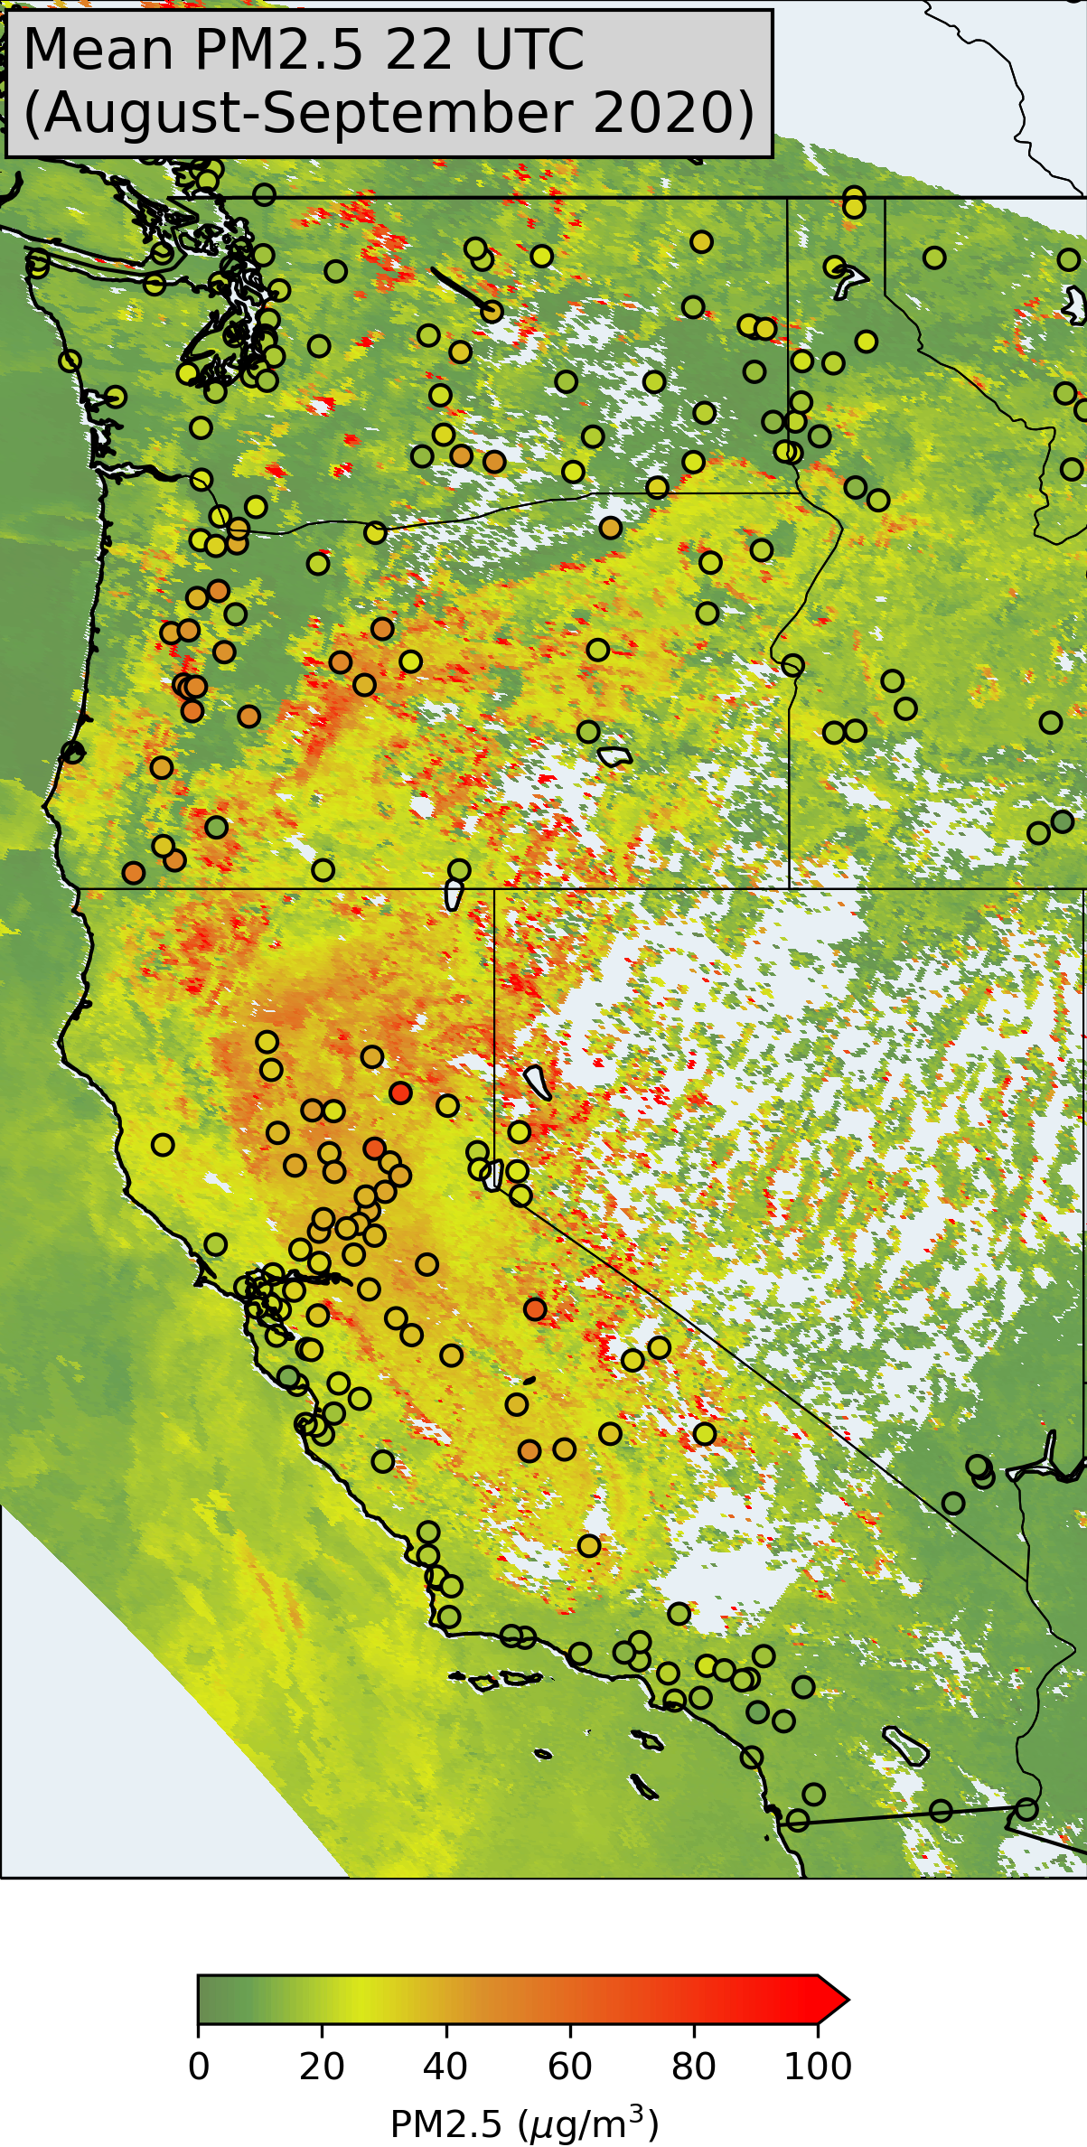
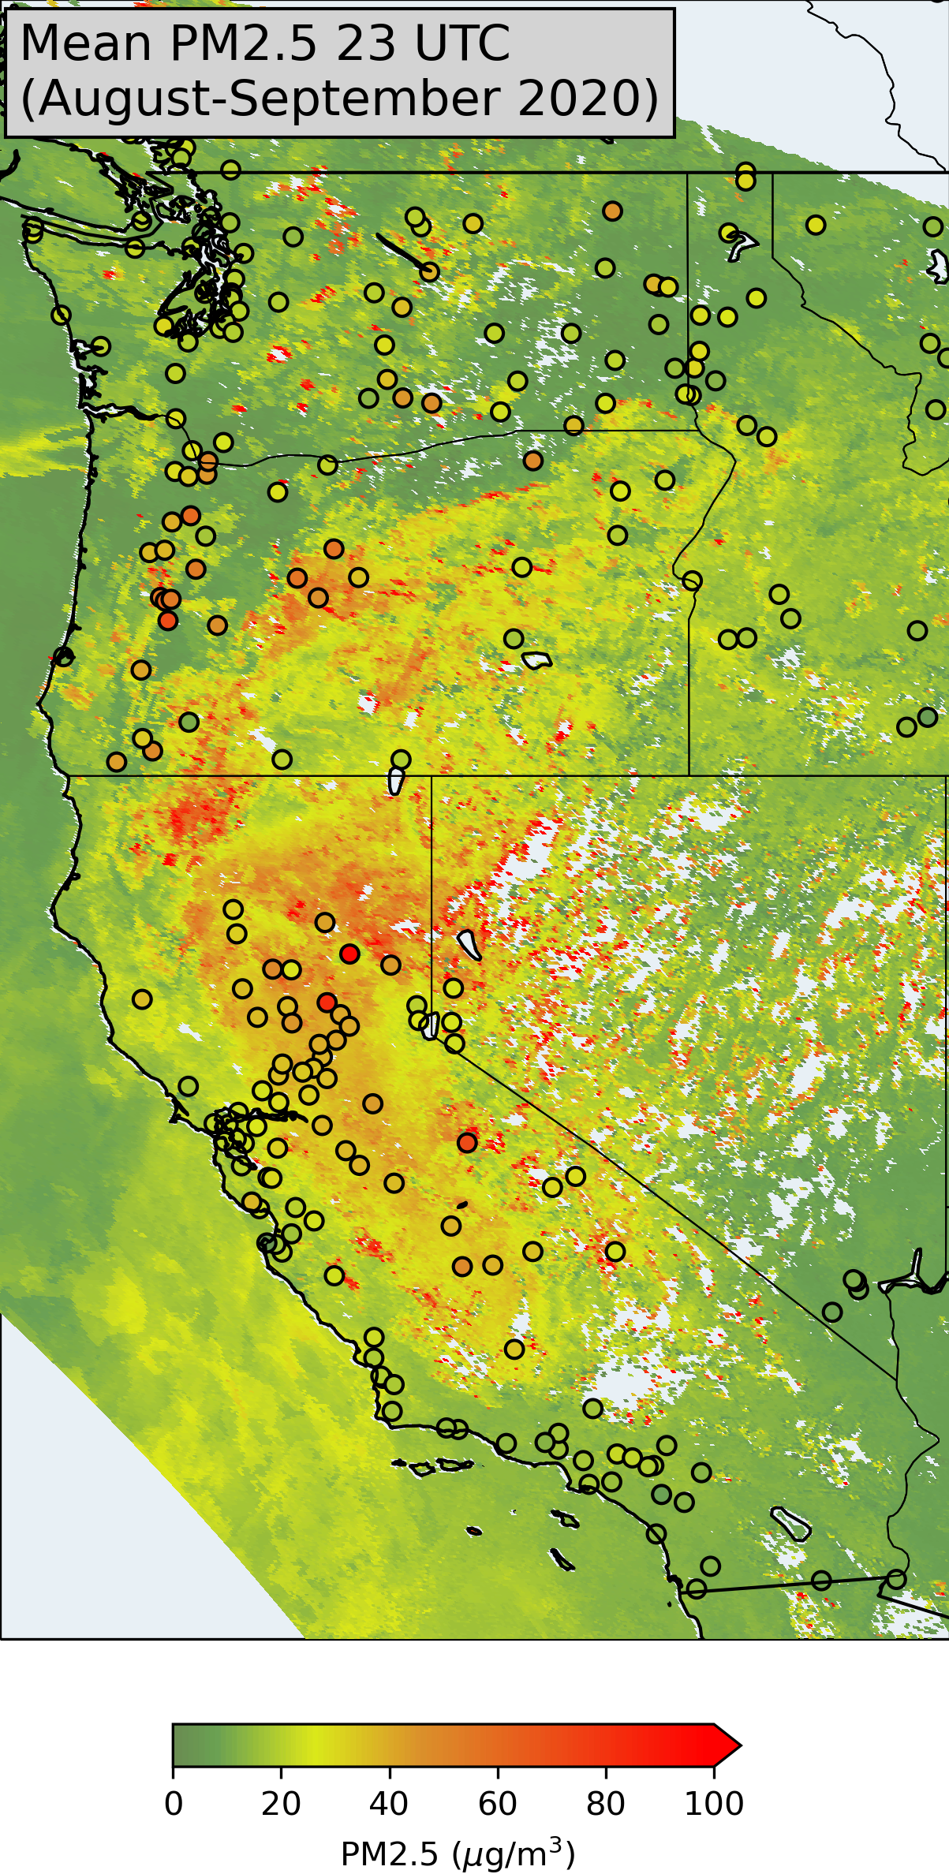
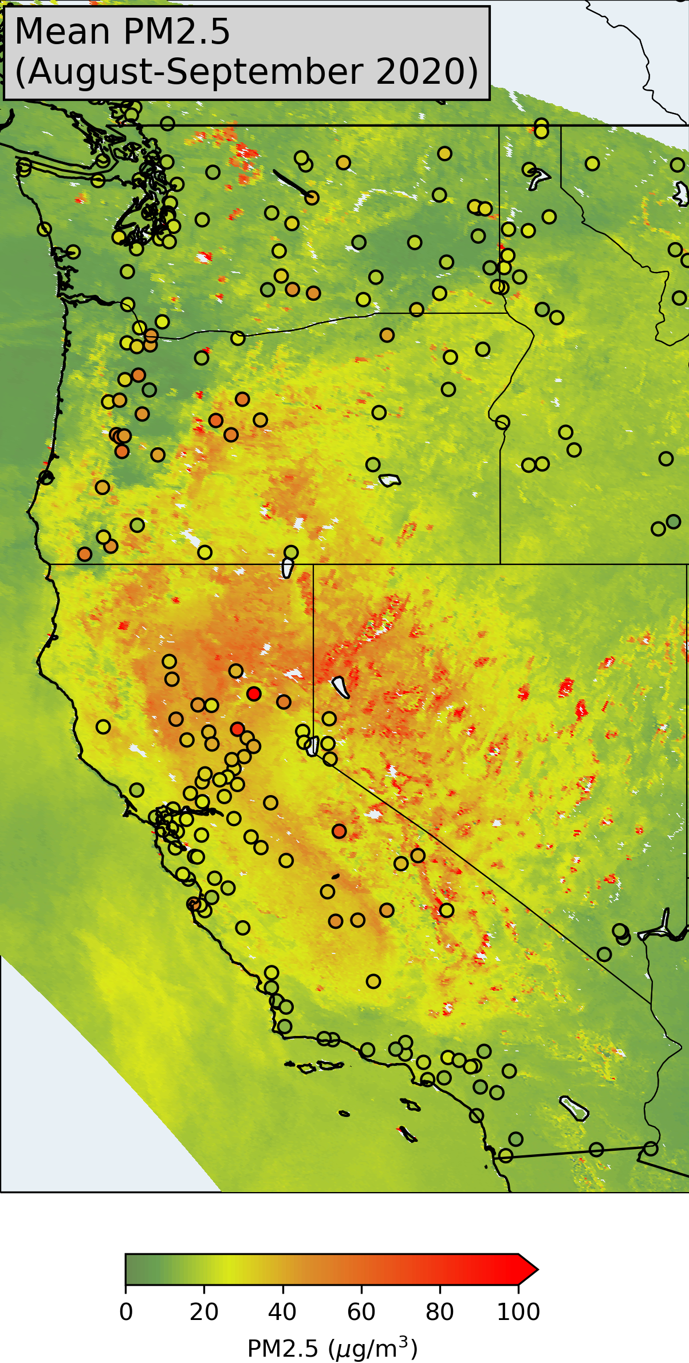
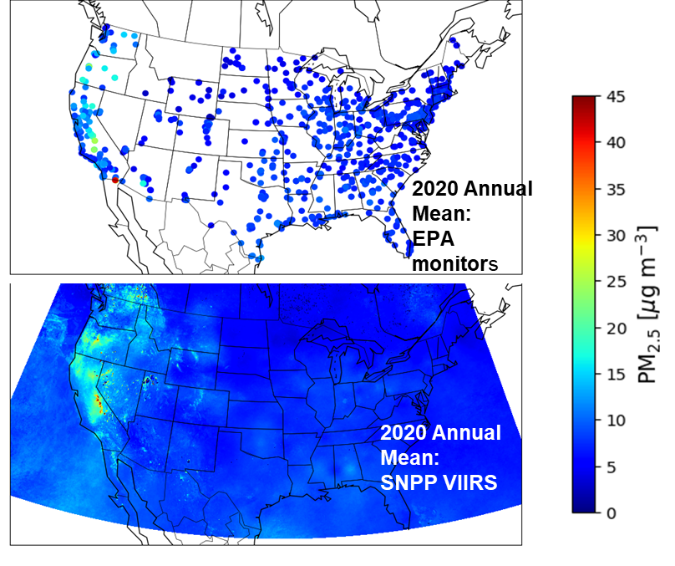

Slide 3
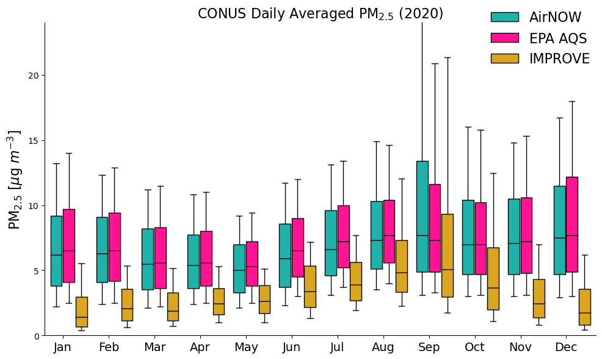

Slide 4
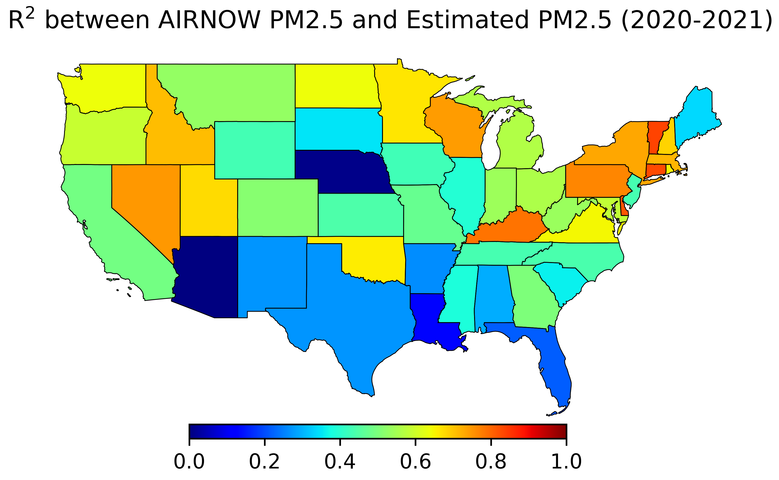
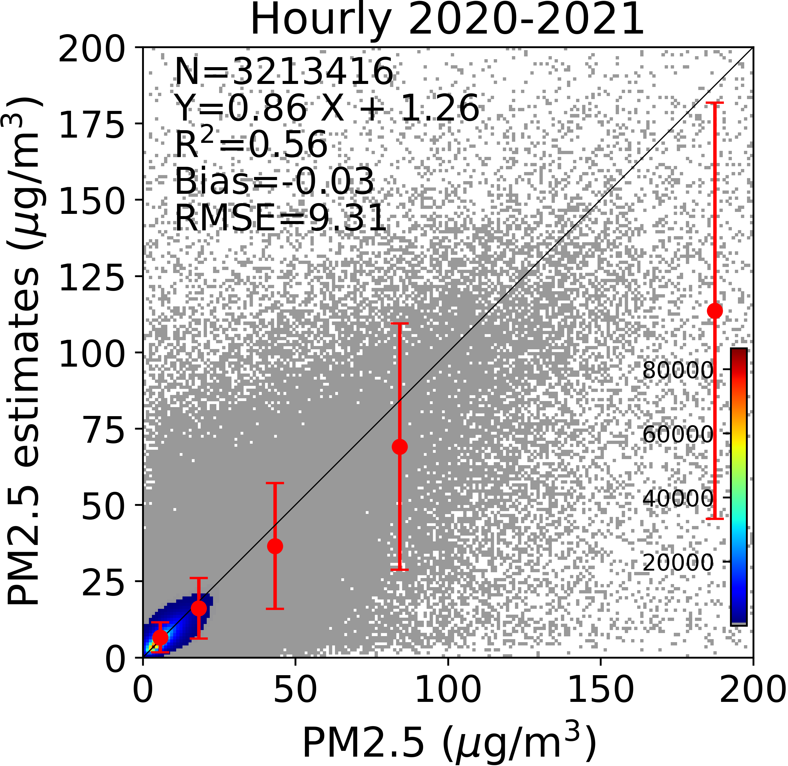
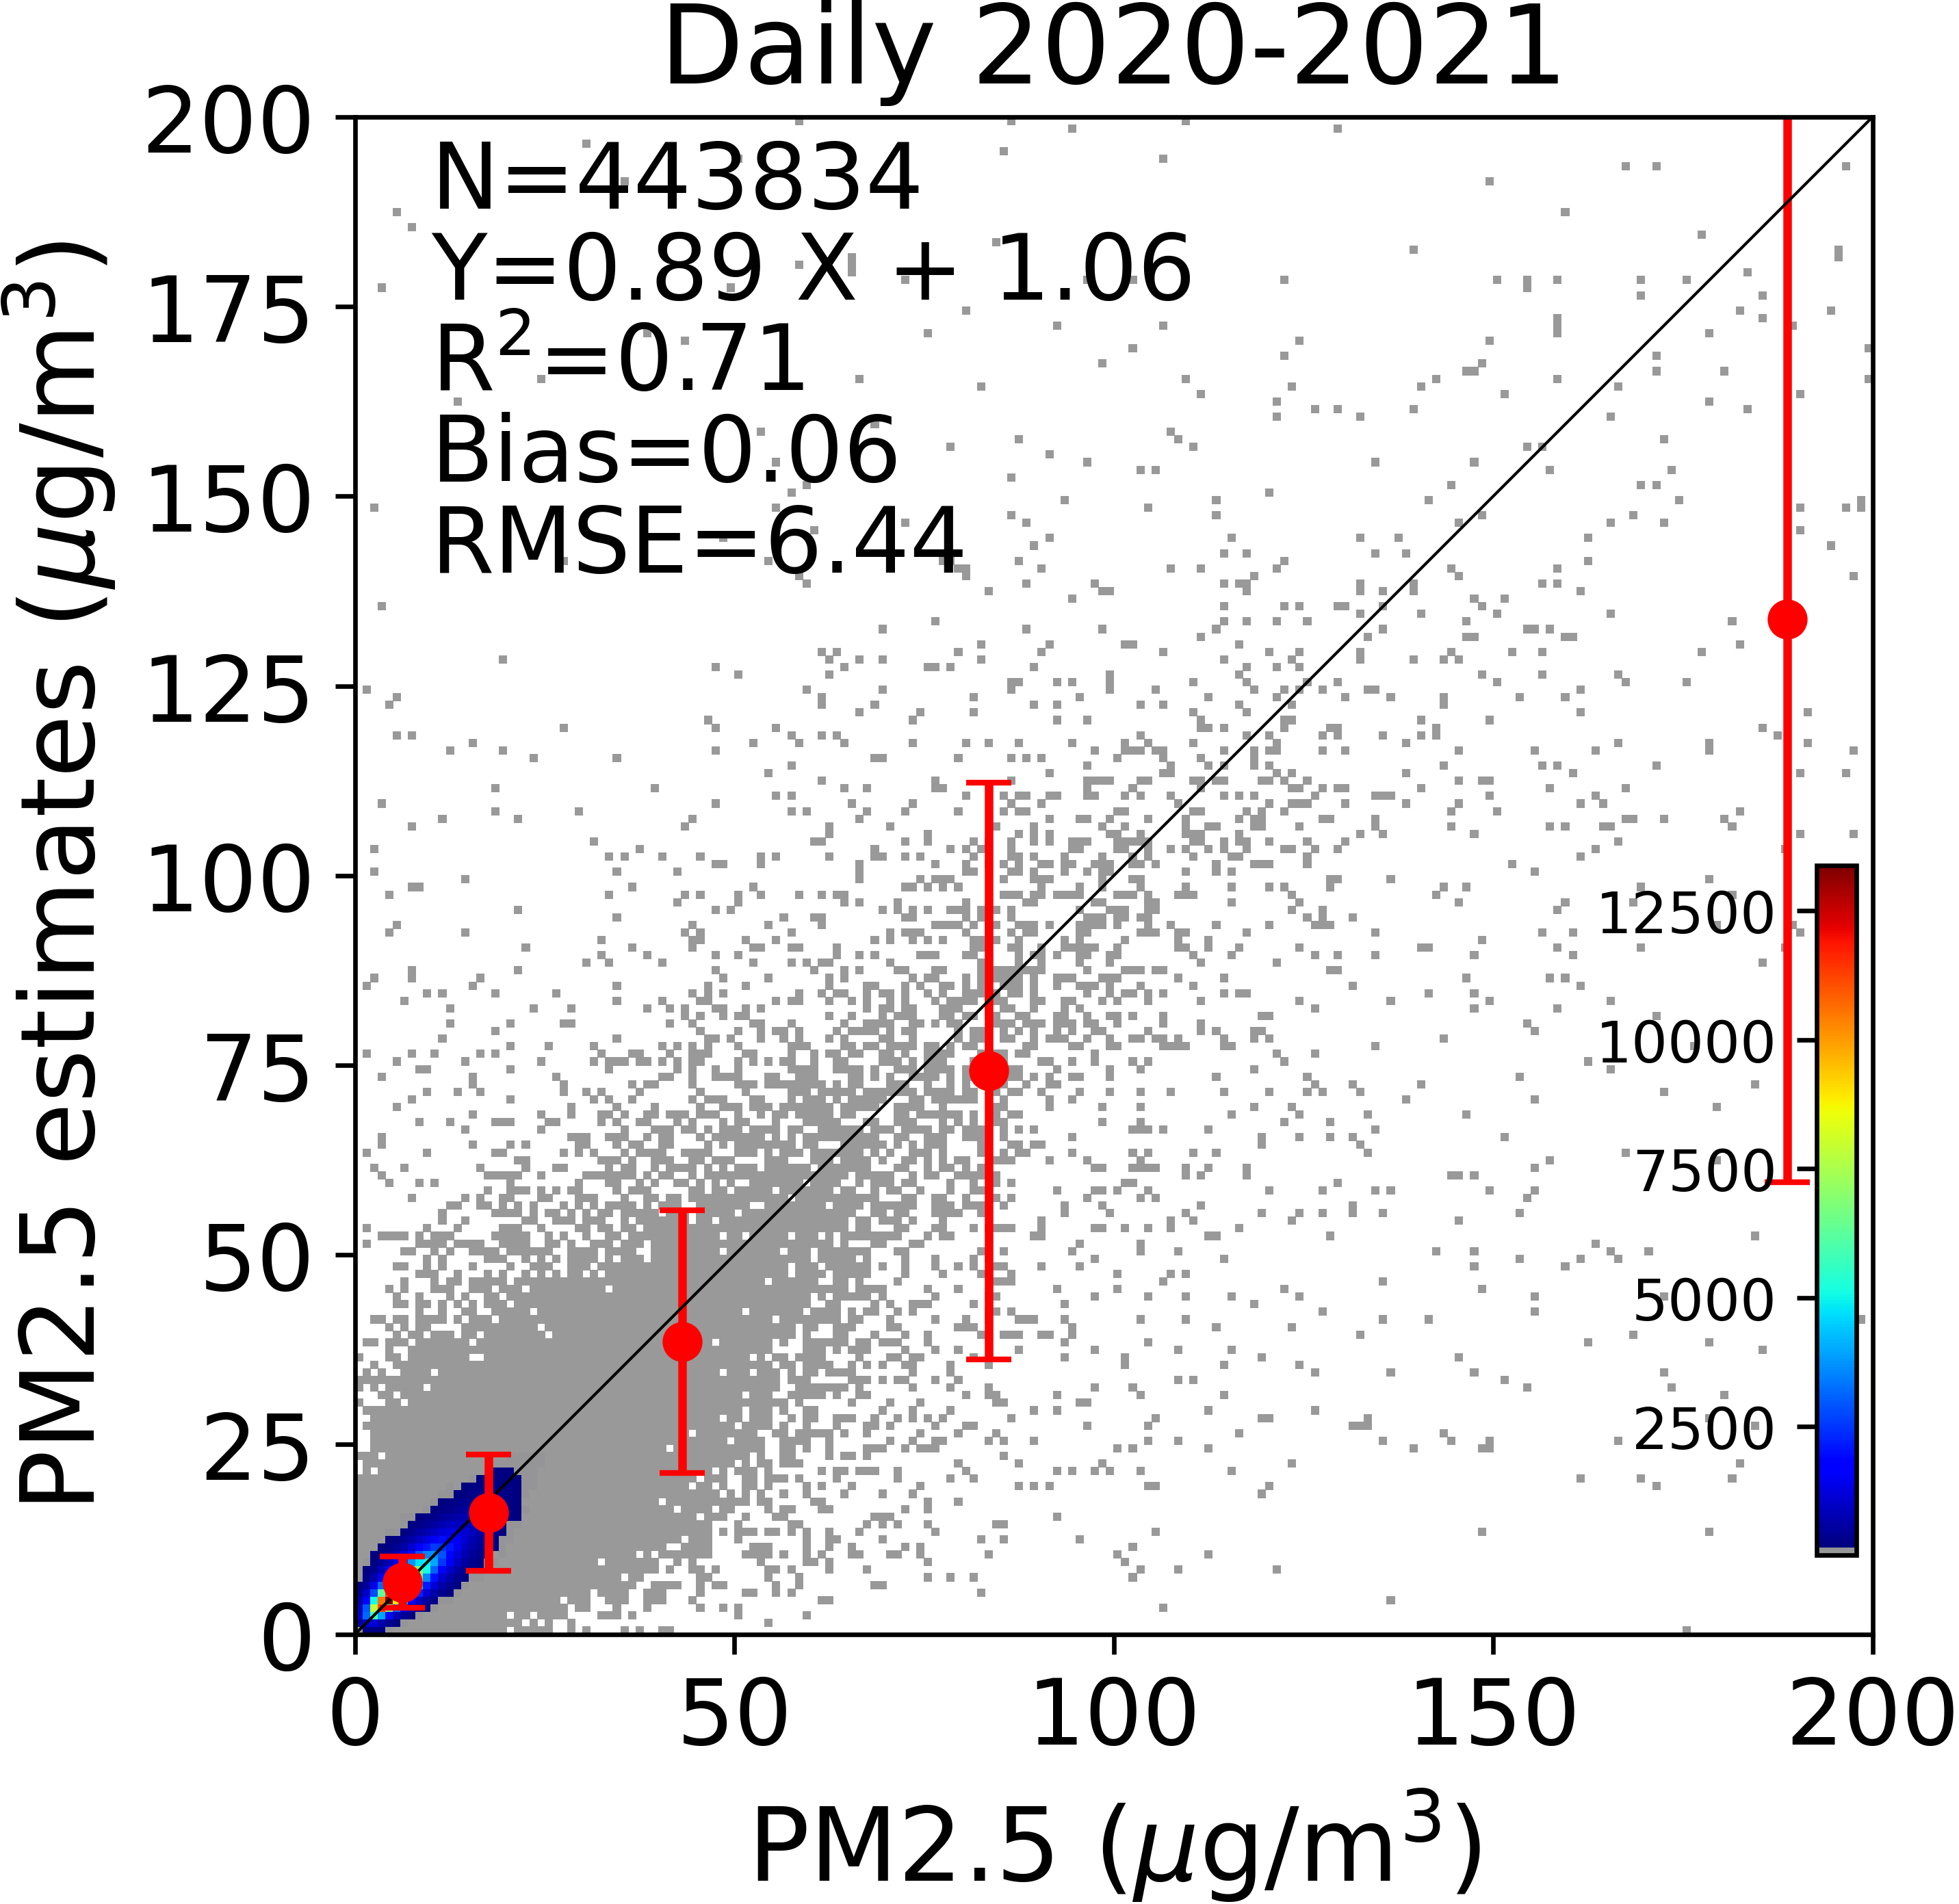
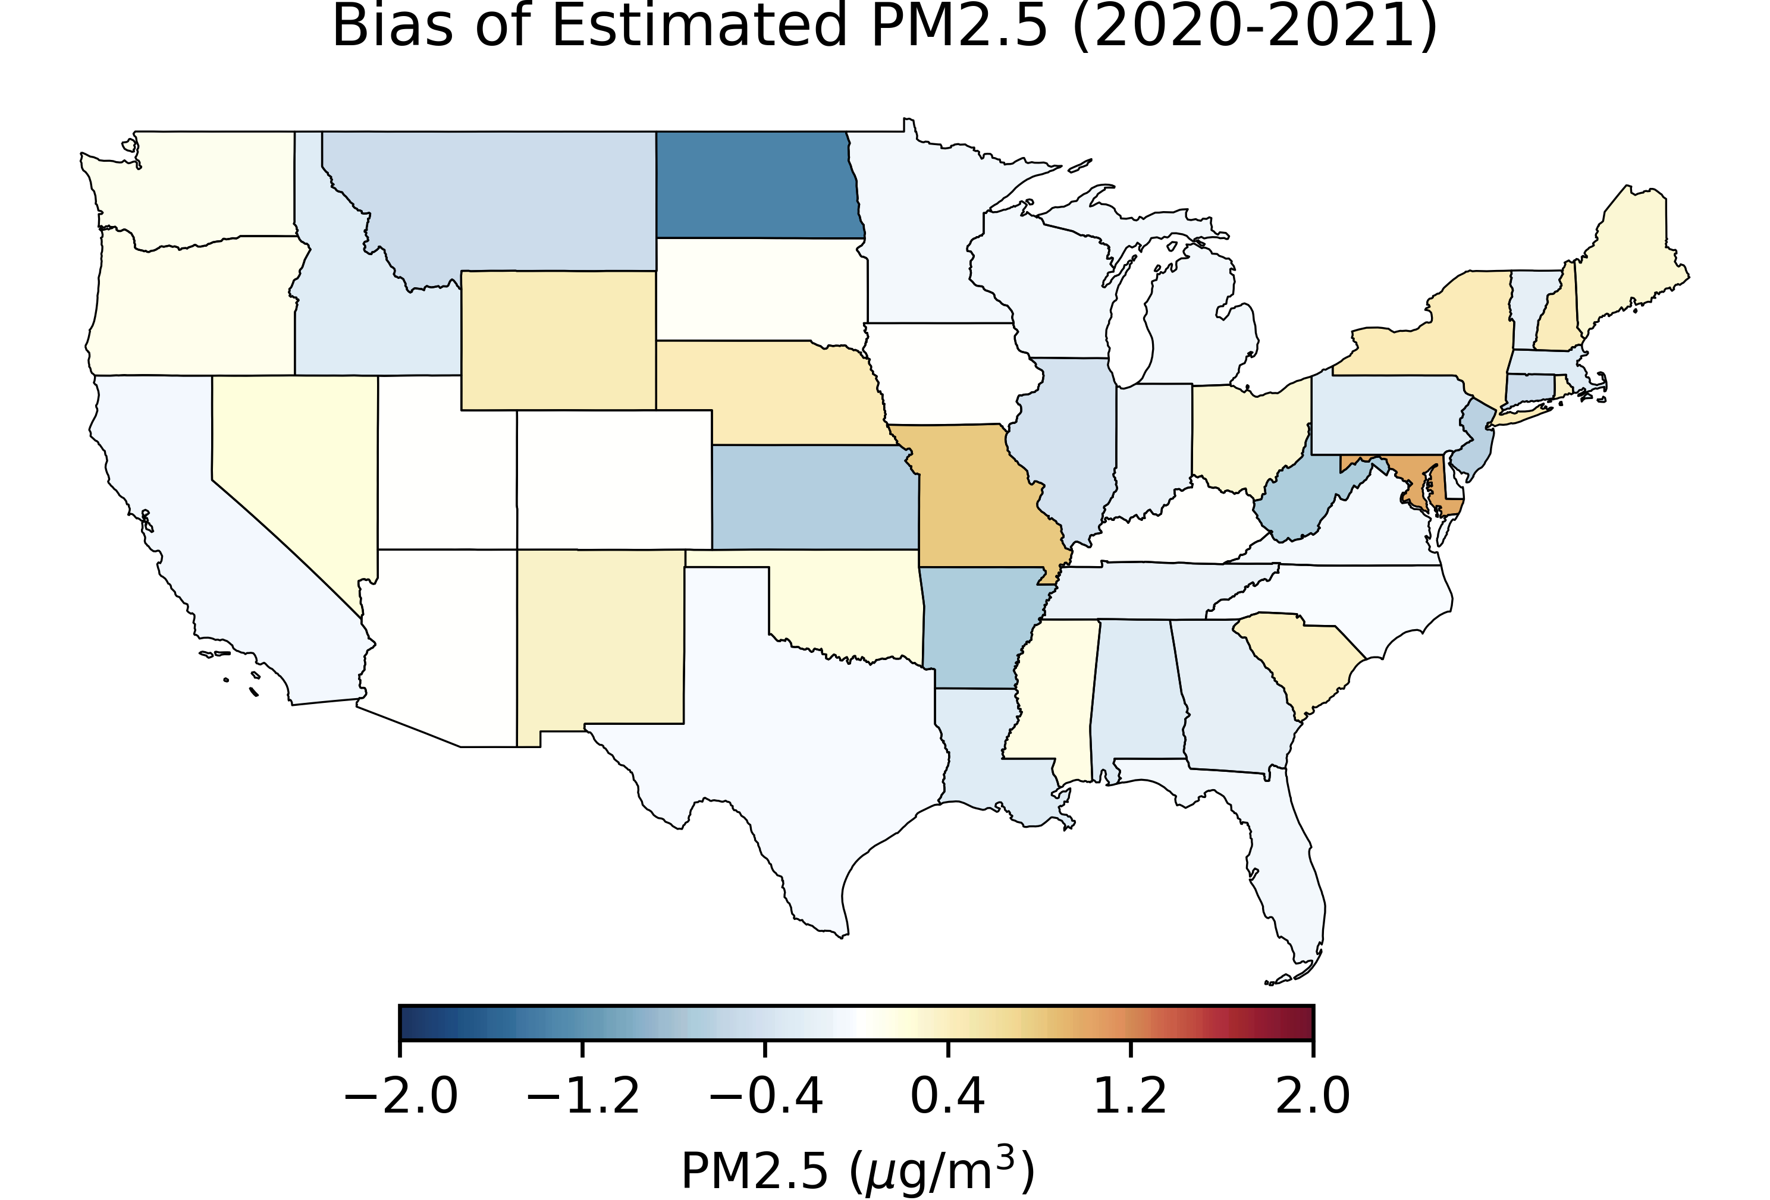
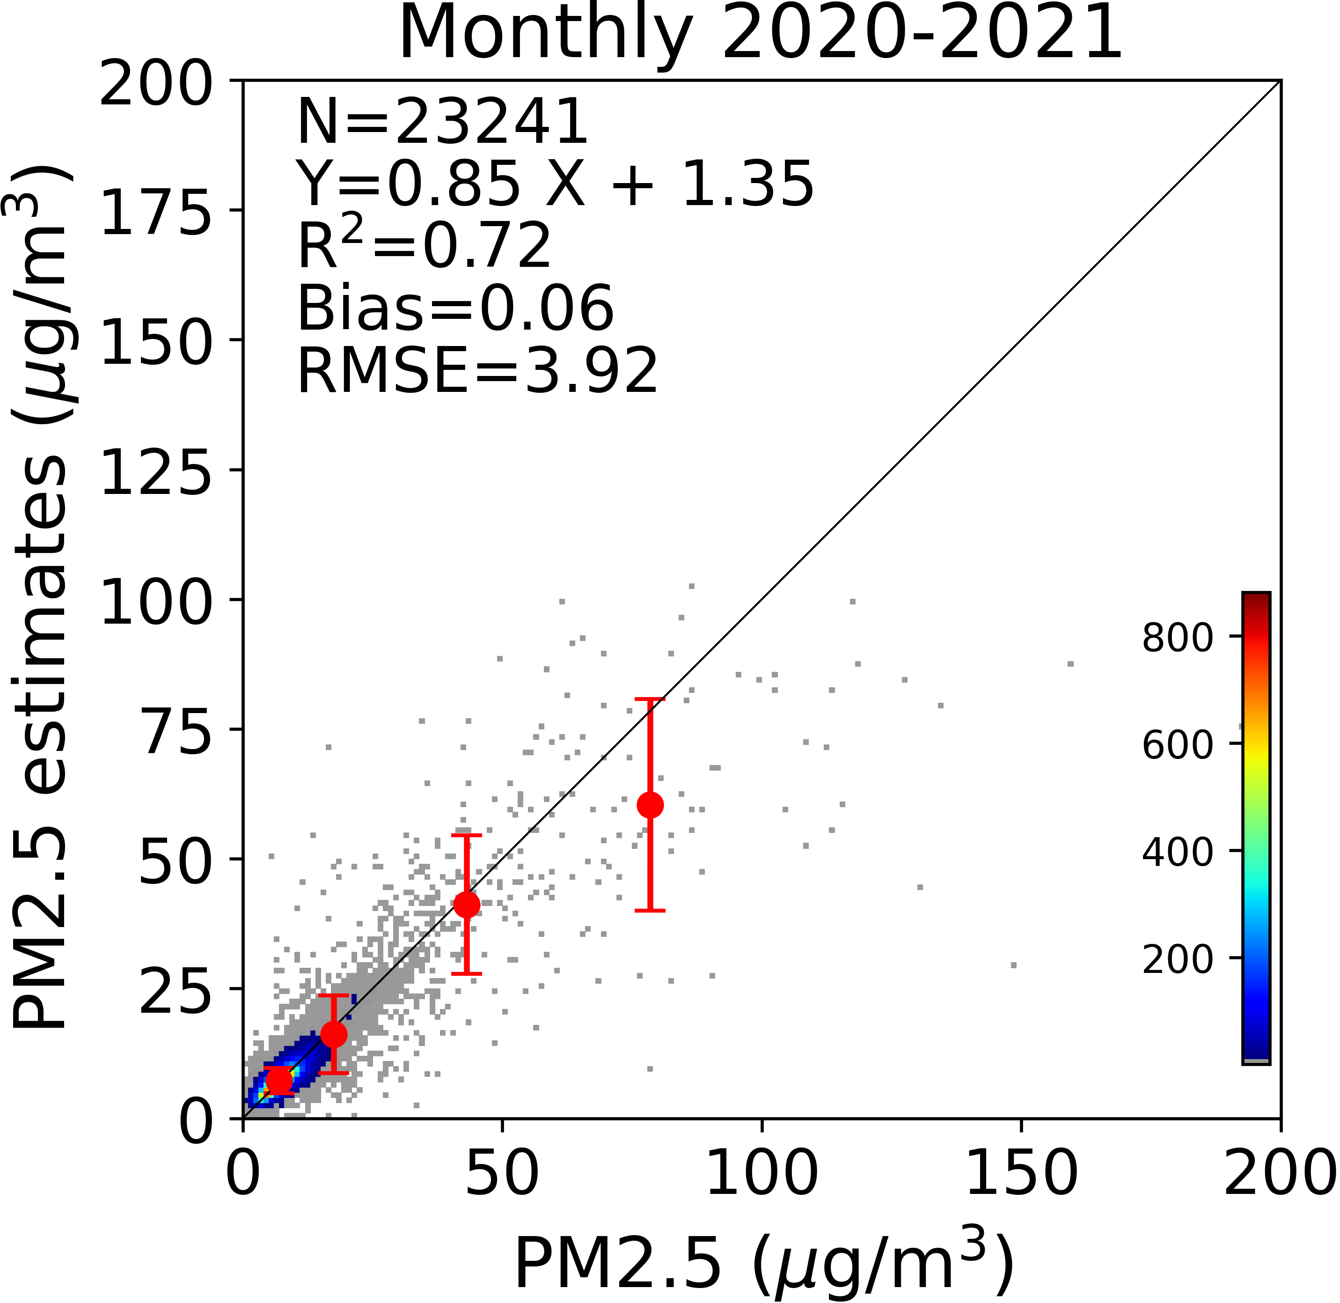
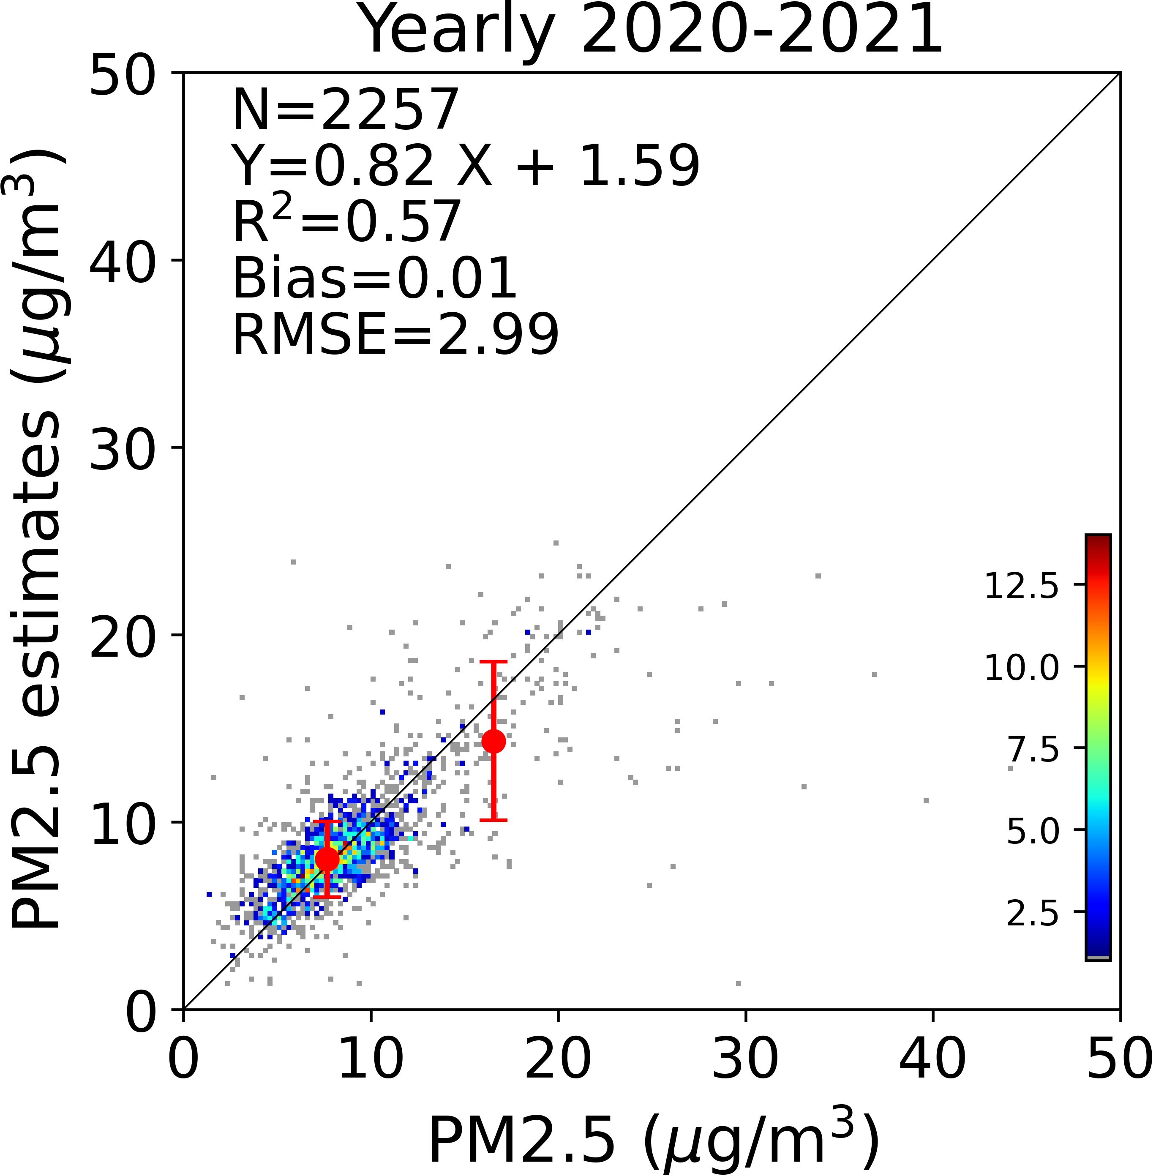
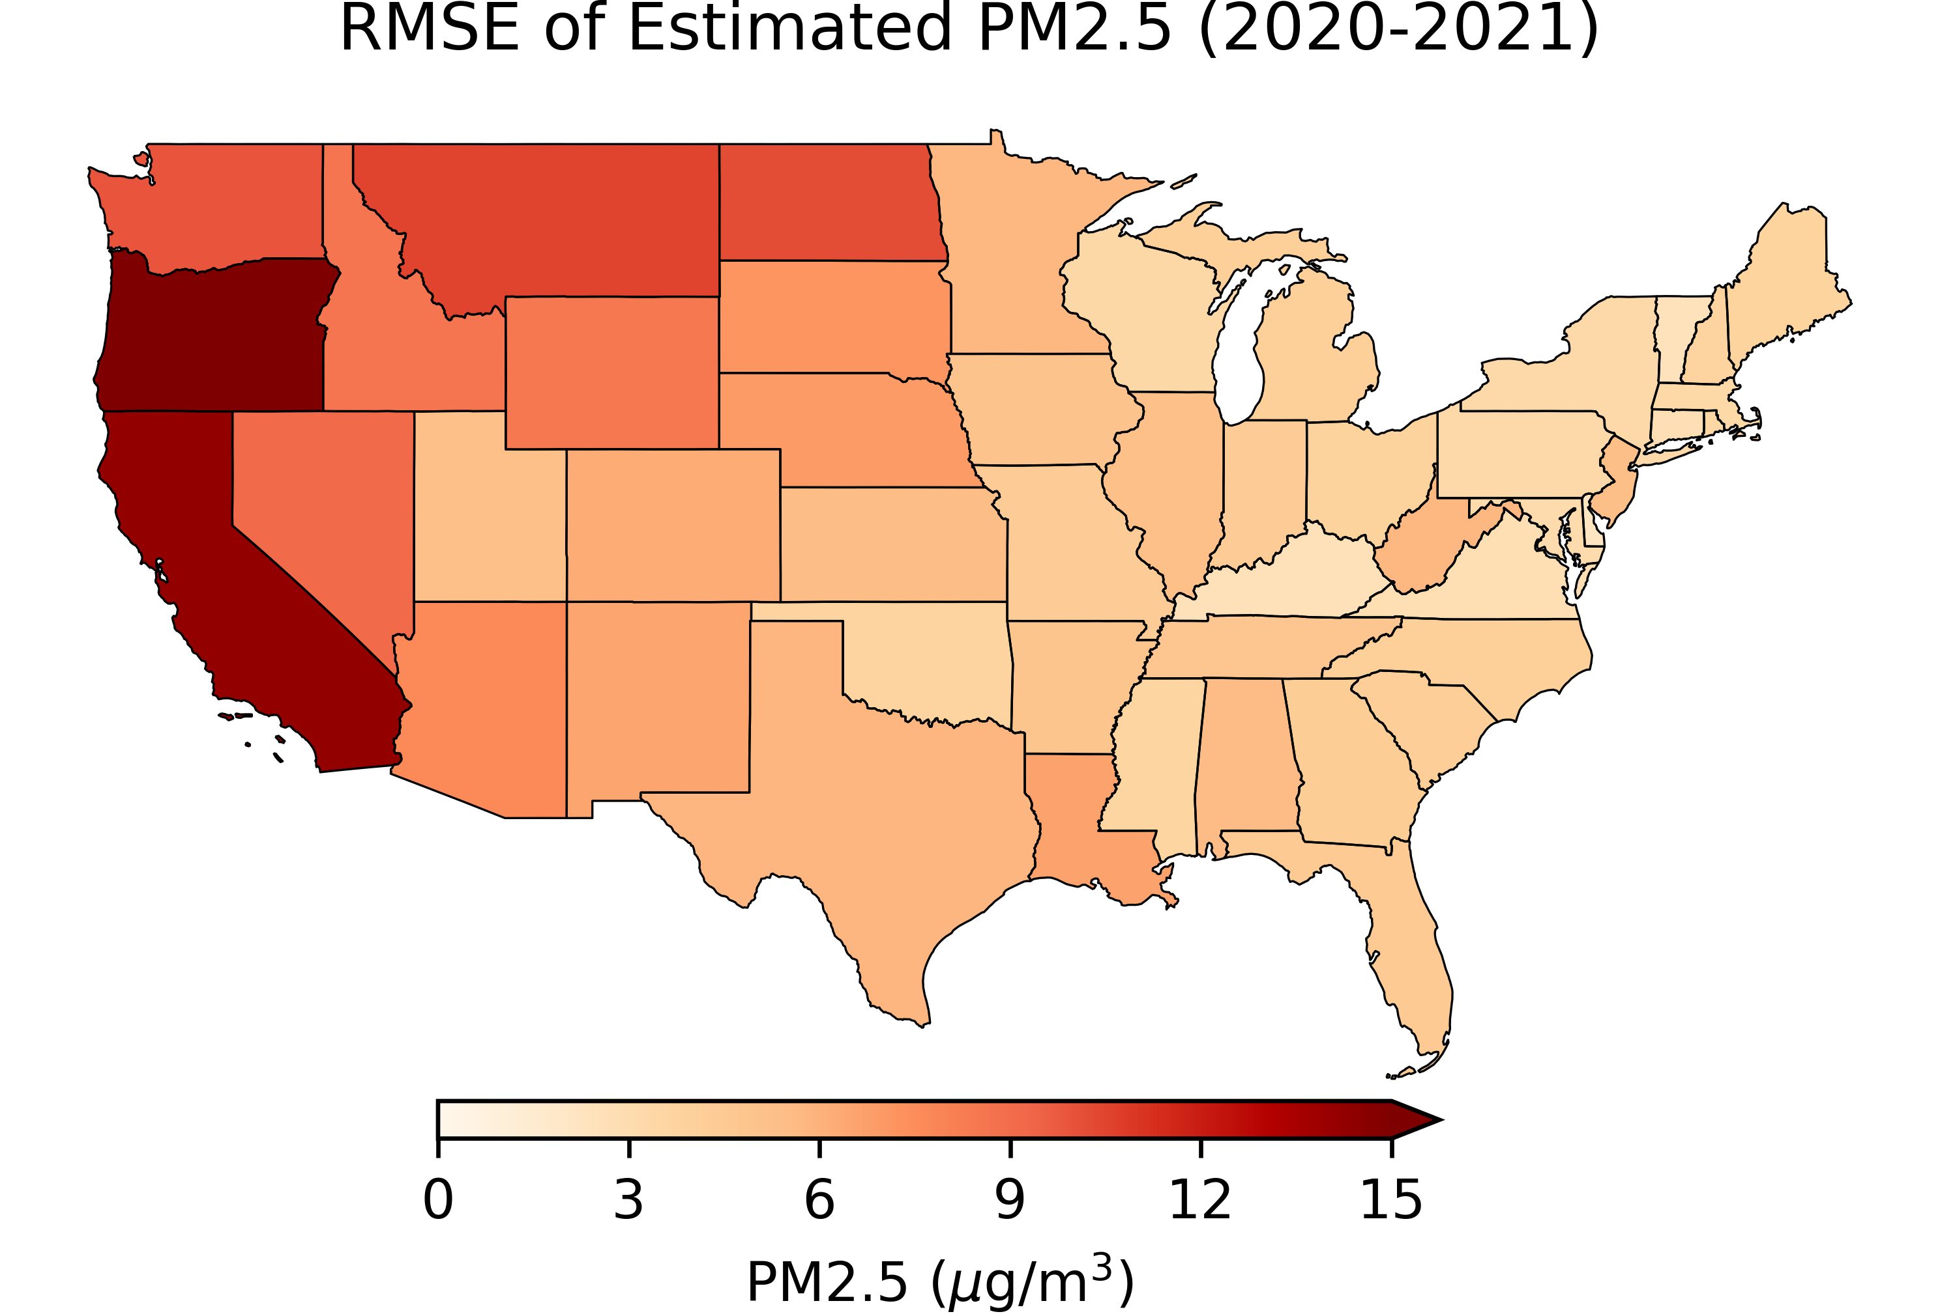
10-fold Cross Validation on Different Time Scales
10-fold Cross Validation of Hourly PM2.5 Estimated from GOES-16/17 ABI AOD

Slide 5
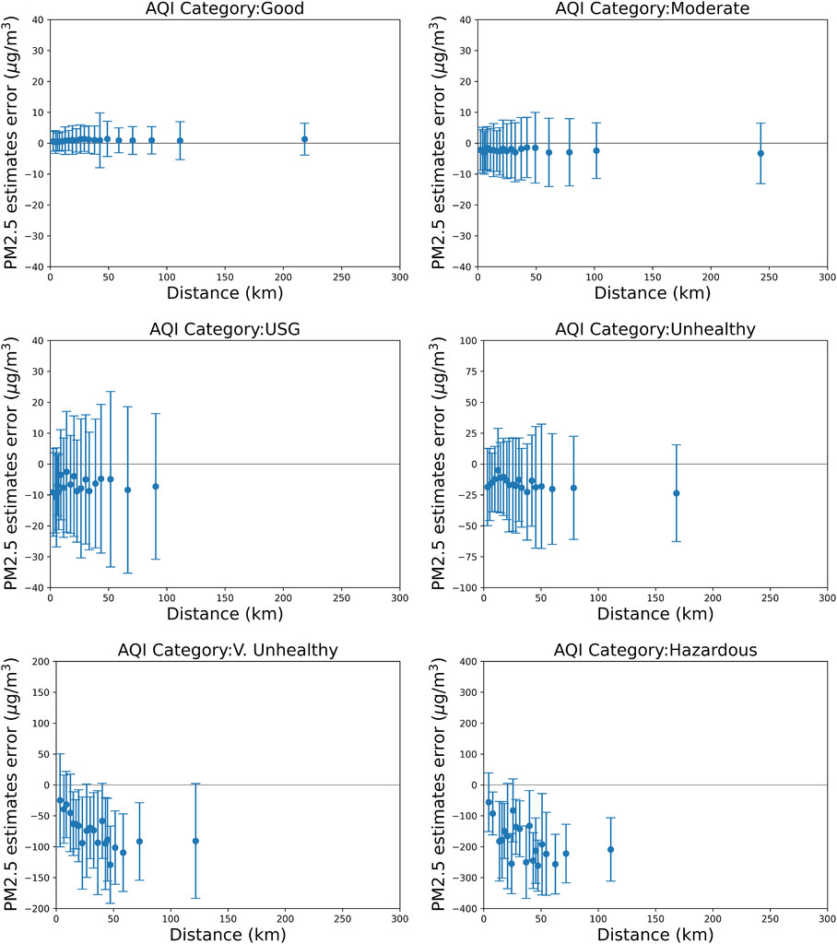
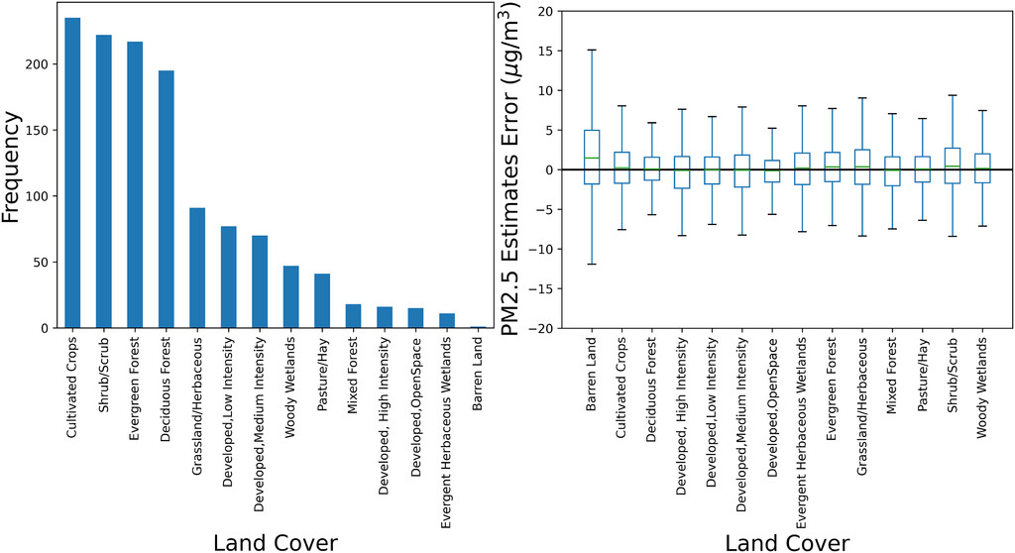
Validation

Slide 6
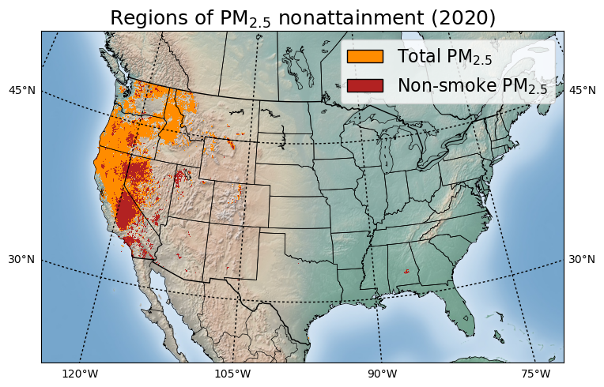
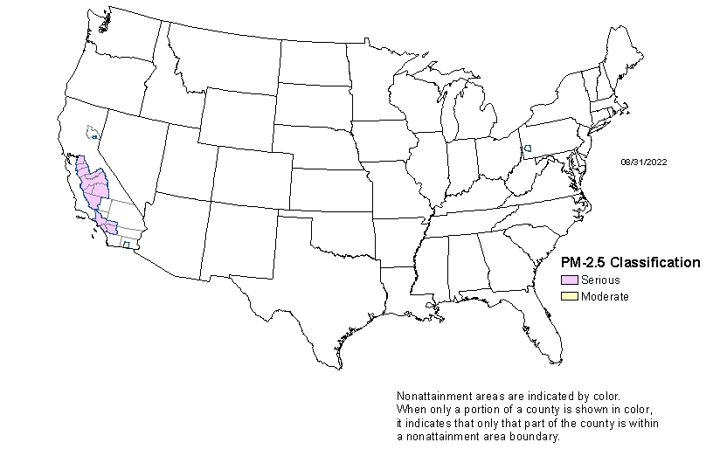



SNPP VIIRS 2020 annual mean PM_{2.5} > 12 µg/m³
Preliminary results…do not cite !!!
M. Cheeseman, H. Zhang, P. Ciren (IMSG at NOAA)

Slide 7
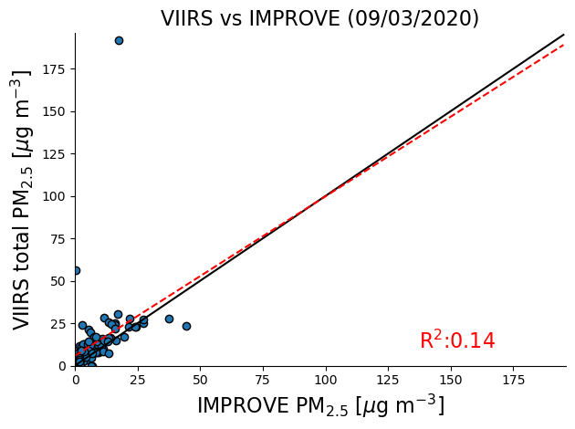
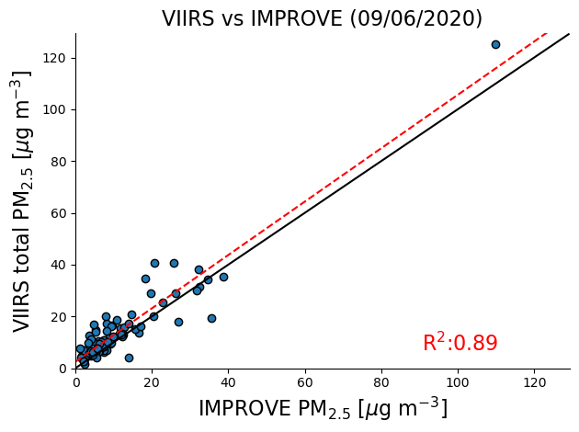
Independent Validation
For near real time surface PM2.5 estimates, we have to rely on 10-fold cross validation
For applications that do not have low latency requirements, we decided to validate PM2.5 estimates using IMPROVE data that are not used in our GWR algorithm

