Slide 1
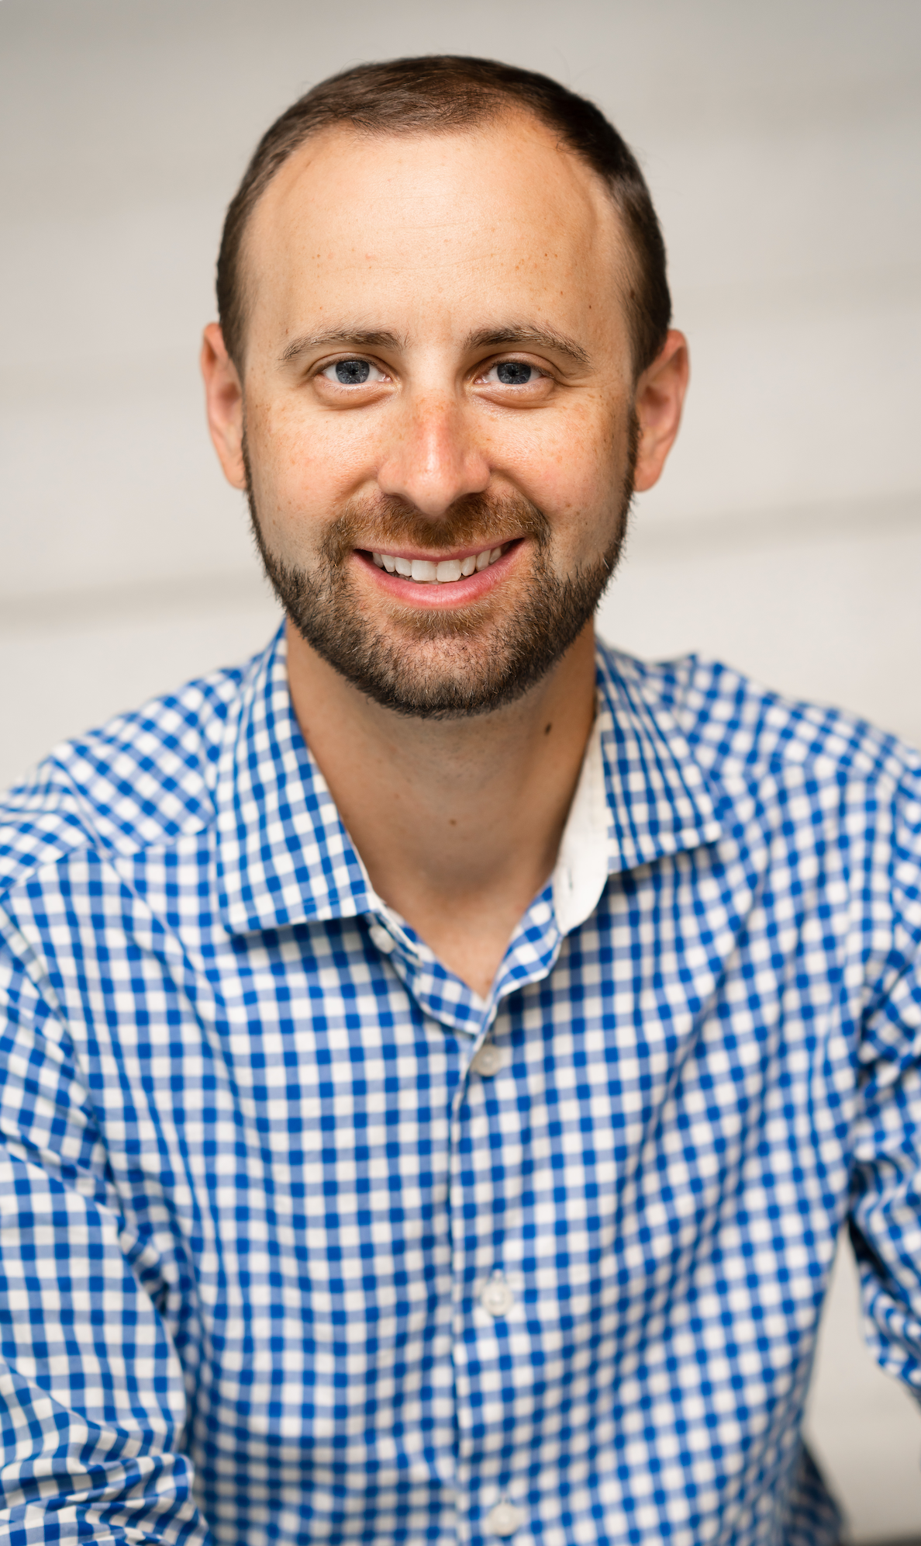
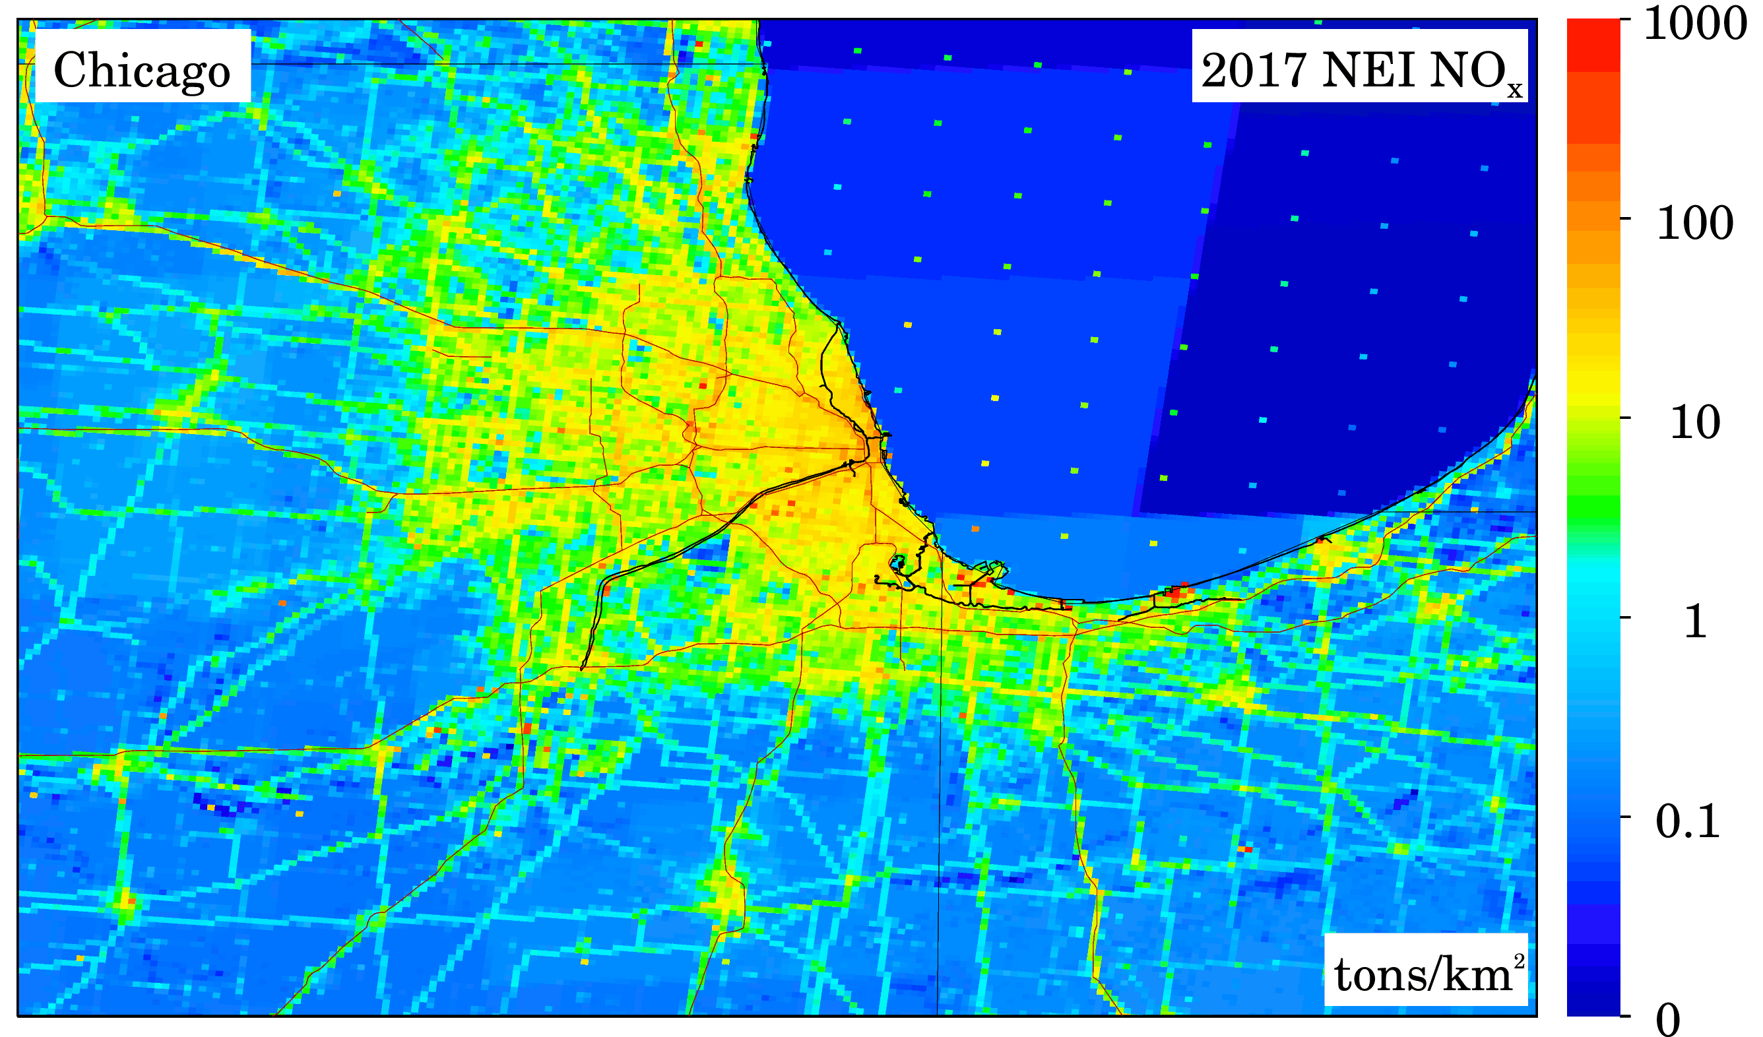
How will TEMPO data improve our current research?
Understanding NOx emissions
for environmental health applications
Dan Goldberg
George Washington University
TEMPO / GeoXO / TolNet
Science Team Meetings
May 4, 2023

Slide 2
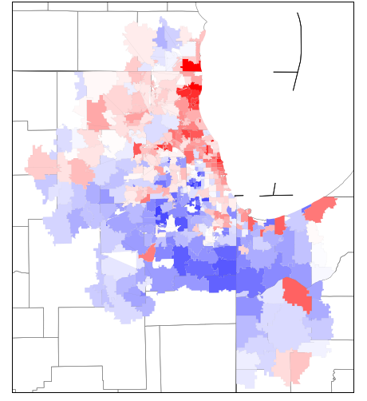
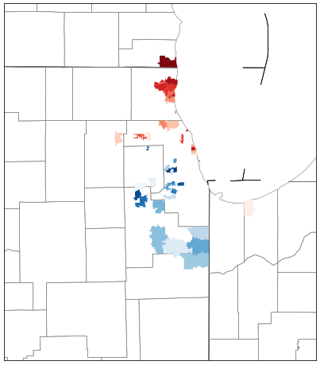
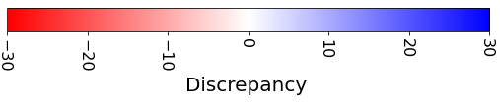
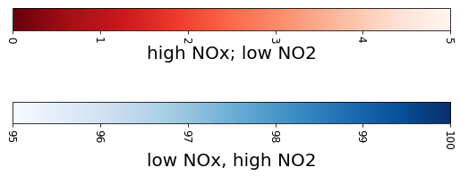
How will TEMPO data improve our current research?
Understanding NOx emissions
for environmental health applications
Chicago
53158
Left column – Satellite vs. Inventory “Discrepancy”
Right column – Same image but now only showing outliers and individual zip codes highlighted
Generally, an inventory overestimate in wealthy neighborhoods, and an inventory underestimate near warehouses and transfer facilities
Inventory > Satellite
60088
60043
60640 & 60660
60526
60490 & 60446
Inventory < Satellite
Missing NO_{X} ?

Slide 3
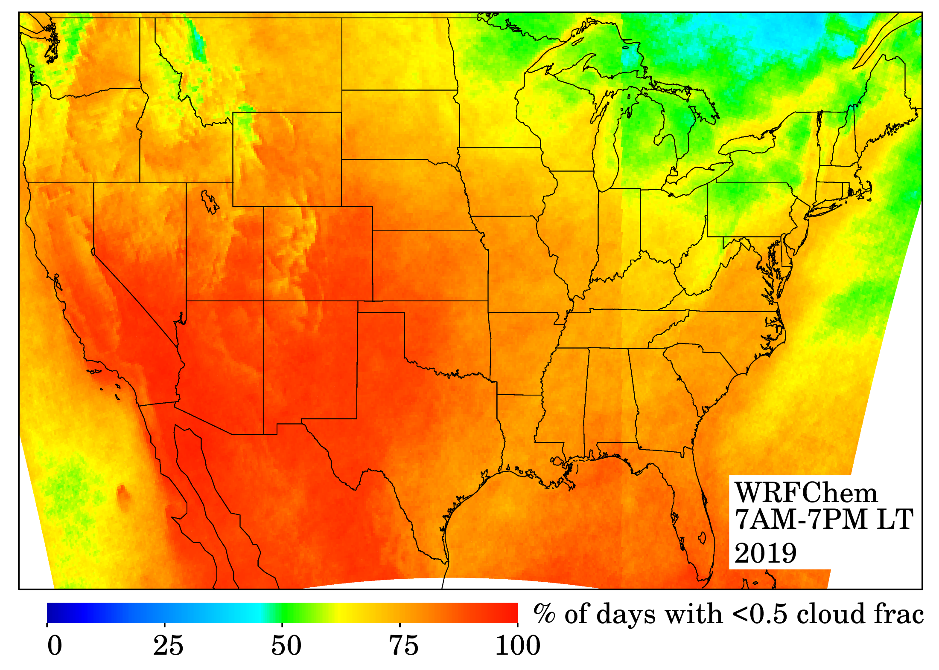
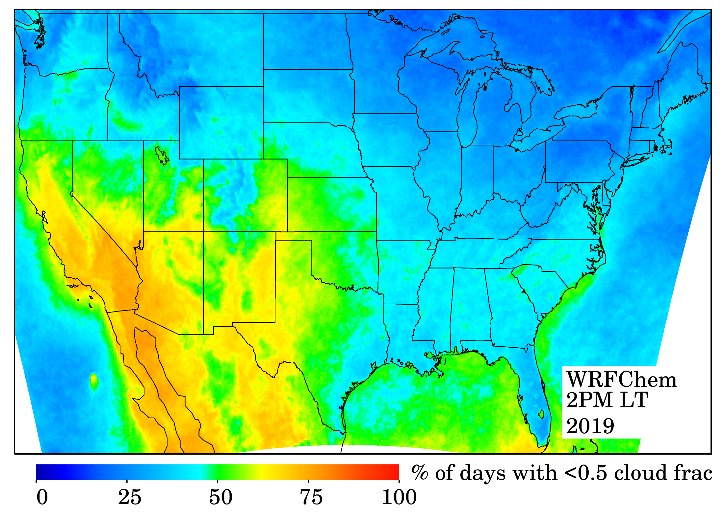
How will TEMPO data improve our current research?
Understanding NOx emissions
for environmental health applications
CONUS cloud patterns: GEO-like vs. LEO-like
WRF-Chem: Cloud-free any time during 7 AM – 7 PM
WRF-Chem: Cloud-free during 1 PM
City | % at 2 PM | % at 7AM-7PM
NYC | 34.7 | 70.9
TOR | 27.5 | 61.9
DMV | 39.3 | 74.5
CHI | 34.6 | 67.9
ATL | 42.3 | 72.7
DEN | 44.2 | 86.3
DFW | 50.1 | 84.4
SEA | 32.2 | 64.6
LA | 69.1 | 89.9
PHX | 69.5 | 92.5
Increase of coverage by a factor of two in eastern US (~40% daily coverage vs. ~75% daily coverage)
In West and Southwest, almost every single day will have some coverage with GEO
Step change across Indiana – Alabama is due to timezone shift

Slide 4
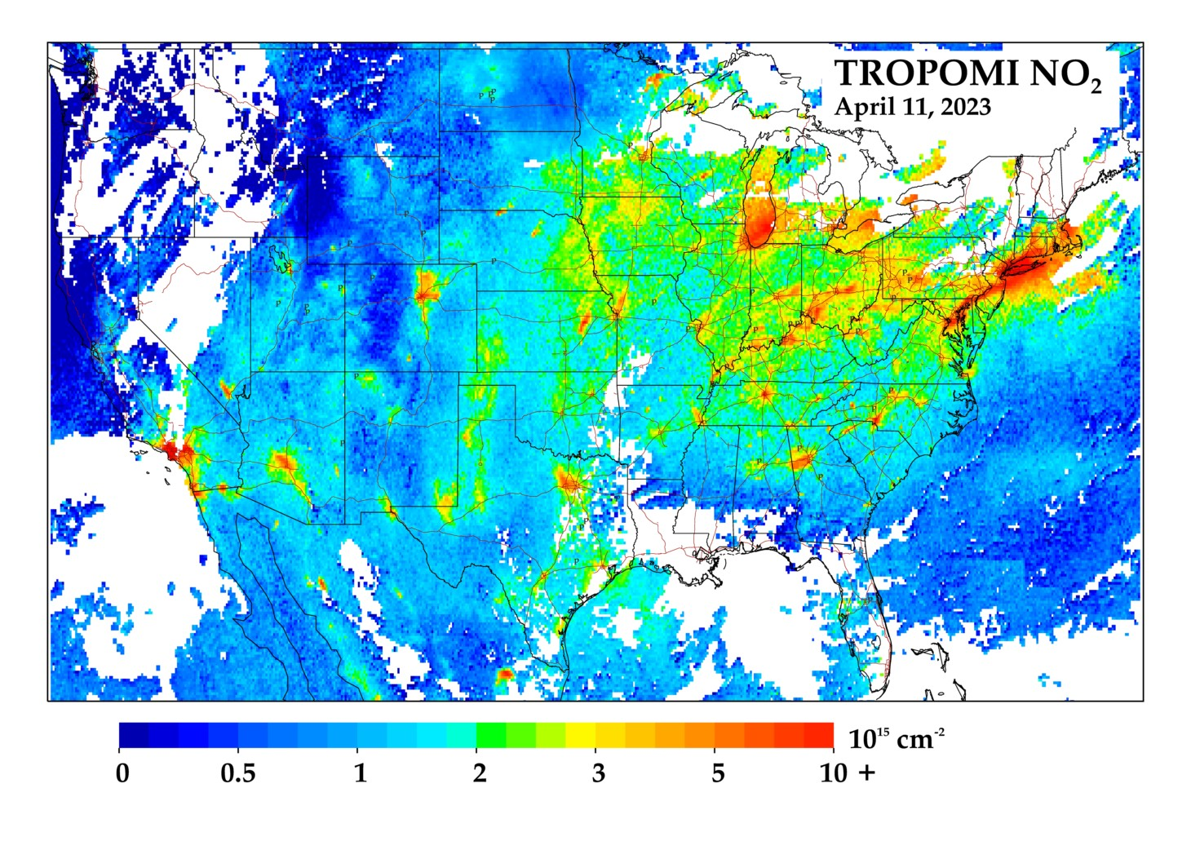
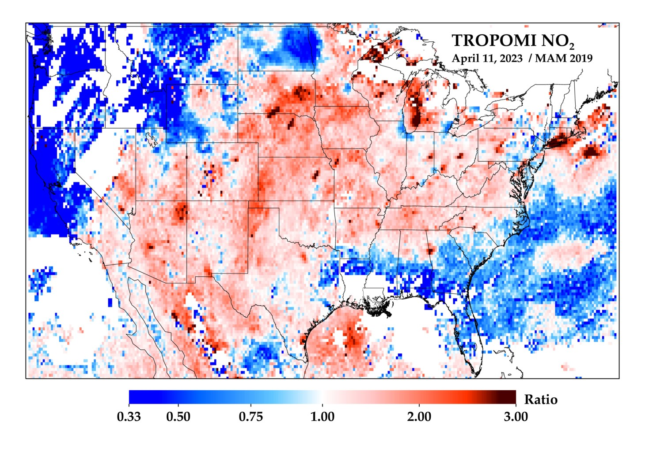
Quick availability of data is critical
Ideally within 24 hours if not within a few hours
tropomino2.us

Slide 5
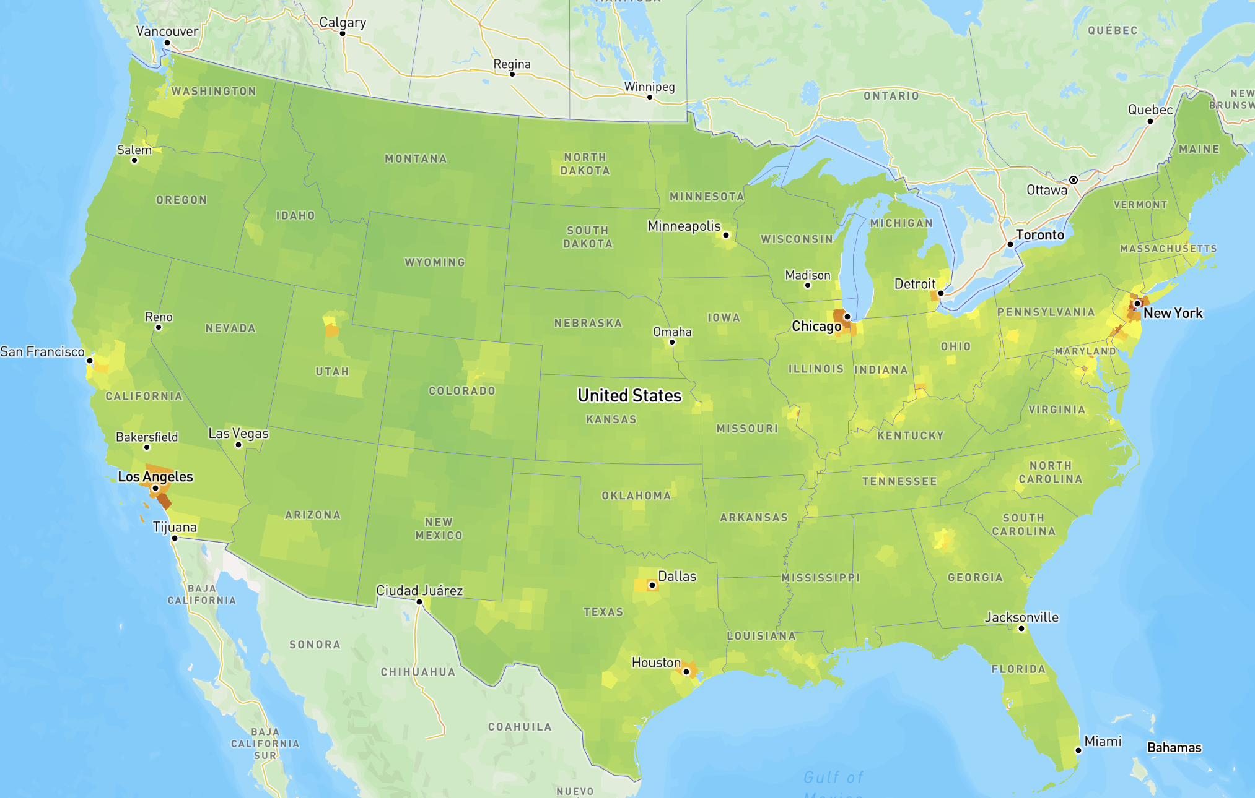
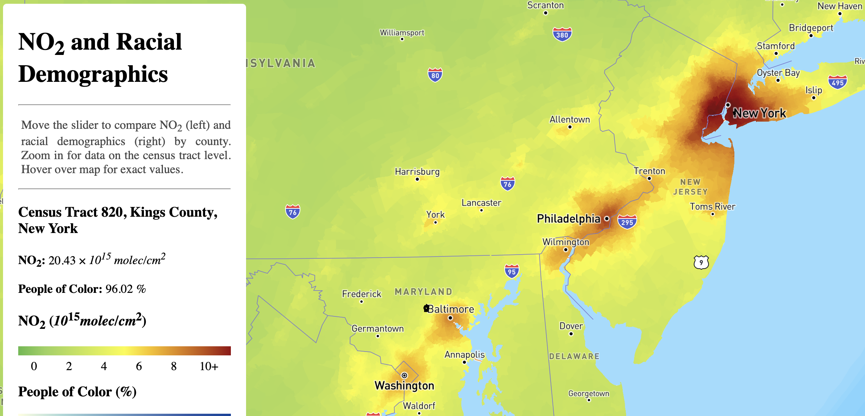
Some projects in the pipeline…
Evaluating NO2 in near-real-time

Slide 6
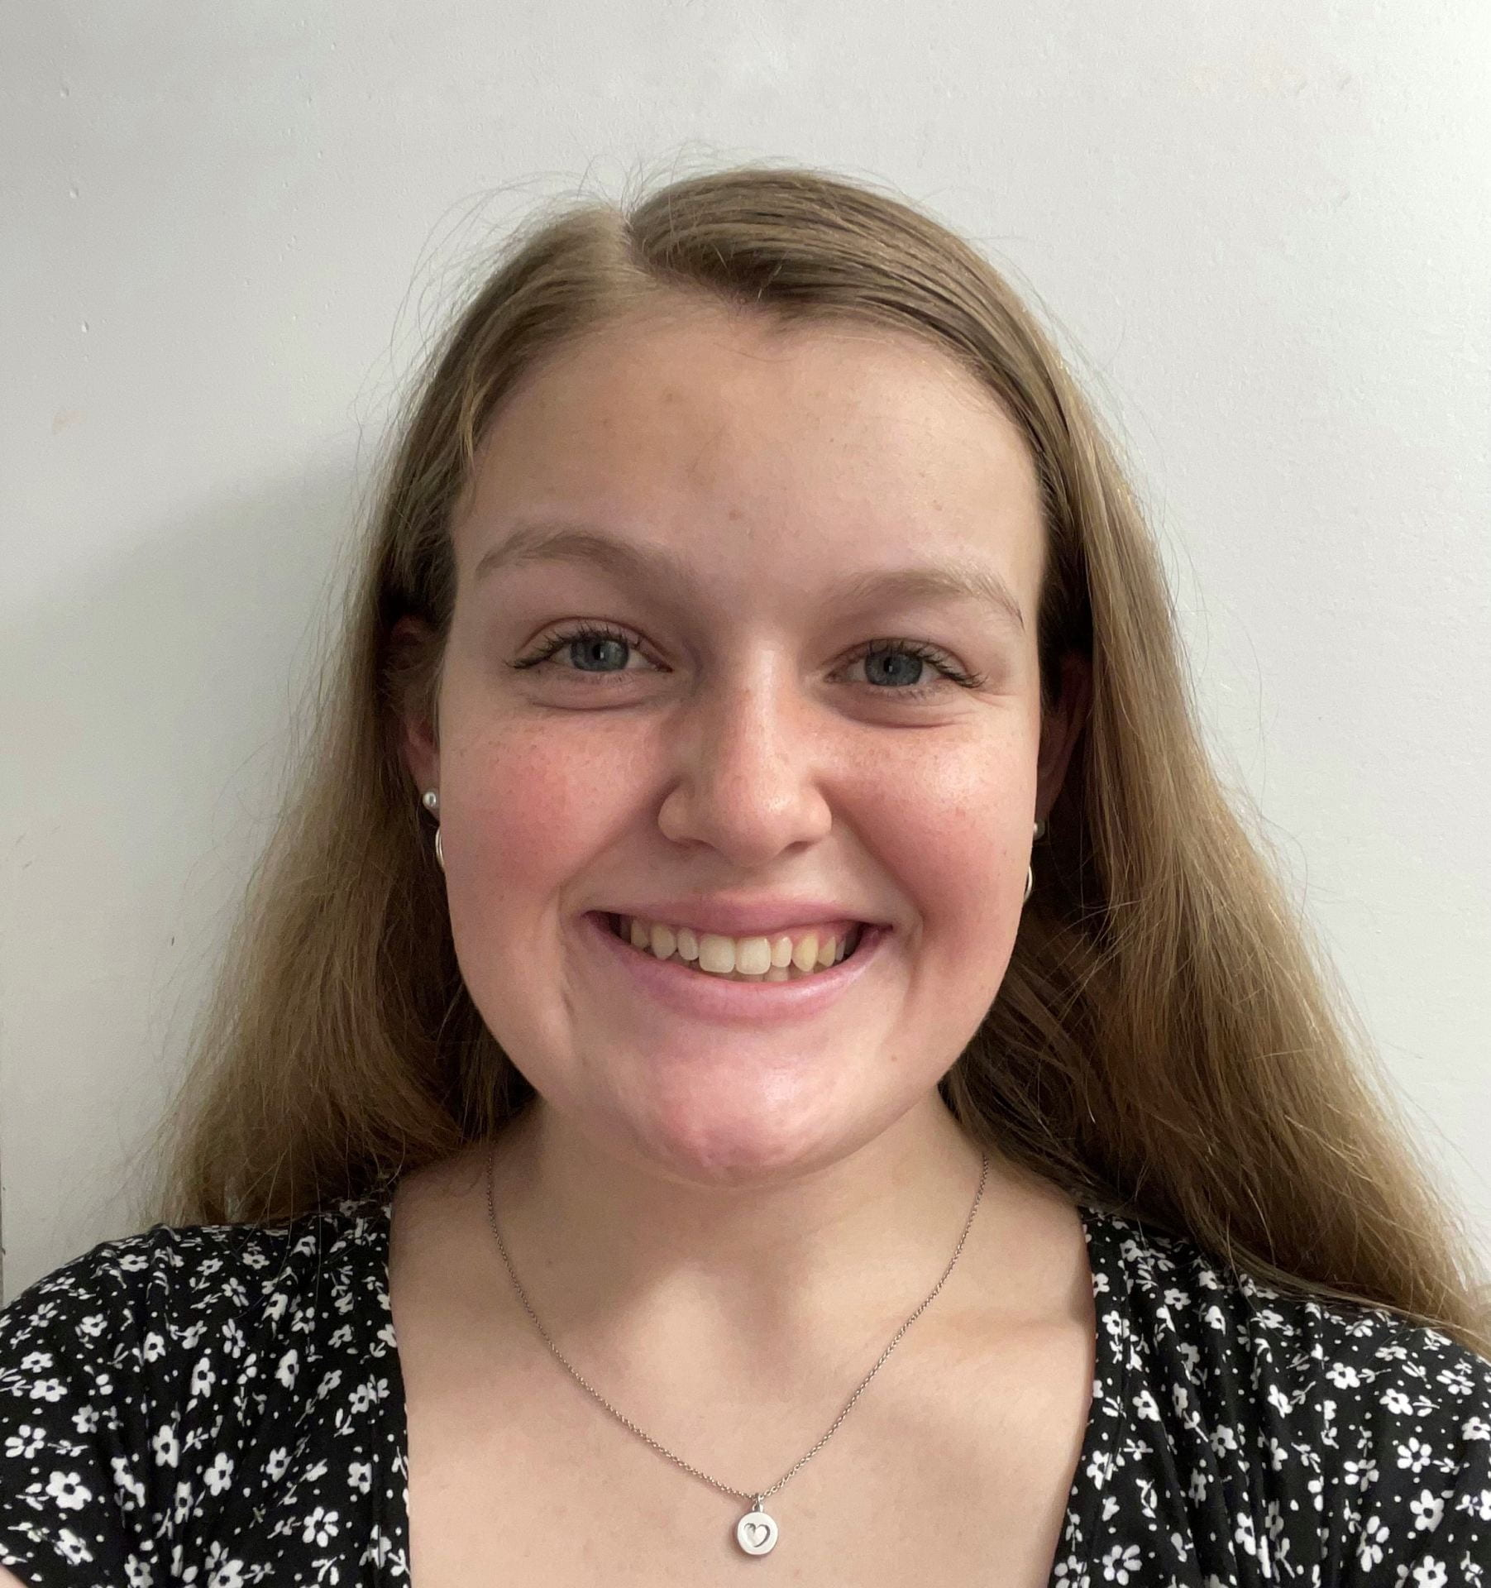
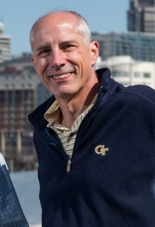




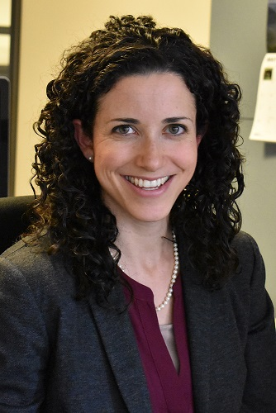
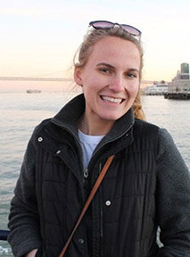
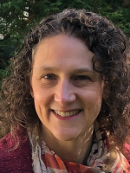
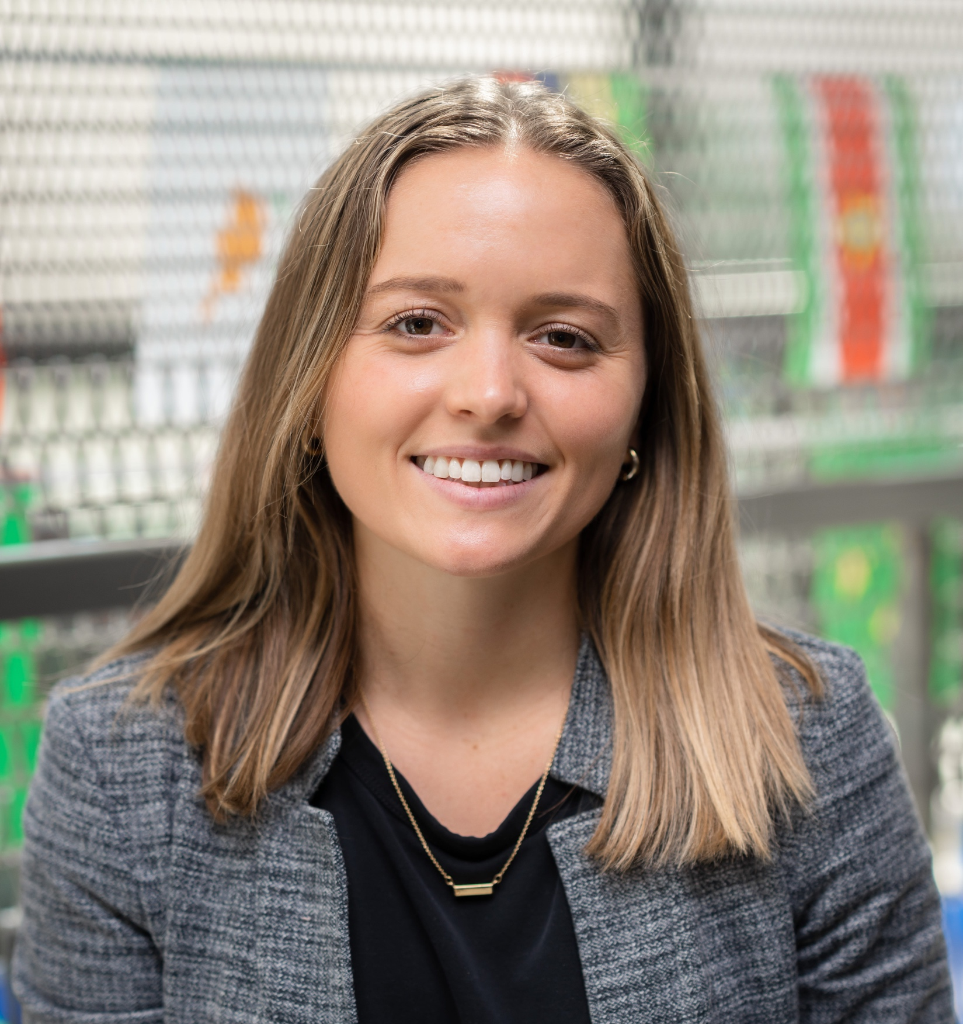
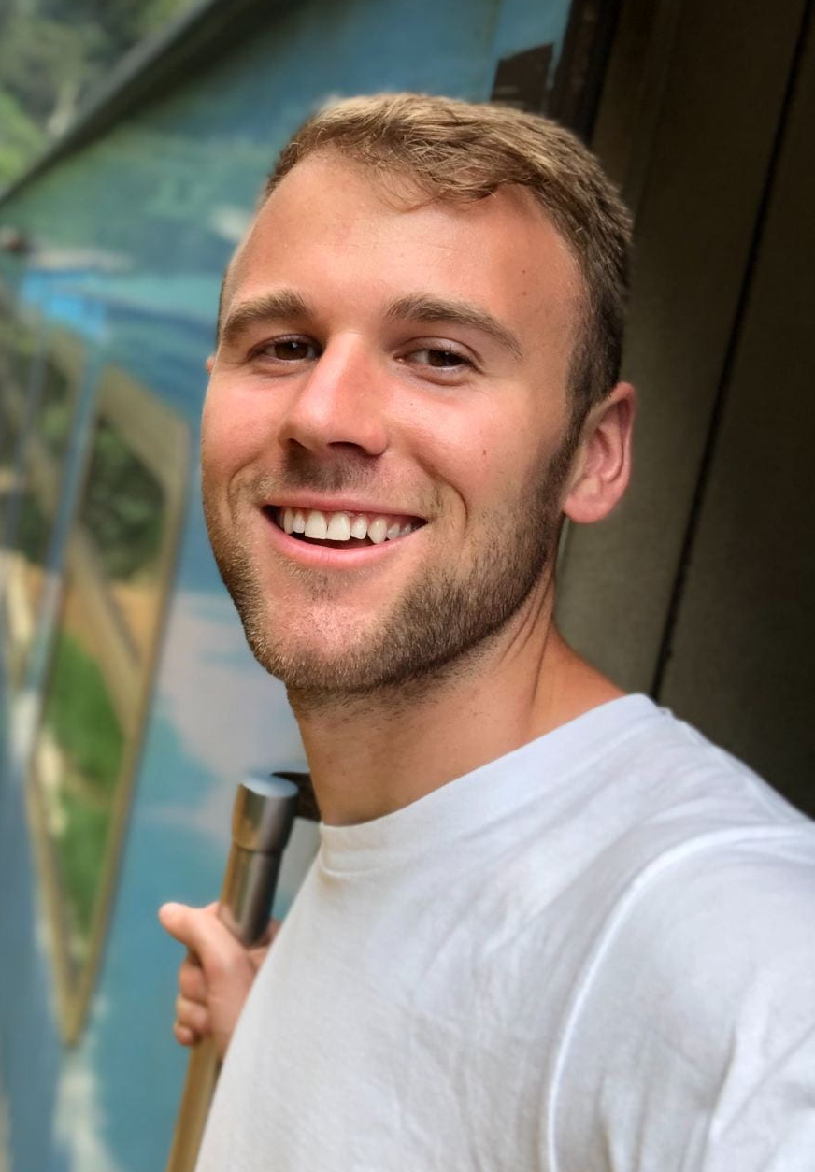
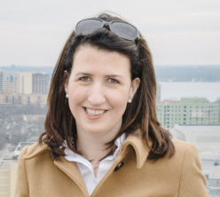
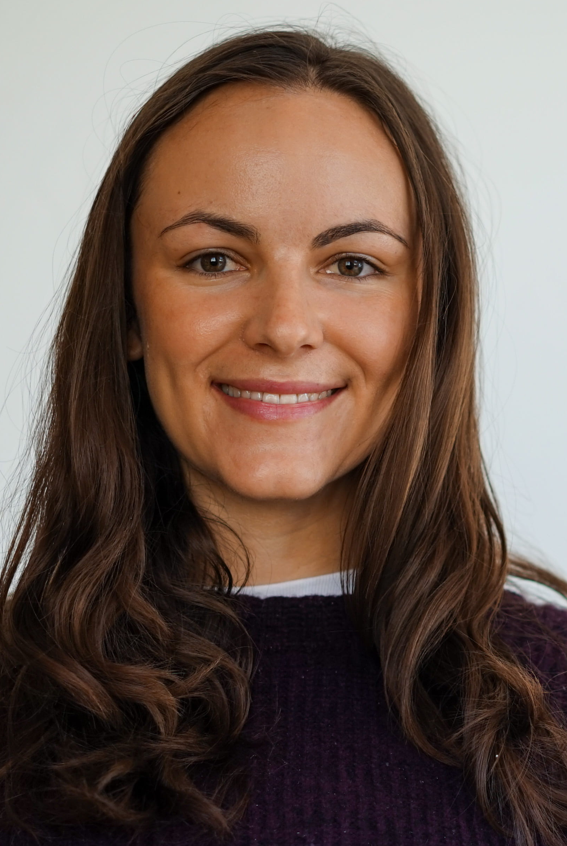

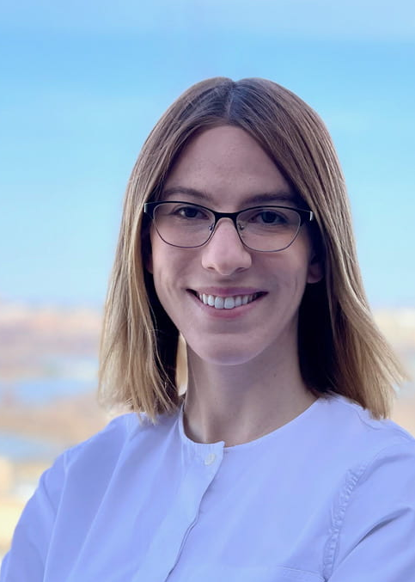
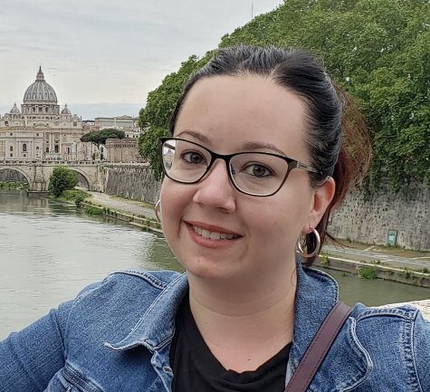
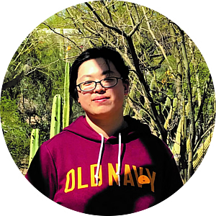
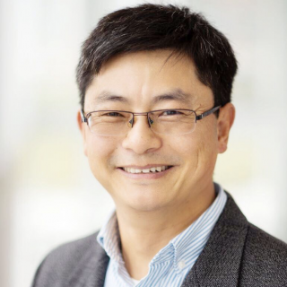
haqast.org
Emily Richardt
Madankui Tao
Dr. Ted Russell
Dr. Tracey Holloway
Colleen Heck
Dr. Arlene Fiore
Dr. Kate O’Dell
Dr. Gaige Kerr
Dr. Susan Anenberg
Dr. Laura Judd
Dr. Siqi Ma
Sara Runkel
Dr. Daniel Tong
Nigel Martis
Perrin Krisko
6
Notes:
Before I going any further I want to acknowledge all of the co-authors of this work. This list is not inclusive of everybody contributing to this work.
(15 seconds)

