Slide 1
Use of Next-Generation Space-based Spatiotemporal Resolution for Intraurban Air Pollution Inequality Analyses
Mary Angelique G. Demetillo, Colin Harkins, Brian C. McDonald, Philip S. Chodrow, Kang Sun, Katherine Knowles, Aracely Navarro, Jeffrey Geddes, Caroline Nowlan, Laura M. Judd, Jassim A. Al-Saadi, and Sally E. Pusede

Slide 2

Improved spatial-resolution remote-sensing observations resolve NO₂ inequalities with race, ethnicity, and income at the census tract scale
NASA GCAS
(500m x 250m)
Oversampled TROPOMI
(~1km x 1km)
Houston
Ship Channel
Downtown Houston
Oil refinery
NO₂ (x10¹⁶ molecules cm^{–2})
NO₂ (x10¹⁵ molecules cm^{–2})
Demetillo et al., Environ. Sci. Technol., 2020
Notes:
In our first analysis, we used a novel dataset over Houston, Texas measured by NASA’s airborne spectrometer GCAS (shown here) because it measures NO2 at subkilometer resolution which is fine enough capture the intraurban NO2 spatial gradients as depicted in this sample circuit. You can see GCAS capturing those NO2 gradients between sources like this large oil refinery, petrochemical and industrial facilities, here along the Houston ship channel, and major roadways, mostly located downtown. We used these observations to conduct a detailed evaluation of recently launched satellite sensor TROPOMI to resolve NO2 inequalities in cities. Although its spatial resolution is not as high as the airborne sensor, TROPOMI has an order of magnitude improved spatial resolution compared to previous satellites.
So, we calculated population-weighted NO2 means at the census tract or neighborhood-level using the NASA aircraft and oversampled TROPOMI observations. And we found that TROPOMI was able to capture differences in NO2 between race, ethnicity, and income at the neighborhood scale comparable to those from the higher resolution aircraft observations. We also confirmed the spatial patterns of NO2 observed by these instruments are representative of those at the surface. These results coupled with TROPOMI’s temporal resolution of near-daily measurements then positioned us to better understand the drivers of inequality within cities.

Slide 3
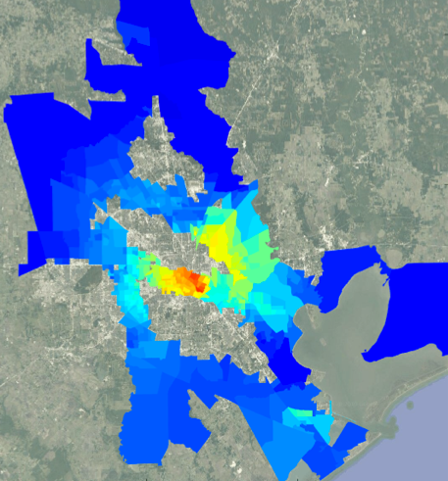
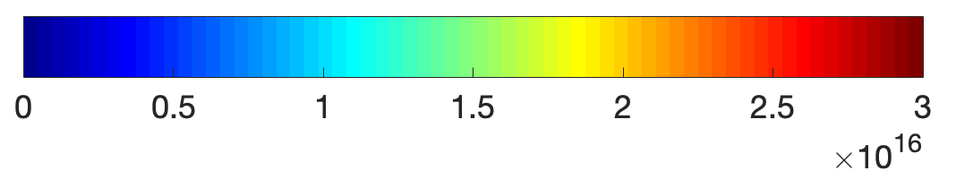
Improved spatial-resolution remote-sensing observations resolve NO₂ inequalities with race, ethnicity, and income at the census tract scale
Midday GCAS flight
Oversampled TROPOMI along GCAS flight path
39 ± 8 % inequality
42 ± 3%
inequality
The Woodlands
Downtown Houston
Texas City
1.5 2 2.5 3.5 4 4.5
x10¹⁵
NO₂ (molecules cm^{–2})
NO₂ (molecules cm^{–2})
Demetillo et al., Environ. Sci. Technol., 2020
Notes:
In our first analysis, we used a novel dataset over Houston, Texas measured by NASA’s airborne spectrometer GCAS (shown here) because it measures NO2 at subkilometer resolution which is fine enough capture the intraurban NO2 spatial gradients as depicted in this sample circuit. You can see GCAS capturing those NO2 gradients between sources like this large oil refinery, petrochemical and industrial facilities, here along the Houston ship channel, and major roadways, mostly located downtown. We used these observations to conduct a detailed evaluation of recently launched satellite sensor TROPOMI to resolve NO2 inequalities in cities. Although its spatial resolution is not as high as the airborne sensor, TROPOMI has an order of magnitude improved spatial resolution compared to previous satellites.
So, we calculated population-weighted NO2 means at the census tract or neighborhood-level using the NASA aircraft and oversampled TROPOMI observations. And we found that TROPOMI was able to capture differences in NO2 between race, ethnicity, and income at the neighborhood scale comparable to those from the higher resolution aircraft observations. We also confirmed the spatial patterns of NO2 observed by these instruments are representative of those at the surface. These results coupled with TROPOMI’s temporal resolution of near-daily measurements then positioned us to better understand the drivers of inequality within cities.

Slide 4
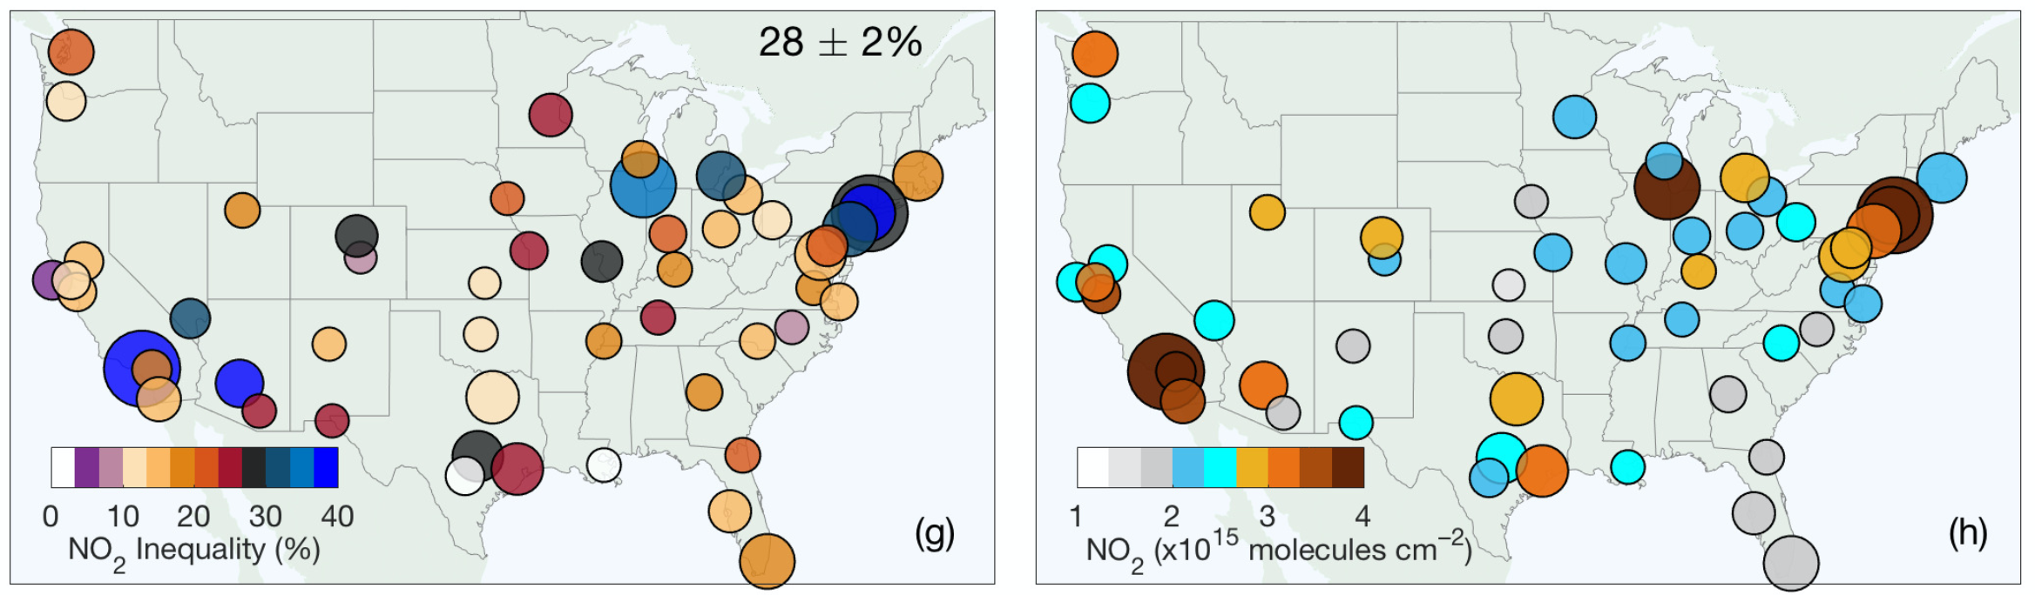
Improved spatial-resolution remote-sensing observations resolve NO₂ inequalities with race, ethnicity, and income at the census tract scale
Average city-level NO₂ abundance
NO₂ disparities with race, ethnicity, and income
Los Angeles, CA
Houston, TX
Baltimore, MD
Demetillo et al., Geophys. Res. Lett., 2021
Notes:
In our first analysis, we used a novel dataset over Houston, Texas measured by NASA’s airborne spectrometer GCAS (shown here) because it measures NO2 at subkilometer resolution which is fine enough capture the intraurban NO2 spatial gradients as depicted in this sample circuit. You can see GCAS capturing those NO2 gradients between sources like this large oil refinery, petrochemical and industrial facilities, here along the Houston ship channel, and major roadways, mostly located downtown. We used these observations to conduct a detailed evaluation of recently launched satellite sensor TROPOMI to resolve NO2 inequalities in cities. Although its spatial resolution is not as high as the airborne sensor, TROPOMI has an order of magnitude improved spatial resolution compared to previous satellites.
So, we calculated population-weighted NO2 means at the census tract or neighborhood-level using the NASA aircraft and oversampled TROPOMI observations. And we found that TROPOMI was able to capture differences in NO2 between race, ethnicity, and income at the neighborhood scale comparable to those from the higher resolution aircraft observations. We also confirmed the spatial patterns of NO2 observed by these instruments are representative of those at the surface. These results coupled with TROPOMI’s temporal resolution of near-daily measurements then positioned us to better understand the drivers of inequality within cities.

Slide 5
TEMPO spatiotemporal resolution will provide additional axes of analysis for addressing current uncertainties in differences of community-level air quality burdens
EJ analyses have largely leveraged spatial information from observations to characterize air pollution inequalities
Air pollution inequality analyses are moving towards assessments of intervention and mitigation strategies
Spatially continuous intra-daily pollutant observations allows for integration of information from temporally varying factors linked to community-level air quality experiences:
human mobility and activity patterns
transportation modes
Urban resource accessibility
Notes:
In our first analysis, we used a novel dataset over Houston, Texas measured by NASA’s airborne spectrometer GCAS (shown here) because it measures NO2 at subkilometer resolution which is fine enough capture the intraurban NO2 spatial gradients as depicted in this sample circuit. You can see GCAS capturing those NO2 gradients between sources like this large oil refinery, petrochemical and industrial facilities, here along the Houston ship channel, and major roadways, mostly located downtown. We used these observations to conduct a detailed evaluation of recently launched satellite sensor TROPOMI to resolve NO2 inequalities in cities. Although its spatial resolution is not as high as the airborne sensor, TROPOMI has an order of magnitude improved spatial resolution compared to previous satellites.
So, we calculated population-weighted NO2 means at the census tract or neighborhood-level using the NASA aircraft and oversampled TROPOMI observations. And we found that TROPOMI was able to capture differences in NO2 between race, ethnicity, and income at the neighborhood scale comparable to those from the higher resolution aircraft observations. We also confirmed the spatial patterns of NO2 observed by these instruments are representative of those at the surface. These results coupled with TROPOMI’s temporal resolution of near-daily measurements then positioned us to better understand the drivers of inequality within cities.

