Slide 1
Advancements in Environmental Health Applications
Allan Just, Icahn School of Medicine at Mount Sinai
Susan Alexander, University of Alabama in Huntsville
Jesse Bell, University of Nebraska Medical Center
Mary Angelique Demetillo, NASA Langley Research Center
Dan Goldberg, George Washington University
Susan Anenberg, George Washington University
Shobha Kondragunta, NOAA

Slide 2
TEMPO and environmental health application needs
How will TEMPO data improve your current research or operations?
How will TEMPO enhance your application area?
What are the broader implications of TEMPO data on environmental health research?
How do you (as an organization) intend to process and analyze TEMPO data?
Do you have the resources needed to implement using TEMPO in your research or operations?
What are your needs in terms of data products and levels?
Discuss needs for any level 3 products and resolution?
Data latency needs?
PBL ozone? Aerosols?
What other data formats and tools would facilitate your use of TEMPO data?
Do you have any needs for data from the TEMPO special operations to further improve your research or operations?
Are there additional scientific or other organizational partners that might pair up with TEMPO early adopters in environmental health?
What attainable “early wins” with TEMPO data could help address scientific or policy-relevant gaps / questions in environmental health and demonstrate the contributions of this new instrument?

Slide 3
No one breathes 24-hour averaged air

Slide 4
TEMPO and health is all about the timing
“Why today?”
What is the relevant etiologic window?
Peak Exposures Matter!
Epidemiologic approaches leveraging TEMPO’s unique contribution
Distributed Lag Nonlinear Modeling (DLNM)
Case crossover modeling

Slide 5
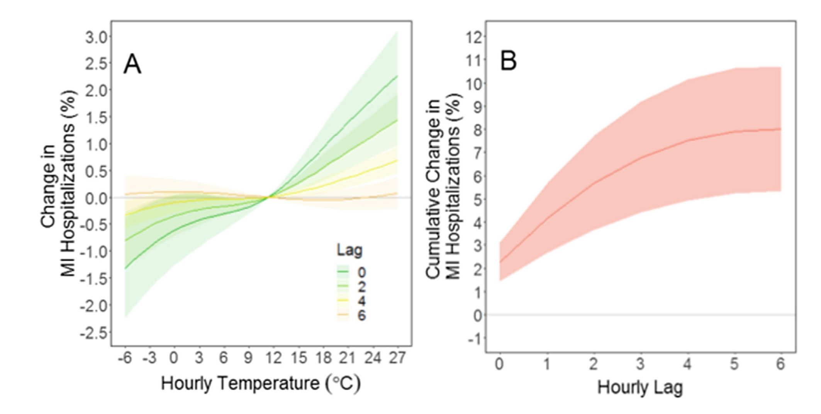
Exposure-response curves from hourly exposures with hourly outcomes!
Dataset: Linked hourly NLDAS-2 temperature by zipcode of residence
for 791,695 primary MI hospital admissions (lag 0 = admit hour minus 3)
Panel B illustrates the cumulative association for an increase from median temperature (11 °C) to the 95th percentile (27 °C) for lags 0–6.
Can ultra short-term changes in ambient temperature trigger myocardial infarction?
2020. Rowland et al. Env Int.
Notes:
Exposure-Response Curve for Selected Lags, In panel A, each curve illustrates the exposure–response relationship for selected lags. Only the first 4 even- numbered lags are included for visibility. Panel B illustrates the cumulative association for an increase from median temperature (11 °C) to the 95th percentile (27 °C) for lags 0–6. Shaded areas represent 95% confidence intervals.

Slide 6
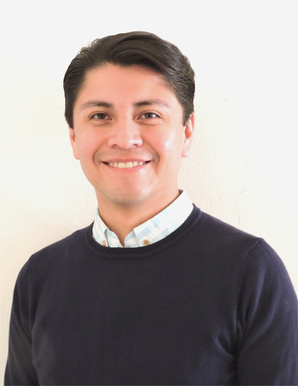
Daily exposure to PM_{2.5} and 1.5 million deaths: A time-stratified case-crossover analysis in the Mexico City Metropolitan Area
Daily exposures for each of 586 sub-county regions from our satellite-based geostatistical model
1,479,950 non-accidental deaths (≥18 years-old) 2004-2019
Largest acute air pollution analysis in Central Mexico
Cause-specific mortality, per 10μg/m³ PM_{2.5} (lag₀₆):
Dr. Iván Gutiérrez Avila
*HERE TODAY! See his poster
Notes:
Under-studied outcomes in air pollution epidemiology

Slide 7
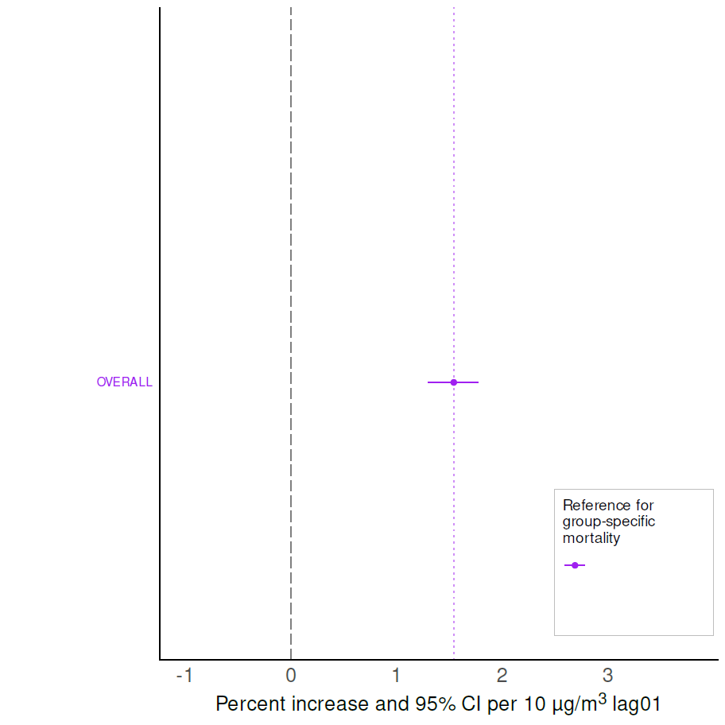
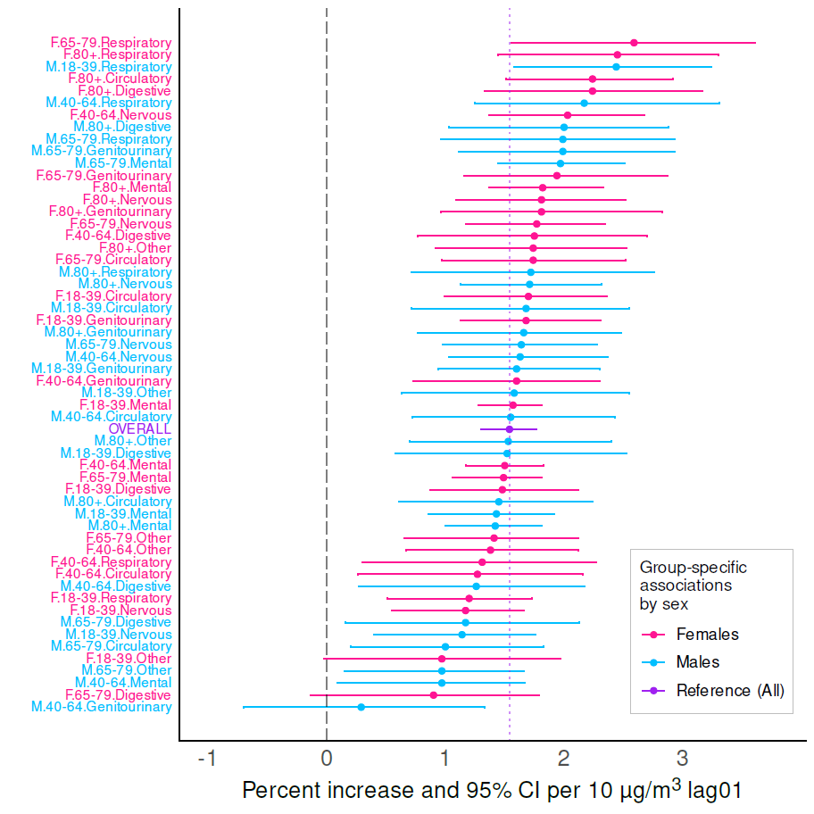
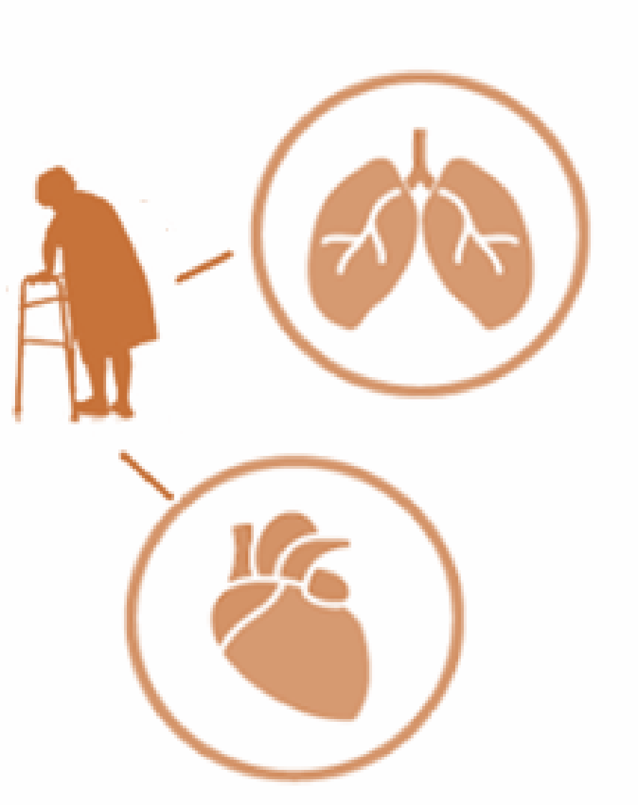

Ridge-derived estimates
Group-specific categories associated with PM_{2.5}
(Sex:Age-group:ICD-Group code)
Overall, a 10μg/m³ higher lag₀₁ PM_{2.5} was associated with
1.5% higher mortality (95%CI: 1.3% to 1.8%)
3 largest associations in Females for:
Respiratory mortality, 65-79 y/o: 2.6%
(95%CI: 1.6% to 3.6%)
Respiratory mortality, ≥80 y/o: 2.5%
(95%CI: 1.4% to 3.3%)
Circulatory mortality, ≥80 y/o: 2.2%
(95%CI: 1.5% to 2.9%)
3 largest associations in Males for:
Respiratory mortality, 18-39 y/o: 2.4%
(95%CI: 1.6% to 3.2%)
Respiratory mortality, 40-64 y/o: 2.2%
(95%CI: 1.3% to 3.3%)
Digestive mortality, 80+ y/o: 2.0%
(95%CI: 1.0% to 2.9%)

Slide 8
Challenges of connecting within-day exposure and health data
No remote sensing for air pollutants after dark
Lots of other reasons for missing products
Why the data is missing can matter – we need clean data AND integration with observations and models
Air pollution epidemiology is embracing uncertainty – let’s try to propagate it!

Slide 9
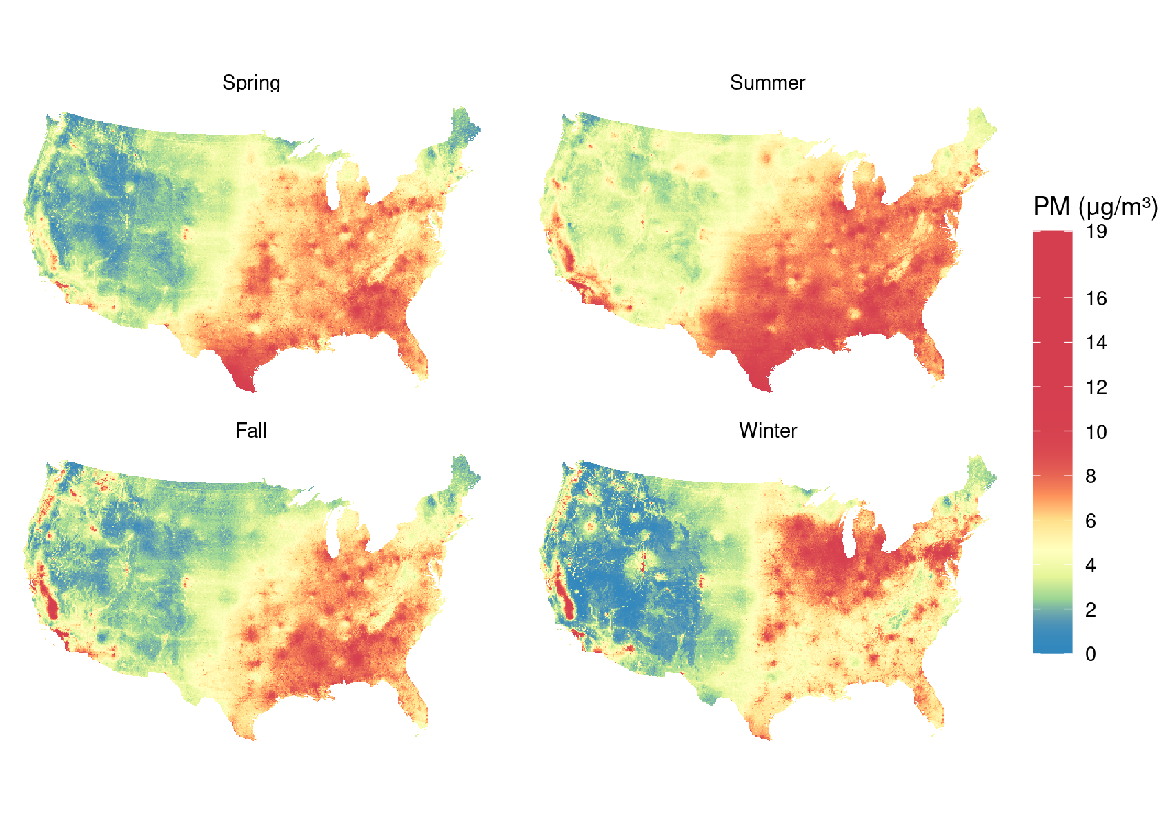
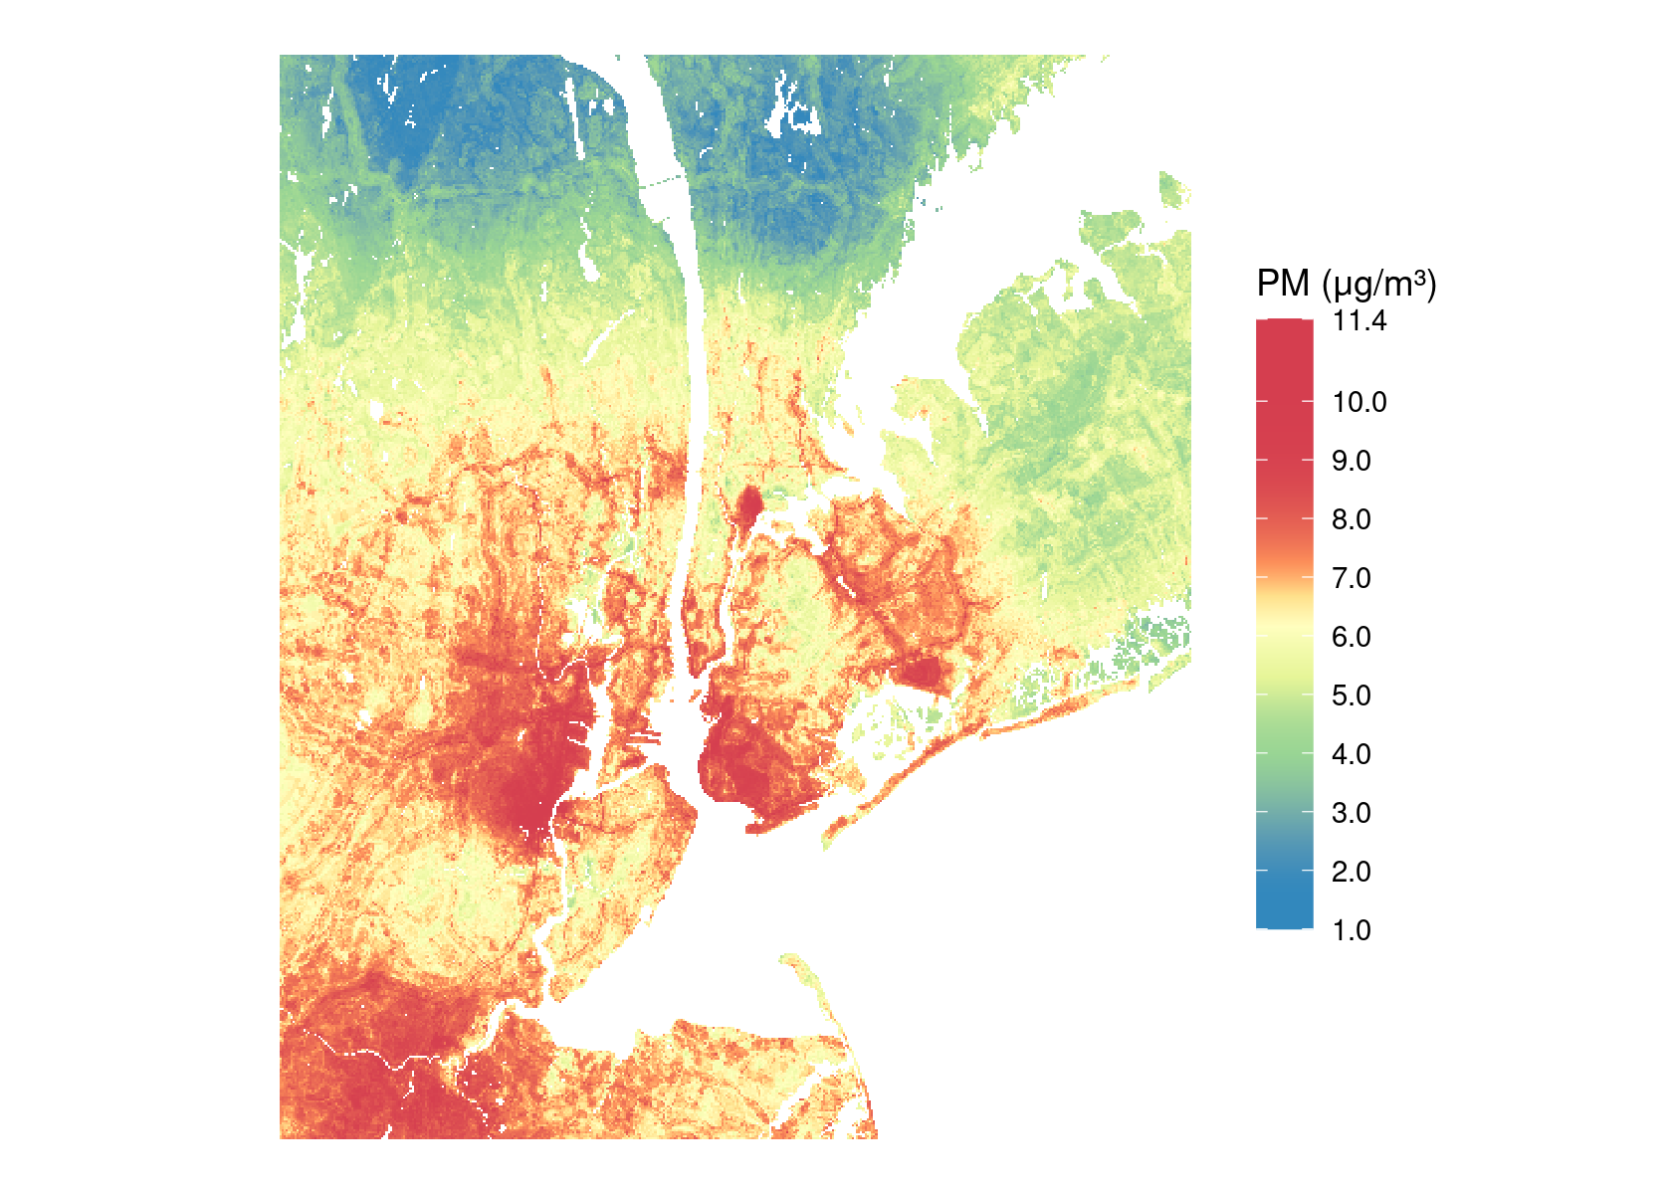
Daily high-resolution temperature and PM_{2.5} across the Continental USA (developed originally with support from NIH ECHO OIF)
Example: average 24-hour PM_{2.5}
Meteorologic seasons of 2019
Example: 24-hour PM_{2.5}
July 10, 2021
(different color scale)
Just et al. [Preprint] https://doi.org/10.1002/essoar.10512861.1
Notes:
Predicted PM2.5 on 10 Jul 2021 in the New York City area. We chose this date by computing the mean PM2.5 at all stations in this area for each day in 2021, then taking the median day.

Slide 10
Linking to large registries
Comprehensive NYS hospitalization records with dates (admission hour!)
and exact residential addresses 2007-2023 (but only through 2020 for now)
Statewide Planning and Research Cooperative System (SPARCS)
Year 2 of 5-year R01 for the NIEHS Outstanding New Environmental Scientist (ONES) RFA:
“Extreme temperature, humidity, air pollution and spontaneous preterm birth”

Slide 11
Everything is a mixture
Multiple air pollutants
Components of thermal stress
Social determinants of health
allan.just@mssm.edu
allan_just@brown.edu (July 1)

Slide 12
TEMPO and environmental health application needs
How will TEMPO data improve your current research or operations?
How will TEMPO enhance your application area?
What are the broader implications of TEMPO data on environmental health research?
How do you (as an organization) intend to process and analyze TEMPO data?
Do you have the resources needed to implement using TEMPO in your research or operations?
What are your needs in terms of data products and levels?
Discuss needs for any level 3 products and resolution?
Data latency needs?
PBL ozone? Aerosols?
What other data formats and tools would facilitate your use of TEMPO data?
Do you have any needs for data from the TEMPO special operations to further improve your research or operations?
Are there additional scientific or other organizational partners that might pair up with TEMPO early adopters in environmental health?
What attainable “early wins” with TEMPO data could help address scientific or policy-relevant gaps / questions in environmental health and demonstrate the contributions of this new instrument?

