Slide 1
Can TEMPO Help Save Lives from Dust-Caused Roadway Crashes?
Daniel Tong, George Mason University
Barry Baker, NOAA Air Resources Laboratory

Slide 2
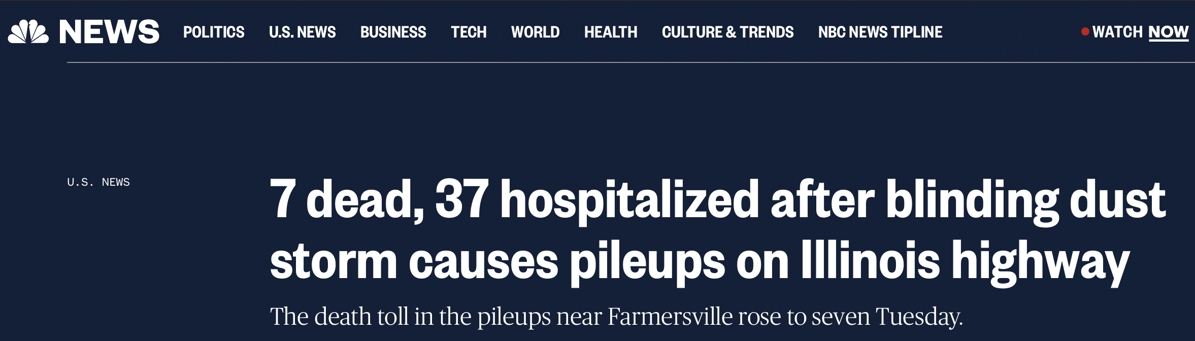

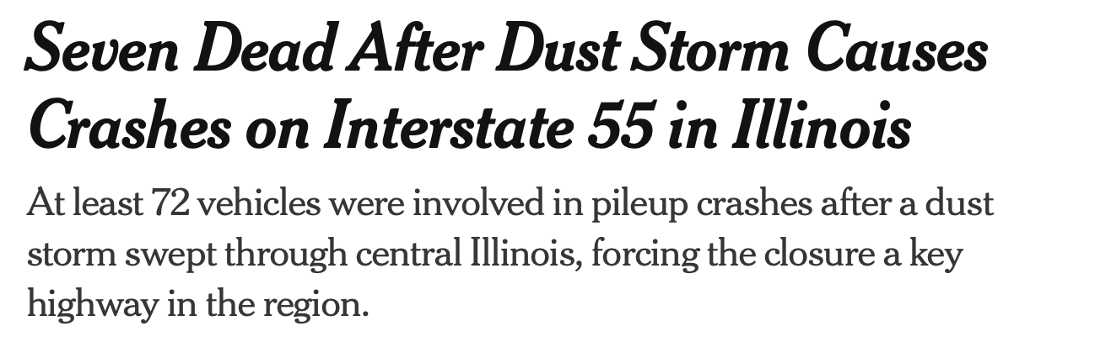
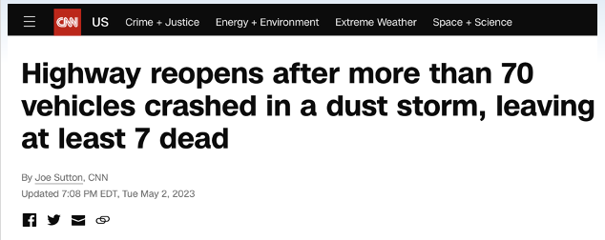

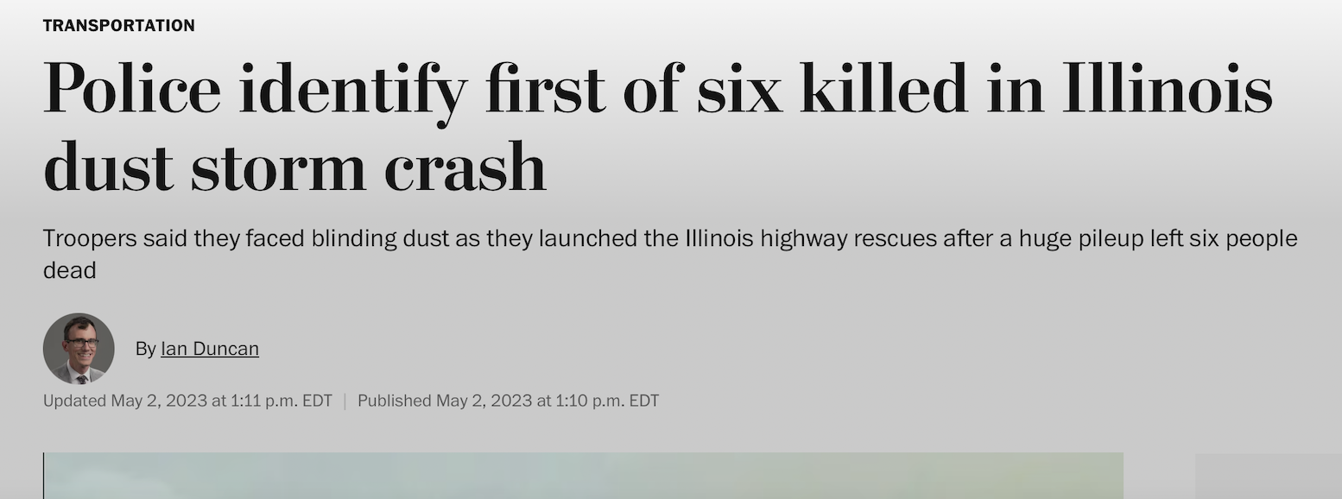
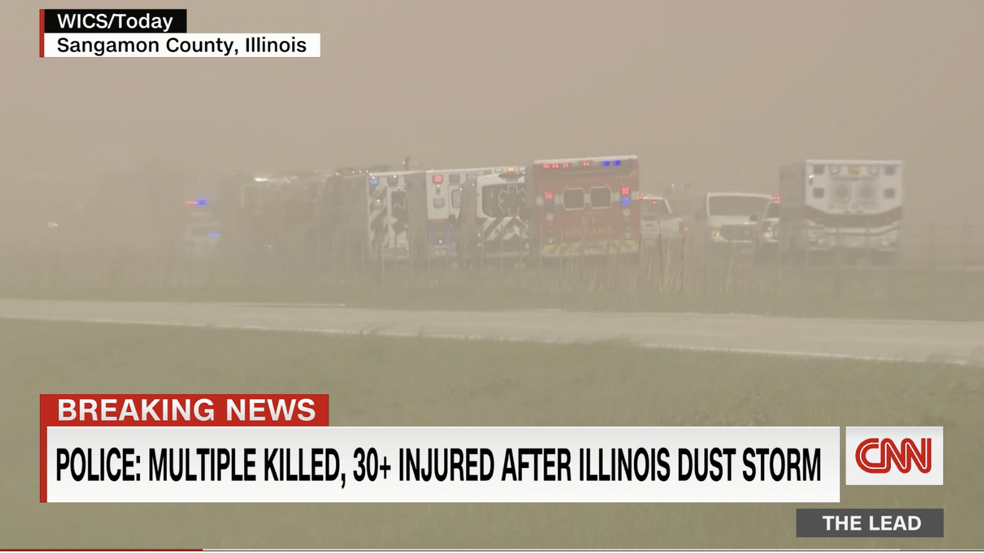
May 1, 2023 Dust Storm in Illinois

Slide 3
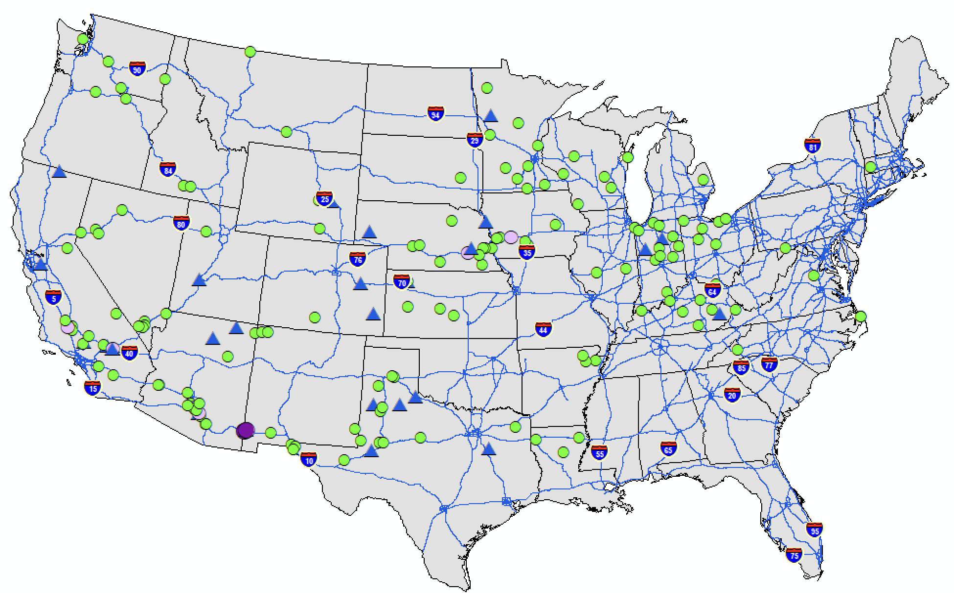
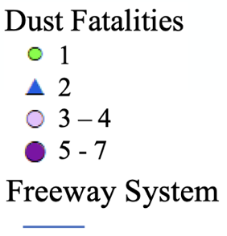
How Many People Were Killed by Dust Storms in the US?
14-33 dust fatalities (2007-2017)
→ Comparable life losses from hurricanes and wildfires
(Tong et al., BAMS 2023)

Slide 4
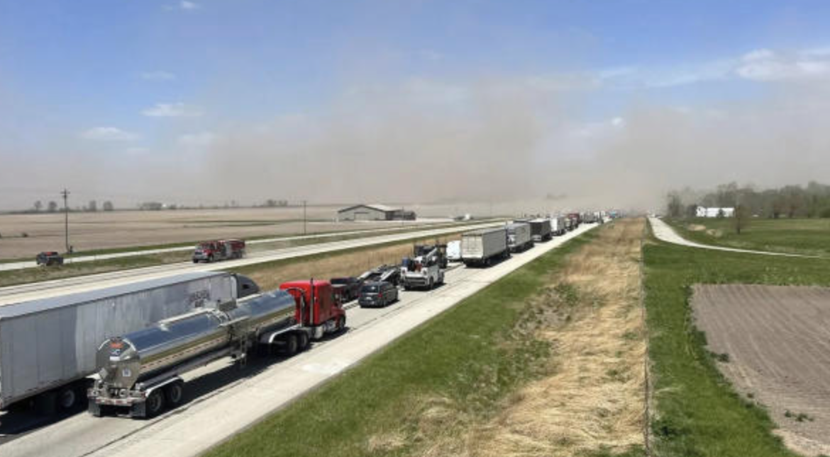
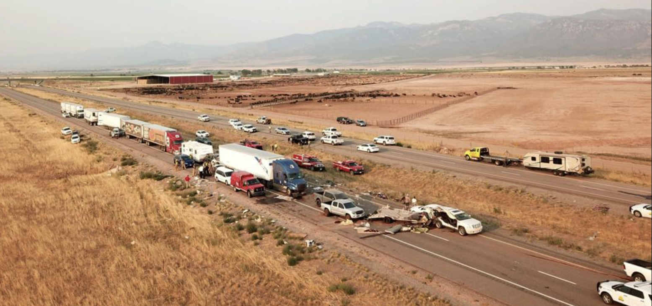
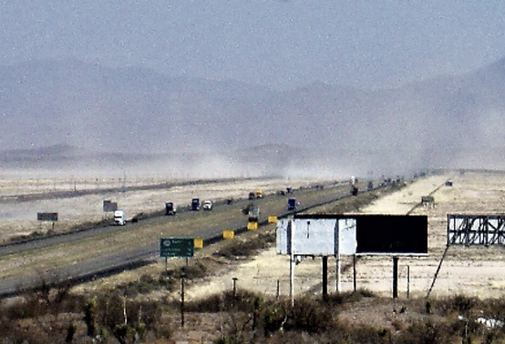
“Killer” Dust Storms
Deadliest Dust Storms
Dust Sources
- 17 deaths, 11/29/1991 CA
- 8 deaths, 7/26/2021 Utah
- 7 deaths, 5/1/2023 Illinois
- 7 deaths, 5/22/2014 NM
- 6 deaths, 6/19/2017 NM
- Agricultural fields
- Exposed land (unknown land use)
- Agricultural fields
- Playa (dry lake)
- Playa (dry lake)
Agricultural fields
Exposed Land
Playa
How can we detect land disturbance (e.g., agricultural tilling) in real time?

Slide 5
Possible to Predict “Killer” Dust Storms?
How to predict a dust storm?
Escape Fraction
Source Area
Soil Erosion Potential
Friction Velocity
Threshold
Friction Velocity
Land Use
Challenges
Opportunities
- Dynamic changes in Source Area (S)
- Hard to predict high winds
- Land surface conditions (roughness)
- Threshold velocity
- True color, albedo?
- Dust/Aerosols to verify wind fields?
- Albedo
- Soil moisture

