Slide 1
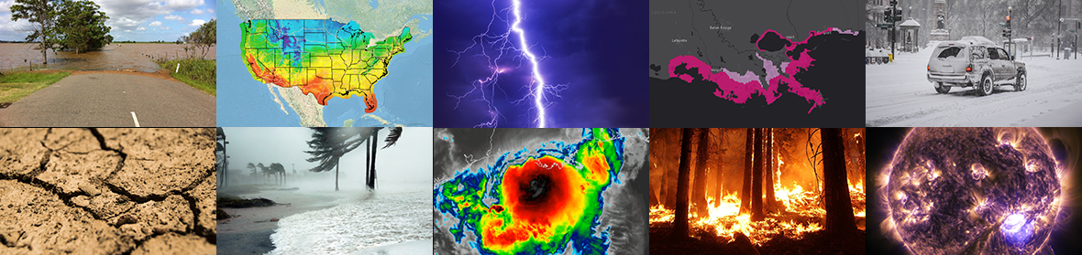
Panel Discussion
Ivanka Stajner, NOAA/NWS/NCEP/EMC
TEMPO Early Adopters / Science Team Joint Panel
Joint Science Meeting for TEMPO, GeoXO ACX, & TOLNet May 4, 2023

Slide 2
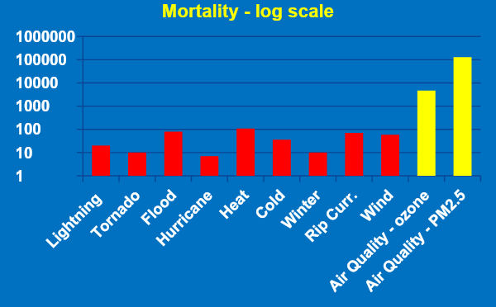
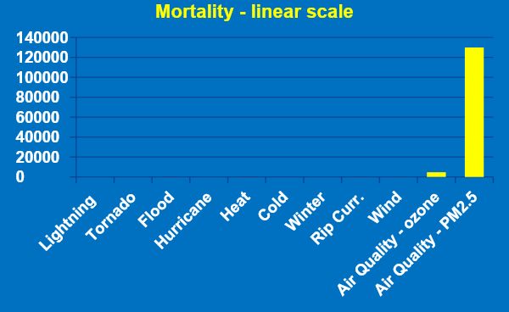
Why: Societal Impacts of Weather and Air Quality
█ Red: Weather fatalities for 2018 (source: https://www.weather.gov/hazstat/) same data - linear scale
█ Yellow: Air Quality mortality for 2005 (source: Fann et al., Risk Analysis, 2012 https://onlinelibrary.wiley.com/doi/abs/10.1111/j.1539-6924.2011.01630.x)
In the United States, annual mortality from poor air quality (over 100,000) substantially exceeds mortality from all other weather phenomena (530).
AQ prediction customers include: general public, state and local environmental agencies, EPA, CDC
Notes:
Weather fatalities for 2018 (source: https://www.weather.gov/hazstat/)
Air Quality mortality for 2005 (source: Fann et al., Risk Analysis, 2012 https://onlinelibrary.wiley.com/doi/abs/10.1111/j.1539-6924.2011.01630.x)
Updated PM2.5 mortality estimates for 2014 are 121,000 (95% confidence interval: 83,000–160,000) by Fann et al., Environmental Research (2018) https://doi.org/10.1016/j.envres.2018.08.018.

Slide 3
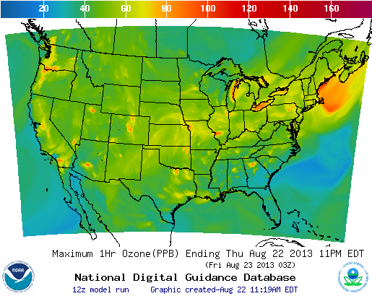
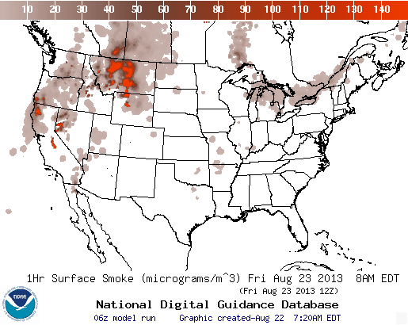
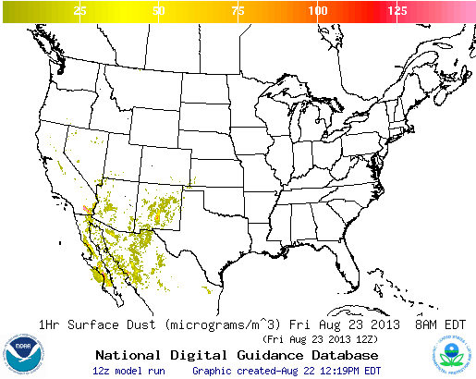
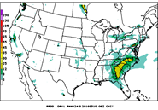
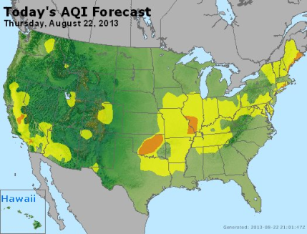
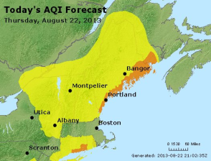
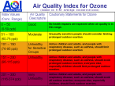
Air Quality Forecasting Partnership
http://airquality.weather.gov/
Exposure to fine particulate matter and ozone pollution leads to premature deaths of over 100,000 annually in the US (Fann, 2011, Risk Analysis)
Air quality forecasting in the US relies on a partnership among NOAA, EPA, state and local agencies. NOAA-EPA MOU renewed in January 2021.
NOAA air quality forecasting team includes NWS, OAR and NESDIS
ozone
smoke
dust
NOAA
integrate, evaluate and improve models; provide operational AQ predictions
PM2.5
EPA
maintain national emissions, monitoring data, develop AQ models;
disseminate/interpret AQ forecasts
State and
local agencies
provide monitoring data & emissions; provide
AQI forecasts
http://airnow.gov/
Notes:
Partners’ roles:
State and local agencies provide emissions and monitoring data.
Those data are compiled and maintained by the EPA for the Nation and air quality models are developed.
Using national emissions and monitoring data NOAA integrates, evaluates and improves air quality prediction models.
NOAA produces operational air quality predictions of ozone, smoke and dust (available to the public at http://airquality.weather.gov).
State and local agencies use NOAA’s predictions in issuing Air Quality Index (AQI) forecasts for their areas.
EPA sets the AQI scale based on health impacts of poor air quality.
EPA facilitates dissemination AQI forecasts to the public through the AIRNow web site.

Slide 4
Air Quality Predictions for the U.S.
Operational air quality predictions for the US (hours to days):
  CMAQ: AQ (ozone and PM2.5). Since July 2021 it is driven by GFS and produces 72 hour predictions
  HYSPLIT: dust dispersion
  RAP/HRRR: smoke dispersion and radiative impacts
Online CMAQ system development:
  full chemistry, one large domain
  online transport
  hourly resolved representation of wildfire emissions
  higher resolution
  data assimilation: AOD, PM2.5, NO2
  AI methods for computational efficiency

Slide 5
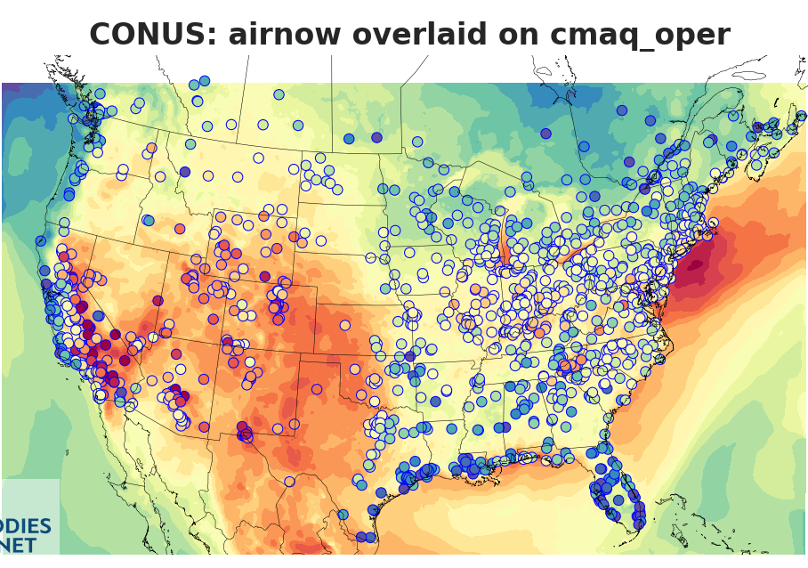
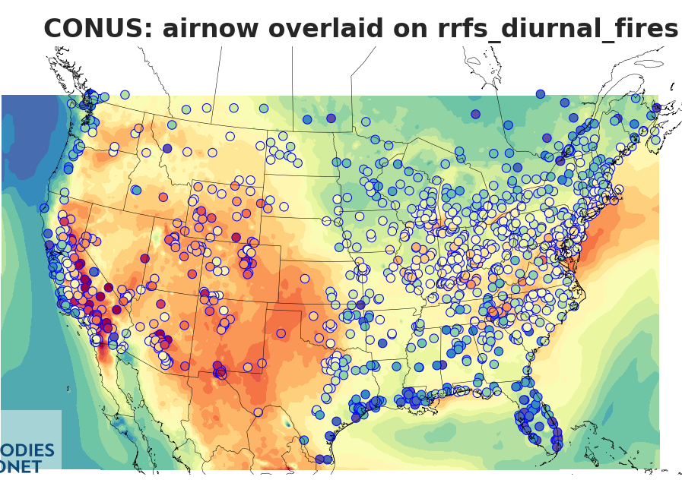
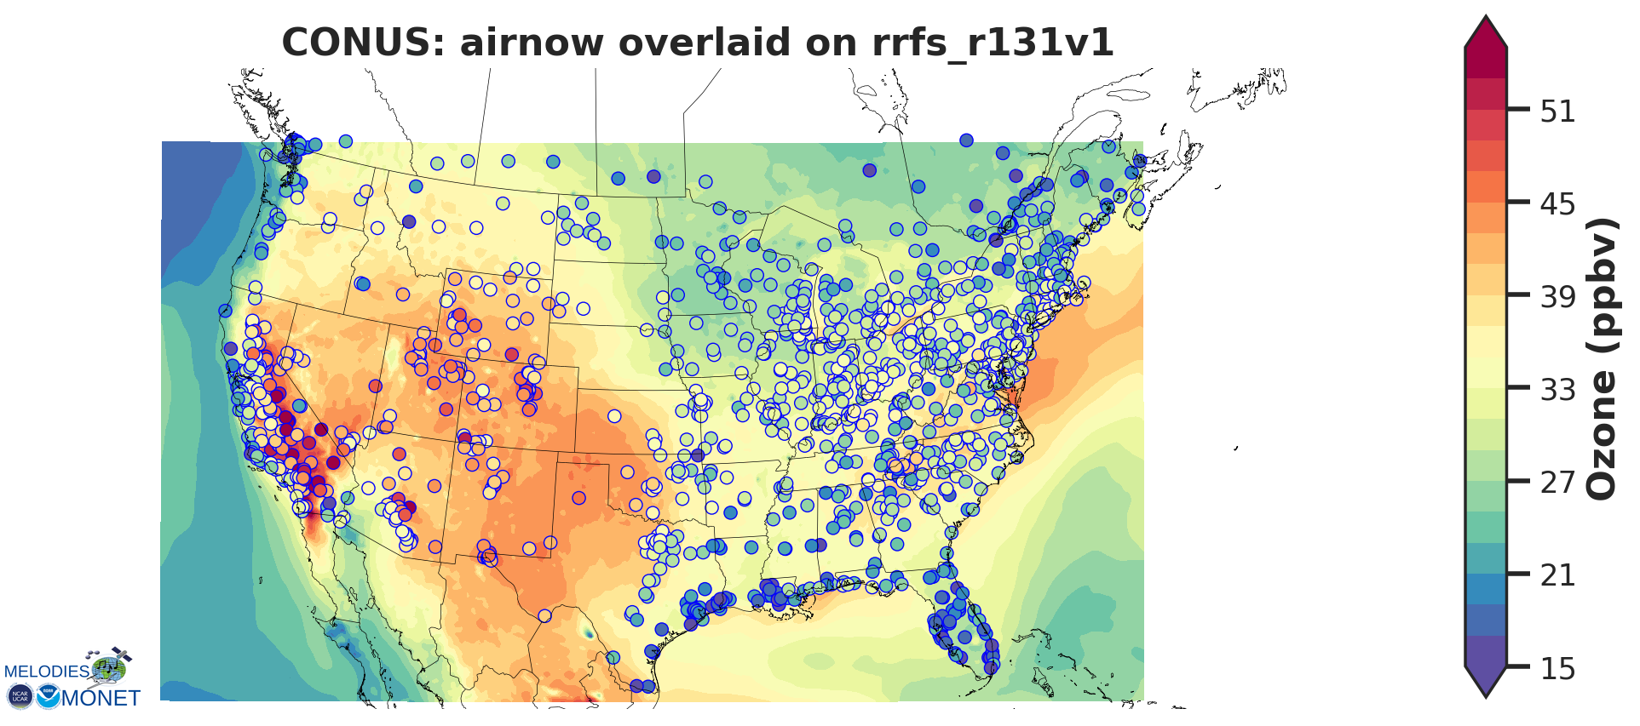
Ozone Average for August 1-10, 2019
AIRNow overlaid on operational CMAQ
AIRNow overlaid on Online CMAQ (143_a)
Initial comparisons indicate comparable ozone performance, with reduced ozone prediction biases in Online CMAQ compared to operational CMAQ in coastal areas along the Atlantic and the Gulf of Mexico

Slide 6
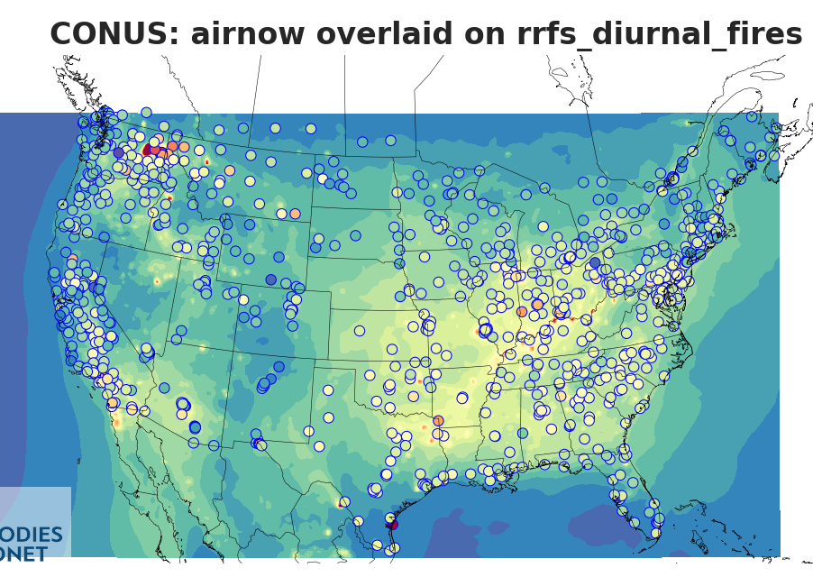
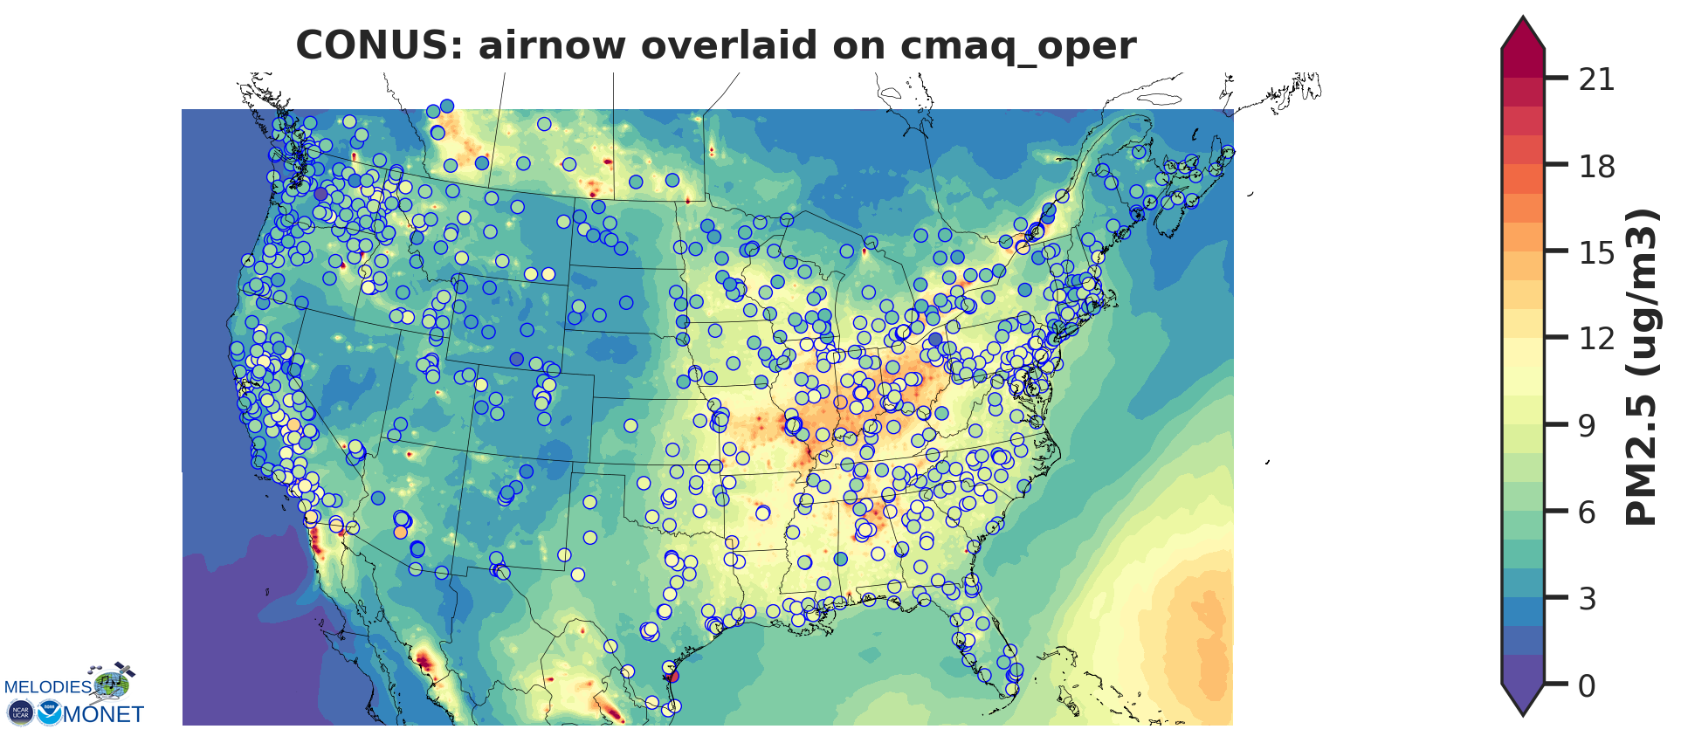
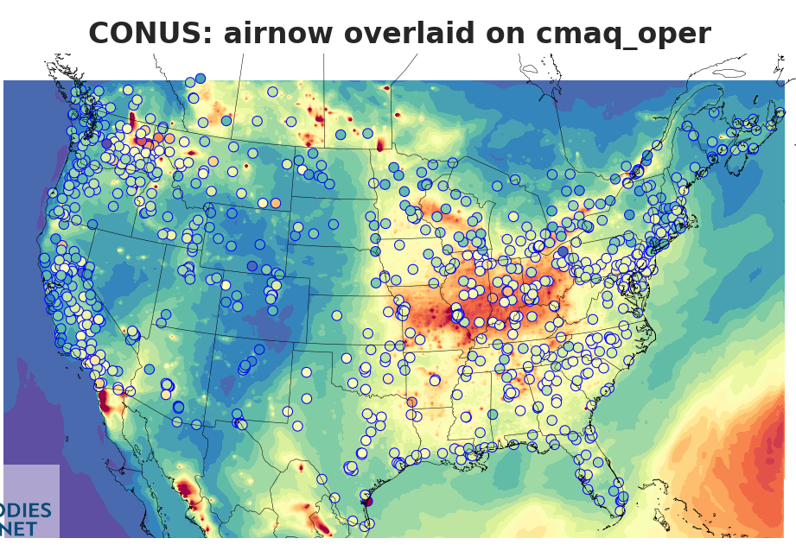
PM2.5 Average for August 1-10, 2019
AIRNow overlaid on Online CMAQ (143_a)
AIRNow overlaid on operational CMAQ
Initial comparisons indicate:
Reduced bias for PM2.5 in Online CMAQ (especially in the Eastern US),
Improved representation of the diurnal cycle (not shown),
There is some underestimation (LBCs, fires?).

Slide 7
Potential impacts from TEMPO
Better air quality prediction of ozone and PM2.5:
  Data assimilation of atmospheric concentrations of gases (ozone and precursors) and aerosols
  Better emission inputs
  Coupled data assimilation of atmospheric concentrations and emissions
Better representation of atmospheric composition
Potential improvements to weather prediction from including atm. comp. - physics interactions

Slide 8
TEMPO: needs and potential intentions
Level 2 data for data assimilation with information needed for DA (averaging kernel)
Potential interest in: ozone profile, nitrogen dioxide, formaldehyde, aerosol optical depth, aerosol height and aerosol absorption index
An hour latency would be ideal
There is minimal initial funding for use of TEMPO data and a more robust approach is needed

Slide 9
Summary
National AQ predictions:
Mortality for poor AQ far exceeds that from all other weather phenomena combined
Partnership among NOAA, EPA, state and local agencies to provide AQ forecasts for the U.S.
NWS provides national ozone (72h), PM2.5 (72h), smoke (48h), dust (48h) predictions
Under development: online CMAQ predictions, higher resolution, wildfire impacts, DA
Satellite data needs:
Emissions inputs (fire emissions, NOx trends, dust sources) and verification of predictions
Developing assimilation of satellite AOD and NO2 data into CMAQ coupled with a high resolution weather model.
Assimilation of ozone and formaldehyde

Slide 10
Needs and challenges
Build foundational DA capability to effectively use AQ and Atm. Comp. satellite data
Emissions:
Specification & prediction of biomass burning & dust emissions
Timely updates of anthropogenic emissions
Data Assimilation:
Integral quantities observed – AOD is integral over all aerosol species, sizes and the column
Loss of satellite instrument sensitivity for gaseous composition in PBL
Quality Control and correction of observation biases
Better coordination with product developers from retrieval to data assimilation
Synergies:
Coupled data assimilation for real-time updates of atmospheric concentrations and emissions
Use information from observation-model comparisons in DA to improve process representation in the model
of

