Slide 1

NASA’s Engagement Efforts with the Volcanic Ash Advisory Centers
Panel discussion TEMPO’s application workshop; 5/4/2023
Jean-Paul Vernier (NASA LARC), Mairen Flanagan (NASA HQ)

Slide 2
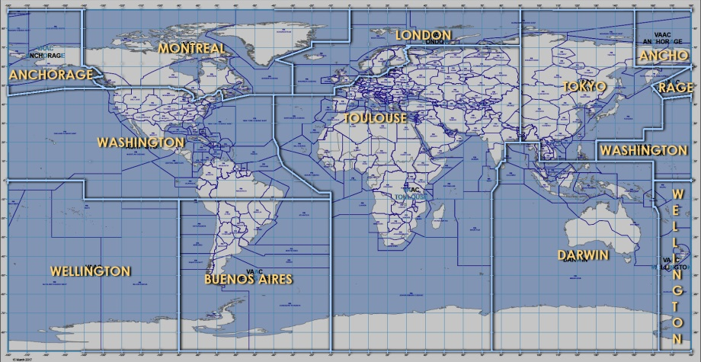
VAAC Overview
Nine Volcanic Ash Advisory Centers worldwide, usually overseen by meteorological agencies
Dual responsibility for some of providing ash and weather forecasts
Focus on real-time operations, rarely able to perform retrospective studies
Tasked by International Civil Aviation Organization (ICAO) with monitoring eruptions, providing information/advisories about ash clouds
Extent of cloud, trajectory forecast, any changes, etc
Aviation hazards major focus- aircraft encounters with ash, damage

Slide 3
NASA Disasters program initiatives
Goal: Understand how VAACs using NASA data, improve connections, determine how NASA can provide support
A Survey was created last year to understand how VAACs operate, what limitations present in NASA data/products, what improvements are desired (Feedbacks from 5/9)
Bi-annual workshop was established since last year for continuous dialogue. 3rd NASA-VAAC workshop will be held in June 2023
TEMPO application workshop : two representatives from the VAAC in Anchorage and Montreal (Nate Eckstein, Dov Bensimon) will share their views on how TEMPO might be used in their operations and discuss opportunities and challenges. Jamie Kibler from Washington VAAC could not join.

