Slide 1
TEMPO & NWS Operations
Kristopher White
Applications Integration Meteorologist
NWS / NASA SPoRT – Huntsville, AL

Slide 2
TEMPO Data for NWS Operations
What type of extreme events or disasters are most applicable to our work?
This will be variable of course across the National Weather Service (NWS) domain.
Severe weather from thunderstorms and tropical systems tends to dominate in the Southeast CONUS. That is, the prediction of severe weather of all types (winds, tornadoes, flooding, hail) is generally most applicable. Although, phenomena such as extreme temperatures, droughts, and wildfire activity can certainly play an important role in our work here.
Other regions, however, typically have more significant impacts and responsibilities associated with wildfires/smoke, blowing dust, winter weather hazards (e.g., blizzards, ice storms, extreme cold), volcanic eruptions, etc.

Slide 3
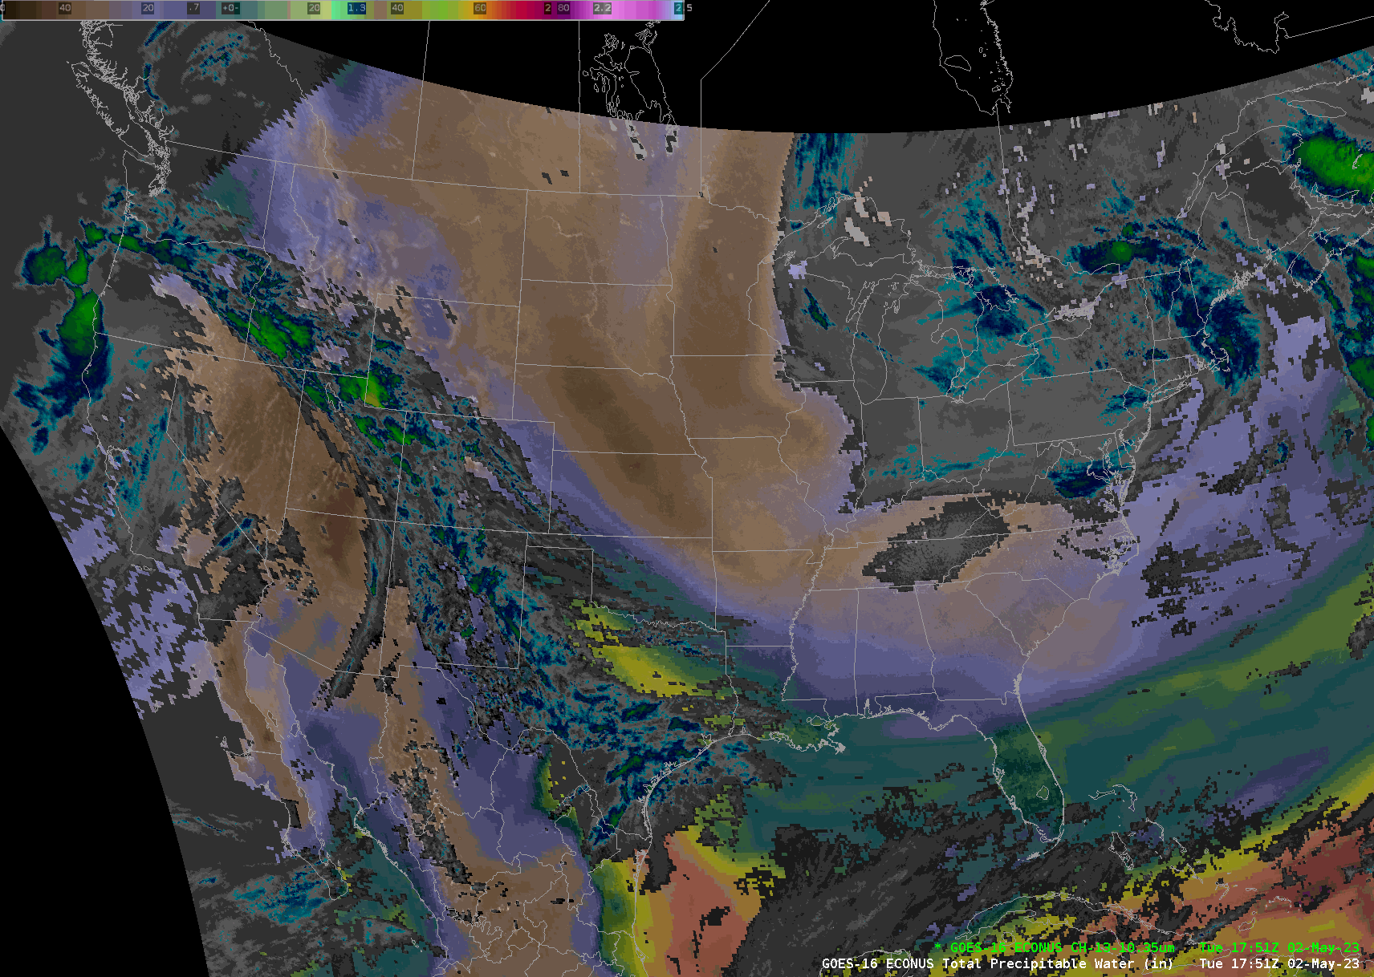
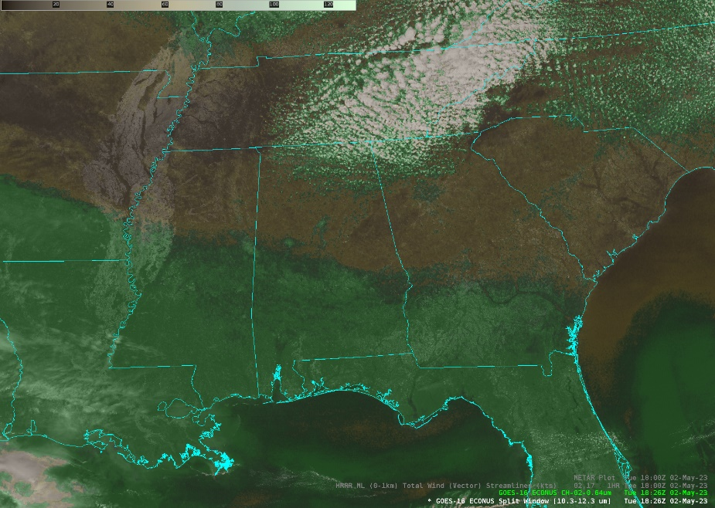
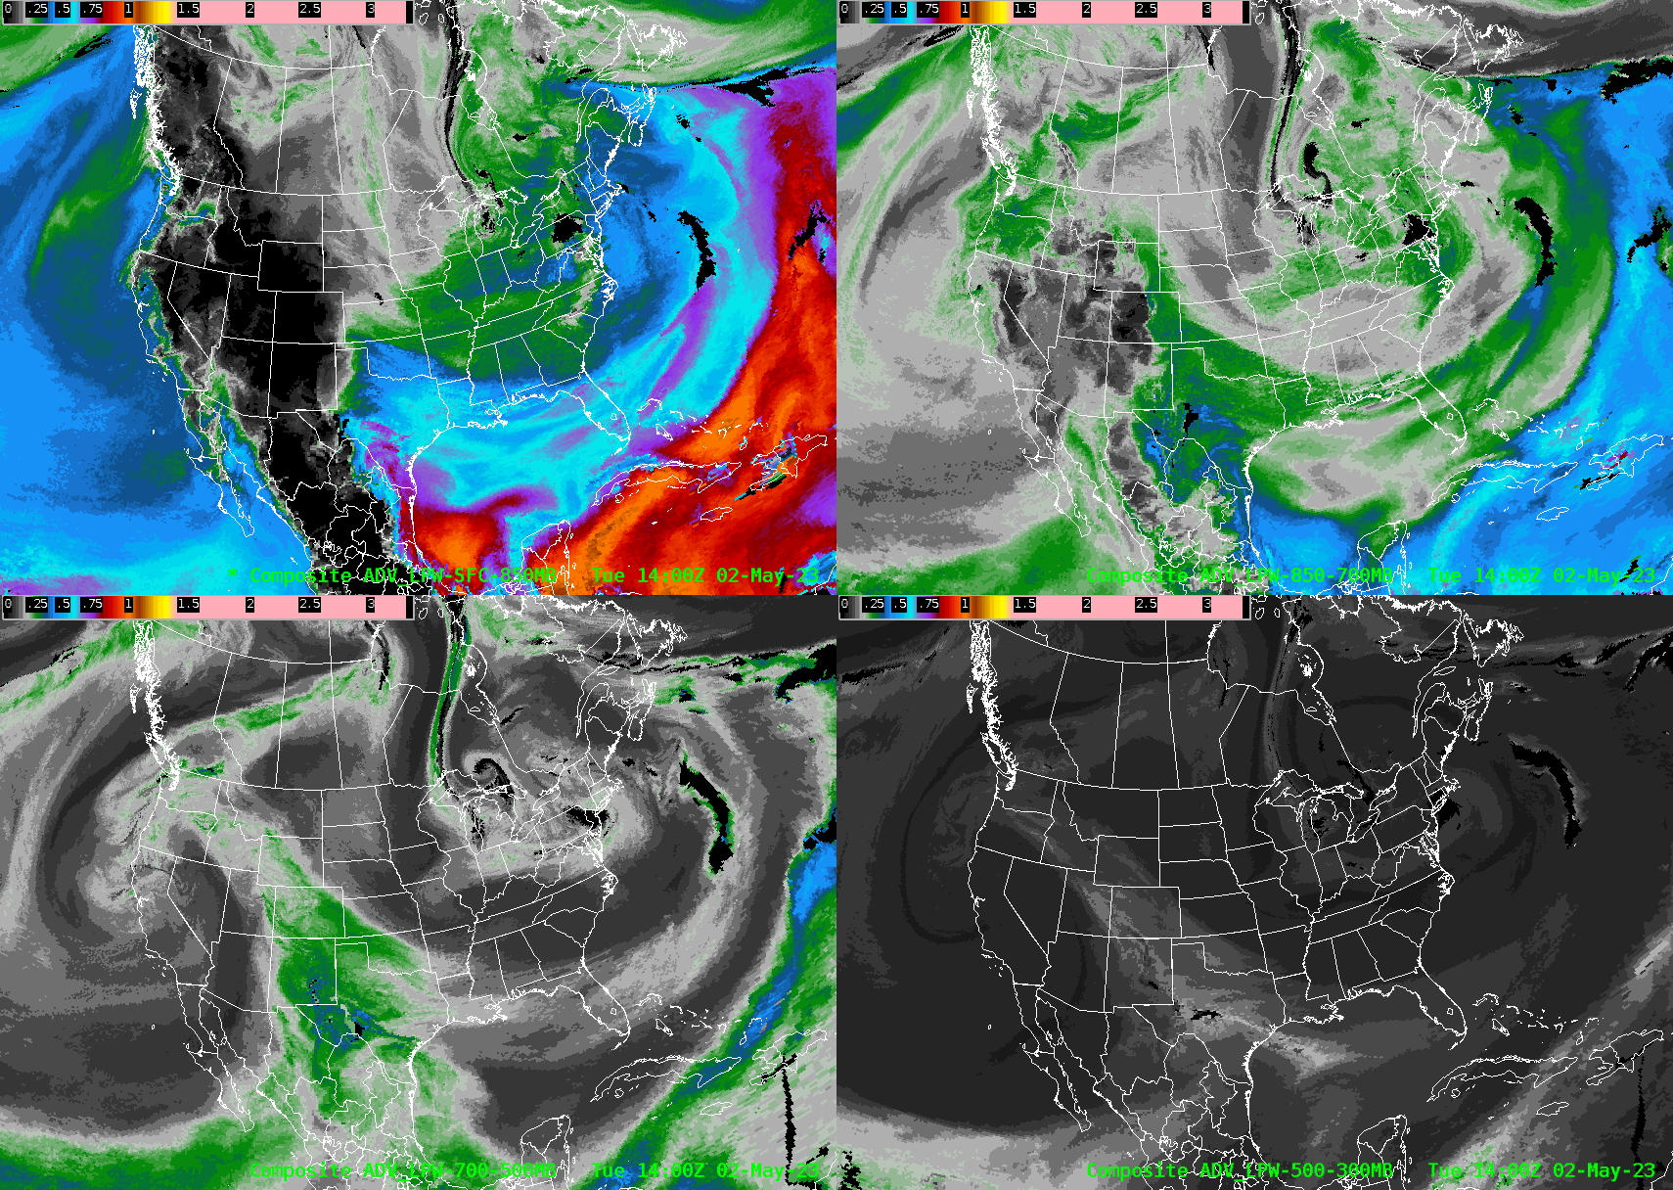
TEMPO Data for NWS Operations
How will TEMPO data improve or potentially affect your current operations?
Speaking for my own NWS region who share similar interests/impacts…
Moisture plume/boundary detection
Detection of magnitude of PW in moisture plumes and/or atmospheric rivers can be critical to NWS forecasts.
The detection of low-level moisture boundaries/gradients can be especially critical since they may foretell where convection is most likely to develop. Additionally, their orientation to other features can be crucial for assessing prospects for severe weather.
How well will TEMPO data be able to resolve these features?

Slide 4
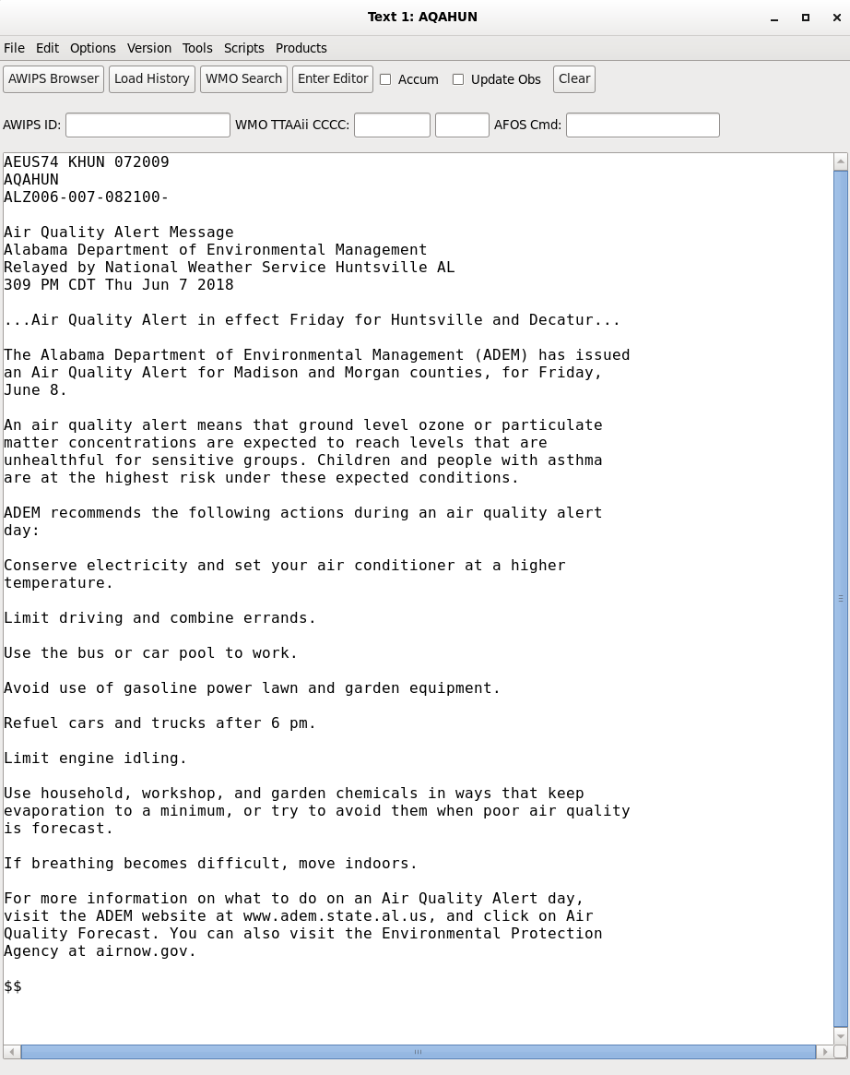
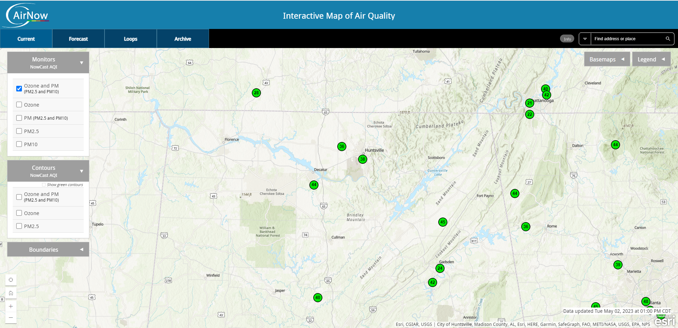
TEMPO Data for NWS Operations
How will TEMPO data improve or potentially affect your current operations?
Speaking for my own NWS region who share similar interests/impacts…
Air Quality Alerts
Daily checks of Ozone and PM2.5 data at EPA’s AirNow website. If the Air Quality Index exceeds 100, then an AQA is issued.
Air Quality Alerts (AQAs) issued by NWS offices are limited in space and time. For example, at NWS HUN, AQAs are only issued for Huntsville/Decatur metro area (Madison/Morgan Counties), and once per day.
How will data from TEMPO affect the issuance of AQA products? Will TEMPO data affect Air Quality Forecast Guidance for the National Air Quality Forecast Capability?
https://airquality.weather.gov/

Slide 5
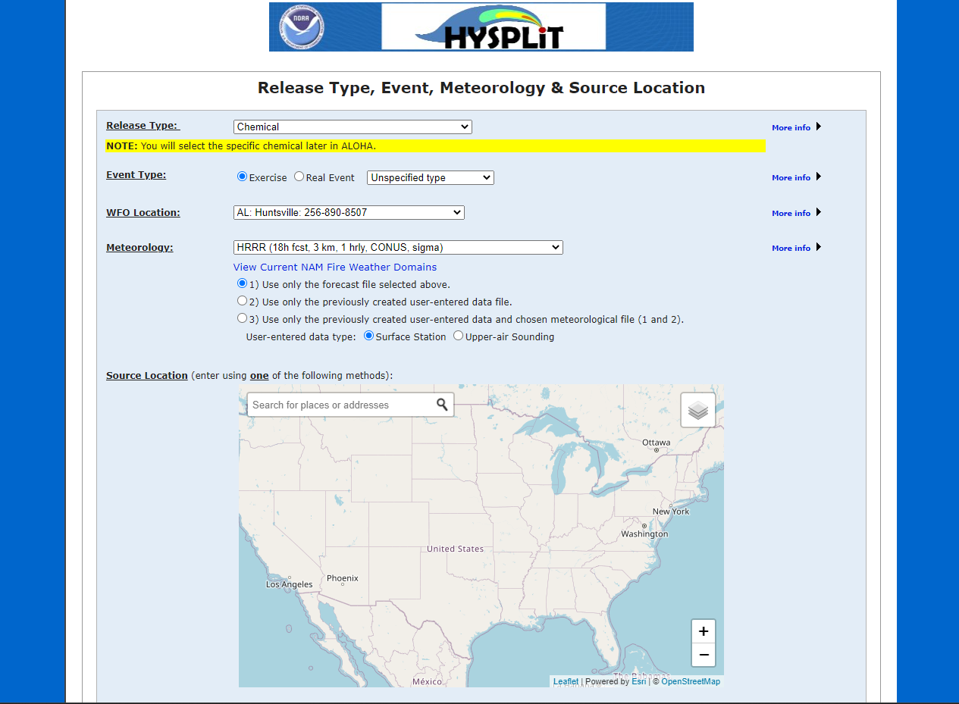
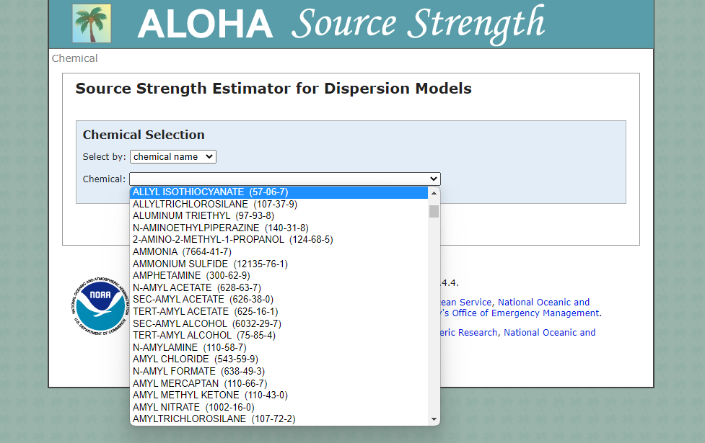
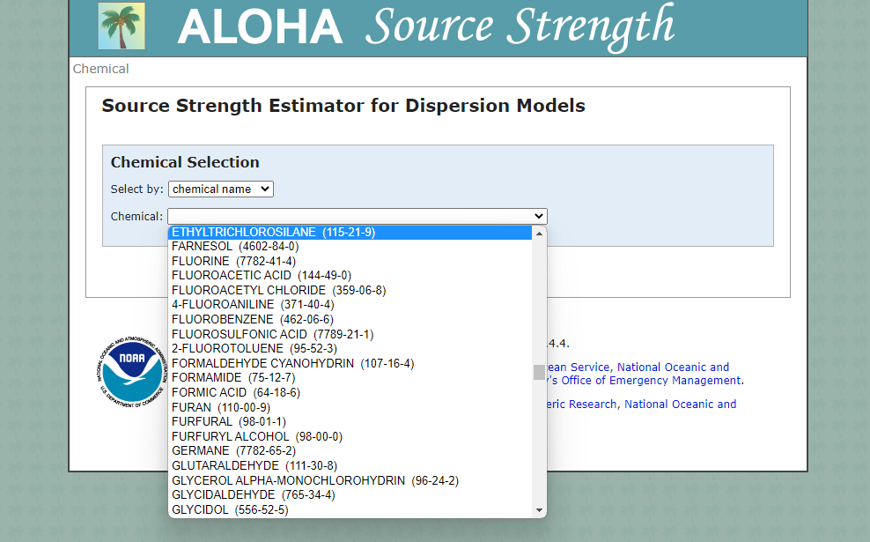
TEMPO Data for NWS Operations
How will TEMPO data improve or potentially affect your current operations?
Speaking for my own NWS region who share similar interests/impacts…
Hysplit/ALOHA dispersion models
Emergency Managers may request Hysplit/ALOHA dispersion model runs in Hazmat incidents. For known chemical substances, there is a rather lengthy list available. Can TEMPO resolve some of these specific chemical releases and will data be available to update dispersion model runs?

Slide 6
TEMPO Data for NWS Operations
How do you (organization) intend on processing and analyzing TEMPO data?
Good question! In NWS Offices, we often use the Automated Weather Interactive Processing System (AWIPS) to interrogate satellite imagery/data. Official satellite data are received via the Satellite Broadcast Network and the Total Operational Weather Readiness – Satellites (TOWR-S) group determines satellite products and menus.
Do you have the resources needed to implement TEMPO into your research or operations?
Training would be needed. Training that addresses intended applications for products, but also that importantly discusses data/product limitations.
Data latency needs?
As an operational entity, the NWS needs as little latency as possible. Generally speaking, latency and data temporal resolution should be appropriate to match that of the weather/climate phenomena in question (tornadoes, cold fronts, tropical cyclone, drought). Typically, data latency in NWS operations is on scales from minutes to hours. Critical moisture data in the lower levels can be one hour less, but a little longer could suffice. Detection/measurements of smoke, and other chemical dispersions of hazmat significance should be of similar latency, or as quickly as possible.
Would the TEMPO special operations further improve your research or operations? How?
The increase in temporal resolution can certainly positive impact NWS operations, especially for rapidly-evolving features such as moisture boundaries. The same may be true for particularly hazardous chemical releases.

