Slide 1
Exploring the Value of GeoXO Atmospheric Composition Data for Improving Health and Air Pollution Injustice
Katelyn O’Dell, Daniel Goldberg, Gaige H. Kerr, Zigang Wei, Hai Zhang, Barron Henderson, Shobha Kondragunta, and Susan C. Anenberg

Slide 2
There are many exciting applications of GeoXO atmospheric composition data with potential health benefits.
GeoXO will have hourly atmospheric composition measurements of trace gases and particles
which has many health-relevant applications:
Monitoring pollutant concentrations between monitors, flagging additional locations which may exceed daily and annual NAAQS.
Improved identification of pollutant sources, providing better guidance for policy to reduce emissions and protect health.
Identification of air quality alert days in near-real time in locations without surface monitors.
And more!
Notes:
There are a few reasons we might want a how-to guide like this one for applications of current and upcoming geostationary satellite data and a second for planning future missions, which is the origins of our project. …… there are many potential applications of this data for reducing exposure to air pollution, here I’m going to talk about air quality nowcasting applications

Slide 3
There are many exciting applications of GeoXO atmospheric composition data with potential health benefits.
GeoXO will have hourly atmospheric composition measurements of trace gases and particles
which has many health-relevant applications:
Monitoring pollutant concentrations between monitors, flagging additional locations which may exceed daily and annual NAAQS.
Improved identification of pollutant sources, providing better guidance for policy to reduce emissions and protect health.
Identification of air quality alert days in near-real time in locations without surface monitors.
And more!
Notes:
There are a few reasons we might want a how-to guide like this one for applications of current and upcoming geostationary satellite data and a second for planning future missions, which is the origins of our project. …… there are many potential applications of this data for reducing exposure to air pollution, here I’m going to talk about air quality nowcasting applications

Slide 4
Monitoring networks used for EPA NowCast are sparse, especially in the west where wildfires have increased short-term PM_{2.5} events.
Decadal change in extreme PM_{2.5} days
[2016-2020] – [2006-2010]
Figure from Burke et al., 2022
Notes:
This is an important application of satellite data for protecting health ….

Slide 5
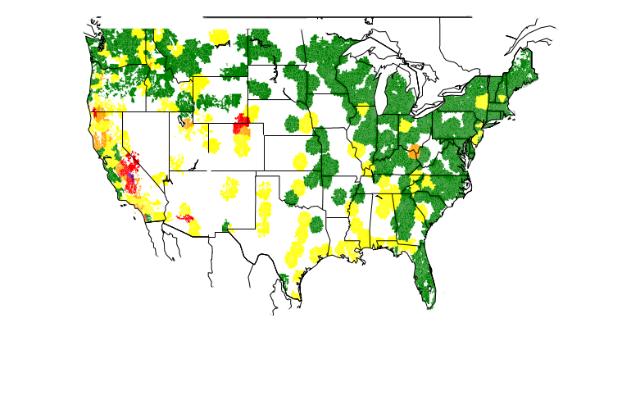
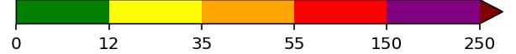
Monitoring networks used for EPA NowCast are sparse, especially in the west where wildfires have increased short-term PM_{2.5} events.
AirNow monitor based NowCast
Decadal change in extreme PM_{2.5} days
[2016-2020] – [2006-2010]
PM_{2.5} [µg m⁻³]
Figure from Burke et al., 2022
Notes:
But when we look at nowcasting based solely on surface monitors, there are large gaps in the western US. Geostationary data not only gives us information between the monitors but also provides a higher spatial resolution.

Slide 6

Monitoring networks used for EPA NowCast are sparse, especially in the west where wildfires have increased short-term PM_{2.5} events.
AirNow monitor based NowCast
Decadal change in extreme PM_{2.5} days
[2016-2020] – [2006-2010]
Geostationary-satellite based NowCast
Figure from Burke et al., 2022
PM_{2.5} [µg m⁻³]
Notes:
But when we look at nowcasting based solely on surface monitors, there are large gaps in the western US. Geostationary data not only gives us information between the monitors but also provides a higher spatial resolution. …. Also polar orbiters and fire timing

Slide 7
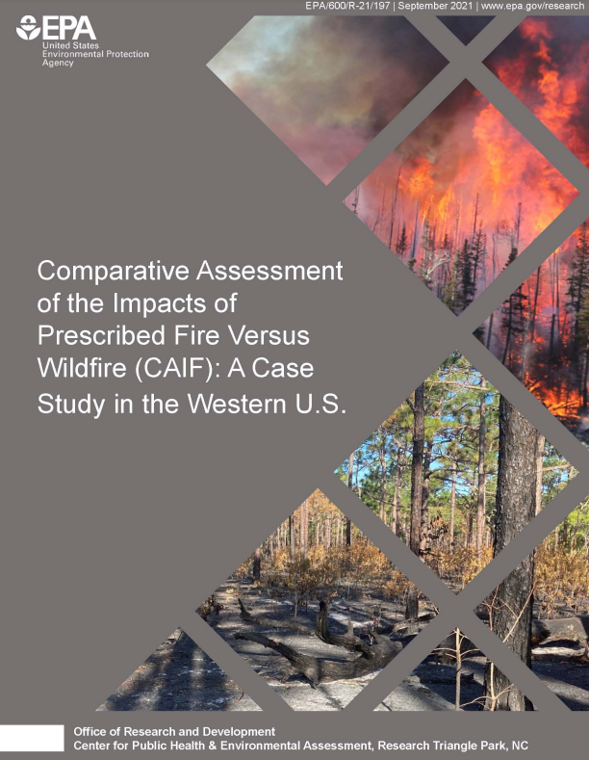
When aware of poor air quality, people modify their behavior to reduce exposure.
% reduction in PM_{2.5} exposure
Graphic adapted from EPA CAIF report, 2021
Notes:
Monitoring these events in near real time is important from a health perspective, because … this is a great diagram from an EPA report which conducted a review of literature on personal behavior modification on poor air quality days … [read graphic]

Slide 8
When aware of poor air quality, people modify their behavior to reduce exposure.
% reduction in PM_{2.5} exposure
Graphic adapted from EPA CAIF report, 2021
Notes:
Monitoring these events in near real time is important from a health perspective, because … this is a great diagram from an EPA report which conducted a review of literature on personal behavior modification on poor air quality days … [read graphic]

Slide 9
When aware of poor air quality, people modify their behavior to reduce exposure.
How-to guide, step 1
Satellite-based information on air quality
% reduction in PM_{2.5} exposure
Graphic adapted from EPA CAIF report, 2021
Notes:
In this project, our how-to-guide, is exploring how satellite data can feed into this pathway to reduced PM2.5 exposure.

Slide 10
Step 1: We use two datasets to assess the benefits of geostationary over polar orbiting satellites for identifying air quality alert days.
Aerosol Optical Depth (AOD) from ABI instrument on the GOES satellite used to estimate daily surface PM_{2.5} concentrations for two cases:
Geostationary case
Polar-orbiting case
Uses observations from all daylight hours.
Only uses observations at 1 pm local time.
Datasets from H. Zhang, Z. Wei, B.H. Henderson, S.C. Anenberg, K. O'Dell, and S. Kondragunta. (2022). Nowcasting Applications of Geostationary Satellite Hourly Surface PM2.5 Data. Weather and Forecasting.
Notes:
Highlight Hai’s talk

Slide 11
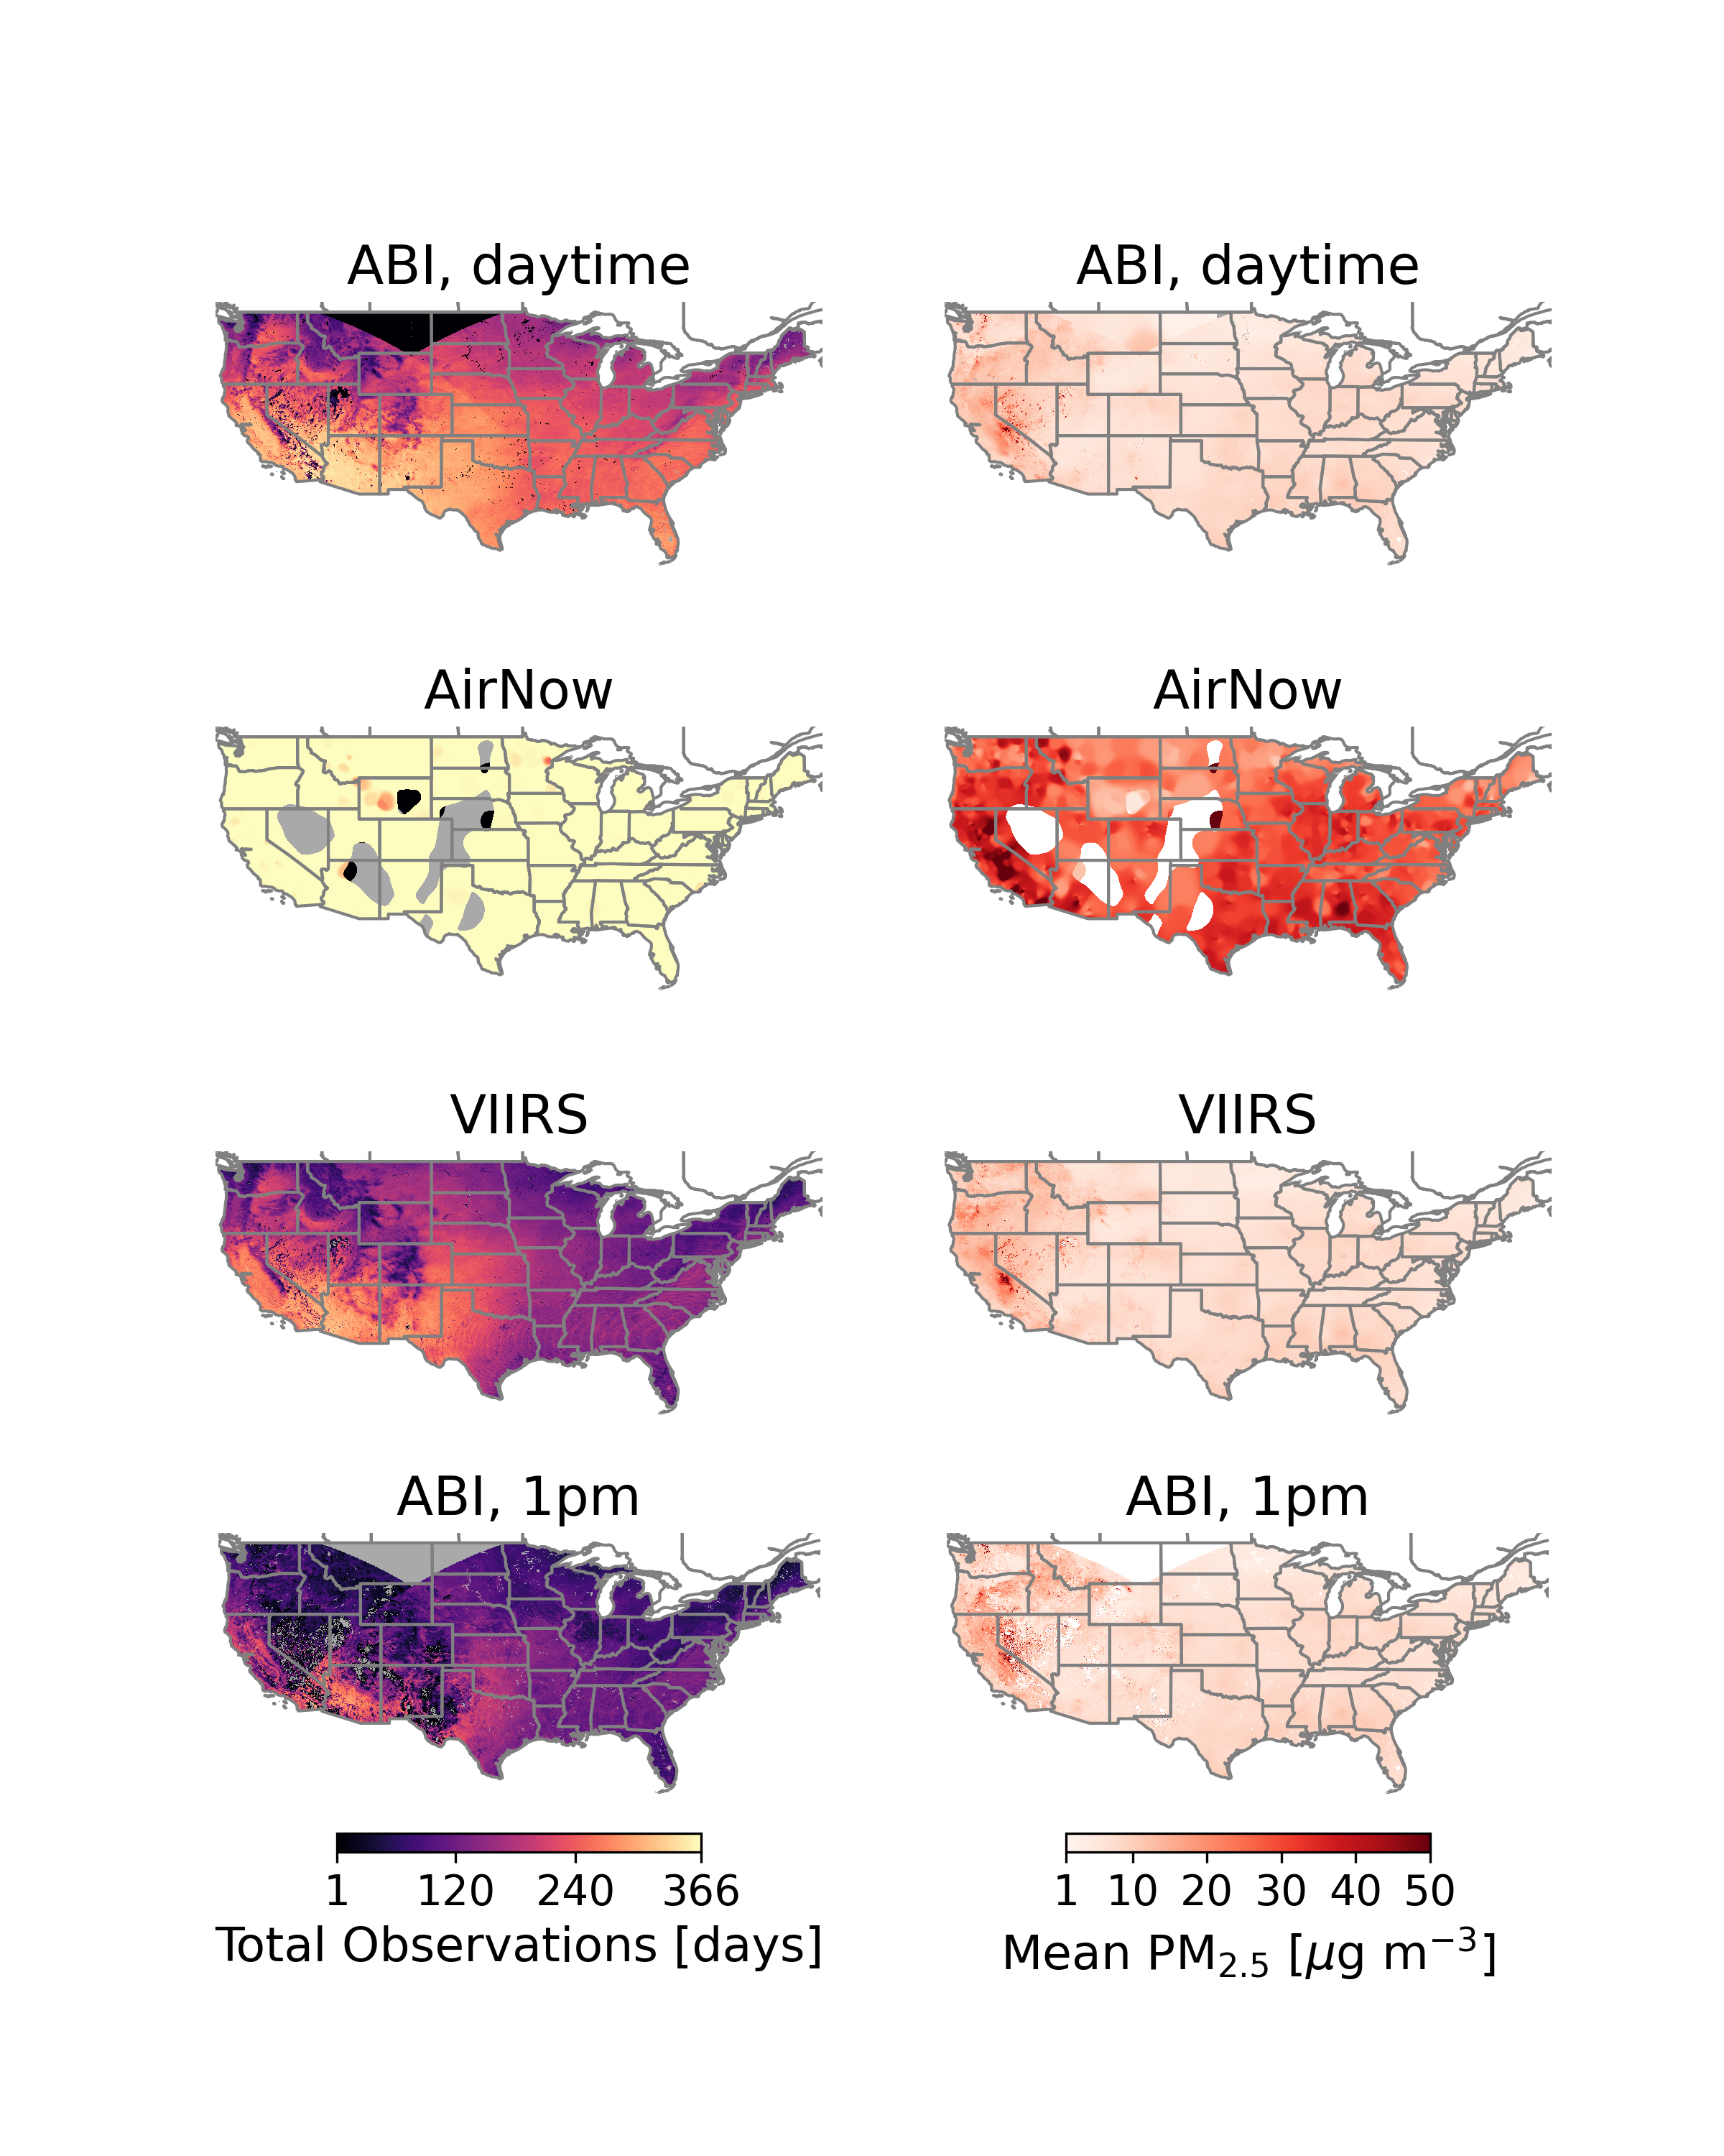
Step 1: We use two datasets to assess the benefits of geostationary over polar orbiting satellites for identifying air quality alert days.
Aerosol Optical Depth (AOD) from ABI instrument on the GOES satellite used to estimate daily surface PM_{2.5} concentrations for two cases:
Geostationary case
Polar-orbiting case
Uses observations from all daylight hours.
Only uses observations at 1 pm local time.
Days missing due to clouds, snow/ice, satellite footprint, etc.
N days with observations, 2020
N days with observations, 2020
Datasets from H. Zhang, Z. Wei, B.H. Henderson, S.C. Anenberg, K. O'Dell, and S. Kondragunta. (2022). Nowcasting Applications of Geostationary Satellite Hourly Surface PM2.5 Data. Weather and Forecasting.
Notes:
Highlight Hai’s talk

Slide 12
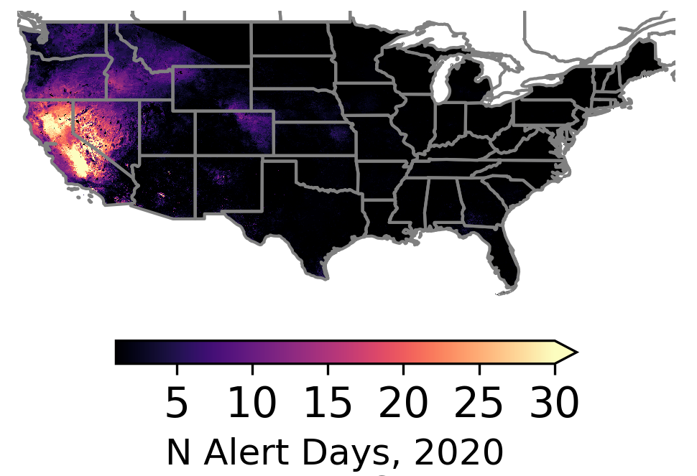
Geostationary-satellite based estimates of surface PM_{2.5} are able to identify more air quality alert days.
Most alert days concentrated in California in 2020
Geostationary
Alert day = 24hr mean PM_{2.5} > 35 µg m⁻³ (AQI of 100)
Notes:
Need to recreate these with the updated data from Shobha and hai

Slide 13
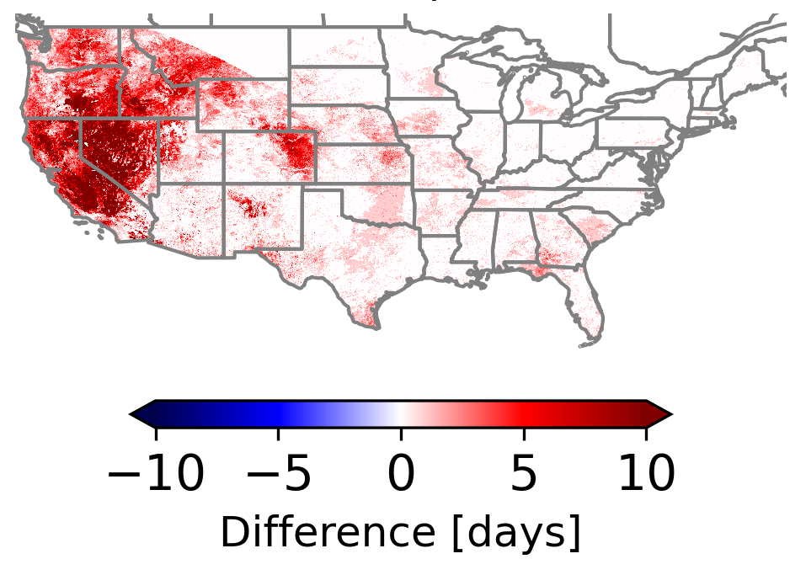
Geostationary-satellite based estimates of surface PM_{2.5} are able to identify more air quality alert days.
Most alert days concentrated in California in 2020
Geostationary case “sees” more alert days than polar-orbiting
Geostationary
Geostationary – Polar Orbiting
Alert day = 24hr mean PM_{2.5} > 35 µg m⁻³ (AQI of 100)
Notes:
Need to recreate these with the updated data from Shobha and hai

Slide 14
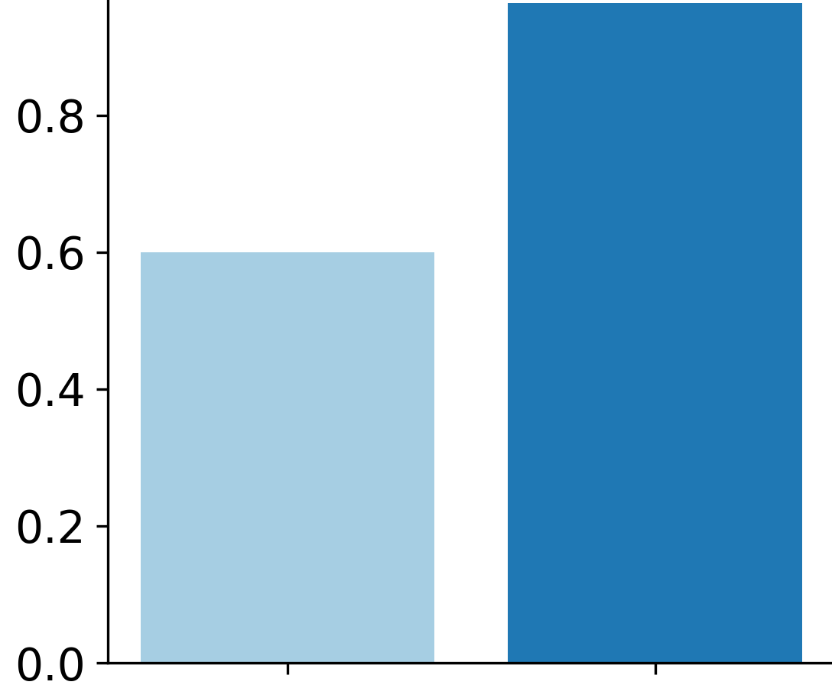
Geostationary-satellite based estimates of surface PM_{2.5} are able to identify more air quality alert days.
Most alert days concentrated in California in 2020
Geostationary case “sees” more alert days than polar-orbiting
~350 million more person-alerts identified in geostationary over polar-orbiting in 2020
Geostationary
Geostationary – Polar Orbiting
Person-alerts [billions]
Polar orbiting
Geostationary
Alert day = 24hr mean PM_{2.5} > 35 µg m⁻³ (AQI of 100)
Notes:
If we assume these identified alerts lead directly to alerts for the public, which is different from how this data may be incorporated in practice, but can give us a first-order approximation of the benefits of these additional alert days…

Slide 15
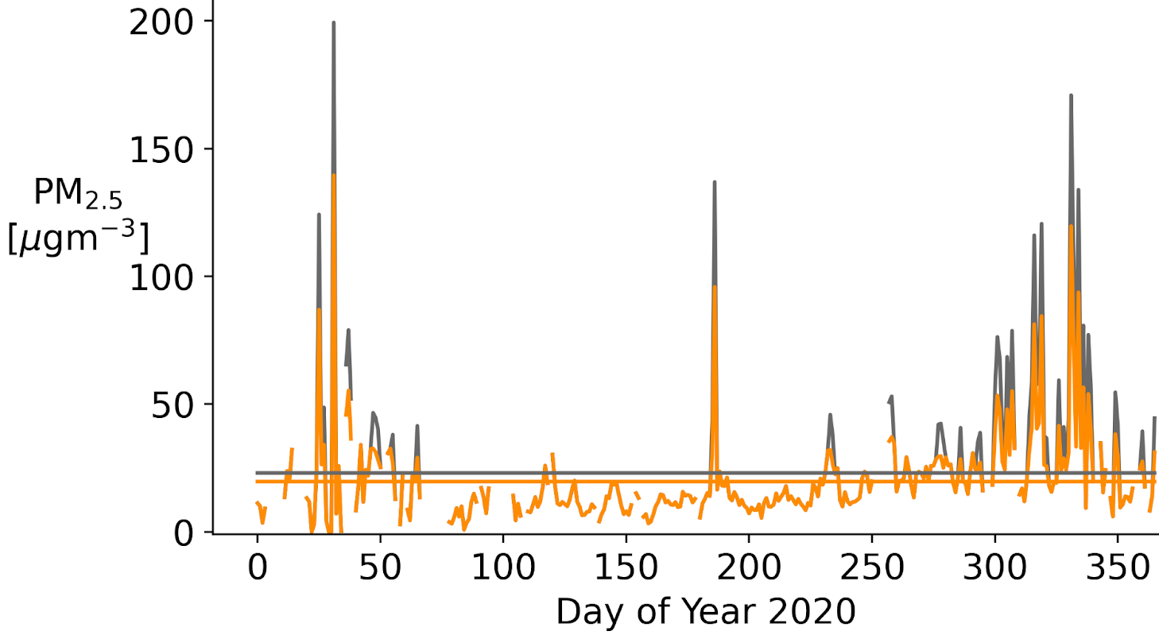
Step 2: We reduce daily PM_{2.5} exposure by 30% on satellite-identified air quality alert days.
30% reduction in exposure from EPA synthesis¹ of studies on behavior modification and accounts for fraction of population taking exposure-reducing actions and the effectiveness of the actions.
An example in Los Angeles, CA
Base PM_{2.5} (no behavior modification)
PM_{2.5} w/ Geostationary case alerts & behavior modification
¹CAIF report, US EPA, 2021

Slide 16
Step 2: We reduce daily PM_{2.5} exposure by 30% on satellite-identified air quality alert days.
30% reduction in exposure from EPA synthesis¹ of studies on behavior modification and accounts for fraction of population taking exposure-reducing actions and the effectiveness of the actions.
An example in Los Angeles, CA
Base PM_{2.5} (no behavior modification)
PM_{2.5} w/ Geostationary case alerts & behavior modification
Alert day identified by satellite-based data
Exposure reduced by 30%
¹CAIF report, US EPA, 2021

Slide 17
Step 2: We reduce daily PM_{2.5} exposure by 30% on satellite-identified air quality alert days.
30% reduction in exposure from EPA synthesis¹ of studies on behavior modification and accounts for fraction of population taking exposure-reducing actions and the effectiveness of the actions.
An example in Los Angeles, CA
Base PM_{2.5} (no behavior modification)
PM_{2.5} w/ Geostationary case alerts & behavior modification
Baseline annual mean, 23 µg m⁻³
Adjusted annual mean, 20 µg m⁻³
¹CAIF report, US EPA, 2021

Slide 18
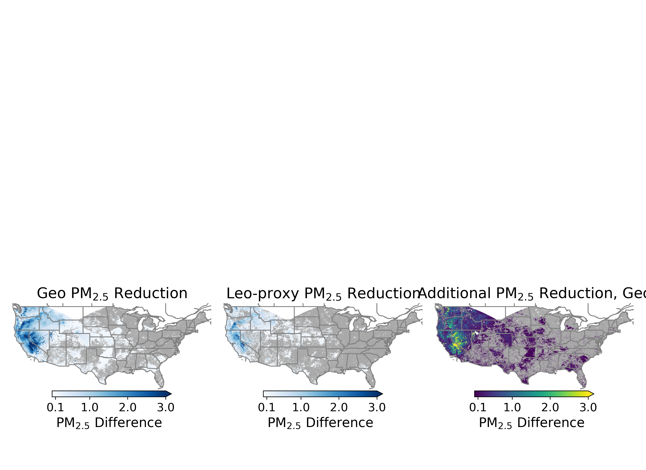
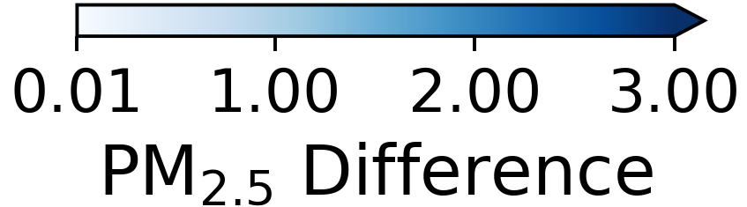
Step 3: Geostationary alerts lead to a larger reduction in annual mean PM_{2.5} exposure compared to polar orbiting due to additional observations.
Geostationary informed exposure reduction
Polar Orbiting informed exposure reduction
Figures assume a 30%¹ reduction in PM_{2.5} exposure on days with air quality alerts.
¹CAIF report, US EPA, 2021
Notes:
Colorbar needs units

Slide 19
Step 3: Geostationary alerts lead to a larger reduction in annual mean PM_{2.5} exposure compared to polar orbiting due to additional observations.
Geostationary informed exposure reduction
Polar Orbiting informed exposure reduction
Geostationary – Polar Orbiting
Figures assume a 30%¹ reduction in PM_{2.5} exposure on days with air quality alerts.
¹CAIF report, US EPA, 2021
Notes:
Colorbar needs units

Slide 20
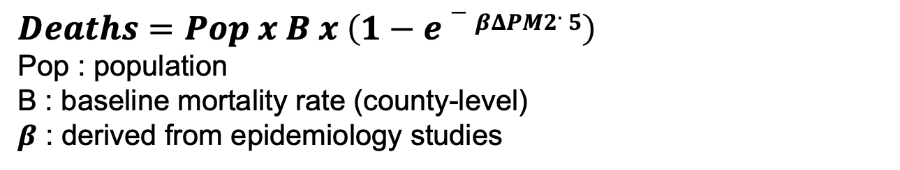
Using evidence from epidemiology studies, we estimate health benefits of reduced exposure to PM_{2.5}.
$$Deaths=Pop x B x \left(1−e−βΔPM2.5\right)$$
Pop : population
B : baseline mortality rate (county-level)
$β$ : derived from epidemiology studies
Notes:
Colorbar needs units

Slide 21
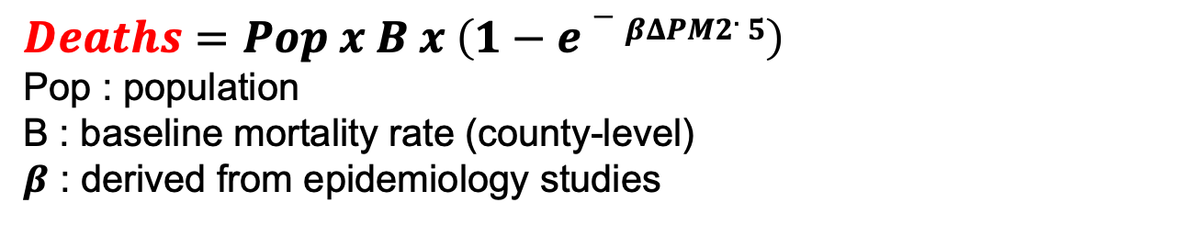
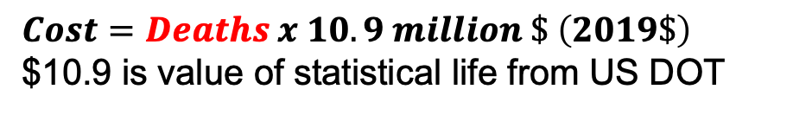
Using evidence from epidemiology studies, we estimate health benefits of reduced exposure to PM_{2.5}.
$$Deaths=Pop x B x \left(1−e−βΔPM2.5\right)$$
Pop : population
B : baseline mortality rate (county-level)
$β$ : derived from epidemiology studies
$$Cost=Deaths x 10.9 million \$ \left(2019\$\right)$$
$10.9 is value of statistical life from US DOT
Notes:
Colorbar needs units

Slide 22
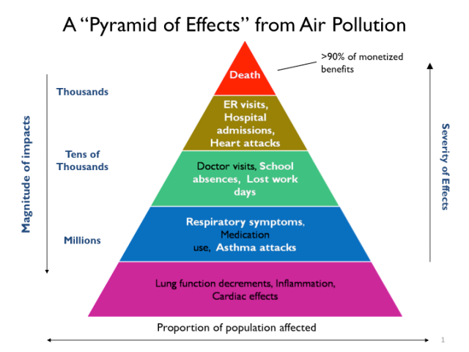
Using evidence from epidemiology studies, we estimate health benefits of reduced exposure to PM_{2.5}.
$$Deaths=Pop x B x \left(1−e−βΔPM2.5\right)$$
Pop : population
B : baseline mortality rate (county-level)
$β$ : derived from epidemiology studies
$$Cost=Deaths x 10.9 million \$ \left(2019\$\right)$$
$10.9 is value of statistical life from US DOT
Figure from US EPA
Notes:
Colorbar needs units

Slide 23
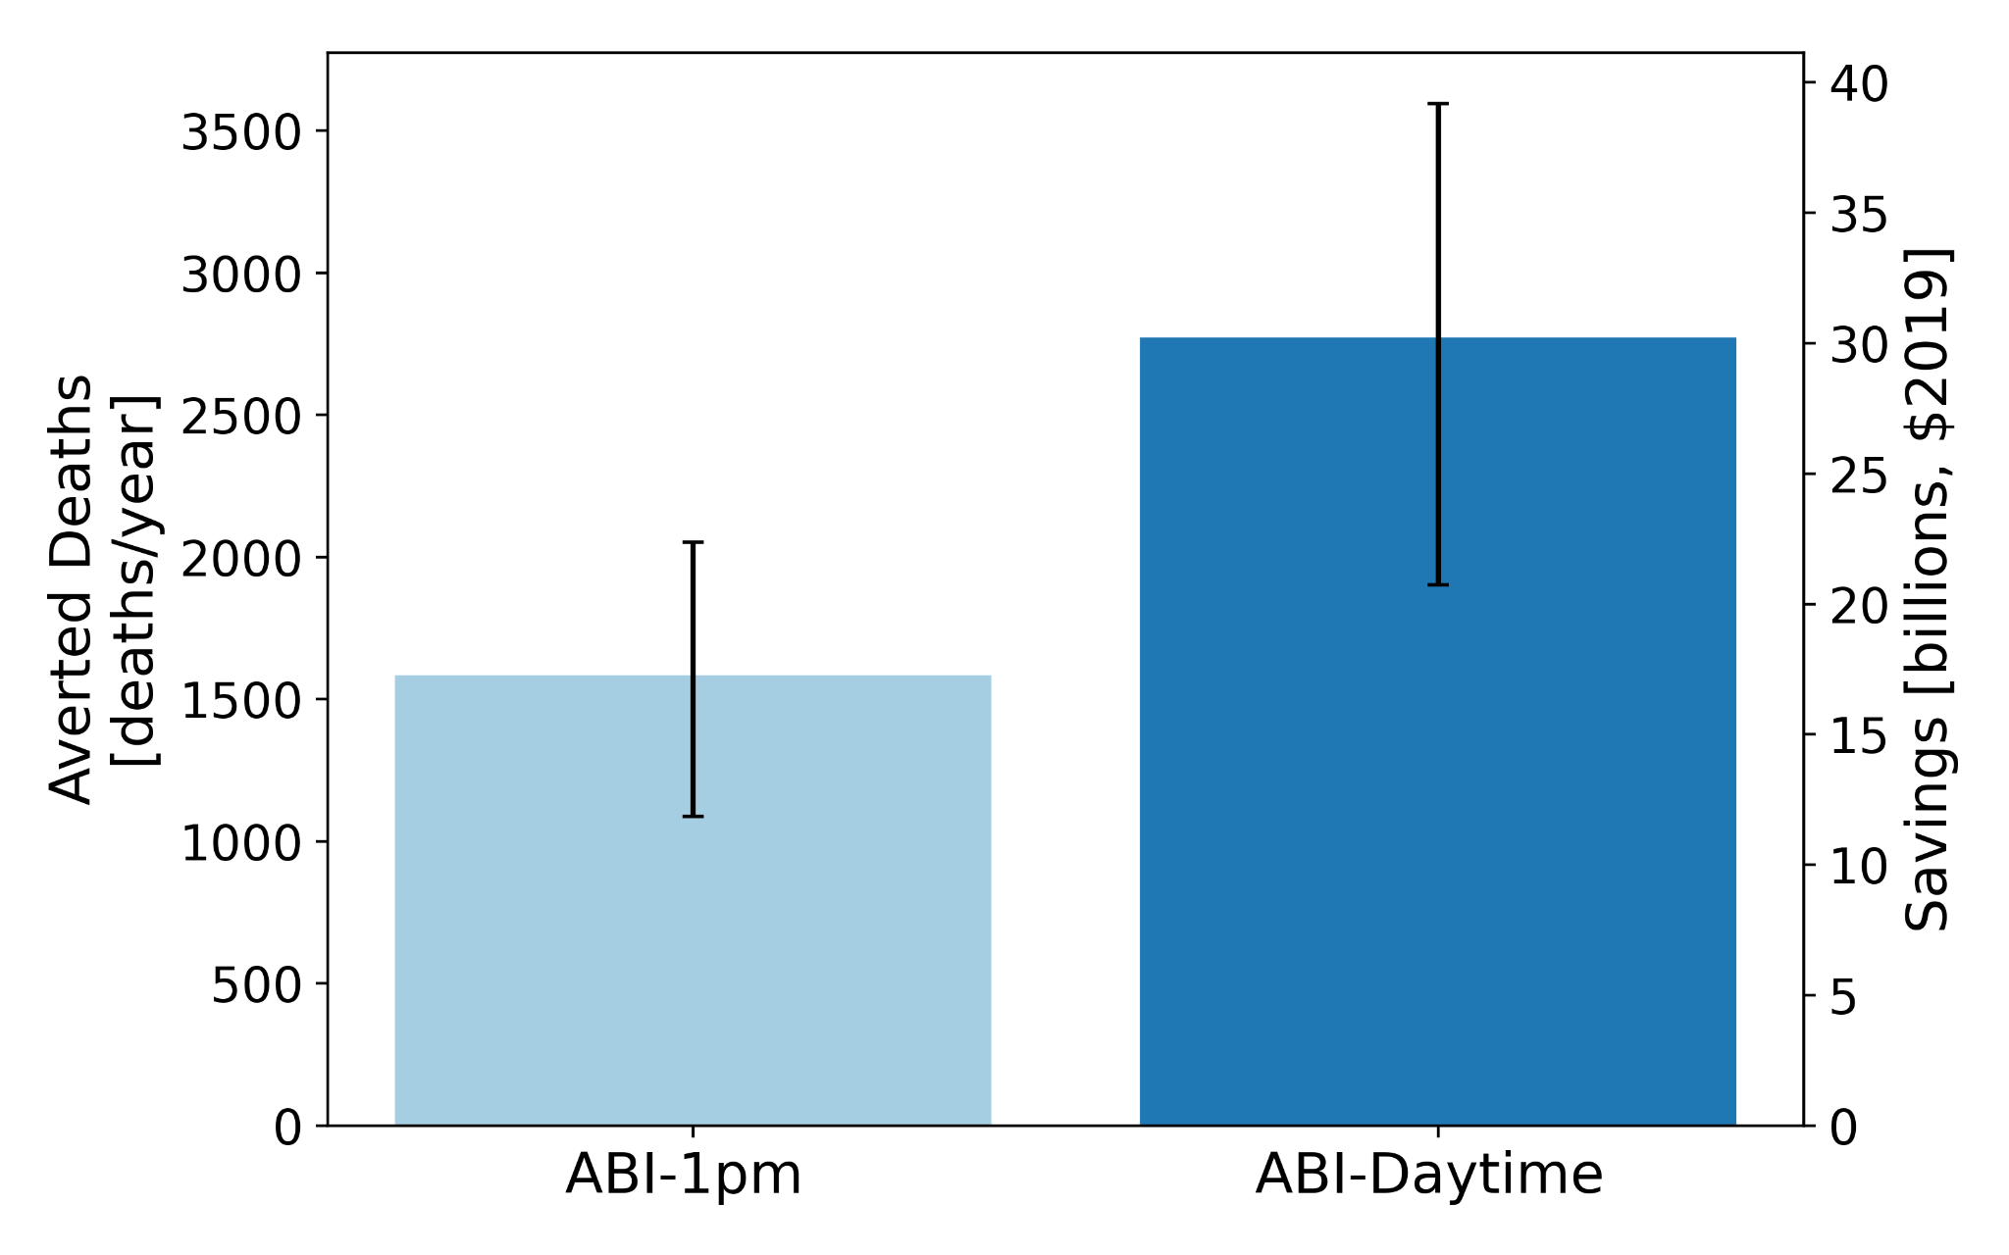
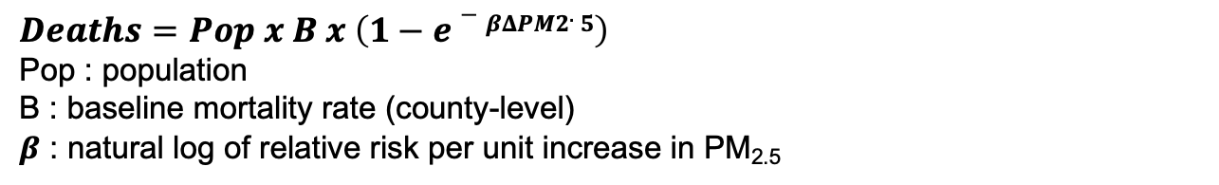
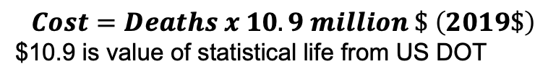
Step 4: We estimate 1,000 additional averted deaths with an economic benefit of over $10 billion from Geostationary-based PM_{2.5} alerts.
~1000 averted deaths
$10 billion dollars
Polar Orbiting
Geostationary
$$Deaths=Pop x B x \left(1−e−βΔPM2.5\right)$$
Pop : population
B : baseline mortality rate (county-level)
$β$ : natural log of relative risk per unit increase in PM_{2.5}
$$Cost=Deaths x 10.9 million \$ \left(2019\$\right)$$
$10.9 is value of statistical life from US DOT
Notes:
Note the equations on the bottom

Slide 24
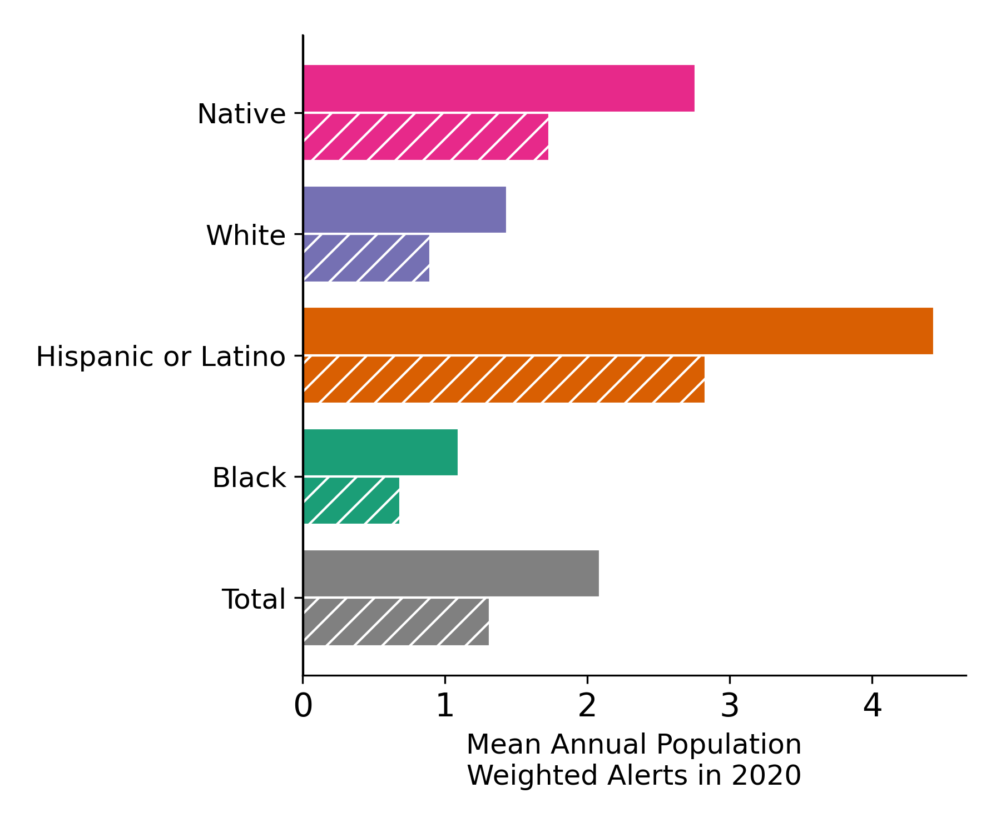
With high-resolution, daily estimates of surface PM_{2.5} we can explore disparities in exposure to short-term PM_{2.5} pollution events.
Geostationary
Polar Obiting
Geostationary observes more alert days across each racial/ethnic group compared to Polar Orbiting.
Both Geostationary and Polar Orbiting based alerts find Native and Hispanic/Latino populations were exposed to disproportionately more alert days in 2020.
Demographic data from 2015-2019 American Community Survey
Results are preliminary.

Slide 25
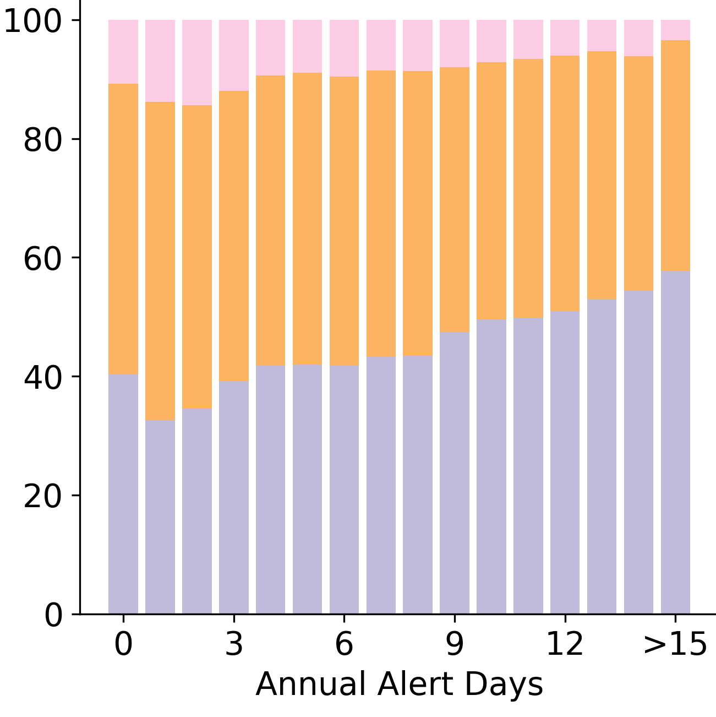
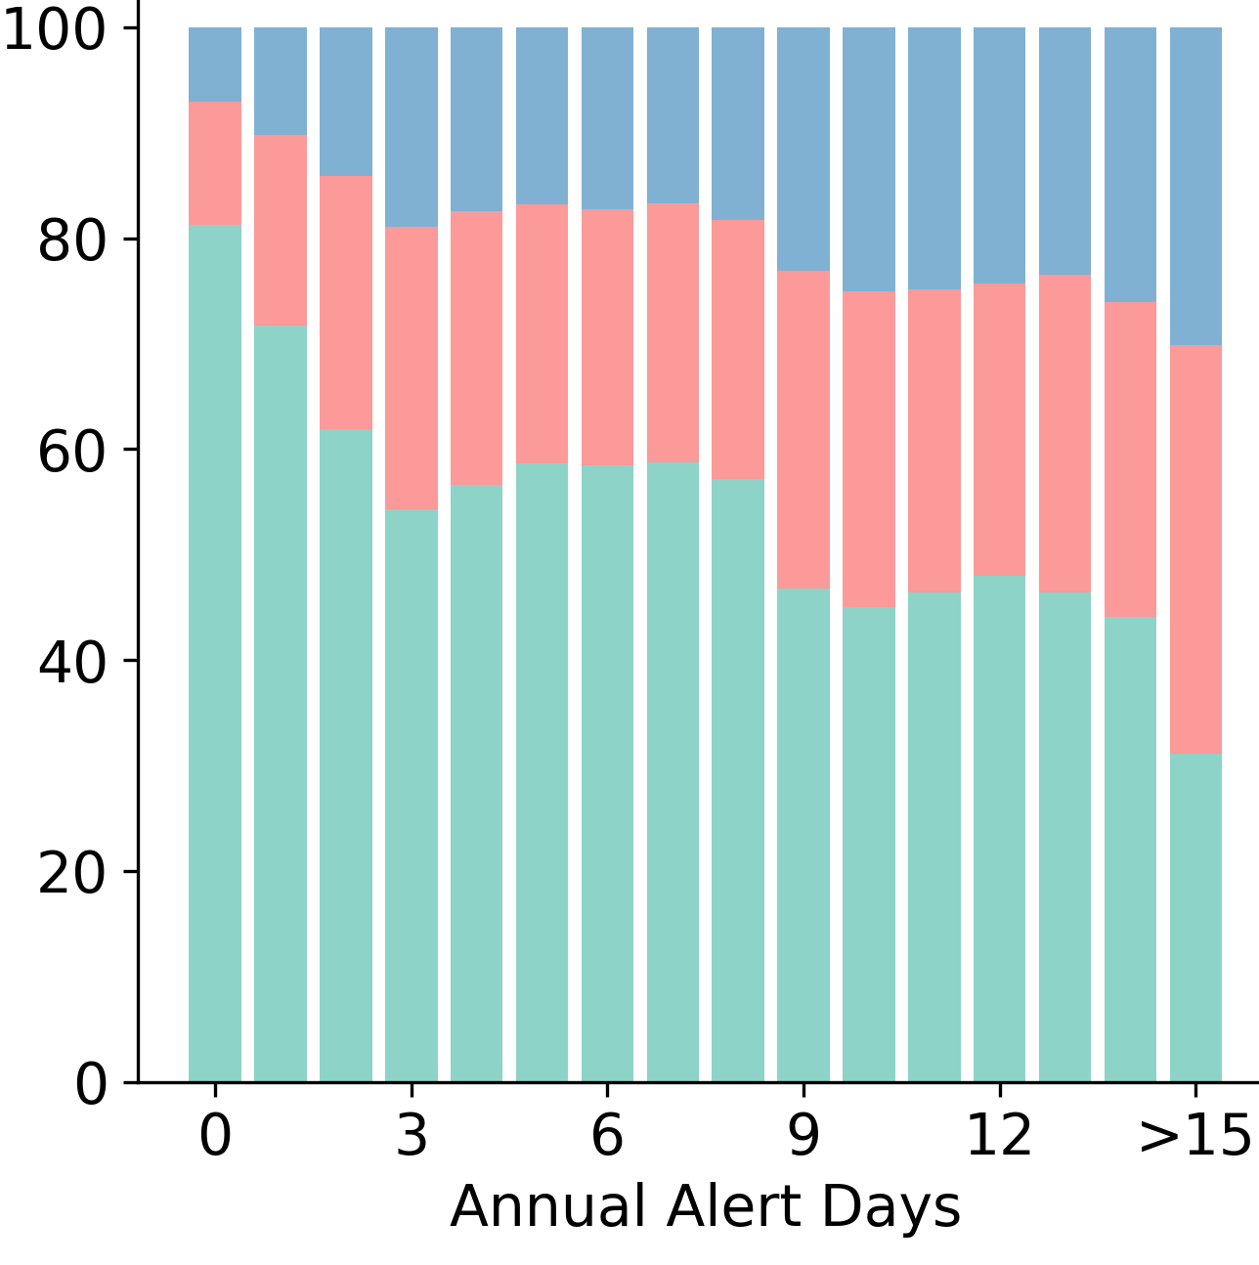
We are exploring characteristics of populations exposed to more alert days which could inform alert systems.
Educational attainment
English language proficiency
Grad
Less than “very well”
Populations exposed to more alert days in 2020 were more likely to:
Have lower educational attainment
Speak English less than “very well”
Percent of population
College
“very well”
English only
High school
Demographic data from 2015-2019 American Community Survey
Results are preliminary.

Slide 26

Conclusions and Implications
The methods presented here allow us to incorporate health benefits of atmospheric composition observations from Geostationary satellites into economic analysis to support satellite missions.
Geostationary-based data can identify more air quality alert days than Polar Orbiting. Assuming behavior modification in alerted populations, this leads to 1.4k fewer PM_{2.5} attr. deaths & economic savings over $10 billion.
Geostationary and Polar Orbiting based datasets observe similar disparities in exposure to air quality alert days. Native and Hispanic/Latino populations experience more alert days than other racial and ethnic groups.
This work is ongoing. We are planning to explore additional pathways to quantify health benefits of geostationary satellite observations of atmospheric composition.
Email: kodell@gwu.edu
@K8ODell
This work was funded by NOAA grant number: 1305M322PNRMT0426

