Slide 1
NOAA AC Value Assessment Studies: overview
Gregory Frost¹, Shobha Kondragunta², Monika Kopacz¹, Victoria Breeze¹, Kathryn Mozer¹, Shiv Das¹
¹NOAA Office of Oceanic and Atmospheric Research
²NOAA National Environmental Satellite, Data, and Information Service

Slide 2
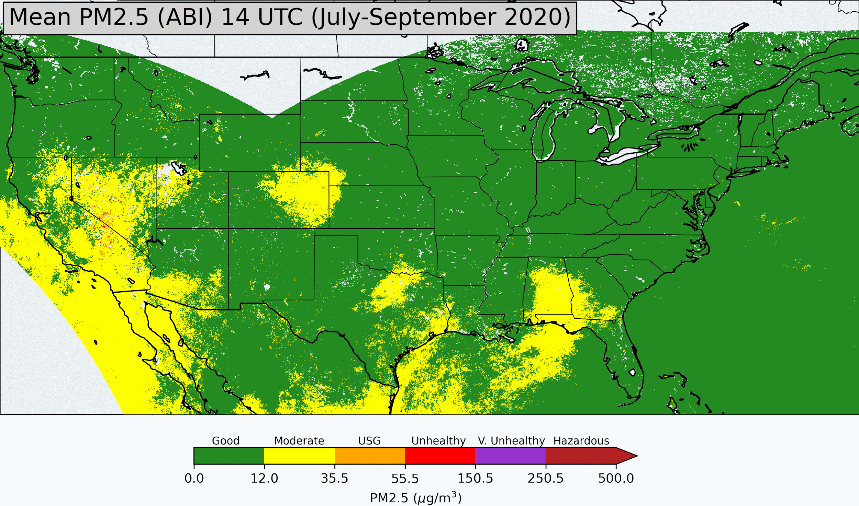
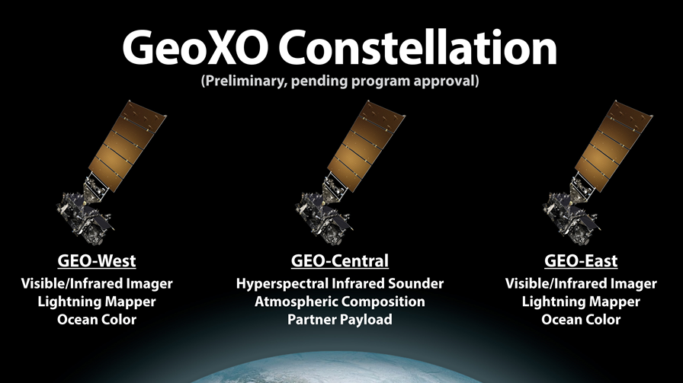
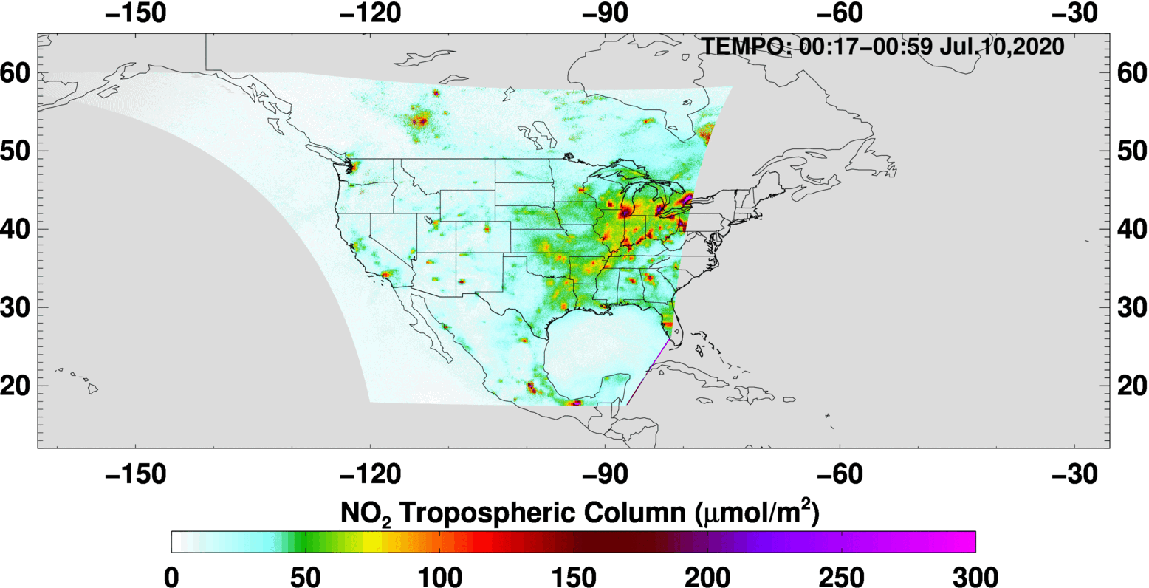
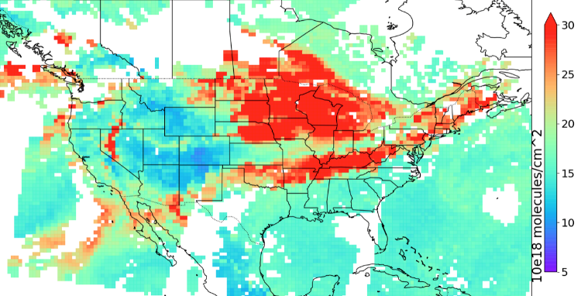
GeoXO’s Multi-Instrument Synergy (and value) for Atmospheric Composition
PM2.5 derived from GOES ABI AOD
PM2.5 derived from GOES ABI AOD
Vis/IR Imager (GXI)
Fire detection
Fire radiative power
Aerosol type
Aerosol optical depth
Aerosol concentration
Vis/IR Imager (GXI)
Fire detection
Fire radiative power
Aerosol type
Aerosol optical depth
Aerosol concentration
UV/Vis Spectrometer (ACX)
Ozone
Nitrogen dioxide
Sulfur dioxide
Formaldehyde
Aerosol layer height
IR Sounder (GXS)
Ozone
Carbon monoxide
Carbon dioxide
Ammonia
Isoprene
CO total column, CrIS on NOAA-20, 14 Sep 2020
‹#›

Slide 3
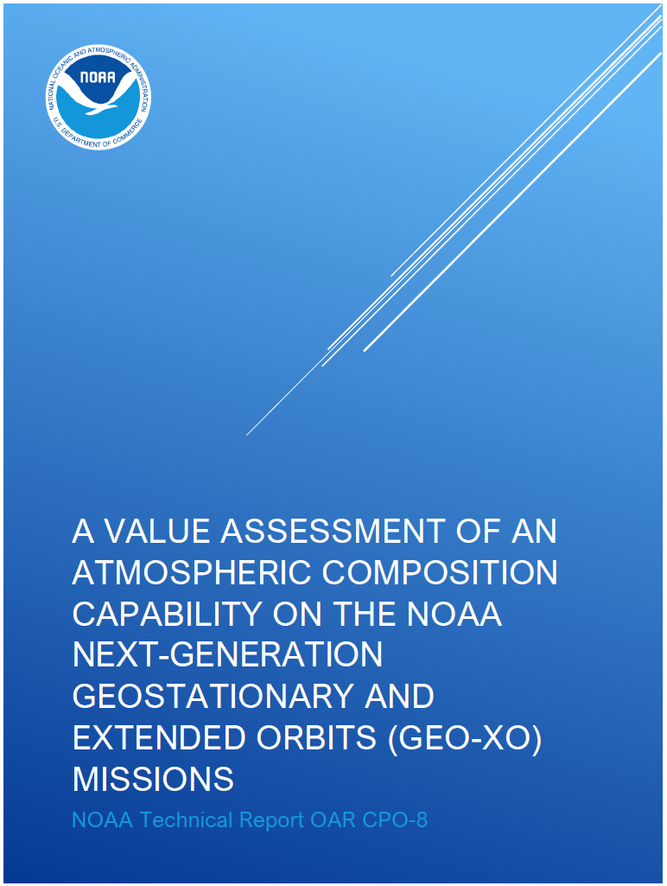
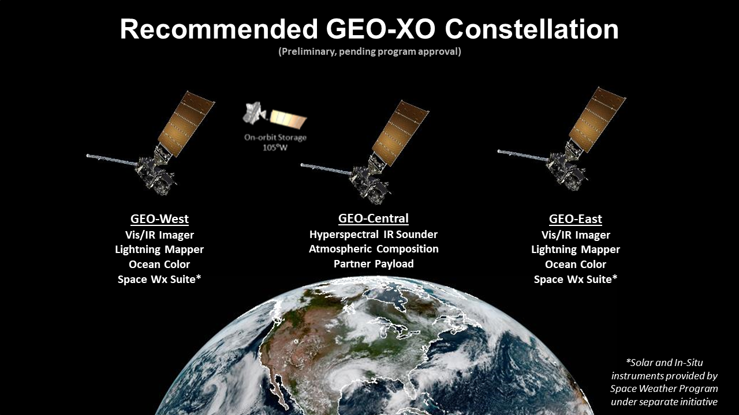
GeoXO timeline and planning process
Value assessment report for AC science and application ideas
October 2020
Proposed constellation based on costs
January 2021
https://doi.org/10.25923/1s4s-t405
August 2021
Begin values studies calculating benefits of AC obs; economic analysis and external community engagement

Slide 4
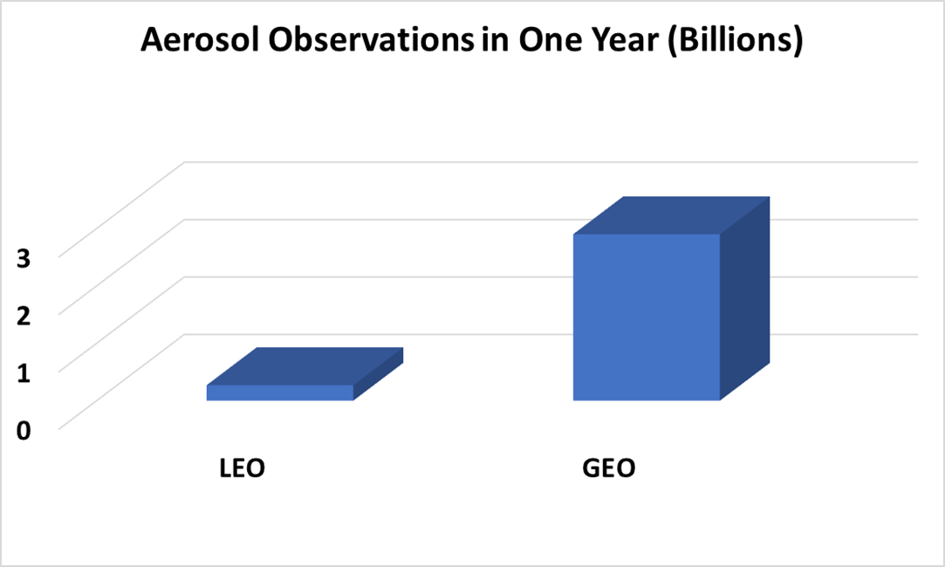
GeoXO program office supported three projects to study the socioeconomic benefits of atmospheric composition observations focused on
Improving monitoring of surface PM2.5
Updating emissions in near-real-time via data assimilation
Human exposure estimates and risk factors, improved understanding of environmental justice, etc.
GEO brings extraordinary volume of observations

Slide 5
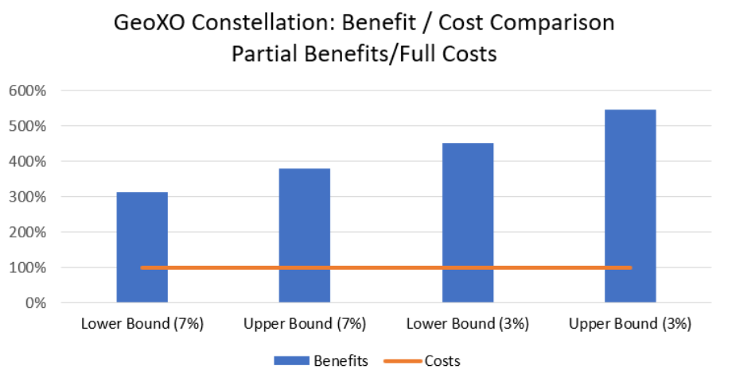
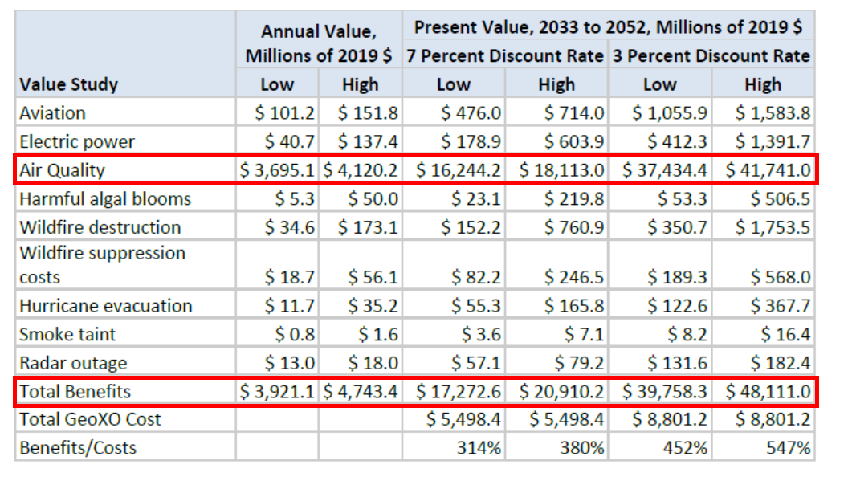
Cost-benefit analysis of GeoXO program
The GeoXO Program commissioned an analysis of the economic benefits of the mission
Analysis identified 175 value chains that could be informed by GeoXO data
Analysis carried out 9 economic studies addressing 44 of these 175 value chains
Found that GeoXO’s benefits/costs ratio is 3.1 – 5.5
GeoXO’s air quality benefits account for > 86% of the total annual benefits of the mission
See full report for details: https://repository.library.noaa.gov/view/noaa/47719
Credit: Jeff Atkins

Slide 6


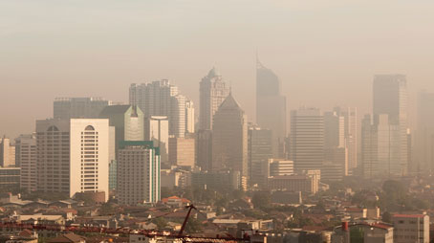
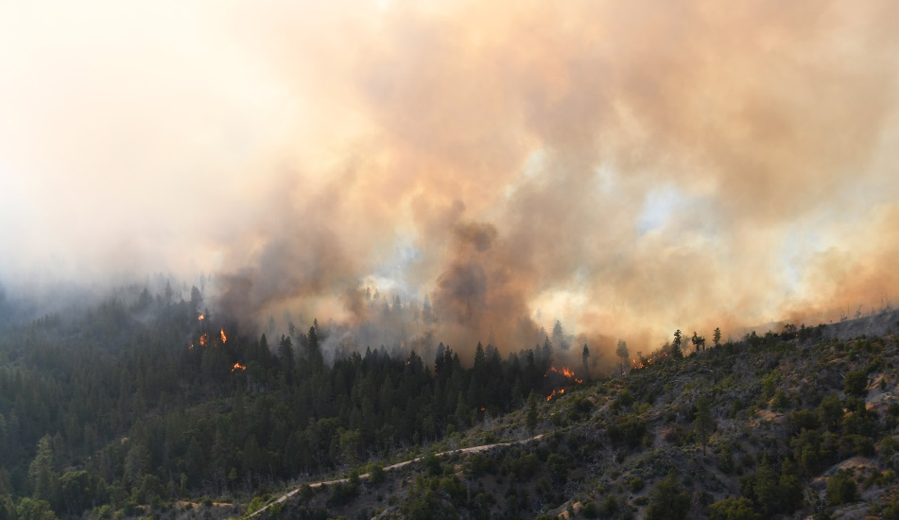

For more information…
GeoXO
https://www.nesdis.noaa.gov/next-generation/geostationary-extended-observations-geoxo
NOAA Atmospheric Composition from Space
https://csl.noaa.gov/nacs
NOAA Pathfinder Initiative

Slide 7
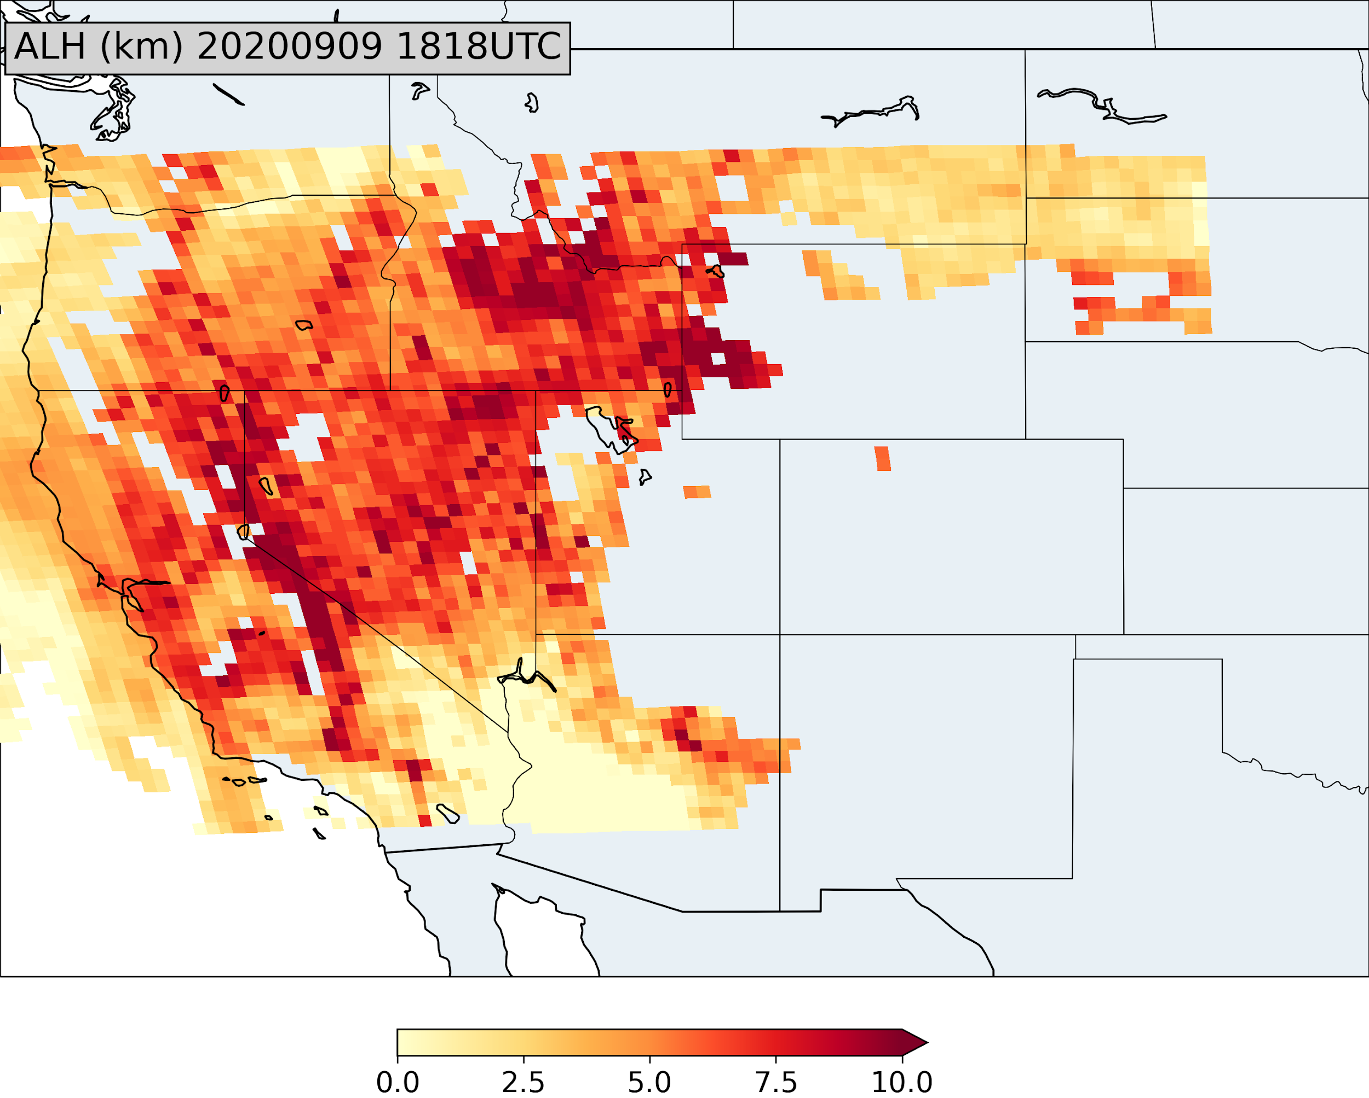
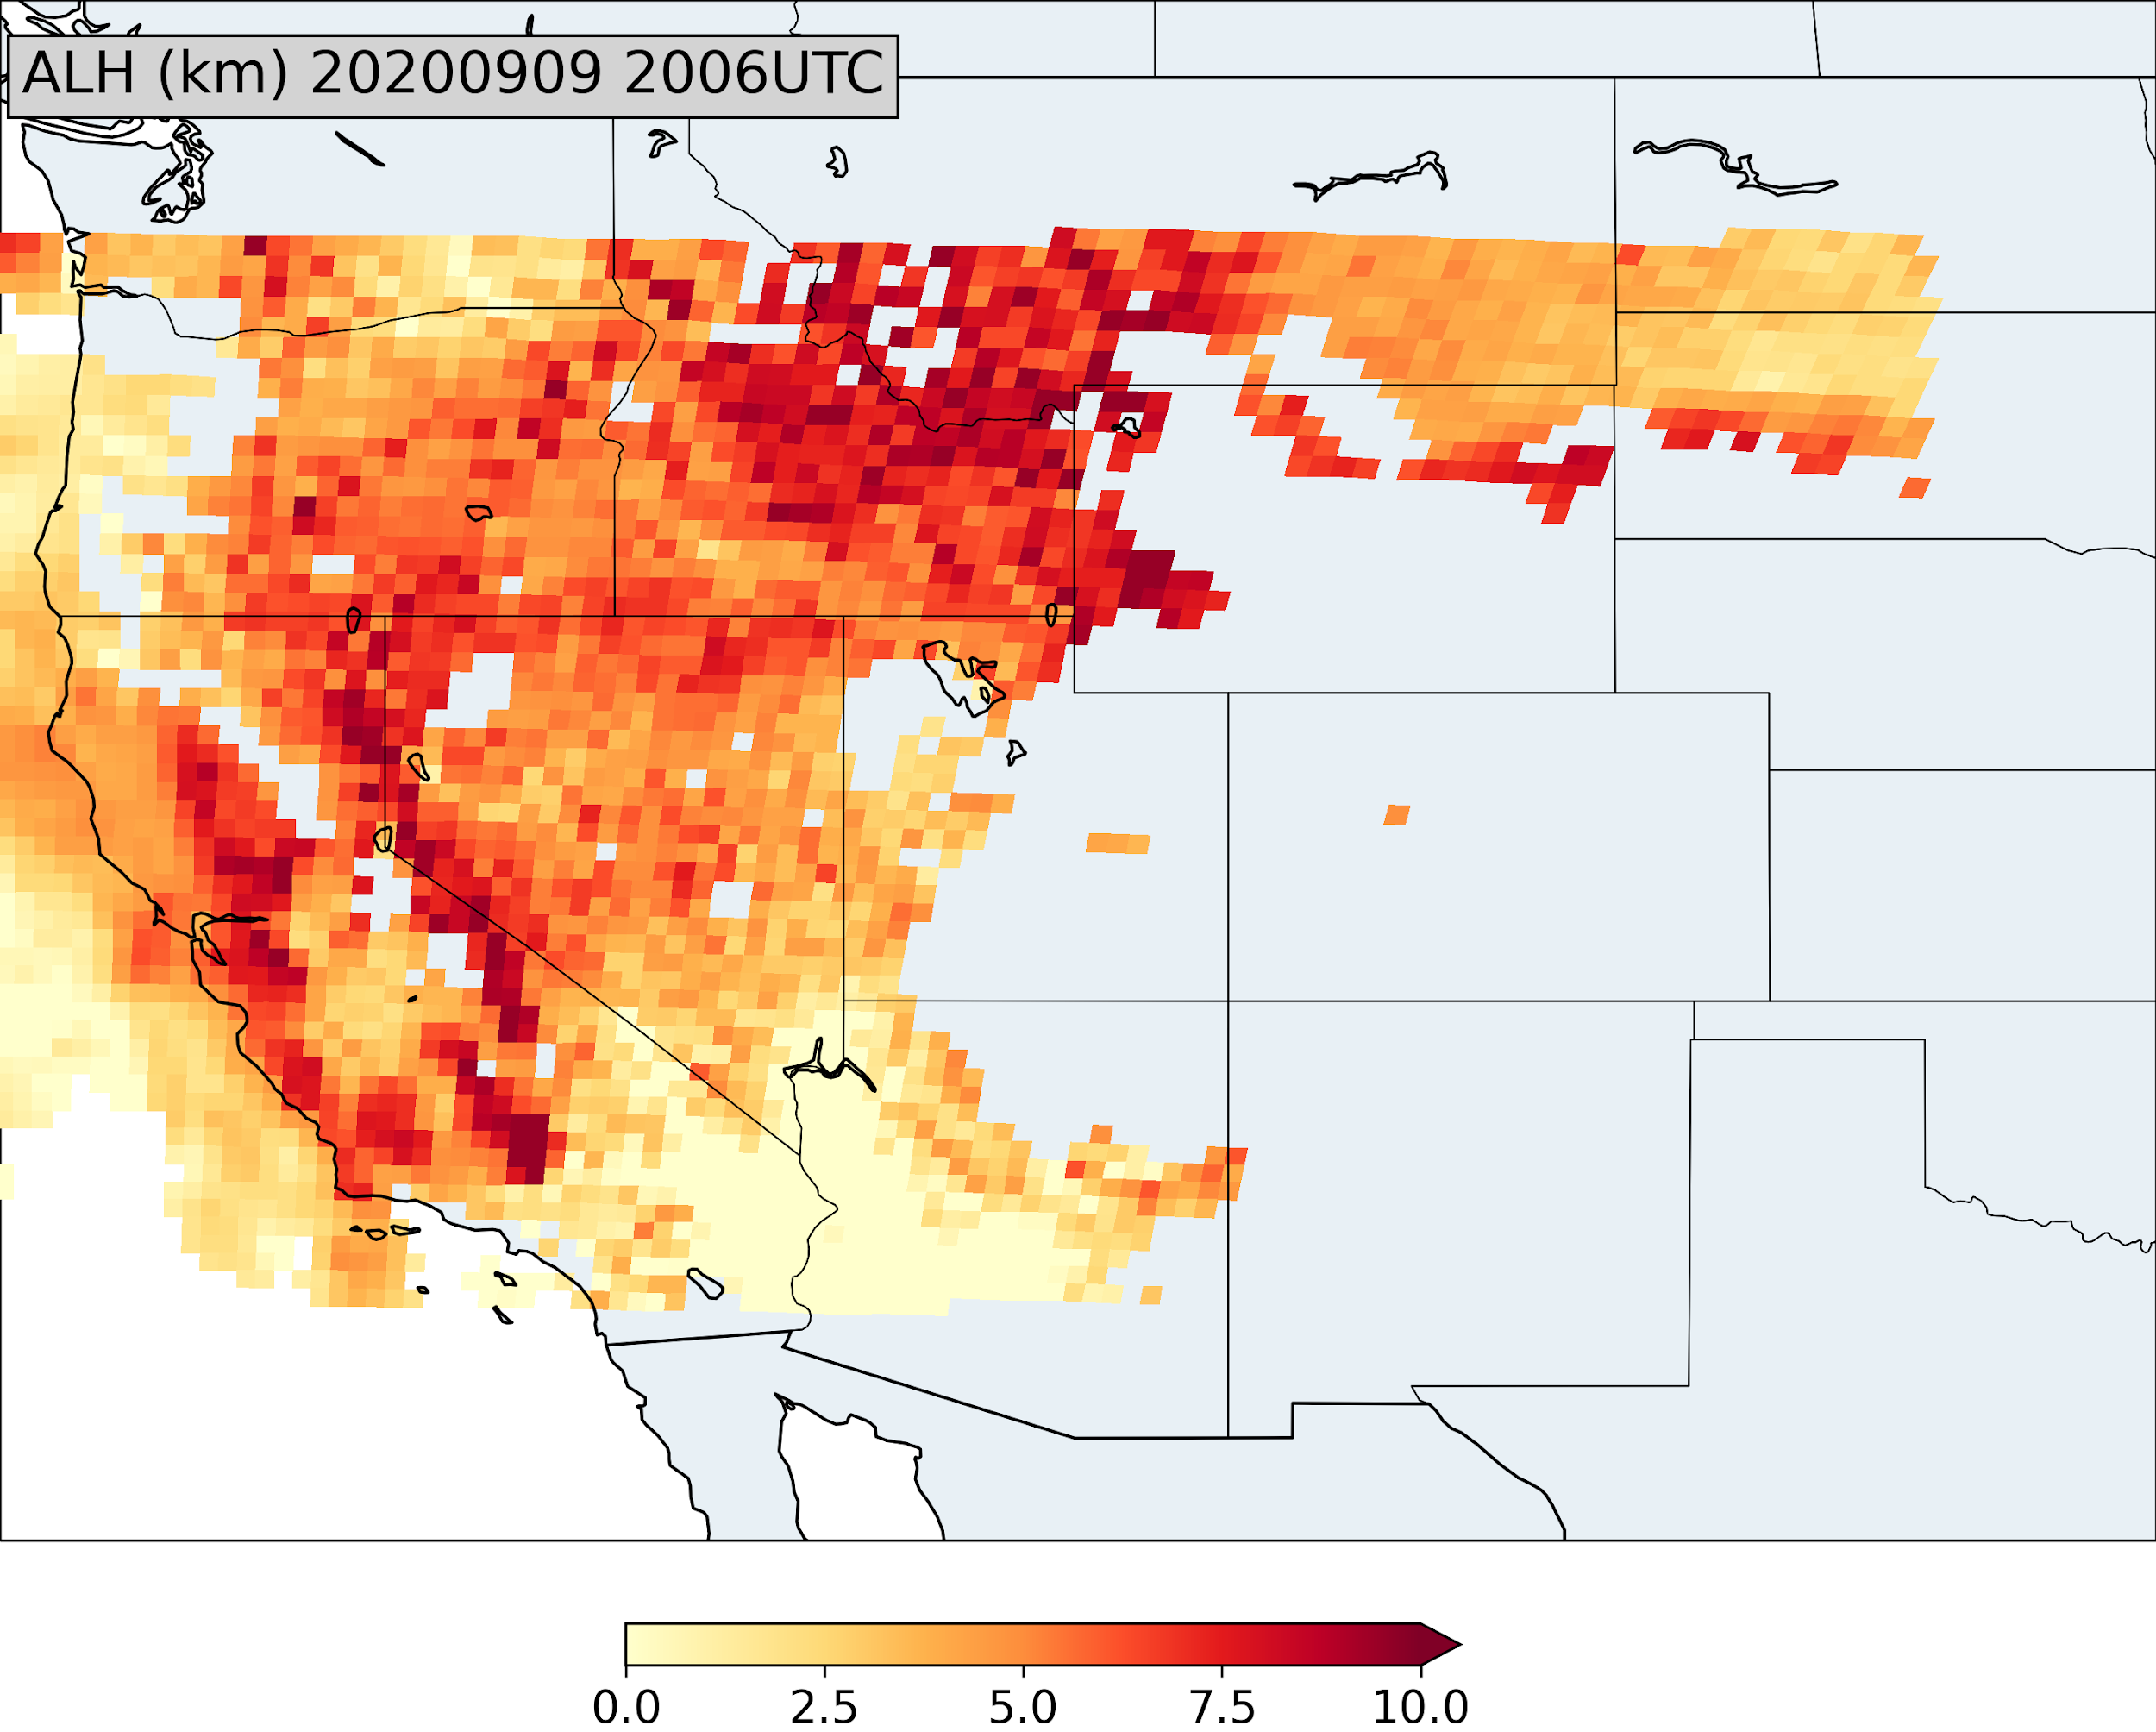
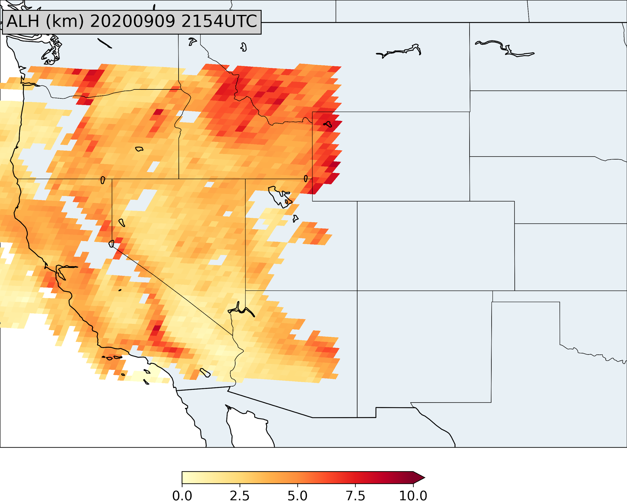
GEO data offer new insights on aerosols
TEMPO and ACX offer the opportunity to develop and apply new GEO aerosol products, like aerosol layer height derived from EPIC/DSCOVR observations, that will improve the understanding and prediction of aerosols as they evolve throughout the day at the surface and aloft.
1818 UTC
2006 UTC
2154 UTC
GeoXO Value Study: Advancing Aerosol Layer Height Retrieval for Surface PM2.5 Monitoring
PI: Jun Wang, Co-I: Shobha Kondragunta

Slide 8
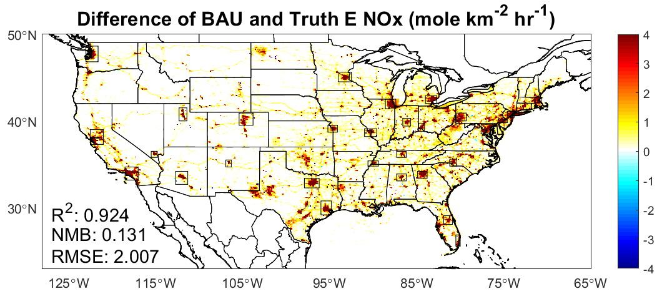
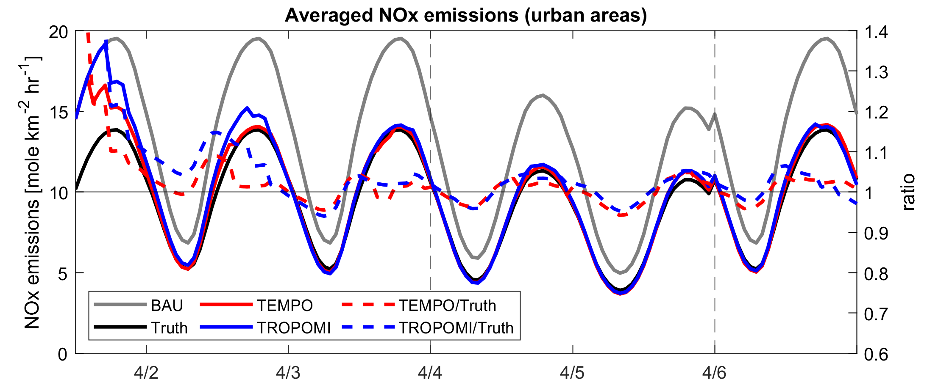
GEO AC data enable faster emissions updates than LEO
April 2020 NOx Emissions Differences
Business-as-usual (BAU) – COVID-19 period
TEMPO and ACX will allow more rapid generation of near-real-time emissions, faster assessment of unexpected emissions trends, and likely improve air quality forecasts compared with LEO AC datasets
E(NO_{x}), mole/km²/h
NOx Emissions in April 2020
True = COVID-19 period, BAU = Business-as-usual,
TEMPO = BAU adjusted using TEMPO proxy data
GeoXO Value Study: The Value of GeoXO Atmospheric Composition Observations for Emissions Updating and Air Quality Forecasting
PI: Brian McDonald, Co-Is: Chia-Hua Hsu, Arthur Mizzi, Daven Henze

Slide 9
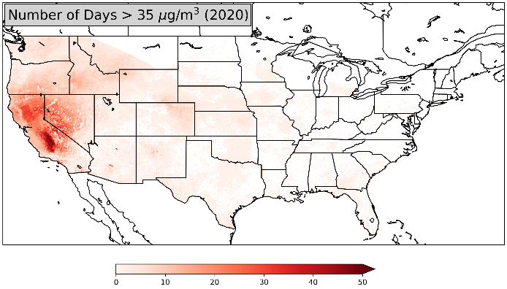
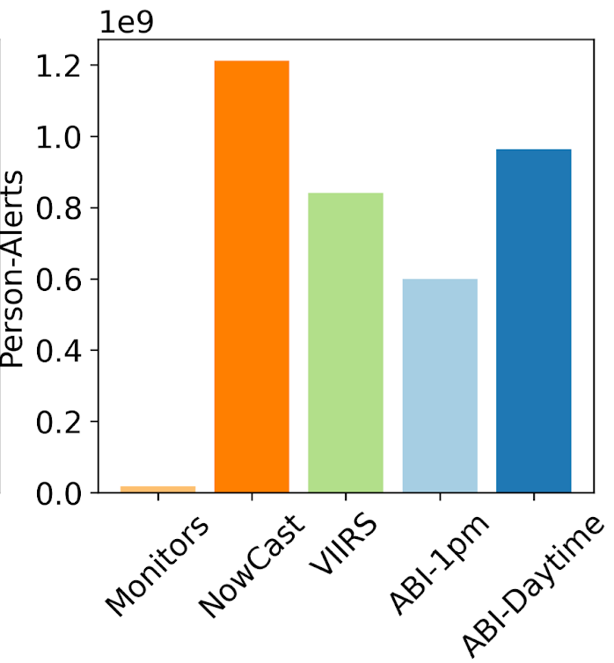
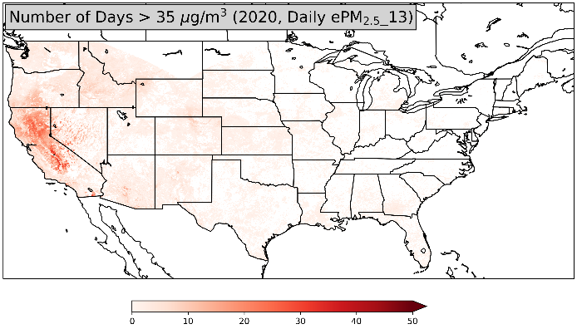
GEO AC data enhance pollution exposure studies
TEMPO and GeoXO observations provide enhanced estimates of exposure, more timely pollution alerts, and improved assessment of aerosol-attributable health impacts compared with LEO observations
Hai Zhang et al., Nowcasting applications of geostationary satellite hourly surface PM2.5 data, Weather and Forecasting, 2022
GEO
GEO sampled as LEO
GeoXO Value Study: Value of GeoXO Atmospheric Composition Data for Estimating Air Pollution-Related Health Impacts
PI: Susan Anenberg, Co-Is: Katelyn O’Dell, Gaige Kerr, Dan Goldberg
Number of Days

Slide 10
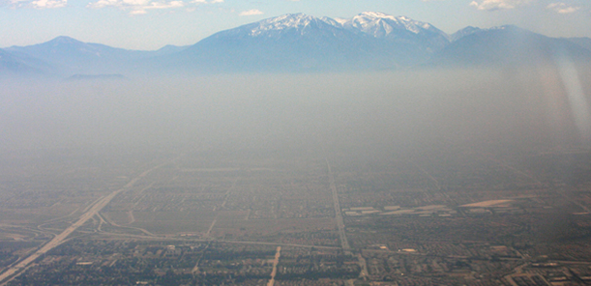
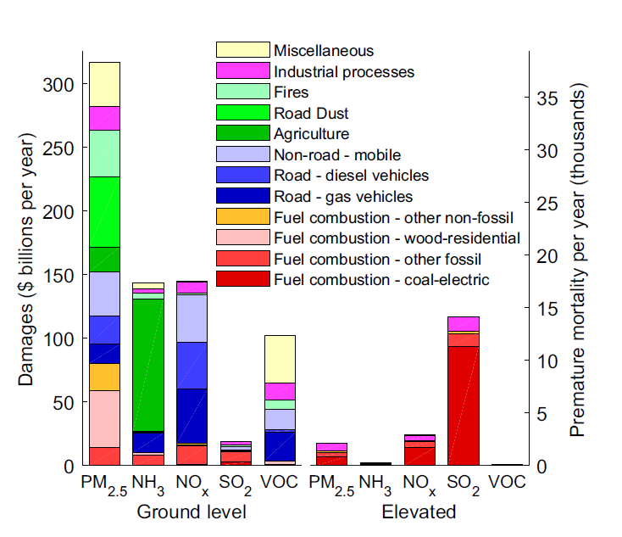
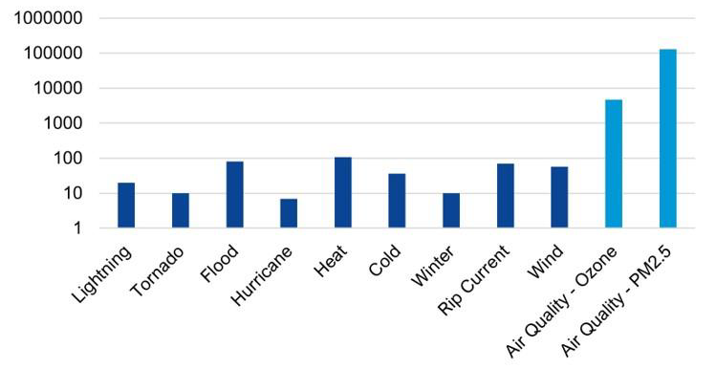
GEO capabilities for quantifying air pollution
Air pollution results in 100,000+ premature deaths and nearly $1T in damages in the U.S. annually, many times greater than damages from extreme weather events.
U.S. Damages from Air Pollutants by Source
Goodkind et al., Proc. Natl. Acad. Sci., 2019
Annual U.S. premature mortality
GOES ABI, TEMPO, and GeoXO’s ACX, GXI, and GXS will measure air pollutants that are harmful to human health, informing emissions estimates, air quality forecasts, and epidemiological studies.
ABI GXI
GXS
TEMPO ACX

Slide 11
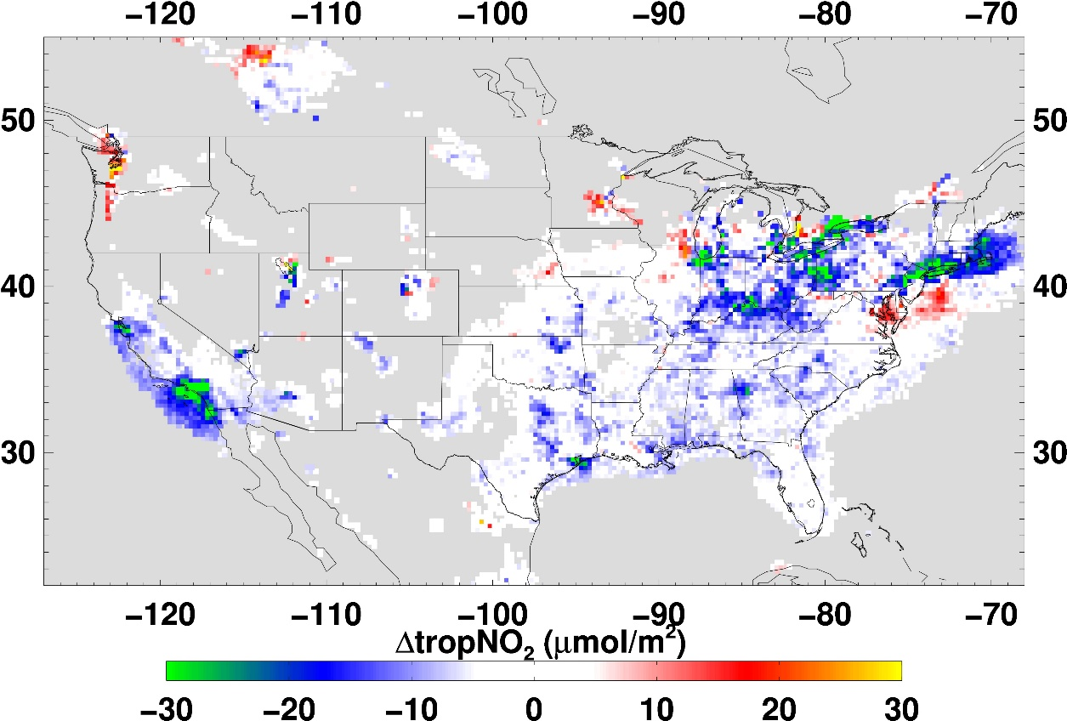
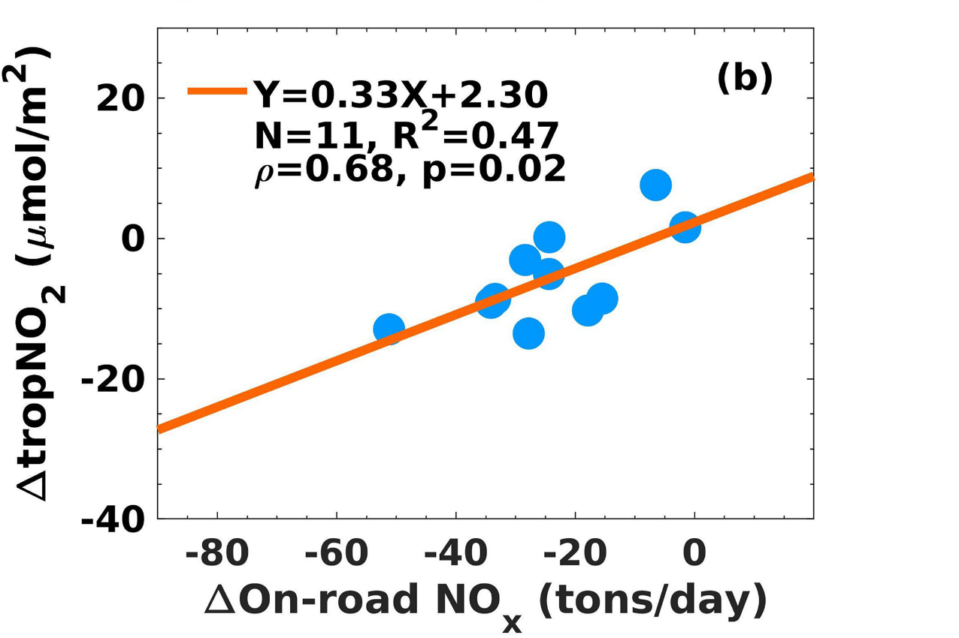
LEO AC data help to quantify rapid changes to emissions
Lower on-road NO_{x} emissions resulting from COVID-19 pandemic lockdowns correlated with changes in low-Earth-orbit satellite NO₂ data, providing opportunities to develop and optimize near-real-time emissions applications
S. Kondragunta, Z. Wei, B. McDonald, D. Goldberg, D. Tong, Fingerprints of a new normal urban air quality in the United States, JGR-Atmospheres, 2021

