Slide 1

Nowcasting applications of geostationary satellite hourly surface PM2.5 data
H. Zhang¹, Z. Wei¹, B. Henderson², S. Anenberg³, K. O’Dell³, S. Kondragunta⁴
Published in Weather and Forecasting
https://doi.org/10.1175/WAF-D-22-0114.1
¹IMSG@NOAA | ²EPA | ³GWU | ⁴NOAA
Disclaimer: The scientific results and conclusions, as well as any views or opinions expressed
herein, are those of the author(s) and do not necessarily reflect those of NOAA or
the Department of Commerce.

Slide 2
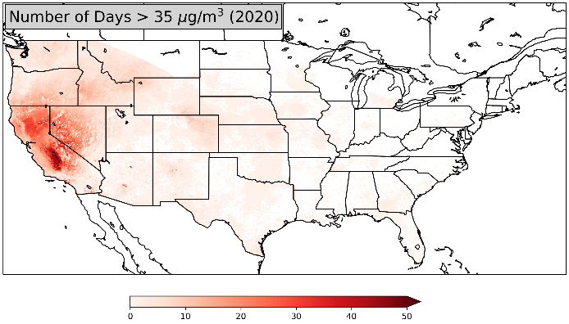
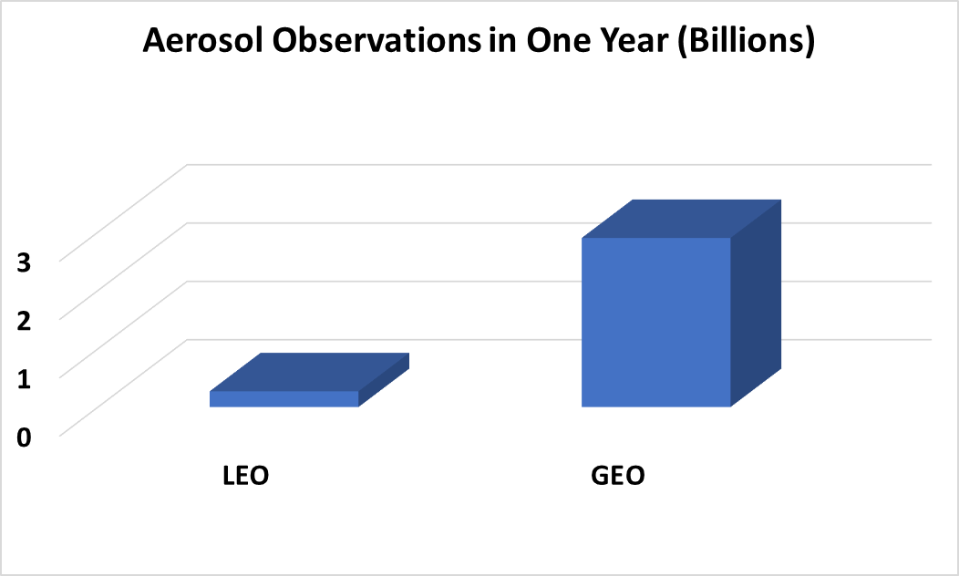
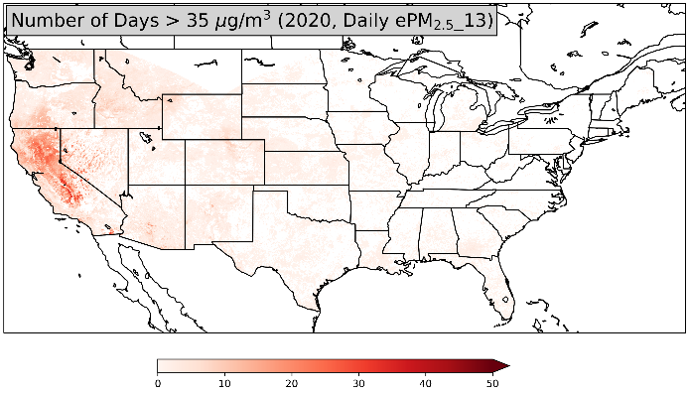
Value of Geostationary Satellite Observations of Air Quality
GEO
Zhang et al., Nowcasting applications of geostationary satellite hourly surface PM2.5 data, Weather and Forecasting, 2022
GEO imager observations provide better estimates of fine particulate pollution (PM2.5) and the resulting exposure of harmful levels of pollution compared to LEO or surface observations.
Example: 2020 Gigafire event
On a daily basis, about 40% more people would be informed about harmful air quality using GEO observations compared with LEO data.
On an hourly basis, 10 times as many people would be informed about air pollution using GEO observations compared with surface-based data.
GEO sampled as LEO
Number of Days
Notes:
Using NOAA’s operational geostationary satellite estimates of hourly surface fine particulate matter concentrations, we also investigated to see how many days in a year do we have air quality standard violated? When we did this study using geo vs. leo, we quickly found that the information content from geo is so much more than leo due to density of observations. Again, most of the air quality standard violations are in the west because that is where most of the fire activity is. In the east, due to pollution control strategies, we no longer see air quality standard violations.

Slide 3
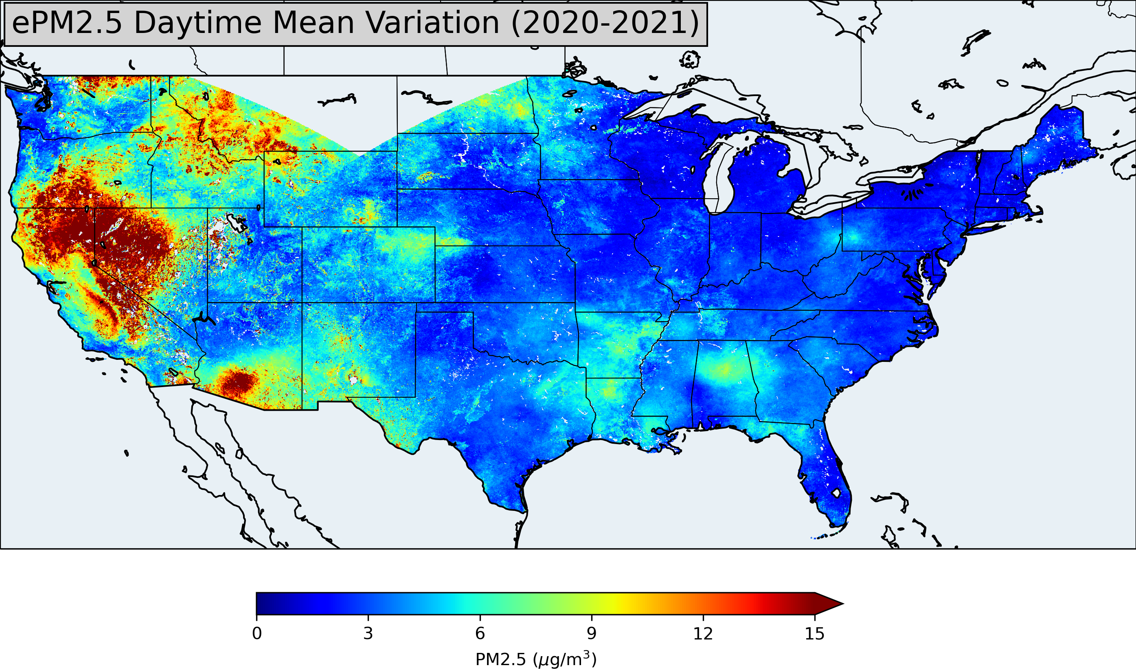
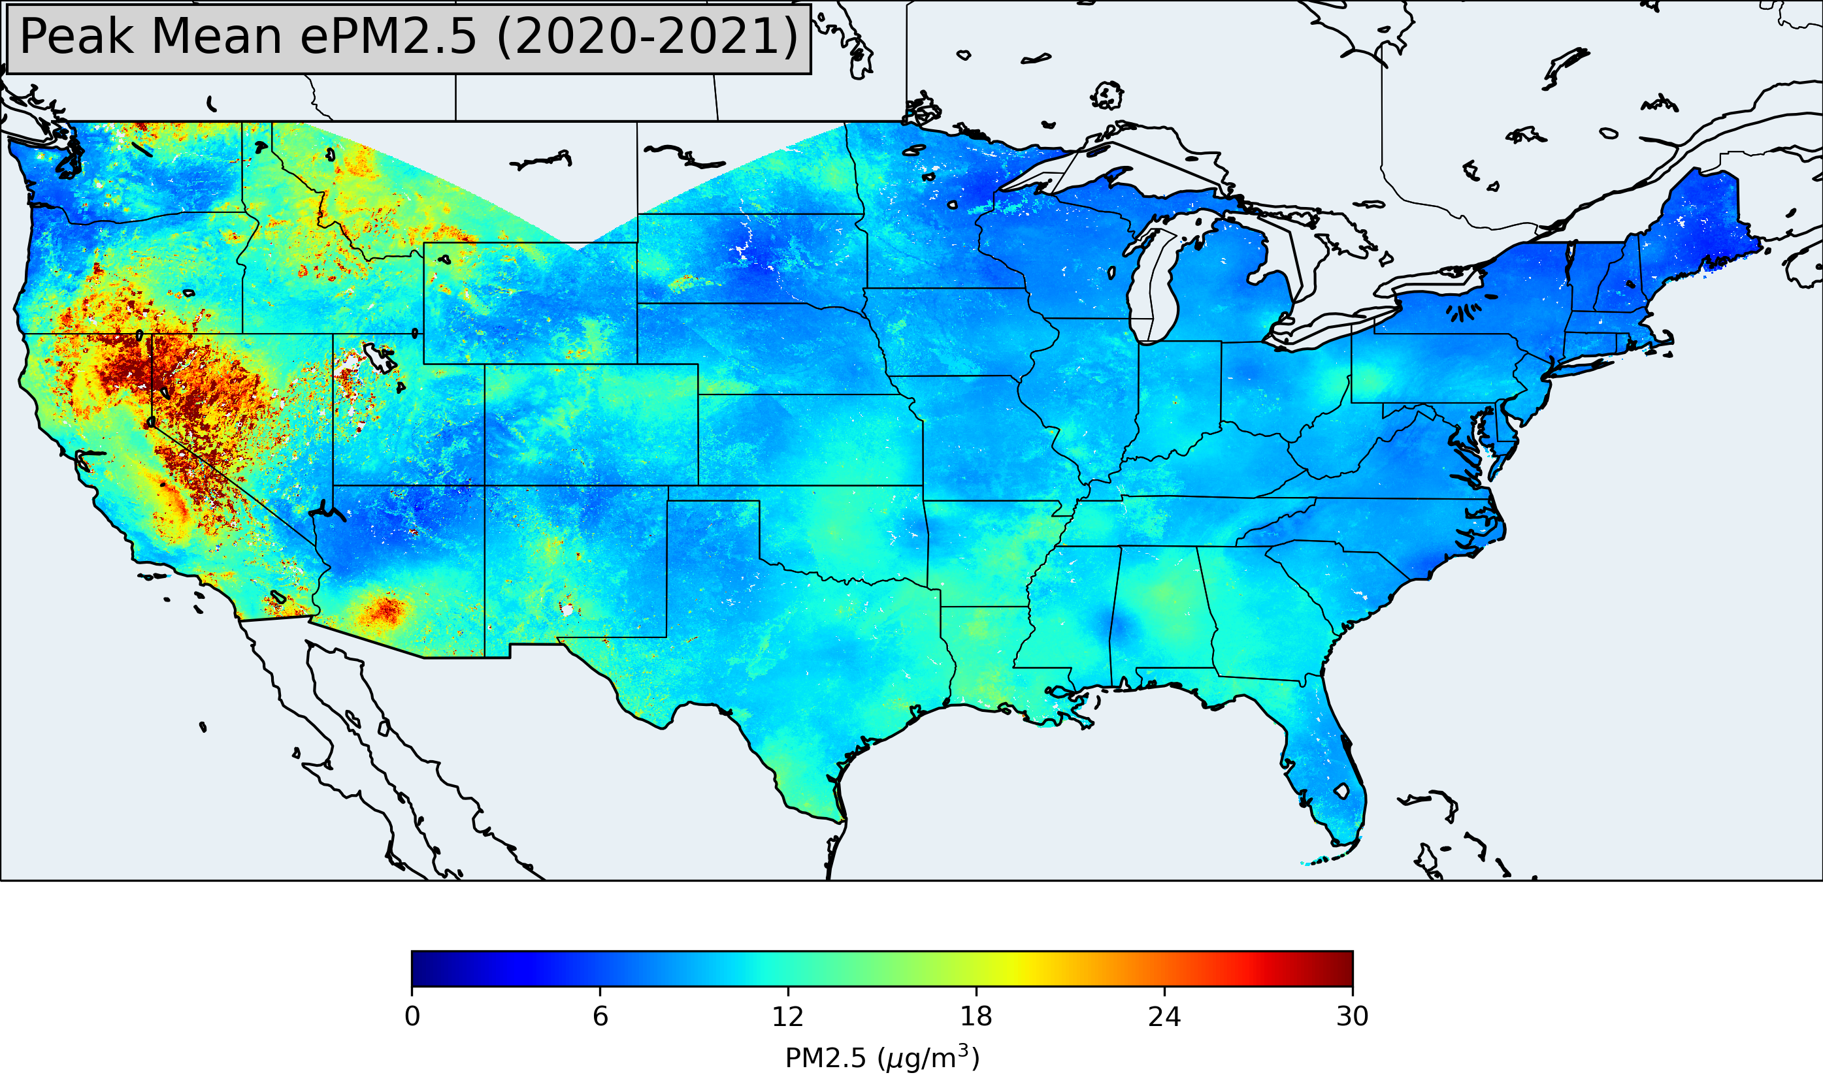
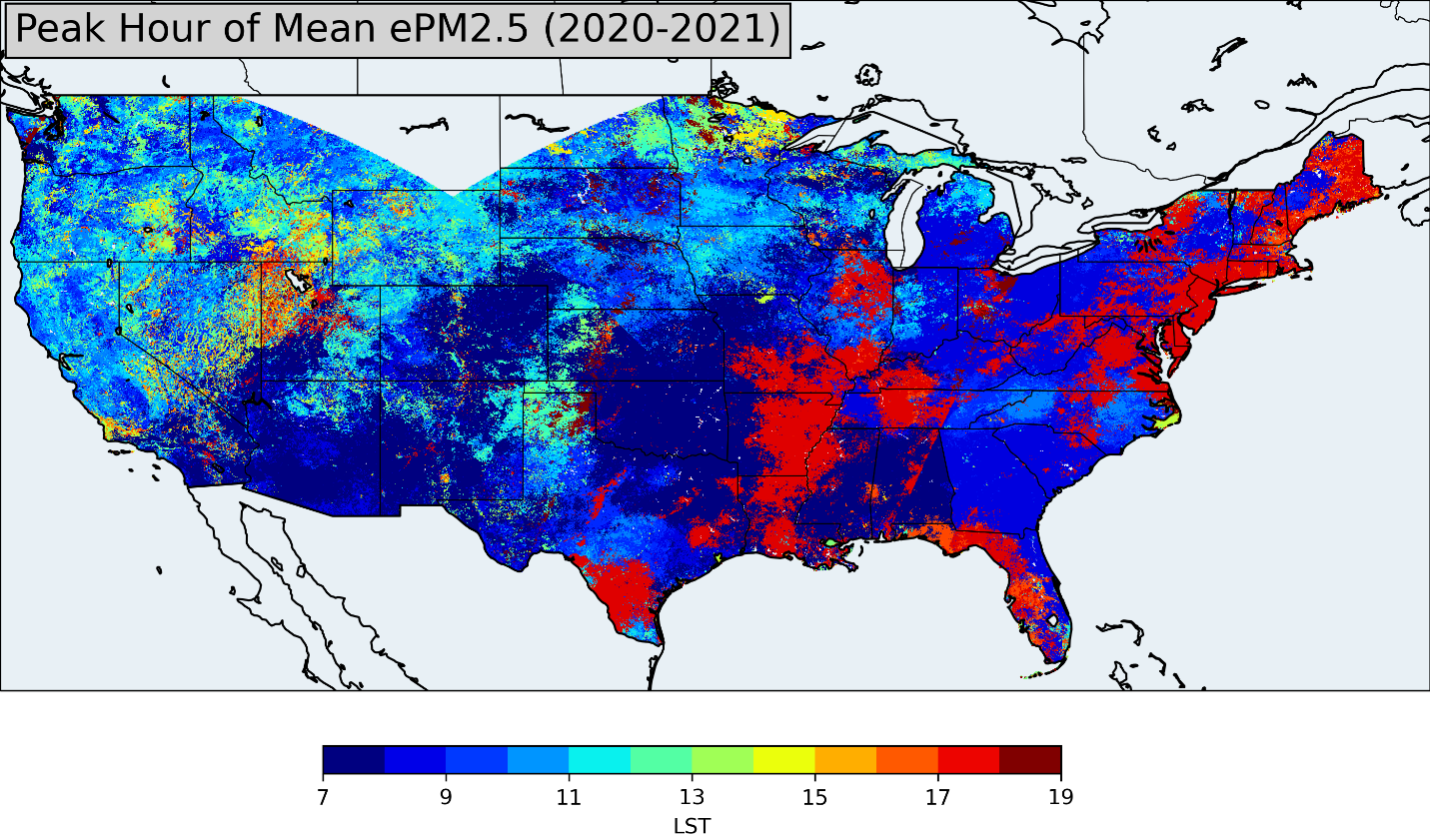
Value of Geostationary Satellite Observations of Air Quality
Zhang et al., Nowcasting applications of geostationary satellite hourly surface PM2.5 data, Weather and Forecasting, 2022
Notes:
This slide and next slide show why having geostationary satellite data are beneficial. NOAA has been flying an imager for several decades and now we have an advanced baseline imager with onboard calibration that can provide good aerosol retrievals. For air quality applications, we converted the aerosol optical depth to surface fine particulate matter concentrations to conduct some scientific studies. This map shows what time of the day pollution peaks. Indeed, consistent with our understanding of planetary boundary layer dynamics, sources, and chemistry pollution peaks either in the late evening or early morning associated with rush hour traffic. Whereas in the west where wildfires dominate fine particulate pollution, it peaks during the day because fires have strong diurnal variation and peak during the day.

Slide 4
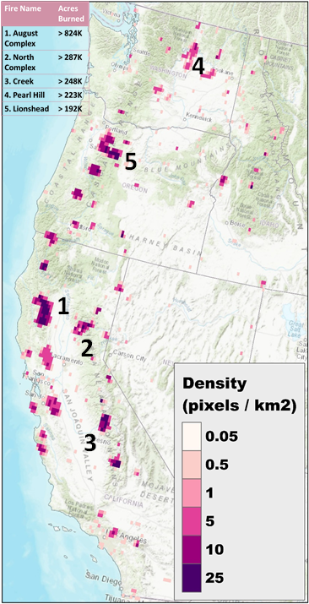
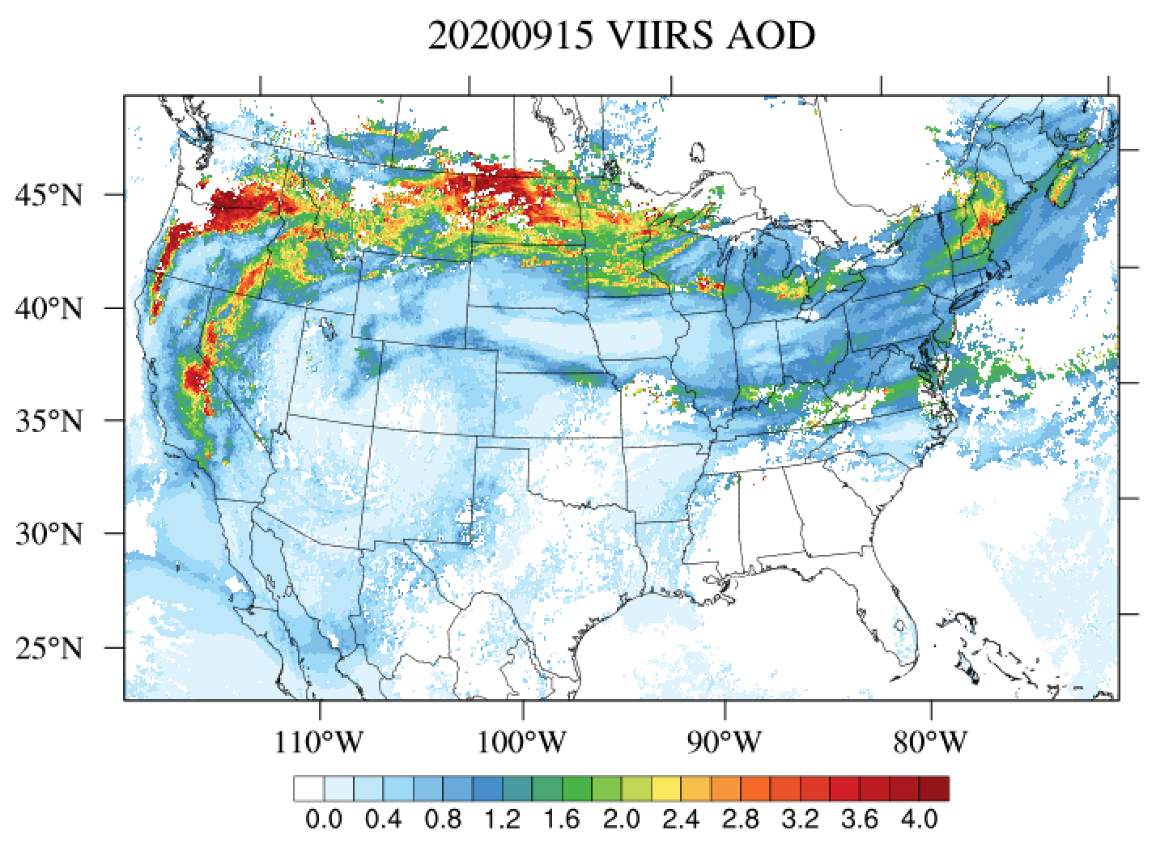
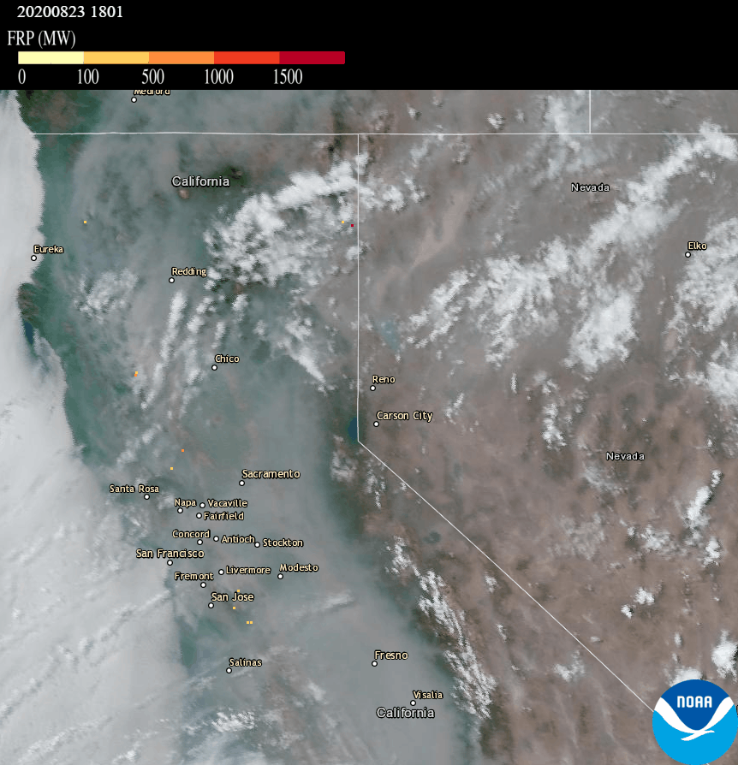
9/15/2020
SNPP VIIRS AOD. Figure from Li et al., GRL, 2021
0
4.0
Extreme Fires of 2020
NOAA satellites follow the smoke journey: https://www.star.nesdis.noaa.gov/star/news2020_202010Smoke.php
At what altitude is the smoke and how is it impacting surface air quality?

Slide 5
NOAA GeoXO ACX Instrument Value Study: Advancing Aerosol Layer Height Retrieval for Surface PM2.5 Monitoring
Jun Wang, Zhendong Lu, Xi Chen
College of Engineering, The University of Iowa
Shobha Kondragunta, Hai Zhang
NOAA NESDIS
April 2023

Slide 6
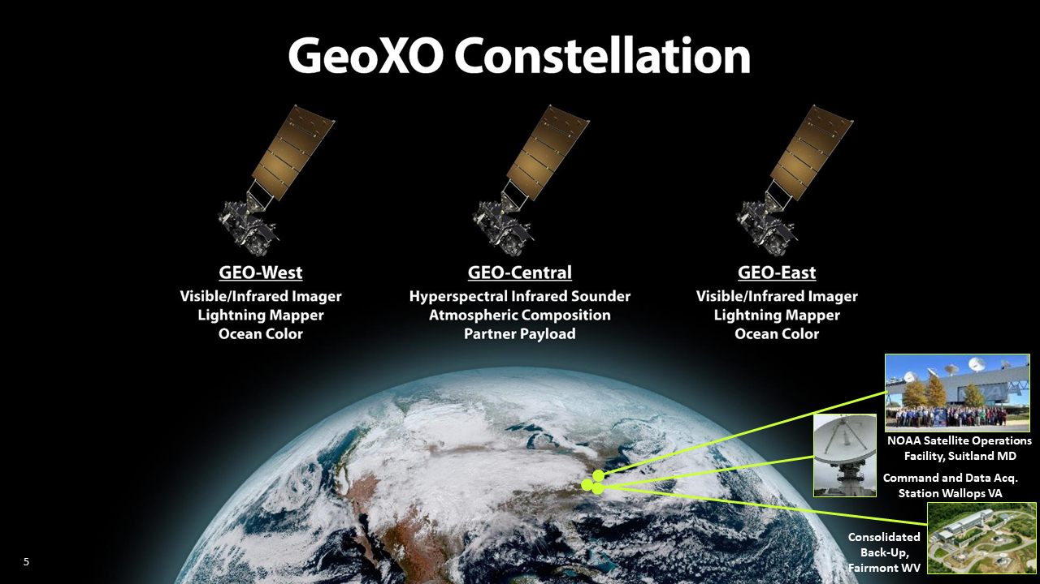
Techniques for sensing aerosol vertical distribution from space
Diurnal variation
Full spatial, regional/global coverage
2020s
2030s
2030s
Active
Lidar such as CALIOP and CATS
Passive
Limb/ occultation : SAGE, OMPS
Stereo photogrammetry : ATSR, MISR
UV, Deep Blue + Polarization : OMI, TROPOMI POLDER/PARASOL
Oxygen absorption spectroscopy: POLDER and MERIS, OMI, TROPOMI, SCIAMACHY; EPIC/DSCOVR, GEMS, TEMPO
Infrared: dust and smoke, MODIS, VIIRS, AIRS…
Oxygen absorption spectroscopy is the only technique that can work at both thick and moderate-thin aerosol optical depth conditions for both absorbing and non- or weak-absorbing aerosols (which is contrast with UV technique that can only be applied to strong absorption aerosols.
Notes:
2 min
spatial resolution

Slide 7


Oxygen absorption spectroscopy
I₀
I₁
I₀
I₂
O₂
O₂
Aerosol plume
O₂
Aerosol plume
O₂
I₁> I₂

Slide 8
Enabled by TROPOMI (as a proxy for GeoXO)
VIIRS
This study
KNMI product
CALIOP overlaid with AOCH retrievals
This study
VIIRS classifies as cloud
KNMI
Chen et al., 2021, RSE.

Slide 9
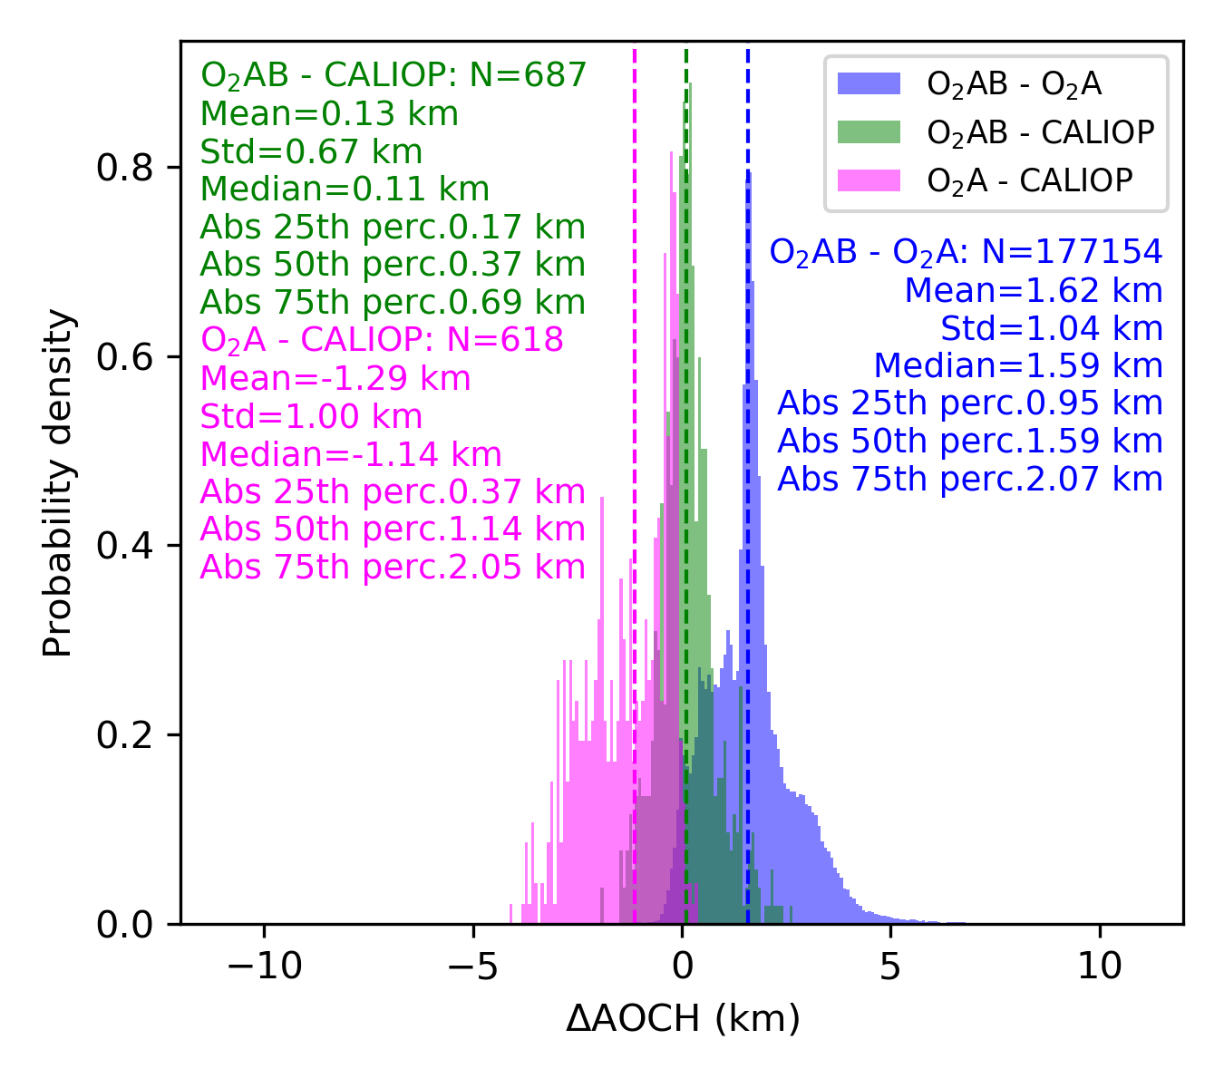
Validation
TROPOMI operational ALH product based on O2 A-band has 1.5 km low bias (Nanda et al., 2020)
This study using O2 A- and B-bands has mean bias of nearly zero in AOCH.

Slide 10
Demonstration for societal benefits
Air quality forecast is needed by the state/local communities to make advisories/decisions for mitigating public exposure to air pollution.
Aerosol layer height is one of the most needed information air quality mangers wants (based on HAQAST group discussion on air quality forecast in smoke conditions).

Slide 11
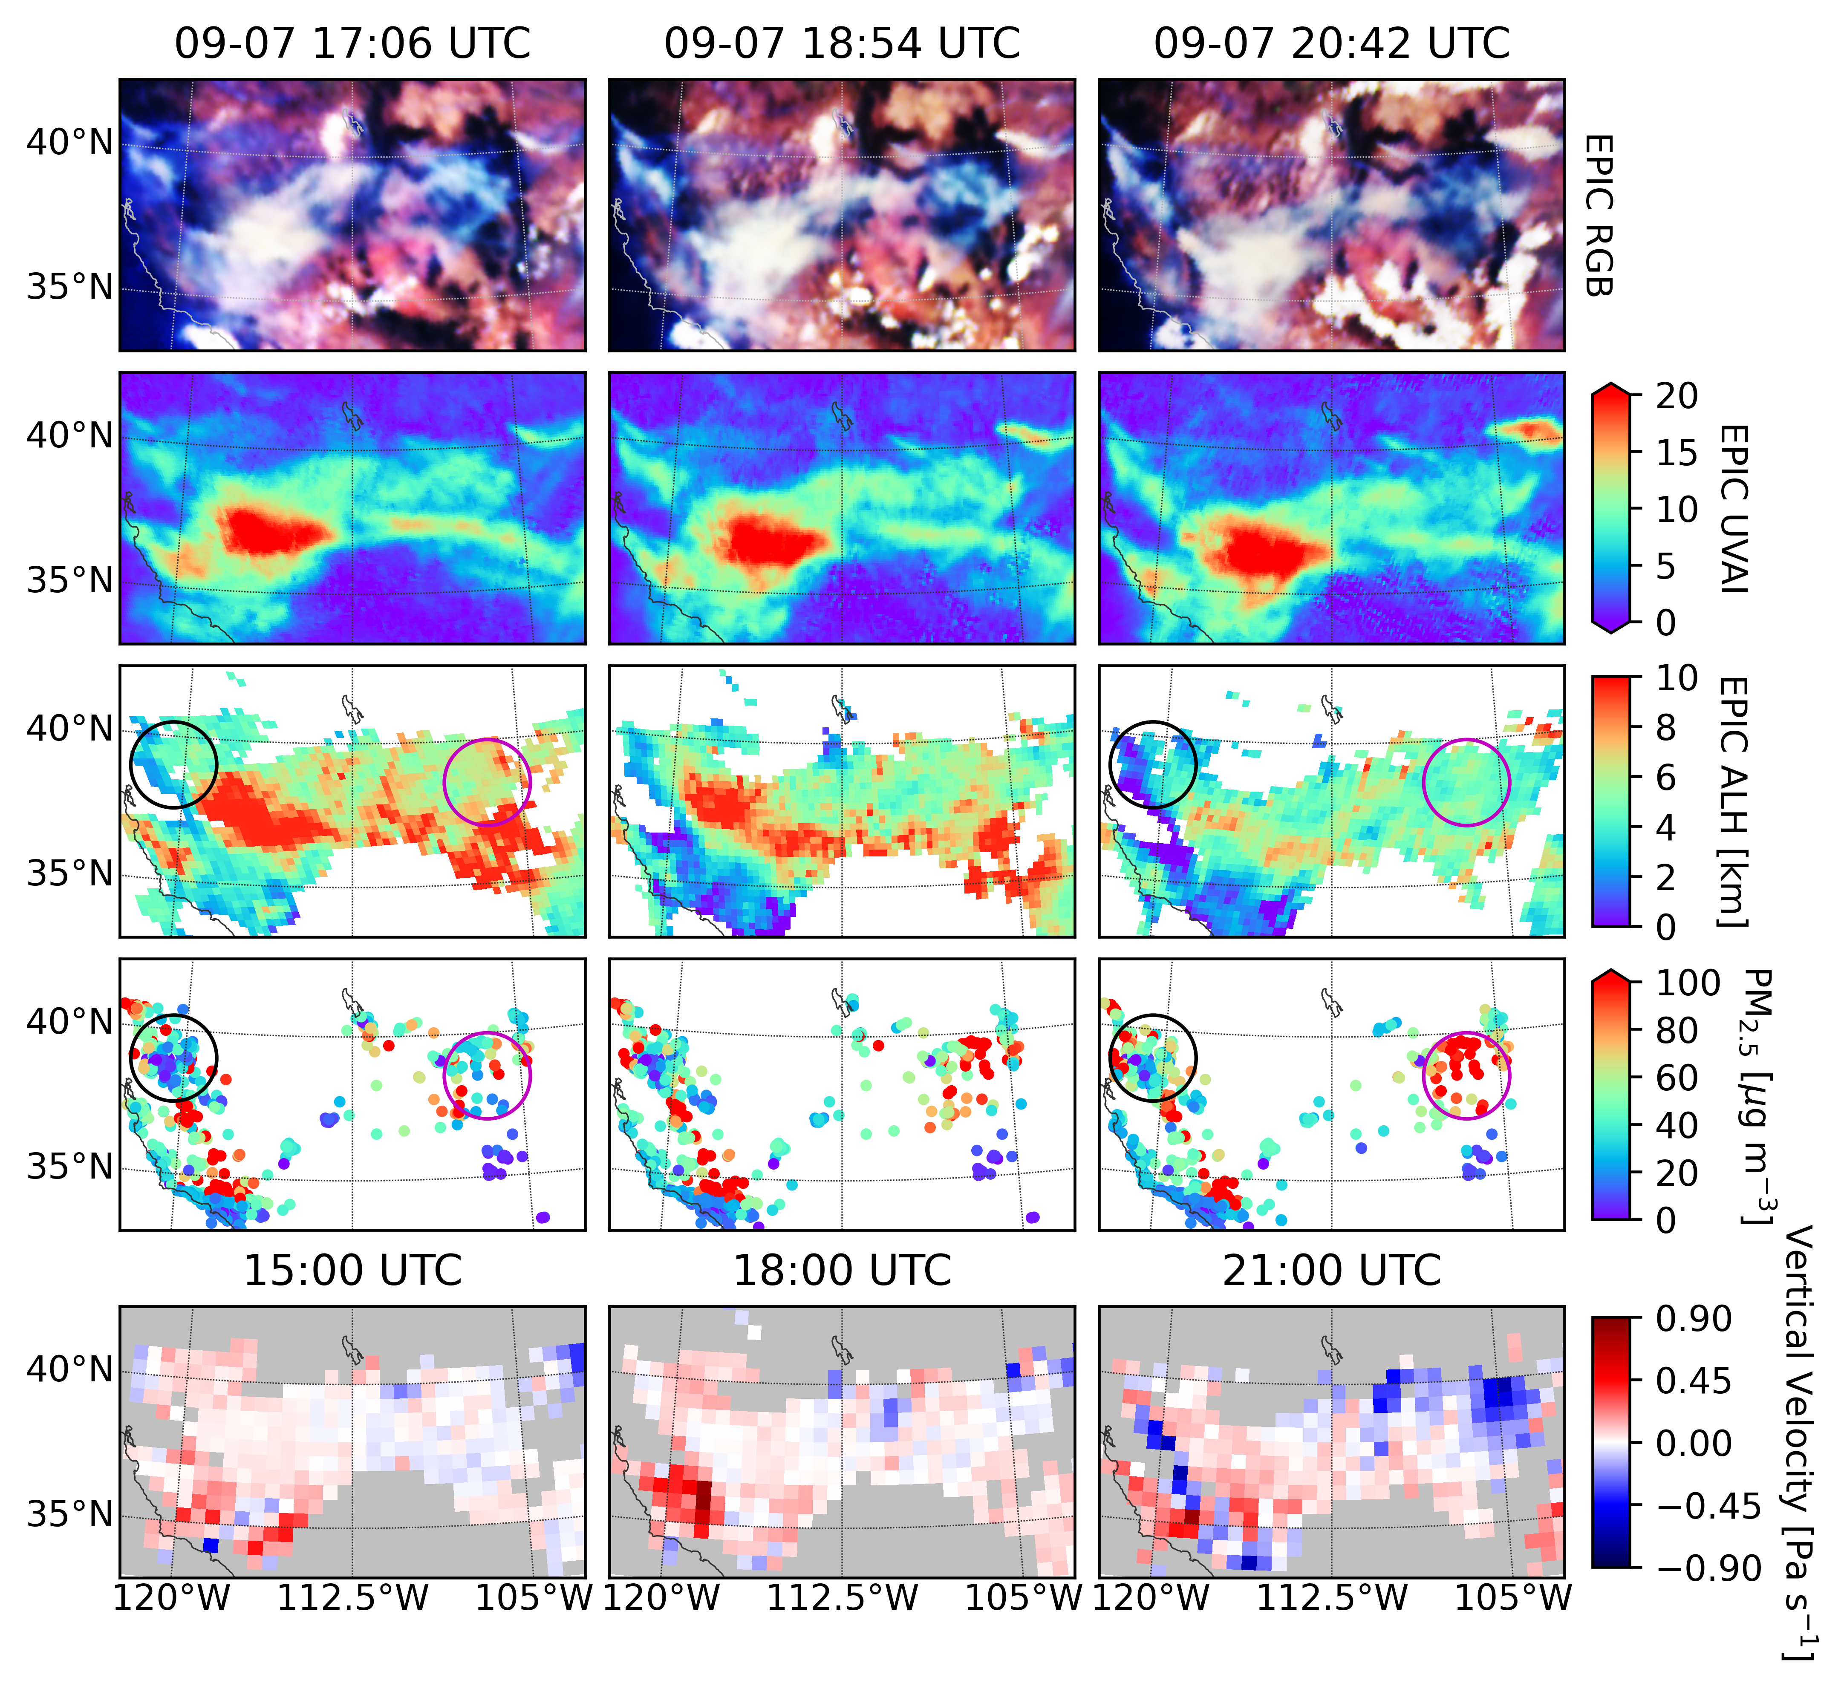
Hourly mapping of smoke height
Algorithm Revisions
vicarious calibration based on TROPOMI data
adjust cloud mask so that thick smokes would not be misclassified as clouds
Descending smoke heights lead to increasing PM_{2.5}
Positive vertical pressure velocity indicates descending air motion
Lu, Z. et al., 2022
Notes:
mark on the figure: AOCH, PM2.5
UVAI no info.

Slide 12
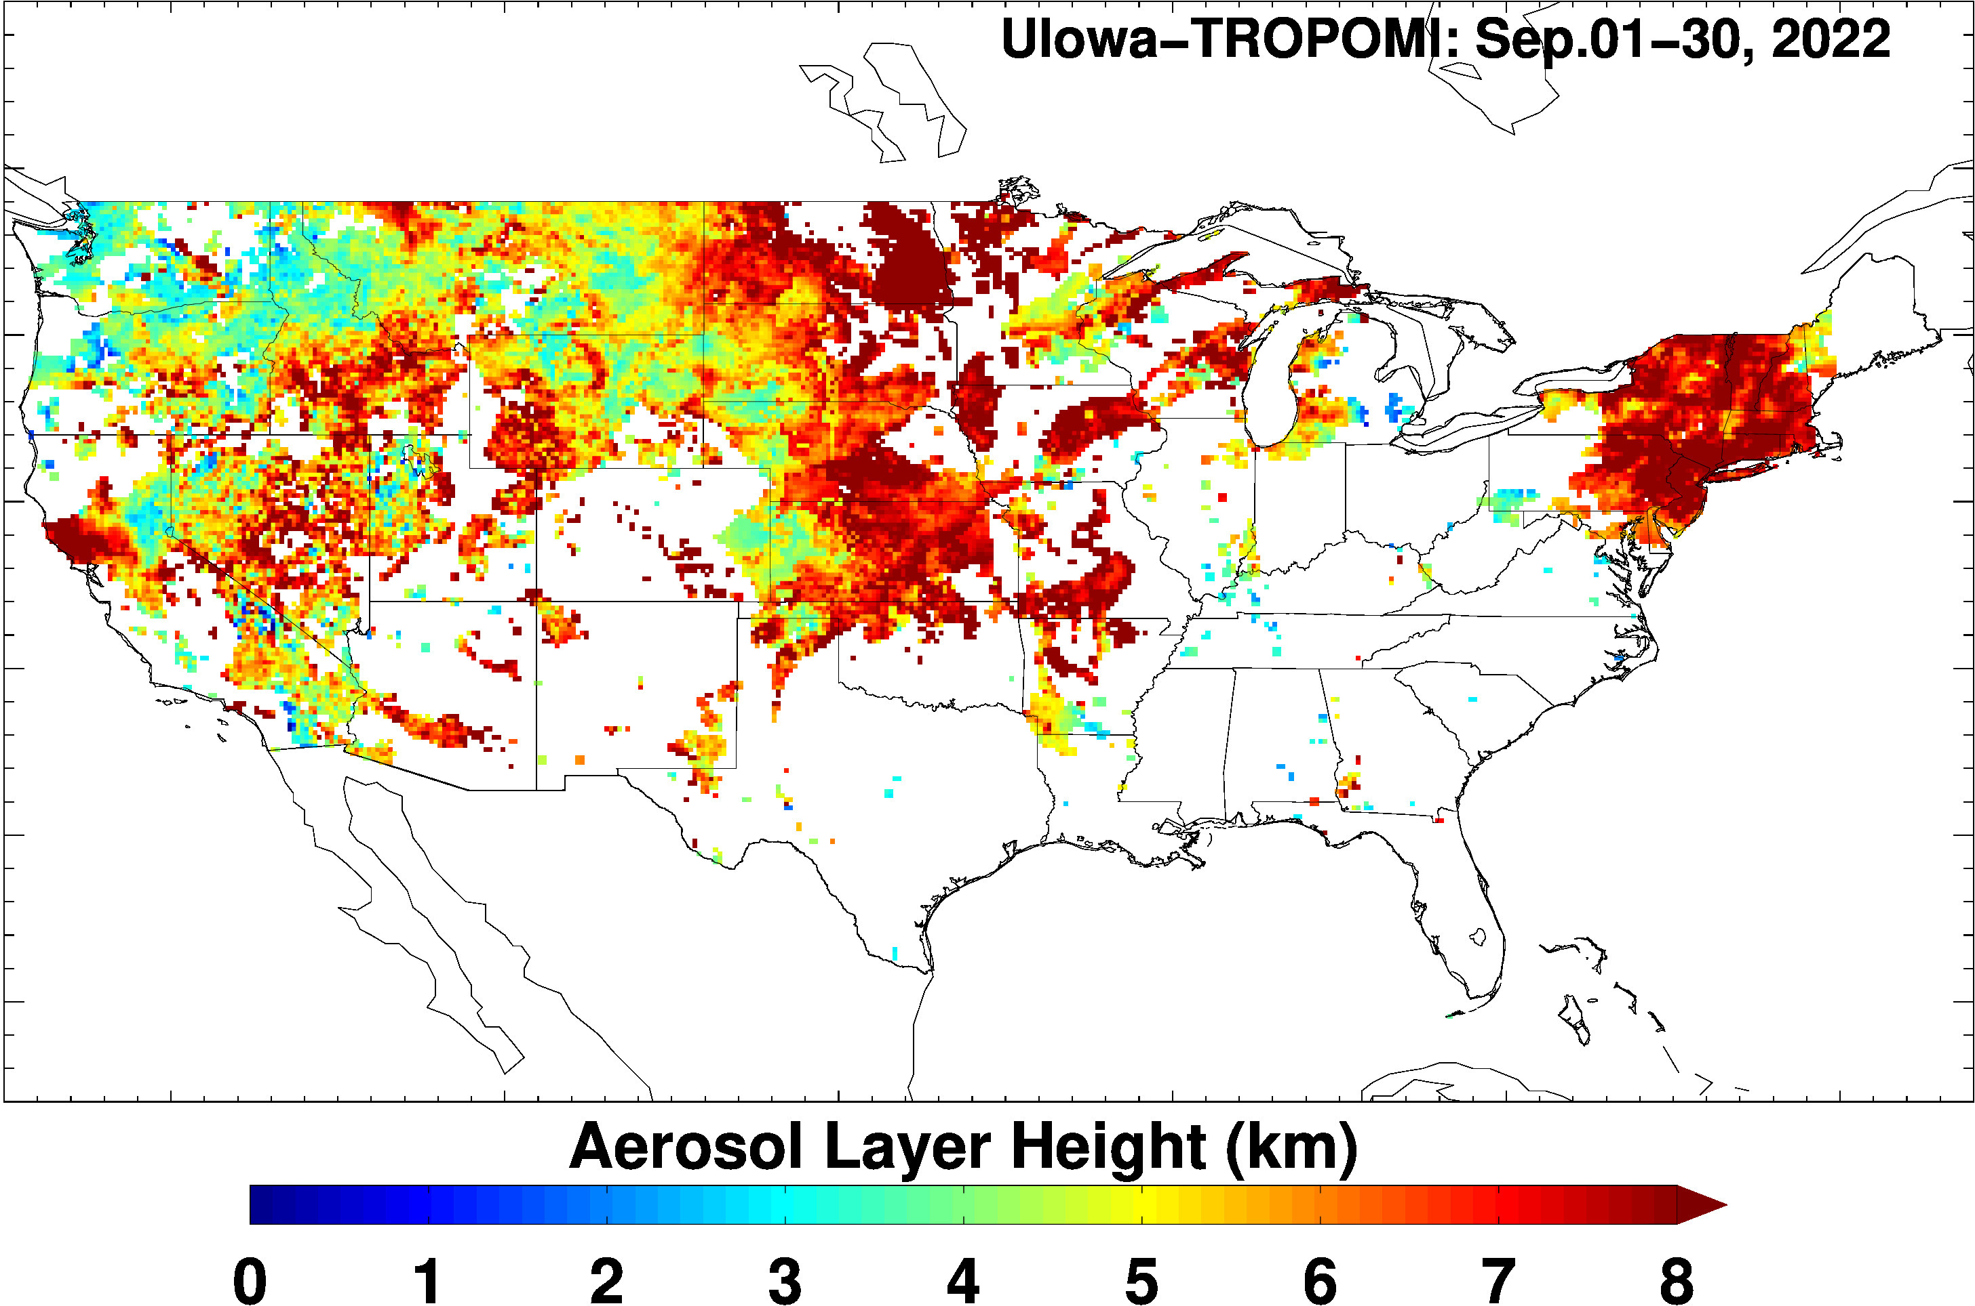
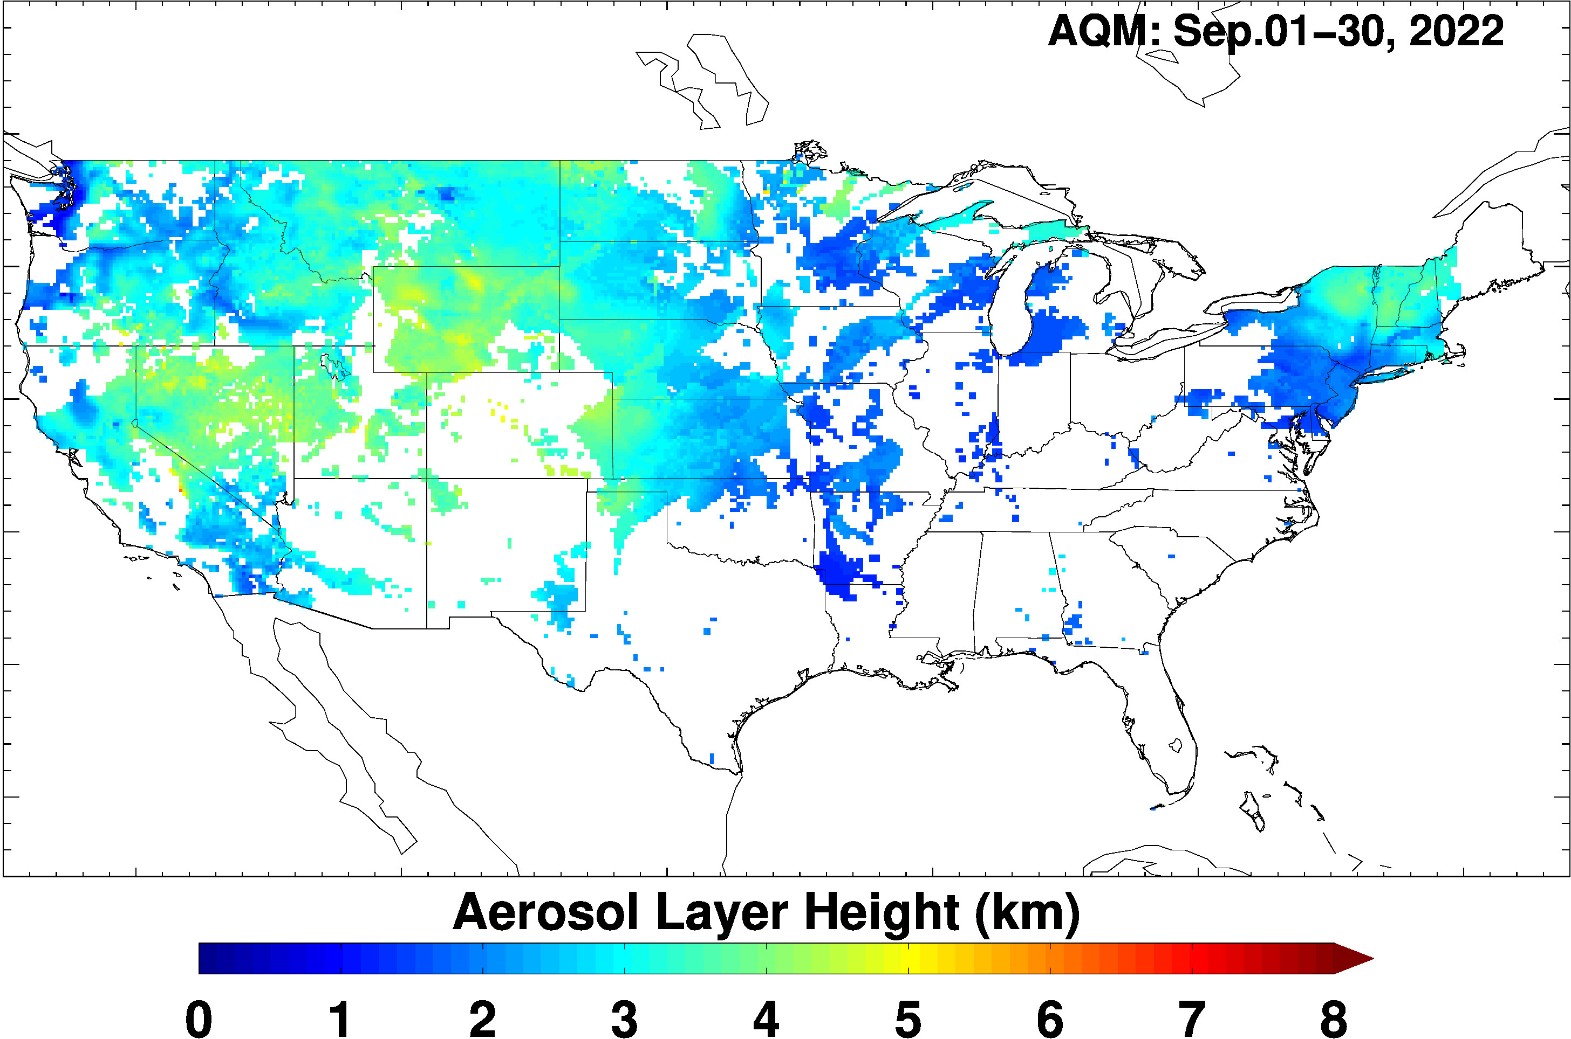
Summary
Demonstrated capabilities of aerosol layer height retrievals
Using TROPOMI and EPIC showed that O2 B band is extremely useful for aerosol layer height retrieval over vegetated surface.
Applications
PM2.5 monitoring
Plume injection height
Assimilation of AOD along with layer height in air quality models
Ongoing research
Provide AOCH data from EPIC and TROPOMI to various groups (NOAA and several universities have requested the data from us)
Work with NOAA to refine the algorithm and further show the utility of AOCH and aerosol vertical profiles for the surface PM2.5 estimates and predictions.
AQM is the NWS soon-to-be operational new version of the CMAQ model

