Slide 1




GeoXO Atmospheric Composition Capabilities
Presented by Shobha Kondragunta
Joanna Joiner
Instrument Scientist
Shobha Kondragunta
Product Scientist
Greg Frost
User Scientist
Disclaimer: The scientific results and conclusions, as well as any views or opinions expressed
herein, are those of the author(s) and do not necessarily reflect those of NOAA or
the Department of Commerce.

Slide 2
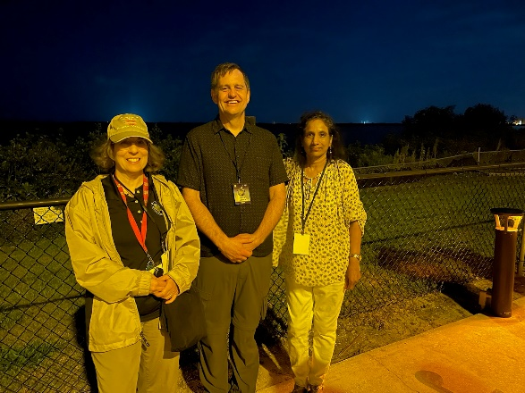
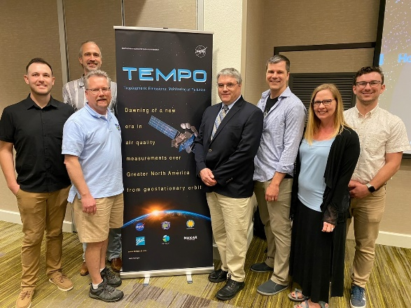
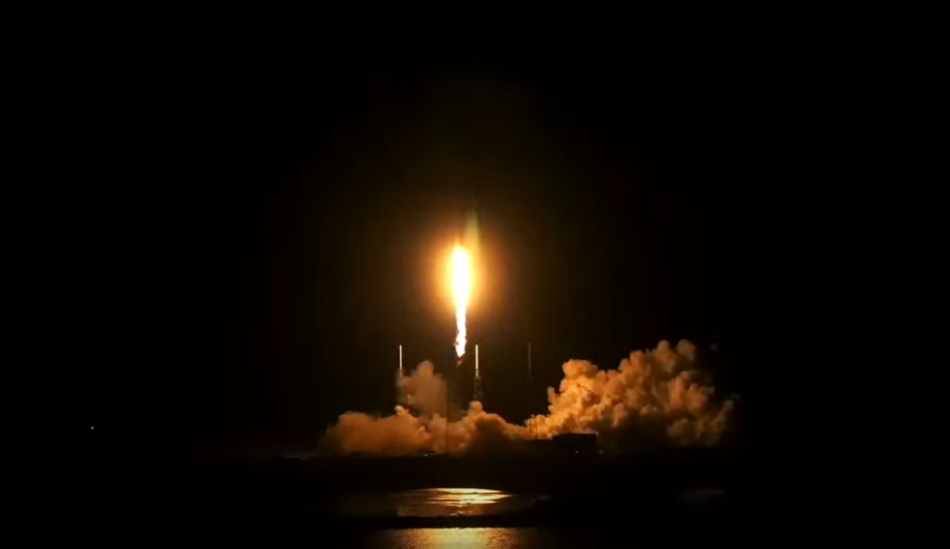
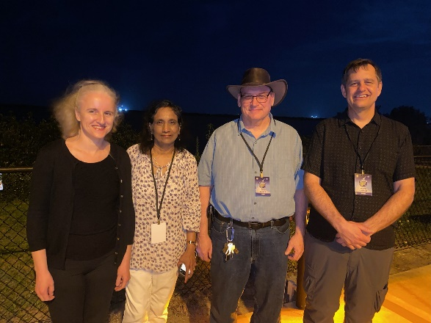
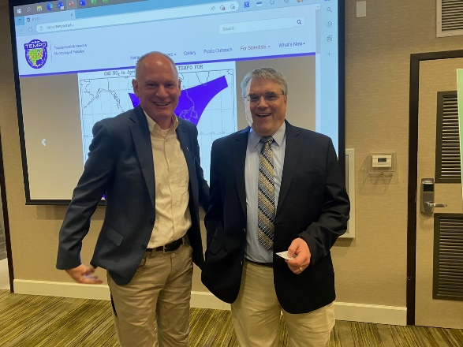
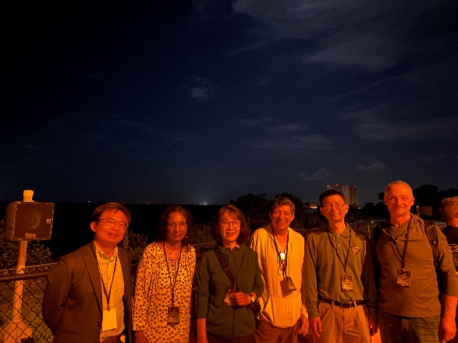


https://www.nasa.gov/press-release/nasa-s-high-resolution-air-quality-control-instrument-launches
Photo credit: Greg Frost, Nick Krotkov, Shobha Kondragunta

Slide 3
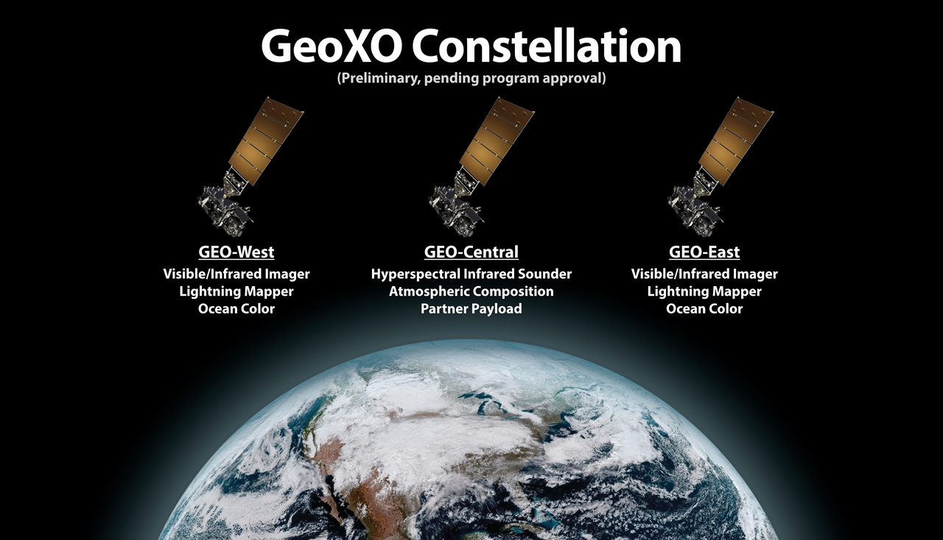

Slide 4
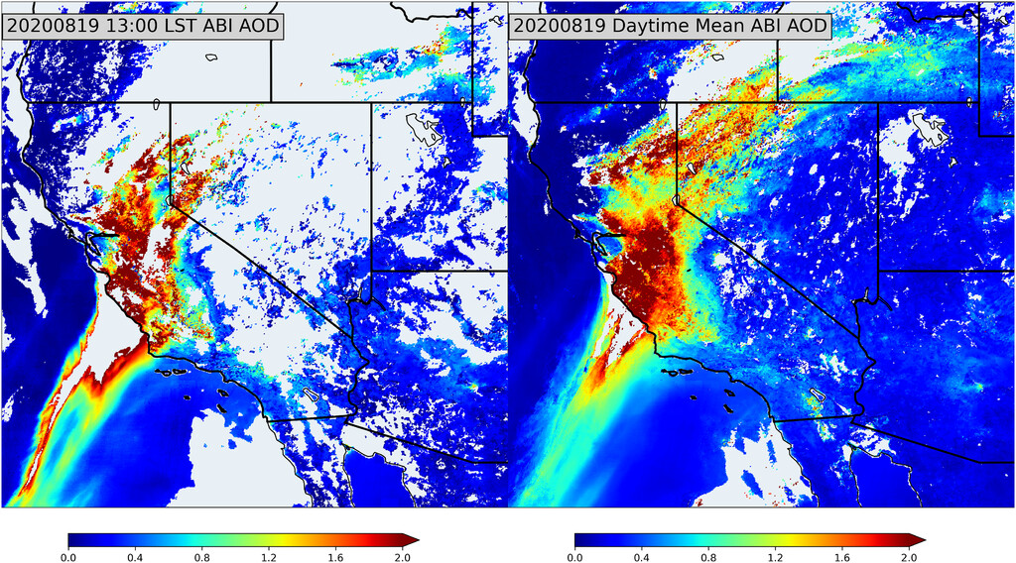
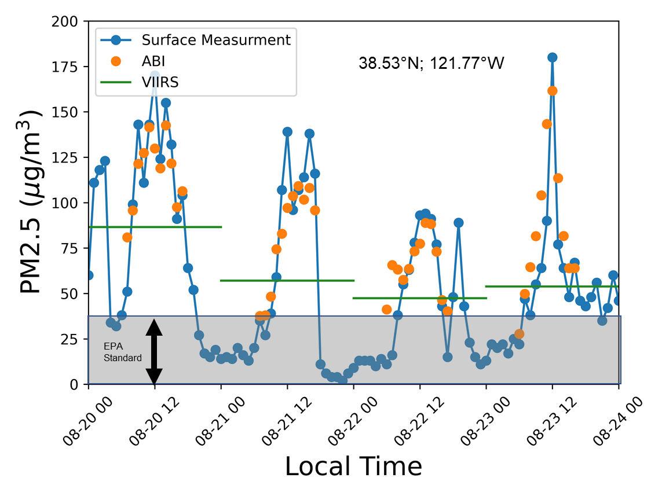
GeoXO ACX Instrument
Attribute |  | What |  | Why
Coverage |  | CONUS, southern Canada, northern Mexico, Caribbean |  | Hourly inputs to national air quality, hazard and fire forecasting capabilities and warnings.
Spatial Resolution |  | 8x3 km² @ nadir |  | Resolve sources, including cities, highway corridors, airports, oil/gas fields, large point sources like fires and power plants.
Temporal Resolution |  | 60 min |  | Capture diurnal variations in pollution emissions, photochemistry, and exposure. Detect episodic events like wildfires and volcanoes. Select for cloud-free conditions. Increase geographic coverage compared with LEO or surface observations.
Spectral Coverage / Resolution |  | UV: 300-500 nm Vis: 540-740 nm Both @ 0.6 nm |  | UV: ozone, nitrogen dioxide, formaldehyde, sulfur dioxide, absorption aerosol optical depth. Vis: cloud/aerosol layer height, PBL ozone, vegetation.
Notes:
GeoXO ACX attributes are similar to NASA’s TEMPO instrument. GEMS which is already in orbit does not have the second visible detector to do boundary layer ozone and aerosol layer height using oxygen absorption. NOAA is working with GEMS data and adapting some of its algorithms to run on GEMS radiances in preparation for TEMPO and ACX. The diurnal variations of NO2 over Seoul, New York, and Los Angeles shows the complexity of understanding air quality issues as these are region specific and source specific.

Slide 5
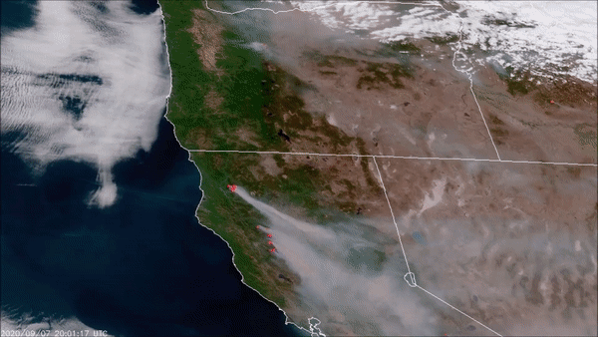
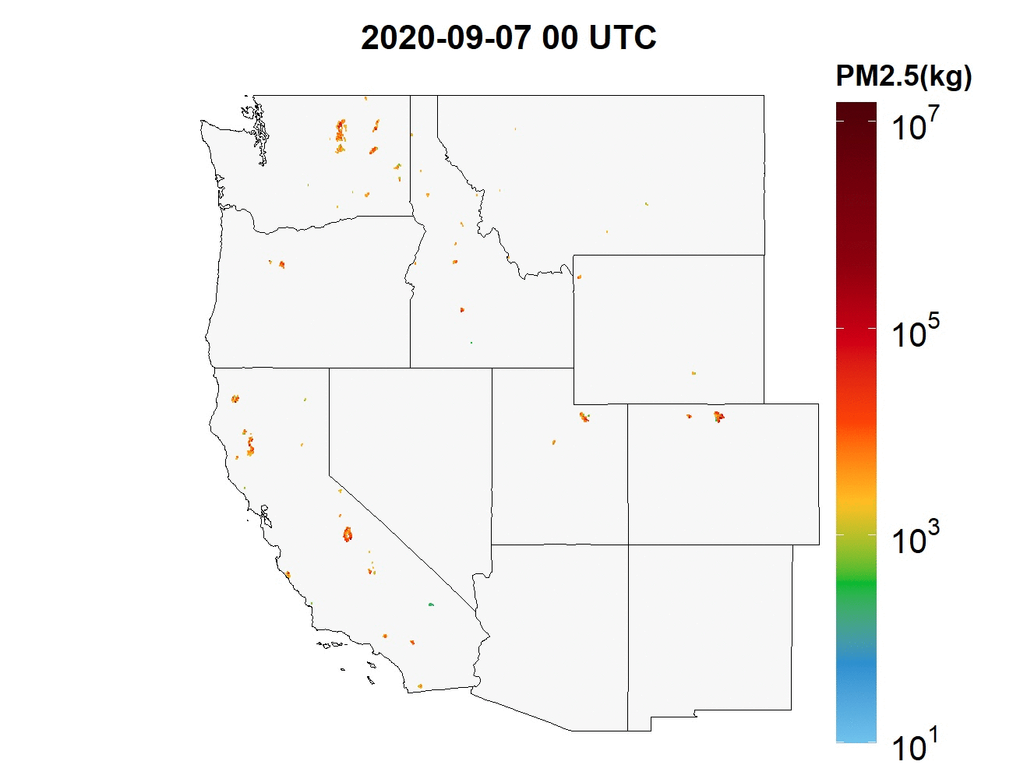
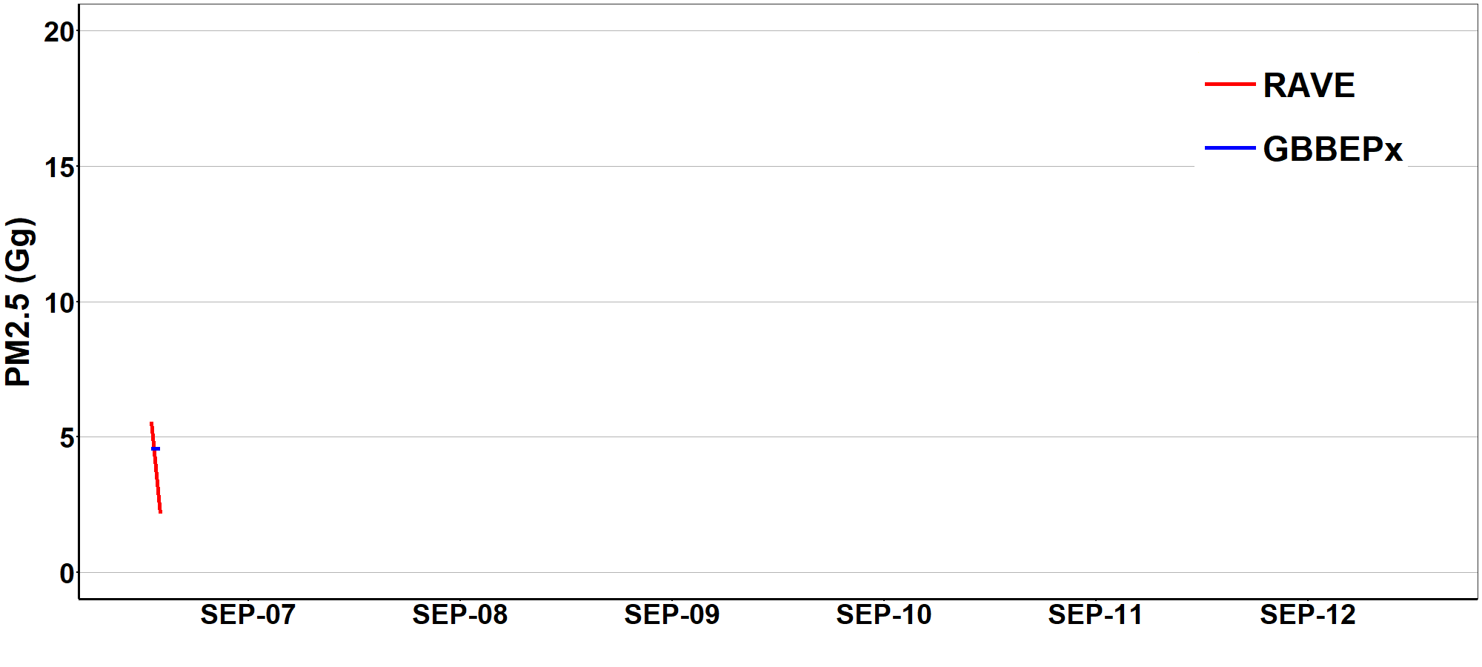
Aerosol spatial and temporal variability
Sources and sinks
Meteorology
Chemistry
Li, F., X. Zhang, S. Kondragunta, X. Lu, I. Csiszar, and C. Schmidt, Hourly biomass burning emissions product from blended geostationary and polar-orbiting satellites for air quality forecasting applications, RSE, 2022

Slide 6
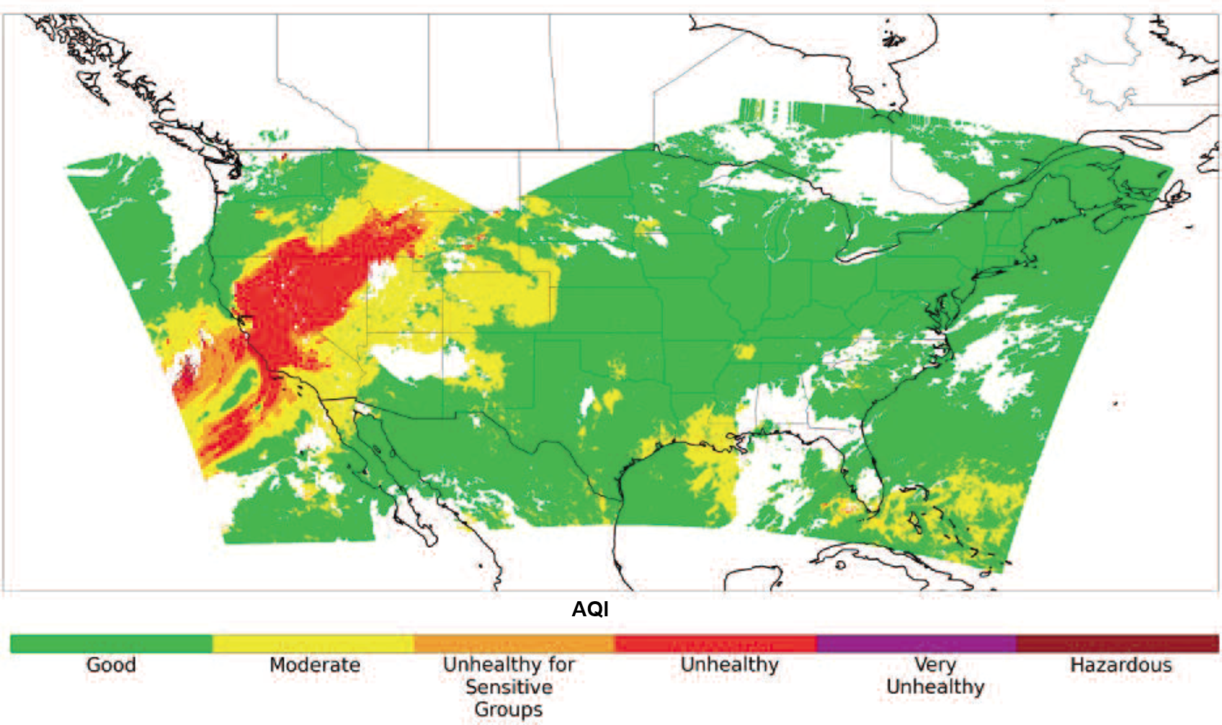

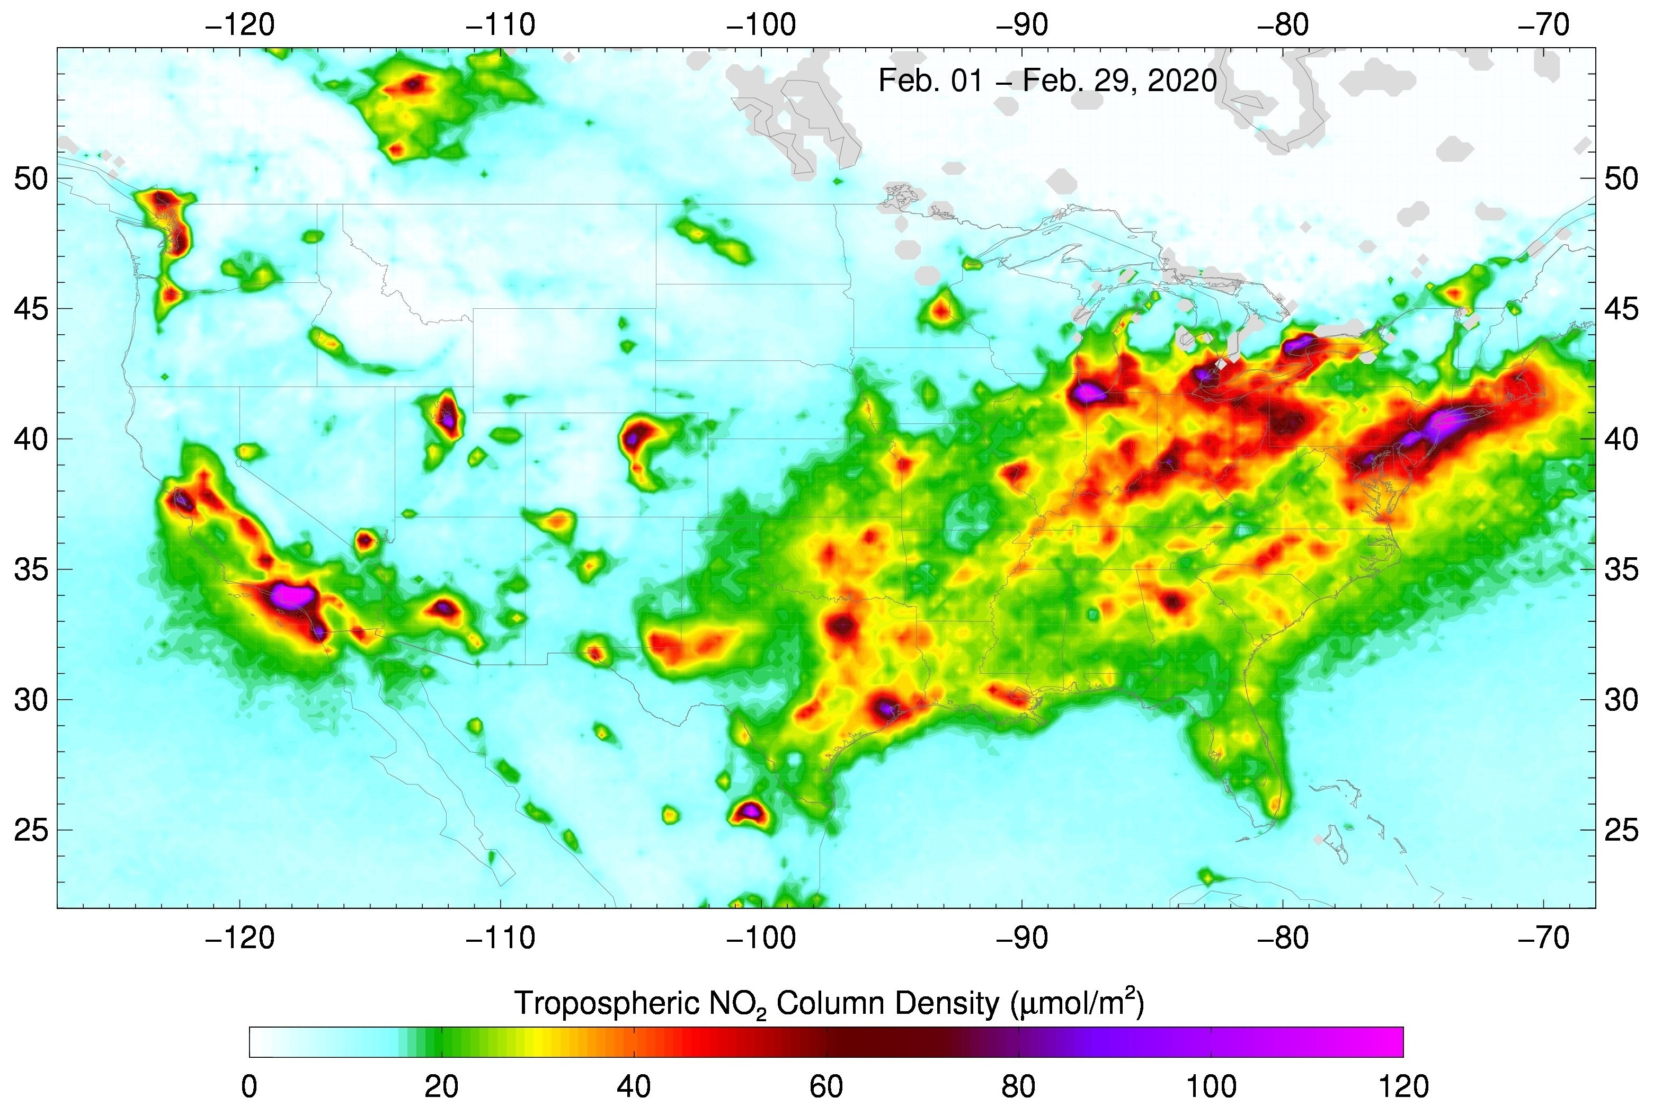
GeoXO atmospheric composition will be a multi-instrument strategy for various NOAA applications
  Fire detection
  Fire radiative power
  Aerosol type
  Aerosol optical depth
  Aerosol concentration
Ozone
Carbon monoxide
Carbon dioxide
Ammonia
Isoprene
Ozone
Nitrogen dioxide
Sulfur dioxide
Formaldehyde
Aerosol layer height
UV AI
UV aerosol optical depth
IMAGER
SOUNDER
SPECTROMETER
Applications
Near real time emissions | Air quality forecasting
Air quality monitoring | Fire weather forecasting
Fire emissions monitoring | Ozone monitoring
Hazards forecasting | Greenhouse gas monitoring
Climate modeling and earth system science research

Slide 7
Application Area | Satellite Products
Near-real-time emissions monitoring | NO₂, CH₂O, CO, SO₂
Air quality forecasting | O₃, NO₂, CH₂O, CO, SO₂, C₂H₂O₂, CO, AOD, UV AOD, PM_{2.5}, aerosol layer height, radiative fluxes
Air quality monitoring | O₃, NO₂, CH₂O, CO, SO₂, C₂H₂O₂, CO, AOD, UV AOD, PM_{2.5}, aerosol imagery, UV aerosol index, aerosol layer height
Fire weather forecasting | Fire detections, fire radiative power, smoke plume height
Fire emissions monitoring | Fire detections, fire radiative power
Hazards forecasting | Fire detections, dust detection, smoke detection, SO₂, volcanic ash
Greenhouse gas monitoring | CH₄, CO₂, O₃
Stratospheric ozone monitoring | O₃ vertical profile
Climate modeling and Earth system modeling | NO₂, CO, O₃, O₃ profile, CH₂O, AOD, NH₃, CH₄, Isoprene, stratospheric aerosols, TOA radiation, land cover, UVAOD, aerosol layer height, fire detection, fire radiative power, smoke injection height, dust detection, volcanic ash, Solar Induced Fluorescence, surface and profile of radiative fluxes

Slide 8

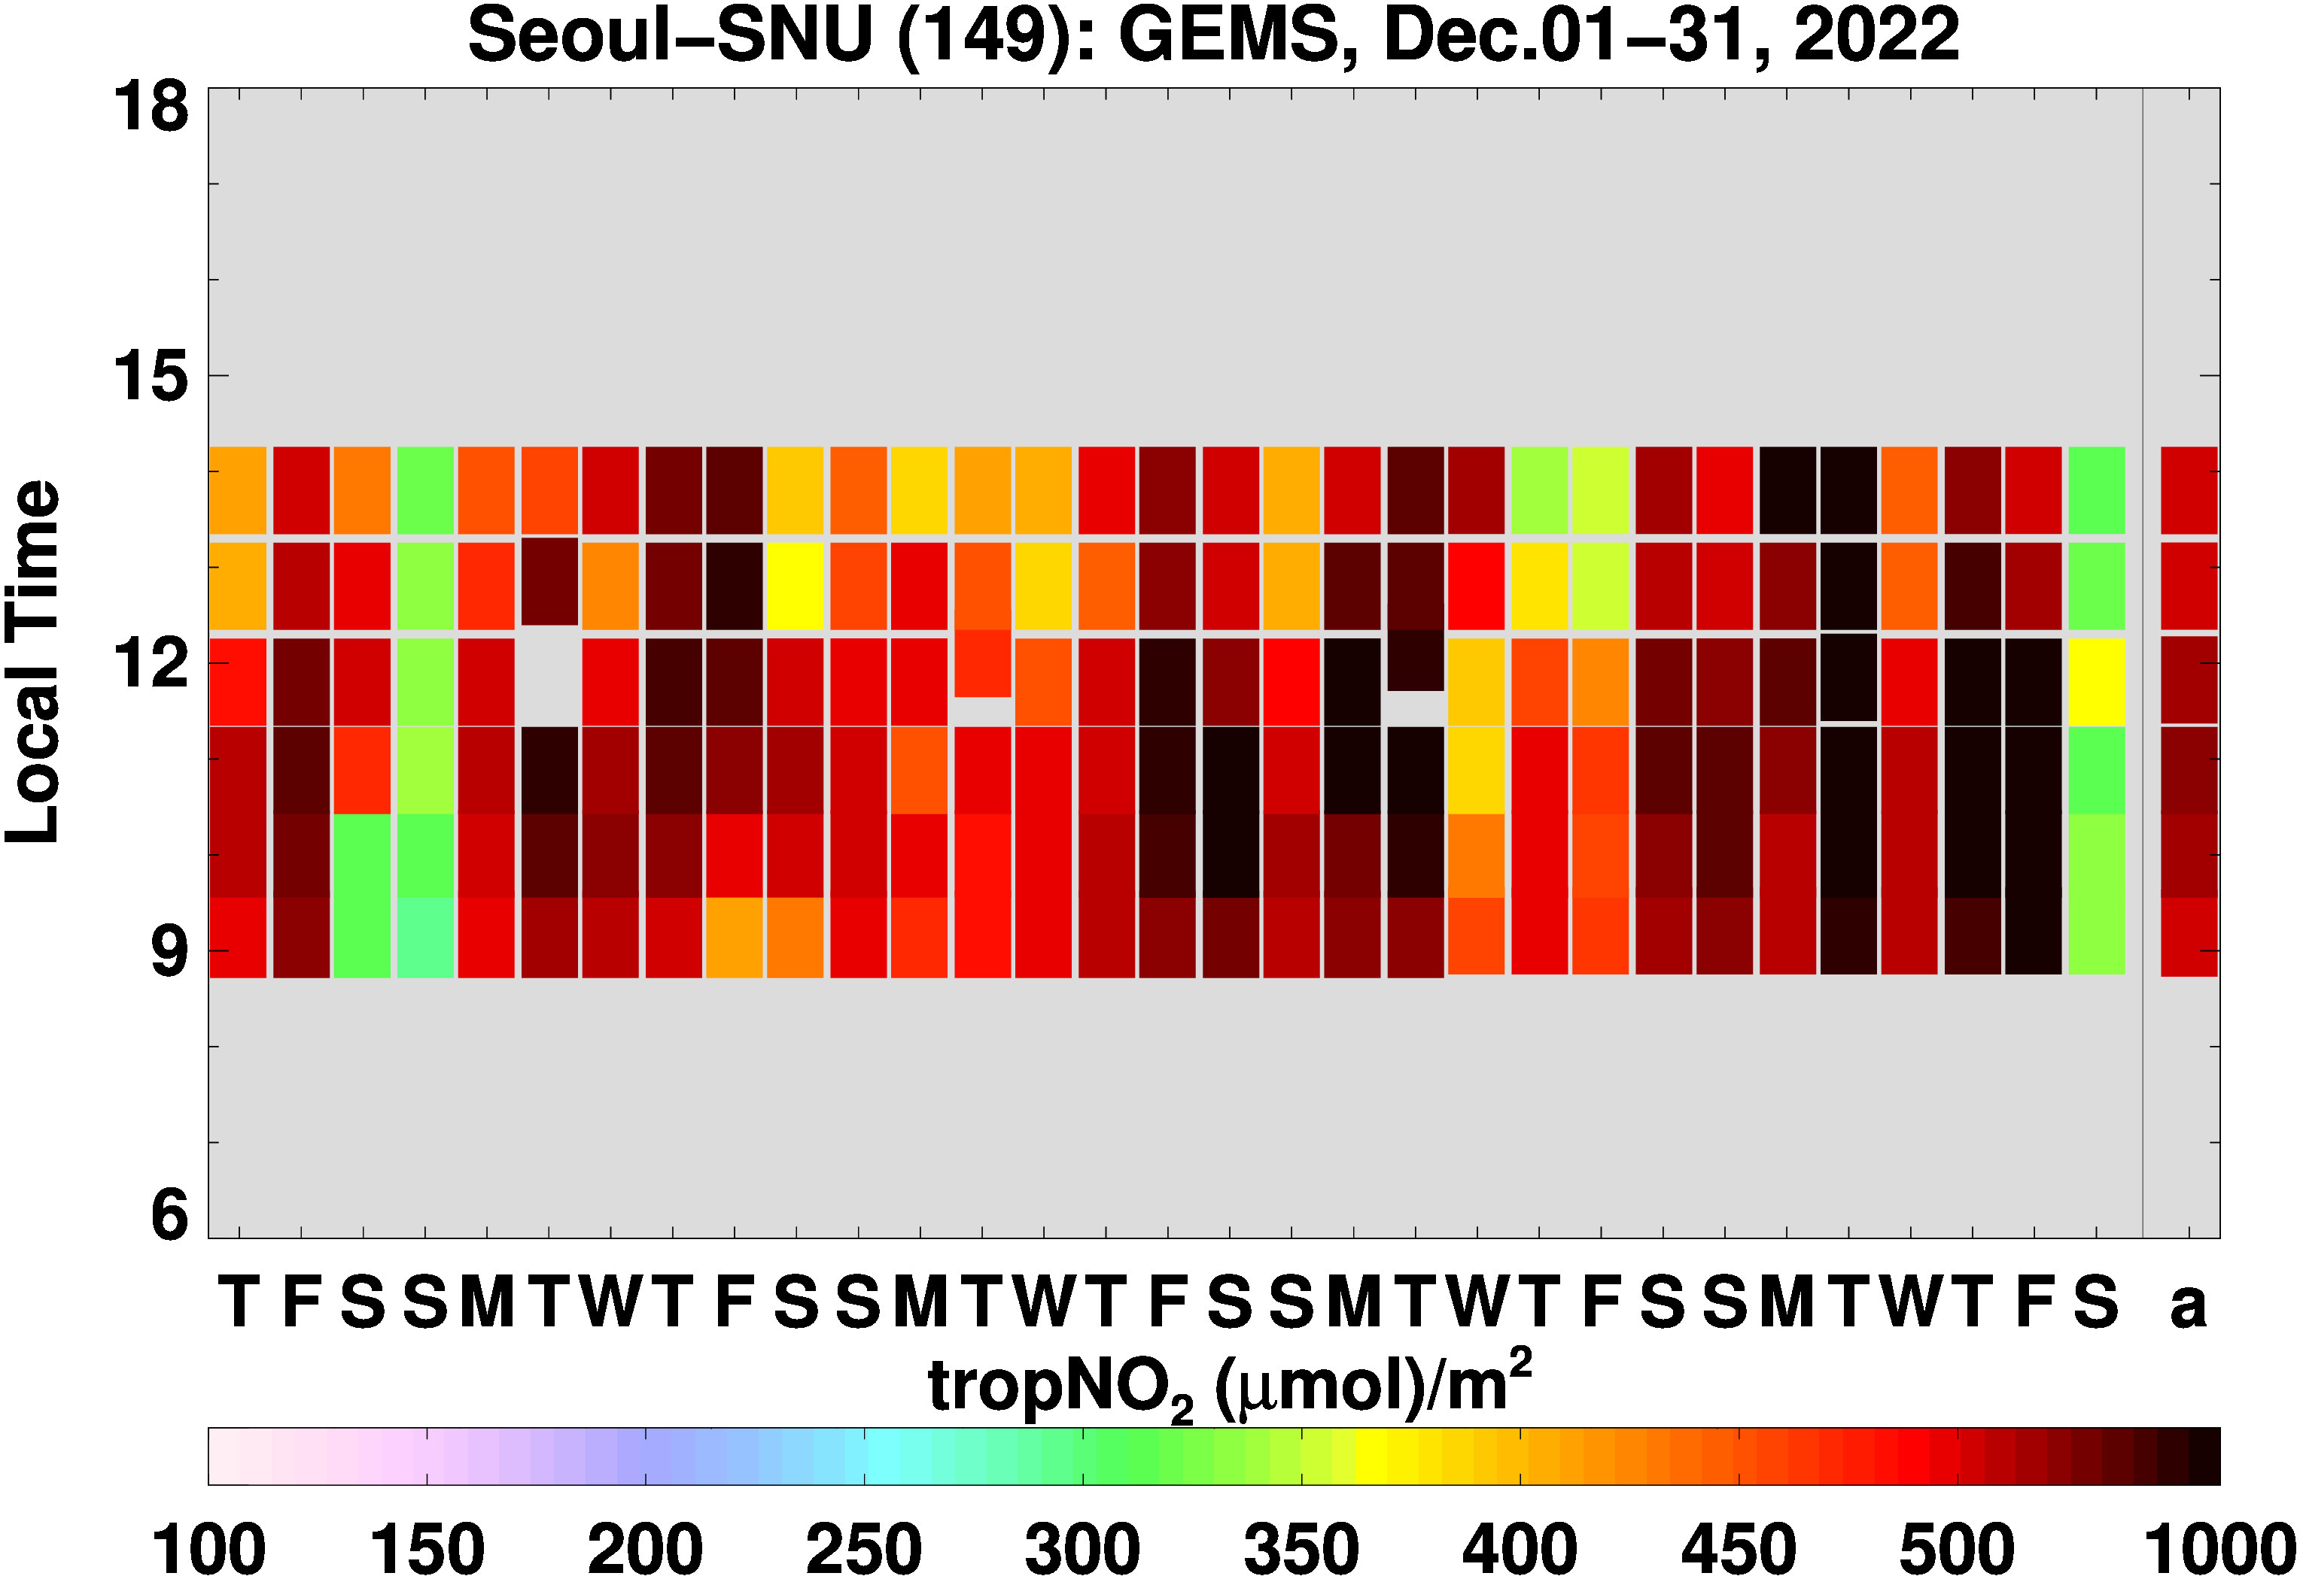
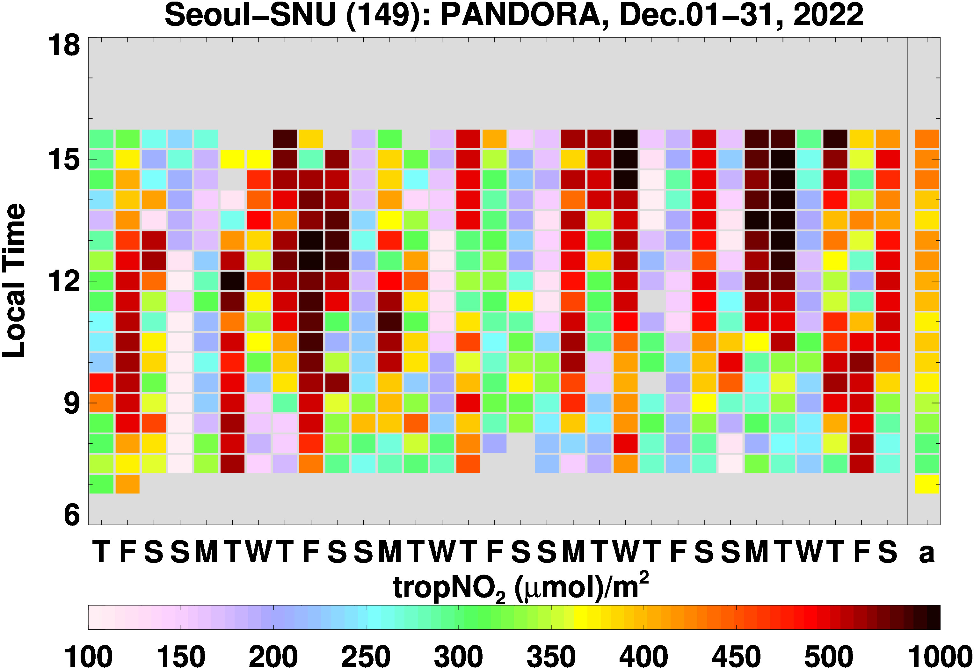



Preparing for GeoXO ACX
Analyzing GEMS aerosol and trace gas products to understand retrieval performance issues
Adapting NOAA enterprise processing system algorithms to run on GEMS and TROPOMI L1B data
Assessing GEMS L1B data for calibration issues
Adapting Ozone Mapping and Profiler Suite (OMPS) and Visible Infrared Imaging Radiometer Suite (VIIRS) trace gas and aerosol algorithms to GEMS and TROPOMI
Proxy Data
GEMS data from NIER; Analysis by Zigang Wei (IMSG at NOAA)

Slide 9
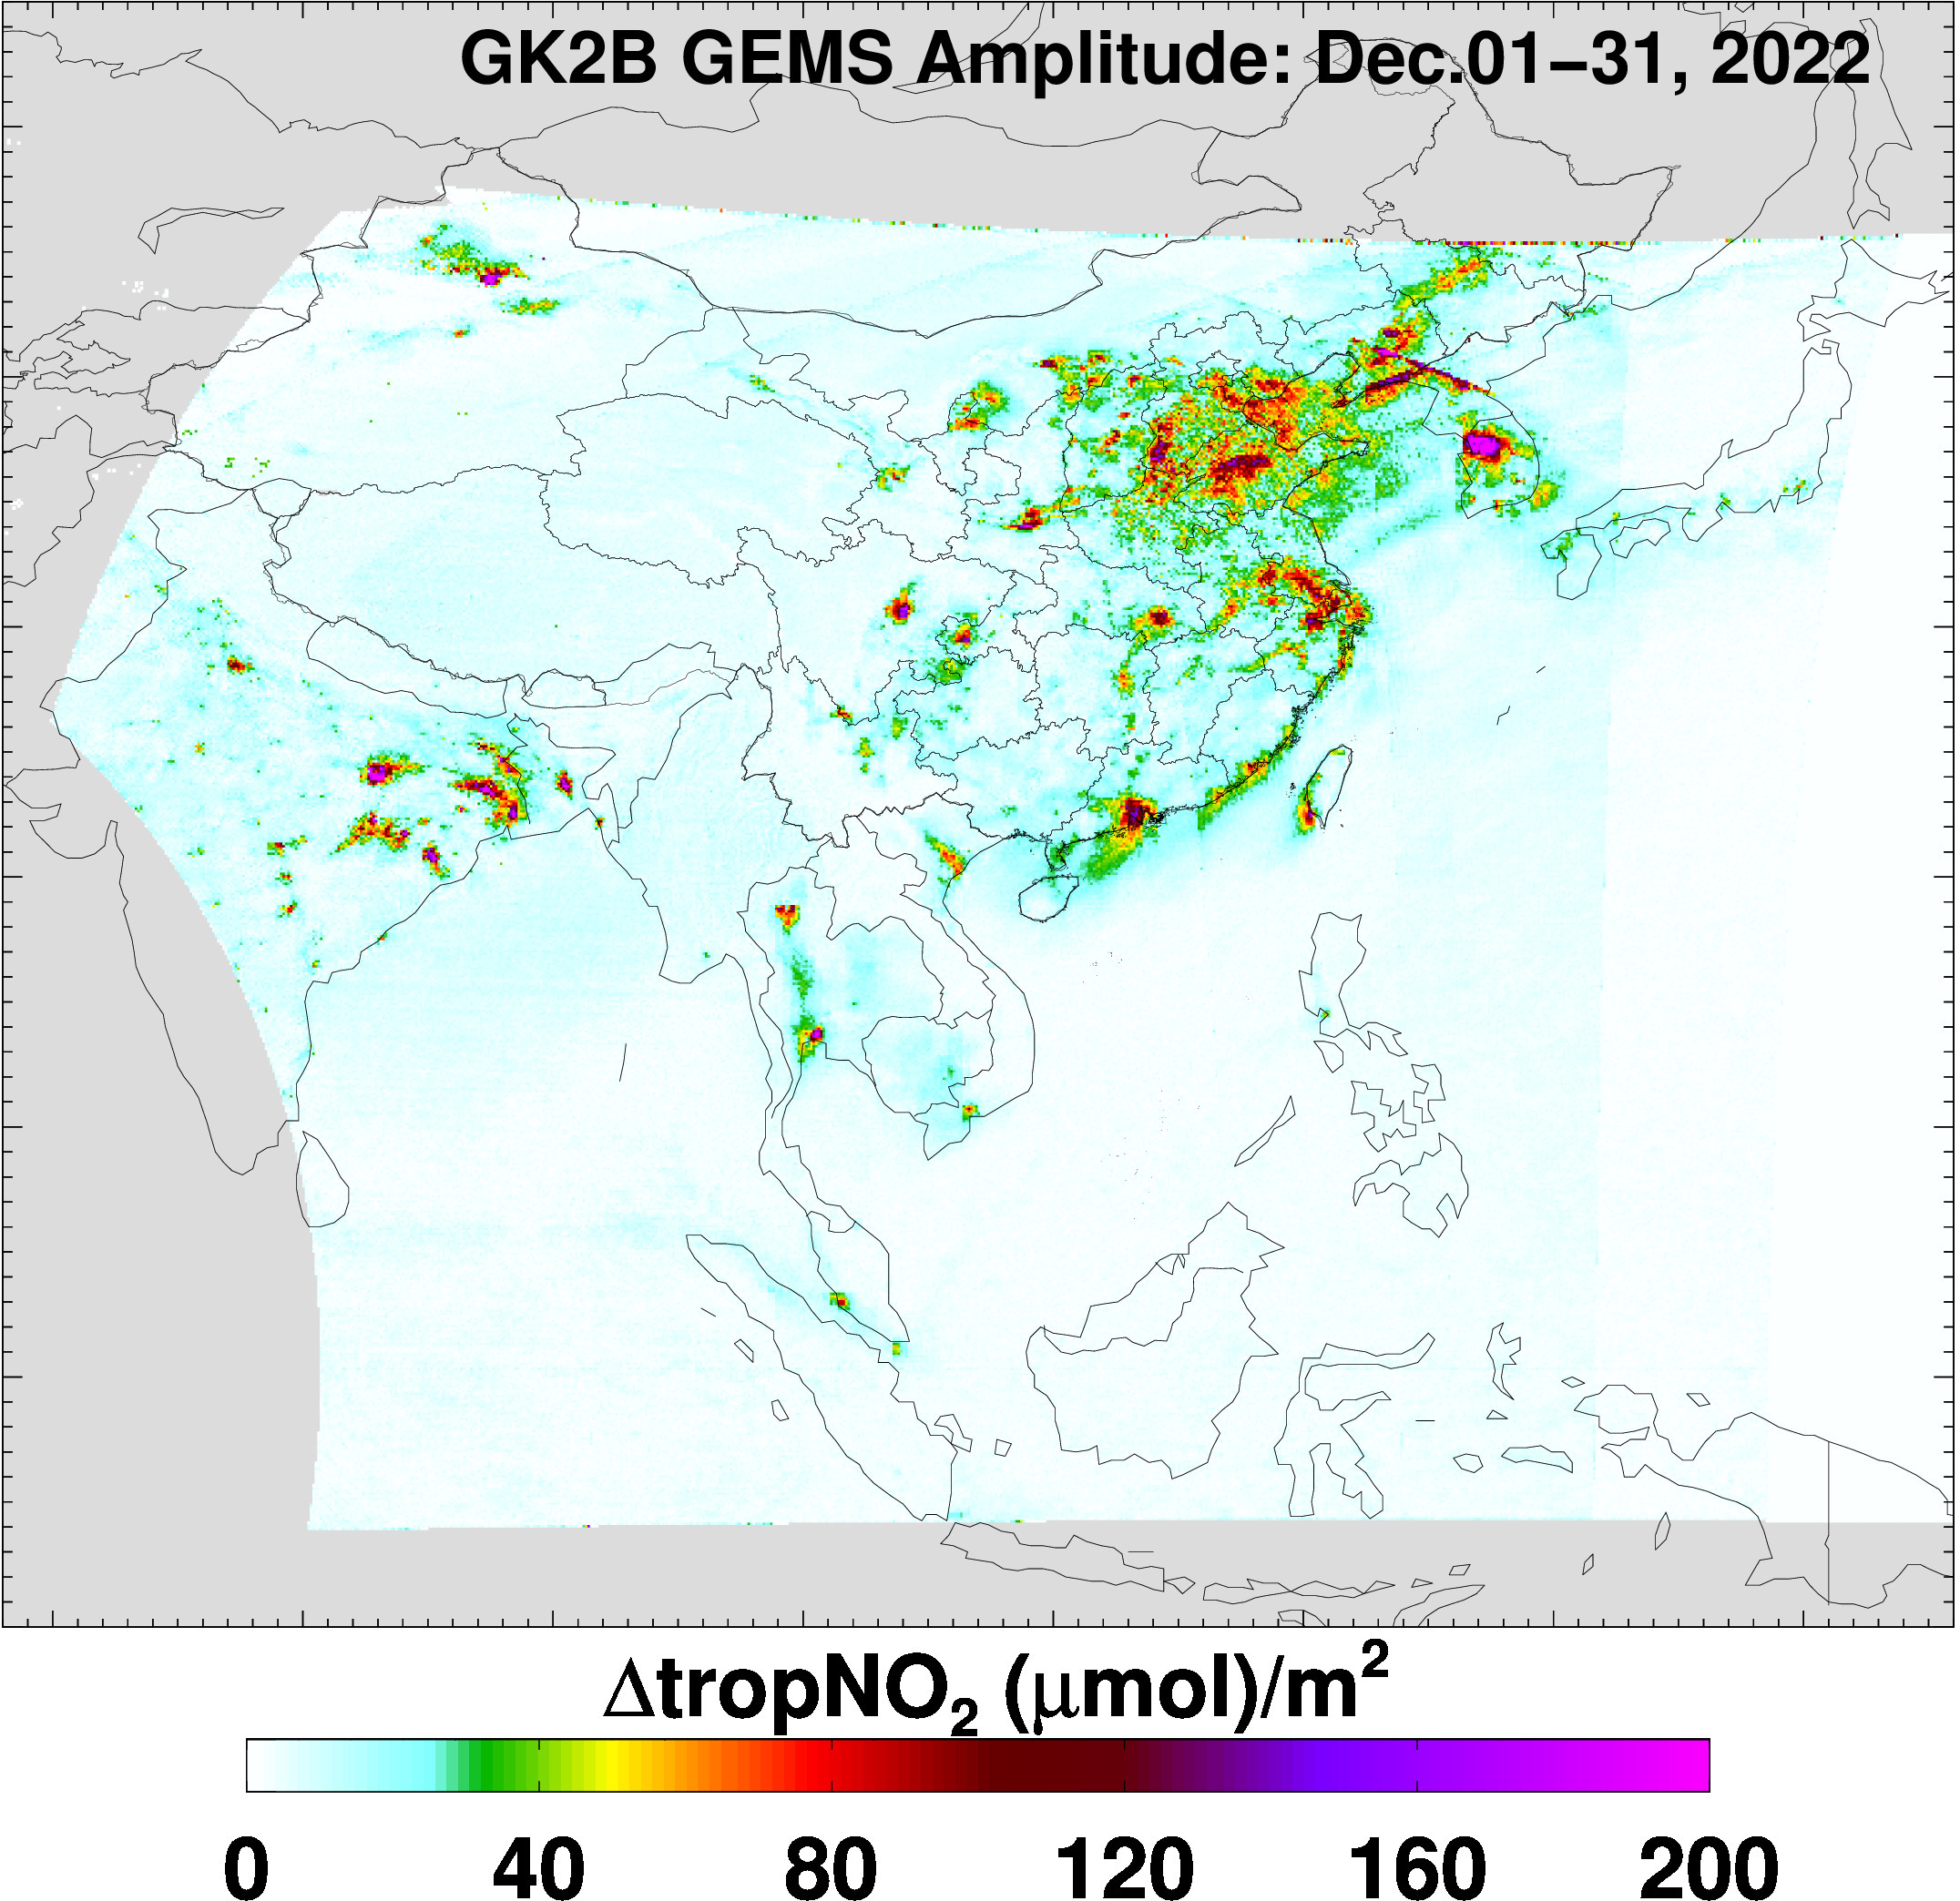
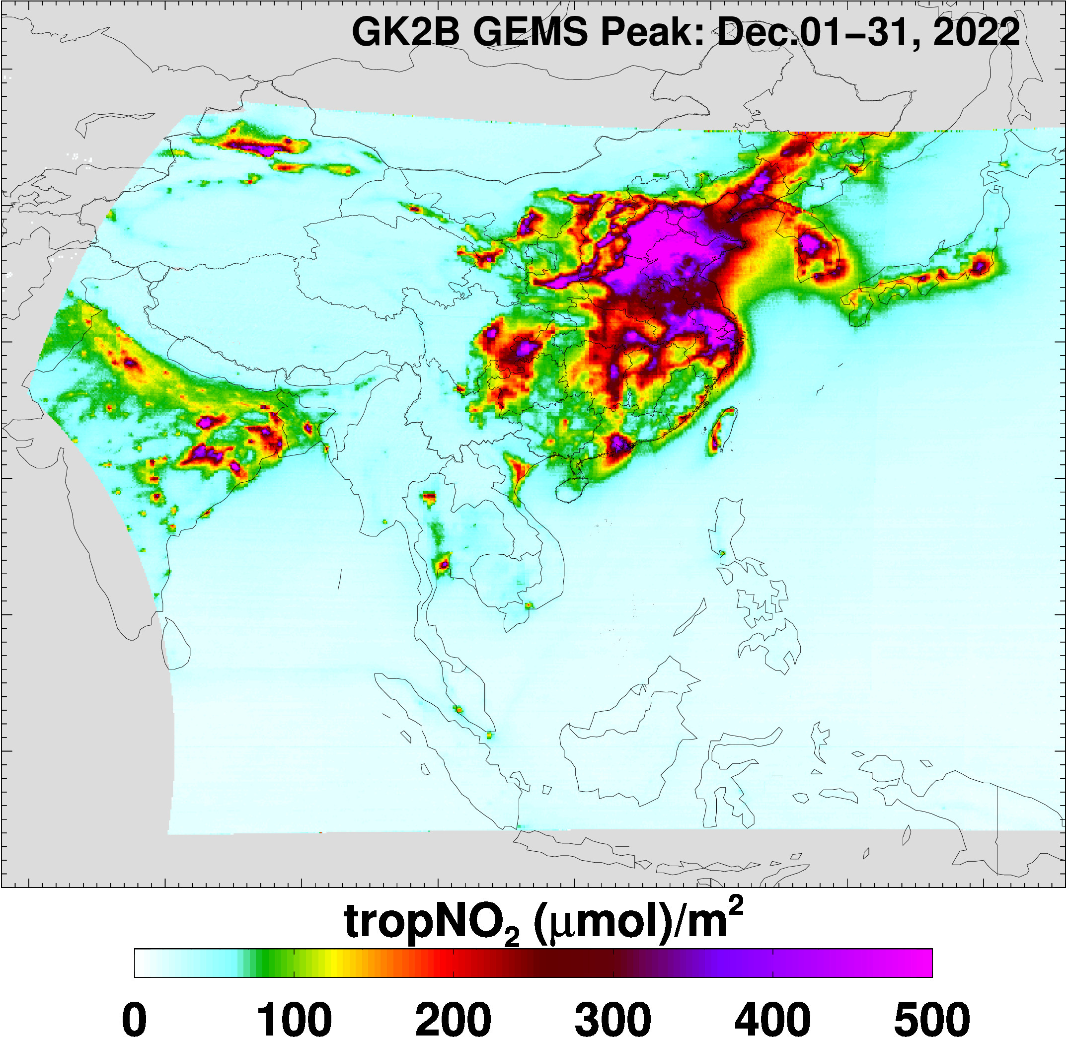
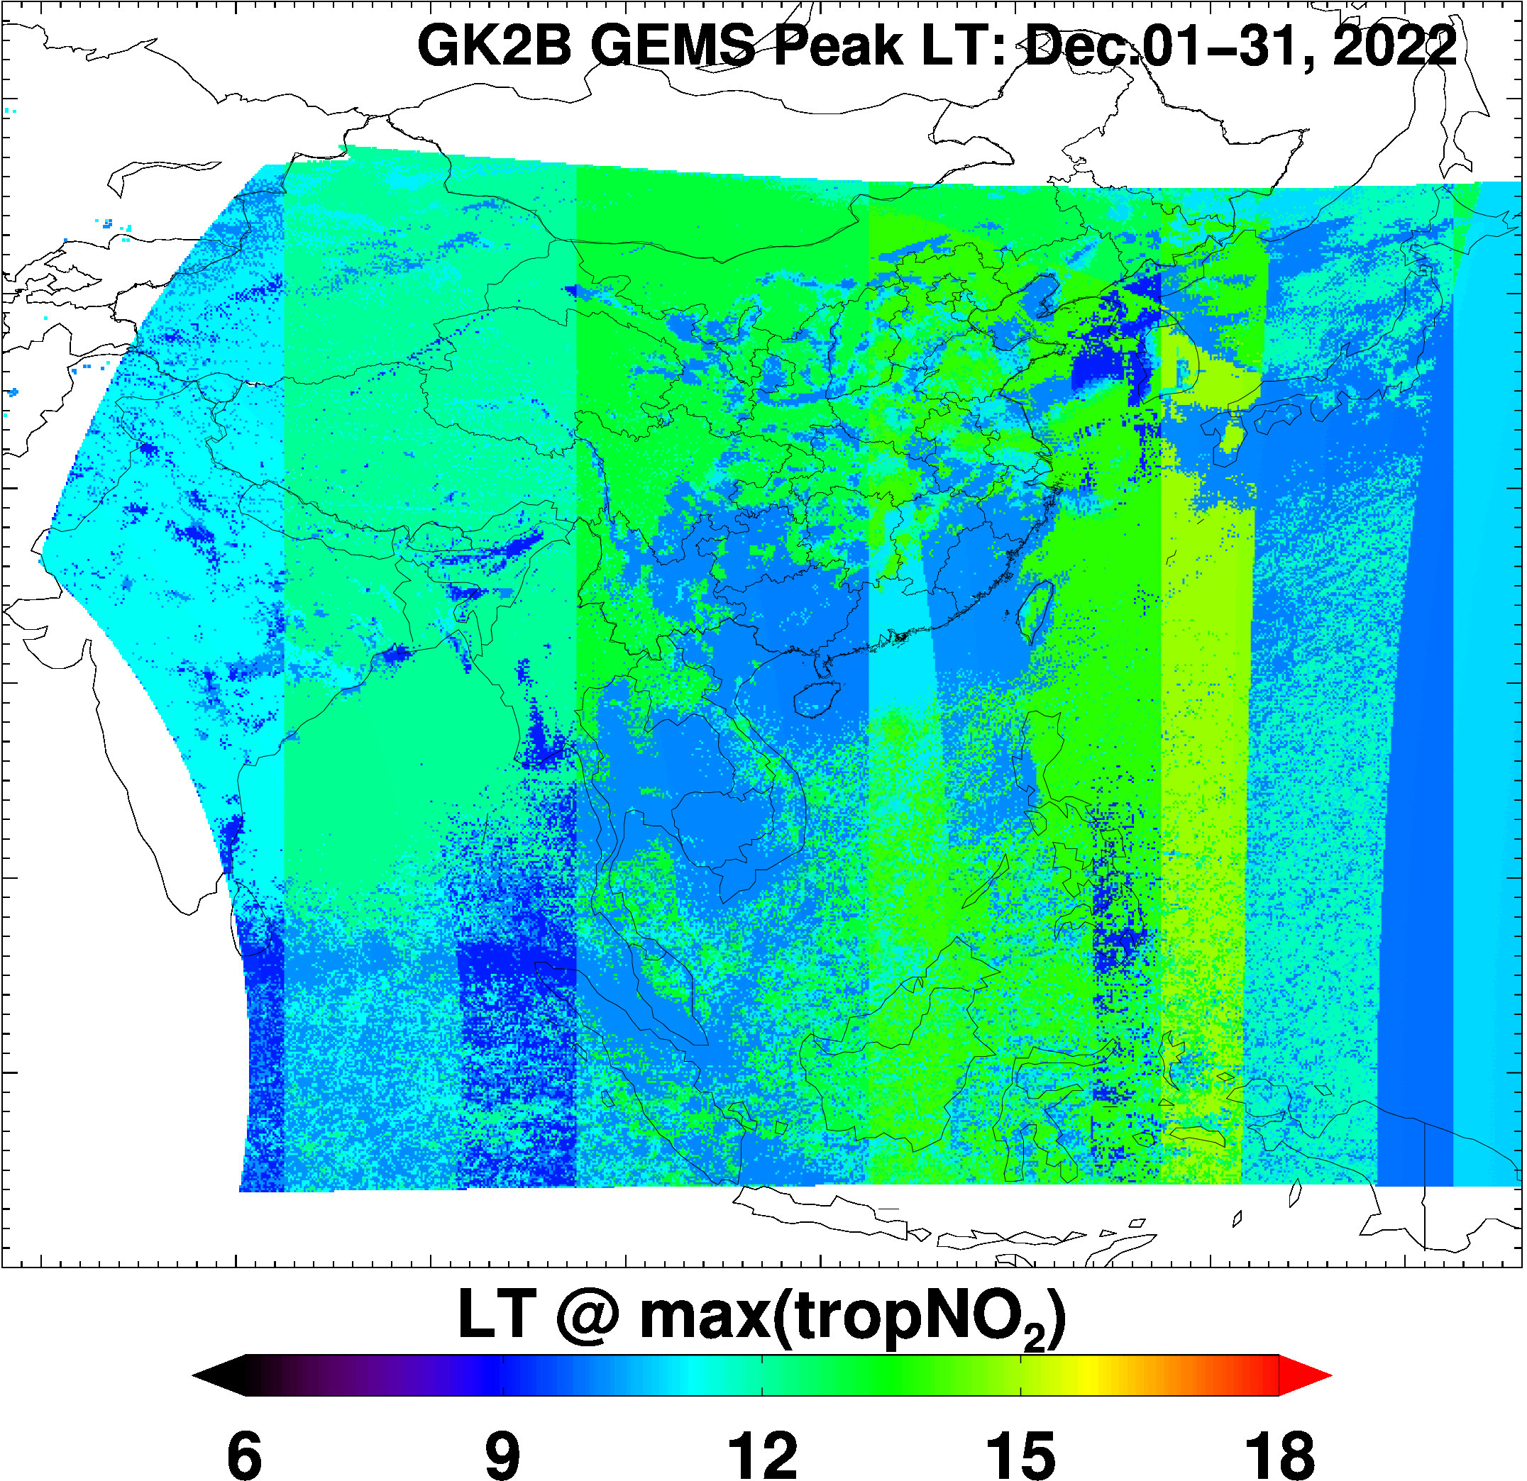
GEMS tropNO₂ Product Features
Diurnal amplitude of GEMS tropNO₂ appears to be a better indicator of source regions than daily mean tropNO₂ or tropNO₂ at any given time of the day.
GEMS data from NIER; Analysis by Zigang Wei (IMSG at NOAA)

Slide 10
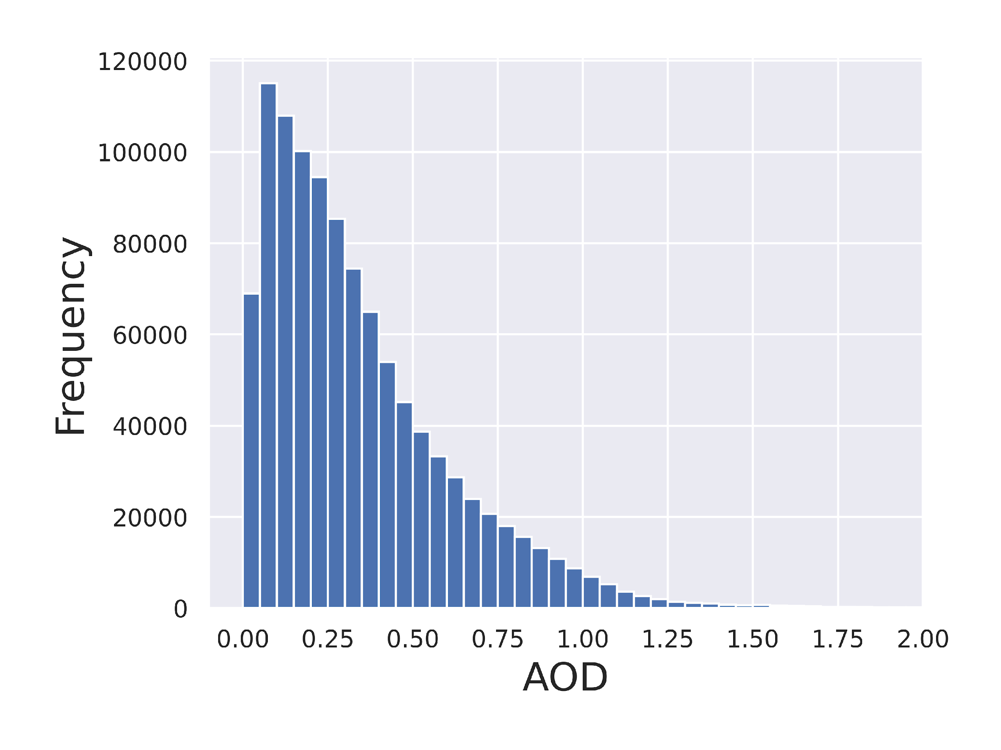
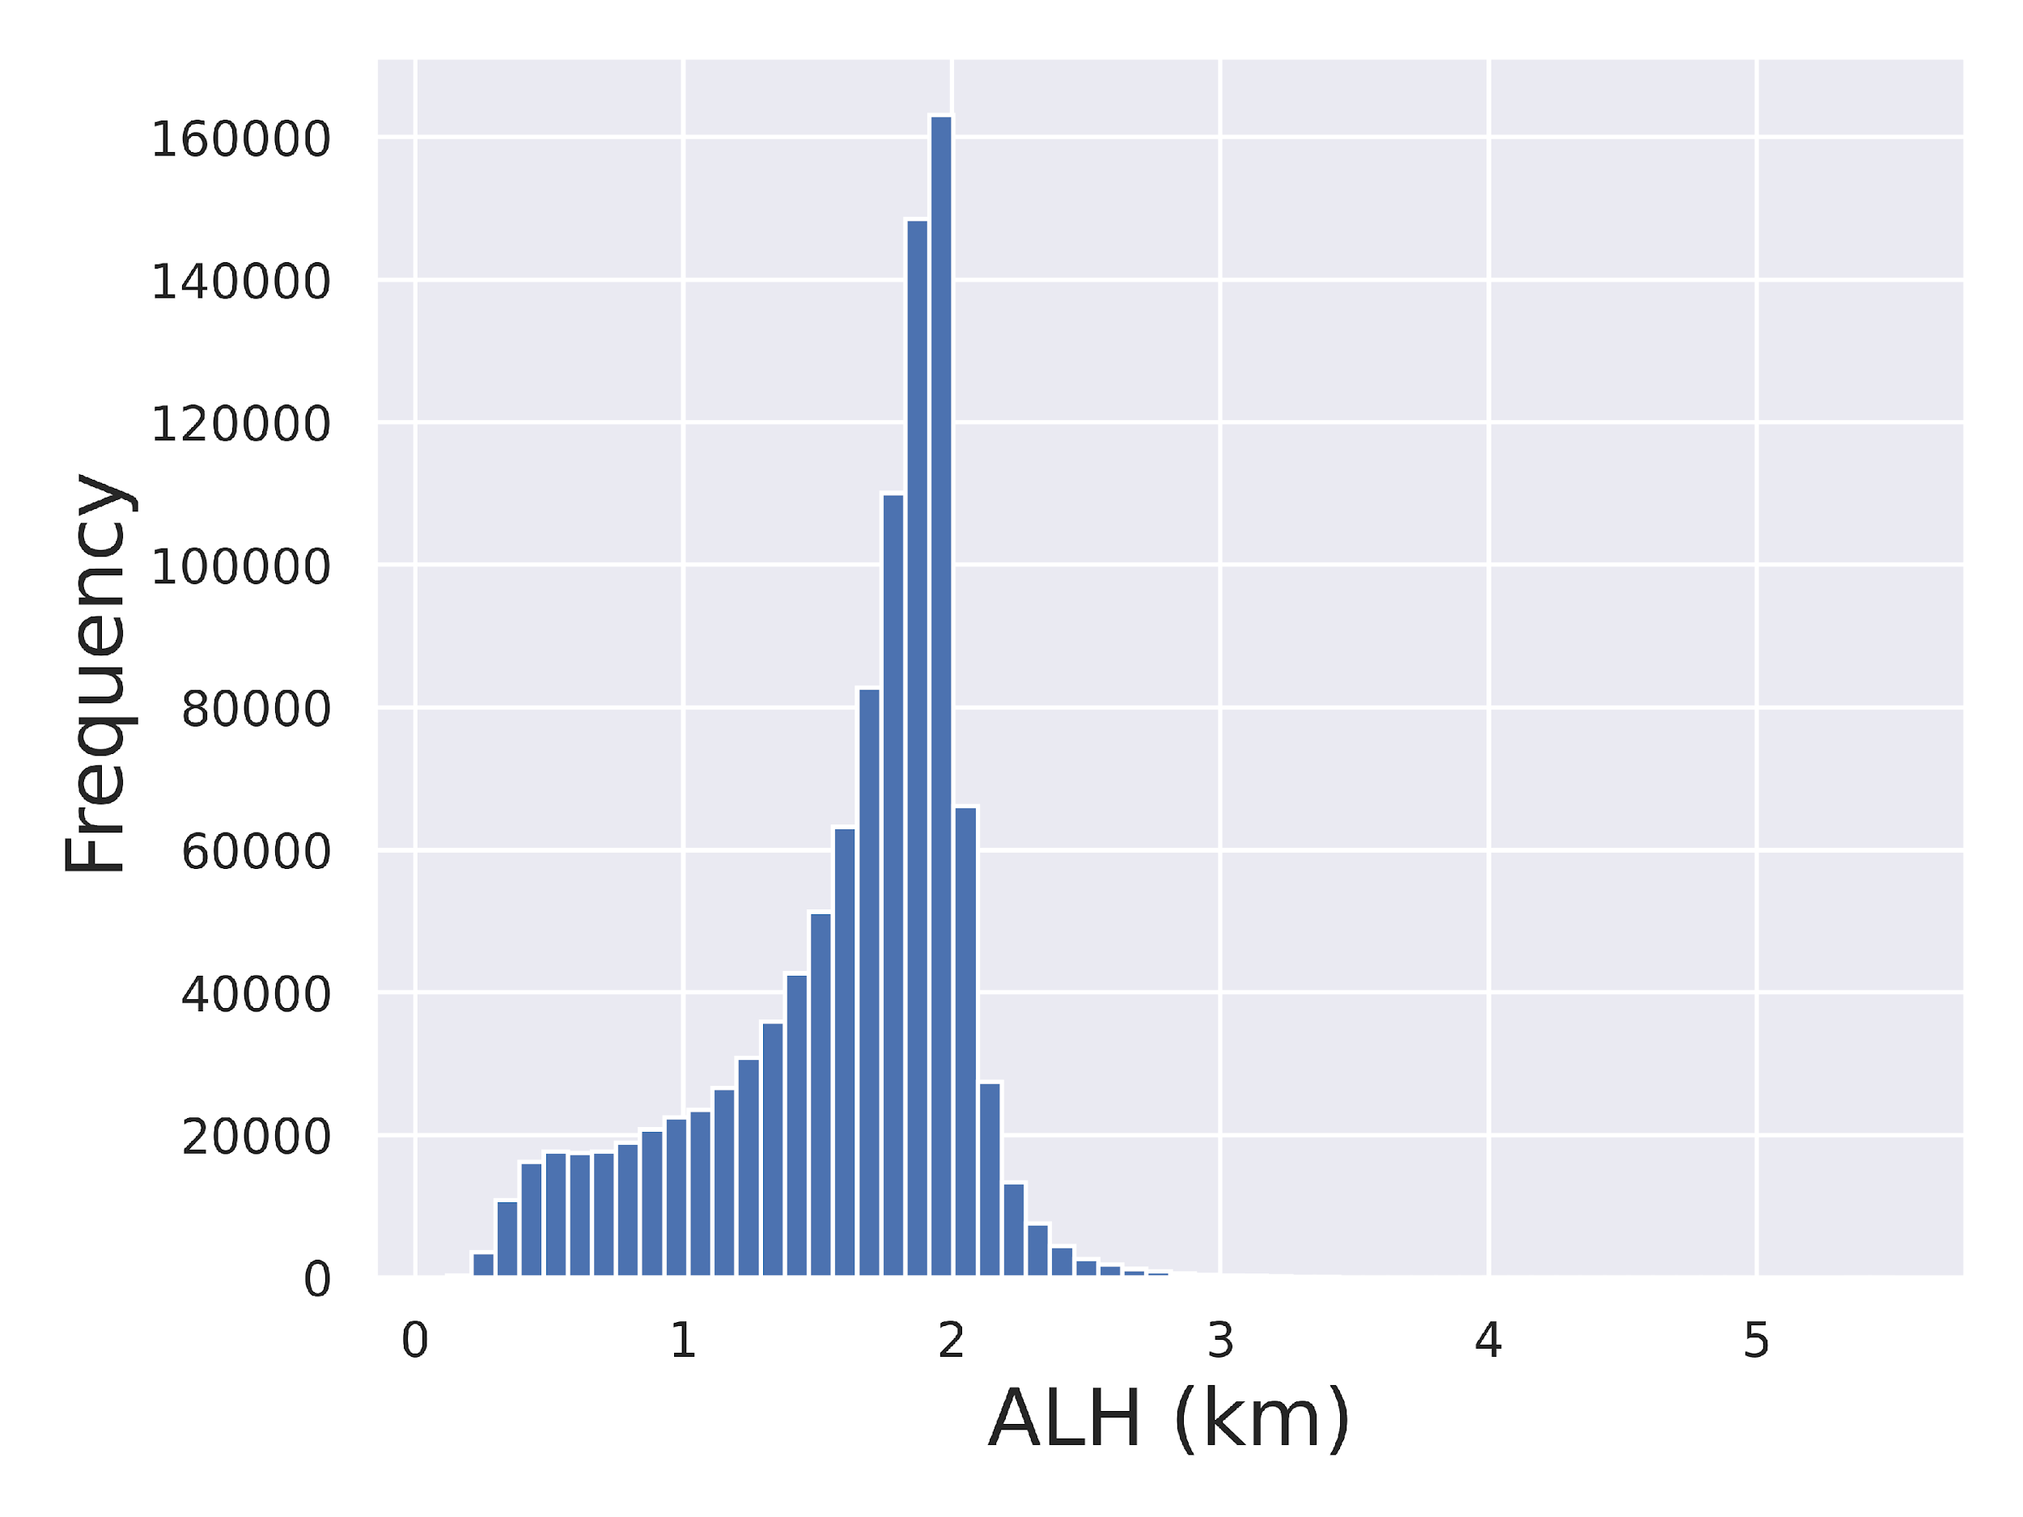
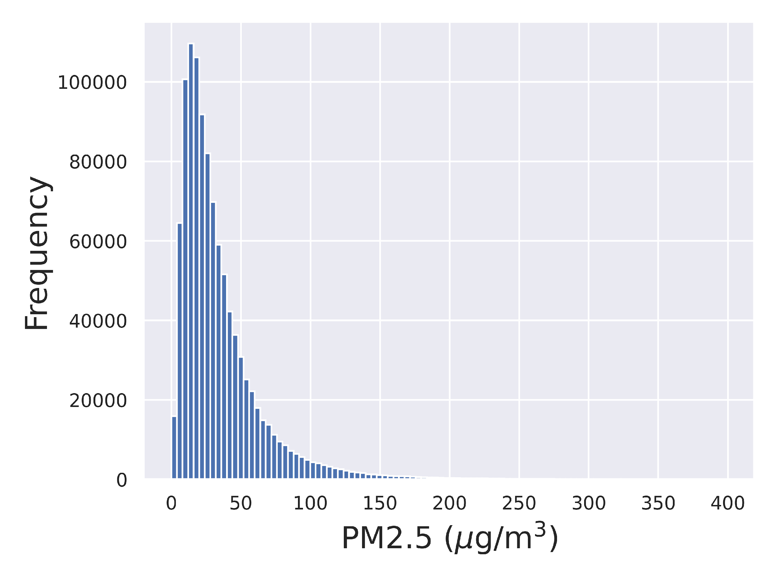
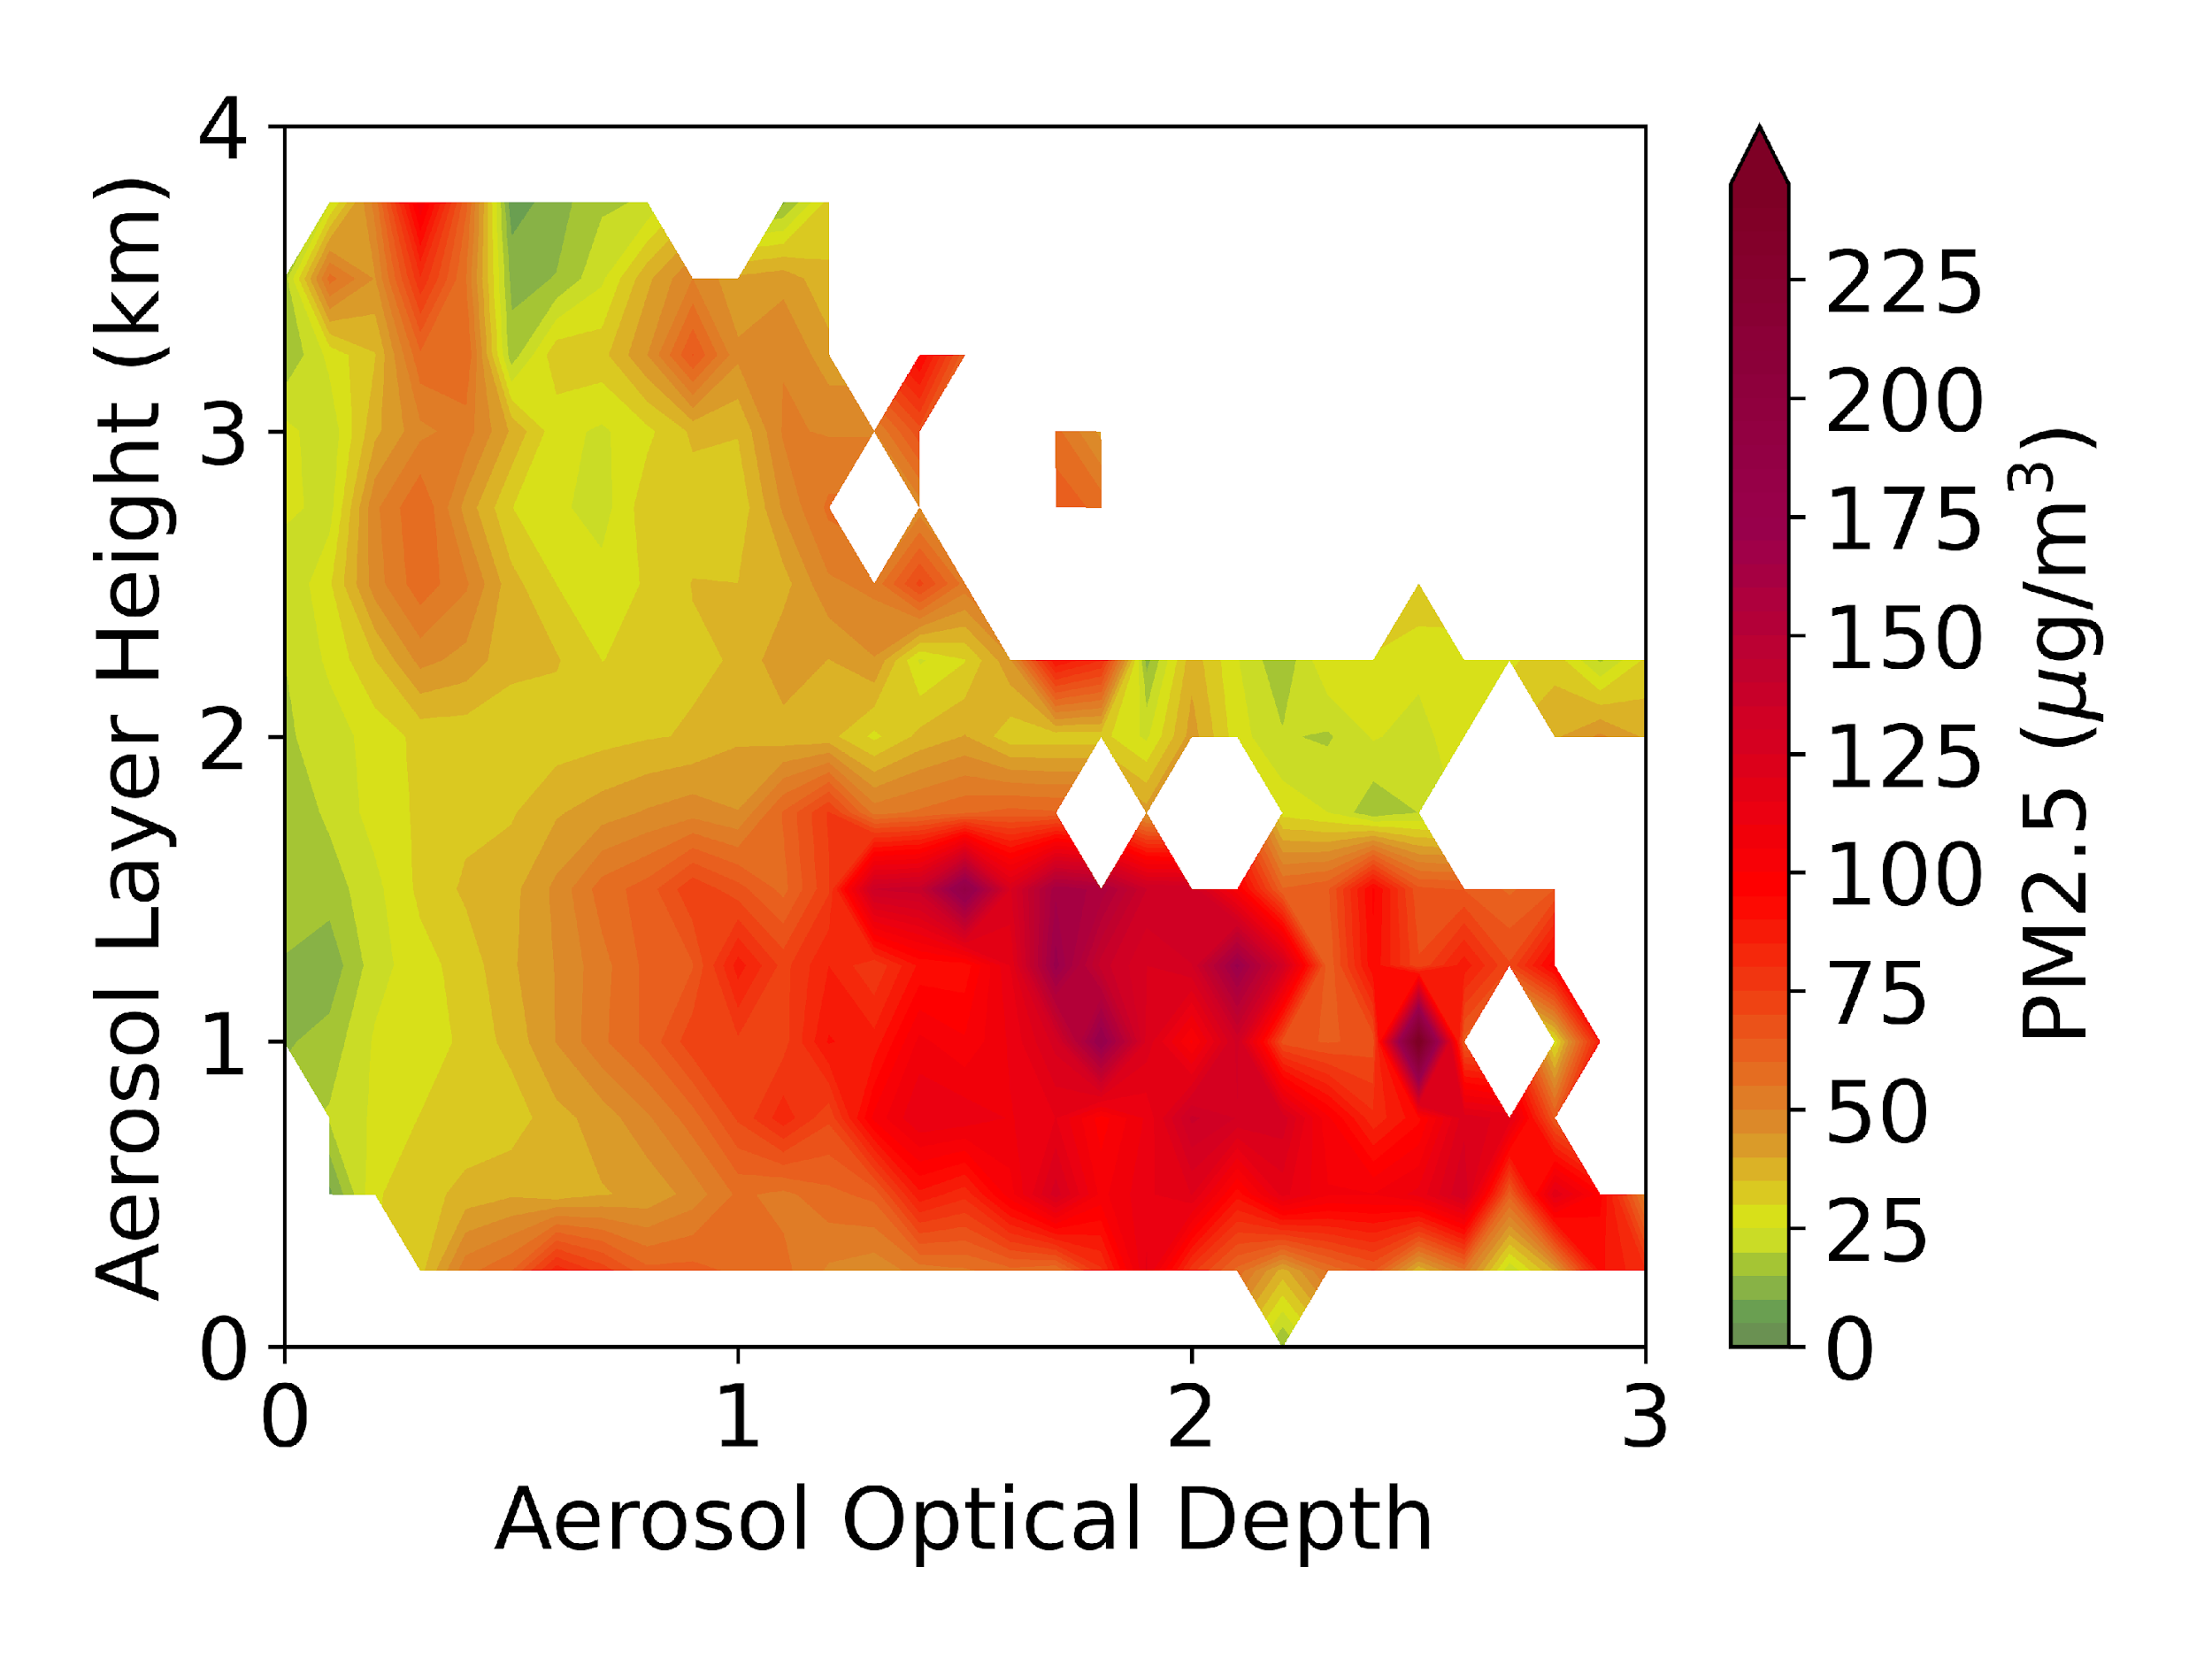

GEMS Aerosol Product Features (Jan-July 2021)
PM2.5, AOD and ALH matchup dataset
For both AOD and PM2.5, no tails. Very few AOD values greater than 1.75 and very few PM2.5 values greater than 200 µg/m³.
Dynamic range of ALH is between 0 and 4 km. Peak at about 2 km, but mostly below 2 km.
The 2D plot shows that PM2.5 increases with increasing AOD for ALH below 2 km. High PM2.5 values between 2 and 4 km when AOD is low appear to be data artifacts.
GEMS data from NIER; Analysis by Hai Zhang (IMSG at NOAA)

Slide 11
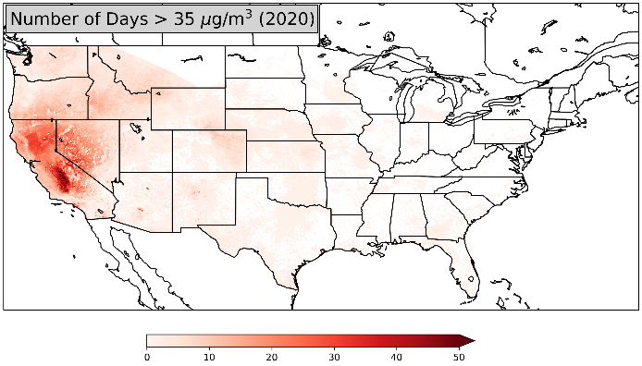
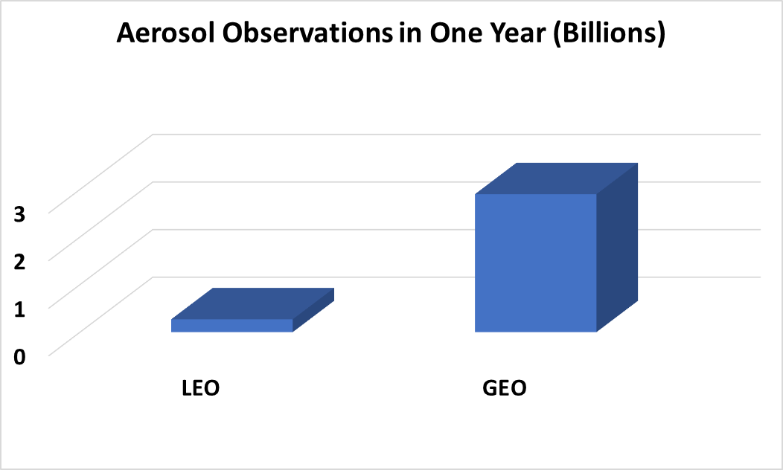
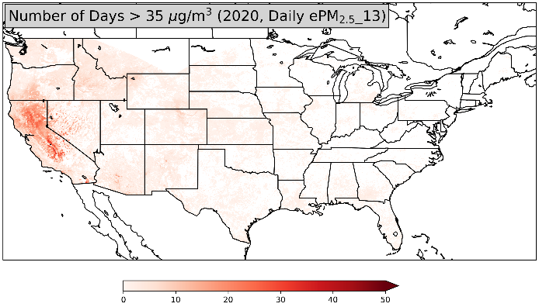
Value of Geostationary Satellite Observations of Air Quality
GEO
Zhang et al., Nowcasting applications of geostationary satellite hourly surface PM2.5 data, Weather and Forecasting, 2022
GEO imager observations provide better estimates of fine particulate pollution (PM2.5) and the resulting exposure of harmful levels of pollution compared to LEO or surface observations.
Example: 2020 Gigafire event
On a daily basis, about 40% more people would be informed about harmful air quality using GEO observations compared with LEO data.
On an hourly basis, 10 times as many people would be informed about air pollution using GEO observations compared with surface-based data.
GEO sampled as LEO
Number of Days
Notes:
Using NOAA’s operational geostationary satellite estimates of hourly surface fine particulate matter concentrations, we also investigated to see how many days in a year do we have air quality standard violated? When we did this study using geo vs. leo, we quickly found that the information content from geo is so much more than leo due to density of observations. Again, most of the air quality standard violations are in the west because that is where most of the fire activity is. In the east, due to pollution control strategies, we no longer see air quality standard violations.

Slide 12
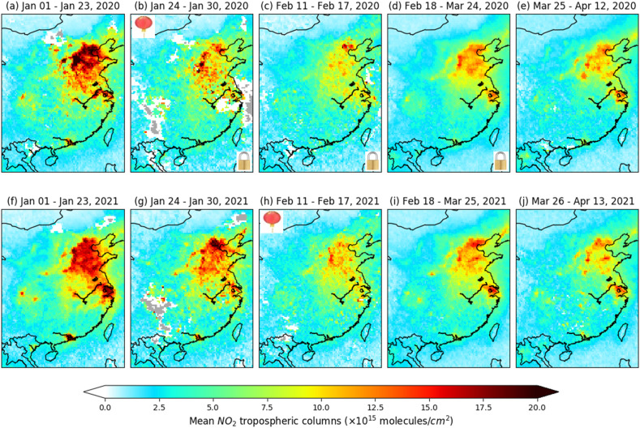
Preparing for GeoXO ACX
NOAA is taking an enterprise approach to developing algorithms for retrievals of atmospheric composition products
Algorithm is satellite and sensor agnostic
Algorithms under development
Total ozone
Tropospheric Nitrogen Dioxide column
Suite of aerosol products including aerosol Optical Depth, Aerosol Layer Height, Aerosol Index (UV and VIS), Composition (Single Scattering Albedo), smoke/dust mask
Platforms/sensors
GEO: GEMS, TEMPO, ABI, AHI, Sentinel-4
LEO: OMPS, VIIRS, TROPOMI, metImage, UVN
Huang X, Yang K, Kondragunta S, Wei Z, Valin L, Szykman J, Goldberg M. NO₂ retrievals from NOAA-20 OMPS: Algorithm, evaluation, and observations of drastic changes during COVID-19. Atmos Environ (1994). 2022 Sep 5:119367. doi: 10.1016/j.atmosenv.2022.119367
NO₂ algorithm PI: Kai Yang (UMD)

Slide 13
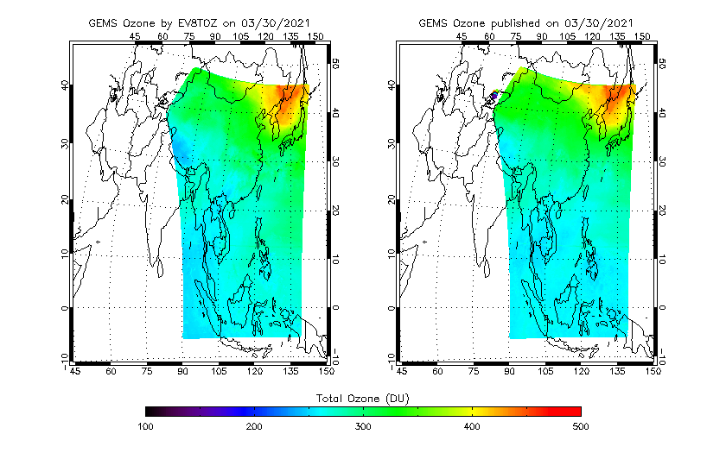
Preparing for GeoXO ACX
NOAA is taking an enterprise approach to developing algorithms for retrievals of atmospheric composition products
Algorithm is satellite and sensor agnostic
Algorithms under development
Total ozone
Tropospheric Nitrogen Dioxide column
Suite of aerosol products including aerosol Optical Depth, Aerosol Layer Height, Aerosol Index (UV and VIS), Composition (Single Scattering Albedo), smoke/dust mask
Platforms/sensors
GEO: GEMS, TEMPO, ABI, AHI, Sentinel-4
LEO: OMPS, VIIRS, TROPOMI, metImage, UVN
NOAA Algorithm
NIER Operational
O₃ algorithm PI: Larry Flynn (NOAA)

Slide 14
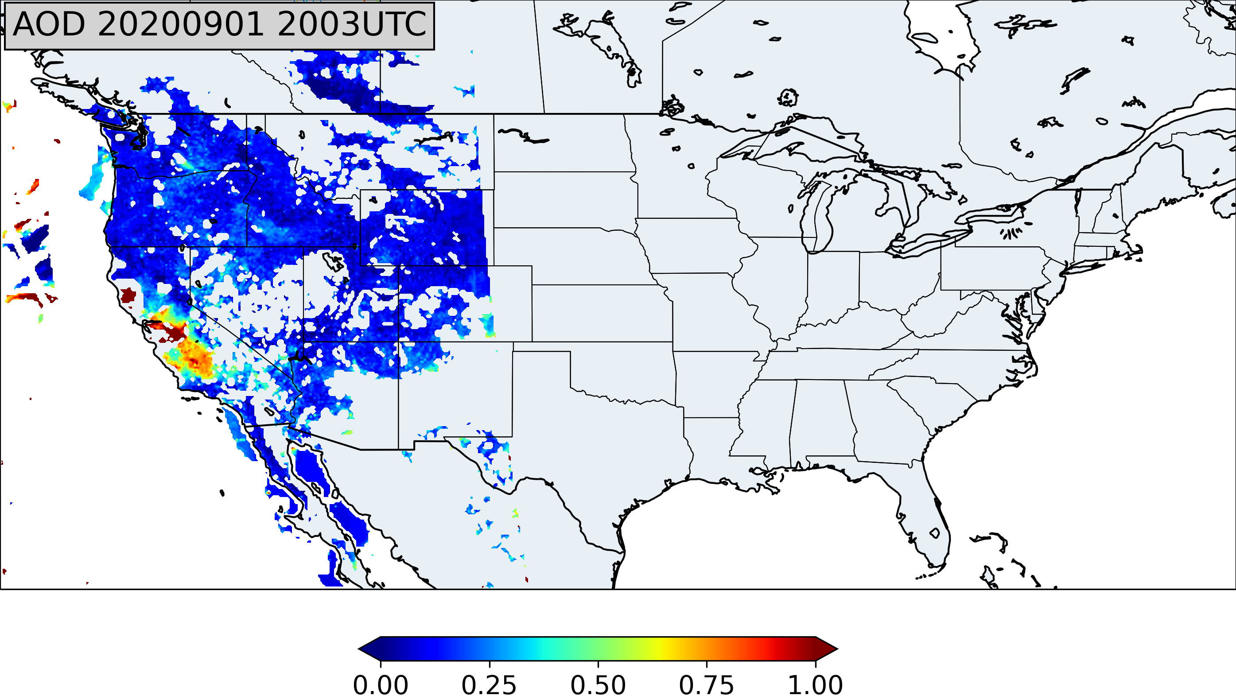
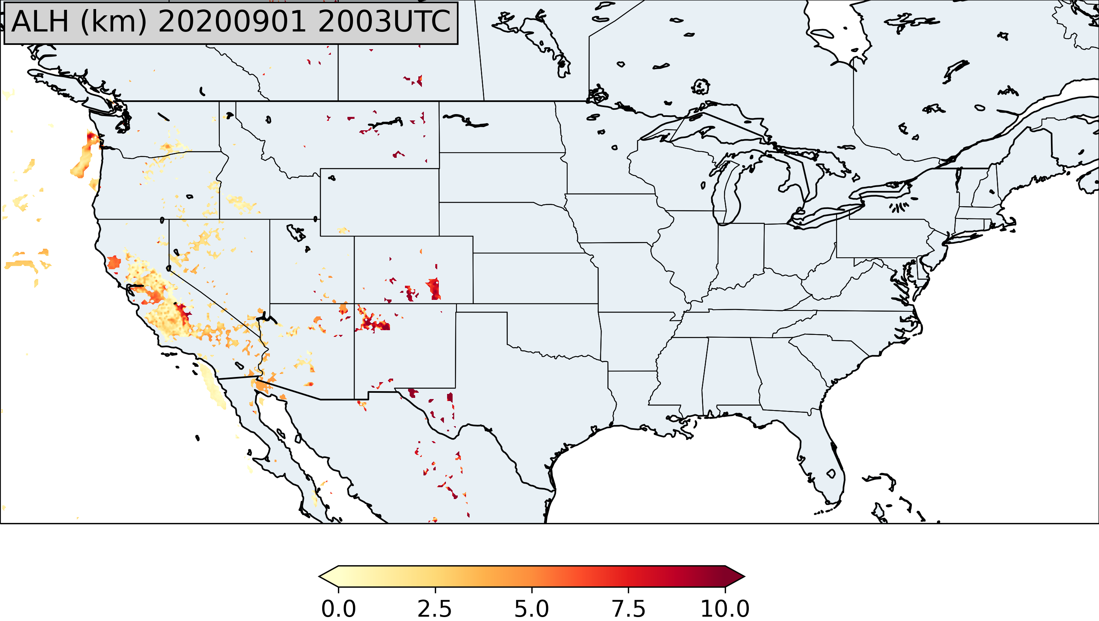
Preparing for GeoXO ACX
NOAA is taking an enterprise approach to developing algorithms for retrievals of atmospheric composition products
Algorithm is satellite and sensor agnostic
Algorithms under development
Total ozone
Tropospheric Nitrogen Dioxide column
Suite of aerosol products including aerosol Optical Depth, Aerosol Layer Height, Aerosol Index (UV and VIS), Composition (Single Scattering Albedo), smoke/dust mask
Platforms/sensors
GEO: GEMS, TEMPO, ABI, AHI, Sentinel-4
LEO: OMPS, VIIRS, TROPOMI, metImage, UVN
Zhang, H., Kondragunta, S., Laszlo, I., Liu, H., Remer, L. A., Huang, J., Superczynski, S., and Ciren, P. (2016), An enhanced VIIRS aerosol optical thickness (AOT) retrieval algorithm over land using a global surface reflectance ratio database, J. Geophys. Res. Atmos., 121, 10,717– 10,738, doi:10.1002/2016JD024859.
Aerosol algorithms PI: Shobha Kondragunta

Slide 15
NOAA Talks/Posters Recommended
Aerosol Session May 3 Wednesday 4 PM
  Pubu Ciren will present on hybrid (imager/spectrometer) algorithm for smoke and dust detection
Advancements in Environmental Health Applications with TEMPO Session May 4 Thursday 2:30 PM
  Shobha Kondragunta will present “data provider perspective on PM2.5 applications”
PM2.5 Estimates over Eastern Asia from GEMS Aerosol Optical Depth and Aerosol Layer Height by Hai Zhang
Evaluation of GEMS Tropospheric NO2 Product over Northern China Region by Zigang Wei

