Slide 1
GeoXO Atmospheric Composition (ACX) Instrument Studies
Joanna Joiner, Monica Cook, Aaron Pearlman, Boryana Efremova, Frank Padula, Emery Bacon, Joel McCorkel, Erin Farrell, Monica Coakley, Pete Armstrong, Phil Driggers

Slide 2
ACX Driving Requirements
Parameters | XORWG (GeoXO Operational Requirements Working Group) Baseline | Current Status
Spatial resolution | 8.1x3.1 km² at nadir | 5 x 5 km² equivalent IFOV at nadir
Coverage area | 4.82º x 8.38º around Greater North America | A rectangle 8.0215° x 4.8129°, the equivalent at nadir of 5000 km E/W x 3000 km N/S, nominally centered at 30° N and 105° W
Revisit Period | Hourly | 60-minute revisit during daylight
Spectral characteristics | 300-500 nm @ FWHM 0.6 nm (3 samples per FWHM) | 300 – 500 nm and 540 – 740 nm at 0.6 nm spectral resolution (FWHM) and 0.2 nm sampling
SNR (nominal radiance levels) | Set consistent with GEMS and TEMPO | ≥ 20 @ 0.300um ≥ 90 @ 0.306um ≥ 1400 @ 0.325um ≥ 1650 @ 0.355um ≥ 1100 @ 0.390 um ≥ 1250 @ 0.500 um ≥ 1250 @ 0.540 um ≥ 1250 @ 0.635 um ≥ 810 @ 0.685 um ≥ 900 @ 0.740 um ***With some relief in the UV and for deep solar and absorption lines as displayed on the following chart.
Polarization Sensitivity | Not called out | Trade study to examine impact of less than 5% requirement

Slide 3
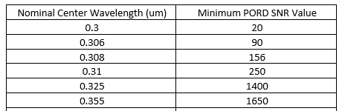
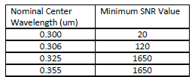
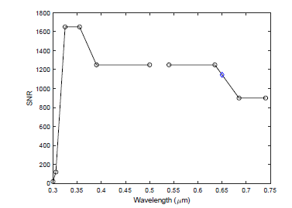
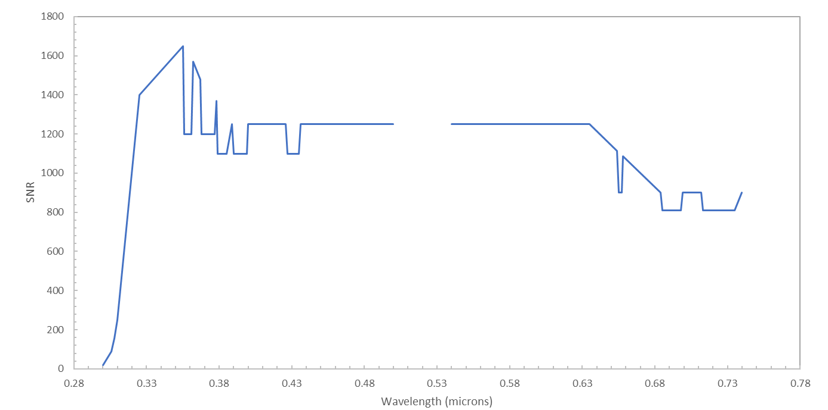
ACX SNR requirement – Performance and Operational Requirements Document (PORD)
Relief in the UV range and for deep features at absorption lines throughout
ACX science team analysis fed into UV relaxation

Slide 4
ACX Phase A Studies
Phase A Study contracts were awarded to Raytheon and Ball Aerospace
The Phase A Studies are 12 months long and used to refine the instrument design concepts and help the Government mature the requirements for the eventual flight instrument
Final Reviews with vendors will be held in mid-May of 2023
Phase A has been successful in helping the Government mature the requirements going into the Flight implementation phase
Currently targeting issuing the request for proposals for the flight contract for late fourth quarter of this fiscal year

Slide 5
ACX simulation studies
Impact of SNR on retrievals (focus on short UV wavelengths)
Impact of location and time of day on retrievals
Combining SNR results and location/time of day to map retrieval errors for different times of year and examine potential scanning scenarios
Effects of polarization sensitivity (PS) on retrievals
Currently adding clouds to “availability” maps

Slide 6
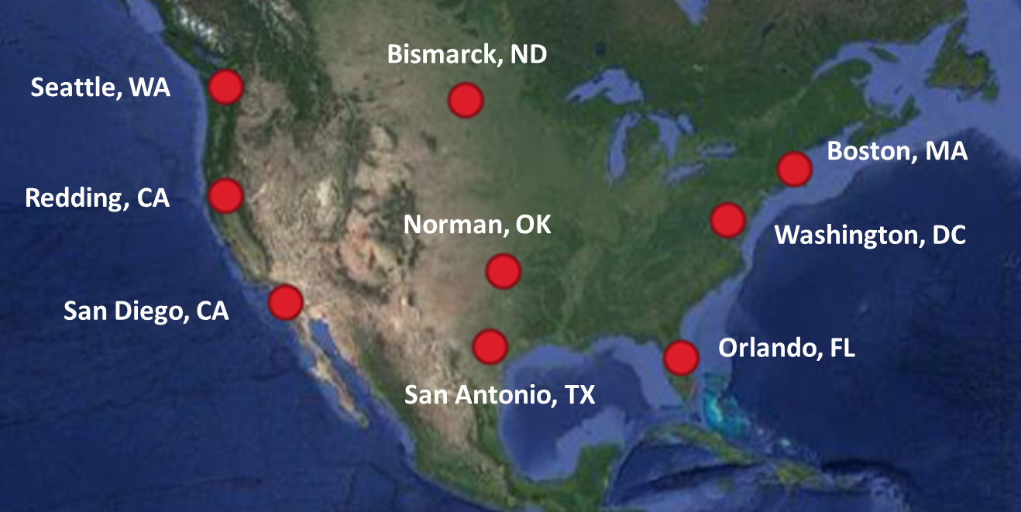
Diurnal Variability in Simulated NO₂ Retrieval Performance
9 Locations Across CONUS, All Daylight Hours
March 20
June 21
December 20
MODTRAN default aerosol
Urban
surface reflectance
Urban
MODTRAN standard atmosphere
US Standard
column amount
medium
high
constituent height in profile
boundary layer
trace gas constituent
NO₂
Also extended study to include retrievals in Boston simulated for three surfaces/aerosols and three atmospheres (three radiance levels, all daylight hours)
  Surface/Aerosol: urban, water, vegetation
  Atmospheres: US standard, tropical, subarctic winter

Slide 7
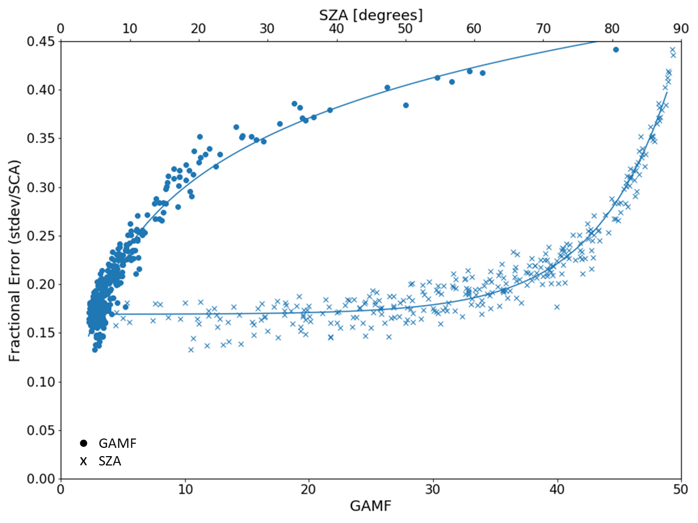

Diurnal Variability in Simulated NO₂ Retrieval Performance
Results shown for medium amount of NO₂
All dates and locations can be modeled together
Fractional Error vs Solar Zenith Angle (SZA) was fit with an exponential model
Fractional Error vs Geometric Air Mass Factor (GAMF) was fit with a logarithmic model
SZA = solar zenith angle
VZA = view (satellite) zenith angle

Slide 8
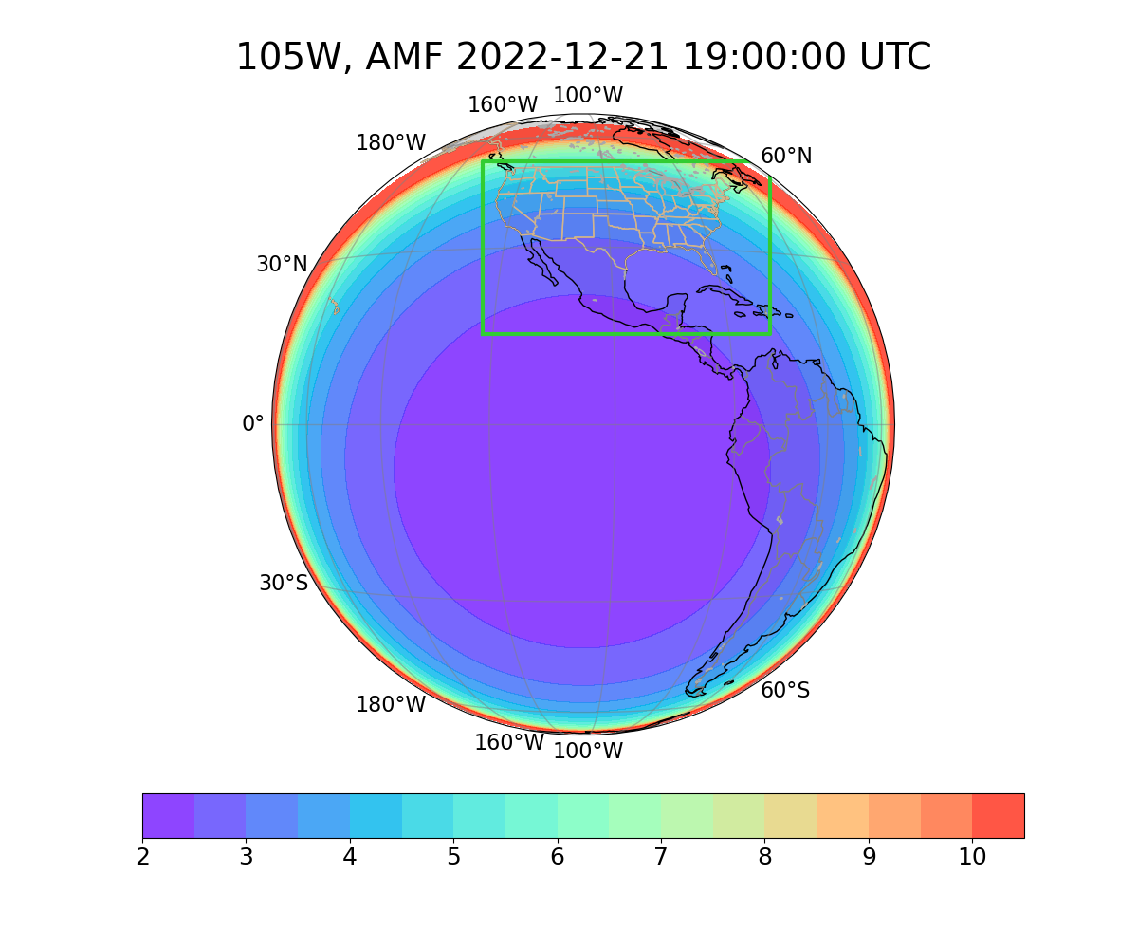
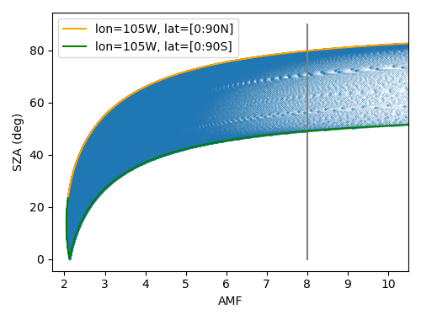
Geometrical Air Mass Factor threshold
The geometric airmass factor (GAMF) <= 8 threshold selection restricts to SZA<=80º at winter solstice (might be able to push it a bit higher).
All subsequent calculations use a
GAMF <=8 threshold as a first cut, though this can be adjusted in the future.
GAMF at subsatellite noon
SZA=80º
The orange envelope consists of points with latitude from 0 to 90N, and subsatellite longitude.
The orange bar corresponds to the points plotted in orange in the right plot. ACX region of interest is shown as a green rectangle.

Slide 9
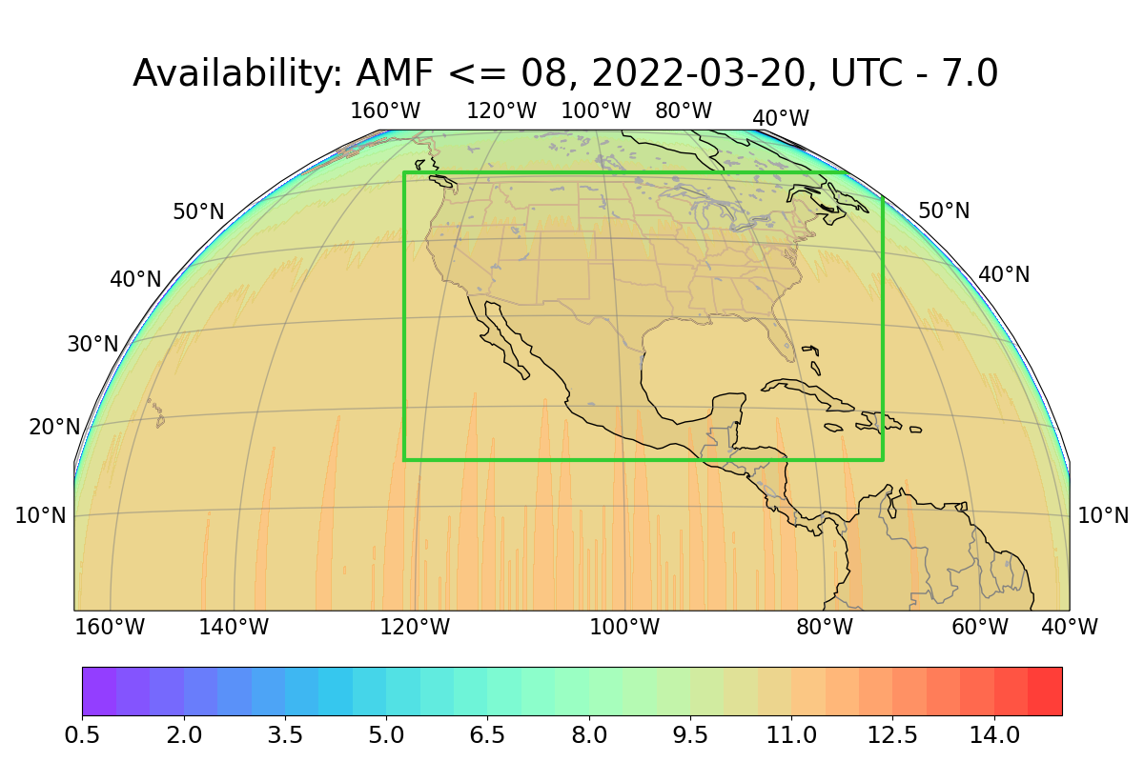
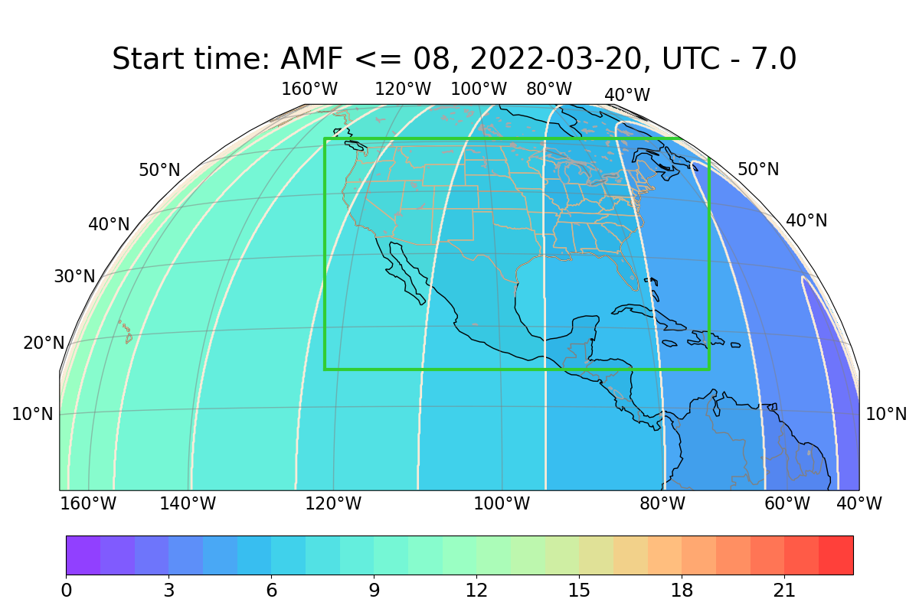
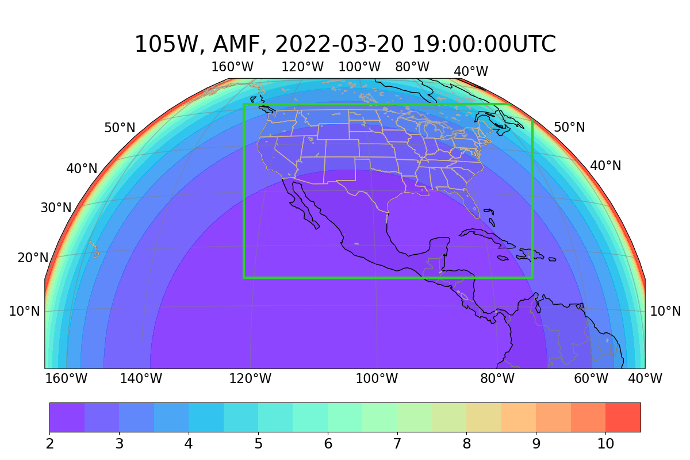
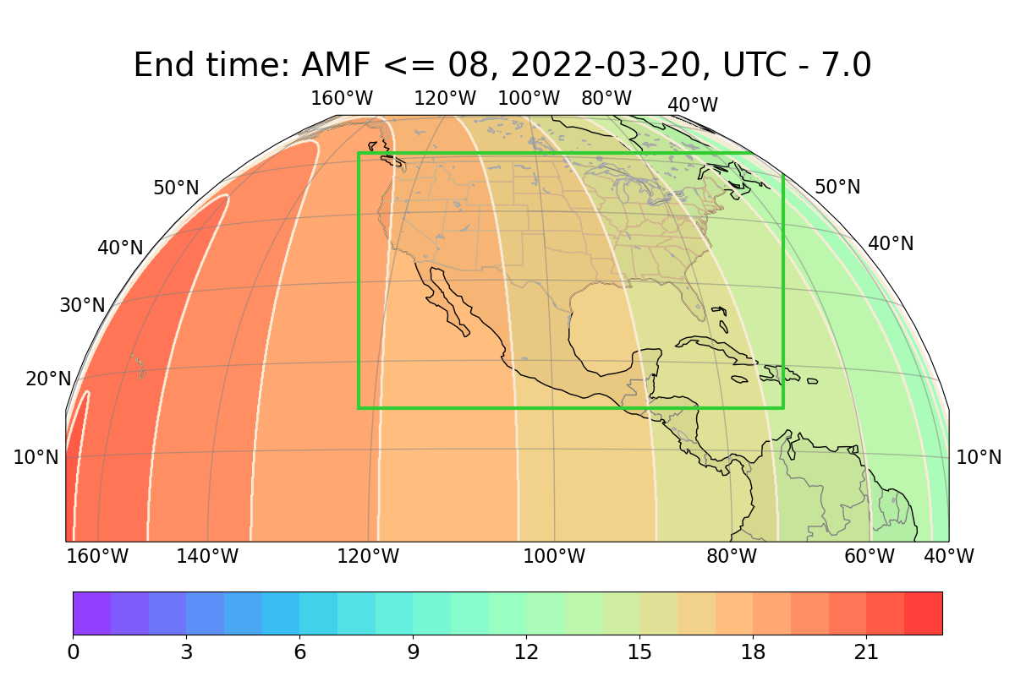
ACX Scanning Availability Example: 2022-03-20 (equinox)
Solar geometry and satellite view geometry used for GAMF threshold to derive start and end times and availability of observations for different days over a year.
Availability (hrs)
Start time (UTC-7)
GAMF
End time (UTC-7)

Slide 10
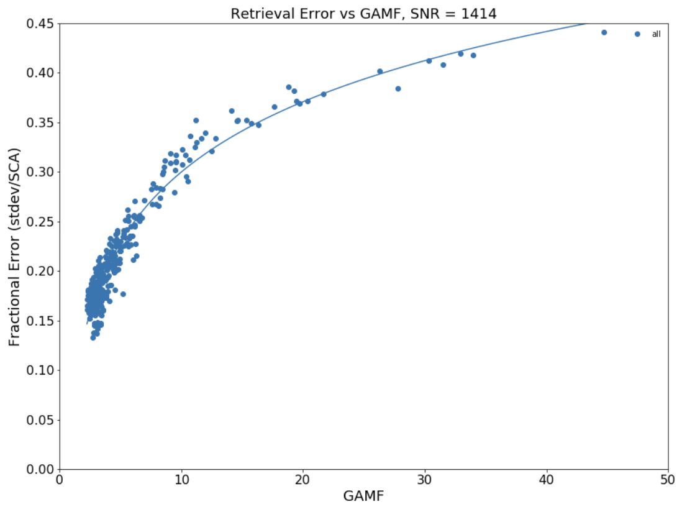
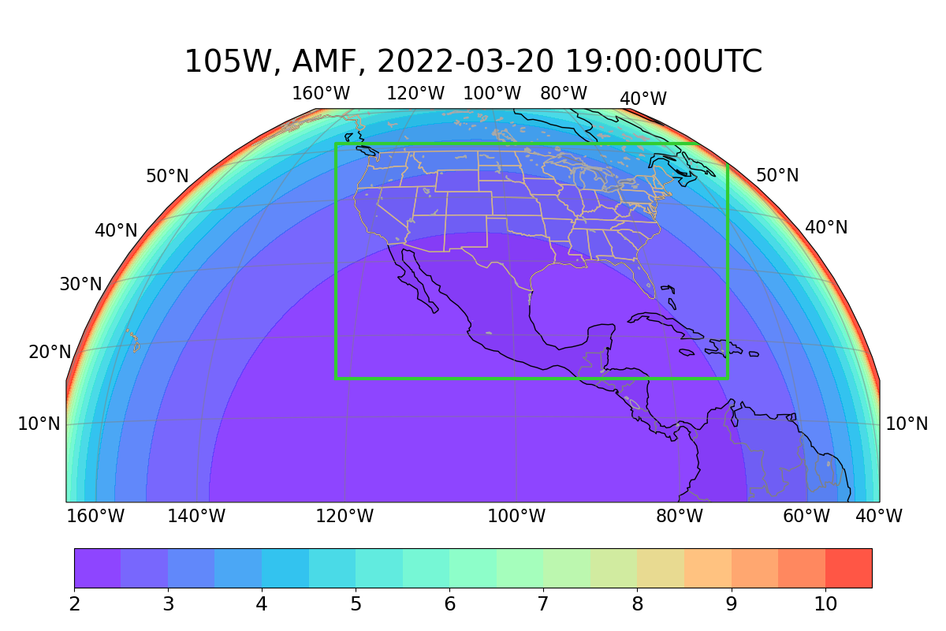
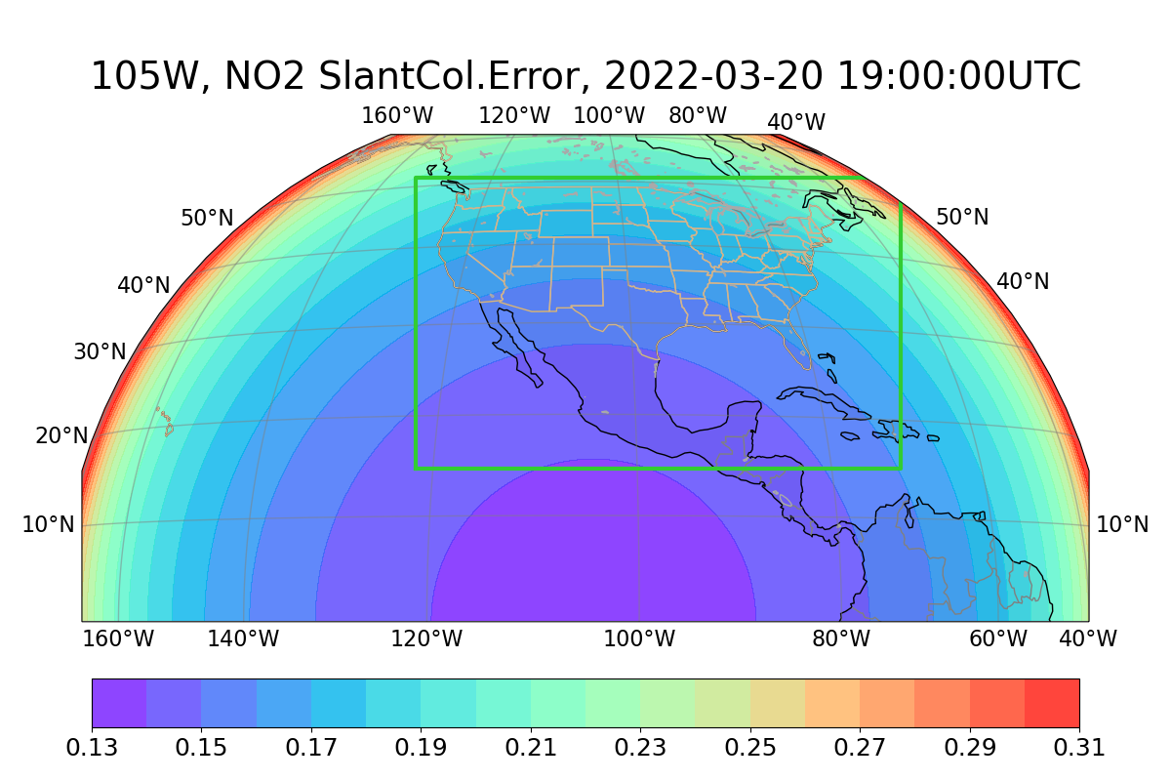
NO₂ Column Fractional Error, March 20 (equinox) used to map errors
The GAMF is translated to NO₂ slant column fractional error using statistics from location/time of day simulations.
The simulations assume an instrument SNR slightly exceeding the ACX requirements.
GAMF
NO₂ column fractional error

Slide 11
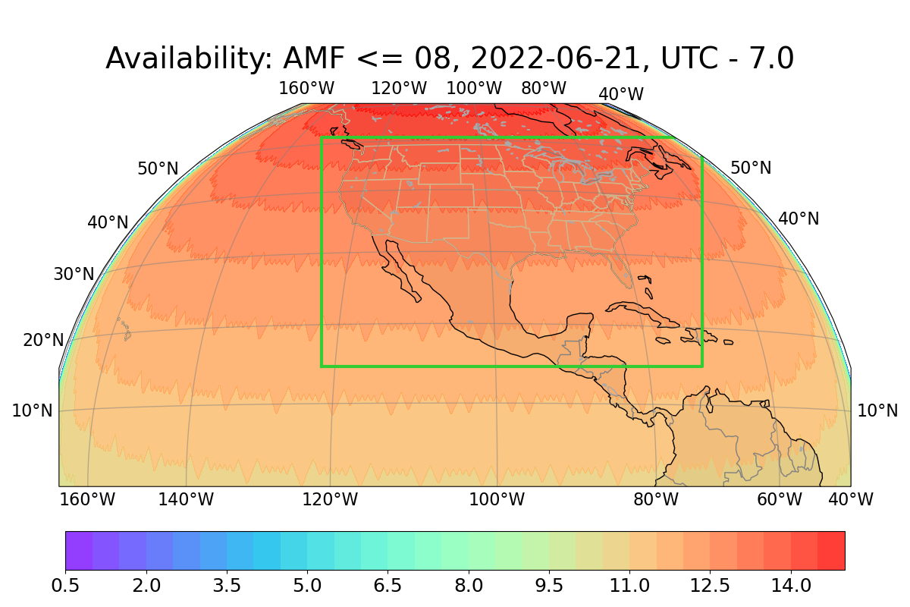
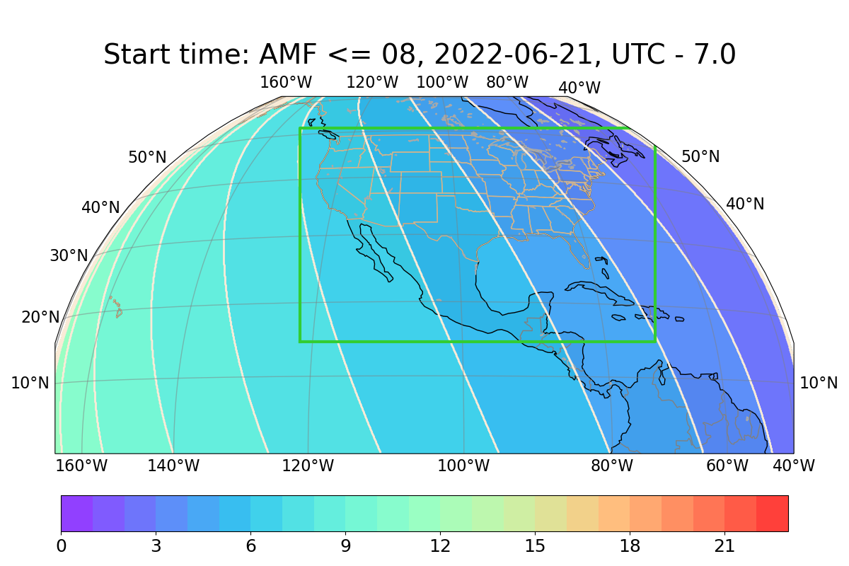
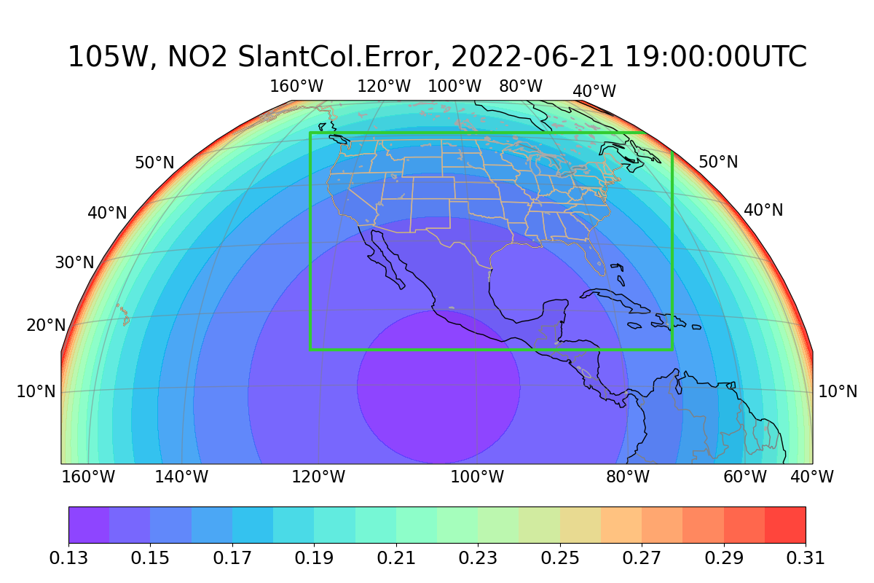
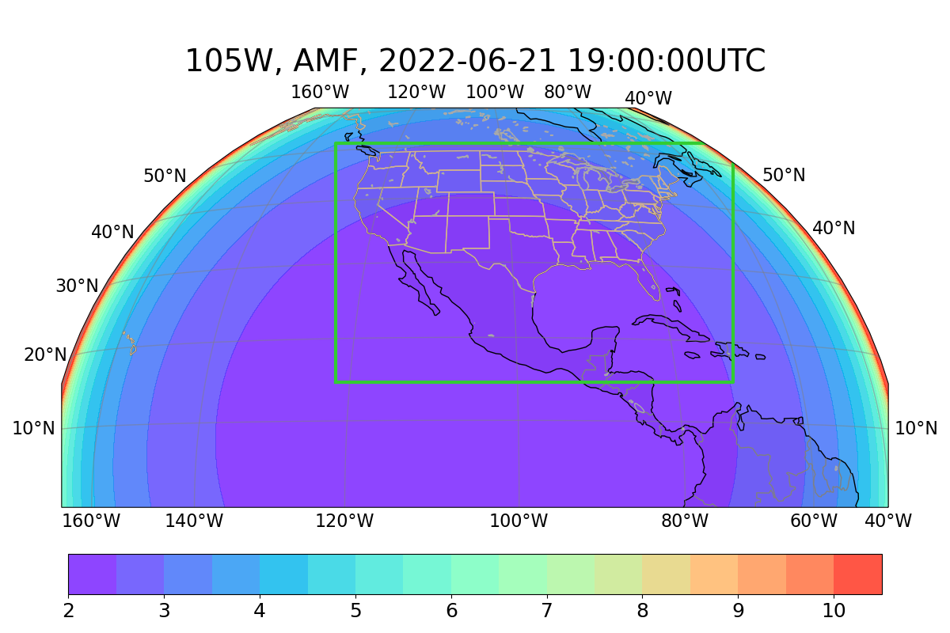
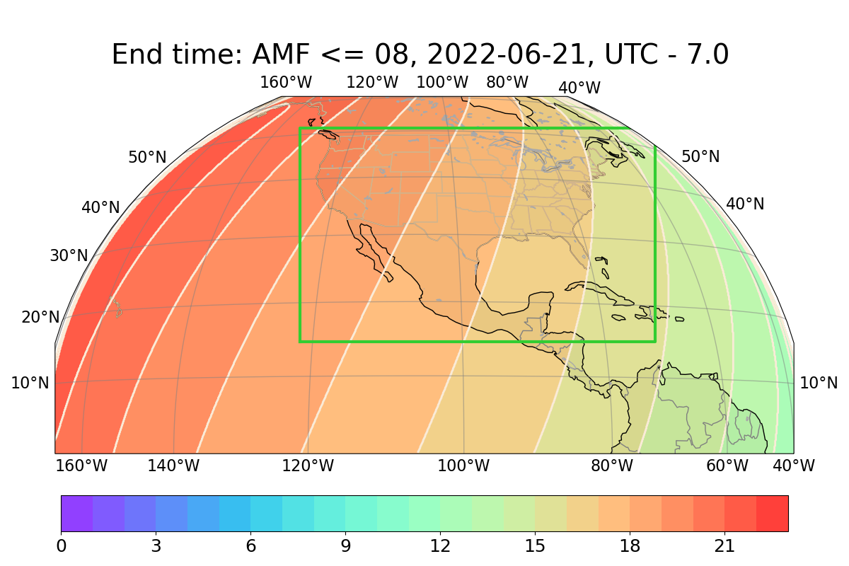
ACX Scanning Availability Example: June 21 (summer solstice)
Availability (hrs)
Start time (UTC-7)
NO₂ column fractional error
GAMF
End time (UTC-7)

Slide 12
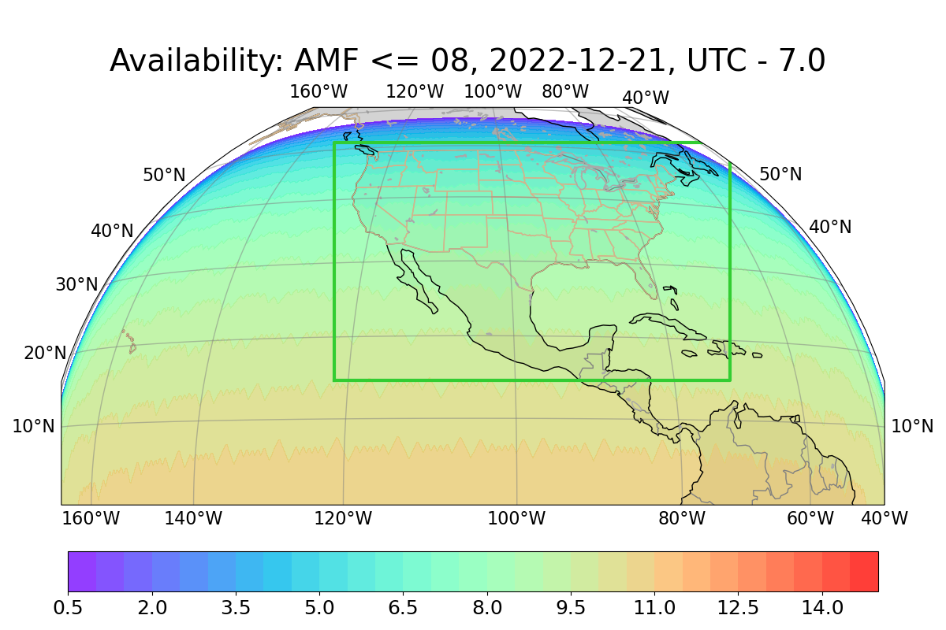
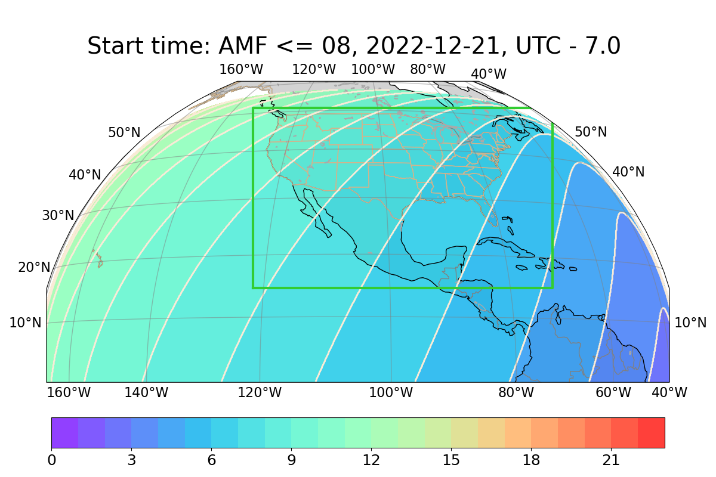
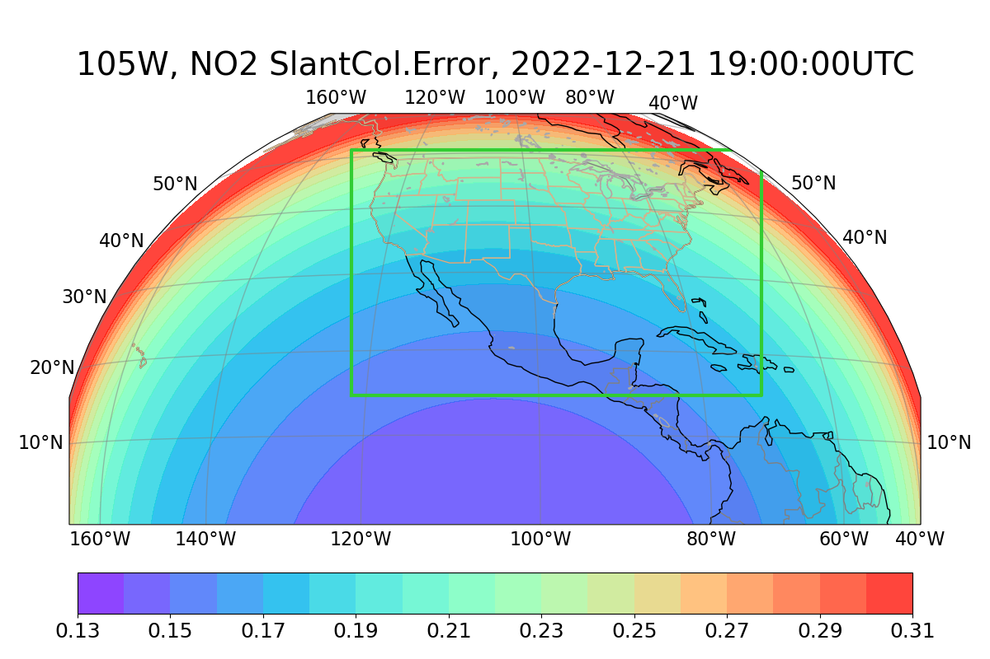
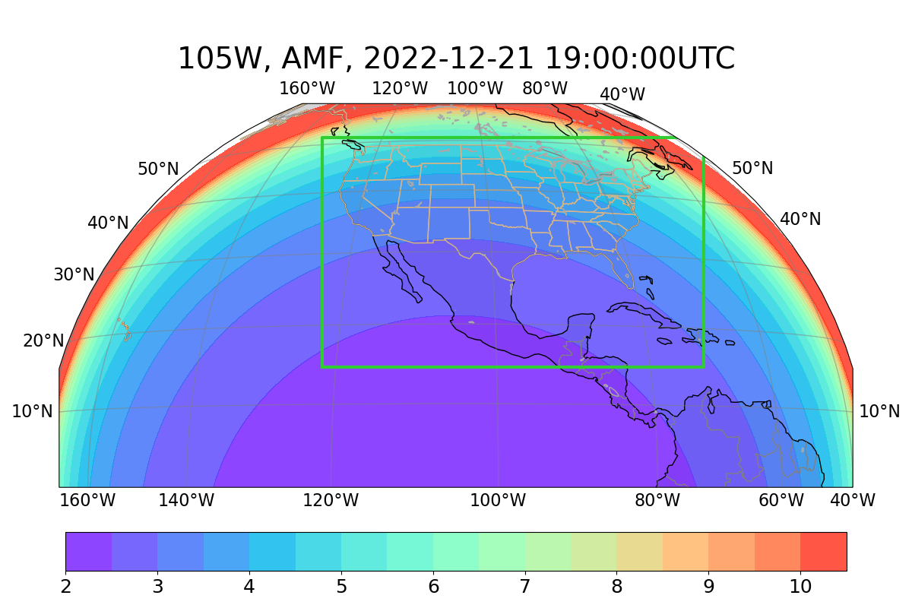
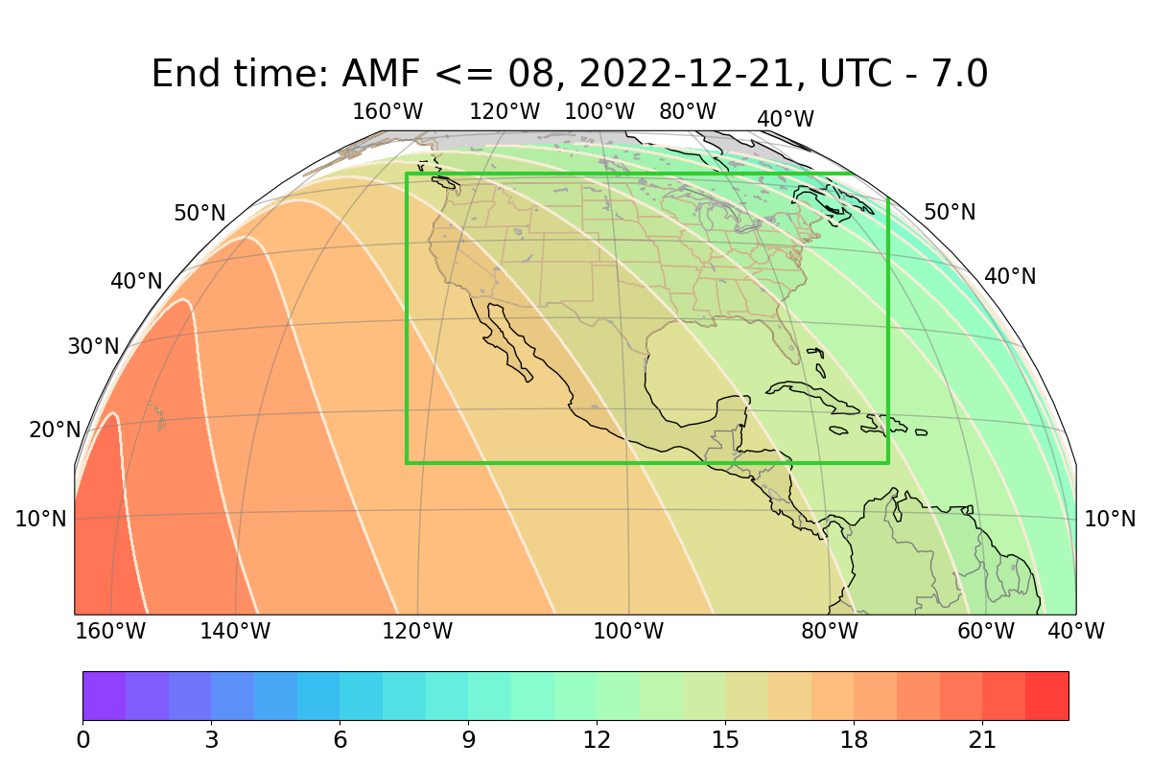
ACX Scanning Availability Example: Dec. 21 (winter solstice)
Availability (hrs)
Start time (UTC-7)
NO₂ column fractional error
GAMF
End time (UTC-7)

Slide 13
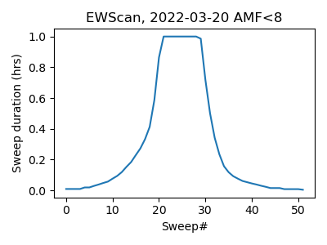
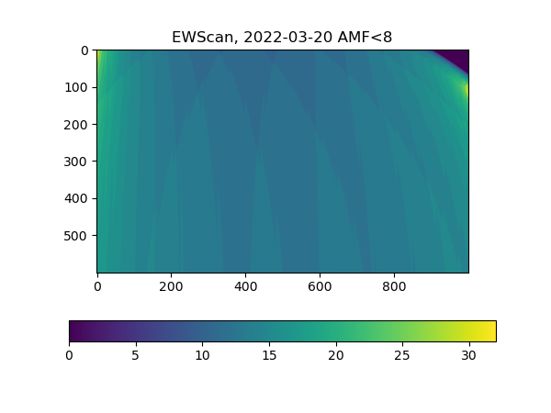
Scanning, Equinox March 20
EW Scan: (i) start at East-most available (at least one pixel meets selection criterium) location;
(ii) scan available region until reaching a vertical scan where all pixels are unavailable;
(iii) repeat.
Collected data:
# of visits per pixel meeting criterium

Slide 14
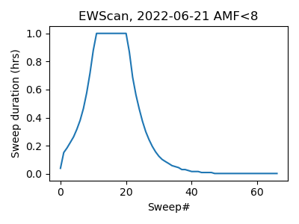
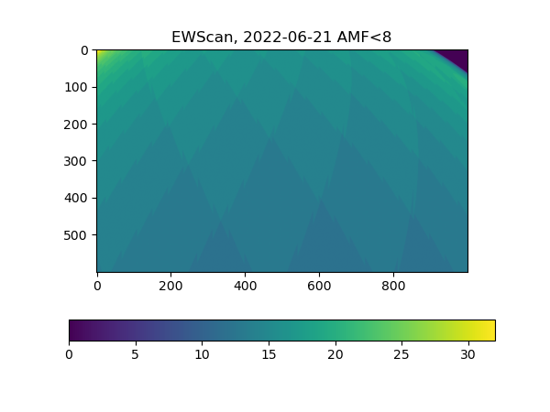
Scanning, Summer Solstice: June 21
Collected data:
# of visits per pixel meeting criterium

Slide 15
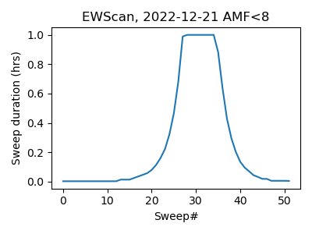
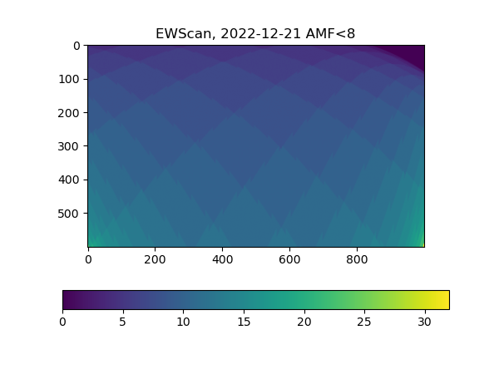
Scanning, Winter Solstice Dec. 21
Collected data:
# of visits per pixel meeting criterium

Slide 16
Summary
End to end simulation system has been used to examine and guide SNR requirements (see poster by Monica Cook for details)
Simulations used to assess availability and expected quality of observations and variations with time of year
Polarization sensitivity (PS) studies are continuing and will address impacts on O₃, SO₂ as well as NO₂ (published results in Pearlman et al., AMT, 2022) will include spectral dependence of PS and examine different ways to correct for it provided it has been well characterized
Future work on availability will build in expected cloudiness

