Slide 1
Welcome & Overview of Special Operations
May 1-5, 2023
Huntsville, AL
Aaron Naeger
NASA / University of Alabama in Huntsville
U.S. Government sponsorship acknowledged.

Slide 2
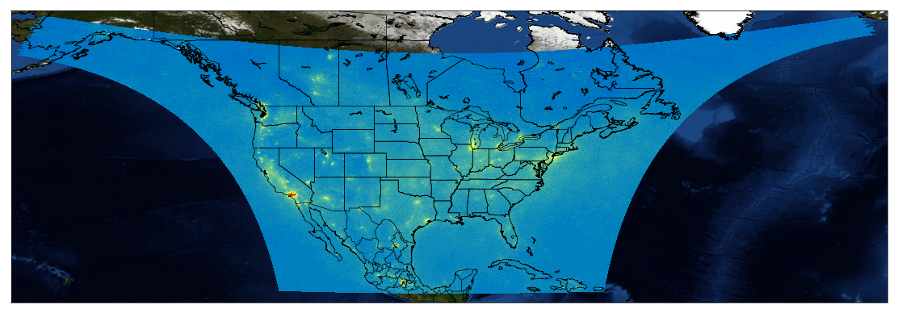
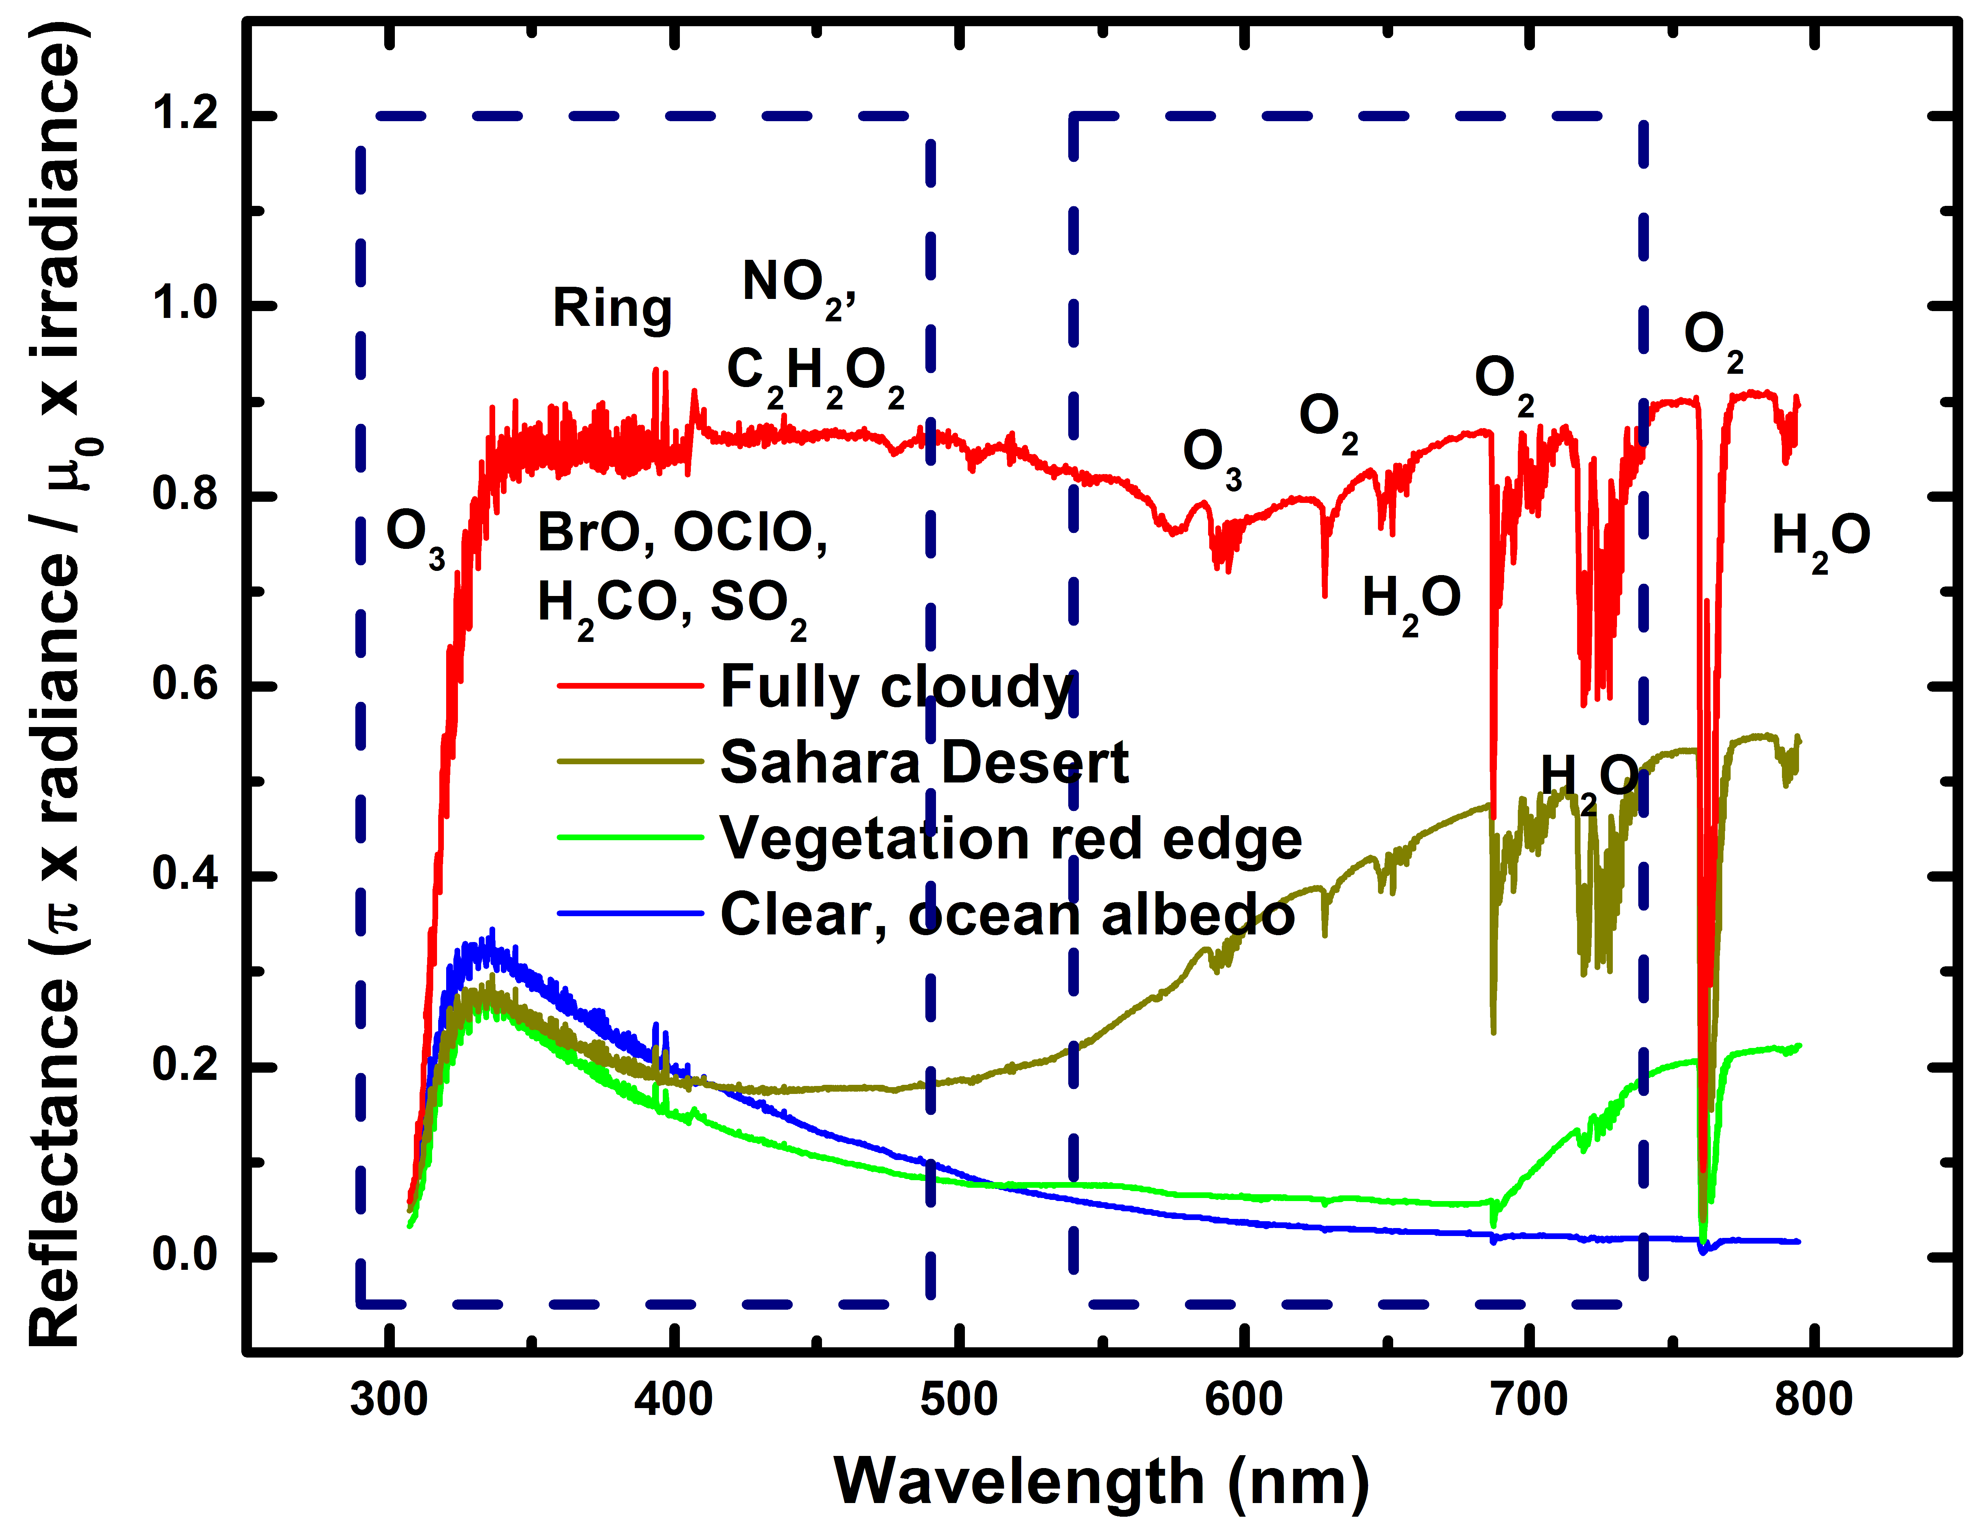
TEMPO Quick Facts
TEMPO’s Field of Regard (FoR)
NASA’s first Earth Venture Instrument (EVI) selected in 2012 & first host payload
Joint NASA & Smithsonian Astrophysical Observatory (PI Kelly Chance) project with domestic and international partners
Observations of atmospheric pollution every daylight hour at high spatial resolution from Geostationary Earth Orbit
NO₂ from TROPOspheric Monitoring Instrument (TROPOMI) mapped to TEMPO
~293-494 nm
~538-741 nm
UV/Visible grating spectrometer is sensitive to policy-relevant pollutants (NO₂, SO₂, O₃) and aerosols.
Capability to distinguish between boundary layer from free tropospheric and stratospheric O₃
Launched April 7, 2023 on SpaceX rocket to satellite host Intelsat (IS40e) @ 91°W (Baseline mission: 20 months).
Part of a geostationary air quality constellation, providing hourly daylight observations over the Northern Hemisphere
Credit: NASA LaRC
2

Slide 3
TEMPO Baseline & Additional Products
Level | Product | Key Variables | Resolution (km²) | Frequency/ SIze
L1b | Radiance | Geolocated, calibrated, geolocation & quality flags | 2.0 x 4.75 | Hourly, granule
L2 | Cloud | Cloud fraction, cloud pressure | 2.0 x 4.75 | Hourly, granule
 | O₃ (Ozone) profile | O₃ profile, Tropospheric O₃ column, 0-2 km O₃ column, Errors | 8.0 x 4.75 OR 8.0 x 9.5 | Hourly, granule
 | Total O₃ | Total column O₃ | 2.0 x 4.75 | Hourly, granule
 | NO₂ (Nitrogen Dioxide) | Slant Column Density (SCD) Tropospheric Vertical Column Density (VCD) Errors | 2.0 x 4.75 | Hourly, granule
 | HCHO (Formaldehyde) | SCD Total VCD Errors | 2.0 x 4.75 | Hourly, granule
 | C₂H₂O₂ (Glyoxal) |  | 2.0 x 4.75 | 2.0 x 4.75
 | H₂O (Water Vapor) |  | 2.0 x 4.75 | 2.0 x 4.75
 | BrO (Bromine) |  | 2.0 x 4.75 | 2.0 x 4.75
 | SO₂ (Sulfur Dioxide) | SCD VCD (Total, Planetary Boundary Layer, & Lower / Middle / Upper Tropospheric, Lower Stratospheric) | 2.0 x 4.75 | Hourly, granule
 | Aerosol | Ultraviolet & Visible Aerosol Optical Depth (AOD) Aerosol Optical Centroid Height (AOCH) Aerosol Absorption Index (AAI) | 8.0 x 4.75 | Hourly, granule
 | TEMPO/GOES-R Synergistic | Aerosol, Fire / Hotspot, Cloud & Mask, Lightning, Snow / Ice, Precipitable Water, etc. | 2.0 x 4.75 | Hourly, granule
L3 | Gridded L2 | Same as L2 | ~5 x 5 (TBD) | Hourly, scan
L4 | UVB | UV irradiance, erythemal irradiance, UVI | TBD | Hourly, scan
**
** Center of Field of Regard
Proposed Near Real-Time products
(latency 2-3 hours)
Black text: Baseline products
Orange text: Additional / proposed products
Level 3 product composed of 10 granules of Level 2 files for each hour TEMPO FoR scan
3
3
3

Slide 4
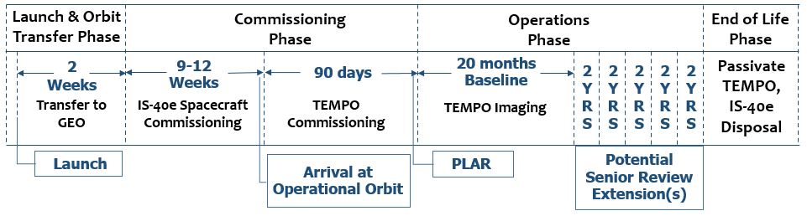
Mission Phases & Operational Timeline
Launched: April 7, 2023
Power On: ~ June 4 -10
Commissioning: July – Sept 2023
TEMPO commissioning phase from July – Sept 2023
First light: First week of August with potential to start by ~10 days earlier
Nominal operation: ~6 months after launch (Oct 2023)
Baseline mission length is 20 months; possible 10+ year lifetime depending on senior reviews
Plan to release level 1b data ~4 months after commissioning phase (Feb 2024) and level 2 and 3 data ~6 months after commissioning phase (April 2024)
4
4

Slide 5
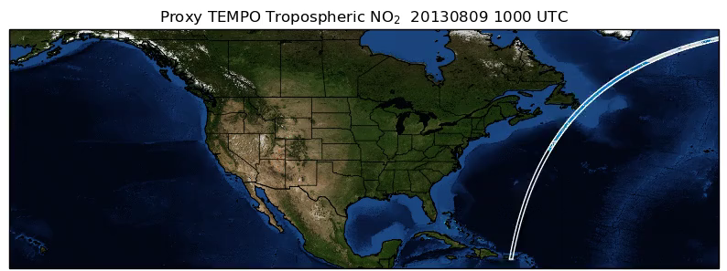
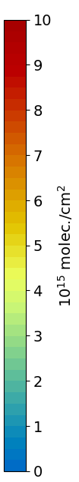
TEMPO Scan Operations
TEMPO will perform standard (nominal) East-West hourly daytime scans consisting of ~1226 mirror steps across the Field of Regard (FoR) over greater North America.
Sub-hourly scans will also be performed:
Optimized scans across the East and West during sunrise and sunset periods, respectively, when SZA is too high (> 80°) over portions of the FoR for collecting measurements of pollutants
Special operations for dedicated experiments (Green Paper!) over a portion or slice of the TEMPO FoR (e.g., <= 10 minutes)
5

Slide 6
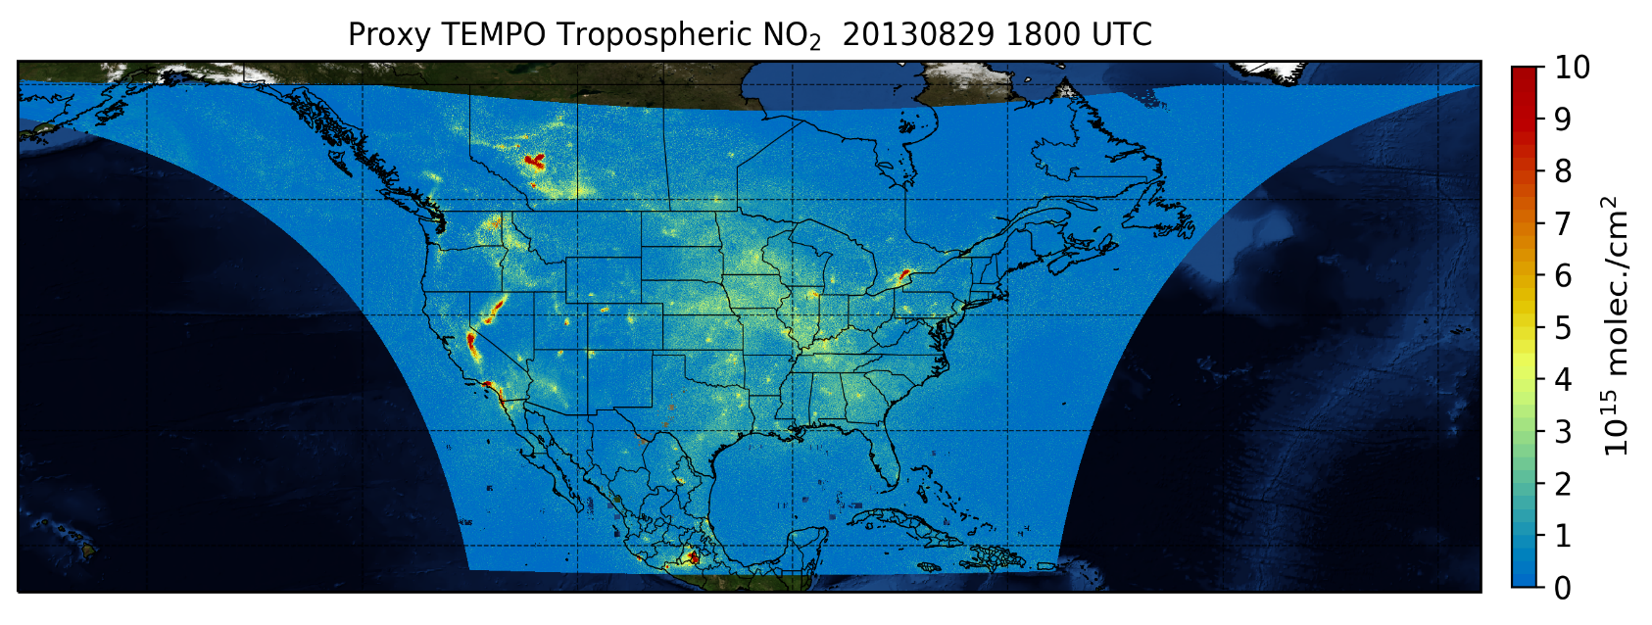
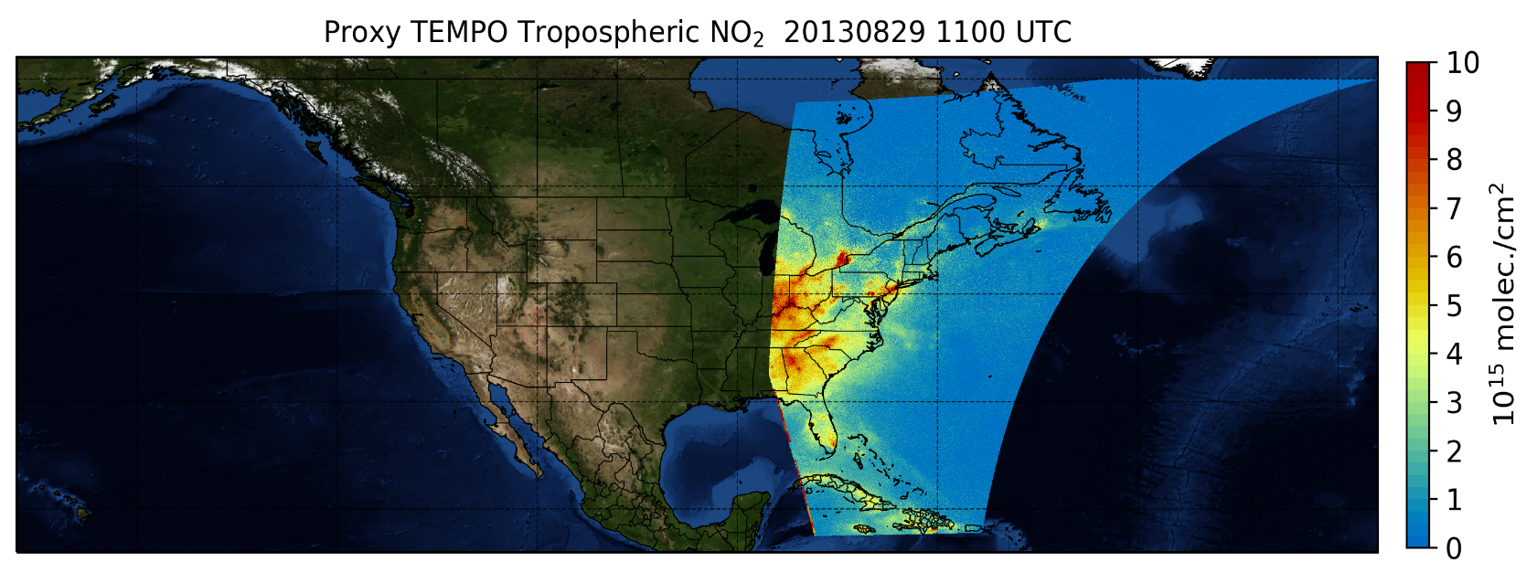
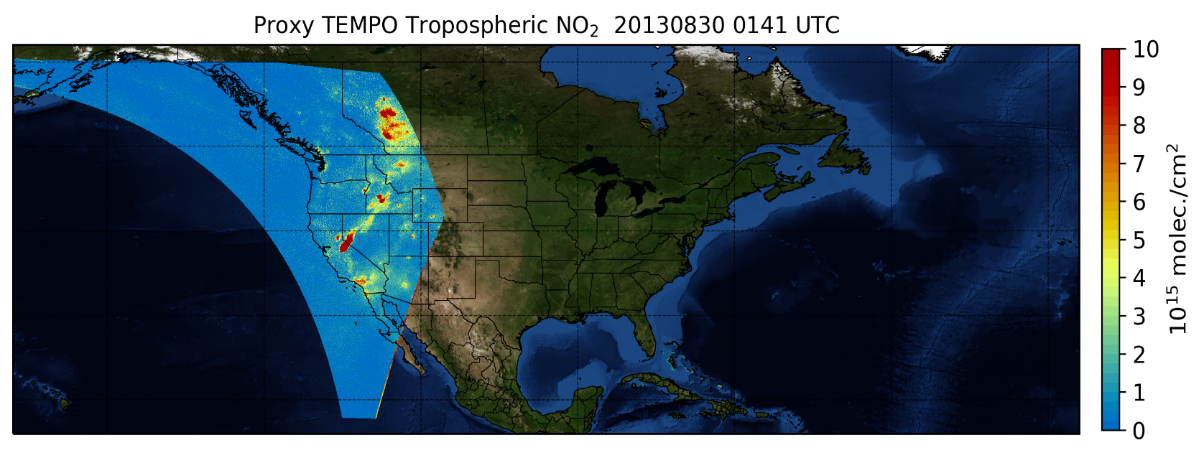
Nominal & Optimized Scans
Nominal hourly scan coverage
Morning
Optimized Scans
Evening
SZA > 80°
SZA > 80°
~20 minutes
~15 minutes
6

Slide 7
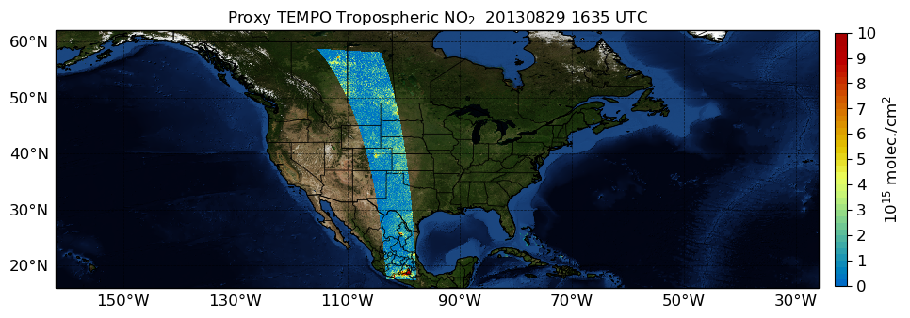
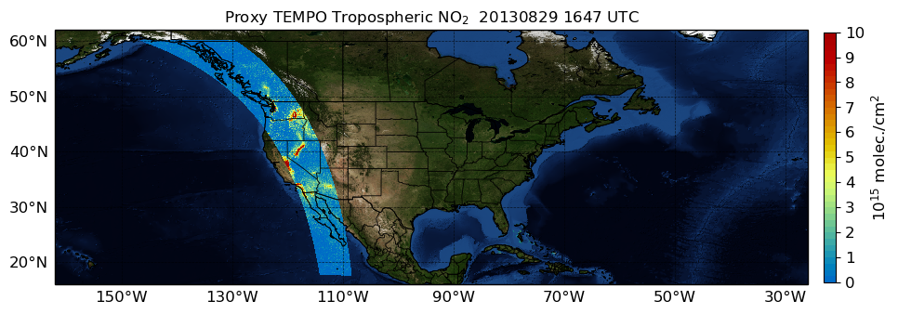
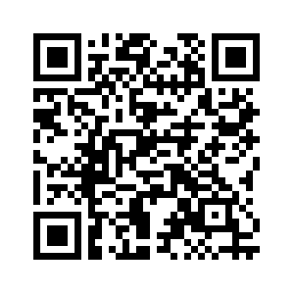
Special Operations
Special operations are higher frequency scans (e.g., ≤ 10 minutes) over selected portions or slices of the Field of Regard.
Up to 25% of TEMPO’s observing time will be committed to special operations, which can be initiated in the commissioning phase
~6 minutes
Example of possible coverage of special operation scan for experiment focused on pollution transport along Colorado Front Range
The TEMPO Green Paper is being regularly updated with experiments proposing to use a portion of TEMPO’s special operational time
~6 minutes
Example of possible coverage of special operation scan for experiment focused on wildfire smoke in Pacific Northwest
7

Slide 8
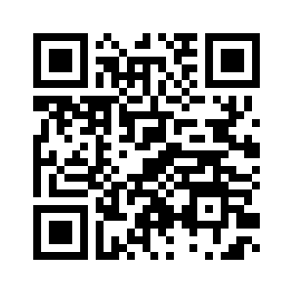
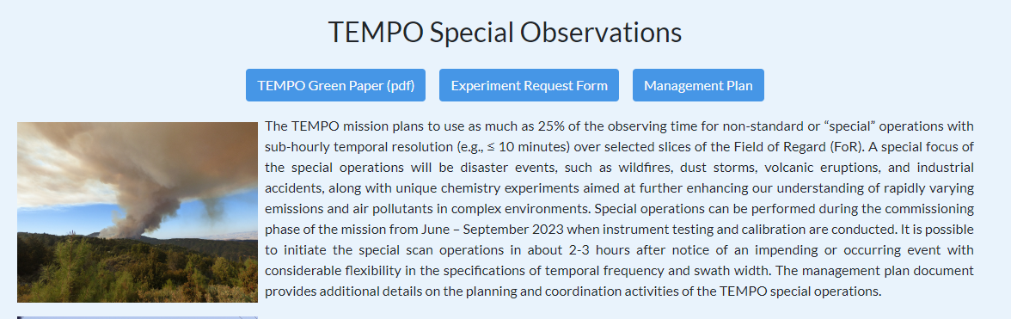
How to make a request?
To make request for using a portion of TEMPO’s special observation time, investigators must complete the Experiment Request Form available on the TEMPO Early Adopters site
Once approved as a suitable experiment for the special operations, the abstract of the experiment will be added to the living TEMPO Green Paper
Inclusion of the experiment in the Green Paper does not guarantee that special operations will be committed to the experiment, but it is critical first step for adding it to the pipeline.
8

Slide 9
Experiment Selection Process & Timeline
Steering committee will prioritize and commence scheduling logistics for experiments requesting the special operations
Committee: Aaron Naeger, Xiong Liu, Kelly Chance, Michael Newchurch, Barry Lefer
Investigator responses in the request form will be evaluated based on the following criteria when selecting and prioritizing experiments:
Scientific value
Societal benefit (applicable to applied experiments)
Execution capabilities of the investigators (Does the team have the resources?)
Experiment logistics including synergy with other experiments
After evaluation, the committee will arrange meetings with the investigators of the selected experiments to ensure optimal execution of the special operations to achieve experiment goals
First round of experiments selected for implementation will be announced by end of June 2023, followed by initial coordination activities with investigators
Additional experiments will be selected and implemented after the commissioning phase on an as needed basis
9

Slide 10
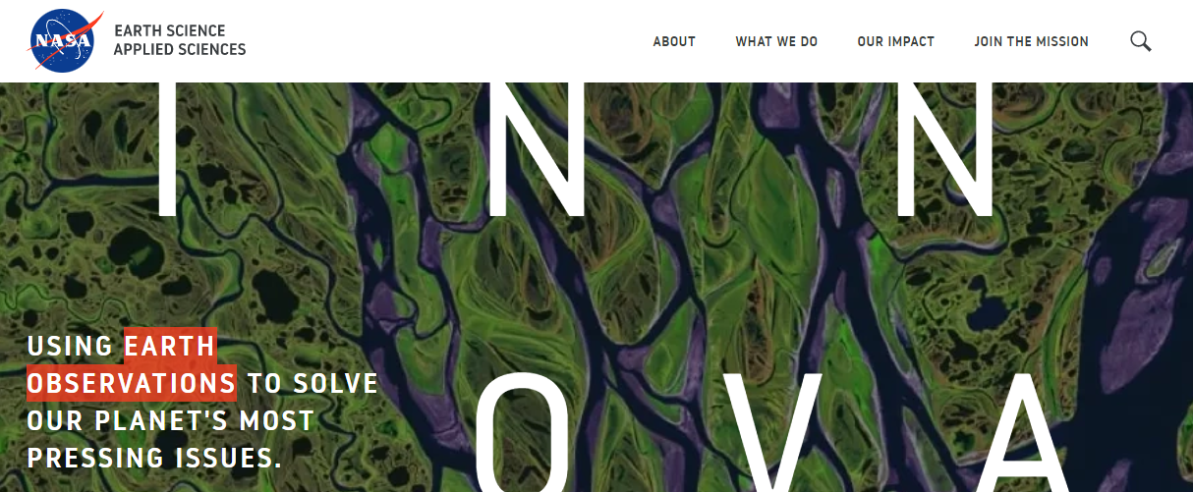
Impact & Outreach Plan
Investigators of the selected experiments can expect follow-up communication with the coordination team on their progress in using the TEMPO data products
Can include requests to share results at TEMPO meetings
For broader outreach, the TEMPO Deputy Program Applications Lead (Aaron Naeger) may communicate with investigators to share impact stories from the experiments to the NASA Applied Science Program
10

