Slide 1
TEMPO High-Resolution Lagrangian Lightning NO_{x} (LNO_{x}) Experiment
Ken Pickering, Dale Allen; University of Maryland
Potential Collaborators: Eric Bucsela, SSAI/GSFC; William Koshak, NASA/MSFC; Caroline Nowlan, SAO; Lok Lamsal; UMBC/GSFC

Slide 2
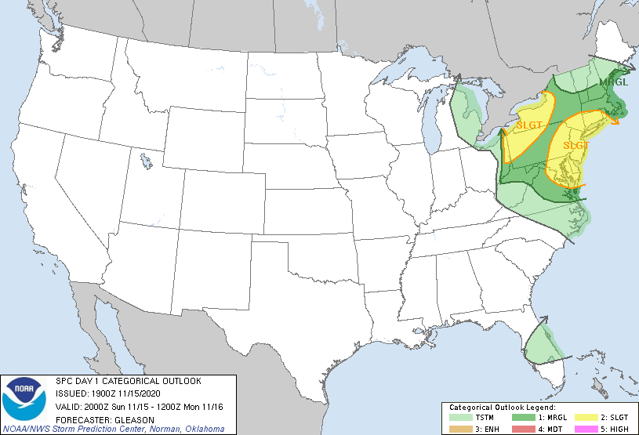
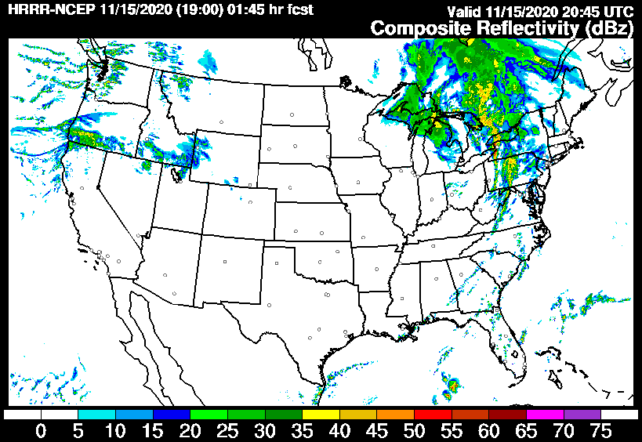
TEMPO High-Resolution Lagrangian Lightning NO_{x} (LNO_{x}) Experiment
Rationale: Global production of NO_{x} by lightning (LNO_{x}) has a factor of four uncertainty (2 to 8 Tg N per year)
- With reduced anthropogenic NO_{x} emissions, LNO_{x} now contributes a greater fraction of tropospheric column NO₂
- NO₂ from polar orbiting satellites (GOME, OMI, TROPOMI) have been used with lightning data to estimate the moles of NO_{x} produced per flash. However, polar-orbiting data are only available once per day usually before diel peaks in thunderstorm activity.
- TEMPO data will be available for all daylight hours allowing NO₂ in and above thunderstorms to be observed from many more storms.
- High temporal and spatial resolution will allow evolution of NO₂ plumes to be observed within and downwind of storms.
Methods: Study selected thunderstorm systems over Greater North America: 25 observation days desired
TEMPO special operations NO₂ retrievals at 10-min time resolution over regions (~800 km-wide swaths) and days during the Summer of 2023 when thunderstorms are likely.
By sampling a variety of storm types (individual air mass cells, multi-cellular storms, squall lines, supercells) and a wide range of lightning flash rates it will be possible to refine estimates of lightning-NO_{x} production
Region and time periods selected
based on NOAA/NCEP/Storm Prediction
Center Convective Outlooks -- some skill
at 3 days ahead; much better at 2 days
and 1 day
If 24-hr notice is adequate – use hourly
NCEP High Resolution Rapid Refresh
(HRRR) forecasts with output every
15-minutes at 3-km resolution

Slide 3
TEMPO LNO_{x} Retrieval and Analysis
General Algorithm for Lightning NOx Retrieval and Production Efficiency (PE) Estimation
LNO_{x} PE is estimated by dividing the moles of NO_{x} due to recent lightning by the number of flashes contributing to the tropospheric columns over/within storms.
These columns are determined by dividing the tropospheric slant column of NO₂ over deep convective pixels, i.e., pixels with large cloud radiative fraction (CRF) and low cloud top pressure (CTP) by a specially derived Air Mass Factor (AMF) appropriate for a thunderstorm.
What is needed for TEMPO LNOx Analysis ?
- Stroke, flash, and flash energy data from GOES-16 and GOES-18 GLM instruments
- Initial analysis – use tropospheric NO₂ columns from standard TEMPO retrievals; convert to estimated NO_{x} columns using GEOS-Composition Forecast (GEOS-CF) NO and NO₂ profiles in deep convection near the time and location of TEMPO-observed storms.
- Post-experiment – Tropospheric NO₂ columns will be revised using additional TEMPO products and AMFs appropriate for deep convective pixels containing LNO_{x}.
- LNO_{x} production analysis will be conducted for individual case-study storms observed by TEMPO.
- Aggregate data to obtain regression-based statistical relationships between
LNO_{x} and lightning flashes.
OMI/TROPOMI/GCAS Lightning NO_{x} Results
Pickering et al. (2016, JGR): OMI Gulf of Mexico
Bucsela et al. (2019, JGR): Mid-latitude continental OMI
Allen et al. (2019, JGR): Regional tropical OMI
Allen et al. (2021a, JGR): GCAS on ER-2 aircraft with GOES GLM;
demonstration of synergy between TEMPO and GLM
Allen et al. (2021b, JGR): TROPOMI with GLM
Ground-
based
ENTLN
flashes
After background subtraction
& bias/uncertainty analysis:
LNO_{x} PE with GLM flashes
= 175 ± 100 moles/flash
GLM Flashes
TROPOMI
Cloud
Pressure
Effective
Cloud
Fraction
TROPOMI
NO₂ Total
Slant Column
Computed
tropospheric
NO_{x} column
over storm

Slide 4
TEMPO Data Will Reduce Biases and Uncertainties in LNO_{x} Retrievals
The three largest uncertainties in OMI and TROPOMI LNO_{x} analyses were:
- Chemical lifetime of NO_{x} in near field of storm (can be 2 – 12 hrs; Nault et al. (2016; 2017)
- NO_{x} background – from upwind storms and convective transport of PBL NO_{x}
- NO_{x}/NO₂ ratio within and near storm - affects AMF_{LNOx}
TEMPO 10-min resolution data will enable better quantification of these uncertainties:
- Lagrangian data will allow analysis of decay of NO_{x} as it moves downwind for determining
estimates of chemical lifetime
- Examine time evolution of NO_{x} in cells with no lightning to aid background estimate
- Diurnal variation of NO₂ will be better constrained
Simultaneous aircraft data would aid in better quantifying NO_{x}/NO₂ ratio

