Slide 1
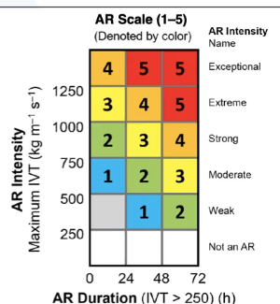
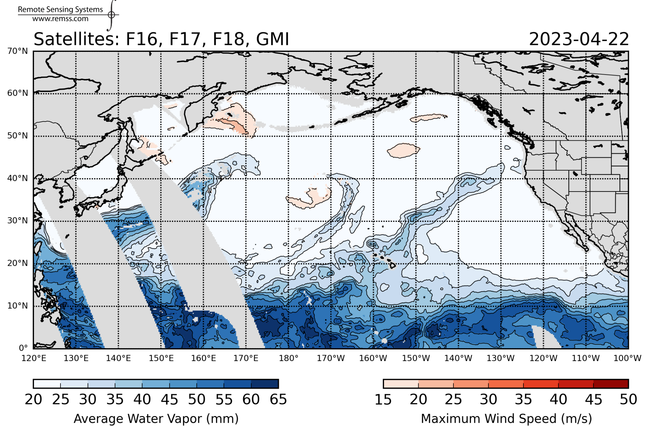
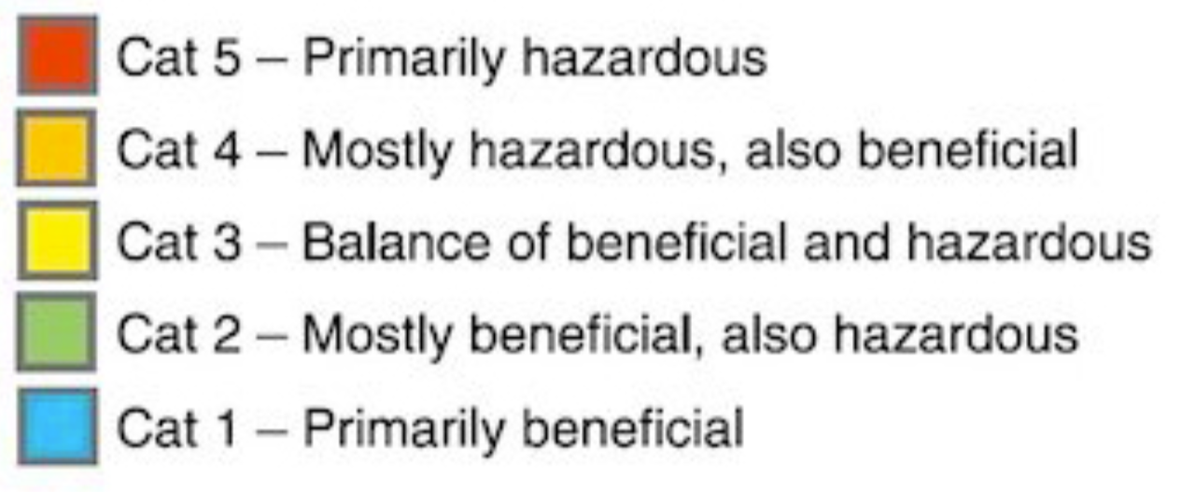
Water Vapor Studies: Atmospheric Rivers (ARs)
Huiqun (Helen) Wang (hwang@cfa.harvard.edu) & the SAO TEMPO team
Amir Souri & Kirsten Hall
Total Column Water Vapor
>90% global meridional moisture transport [Newell & Zhu, 1998]

Slide 2
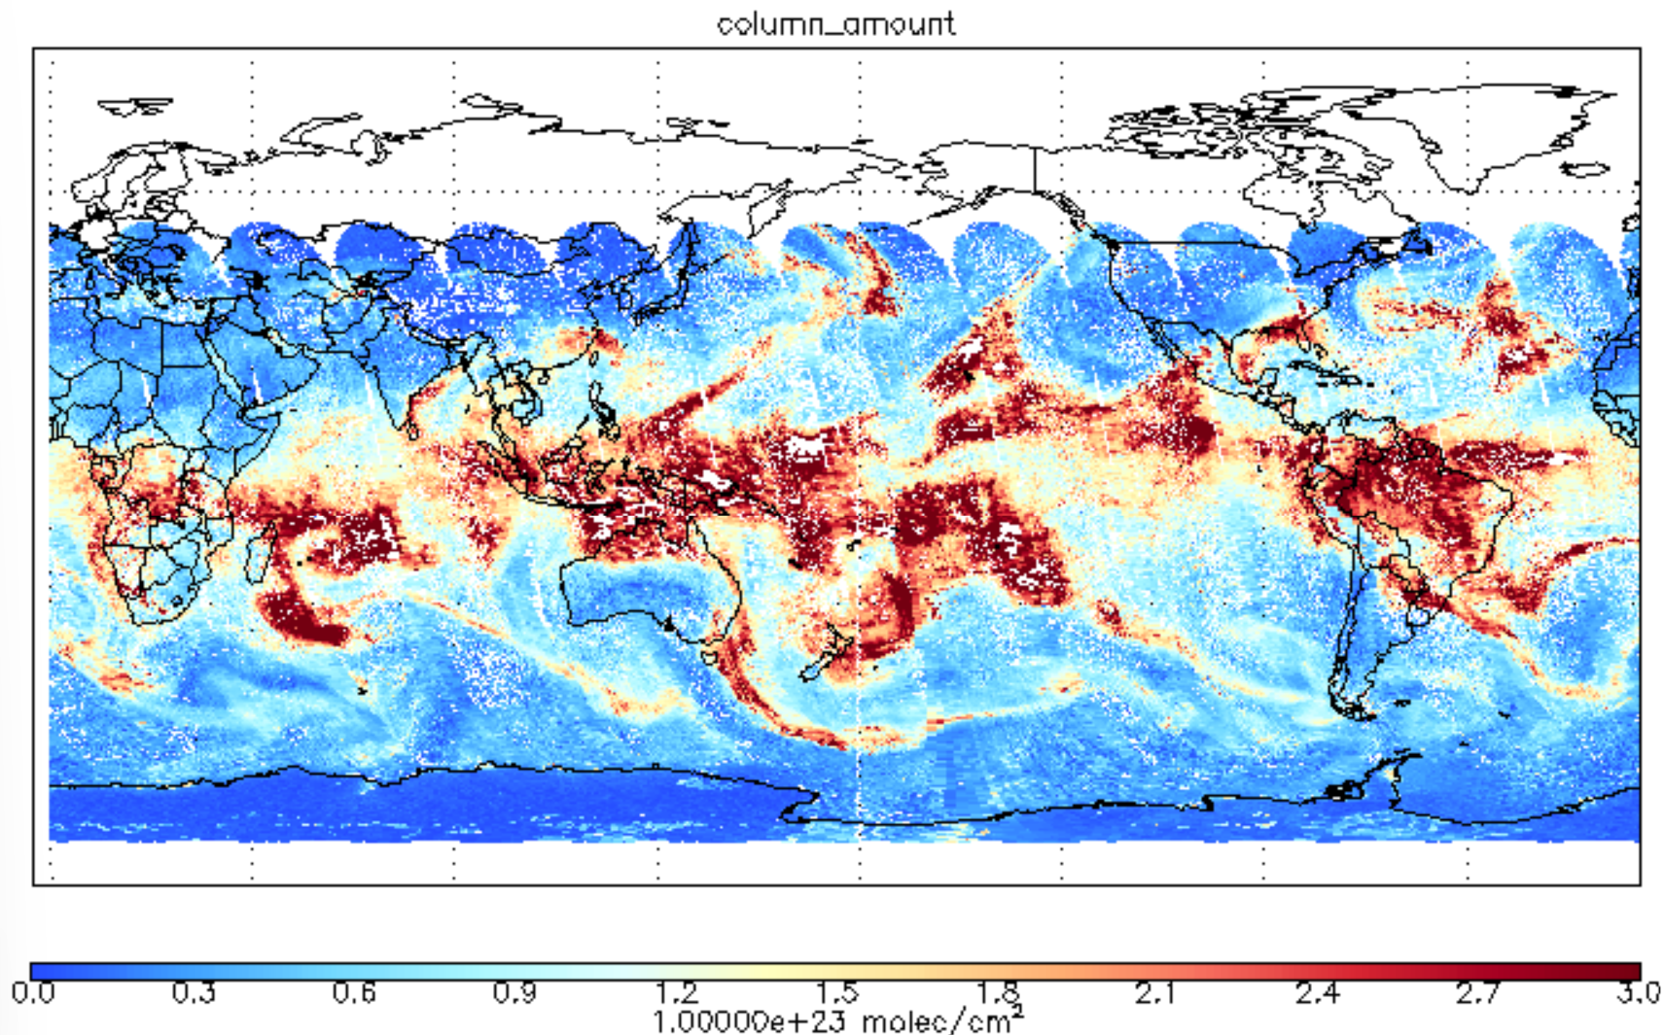
AR Watch
Total Column Water Vapor
OMI Vertical Column Density
Microwave
(ocean only)
Visible
(ocean & land)

Slide 3
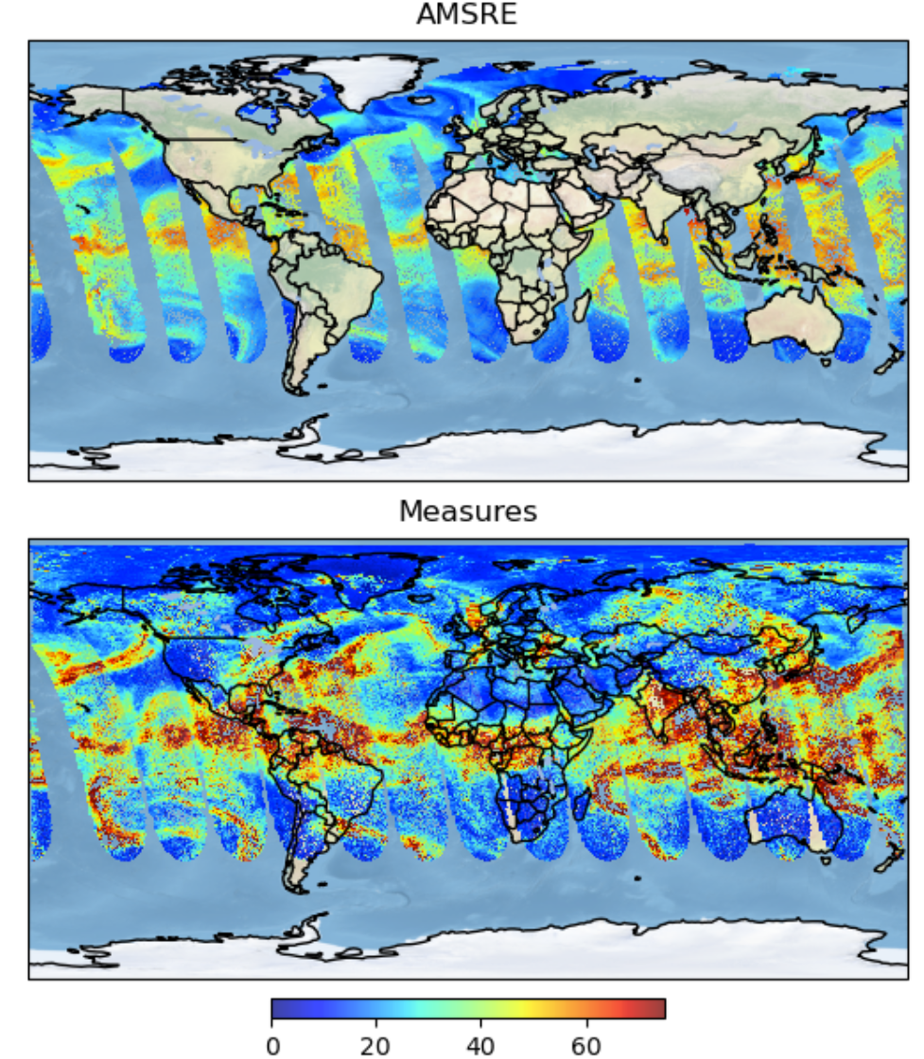
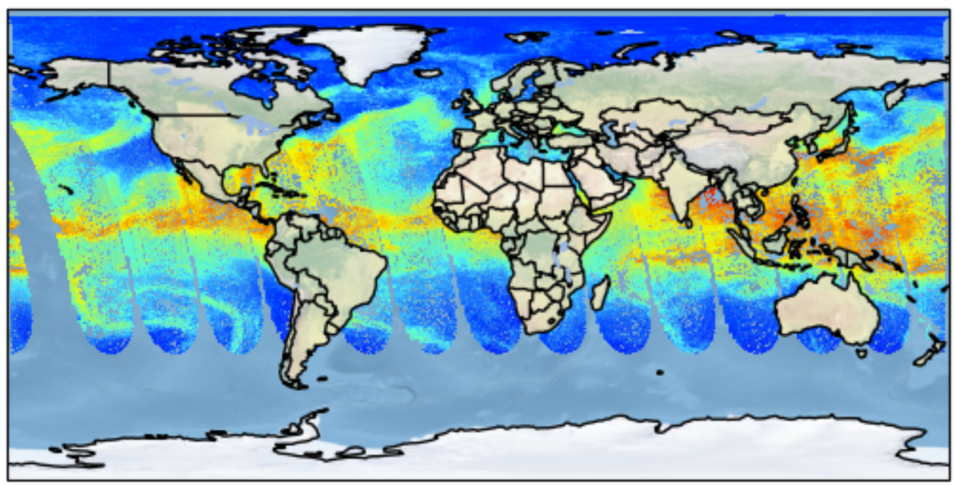
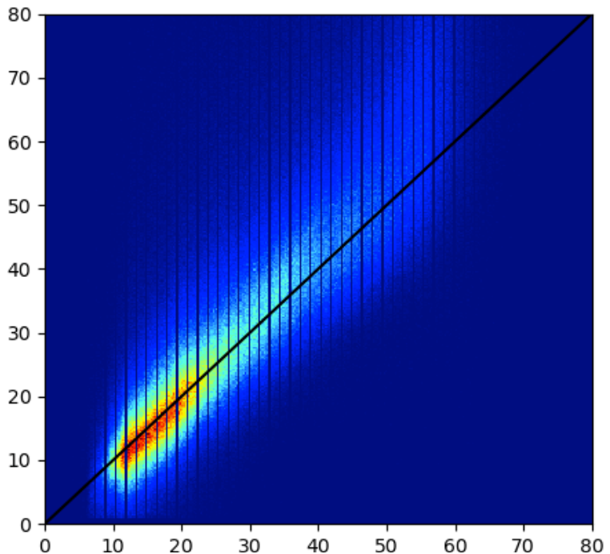
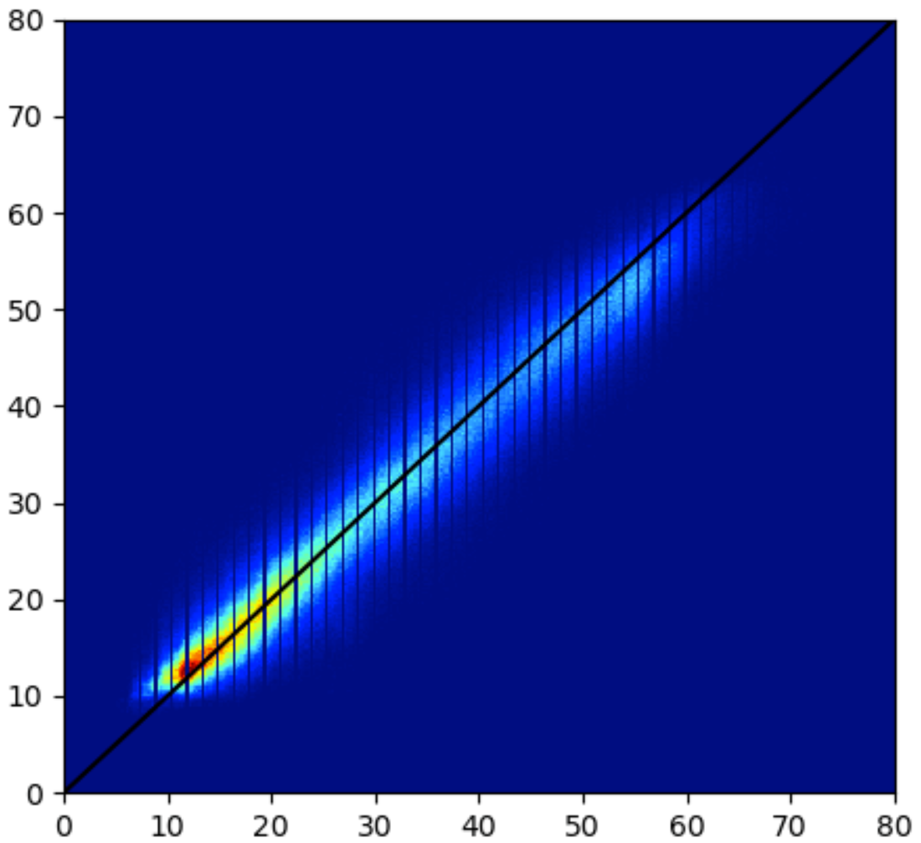
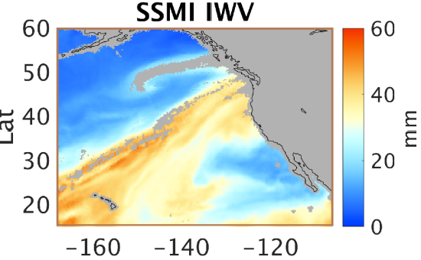
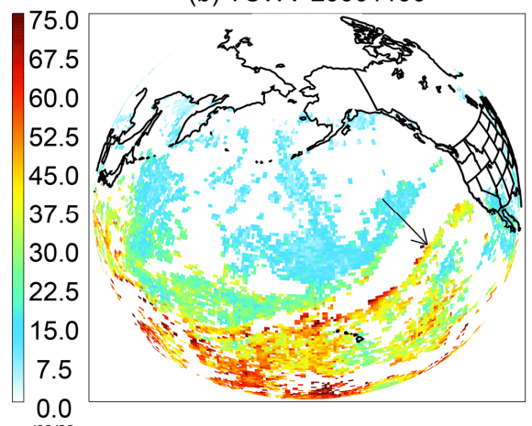
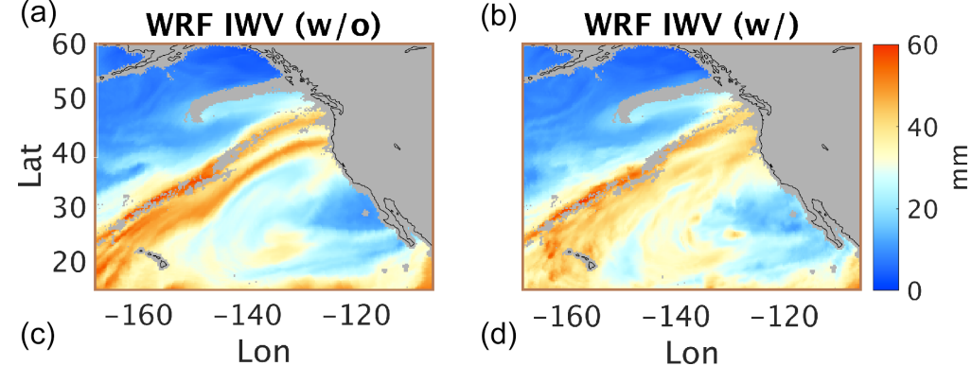
microwave : All-sky “accurate”
Machine Learning (ML)
reduced bias & scatter
Visible (mm)
ML (mm)
Microwave (mm)
Microwave (mm)
[Wang et al., 2023]
“Truth”
Data filtering
Data improves
AR simulation
(Amir Souri)
Control
Assimilation
mm
Visible : biased for cloudy scenes
[Wang et al., 2019]

Slide 4
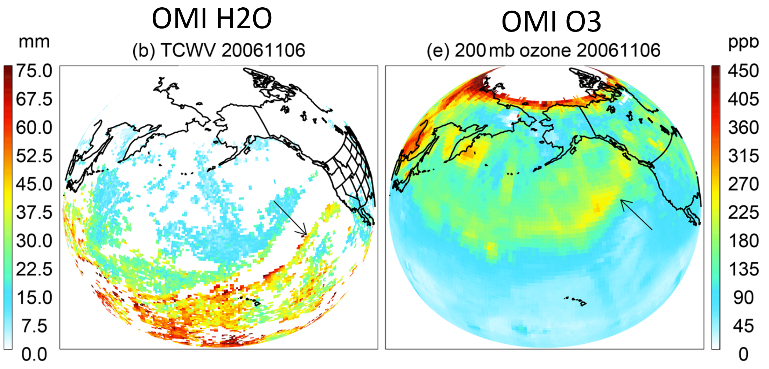
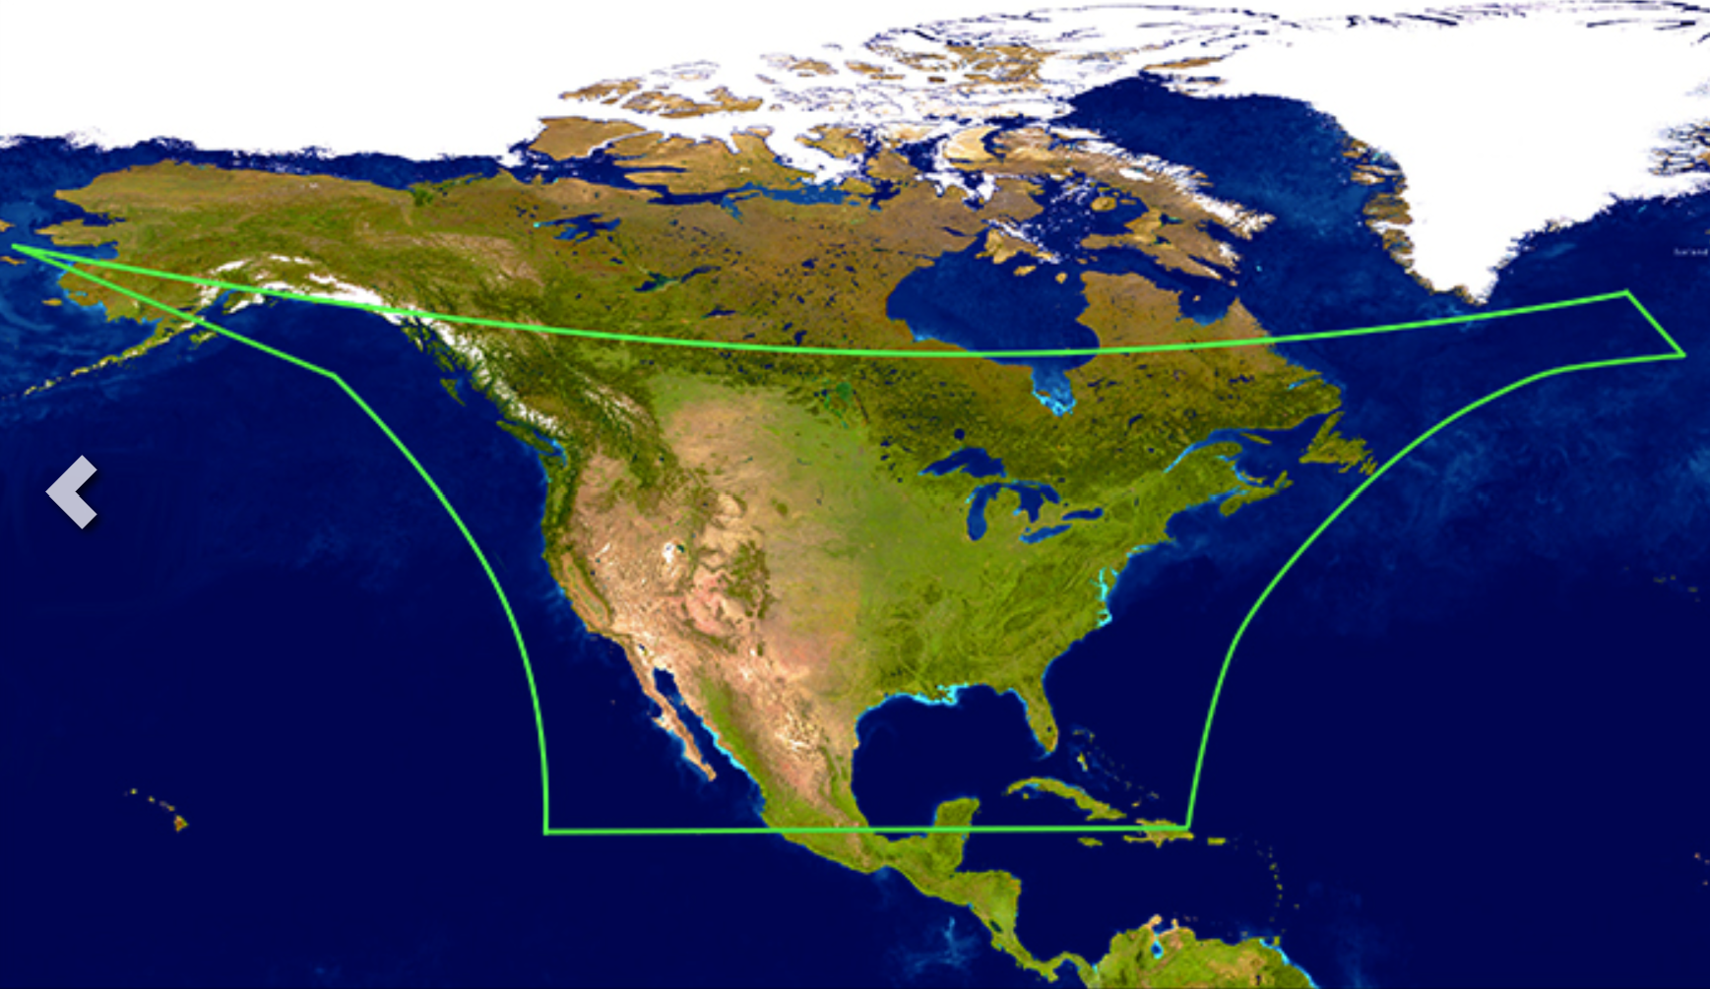
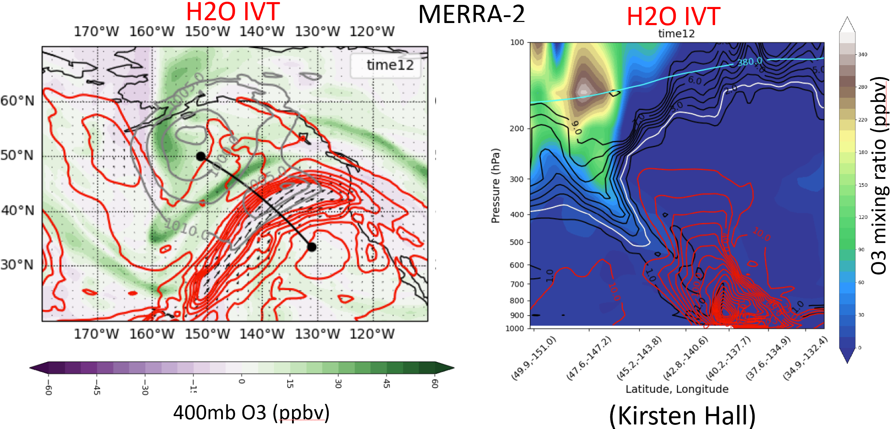
TEMPO Field-of-Regard
TEMPO Special Scan

