Slide 1
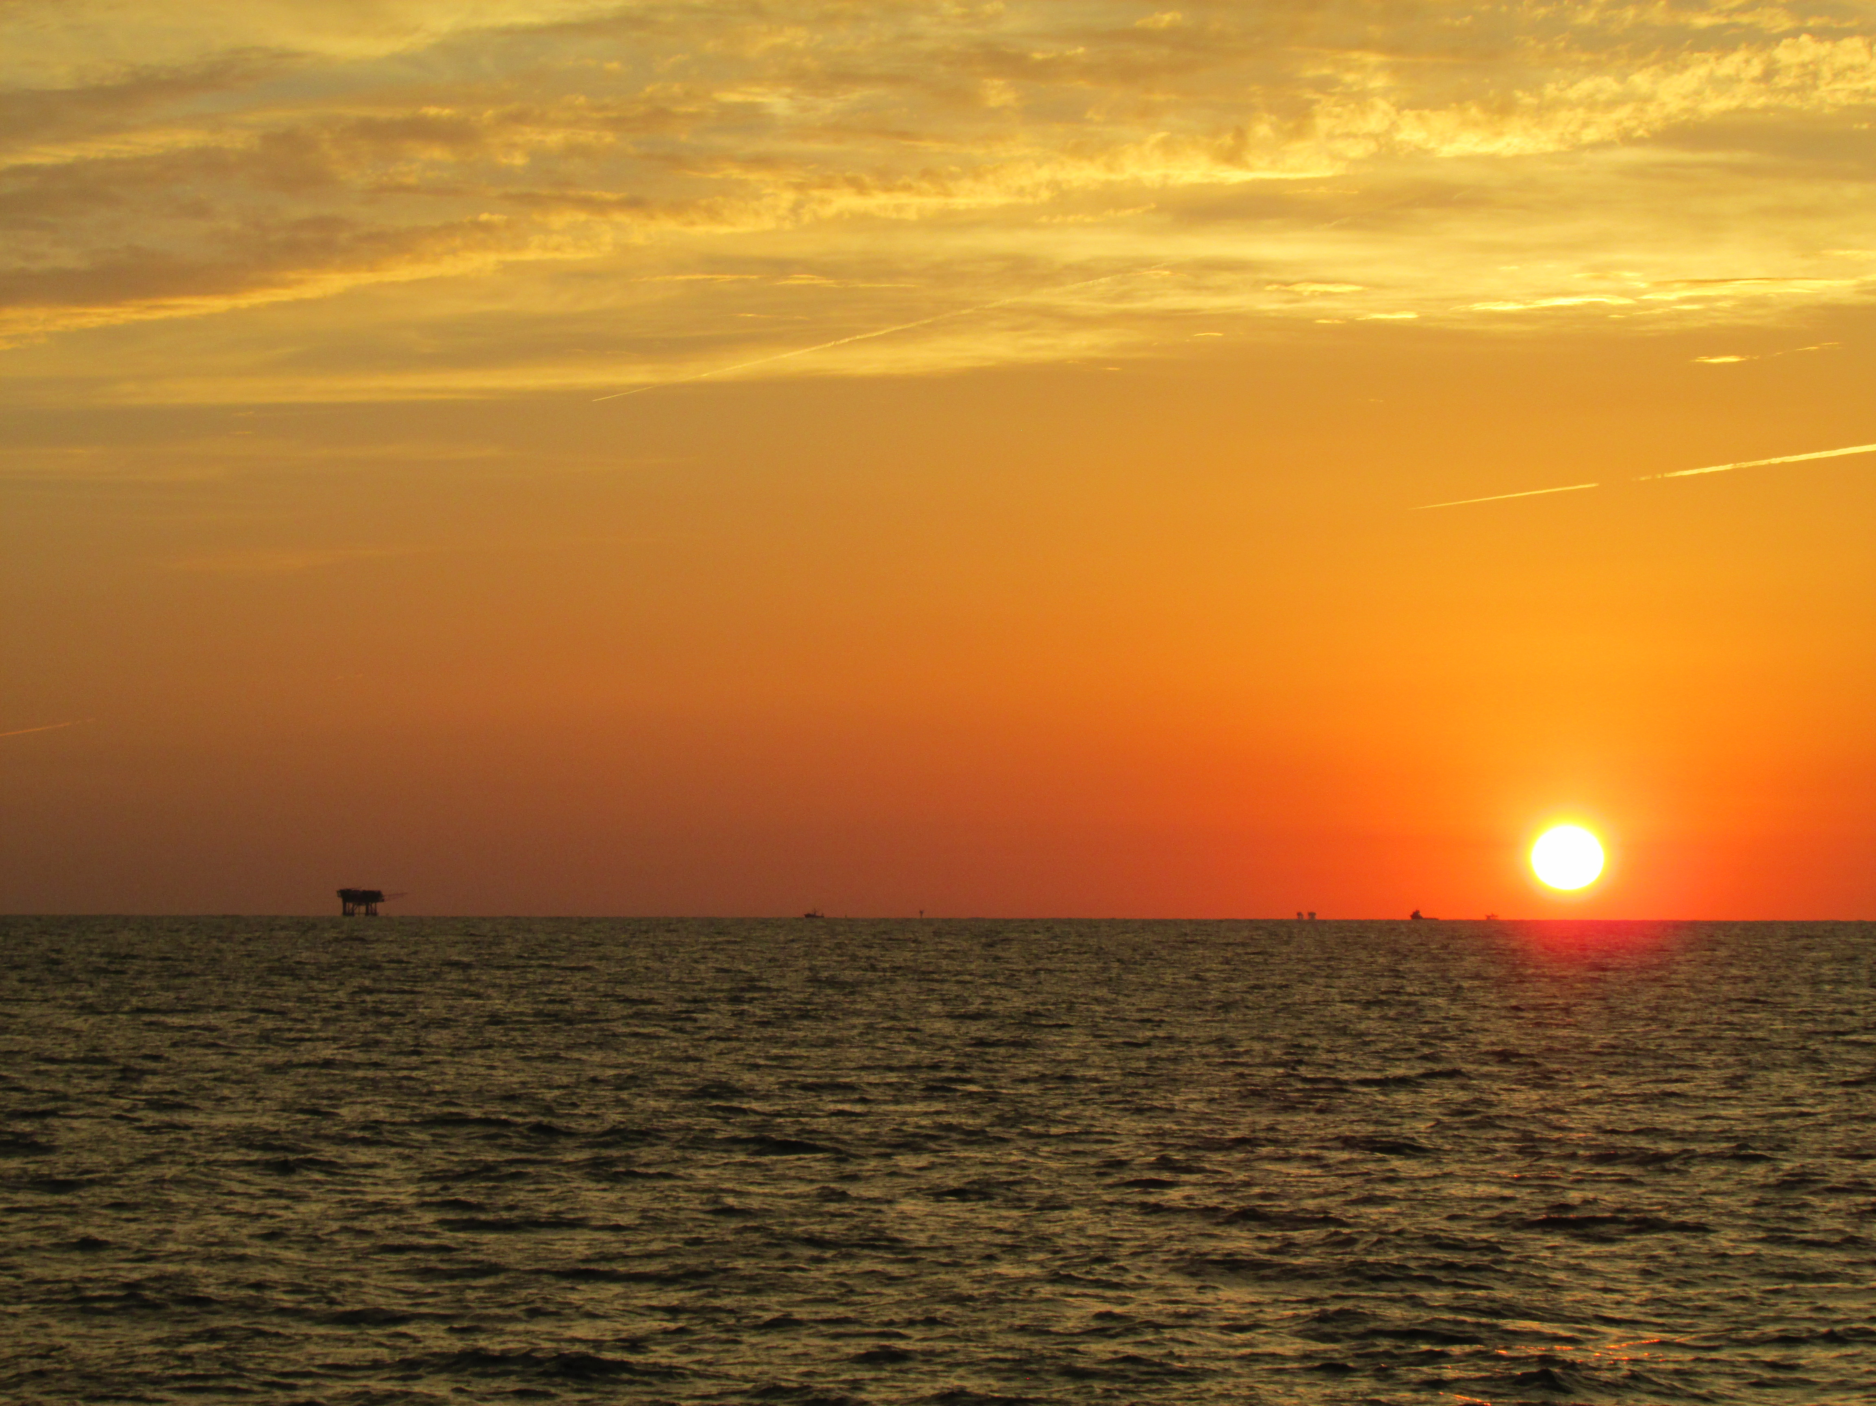
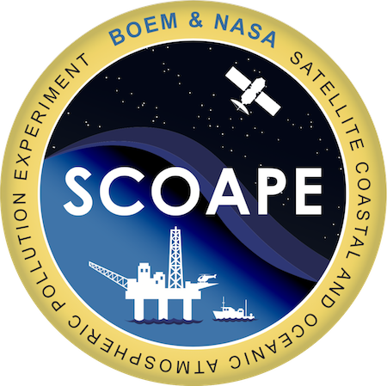



TEMPO Validation during the May-June 2024 Satellite Coastal and Oceanic Atmospheric Pollution Experiment 2 (SCOAPE-II) Gulf of Mexico Cruise
Ryan M. Stauffer¹, Anne M. Thompson^{1,2}, Debra E. Kollonige^{1,3}, Niko M. Fedkin^{1,3}, Holli D. Wecht⁴, Nellie Elguindi⁴
¹NASA/Goddard Space Flight Center, ²Univ. Maryland-Baltimore County, ³Science Systems and Applications, Inc., ⁴BOEM Office of Environmental Programs
Monday, 1 May 2023 TEMPO, GeoXO ACX, & TOLNet STM Lightning Talk

Slide 2
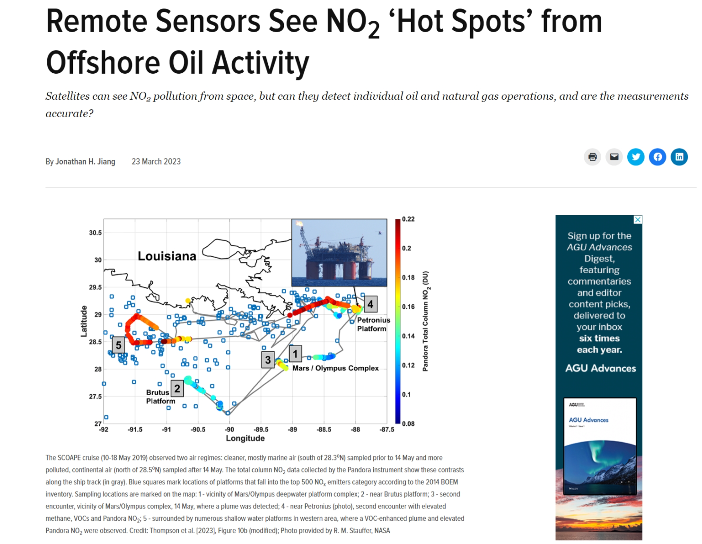
May 2019 Gulf of Mexico (GOM) SCOAPE-I Cruise
How do GOM ONG activities affect US air quality? BOEM is mandated to monitor
Satellite Coastal Oceanic and Atmospheric Pollution Experiment (SCOAPE-I) validated OMI and TROPOMI NO₂ near GOM ONG operations
Thompson et al. (2023) Earth and Space Science (ESS) on SCOAPE selected as an AGU EOS Editor’s Highlight: https://eos.org/editor-highlights/remote-sensors-see-no2-hot-spots-from-offshore-oil-activity.
Pandora and ONG Platform locations on SCOAPE Map

Slide 3
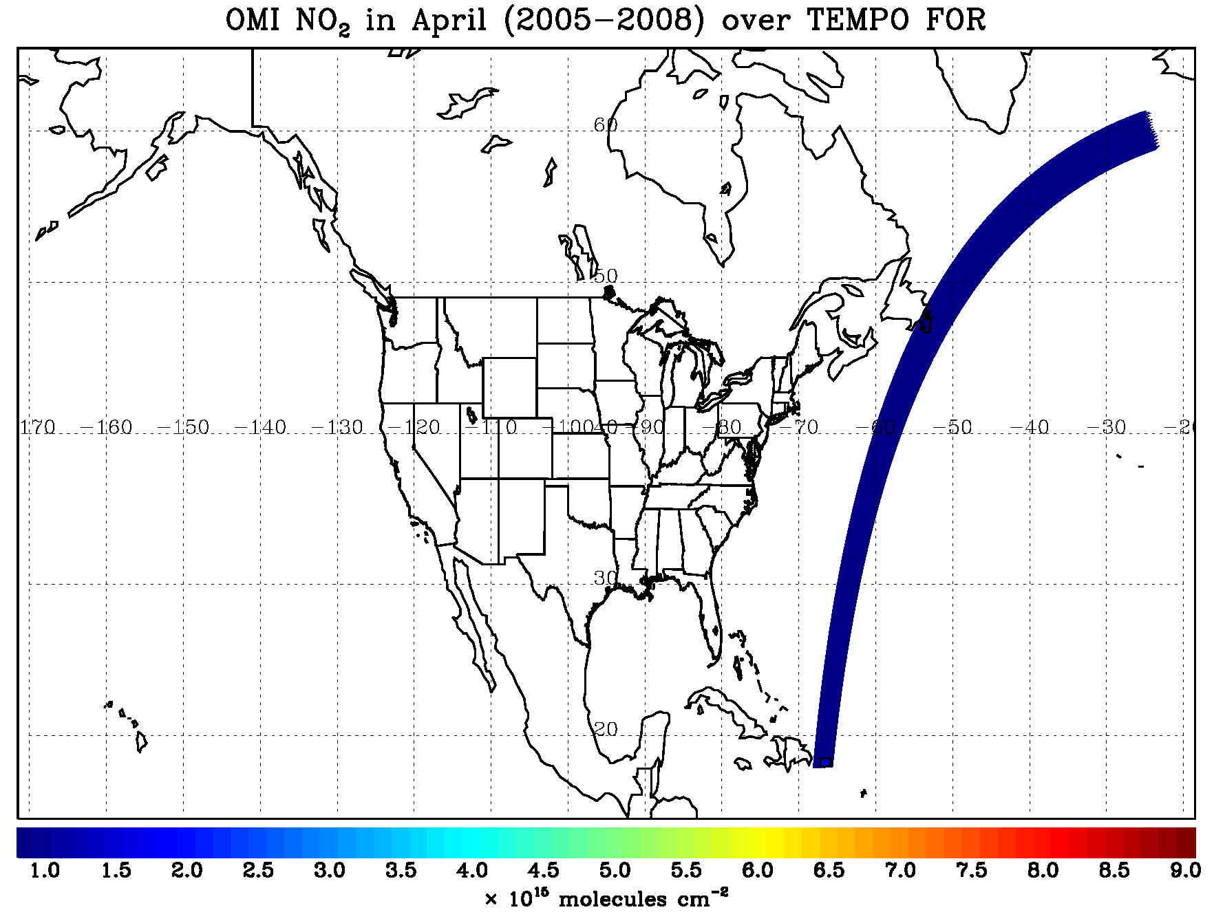
June 2024 SCOAPE-II Cruise: TEMPO val and GHGs
TEMPO Special Experiments Request (p.15): https://weather.msfc.nasa.gov/tempo/publications/TEMPO-Green-Paper.pdf
Satellite Coastal Oceanic and Atmospheric Pollution Experiment-II (SCOAPE-II) Goals:
Validate coastal and over-water TEMPO NO₂ with surface, Pandora and GCAS NO₂
Relate column NO₂ amounts to surface “nose-level” values. NO₂ sonde profiles?
Determine effects of ONG emissions on GOM and coastal air quality
Quantify CH₄ emissions and leaks with surface and AVIRIS-NG measurements
TEMPO: 10x the data (hourly)
http://tempo.si.edu/images/tempo_geo_footprint_92.85W_psr_NO2_v5.gif

Slide 4
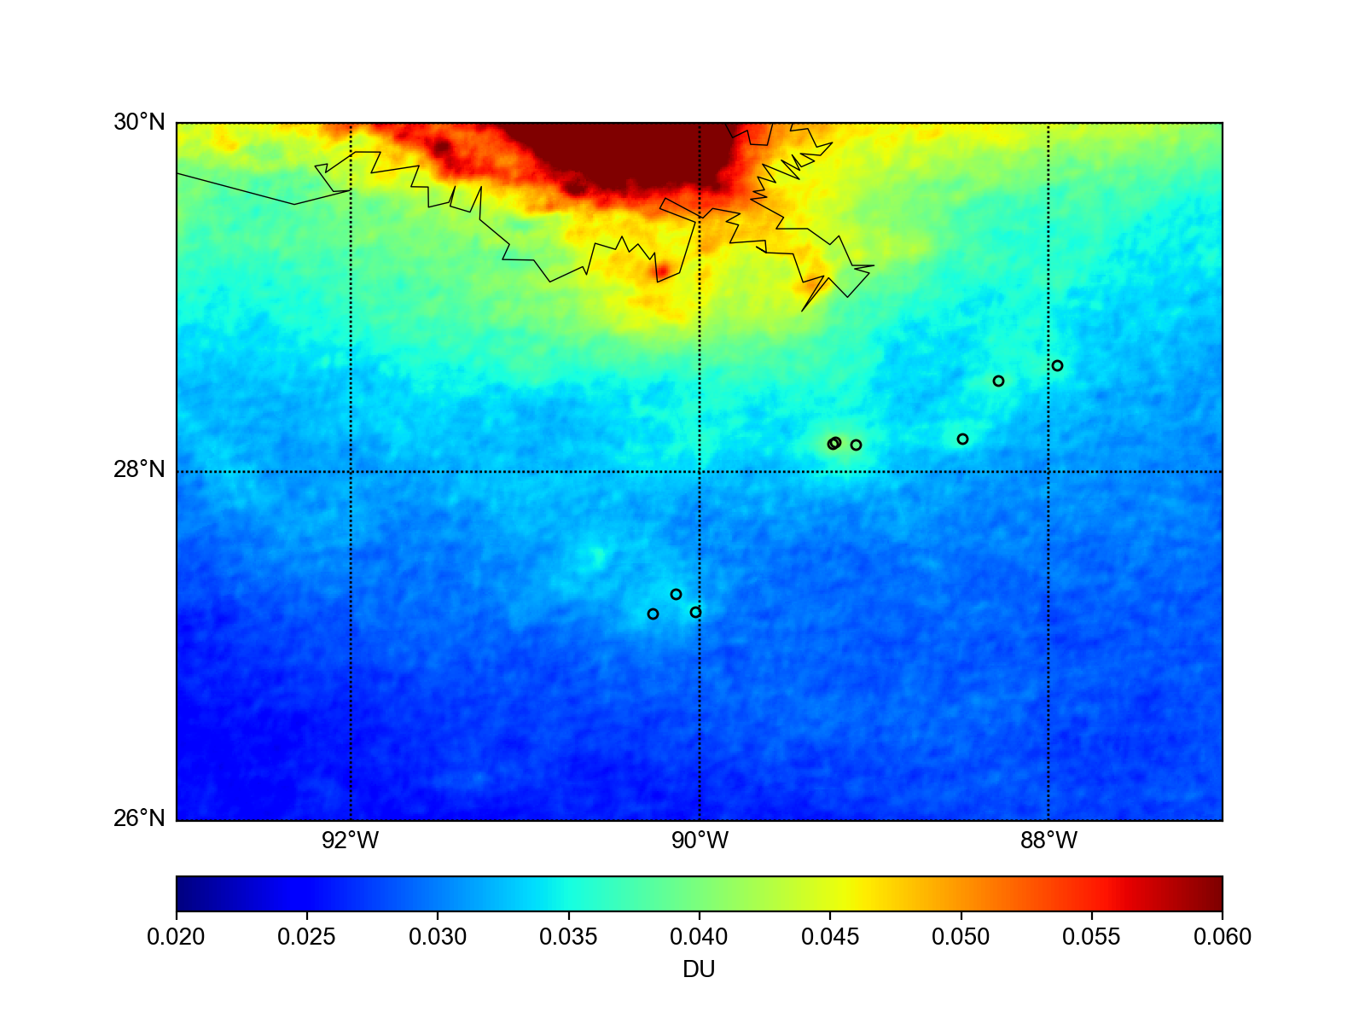
June 2024 SCOAPE-II Cruise: TEMPO val and GHGs
TEMPO Special Experiments Request (p.15): https://weather.msfc.nasa.gov/tempo/publications/TEMPO-Green-Paper.pdf
2018-2022 TROPOMI NO₂ Averages on calm wind days:
Nakika
Appomattox
Mars/Olympus
Ursa
Thunderhorse
TEMPO: 10x the data (hourly)
SHENZI-TLP
Mad Dog
Atlantis
Credit: N. Fedkin
http://tempo.si.edu/images/tempo_geo_footprint_92.85W_psr_NO2_v5.gif

Slide 5
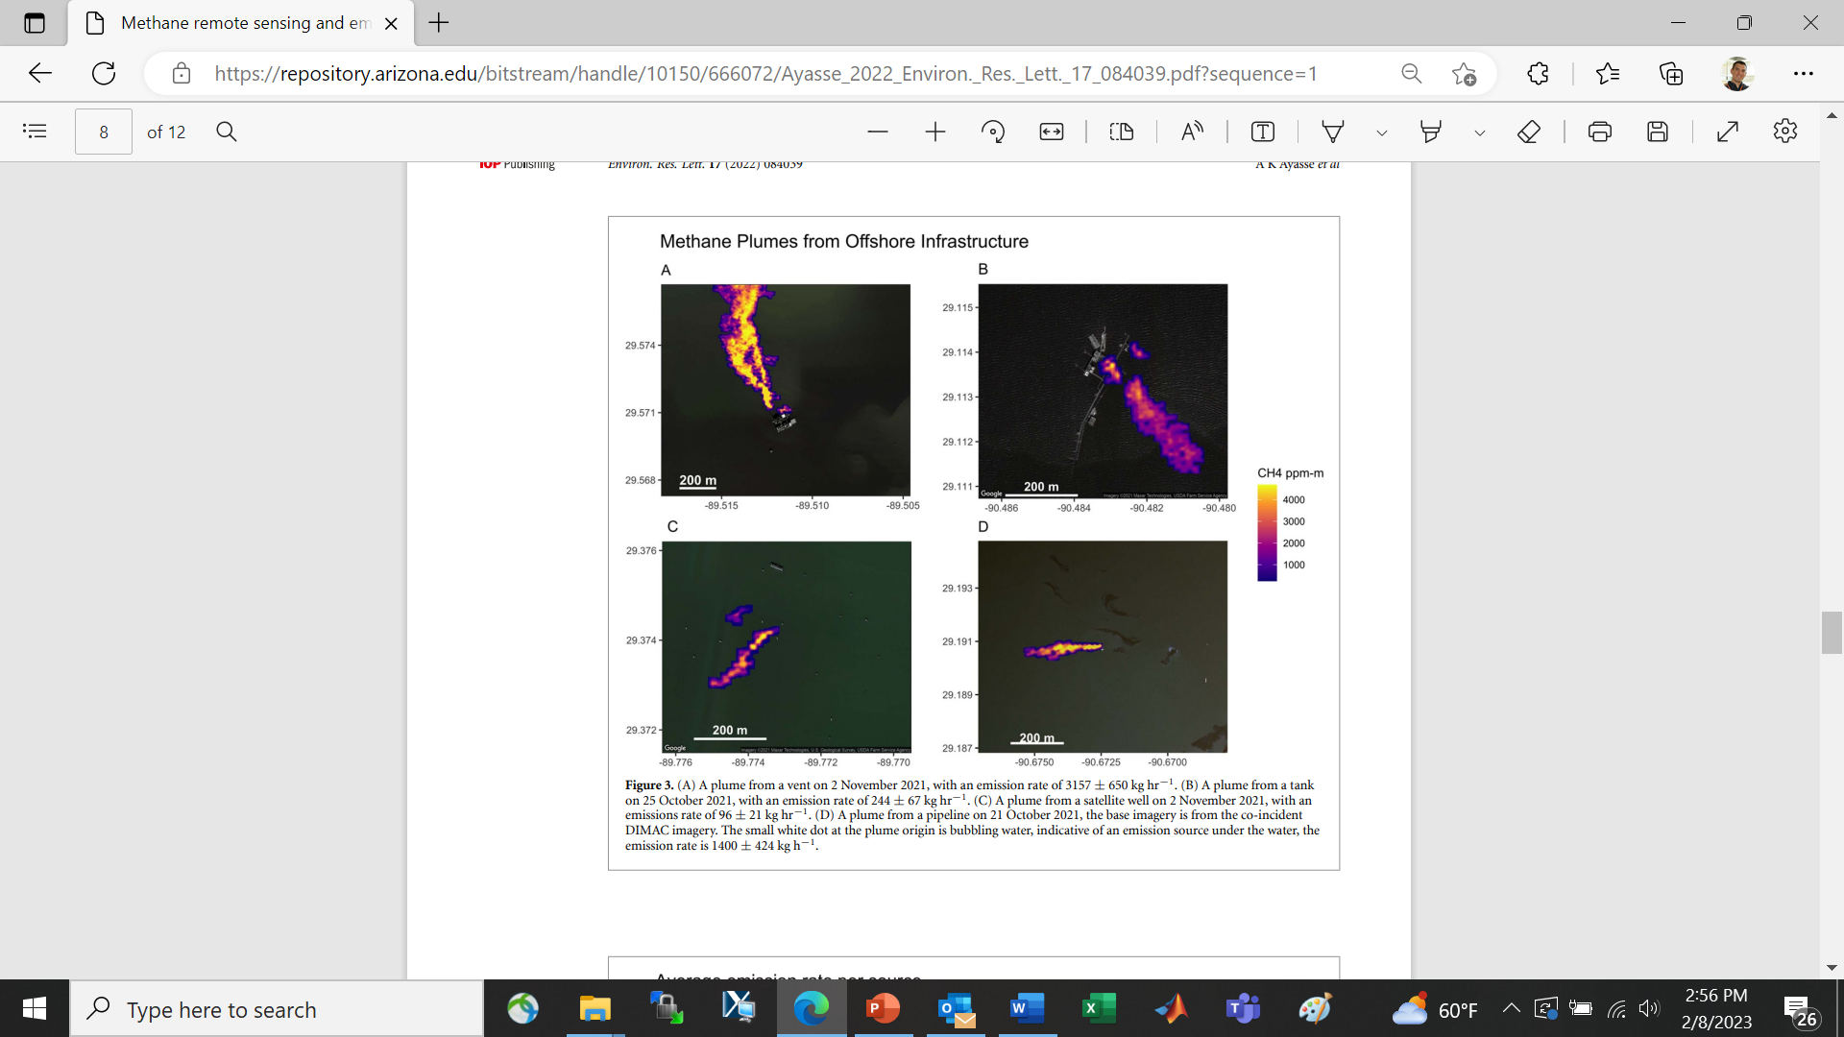
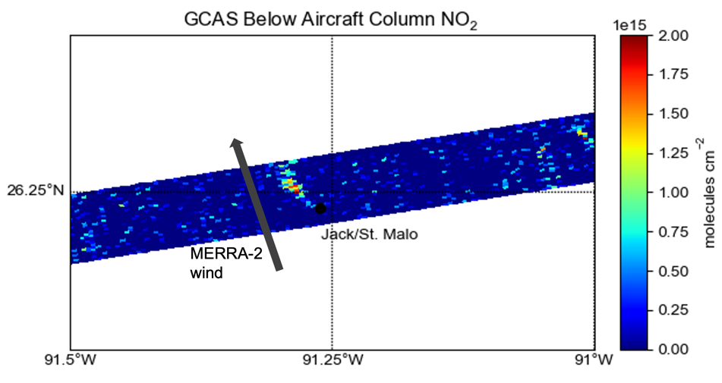
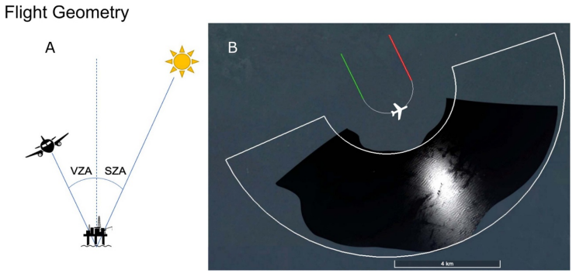
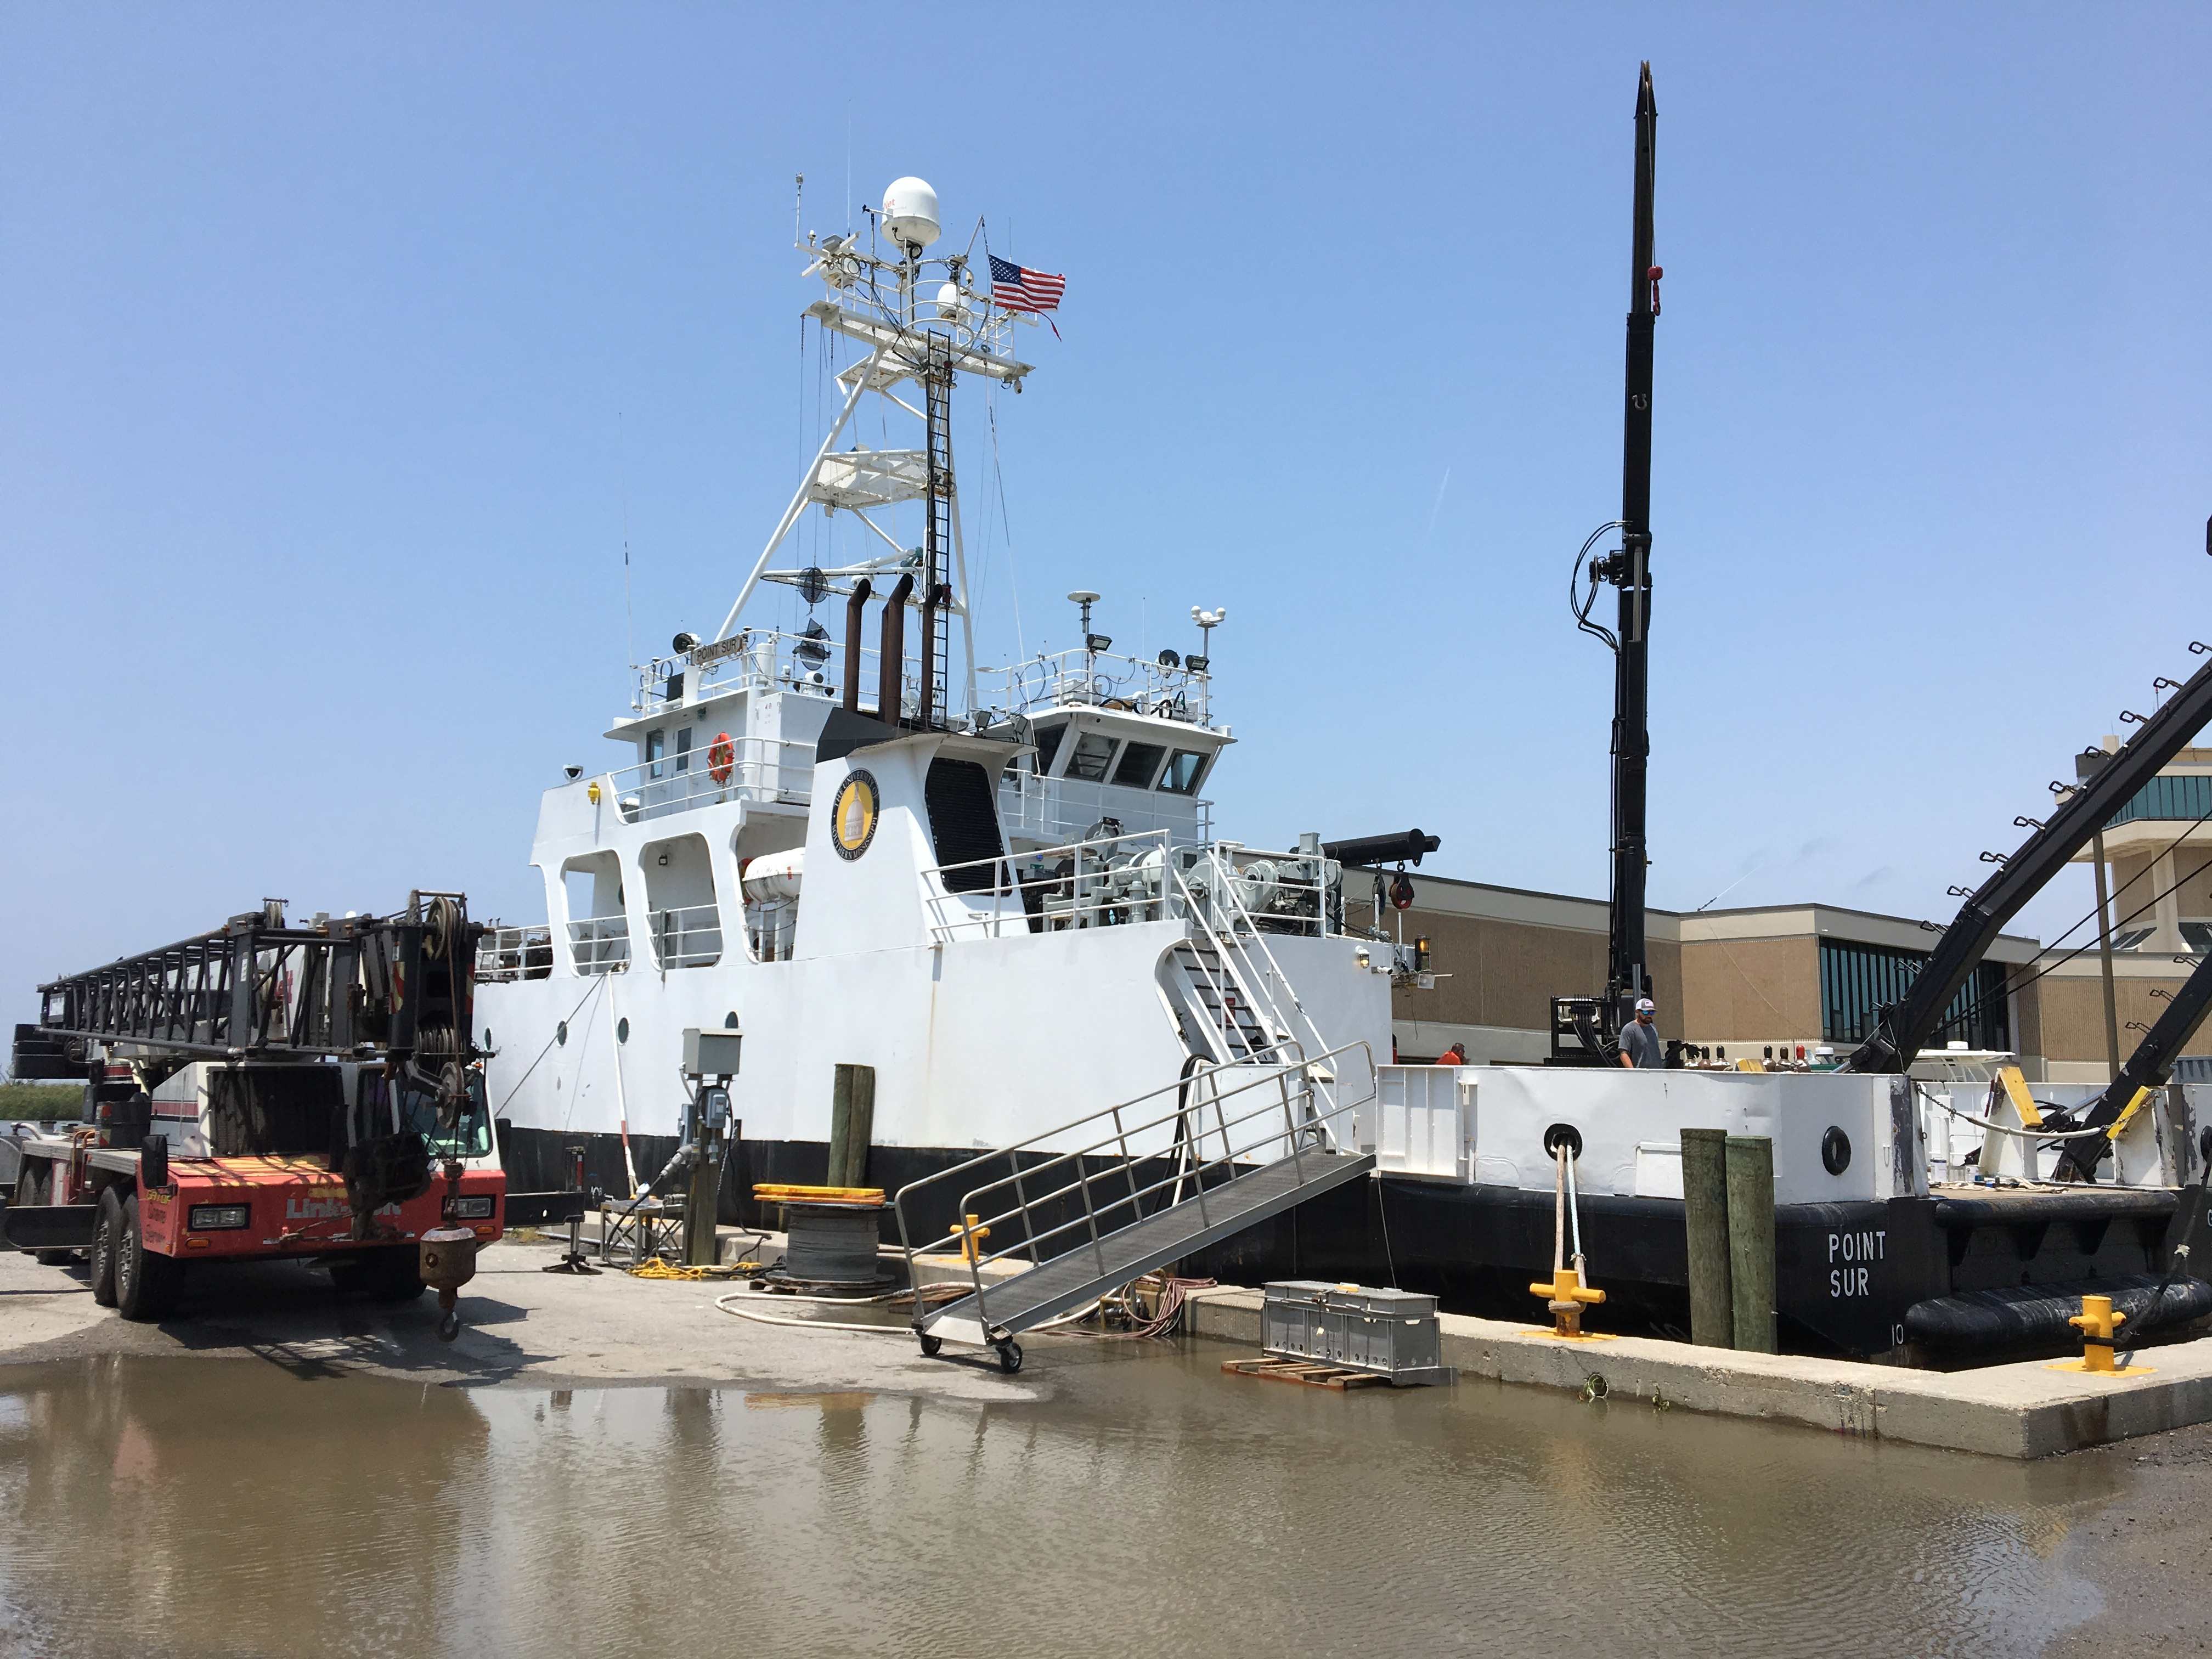
June 2024 SCOAPE-II Cruise: Measurements
GCAS NO₂ Columns
AVIRIS-NG CH₄
Credit: N. Fedkin
Ship in-situ, Pandora, O₃sondes, meteorology
From Ayasse et al., (2022)

Slide 6
Stay Tuned for SCOAPE-II Updates!
SCOAPE Data and DOIs: https://asdc.larc.nasa.gov/project/SCOAPE
Email Contact: ryan.m.stauffer@nasa.gov
Thompson et al., (2023), “Two Air Quality Regimes in Total Column NO₂ over the Gulf of Mexico in May 2019: Shipboard and Satellite Views” https://agupubs.onlinelibrary.wiley.com/doi/10.1029/2022EA002473
Duncan BN. 2020. NASA resources to monitor offshore and coastal air quality. Sterling (VA): U.S. Department of the Interior, Bureau of Ocean Energy Management. OCS Study BOEM 2020-046. 32 p., https://espis.boem.gov/final%20reports/BOEM_2020-046.pdf
Thompson AM. 2020. Evaluation of NASA’s remote-sensing capabilities in coastal environments. Sterling (VA): U.S. Department of the Interior, Bureau of Ocean Energy Management. OCS Study BOEM 2020-047. 33 p., https://espis.boem.gov/final%20reports/BOEM_2020-047.pdf
Disclaimer: This report has been technically reviewed by BOEM, and it has been approved for publication. The views and conclusions contained in this document are those of the authors and should not be interpreted as representing the opinions or policies of the U.S. Government, nor does mention of trade names or commercial products constitute endorsement or recommendation for use.

