Slide 1
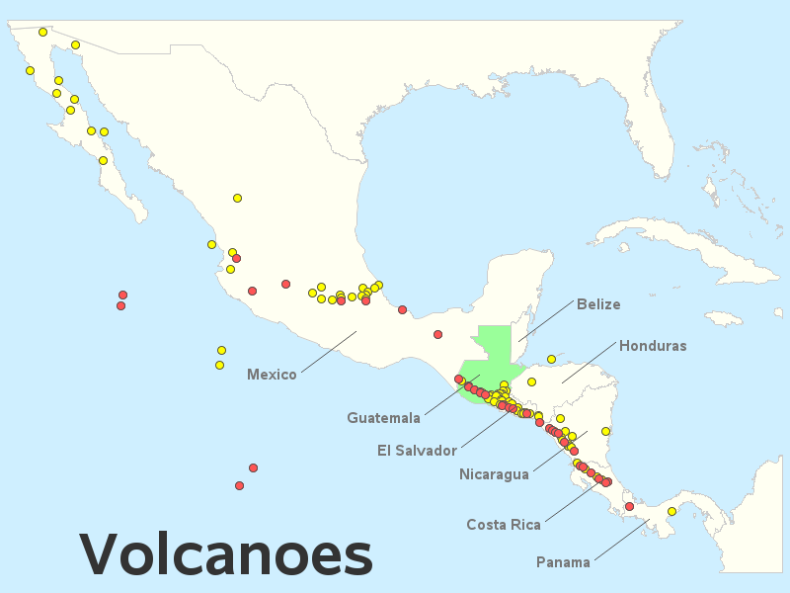
Green Paper – Central American Volcanic Plumes:
TEMPO High-Temporal-Resolution Aerosol & Gas Observations
Ralph Kahn¹, Verity Flower², James Limbacher³, Kathleen McKee⁴, Katherine Noyes¹, Aaron Naeger⁵
¹NASA Goddard Space Flight Center, ²U. of Stirling, ³NOAA, ⁴Vanderbilt U., ⁵U. Alabama Huntsville
Note: Pixel resolution becomes higher toward the equator
17.5°N
15.5°N
Eruption Observed
Eruption Credible
Can we extend the southmost scan operations even further,
to cover as many potentially active volcanoes as possible?

Slide 2
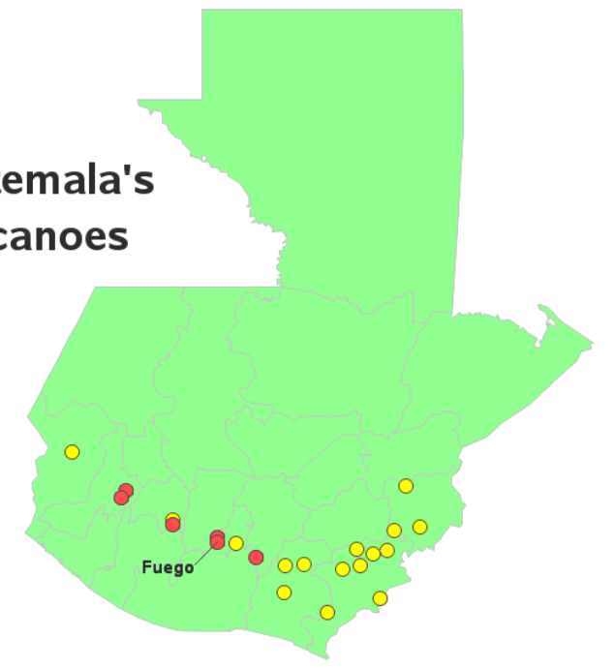
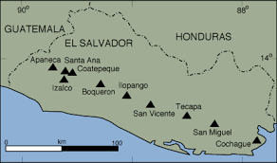
Volcanoes of Guatemala
Volcanoes of El Salvador
Almolonga
Atitlán
Acatenango
Santa María
Pacaya
Eruption Observed
Eruption Credible
Name | N Lat | W Lon | Type | Last Erupt.
Santa Ana | 13.85 | 89.63 | stratovolcano | 1993
Name | N Lat | W Lon | Type | Last Erupt.
Almolonga | 14.80 | 91.52 | Stratovolcano | 1818
Santa María | 14.76 | 91.55 | Stratovolcano | 2022
Atitlán | 14.58 | 91.19 | Stratovolcano | 1853
Acatenango | 14.50 | 90.88 | Stratovolcano | 1976
Fuego | 14.43 | 90.88 | Stratovolcano | 2022
Pacaya | 14.38 | 90.60 | Complex | 2021
Recent Eruptions

Slide 3
Variables of Interest will depend on the composition and elevation of the eruption plume…
TEMPO Variables Likely of Use
Aerosol: AOD, AAOD, UV-AI
Plume Height: UV-B
Related Volcanic Gases: SO₂, H₂O
Related Wildfire Gases: H₂C=O (Formaldehyde);
possibly C₂H₂O₂ (Glyoxal)
Other Space-based Resources Likely to Contribute
Fire, Volcano Hotspots: MODIS/VIIRS 4-micron thermal anomaly
Aerosol Particle Size, Shape (ash/sulfate): MISR; PACE HARP-2
Plume Extent; Height; Particle Properties: GOES ABIs

