Slide 1
Using TEMPO observations to diagnose nonlinear ozone-NO_{x}-VOC chemistry
Xiaomeng Jin
Rutgers University

Slide 2
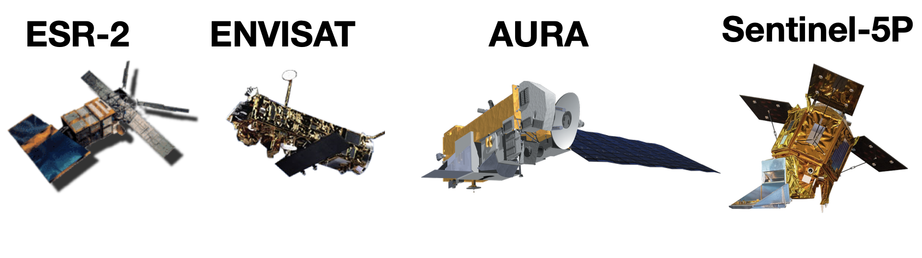
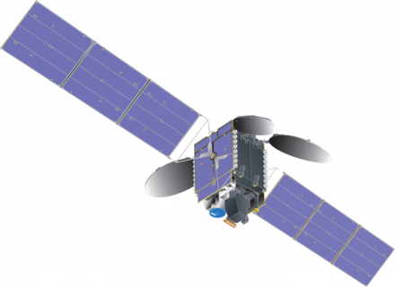
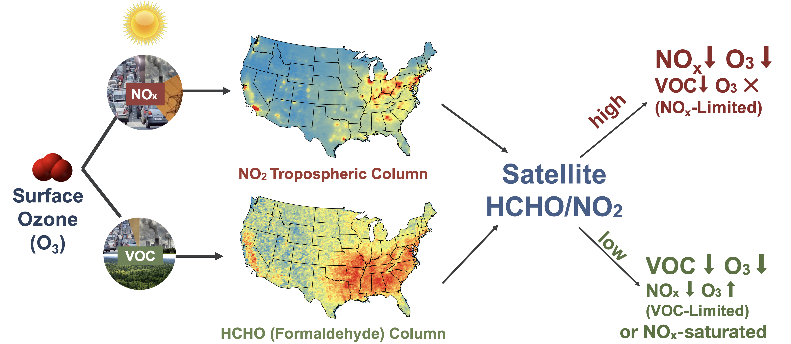
Observing O₃-NO_{x}-VOC chemistry from space
TEMPO

Slide 3
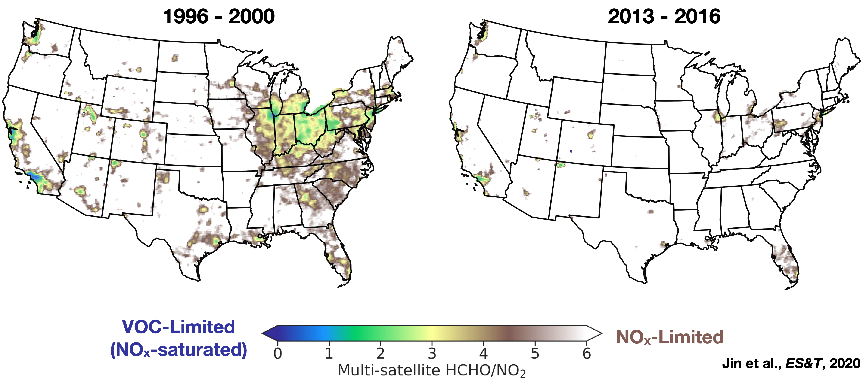
Most U.S. Cities have made transition to NO_{x}-limited regime
at OMI overpass time

Slide 4
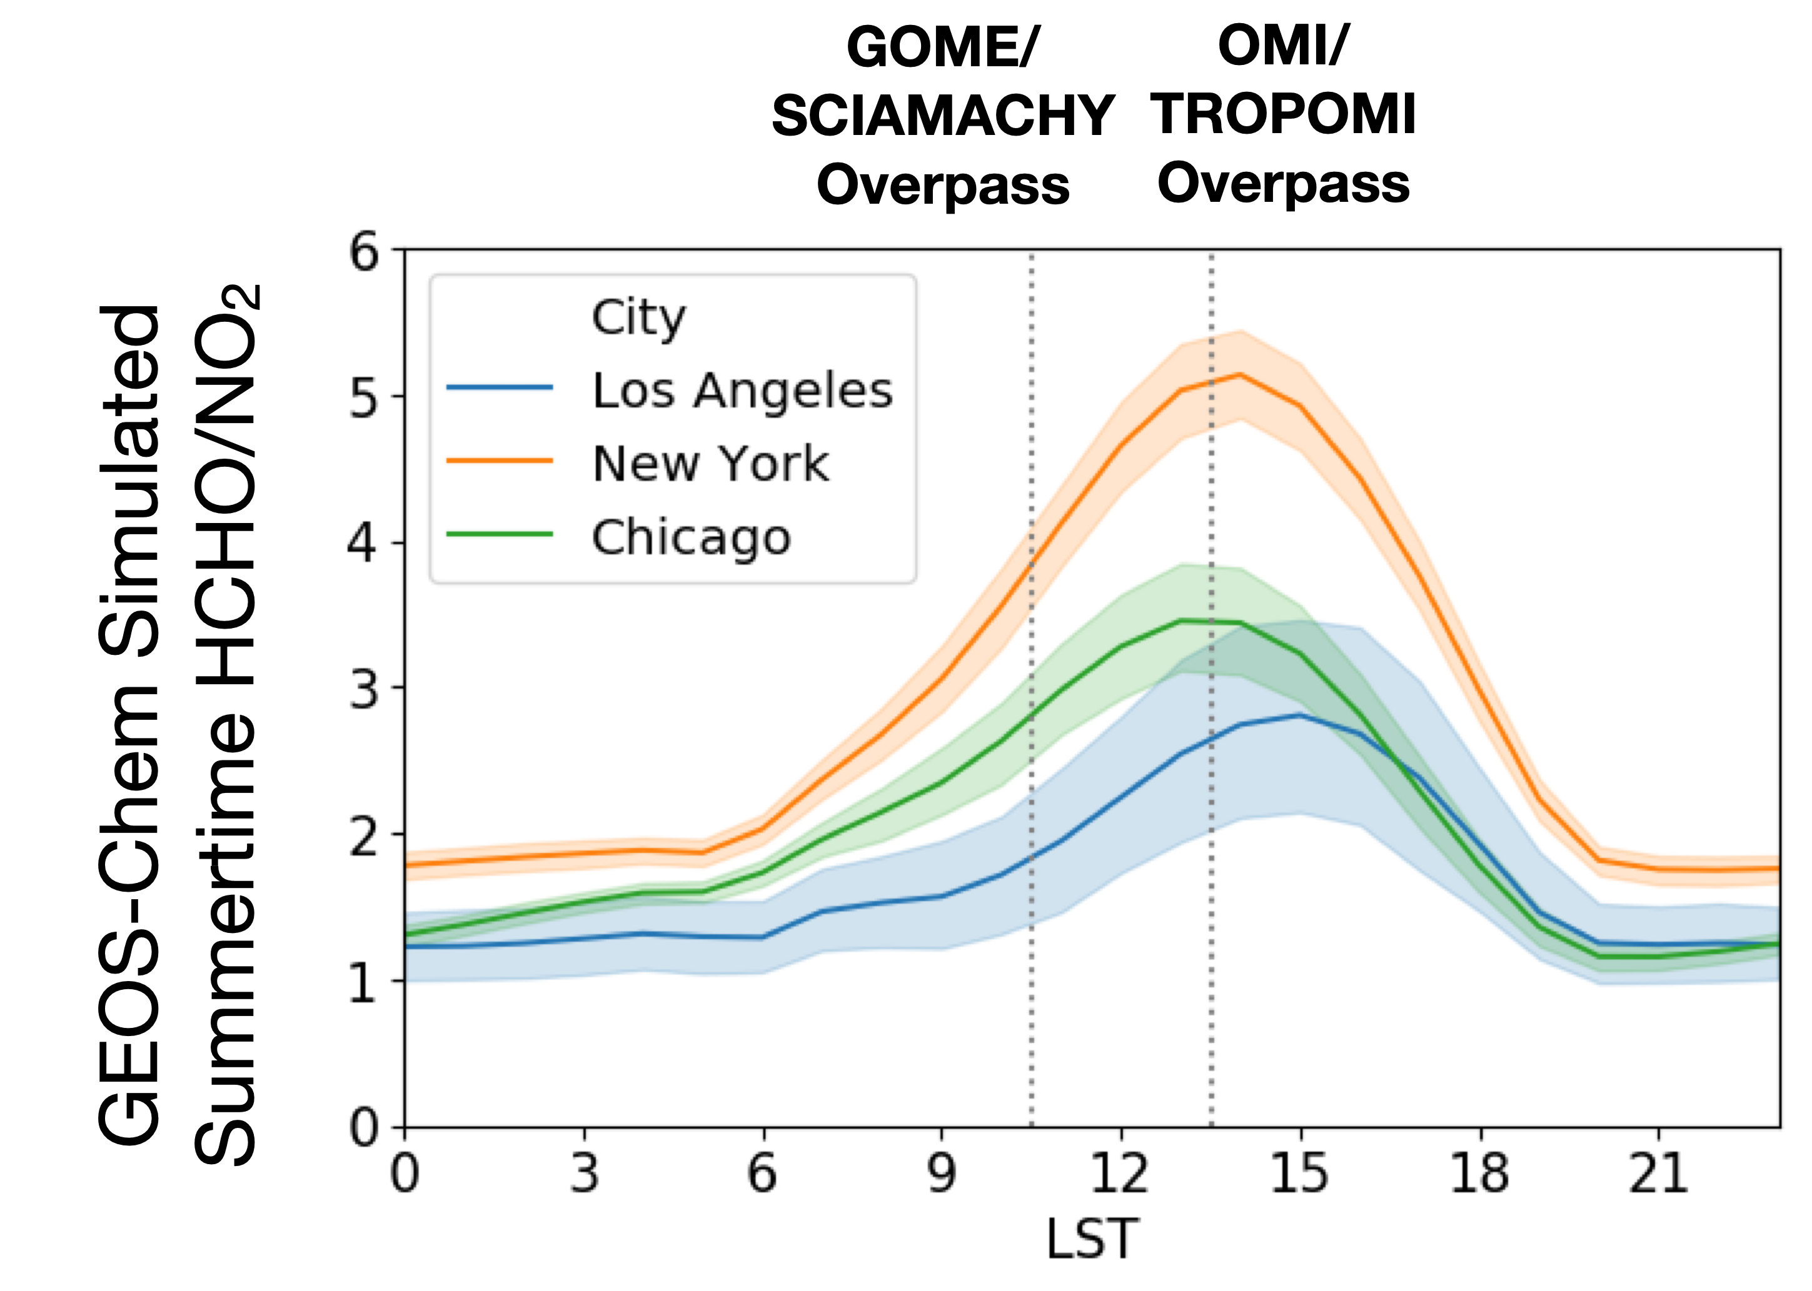
TEMPO will observe O₃-NO_{x}-VOC chemistry throughout the day
Have U.S. cities reached the NO_{x}-limited regimes at other times of the day?
How does the O₃ chemistry vary within the cities?

Slide 5
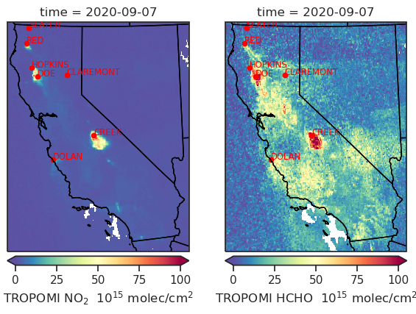
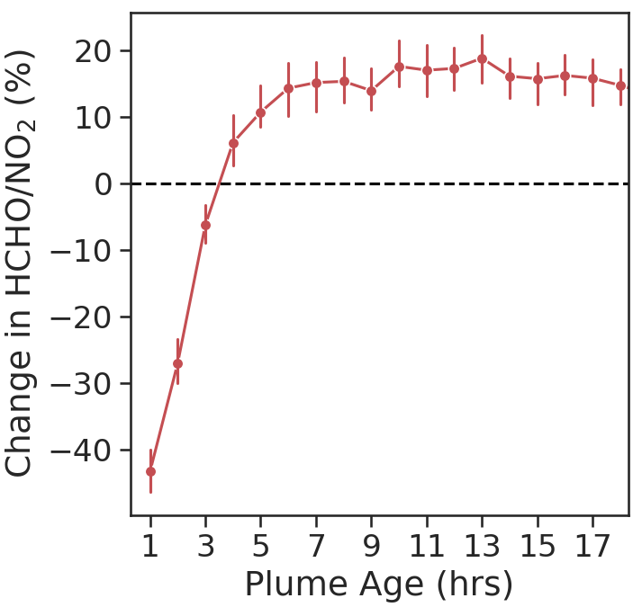
TEMPO can diagnose the varying O₃-NO_{x}-VOC chemistry during extreme events (e.g. wildfires)
NO_{x}-Limited
VOC-Limited
Jin et al., in prep

