Slide 1
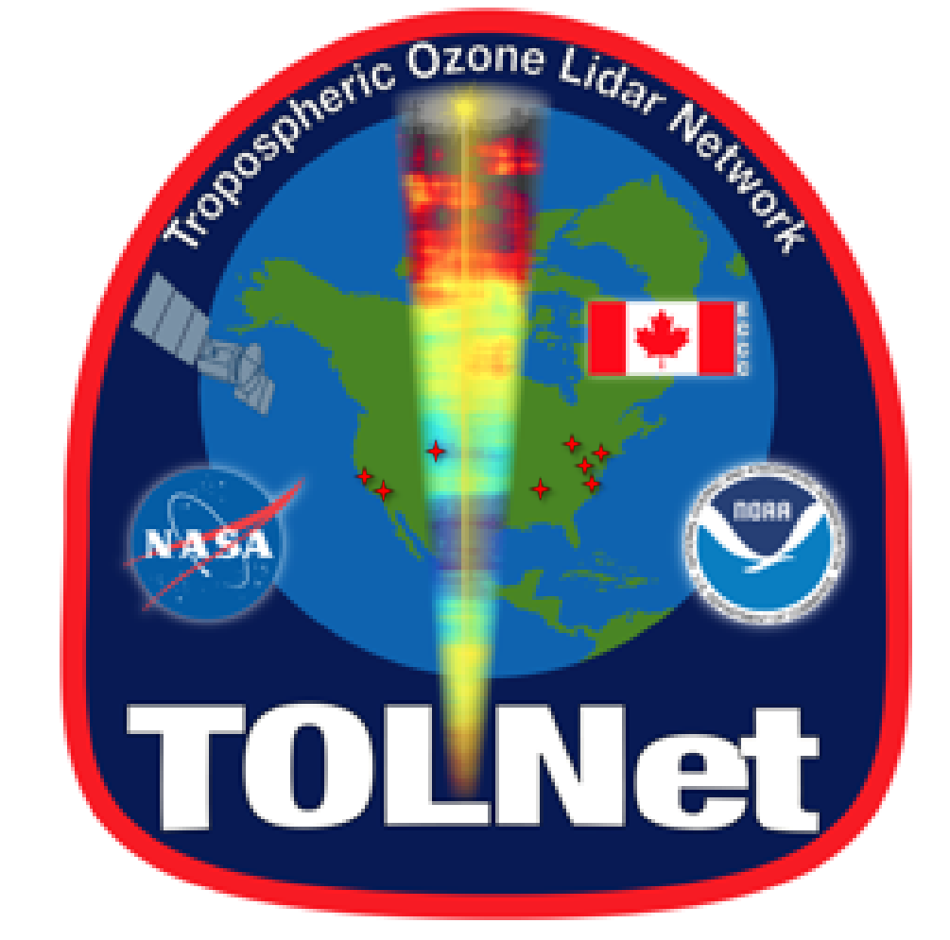

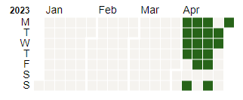
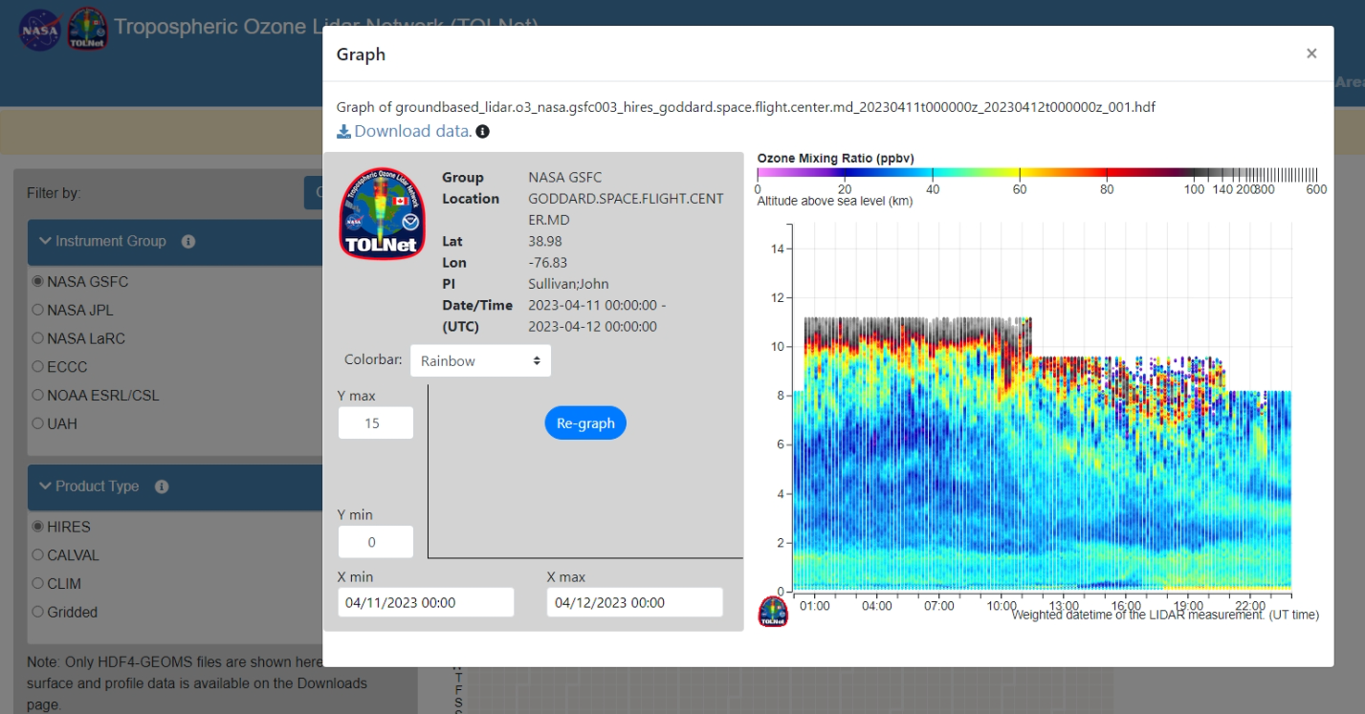
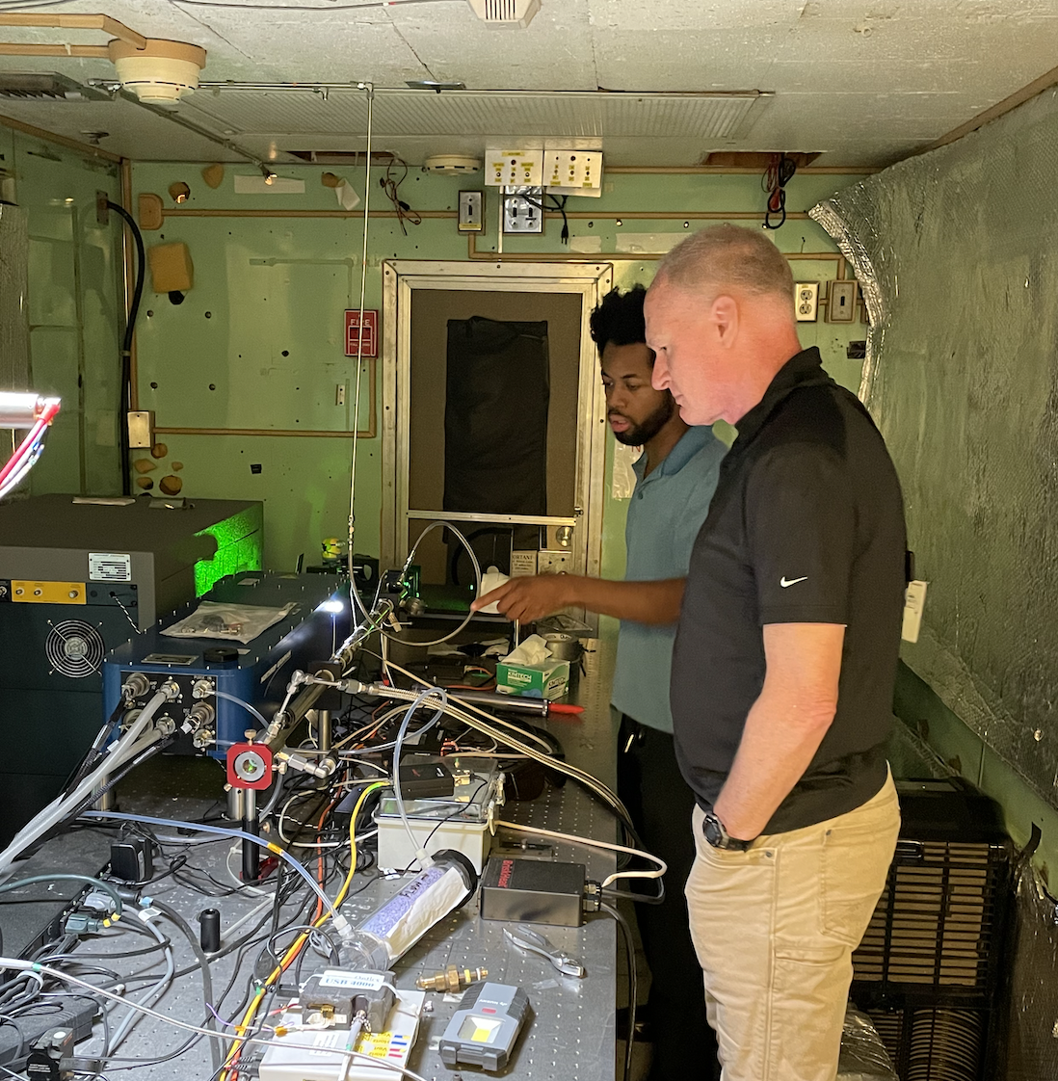
GSFC FY23 Accomplishments
J. Sullivan, L. Twigg, M. Roots
Notable Publications
Dreessen, Joel, Xinrong Ren, Daniel Gardner, Katherine Green, Phillip Stratton, John T. Sullivan, Ruben Delgado et al. "VOC and trace gas measurements and ozone chemistry over the Chesapeake Bay during OWLETS-2, 2018." Journal of the Air & Waste Management Association (2023): 1-22.
Bernier, Claudia, Yuxuan Wang, Guillaume Gronoff, Timothy Berkoff, K. Emma Knowland, John T. Sullivan, Ruben Delgado, Vanessa Caicedo, and Brian Carroll. "Cluster-based characterization of multi-dimensional tropospheric ozone variability in coastal regions: an analysis of lidar measurements and model results." Atmospheric Chemistry and Physics 22, no. 23 (2022): 15313-15331.
Tao, M., Fiore, A.M., Jin, X., Schiferl, L.D., Commane, R., Judd, L.M., Janz, S., Sullivan, J.T., Miller, P.J., Karambelas, A. and Davis, S., 2022. Investigating Changes in Ozone Formation Chemistry during Summertime Pollution Events over the Northeastern United States. Environmental Science & Technology, 56(22), pp.15312-15327.
Johnson, Matthew S., Sajeev Philip, Rajesh Kumar, Aaron Naeger, Amir H. Souri, Jeffrey Geddes, Laura Judd, Scott Janz, and John Sullivan. "Satellite remote-sensing capability to assess tropospheric column ratios of formaldehyde and nitrogen dioxide: case study during the LISTOS 2018 field campaign." Atmospheric Measurement Techniques Discussions (2022): 1-41.
Liu, Xueying, Yuxuan Wang, Shailaja Wasti, Wei Li, Ehsan Soleimanian, Travis Griggs, James Flynn et al. "Evaluating WRF offshore meteorology simulation during TRACER-AQ 2021 in Houston, TX." In AGU Fall Meeting Abstracts, vol. 2022, pp. A25G-1803. 2022. (added Sullivan/Roots, under review)
AGU/AMS Presentations: Kotsakis et al., Sullivan et al., Roots et al., Flynn et al., Flusche (2023 summer intern at GSFC) et al., Gronoff et al.,
Field or Other Activities and Data Archived
Data taken at NASA GSFC and HowardU-Beltsville
Deployment expected for NY/Flax Pond from July 1 to Aug 25, 2023
Outlook for Next FY
Major effort in early FY24 will be analysis and data submission for AGES+ deployment
Expect this to turn into analysis effort and support through partner organizations in some capacity in FY24
Continue collaborating with Howard/Beltsville Campus and UMBC
Hope to automate lidar to archive NRT TOLNet data when operating the system.
Finalize NRT centralized processing workflow with GLASS/ASDC and PUSH TEMPO/TOLNet data to community
Continue to work with M. Roots/UMBC on lidar analysis efforts and preparing for TROPOZ deployment
Transitioned to single D2/H2 Raman cell with mixed results (plots on next page) and replaced entrance optics as lens
Ongoing discussions with Thierry on centralized processing
Hardware and Personnel Updates

Slide 2

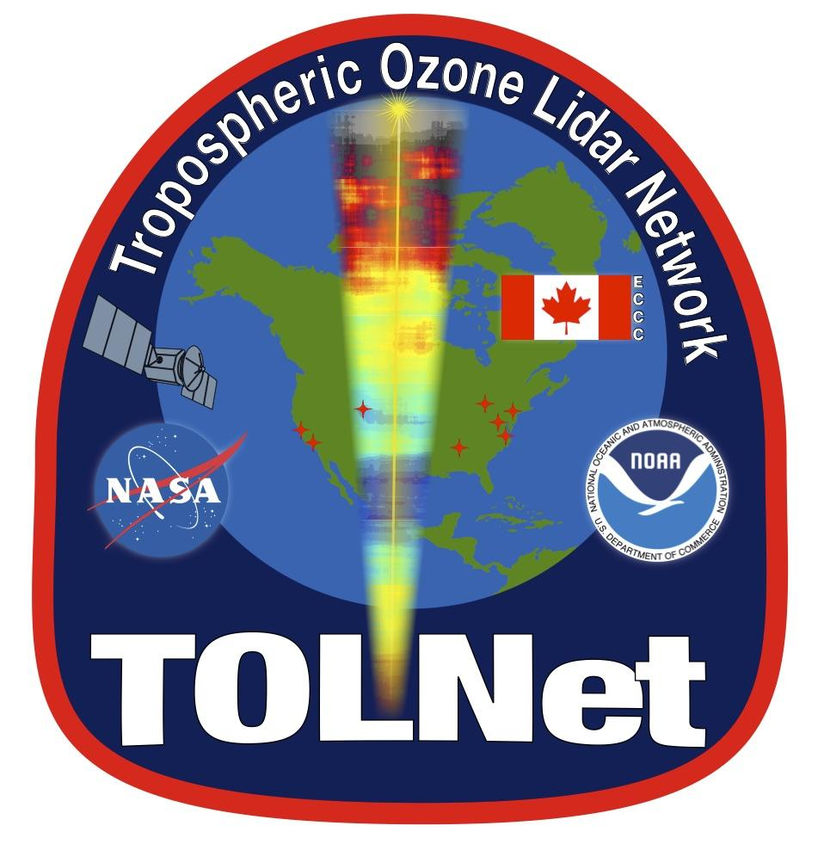
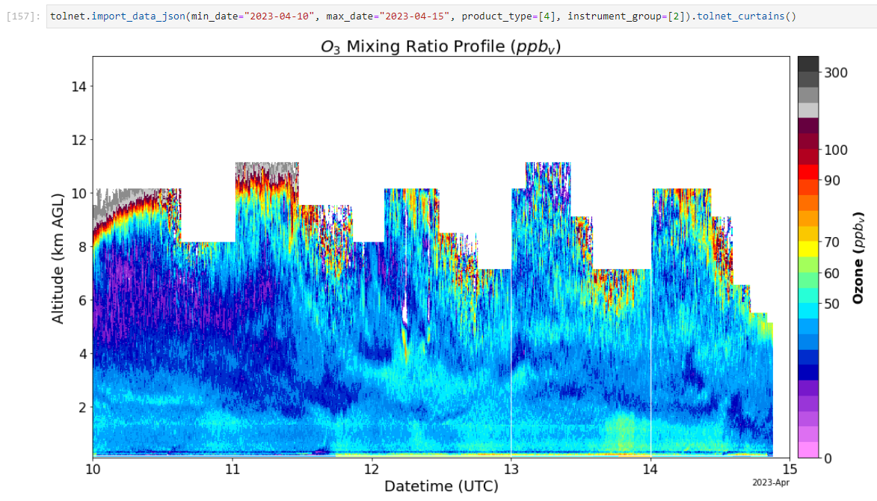
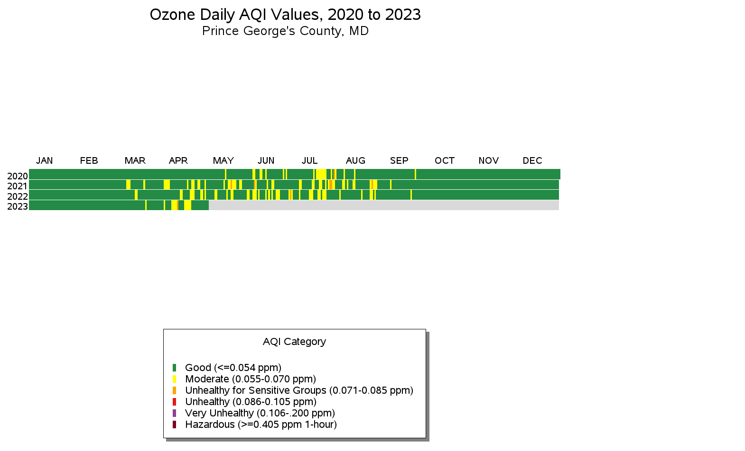
First Exceedance of the Year in Maryland!
New TOLNet Website
API Access & Package Coming Soon

